Slide 1
Chapter 2
Using OpenGL
Chih-Kuo Yeh

Slide 2
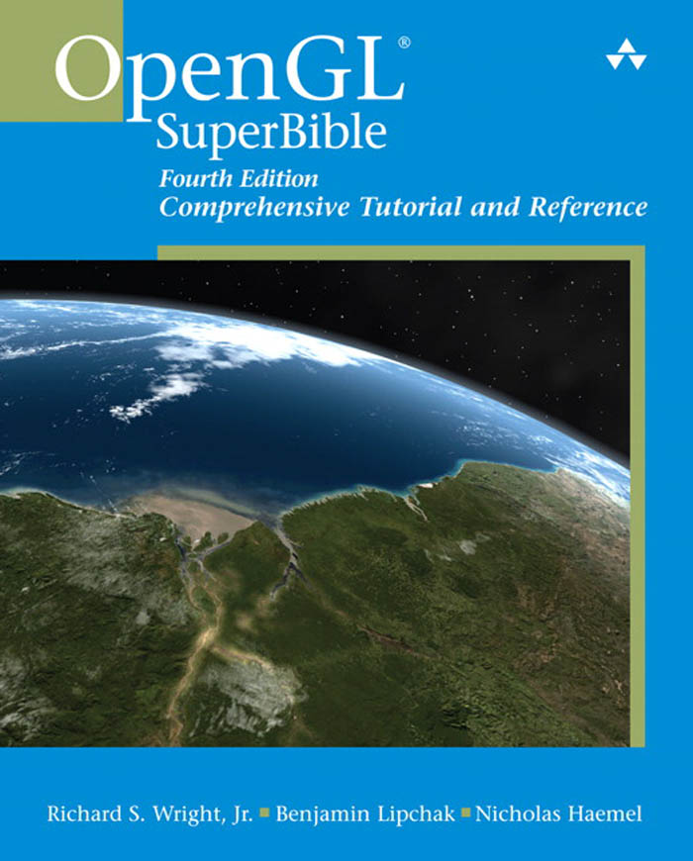
Textbook
Addison Wesley OpenGL SuperBible 4th Edition Jun 2007
Author:
Richard S. Wright, Jr.
Benjamin Lipchak
Nicholas Haemel

Slide 3
OpenGL and GLUT Overview
What is OpenGL & what can it do for me?
OpenGL in windowing systems
Why GLUT
A GLUT program template
Notes:
In this section, we discuss what the OpenGL API (Application Programming Interface) is, and some of its capabilities.
As OpenGL is platform independent, we need some way to integrate OpenGL into each windowing system. Every windowing system where OpenGL is supported has additional API calls for managing OpenGL windows, colormaps, and other features. These additional APIs are platform dependent.
For the sake of simplicity, we’ll use an additional freeware library for simplifying interacting with windowing systems, GLUT. GLUT, the OpenGL Utility Toolkit is a library to make writing OpenGL programs regardless of windowing systems much easier. It’ll be the base of all of our examples in the class.
We conclude the section with a basic program template for an OpenGL program using GLUT.

Slide 4
What Is OpenGL?
Graphics rendering API
high-quality color images composed of geometric and image primitives
window system independent
operating system independent
Notes:
OpenGL is a library for doing computer graphics. By using it, you can create interactive applications which render high-quality color images composed of 3D geometric objects and images.
OpenGL is window and operating system independent. As such, the part of your application which does rendering is platform independent. However, in order for OpenGL to be able to render, it needs a window to draw into. Generally, this is controlled by the windowing system on whatever platform you’re working on.

Slide 5
SGI and GL
Silicon Graphics (SGI) revolutionized the graphics workstation by implementing the pipeline in hardware (1982)
To access the system, application programmers used a library called GL
With GL, it was relatively simple to program three dimensional interactive applications
1.0 (1992)

Slide 6
OpenGL
The success of GL lead to OpenGL (1992), a platform-independent API that was
Easy to use
Close enough to the hardware to get excellent performance
Focus on rendering
Omitted windowing and input to avoid window system dependencies

Slide 7
OpenGL Libraries
OpenGL core library
OpenGL32 on Windows
GL on most unix/linux systems (libGL.a)
OpenGL Utility Library (GLU)
Provides functionality in OpenGL core but avoids having to rewrite code
Links with window system
GLX for X window systems
WGL for Windows
AGL for Macintosh

Slide 8
OpenGL as a Renderer
Geometric primitives
points, lines and polygons
Image Primitives
images and bitmaps
separate pipeline for images and geometry
linked through texture mapping
Rendering depends on state
colors, materials, light sources, etc.
Notes:
As mentioned, OpenGL is a library for rendering computer graphics. Generally, there are two operations that you do with OpenGL:
draw something
change the state of how OpenGL draws
OpenGL has two types of things that it can render: geometric primitives and image primitives. Geometric primitives are points, lines and polygons. Image primitives are bitmaps and graphics images (i.e. the pixels that you might extract from a JPEG image after you’ve read it into your program.) Additionally, OpenGL links image and geometric primitives together using texture mapping, which is an advanced topic we’ll discuss this afternoon.
The other common operation that you do with OpenGL is setting state. “Setting state” is the process of initializing the internal data that OpenGL uses to render your primitives. It can be as simple as setting up the size of points and color that you want a vertex to be, to initializing multiple mipmap levels for texture mapping.

Slide 9
Related APIs
AGL, GLX, WGL
glue between OpenGL and windowing systems
GLU (OpenGL Utility Library)
part of OpenGL
NURBS, tessellators, quadric shapes, etc.
GLUT (OpenGL Utility Toolkit)
portable windowing API
not officially part of OpenGL
Notes:
As mentioned, OpenGL is window and operating system independent. To integrate it into various window systems, additional libraries are used to modify a native window into an OpenGL capable window. Every window system has its own unique library and functions to do this. Some examples are:
GLX for the X Windows system, common on Unix platforms
AGL for the Apple Macintosh
WGL for Microsoft Windows
OpenGL also includes a utility library, GLU, to simplify common tasks such as: rendering quadric surfaces (i.e. spheres, cones, cylinders, etc. ), working with NURBS and curves, and concave polygon tessellation.
Finally to simplify programming and window system dependence, we’ll be using the freeware library, GLUT. GLUT, written by Mark Kilgard, is a public domain window system independent toolkit for making simple OpenGL applications. It simplifies the process of creating windows, working with events in the window system and handling animation.

Slide 10
OpenGL and Related APIs
application program
OpenGL Motif
widget or similar
GLUT
GLX, AGL or WGL
GLU
X, Win32, Mac O/S
GL
software and/or hardware
Notes:
The above diagram illustrates the relationships of the various libraries and window system components.
Generally, applications which require more user interface support will use a library designed to support those types of features (i.e. buttons, menu and scroll bars, etc.) such as Motif or the Win32 API.
Prototype applications, or one which don’t require all the bells and whistles of a full GUI, may choose to use GLUT instead because of its simplified programming model and window system independence.

Slide 11
OpenGL Architecture
Per Vertex
Operations &
Primitive
Assembly
Polynomial
Evaluator
CPU
Display List
Rasterization
Per Fragment
Operations
Frame
Buffer
Texture
Memory
Pixel
Operations
Notes:
This is the most important diagram you will see today, representing the flow of graphical information, as it is processed from CPU to the frame buffer.
There are two pipelines of data flow. The upper pipeline is for geometric, vertex-based primitives. The lower pipeline is for pixel-based, image primitives. Texturing combines the two types of primitives together.
There is a pull-out poster in the back of the OpenGL Reference Manual (“Blue Book”), which shows this diagram in more detail.

Slide 12
Preliminaries
Headers Files
#ifdef WIN32
#include <windows.h> // Must have for Windows platform builds
#include "glee.h" // OpenGL Extension "autoloader"
#include <gl\gl.h> // Microsoft OpenGL headers (version 1.1 by themselves)
#include <gl\glu.h> // OpenGL Utilities
#include "glut.h" // Glut (Free-Glut on Windows)
#endif
Libraries
Enumerated Types
OpenGL defines numerous types for compatibility
GLfloat, GLint, GLenum, etc.
Notes:
All of our discussions today will be presented in the C computer language.
For C, there are a few required elements which an application must do:
Header files describe all of the function calls, their parameters and defined constant values to the compiler. OpenGL has header files for GL (the core library), GLU (the utility library), and GLUT (freeware windowing toolkit).
Note: glut.h includes gl.h and glu.h. On Microsoft Windows, including only glut.h is recommended to avoid warnings about redefining Windows macros.
Libraries are the operating system dependent implementation of OpenGL on the system you’re using. Each operating system has its own set of libraries. For Unix systems, the OpenGL library is commonly named libGL.so and for Microsoft Windows, it’s named opengl32.lib.
Finally, enumerated types are definitions for the basic types (i.e. float, double, int, etc.) which your program uses to store variables. To simplify platform independence for OpenGL programs, a complete set of enumerated types are defined. Use them to simplify transferring your programs to other operating systems.

Slide 13
Notes on compilation
See website and ftp for examples
Unix/linux
Include files usually in …/include/GL
Compile with –lglut –lglu –lgl loader flags
May have to add –L flag for X libraries
Mesa implementation included with most linux distributions
Check web for latest versions of Mesa and glut

Slide 14
Compilation on Windows
Visual C++
Get glut.h, glut32.lib and glut32.dll from web
Create a console application
Add opengl32.lib, glu32.lib, glut32.lib to project settings (under link tab)
Borland C similar
Cygwin (linux under Windows)
Can use gcc and similar makefile to linux
Use –lopengl32 –lglu32 –lglut32 flags

Slide 15
GLUT Basics
Application Structure
Configure and open window
Initialize OpenGL state
Register input callback functions
render
resize
input: keyboard, mouse, etc.
Enter event processing loop
Notes:
Here’s the basic structure that we’ll be using in our applications. This is generally what you’d do in your own OpenGL applications.
The steps are:
1) Choose the type of window that you need for your application and initialize it.
2) Initialize any OpenGL state that you don’t need to change every frame of your program. This might include things like the background color, light positions and texture maps.
3) Register the callback functions that you’ll need. Callbacks are routines you write that GLUT calls when a certain sequence of events occurs, like the window needing to be refreshed, or the user moving the mouse. The most important callback function is the one to render your scene, which we’ll discuss in a few slides.
4) Enter the main event processing loop. This is where your application receives events, and schedules when callback functions are called.

Slide 16
Your First Program

Slide 17
simple.cpp
#include “../../shared/gltools.h” // OpenGL toolkit
void RenderScene(void)
{
glClear(GL_COLOR_BUFFER_BIT);
glFlush();
}
void SetupRC(void)
{
glClearColor(0.0f, 0.0f, 1.0f, 1.0f);
}
int main(int argc, char* argv[])
{
glutInit(&argc, argv);
glutInitDisplayMode(GLUT_SINGLE | GLUT_RGBA);
glutCreateWindow(“Simple”);
glutDisplayFunc(RenderScene);
SetupRC();
glutMainLoop();
return 0;
}
Notes:
Here’s an example of the main part of a GLUT based OpenGL application. This is the model that we’ll use for most of our programs in the course.
The glutInitDisplayMode() and glutCreateWindow() functions compose the window configuration step.
We then call the init() routine, which contains our one-time initialization. Here we initialize any OpenGL state and other program variables that we might need to use during our program that remain constant throughout the program’s execution.
Next, we register the callback routines that we’re going to use during our program.
Finally, we enter the event processing loop, which interprets events and calls our respective callback routines.

Slide 18
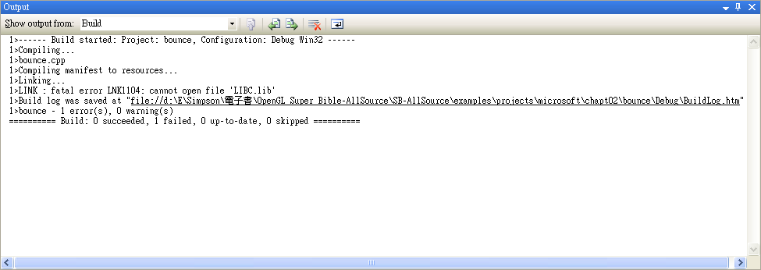
VC 2005 Compiler

Slide 19
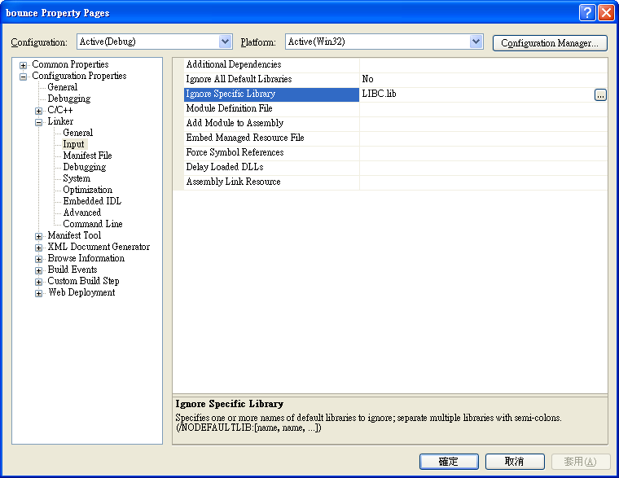
VC 2005 Compiler

Slide 20
Sample Program

Slide 21
GLUT Callback Functions
Routine to call when something happens
window resize or redraw
user input
animation
“Register” callbacks with GLUT
glutDisplayFunc( display );
glutIdleFunc( idle );
glutKeyboardFunc( keyboard );
Notes:
GLUT uses a callback mechanism to do its event processing. Callbacks simplify event processing for the application developer. As compared to more traditional event driven programming, where the author must receive and process each event, and call whatever actions are necessary, callbacks simplify the process by defining what actions are supported, and automatically handling the user events. All the author must do is fill in what should happen when.
GLUT supports many different callback actions, including:
glutDisplayFunc() - called when pixels in the window need to be refreshed.
glutReshapeFunc() - called when the window changes size
glutKeyboardFunc() - called when a key is struck on the keyboard
glutMouseFunc() - called when the user presses a mouse button on the mouse
glutMotionFunc() - called when the user moves the mouse while a mouse button is pressed
glutPassiveMouseFunc() - called when the mouse is moved regardless of mouse button state
glutIdleFunc() - a callback function called when nothing else is going on. Very useful for animations.

Slide 22
void glClearColor(GLclampf red, GLclampf green, GLclampf blue, GLclampf alpha);

Slide 23
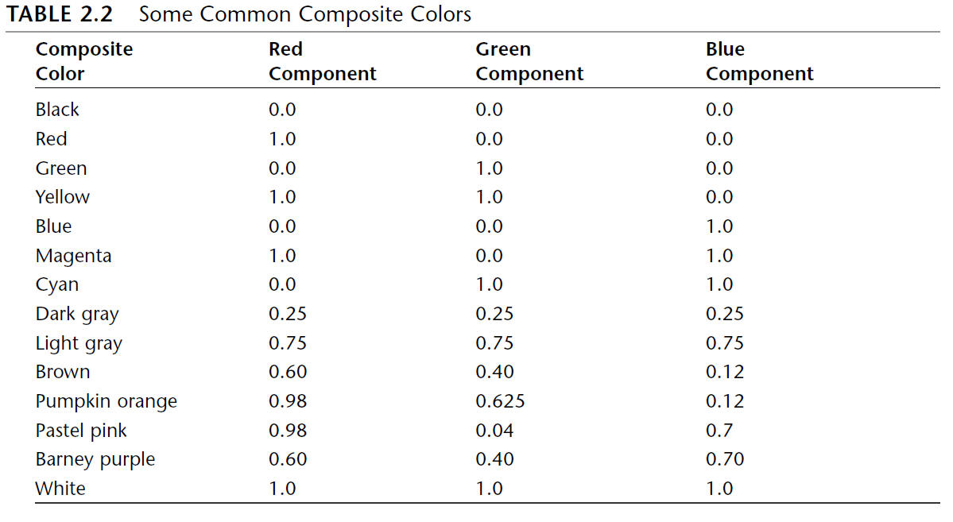
Some Common Composite Colors

Slide 24
Clearing the Color Buffer
glClear(GL_COLOR_BUFFER_BIT);
glFlush();

Slide 25
Drawing Shapes with OpenGL

Slide 26
glrect.cpp
int main(int argc, char* argv[])
{
glutInit(&argc, argv);
glutInitDisplayMode(GLUT_SINGLE | GLUT_RGB);
glutCreateWindow("GLRect");
glutDisplayFunc(RenderScene);
glutReshapeFunc(ChangeSize);
SetupRC();
glutMainLoop();
return 0;
}

Slide 27
Rendering Callback
Do all of your drawing here
void RenderScene(void)
{
glClear(GL_COLOR_BUFFER_BIT);
glColor3f(1.0f, 0.0f, 0.0f);
glRectf(-25.0f, 25.0f, 25.0f, -25.0f)
glFlush();
}

Slide 28
Reshape Callback
void ChangeSize(int w, int h)
{
GLfloat aspectRatio;
if(h == 0)
h = 1;
glViewport(0, 0, w, h);
glMatrixMode(GL_PROJECTION);
glLoadIdentity();
aspectRatio = (GLfloat)w / (GLfloat)h;
if (w <= h)
glOrtho (-100.0, 100.0, -100 / aspectRatio, 100.0 / aspectRatio, 1.0, -1.0);
else
glOrtho (-100.0 * aspectRatio, 100.0 * aspectRatio, -100.0, 100.0, 1.0, -1.0);
glMatrixMode(GL_MODELVIEW);
glLoadIdentity();
}

Slide 29
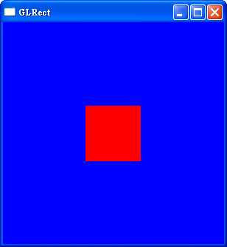

Slide 30
Drawing a Rectangle
void glColor3f(GLfloat red, GLfloat green, GLfloat blue);
void glRectf(GLfloat x1, GLfloat y1, GLfloat x2, GLfloat y2);

Slide 31
OpenGL Command Formats
glVertex3fv( v )
Number of
components
Data Type
Vector
b - byte
ub - unsigned byte
s - short
us - unsigned short
i - int
ui - unsigned int
f - float
d - double
omit “v” for
scalar form
glVertex2f( x, y )
2 - (x,y)
3 - (x,y,z)
4 - (x,y,z,w)
Notes:
The OpenGL API calls are designed to accept almost any basic data type, which is reflected in the calls name. Knowing how the calls are structured makes it easy to determine which call should be used for a particular data format and size.
For instance, vertices from most commercial models are stored as three component floating point vectors. As such, the appropriate OpenGL command to use is glVertex3fv( coords ).
As mentioned before, OpenGL uses homogenous coordinates to specify vertices. For glVertex*() calls which don’t specify all the coordinates ( i.e. glVertex2f()), OpenGL will default z = 0.0, and w = 1.0 .

Slide 32
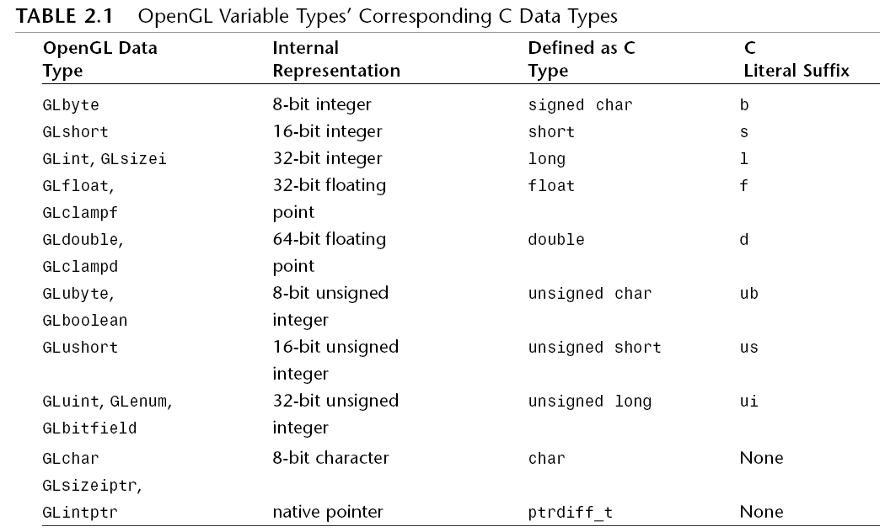
OpenGL Variable Types

Slide 33
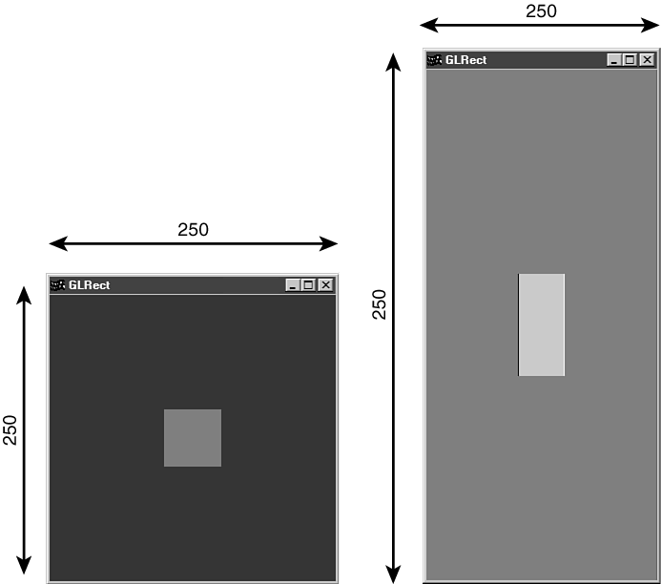
Setting the Viewport and Clipping Volume

Slide 34
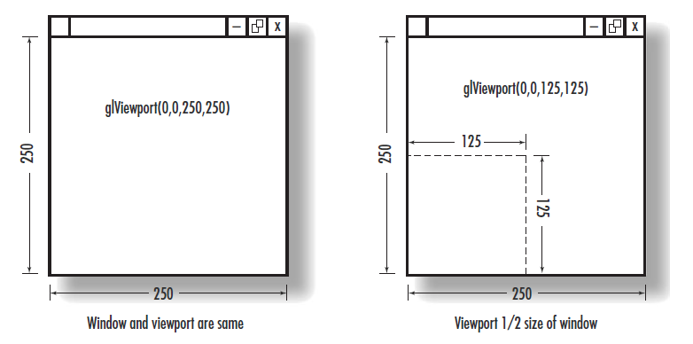
Defining the Viewport
void glViewport(GLint x, GLint y, GLsizei width, GLsizei height);

Slide 35
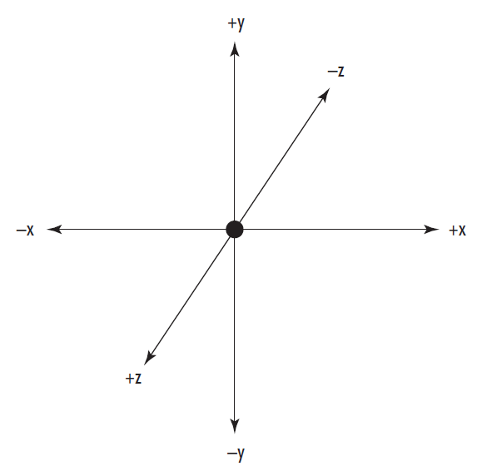
Defining the Clipped Viewing Volume
void glOrtho(GLdouble left, GLdouble right, GLdouble bottom, GLdouble top, GLdouble near, GLdouble far );

Slide 36
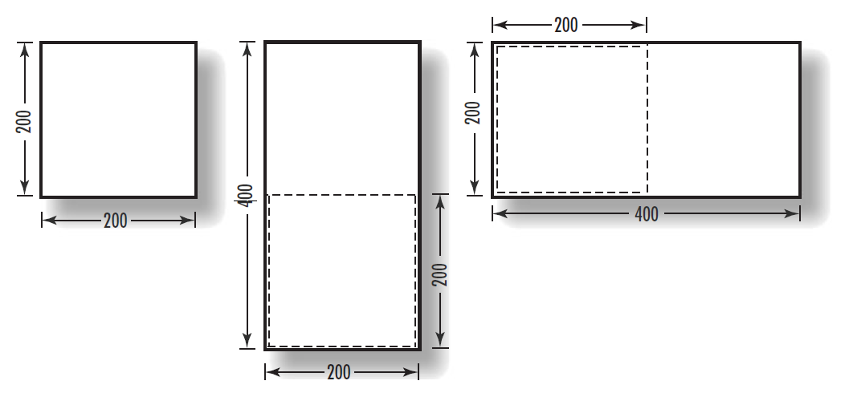
Keeping a Square Square

Slide 37
Keeping a Square Square
aspectRatio = (GLfloat)w / (GLfloat)h;
if (w <= h)
glOrtho (-100.0, 100.0, -100 / aspectRatio, 100.0 / aspectRatio, 1.0, -1.0);
else
glOrtho (-100.0 * aspectRatio, 100.0 * aspectRatio, -100.0, 100.0, 1.0, -1.0);

Slide 38
Animation with OpenGL and GLUT

Slide 39
bounce.cpp
int main(int argc, char* argv[])
{
glutInit(&argc, argv);
glutInitDisplayMode(GLUT_DOUBLE | GLUT_RGBA);
glutInitWindowSize(800,600);
glutCreateWindow("Bounce");
glutDisplayFunc(RenderScene);
glutReshapeFunc(ChangeSize);
glutTimerFunc(33, TimerFunction, 1);
SetupRC();
glutMainLoop();
return 0;
}

Slide 40
Rendering Callback
GLfloat x = 0.0f;
GLfloat y = 0.0f;
GLfloat rsize = 25;
GLfloat xstep = 1.0f;
GLfloat ystep = 1.0f;
GLfloat windowWidth;
GLfloat windowHeight;
void RenderScene(void)
{
glClear(GL_COLOR_BUFFER_BIT);
glColor3f(1.0f, 0.0f, 0.0f);
glRectf(x, y, x + rsize, y - rsize);
glutSwapBuffers();
}

Slide 41
Timer Callback
void TimerFunction(int value)
{
if(x > windowWidth-rsize || x < -windowWidth)
xstep = -xstep;
if(y > windowHeight || y < -windowHeight + rsize)
ystep = -ystep;
x += xstep;
y += ystep;
if(x > (windowWidth-rsize + xstep))
x = windowWidth-rsize-1;
else if(x < -(windowWidth + xstep))
x = -windowWidth -1;
if(y > (windowHeight + ystep))
y = windowHeight-1;
else if(y < -(windowHeight - rsize + ystep))
y = -windowHeight + rsize - 1;
glutPostRedisplay();
glutTimerFunc(33,TimerFunction, 1);
}

Slide 42
Time function
glutTimerFunc(unsigned int millis, void (GLUTCALLBACK *func)(int value), int value);
Registers a timer callback to be triggered in a specified number of milliseconds.

Slide 43
Double Buffering
glutInitDisplayMode(GLUT_DOUBLE | GLUT_RGBA);
glutSwapBuffers();

Slide 44
User Input Callbacks
Process user input
glutKeyboardFunc( keyboard );
void keyboard( unsigned char key, int x, int y )
{
switch( key ) {
case ‘q’ : case ‘Q’ :
exit( EXIT_SUCCESS );
break;
case ‘r’ : case ‘R’ :
rotate = GL_TRUE;
glutPostRedisplay();
break;
}
}
Notes:
Above is a simple example of a user input callback. In this case, the routine was registered to receive keyboard input. GLUT supports user input through a number of devices including the keyboard, mouse, dial and button boxes and spaceballs.

Slide 45
The mouse callback
glutMouseFunc(mymouse)
void mymouse(GLint button, GLint state, GLint x, GLint y)
Returns
which button (GLUT_LEFT_BUTTON, GLUT_MIDDLE_BUTTON, GLUT_RIGHT_BUTTON) caused event
state of that button (GLUT_UP, GLUT_DOWN)
Position in window

