Slide 1
OpenGL SuperBible
Chapter 3. Drawing primitives in Space
2010.10.04 Presented by Garrett Yeh

Slide 2
Outline
Primitives and buffers (Ch3)
Rendering primitives
Using stand buffers

Slide 3
Primitives and Buffers

Slide 4
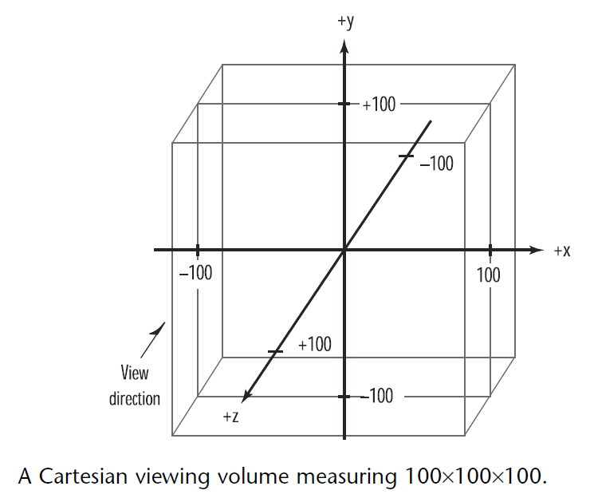
Setting Up a 3D Canvas

Slide 5
Reshape function
void ChangeSize(GLsizei w, GLsizei h)
{
Glfloat nRange = 100.0f;
// Prevent a divide by zero
if(h == 0)
h = 1;
// Set Viewport to window dimensions
glViewport(0, 0, w, h);
// Reset projection matrix stack
glMatrixMode(GL_PROJECTION);
glLoadIdentity();

Slide 6
Reshape function _{cont.}
//Establish clipping volume
if (w <= h)
glOrtho (-nRange, nRange,
-nRange*h/w, nRange*h/w, -nRange, nRange);
else
glOrtho (-nRange*w/h, nRange*w/h, -nRange, nRange, -nRange, nRange);
// Reset Model view matrix stack
glMatrixMode(GL_MODELVIEW);
glLoadIdentity();
}
Notes:
void glOrtho(GLdouble left, GLdouble right,
GLdouble bottom, GLdouble top,
GLdouble nearVal, GLdouble farVal);

Slide 7
Drawing Points
void RenderScene(void) {
GLfloat x,y,z,angle; // Storage for coordinates and angles
// Clear the window with current clearing color
glClear(GL_COLOR_BUFFER_BIT);
// Save matrix state and do the rotation
glPushMatrix();
glRotatef(xRot, 1.0f, 0.0f, 0.0f);
glRotatef(yRot, 0.0f, 1.0f, 0.0f);
// Drawing Points
… (next slide)
// Restore transformations
glPopMatrix();
// Flush drawing commands
glutSwapBuffers();
}

Slide 8
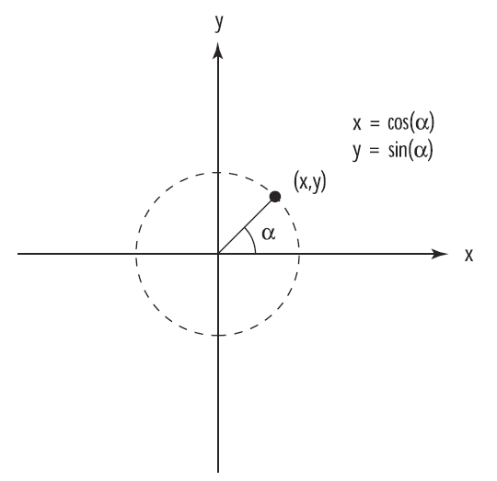
Drawing Points _{cont.}
// Call only once for all remaining points
glBegin(GL_POINTS);
z = -50.0f;
for(angle = 0.0f; angle <= (2.0f*GL_PI)*3.0f; angle += 0.1f)
{
x = 50.0f*sin(angle);
y = 50.0f*cos(angle);
// Specify the point and move the Z value up a little
glVertex3f(x, y, z);
z += 0.5f;
}
// Done drawing points
glEnd();

Slide 9
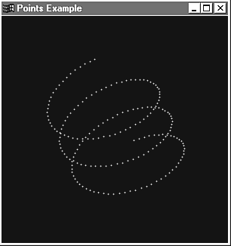

Slide 10
Setting Point Size
GLfloat sizes[2]; // Store supported point size range
GLfloat step; // Store supported point size increments
// Get supported point size range and step size
glGetFloatv(GL_POINT_SIZE_RANGE,sizes);
glGetFloatv(GL_POINT_SIZE_GRANULARITY,&step);
… setup point size between size[0]~size[1]
// Specify the point size before the primitive is specified
glPointSize(curSize); // a floating point
// Draw the point
glBegin(GL_POINTS);
glVertex3f(x, y, z);
glEnd();
…

Slide 11
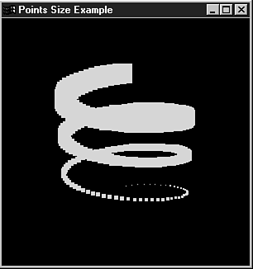

Slide 12
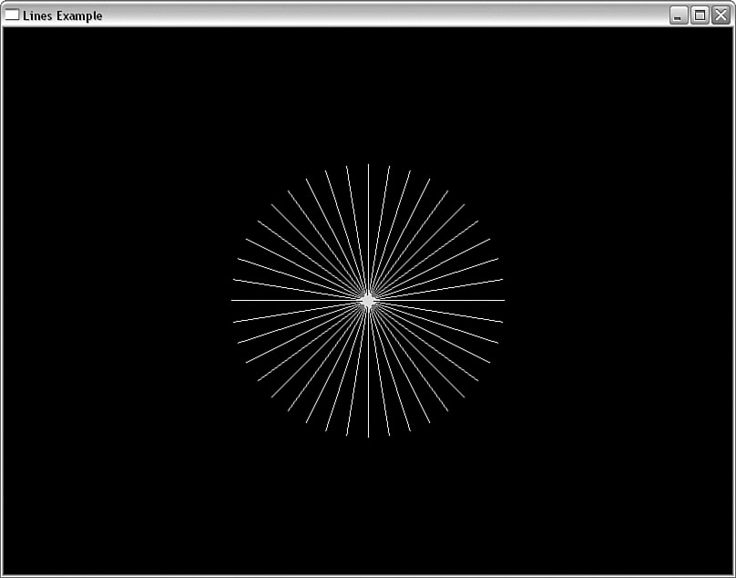
Line
glBegin(GL_LINES);
z = 0.0f;
for(angle = 0.0f; angle <= GL_PI; angle += (GL_PI / 20.0f))
{
// Top half of the circle
x = 50.0f*sin(angle);
y = 50.0f*cos(angle);
glVertex3f(x, y, z);
// Bottom half of the circle
x = 50.0f*sin(angle+GL_PI);
y = 50.0f*cos(angle+GL_PI);
glVertex3f(x, y, z);
}
// Done drawing points
glEnd();

Slide 13
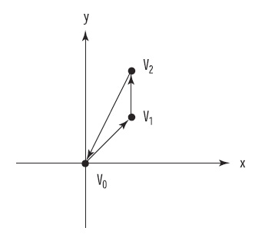
LINE_STRIP
glBegin(GL_LINE_STRIP);

Slide 14
Setting Line Width _{cont.}
GLfloat sizes[2]; // Store supported line width range
GLfloat step; // Store supported line width increments
// Get supported line width range and step size
glGetFloatv(GL_LINE_WIDTH_RANGE,sizes);
glGetFloatv(GL_LINE_WIDTH_GRANULARITY,&step);
… setup line width between size[0]~size[1]
glLineWidth(fCurrSize);
// Draw the line
glBegin(GL_LINES);
glVertex2f(-80.0f, y);
glVertex2f(80.0f, y);
glEnd();
…

Slide 15
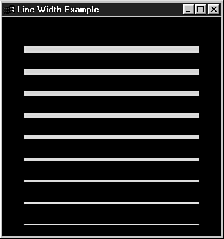

Slide 16
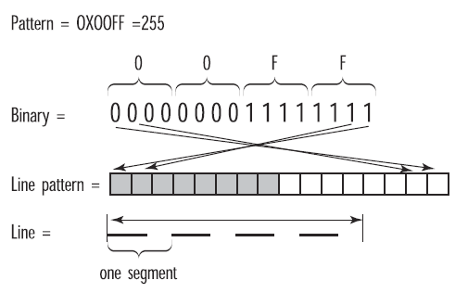
LineStipple
glEnable(GL_LINE_STIPPLE);
GLushort pattern = 0x5555; // Stipple pattern
glLineStipple(factor,pattern); // factor = width of pattern
// Draw the line
glBegin(GL_LINES);
…
glEnd();

Slide 17
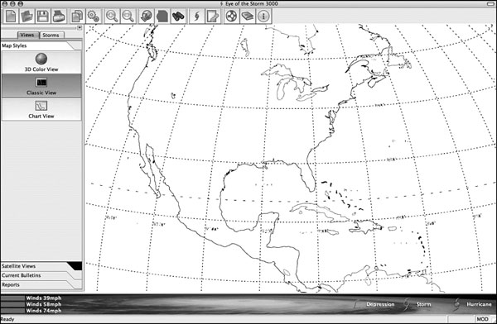

Slide 18
Triangle
glBegin(GL_TRANGLES);
…
glEnd();
Front / Back face
glFrontFace(GL_CW);
GL_TRIANGLES
GL_TRIANGLE_FAN
GL_TRIANGLE_STRIP

Slide 19
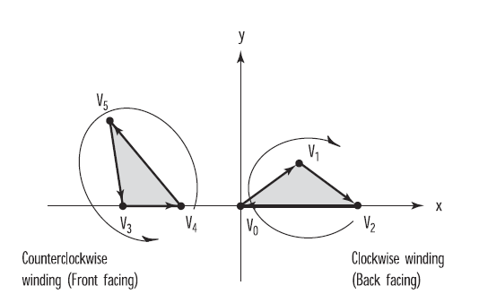
Triangle
glBegin(GL_TRANGLES);
…
glEnd();
Front / Back face
glFrontFace(GL_CW);

Slide 20
glBegin(GL_TRIANGLE_FAN);
// Pinnacle of cone is shared vertex for fan, moved up Z axis to produce a cone instead of a circle
glVertex3f(0.0f, 0.0f, 75.0f);
// Loop around in a circle and specify even points along the circle
// as the vertices of the triangle fan
for(angle = 0.0f; angle < (2.0f*GL_PI); angle += (GL_PI/8.0f))
{
// Calculate x and y position of the next vertex
x = 50.0f*sin(angle);
y = 50.0f*cos(angle);
// Specify the next vertex for the triangle fan
glVertex2f(x, y);
}
// Done drawing fan for cone
glEnd();

Slide 21
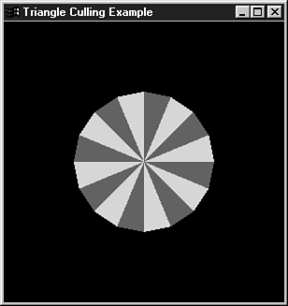

Slide 22
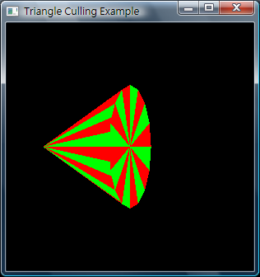
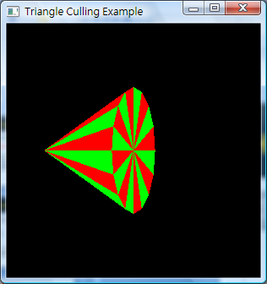
Hidden Surface Remove
glEnable(GL_DEPTH_TEST);

Slide 23
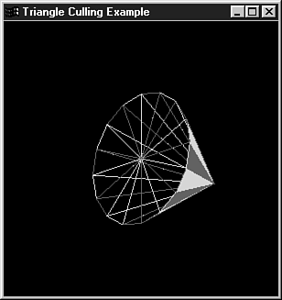
Polygon mode
// Draw back side as a polygon only, if flag is set
if(bOutline)
glPolygonMode(GL_BACK,GL_LINE);
else
glPolygonMode(GL_BACK,GL_FILL);
(Culling disabled)

Slide 24
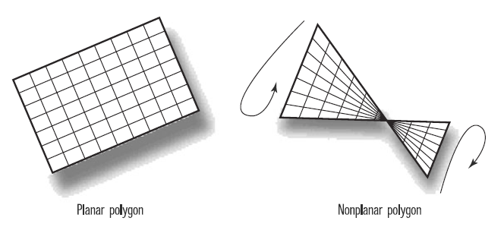
Polygon Construction Rules
All polygons must be planar

Slide 25
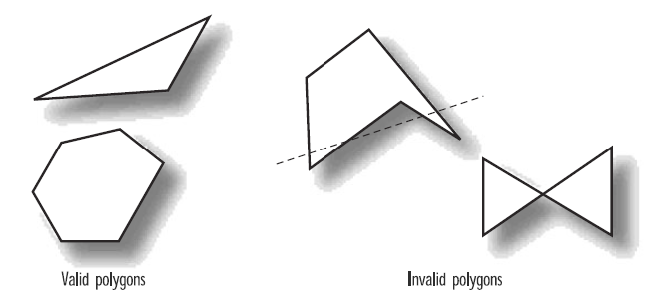
Polygon Construction Rules
All polygons must be convex
glEdgeFlag(TRUE);

