Slide 1
CHAPTER 5
3D Graphics Programming
Color, Material, and Lighting
by Richard S. Wright Jr.
Vivian

Slide 2
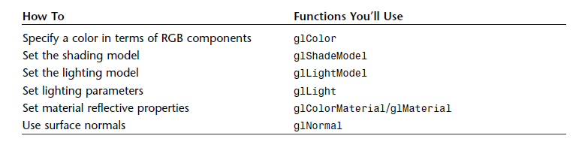

Slide 3
Outline
Color, Material, and Lighting (CH5)
  Color
  ShadeModel
  LightModel
  Light
  ColorMaterial/Material
  Normal
Notes:
ShadeModel 著色模式
LightModel 燈光模式
Light 設定光的參數
ColorMaterial/Material 設定材質反射性質
Normal 表面法向量

Slide 4
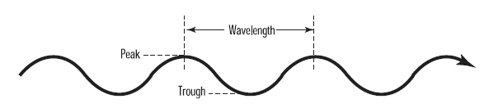
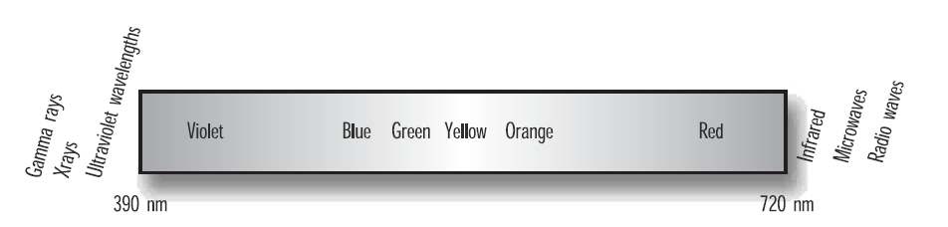
What is Color
Light as a wave
Notes:
http://en.wikipedia.org/wiki/Electromagnetic_spectrum
可見光是 390 nanometers的紫光到720nanometers的紅光

Slide 5
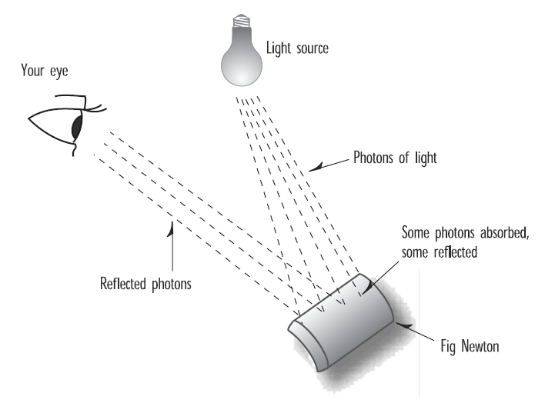
What is Color?
Light as a Particle

Slide 6
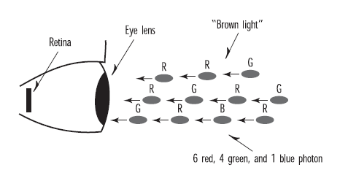
Your Personal Photon Detector

Slide 7
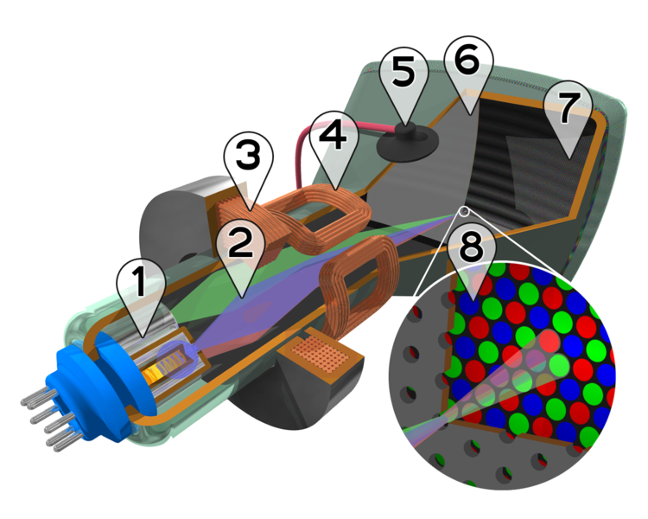
Photon Generator

Slide 8
PC Display Modes
Screen resolution
  640x480 up to 1600x1200 or more
Color Depth
Notes:
Clipping volume and viewport
Color 有三種色階 4bit 8bit 24bit

Slide 9
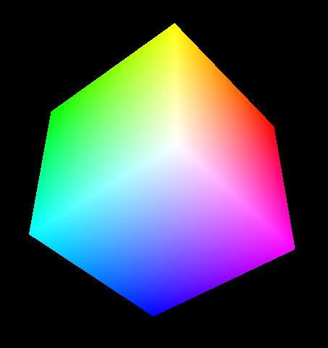
Using Color in OpenGL
The Color Cube
Green
White
(255, 255, 255)
Black
(0, 0, 0)
Red
Blue
The RGB color space.

Slide 10
Setting the Drawing Color
glColor<x><t>(red, green, blue, alpha);
<x>
  The number of arguments (3 or 4)
<t>
  The argument’s data type (double, float, integer…)
Ex: glColor3f
Notes:
X 如果是 3 就是代表r g b 三種顏色
如果是4 就是家加上alpha

Slide 11
Shading
Green
White
(255, 255, 255)
Black
(0, 0, 0)
Red
Blue
Black
(0, 0, 0)
Medium gray
(128, 128, 128)
White
(255, 255, 255)
Notes:
Shading 簡單來說就是將一端的顏色平滑的變到另一顏色.
從黑色變到白色

Slide 12
Shading Model
// Enable smooth shading
glShadeModel(GL_SMOOTH);
// Draw the triangle
glBegin(GL_TRIANGLES);
// Red Apex
glColor3ub((GLubyte)255,(GLubyte)0,(GLubyte)0);
glVertex3f(0.0f,200.0f,0.0f);
// Green on the right bottom corner
glColor3ub((GLubyte)0,(GLubyte)255,(GLubyte)0);
glVertex3f(200.0f,-70.0f,0.0f);
// Blue on the left bottom corner
glColor3ub((GLubyte)0,(GLubyte)0,(GLubyte)255);
glVertex3f(-200.0f, -70.0f, 0.0f);
glEnd();
Notes:
GL_flat

Slide 13
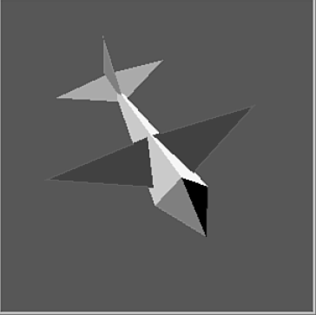
Color in the Real World
A simple jet built by setting a different color for each triangle.

Slide 14
Ambient light

Slide 15
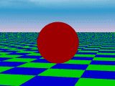
Ambient Light Source
Even though an object in a scene is not directly lit it will still be visible. This is because light is reflected indirectly from nearby objects. A simple hack that is commonly used to model this indirect illumination is to use of an ambient light source. Ambient light has no spatial or directional characteristics. The amount of ambient light incident on each object is a constant for all surfaces in the scene. An ambient light can have a color.
The amount of ambient light that is reflected by an object is independent of the object's position or orientation. Surface properties are used to determine how much ambient light is reflected.

Slide 16
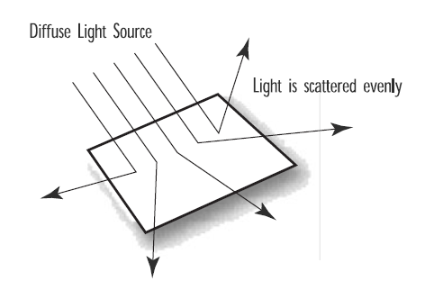
Diffuse light
Notes:
來自某一方向

Slide 17
Specular light
Notes:
反射光

Slide 18
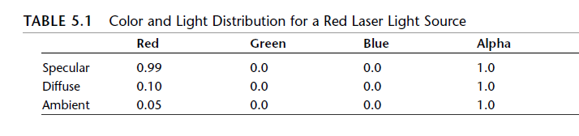
Putting It All Together

Slide 19
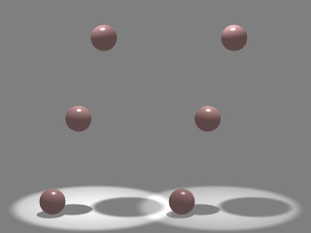
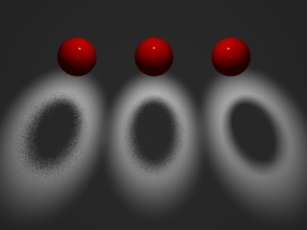
Other Light Sources
Spotlights
  Point source whose intensity falls off away from a given direction
  Requires a color, a point, a direction, parameters that control the rate of fall off
Area Light Sources
  Light source occupies a 2-D area (usually a polygon or disk)
  Generates soft shadows
Extended Light Sources
  Spherical Light Source
  Generates soft shadows

Slide 20
Material in the Real world
Material Properties
.5 Intensity
.5 X .5 =.25

Slide 21
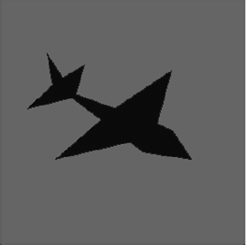
Adding Light to a scene
Enabling the lighting
  glEnable(GL_LIGHTING)
An unlit jet reflects no light.

Slide 22
Setting Up Cosmic Background Radiation
// Bright white light – full intensity RGB valuesLfloat
Glfloat ambientLight[] = { 1.0f, 1.0f, 1.0f, 1.0f };
// Lighting stuff
glEnable(GL_LIGHTING); // Enable lighting
// Set light model to use ambient light specified by ambientLight
glLightModelfv(GL_LIGHT_MODEL_AMBIENT, ambientLight);
Notes:
GL_LIGHT_MODEL_AMBIENT 這個參數是要設定lighting model參數
ambientLight RGBA矩陣

Slide 23
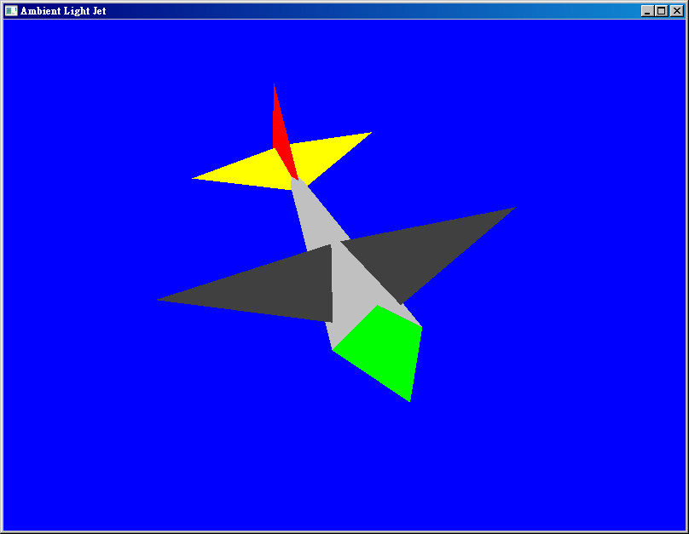

Slide 24
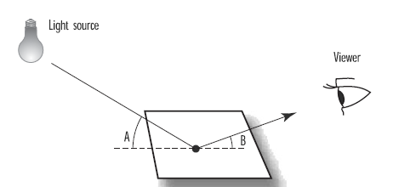
Using a Light Source

Slide 25
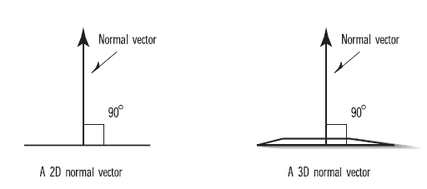
Surface Normal

Slide 26
Specifying a normal
glBegin(GL_TRIANGLES);
glNormal3f(0.0f, -1.0f, 0.0f)
glVertex3f(0.0f, 0.0f, 60.0f);
glVertex3f(-15.0f, 0.0f, 30.0f);
glVertex3f(15.0f,0.0f,30.0f);
glEnd();

Slide 27
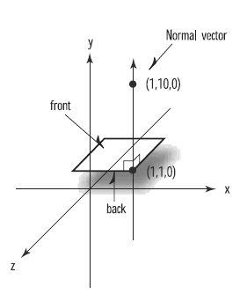
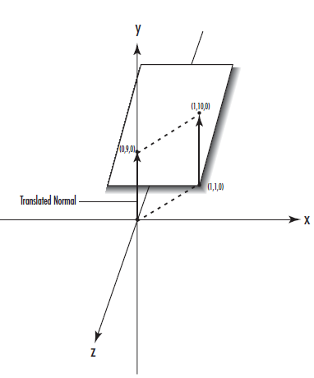
Specifying a Normal

Slide 28
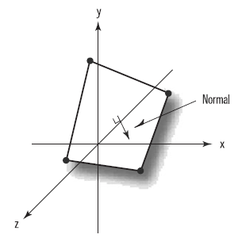
Finding a Normal

Slide 29
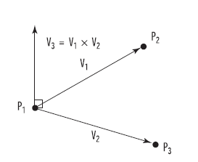
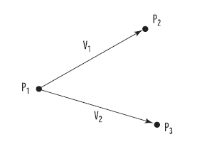
Finding a Normal

Slide 30
Setting Up a Source
// Light values and coordinates
GLfloat ambientLight[] = { 0.3f, 0.3f, 0.3f, 1.0f };
GLfloat diffuseLight[] = { 0.7f, 0.7f, 0.7f, 1.0f };
// Enable lighting
glEnable(GL_LIGHTING);
// Setup and enable light 0
glLightfv(GL_LIGHT0,GL_AMBIENT,ambientLight);
glLightfv(GL_LIGHT0,GL_DIFFUSE,diffuseLight);
glEnable(GL_LIGHT0);

Slide 31
GLfloat lightPos[] = { -50.f, 50.0f, 100.0f, 1.0f };
……
fAspect = (GLfloat) w / (GLfloat) h;
gluPerspective(45.0f, fAspect, 1.0f, 225.0f);
glMatrixMode(GL_MODELVIEW);
glLoadIdentity();
glLightfv(GL_LIGHT0,GL_POSITION,lightPos);
glTranslatef(0.0f, 0.0f, -150.0f);

Slide 32
// Verticies for this panel
{
M3DVector3f vPoints[3] = {{ 15.0f, 0.0f, 30.0f},
{ 0.0f, 15.0f, 30.0f},
{ 0.0f, 0.0f, 60.0f}};
// Calculate the normal for the plane
m3dFindNormal(vNormal, vPoints[0], vPoints[1], vPoints[2]);
glNormal3fv(vNormal);
glVertex3fv(vPoints[0]);
glVertex3fv(vPoints[1]);
glVertex3fv(vPoints[2]);
}

Slide 33
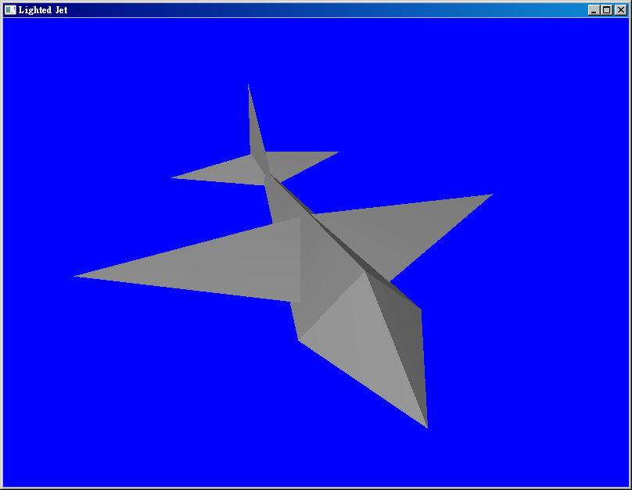
Notes:
LitHet

Slide 34
Lighting Effects
Secular Light
GLfloat specular[] = { 1.0f, 1.0f, 1.0f, 1.0f };
GLfloat specref[] = { 1.0f, 1.0f, 1.0f, 1.0f };
glLightfv(GL_LIGHT0,GL_SPECULAR, specular);
// All materials hereafter have full specular reflectivity
// with a high shine
glMaterialfv(GL_FRONT, GL_SPECULAR, specref);
glMateriali(GL_FRONT, GL_SHININESS, 128);

Slide 35
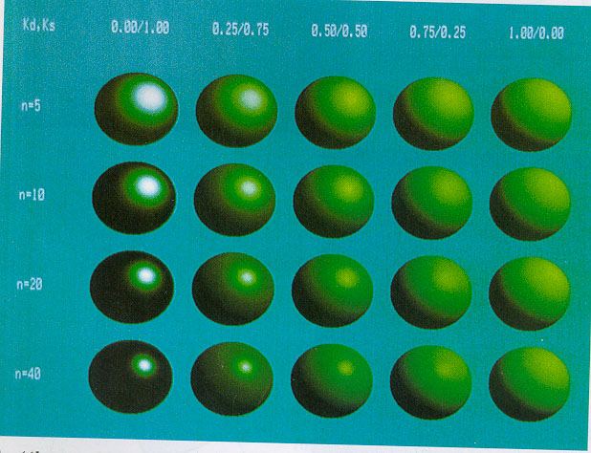
Phong Reflection
Image courtesy of Watt, 3D Computer Graphics

Slide 36
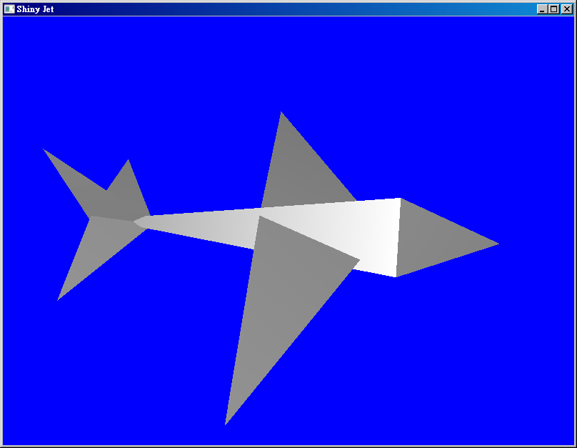
Notes:
ShinyJet

Slide 37
Normal Average

Slide 38
Normalize
glEnable(GL_NORMALIZE);
glEnable(GL_RESCALE_NORMALS);

Slide 39
Lighting soure
Point light
Directional Light
Spot Light

Slide 40
Spot light
// Specific spot effects
// Cut off angle is 60 degrees
glLightf(GL_LIGHT0,GL_SPOT_CUTOFF,50.0f);
cutoff

Slide 41
glPushMatrix();
// Rotate coordinate system
glRotatef(yRot, 0.0f, 1.0f, 0.0f);
glRotatef(xRot, 1.0f, 0.0f, 0.0f);
// Specify new position and direction in rotated coords.
glLightfv(GL_LIGHT0,GL_POSITION,lightPos);
glLightfv(GL_LIGHT0,GL_SPOT_DIRECTION,spotDir);

Slide 42
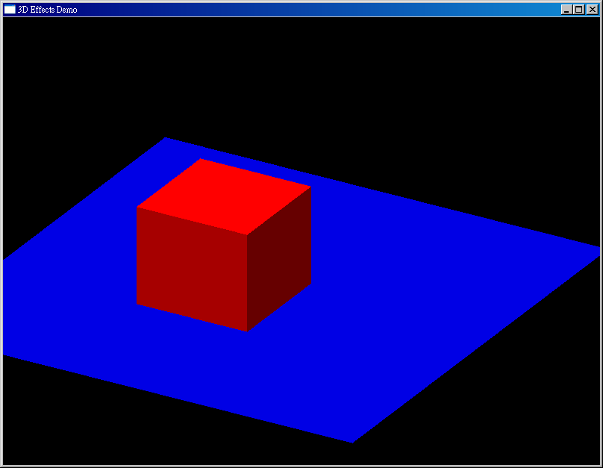
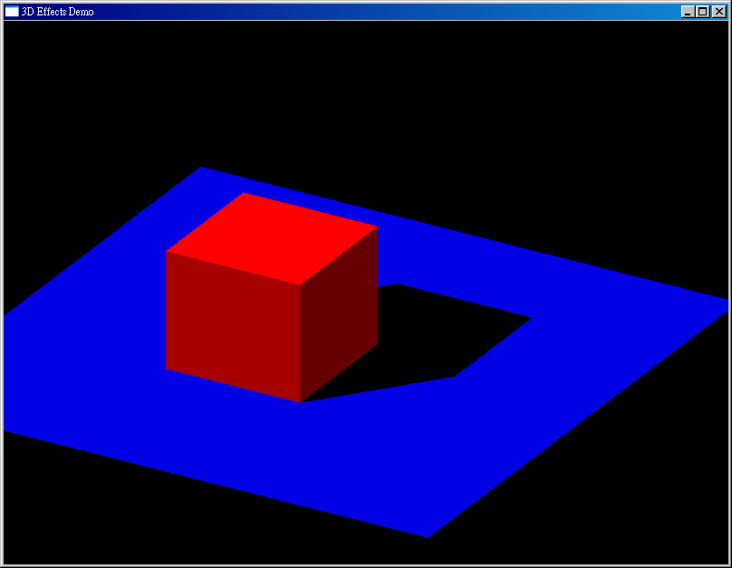
Shadows
Notes:
壓扁的物體

Slide 43
// Get the plane equation from three points on the ground
M3DVector4f vPlaneEquation;
m3dGetPlaneEquation(vPlaneEquation, points[0], points[1], points[2]);
// Calculate projection matrix to draw shadow on the ground
m3dMakePlanarShadowMatrix(shadowMat, vPlaneEquation, lightPos);

Slide 44
// Get ready to draw the shadow and the ground
// First disable lighting and save the projection state
glDisable(GL_DEPTH_TEST);
glDisable(GL_LIGHTING);
glPushMatrix();
// Multiply by shadow projection matrix
glMultMatrixf((GLfloat *)shadowMat);
// Now rotate the jet around in the new flattend space
glRotatef(xRot, 1.0f, 0.0f, 0.0f);
glRotatef(yRot, 0.0f, 1.0f, 0.0f);
// Pass true to indicate drawing shadow
DrawJet(1);
// Restore the projection to normal
glPopMatrix();

