Slide 1
3D Graphics Programming
Chapter 6. More on Color and Material
2010.11.08 Presented by Garrett Yeh

Slide 2
Outline
More on Color, Material, and Lighting (CH6)
Blending
Antialiasing
Fog
Accumulation Buffer

Slide 3
Blending
A common technique to make various rendering effects

Slide 4
Blending
Alpha compositing
The process of combining an image with a background to create the appearance of partial transparency.
Range of alpha value – 0.0~1.0
0.0 represents a fully transparent color
1.0 represents a fully opaque color.
Notes:
http://en.wikipedia.org/wiki/Alpha_compositing

Slide 5
Blending equation
foreground (incoming color)
Ordering: painter’s algorithm
Cf = (Cs * S) + (Cd * D)
glEnable(GL_BLEND);
glBlendFunc(GL_SRC_ALPHA, GL_ONE_MINUS_SRC_ALPHA);
DrawGround();
glDisable(GL_BLEND);
This function tells OpenGL…
take the source (incoming) color and multiply the color (the RGB values) by the (its) alpha value.
Add this to the result of multiplying the destination color by one minus the alpha value from the source.
background
Cf = (Cs * S) + ((1-Cs) * D)

Slide 6
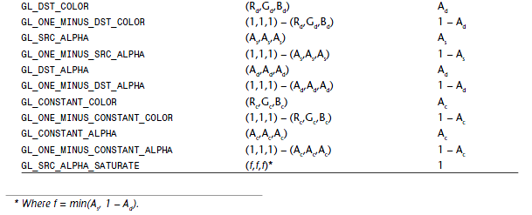
Reference table (p.230~231)
glBlendFunc(GLenum S, GLenum D);
S and D are the source and destination blending factors

Slide 7
More…
glBlendEquation(GLenum mode);
glBlendFuncSeparate(GLenum srcRGB, GLenum dstRGB, GLenum srcAlpha, GLenum dstAlpha); ~ gain full control of blending

Slide 8
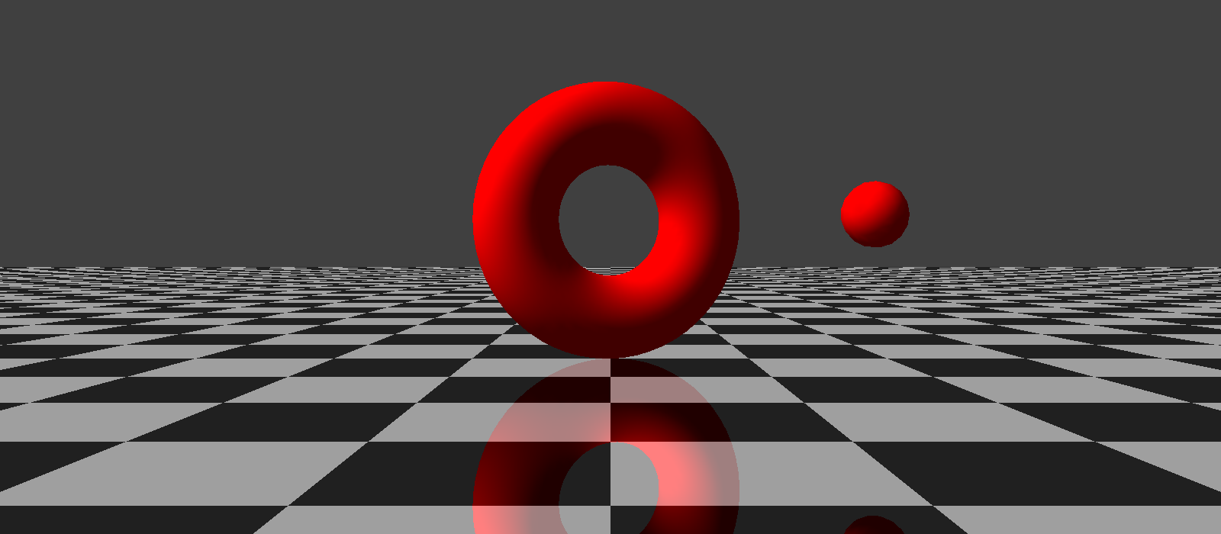
Reflection
Use blending to fake “reflection”

Slide 9
Reflection.cpp
Clockwise
glFrontFace(GL_CW);
glScalef(1.0f, -1.0f, 1.0f);

Slide 10
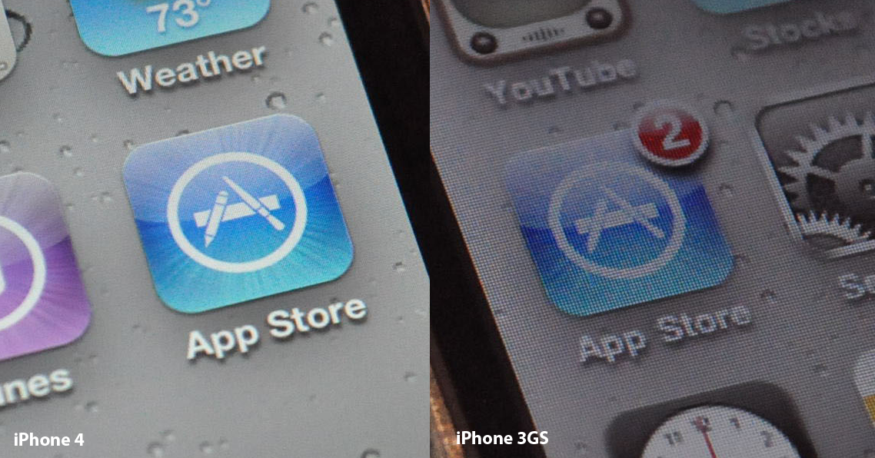
Anti-aliasing

Slide 11
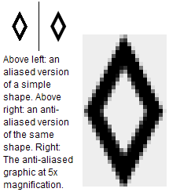
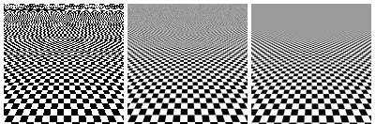
What is “aliasing”
All of aliasing is kind of sampling problem
After we down-sample some lines/curves, we may not reconstruct the original version.
Notes:
In signal processing, aliasing refers to an effect that causes different signals to become indistinguishable when sampled.
It also refers to the distortion or artifact that results when the signal reconstructed from samples is different from the original continuous signal.

Slide 12
Remove jagged edges
OpenGL uses blending to blend the color of the fragment with the destination color of the pixel and its surrounding pixels.
In essence, pixel colors are smeared slightly to neighboring pixels along the edges of any primitives.

Slide 13
Using AA in the opengl

Slide 14
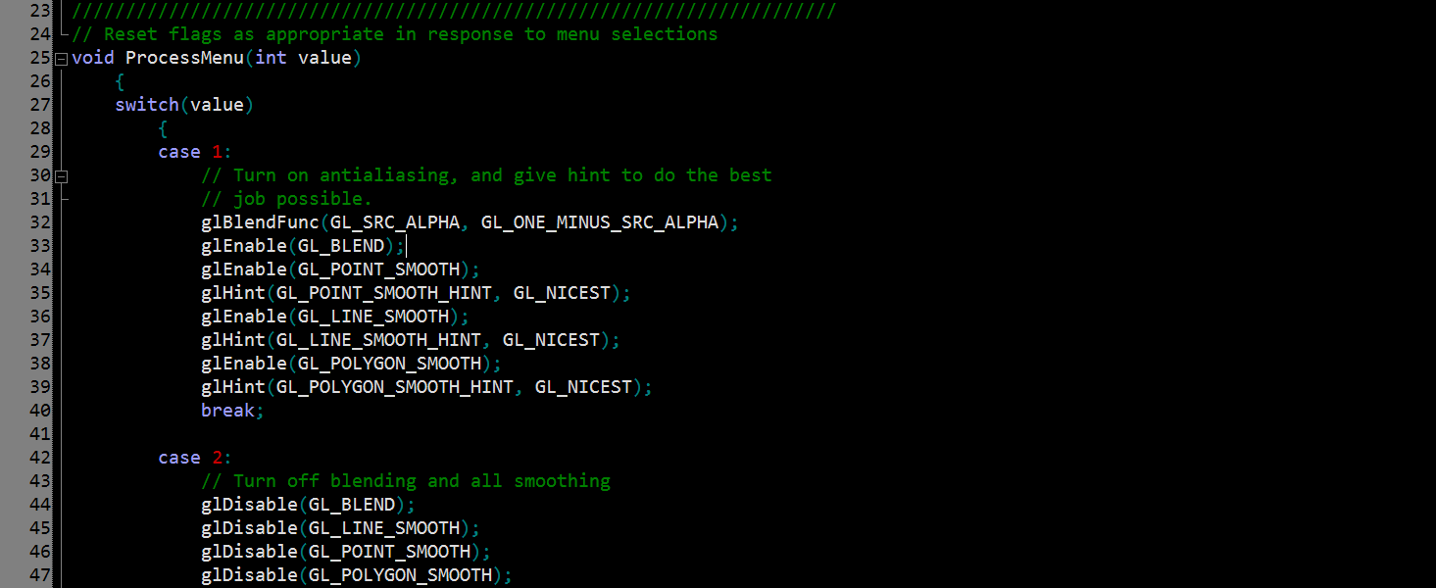
Smoother.cpp
Use glBlendEquation(GL_FUNC_ADD);
This is a default option.
glEnable (…)
glHint (…)

Slide 15
More…
Use “multi-sample” in the initial stage

Slide 16
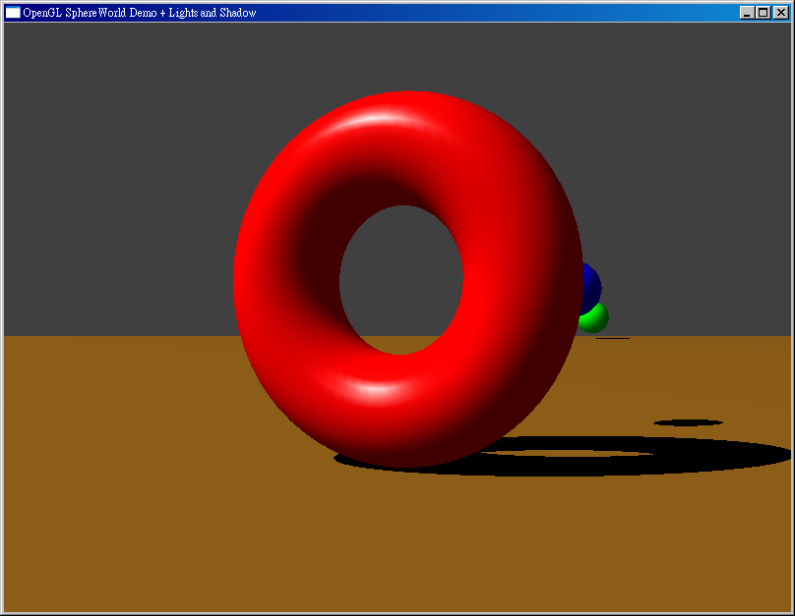
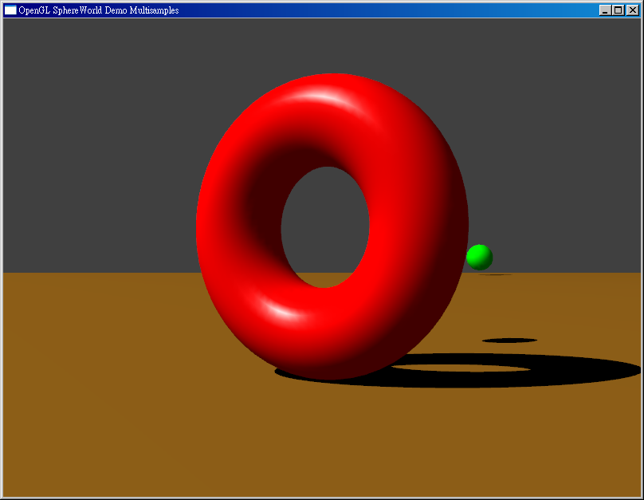
multi-sampled example

Slide 17
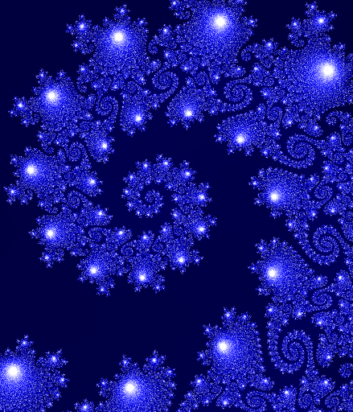
Anti-Aliasing filter

Slide 18
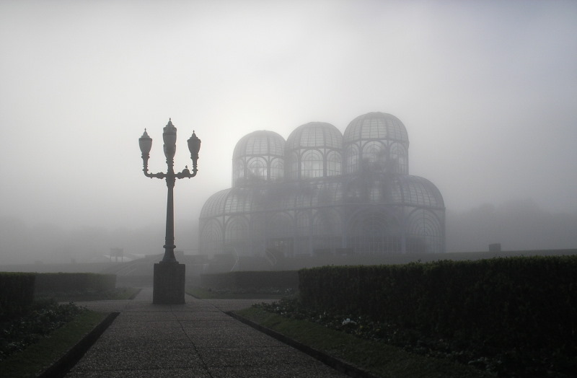
Fog

Slide 19
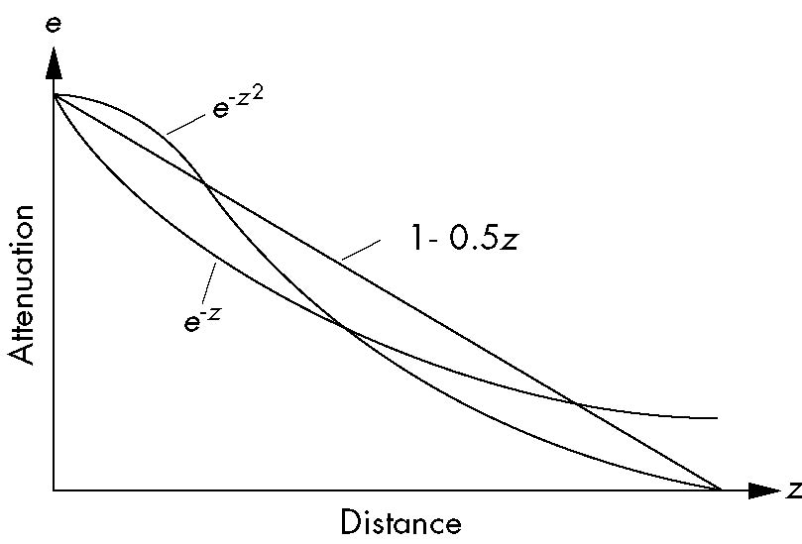
Fog Functions
Blend fog color and rendering result to create fog

Slide 20
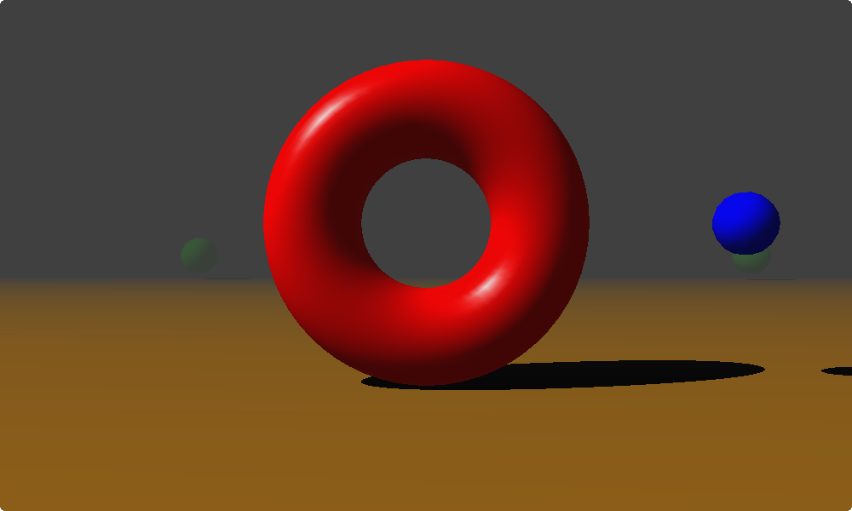
Fog

Slide 21
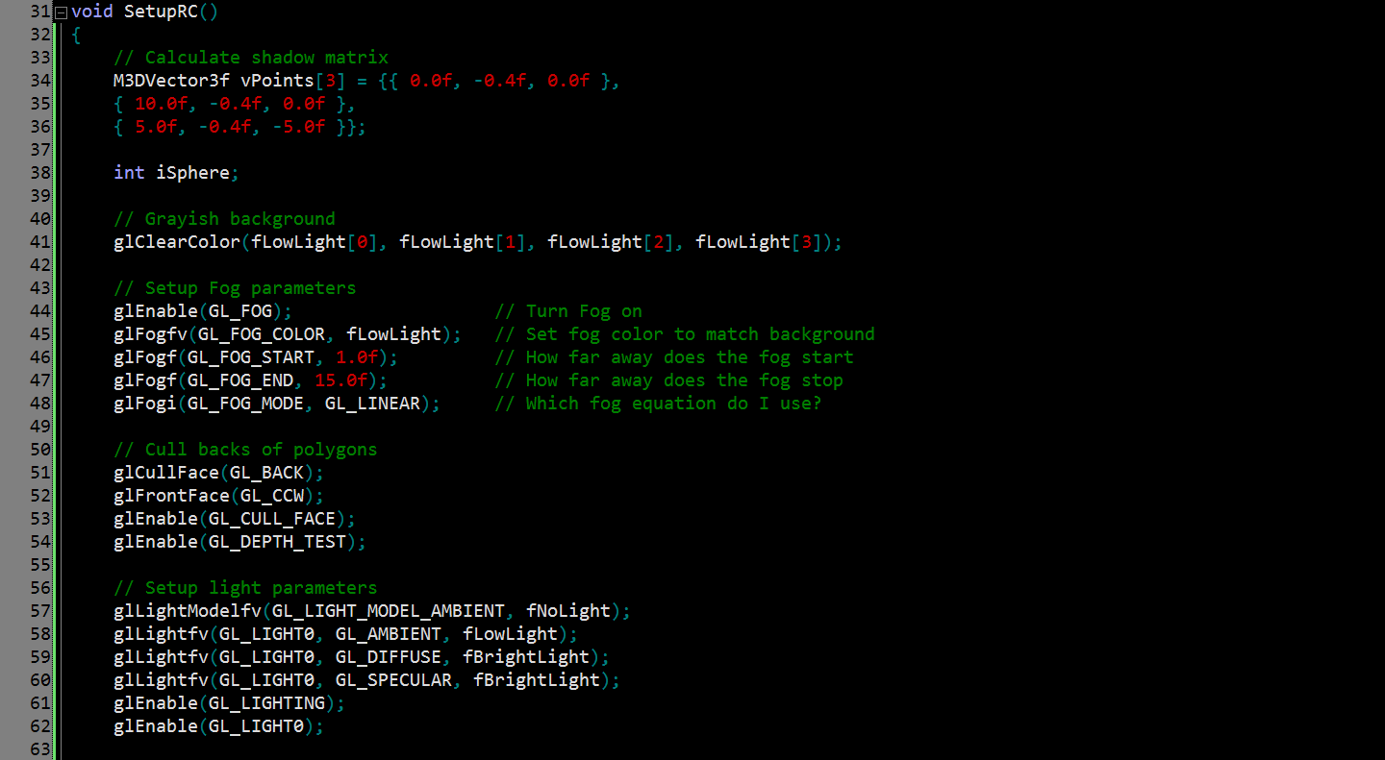
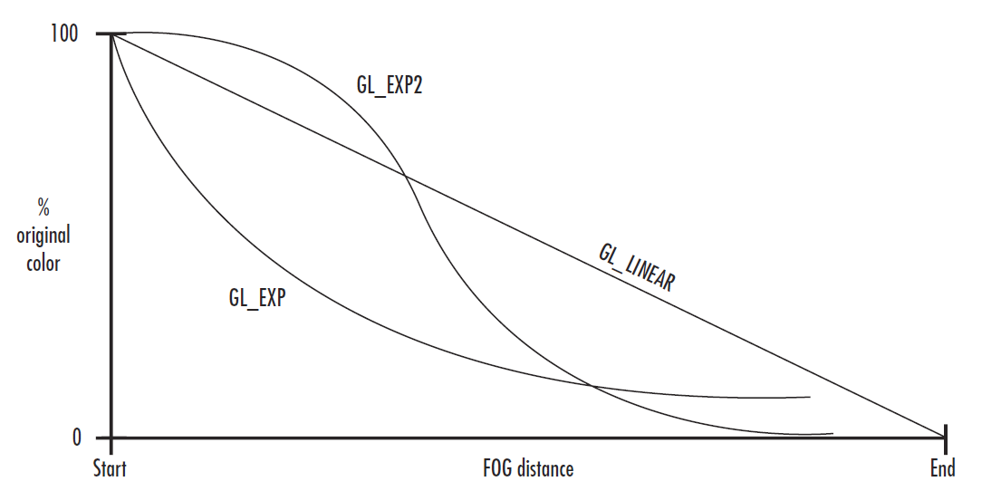
Set color of Fog
Set range of Fog

Slide 22
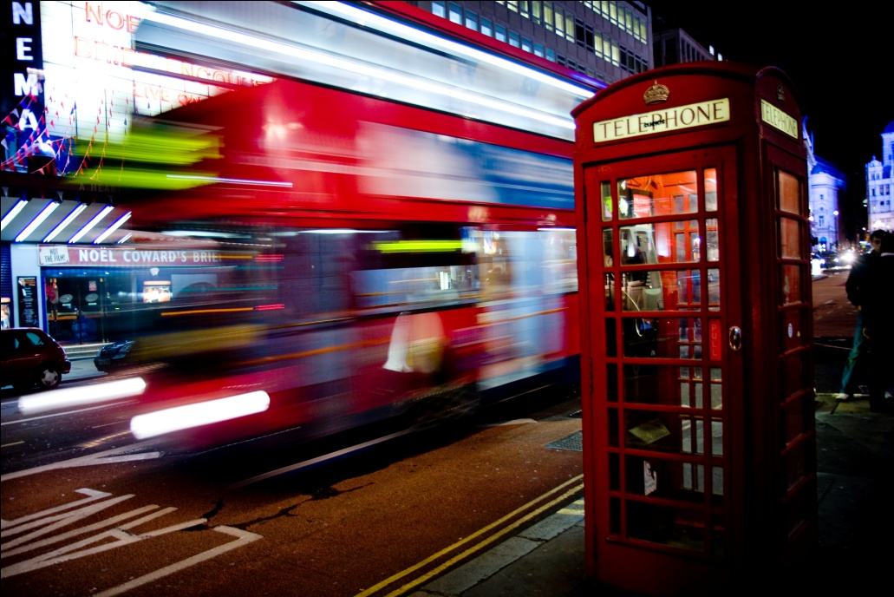
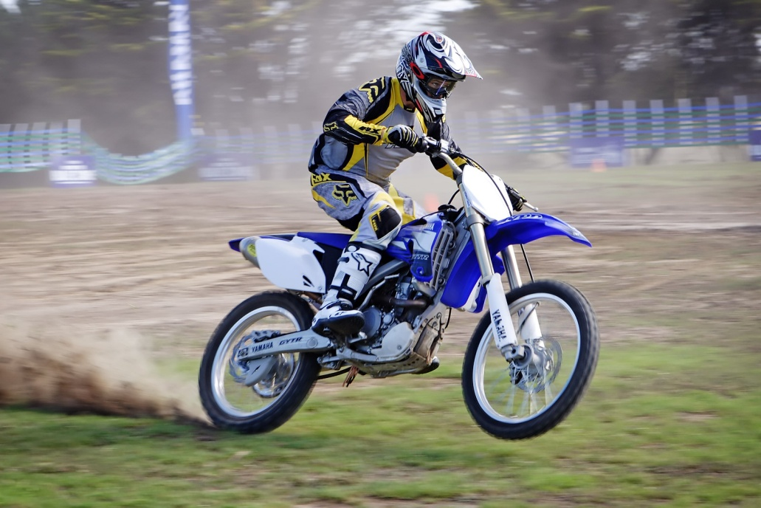
Motion blur
Using Accumulation Buffer
Foreground blurring
Background blurring

Slide 23
What is Motion blur
When a camera creates an image, that image does not always represent a single instant of time.
Because of technological constraints or artistic requirements, the image may represent the scene over a period of time.

Slide 24
Accumulation Buffer
1. Render to the color buffer and copy the contents of the color buffer to the accumulation buffer.
Several supported copy operations allow you to repeatedly blend, in different ways.
2. Copy the accumulation buffer back to the color buffer
Display the results with a buffer swap.
Notes:
This buffer allows you to render to the color buffer, and then instead of displaying the results in the window, copy the contents of the color buffer to the accumulation buffer.
Several supported copy operations allow you to repeatedly blend, in different ways, the color buffer contents with the accumulated contents in the accumulation buffer (thus its name).
When you have finished accumulating an image, you can then copy the accumulation buffer back to the color buffer and display the results with a buffer swap.

Slide 25
Accumulation Buffer
glutInitDisplayMode(GLUT_DOUBLE | GLUT_RGBA | GLUT_DEPTH | GLUT_ACCUM);

Slide 26
Operations
glAccum(Glenum op, Glfloat value);
op : Accumulation operation
GL_ACCUM: color buffer add to accum.
GL_LOAD: color buffer replace to accum.
GL_RETURN: accum. to color buffer
GL_MULT:
GL_ADD:
value : a floating-point value used to scale the operation

Slide 27
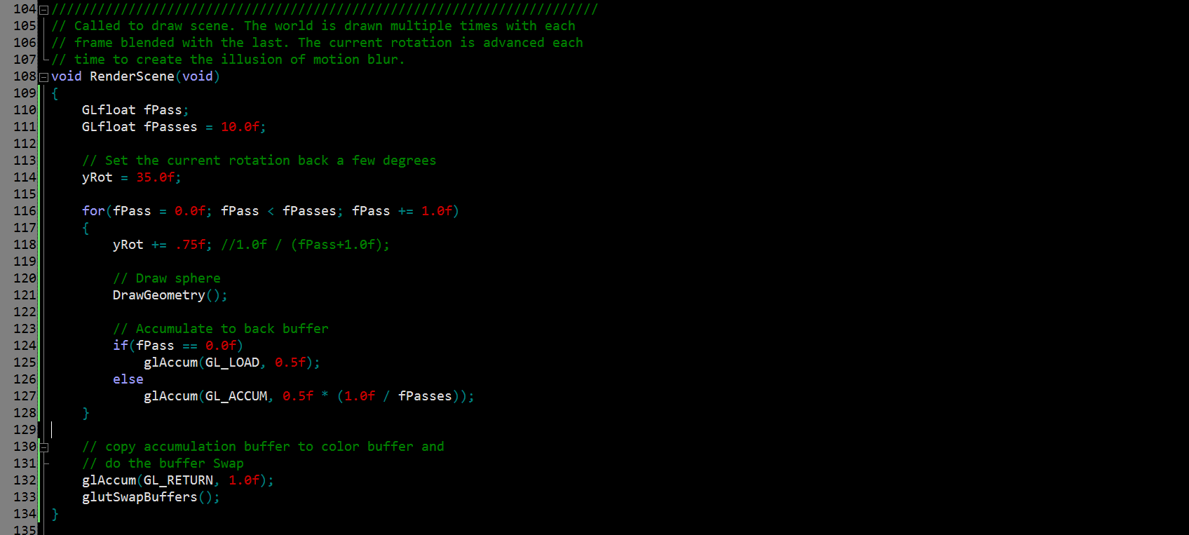

Slide 28
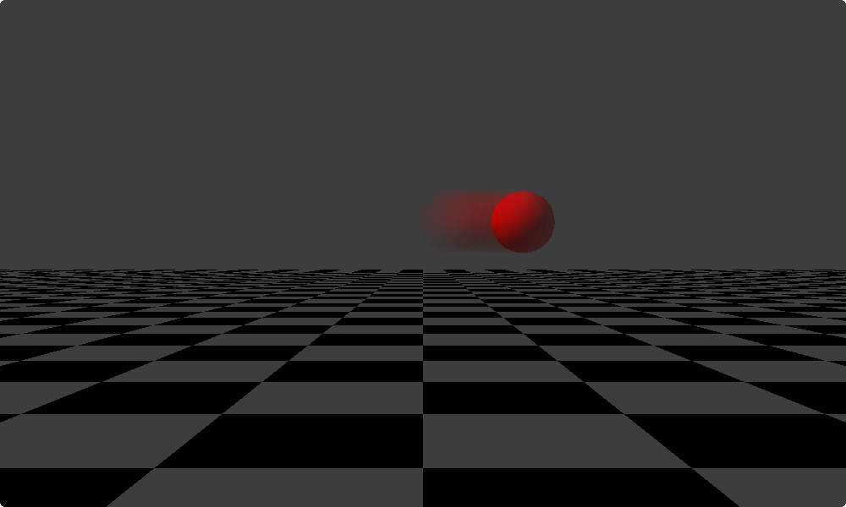
Motion Blur

Slide 29
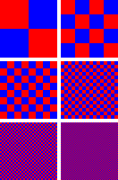
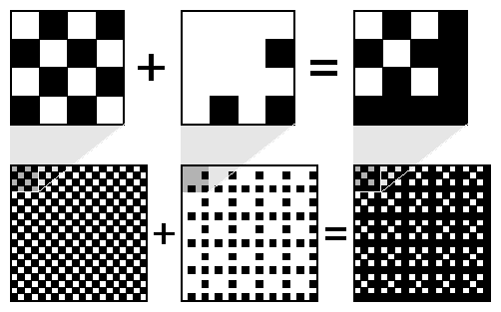
Dithering
A technique to combine some colors to create the effect of other colors
Example: dithering black and white to create gray
glEnable ( GL_DITHER ); glDisable( GL_DITHER );
50% gray
19% gray
69% gray

Slide 30
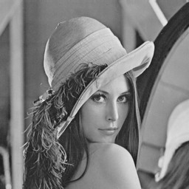
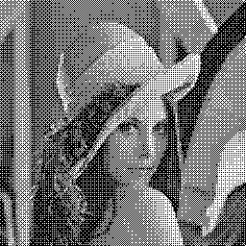
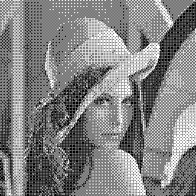
Dithering
Image dithering (gray scale)

Slide 31
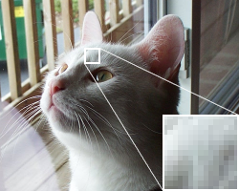
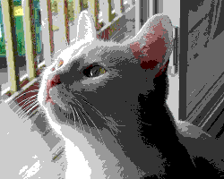
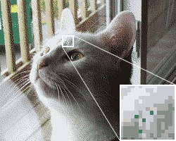
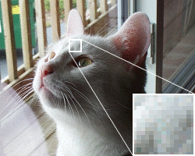
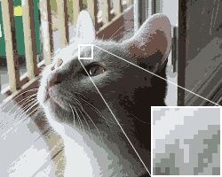
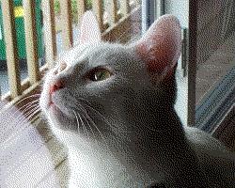
Dithering
+
Original one
web-safe color palette
+
+
256-color with an optimized palette
16-color optimized palette
“+” means With dithering

Slide 32
Q&A

