Slide 1
3D Graphics Programming
Chapter 7. Imaging with openGL
2010.11.15 & 22 Presented by Garrett Yeh

Slide 2
Outline
Imaging with openGL (CH7)
Drawing Image
Bitmap & Pixmap
Pixel operation in openGL
Imaging API in openGL

Slide 3
Drawing Image
Common techniques to draw images on your openGL panels

Slide 4
Image drawing
glRasterPos / glWindowPos
Set the raster position
glBitmap
Draw bitmaps
glReadPixels/glDrawPixels
Read and write color images

Slide 5
Pixel operation
glPixelZoom
Magnify, shrink, and flip images
glPixelTransfer/glPixelMap
Set up operations on colors
glColorTable
Perform color substitutions

Slide 6
Adv. operations
glConvolutionFilter2D
Perform advanced image filtering
glHistogram/glGetHistogram
Collect statistics on images

Slide 7
Image Basics [1/2]
A raster image (or image or pixel rectangle or pixmap) is a 2-D array of color values.
OpenGL (along with other graphics libraries) provides the following types of primitives:
Points.
Polylines.
Filled polygons.
Raster images.
Bitmaps.
Two Pipelines
The geometry pipeline handles the first three.
The image pipeline handles the last two.

Slide 8
Image Basics [2/2]
Top: geometry pipeline. Bottom: image pipeline.
This is a huge over-simplification, as usual.
The image pipeline has the same data type at start & end.
So it can run backwards.
Vertex Data
Vertex
Vertex Operations
Frame Buffer
Vertex
Fragments
Rasterization
Fragment
Fragment Operations
Fragment
Pixel Data
Pixmap
Pixel Operations
Pixmap
Pixmap
Pixmap

Slide 9
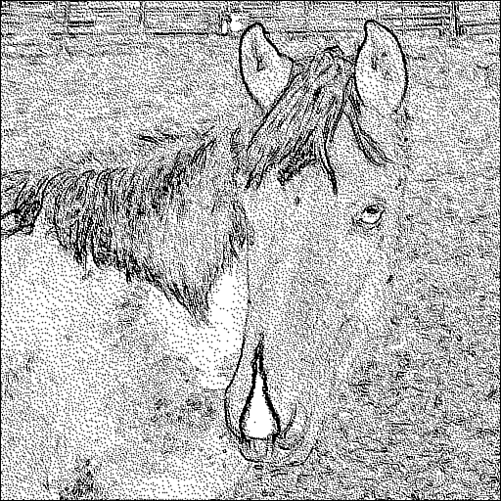
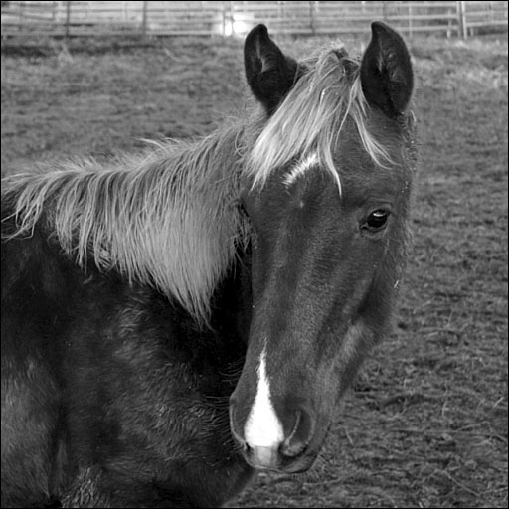
Draw images
Draw pixels… one by one…

Slide 10
Bitmap
A series of ones and zeros representing on and off pixel values…
A bitmapped image of a horse. Only 0 and 1
Notes:
http://en.wikipedia.org/wiki/Alpha_compositing

Slide 11
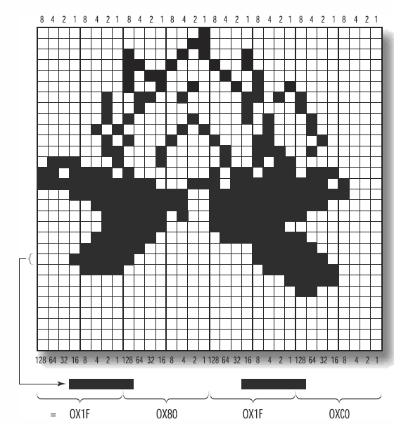
Bitmap
Bitmap, a true binary map of on and off values. ( != windows .bmp)
Bitmaps can be used for masks (polygon stippling), fonts and character shapes, and even two-color dithered images.
A bitmap data in opengl is similar to the representation of polygon stippling sample.
Notes:
http://en.wikipedia.org/wiki/Alpha_compositing

Slide 12
Example of bitmap
GLubyte fire[128] = {
0x00, 0x00, 0x00, 0x00, 0x00, 0x00, 0x00, 0x00,
0x00, 0x00, 0x00, 0x00, 0x00, 0x00, 0x00, 0x00,
0x00, 0x00, 0x00, 0x00, 0x00, 0x00, 0x00, 0x00,
0x00, 0x00, 0x00, 0xc0, 0x00, 0x00, 0x01, 0xf0,
0x00, 0x00, 0x07, 0xf0, 0x0f, 0x00, 0x1f, 0xe0,
0x1f, 0x80, 0x1f, 0xc0, 0x0f, 0xc0, 0x3f, 0x80,
0x07, 0xe0, 0x7e, 0x00, 0x03, 0xf0, 0xff, 0x80,
0x03, 0xf5, 0xff, 0xe0, 0x07, 0xfd, 0xff, 0xf8,
0x1f, 0xfc, 0xff, 0xe8, 0xff, 0xe3, 0xbf, 0x70,
0xde, 0x80, 0xb7, 0x00, 0x71, 0x10, 0x4a, 0x80,
0x03, 0x10, 0x4e, 0x40, 0x02, 0x88, 0x8c, 0x20,
0x05, 0x05, 0x04, 0x40, 0x02, 0x82, 0x14, 0x40,
0x02, 0x40, 0x10, 0x80, 0x02, 0x64, 0x1a, 0x80,
0x00, 0x92, 0x29, 0x00, 0x00, 0xb0, 0x48, 0x00,
0x00, 0xc8, 0x90, 0x00, 0x00, 0x85, 0x10, 0x00,
0x00, 0x03, 0x00, 0x00, 0x00, 0x00, 0x10, 0x00
};

Slide 13
Draw it!
// Called to draw scene
void RenderScene(void)
{
int x, y;
// Clear the window with current clearing color
glClear(GL_COLOR_BUFFER_BIT);
// Set color to white
glColor3f(1.0f, 1.0f, 1.0f);
// Loop through 16 rows and columns
for(y = 0; y < 16; y++)
{
// Set raster position for this “square”
glRasterPos2i(0, y * 32);
for(x = 0; x < 16; x++)
// Draw the “fire” bitmap, advance raster position
glBitmap(32, 32, 0.0, 0.0, 32.0, 0.0, fire);
}
// Do the buffer Swap
glutSwapBuffers();
}

Slide 14
The Raster Position
glRasterPos2i(GLint x, GLint y);
Sets the raster position to the place where you want the bitmap drawn.
The position means image’s lower-left corner.
Also, this value must inside the window’s viewport.
The raster position is interpreted much like a call to glVertex in that the coordinates are transformed by the current modelview and projection matrices.
Notes:
http://www.opengl.org/sdk/docs/man/xhtml/glRasterPos.xml

Slide 15
The Raster Position
glWindowPos2i(GLint x, GLint y);
Allows you to set the raster position in window coordinates without regard to the current transformation matrix or projection
The color of the bitmap is set when either glRasterPos or glWindowPos is called.
Notes:
http://www.opengl.org/sdk/docs/man/xhtml/glRasterPos.xml

Slide 16
Draw it!
glBitmap(32, 32, 0.0, 0.0, 32.0, 0.0, fire);
void glBitmap( GLsizei width, GLsizei height,
the width and height of the bitmap image.
GLfloat xorig, GLfloat yorig,
specifies the location of the bitmap origin relative to the lower left corner of the bitmap image.
GLfloat xmove, GLfloat ymove,
x and y offsets to be added to the current raster position
const GLubyte * bitmap
);
Notes:
The first pair specifies the width and height of the bitmap image. The second pair specifies the location of the bitmap origin relative to the lower left corner of the bitmap image. The third pair of arguments specifies x and y offsets to be added to the current raster position after the bitmap has been drawn. The final argument is a pointer to the bitmap image itself.

Slide 17
Draw it!
// Set color to white
glColor3f(1.0f, 1.0f, 1.0f);
// Loop through 16 rows and columns
for(y = 0; y < 16; y++)
{
// Set raster position for this “square”
glRasterPos2i(0, y * 32);
for(x = 0; x < 16; x++)
// Draw the “fire” bitmap, advance raster position
glBitmap(32, 32, 0.0, 0.0, 32.0, 0.0, fire);
}

Slide 18
Pixel packing
Bitmaps and pixmaps are rarely packed tightly into memory.
Beware the pixel alignment! (4byte in opengl)
You can change how pixels for bitmaps or pixmaps are stored and retrieved
by using the following functions:
void glPixelStorei(GLenum pname, GLint param);
void glPixelStoref(GLenum pname, GLfloat param);

Slide 19
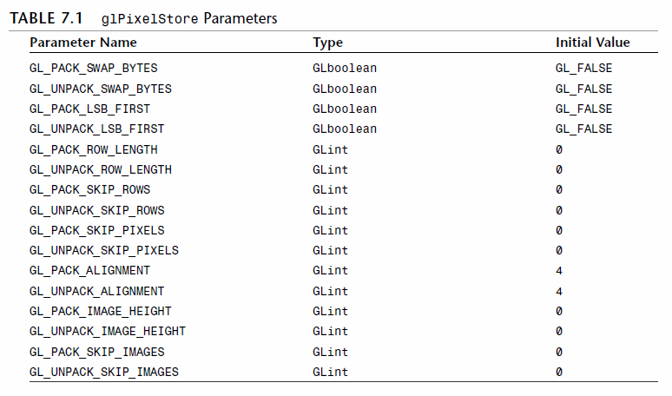
Pixel packing
If you want to change to tightly packed pixel data, make the following function call:
glPixelStorei(GL_UNPACK_ALIGNMENT, 1);

Slide 20
Pixelmap (Pixmap)
Pixmap, a image data that contains color or intensity values for each pixel.
Each pixel has one of 256 different intensities of gray. or color component values to be stored.
bitmap
pixmap

Slide 21
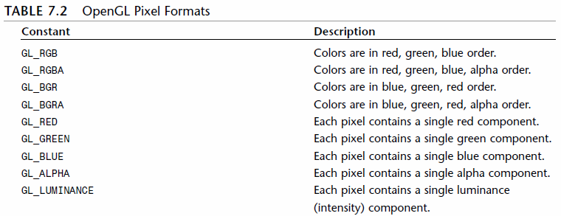
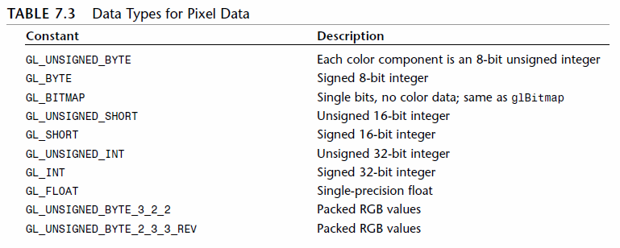
Draw pixmap
void glDrawPixels(GLsizei width, GLsizei height, GLenum format, GLenum type, const void *pixels);
Unlike glBitmap, this function does not update the raster position and is considerably more flexible in the way you can specify image data.
…
…

Slide 22
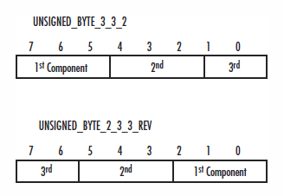
Packed Pixel Formats
For example:
GL_UNSIGNED_BYTE_3_3_2 + GL_BGR
B
G
R

Slide 23
Draw more color!
… (page 261)
// Targas are 1 byte aligned (Targas = Truevision TGA fire format)
glPixelStorei(GL_UNPACK_ALIGNMENT, 1);
// Load the TGA file, get width, height, and component/format information
pImage = gltLoadTGA(“fire.tga”, &iWidth, &iHeight, &iComponents, &eFormat);
// Use Window coordinates to set raster position
glRasterPos2i(0, 0);
// Draw the pixmap
if(pImage != NULL)
glDrawPixels(iWidth, iHeight, eFormat, GL_UNSIGNED_BYTE, pImage);
// Don’t need the image data anymore
free(pImage);
// Do the buffer Swap
glutSwapBuffers();
Please refer to text book…

Slide 24
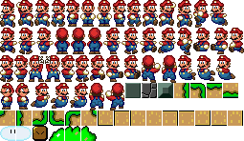
What is TGA??
Truevision TGA, often referred to as TARGA, is a raster graphics file format created by Truevision Inc.
It was the native format of TARGA and VISTA boards, which were the first graphic cards for IBM-PCs to support Highcolor/truecolor display.
Truevision TARGA is mostly used in games for textures. (texture sprite) The file format is also used in many games for saving screenshots.
Contain the maximum 24 bits of RGB and an extra 8-bit alpha channel.
And, a extra region call develop area, a notepad of this image… (ver. 2.0 support this feature)
Please refer to …
http://en.wikipedia.org/wiki/Truevision_TGA

Slide 25
Operating images
More Fun with Pixels !!

Slide 26
Moving Pixels Around
void glReadPixels(GLint x, GLint y, GLsizei width, GLsizei height, GLenum format, GLenum type, const void *pixels);
Read pixels form color buffer
void glCopyPixels(GLint x, GLint y, GLsizei width, GLsizei height, GLenum type);
Set raster position first
Change the source or destination of these pixel operations
void glDrawBuffer(GLenum mode);
void glReadBuffer(GLenum mode);
GL_NONE, GL_FRONT, GL_BACK, GL_FRONT_AND_BACK, GL_FRONT_LEFT, GL_FRONT_RIGHT
Width
Width
Height
Height
copy
(x,y)
(x,y)
Raster position

Slide 27
Saving Pixels
Transfer colors between different pixel format ??
openGL will take care of the necessary conversions automatically!
You may use glPixelTransfer function to customize it.
Please refer the example of using gltWriteTGA function to know how to “Save the Screen as a Targa File” (page 266)

Slide 28
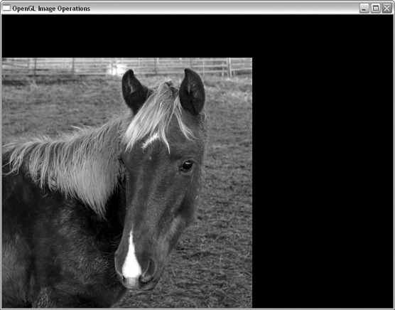
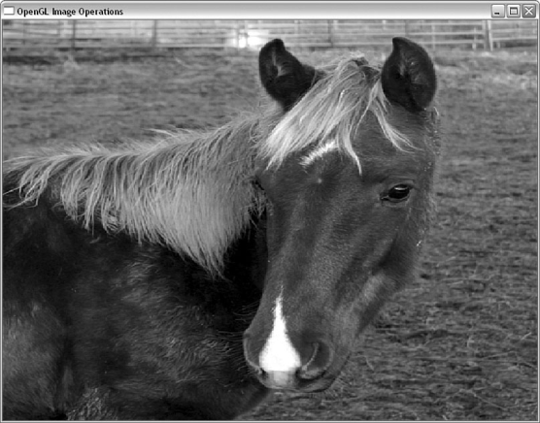
OPERATIONS.cpp
Please refer the example in page 269…
// Do image operation, depending on rendermode index
switch(iRenderMode)
{
case 2: // Flip the pixels
glPixelZoom(-1.0f, -1.0f);
glRasterPos2i(iWidth, iHeight);
break;
case 3: // Zoom pixels to fill window
glGetIntegerv(GL_VIEWPORT, iViewport);
glPixelZoom((GLfloat) iViewport[2] / (GLfloat)iWidth, (GLfloat) iViewport[3] / GLfloat)iHeight);
break;
…

Slide 29
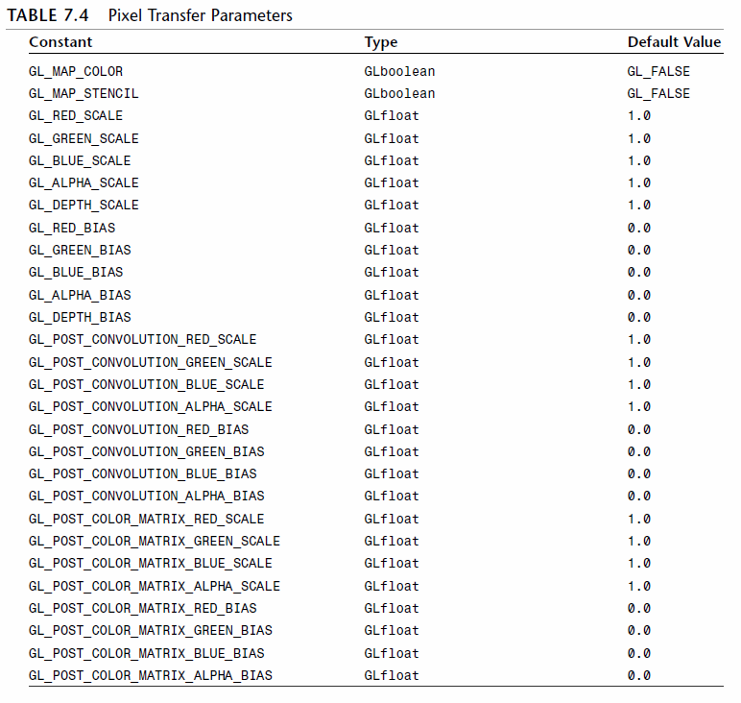
OPERATIONS.cpp
…
case 4: // Just Red
glPixelTransferf(GL_RED_SCALE, 1.0f);
glPixelTransferf(GL_GREEN_SCALE, 0.0f);
glPixelTransferf(GL_BLUE_SCALE, 0.0f);
break;
case 5: // Just Green
glPixelTransferf(GL_RED_SCALE, 0.0f);
glPixelTransferf(GL_GREEN_SCALE, 1.0f);
glPixelTransferf(GL_BLUE_SCALE, 0.0f);
break;
case 6: // Just Blue
glPixelTransferf(GL_RED_SCALE, 0.0f);
glPixelTransferf(GL_GREEN_SCALE, 0.0f);
glPixelTransferf(GL_BLUE_SCALE, 1.0f);
break;
…
Bias / Scale

Slide 30
OPERATIONS.cpp
…
case 7: // Black & White, more tricky
// First draw image into color buffer
glDrawPixels(iWidth, iHeight, eFormat, GL_UNSIGNED_BYTE, pImage);
// Allocate space for the luminance map
pModifiedBytes = (GLbyte *)malloc(iWidth * iHeight);
// Scale colors according to NSTC standard
glPixelTransferf(GL_RED_SCALE, 0.3f);
glPixelTransferf(GL_GREEN_SCALE, 0.59f);
glPixelTransferf(GL_BLUE_SCALE, 0.11f);
// Read pixels into buffer (scale above will be applied)
glReadPixels(0,0,iWidth, iHeight, GL_LUMINANCE, GL_UNSIGNED_BYTE, pModifiedBytes);
// Return color scaling to normal
glPixelTransferf(GL_RED_SCALE, 1.0f);
glPixelTransferf(GL_GREEN_SCALE, 1.0f);
glPixelTransferf(GL_BLUE_SCALE, 1.0f);
break;
…

Slide 31
OPERATIONS.cpp
…
case 8: // Invert colors
invertMap[0] = 1.0f;
for(i = 1; i < 256; i++) // setup color mapping
invertMap[i] = 1.0f - (1.0f / 255.0f * (GLfloat)i);
glPixelMapfv(GL_PIXEL_MAP_R_TO_R, 255, invertMap);
glPixelMapfv(GL_PIXEL_MAP_G_TO_G, 255, invertMap);
glPixelMapfv(GL_PIXEL_MAP_B_TO_B, 255, invertMap);
glPixelTransferi(GL_MAP_COLOR, GL_TRUE);
break;
case 1: // Just do a plain old image copy
default:
// This line intentionally left blank
break;
}

Slide 32
The Imaging API in the openGL
Supported by openGL 1.2…

Slide 33
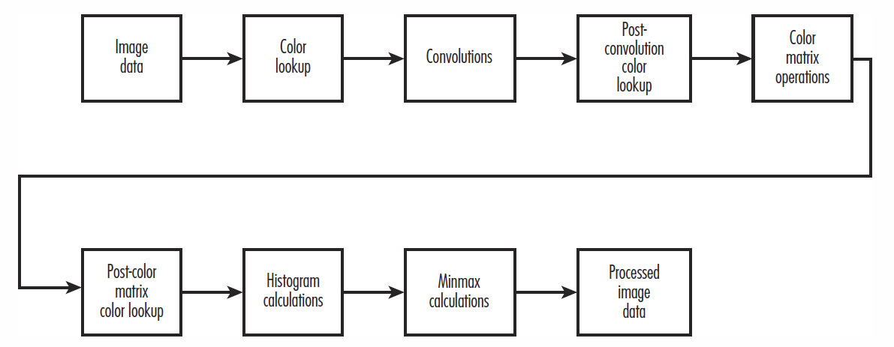
Imaging pipeline in openGL
OpenGL imaging operations are processed in a specific order along what is called the imaging pipeline.

Slide 34
Determine the usability of these functions
//When you use the glTools library, your code might look something like this:
if(gltIsExtSupported(“GL_ARB_imaging”) == 0)
{
// Error, imaging not supported
...
}
else {
// Do some imaging stuff
…
}
//Please refer to the example “IMAGING” for more detail of imaging subset

Slide 35
Color Matrix
Treat color RGBA as coordinates XYZW in the 3D space.
Use glMatrixMode(GL_COLOR); to start to manipulate them…
glLoadIdenentity
glLoadMatrix
…
glScale works fine, too.
…
…
case 2: // Brighten Image
glMatrixMode(GL_COLOR);
glScalef(1.25f, 1.25f, 1.25f);
glMatrixMode(GL_MODELVIEW);
break;
…

Slide 36
Color Lookup
You can specify a table of color values used to replace a pixel’s current color.
Powerful version of “pixel mapping.”
void glColorTable(GLenum target, GLenum internalFormat, GLsizei width,GLenum format, GLenum type,const GLvoid *table);
format and type is similar to param in glDrawPixel.

Slide 37
Color Lookup
Target :
The Place to Apply the Color Lookup Table

Slide 38
Color Lookup
The internalFormat:
specifies the internal OpenGL representation of the color table pointed to by table.
examples
GL_ALPHA4, ... GL_LUMINANCE12, ... GL_LUMINANCE8_ALPHA8, ... GL_INTENSTIY12, ... GL_RGB10, ... GL_RGB16, ... GL_RGBA4, ... GL_RGBA16
color component name
+ the bit count of that component’s representation
Notes:
The color component name in this list should be fairly obvious to you by now,
and the numerical suffix simply represents the bit count of that component’s representation.

Slide 39
Color Lookup (example)
…
case 3: // Invert Image
for(i = 0; i < 255; i++)
{
invertTable[i][0] = 255 - i;
invertTable[i][1] = 255 - i;
invertTable[i][2] = 255 - i;
}
glColorTable(GL_COLOR_TABLE, GL_RGB, 256, GL_RGB, GL_UNSIGNED_BYTE, invertTable);
glEnable(GL_COLOR_TABLE);
///…draw pixels
glDisable(GL_COLOR_TABLE);
Width = count of color level

Slide 40
Proxies
An OpenGL implementation’s support for color tables may be limited by system resources.
So, you can test it!
glColorTable(GL_PROXY_COLOR_TABLE, GL_RGB, 256, GL_RGB,
GL_UNSIGNED_BYTE, NULL);
glGetColorTableParameteriv(GL_PROXY_COLOR_TABLE, GL_COLOR_TABLE_WIDTH, &width);
if(width == 0) {
// Error...
}

Slide 41
Color table operations
void glColorTableParameteriv(GLenum target, GLenum pname, GLint *param);
Set scale value by GL_COLOR_TABLE_SCALE
Set bias value by GL_COLOR_TABLE_BIAS
void glCopyColorTable(GLenum target, GLenum internalFormat,GLint x, GLint y, GLsizei width);
“Render” a color table by using the contents of the color buffer as the source data for the color table.
The color table array is then taken from the color buffer starting at the x,y location and taking width pixels.

Slide 42
Color table operations
void glColorSubTable(GLenum target, GLsizei start, GLsizei count,GLenum format, GLenum type, const void *data);
Replace all or part of a color table by using the glColorSubTable function:
The start parameter is the offset into the color table to begin the replacement,
and count is the number of color values to replace.

Slide 43
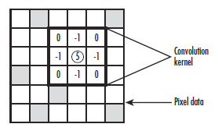
Convolutions
A general image-process technique…
= Apply filters on a image
static GLfloat mSharpen[3][3] = {
// Sharpen convolution kernel
{0.0f, -1.0f, 0.0f},
{-1.0f, 5.0f, -1.0f },
{0.0f, -1.0f, 0.0f }
};

Slide 44
Convolutions (example)
before the glDrawPixels operation…
+ glConvolutionFilter2D(GL_CONVOLUTION_2D, GL_RGB, 3, 3, GL_LUMINANCE, GL_FLOAT, mSharpen);
+ glEnable(GL_CONVOLUTION_2D);
void glConvolutionFilter2D(GLenum target, GLenum internalFormat, GLsizei width, GLsizei height, GLenum format, GLenum type, const GLvoid *image);
internalFormat specifies to which pixel components the convolution is applied.
Only weight value (1D)

Slide 45
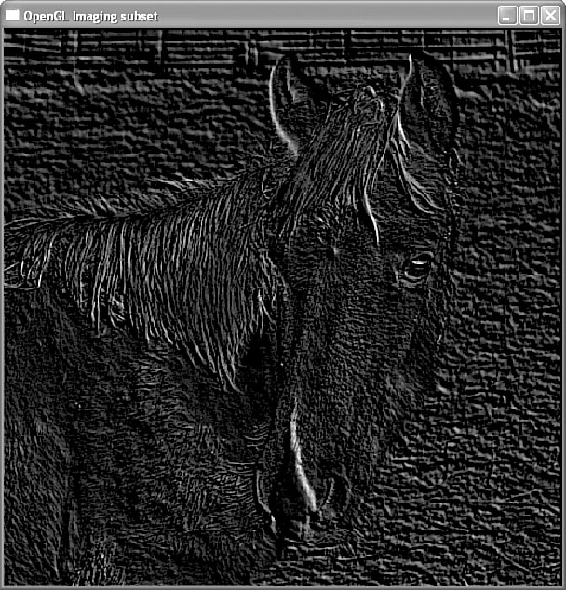
Convolutions (example)
Emboss image
static GLfloat mEmboss[3][3] = {
// Emboss convolution kernel
{2.0f, 0.0f, 0.0f},
{0.0f, -1.0f, 0.0f },
{0.0f, 0.0f, 1.0f }
};
case 4: // Emboss image
glConvolutionFilter2D(GL_CONVOLUTION_2D, GL_RGB, 3, 3,
GL_LUMINANCE, GL_FLOAT, mEmboss);
glEnable(GL_CONVOLUTION_2D);
glMatrixMode(GL_COLOR);
glLoadMatrixf(lumMat); //Transfer into black & white
glMatrixMode(GL_MODELVIEW);
break;

Slide 46
Convolution’s operations
void glCopyConvolutionFilter2D(GLenum target, GLenum internalFormat, GLint x, GLint y, GLsizei width, GLsizei height);
Copy value from color buffer
target value must always be GL_CONVOLUTION_2D
internalFormat refers to the format of the color (buffer) data, as in glConvolutionFilter2D.

Slide 47
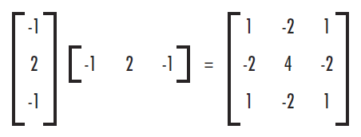
Convolution
Separable Filters
A separable convolution filter is one whose kernel can be represented by the matrix outer product of two one-dimensional filters.
void glSeparableFilter2D(GLenum target, GLenum internalFormat, GLsizei width, GLsizei height, GLenum format, GLenum type, void *row, const GLvoid *column);
target = GL_SEPARABLE_2D

Slide 48
Convolution
Opengl supports one-dimensional convolution filters, too.
glConvolutionFilter1D …
glCopyConvolutionFilter1D …

Slide 49
Convolution
Convolution border mode setting
glConvolutionParameter{i,f}(GLenum target, GLenum pname, GLint param);
glConvolutionParameter{iv,fv}(GLenum target, GLenum pname, GLint *param);
GL_CONSTANT_BORDER
Set a constant pixel value for border
GL_REDUCE
The convolution kernel is not applied to the edge pixels.
GL_REPLICATE_BORDER
Replicate border for missing part.

Slide 50
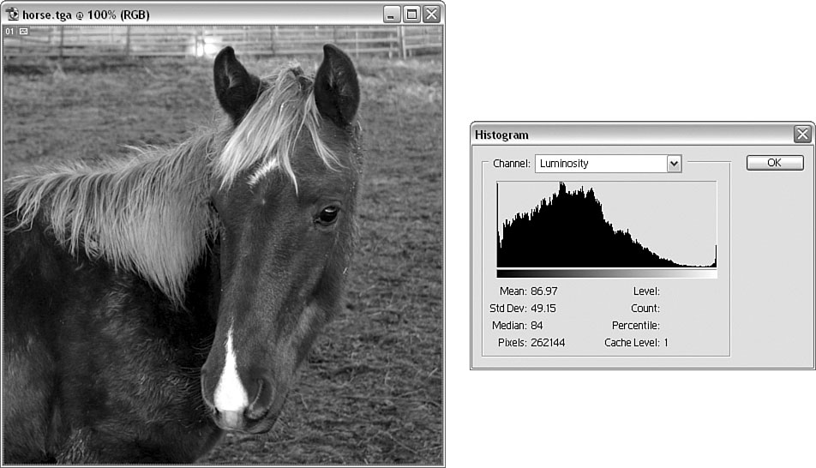
Histogram
A histogram is a graphical representation of an image’s frequency distribution.
Luminosity or R/G/B channel

Slide 51
Collect color imformation
When histogram collection is enabled, OpenGL collects statistics about any images as they are written to the color buffer.
glEnable(GL_HISTOGRAM)
Active the collector
void glHistogram(GLenum target, GLsizei width, GLenum internalFormat, GLboolean sink);
To prepare to collect histogram data, you must tell OpenGL how much data to collect and in what format you want the data.
target = GL_HISTOGRAM or GL_PROXY_HISTOGRAM
width = how many entries to make in the histogram table. (2^n)
sink = true: discard any incoming pixels

Slide 52
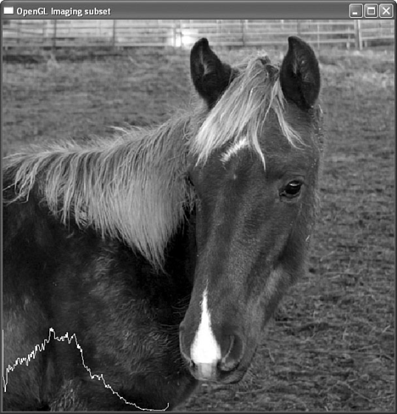
Get histogram
After image data has been transferred, you collect the histogram data with the following function
void glGetHistogram(GLenum target, GLboolean reset, GLenum format, GLenum type, GLvoid *values);
target = GL_HISTOGRAM
reset = GL_True: clear data, otherwise the collector will keep collect

Slide 53
Count it!
static GLint histoGram[256]; // Storage for histogram statistics
if(bHistogram == GL_TRUE) // Collect Histogram data
{
// We are collecting luminance data, use our conversion formula
// instead of OpenGL’s (which just adds color components together)
glMatrixMode(GL_COLOR);
glLoadMatrixf(lumMat);
glMatrixMode(GL_MODELVIEW);
// Start collecting histogram data, 256 luminance values
glHistogram(GL_HISTOGRAM, 256, GL_LUMINANCE, GL_FALSE);
glEnable(GL_HISTOGRAM);
}

Slide 54
Draw it!
// Fetch and draw histogram?
if(bHistogram == GL_TRUE)
{
// Read histogram data into buffer
glGetHistogram(GL_HISTOGRAM, GL_TRUE, GL_LUMINANCE, GL_INT, histoGram);
// Find largest value for scaling graph down
iLargest = 0;
for(i = 0; i < 255; i++)
if(iLargest < histoGram[i])
iLargest = histoGram[i];
// White lines
glColor3f(1.0f, 1.0f, 1.0f);
glBegin(GL_LINE_STRIP);
for(i = 0; i < 255; i++)
glVertex2f((GLfloat)i, (GLfloat)histoGram[i] / (GLfloat) iLargest * 128.0f);
glEnd();
bHistogram = GL_FALSE;
glDisable(GL_HISTOGRAM);
}

Slide 55
Minmax operations
Just get the minimum or maximum value of histogram.
glMinmax(GLenum target, GLenum internalFormat, GLboolean sink);
specify the format of the data on which you want statistics gathered (target is GL_MINMAX)
+ glEnable(GL_MINMAX);
void glGetMinmax(GLenum target, GLboolean reset, GLenum format, GLenum type, GLvoid *values);
Get data back to you…

Slide 56
Fin~

