Slide 1
Chapter 13
Occlusion Queries
Chih-Kuo Yeh

Slide 2
Occlusion Queries

Slide 3
Occlusion

Slide 4
Occluder

Slide 5
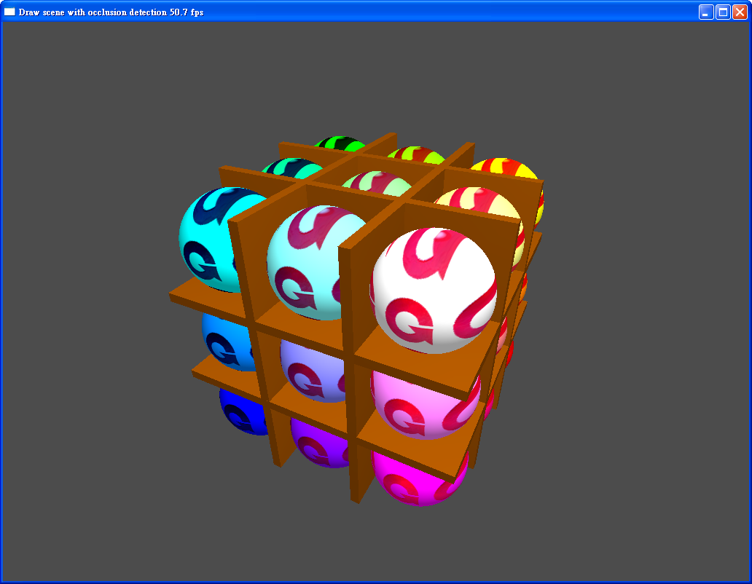
Occlusion detection
Frame rate was about 50 fps.

Slide 6
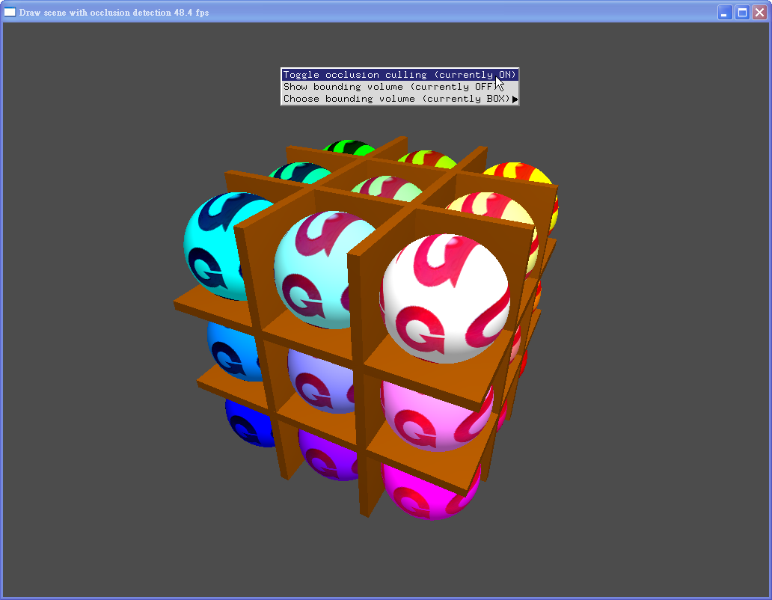
Occlusion detection

Slide 7
Without occlusion detection
Frame rate was about 30 fps.

Slide 8
Generate occlusion query names
Create array memory:
GLuint queryIDs[27]
At the beginning:
glGenQueries(27, queryIDs);
At the ending:
glDeleteQueries(27, queryIDs);

Slide 9
Delimit the boundaries
glBeginQuery(GL_SAMPLES_PASSED, queryIDs);
glEndQuery(GL_SAMPLES_PASSED);
Draw your bonding boxes

Slide 10
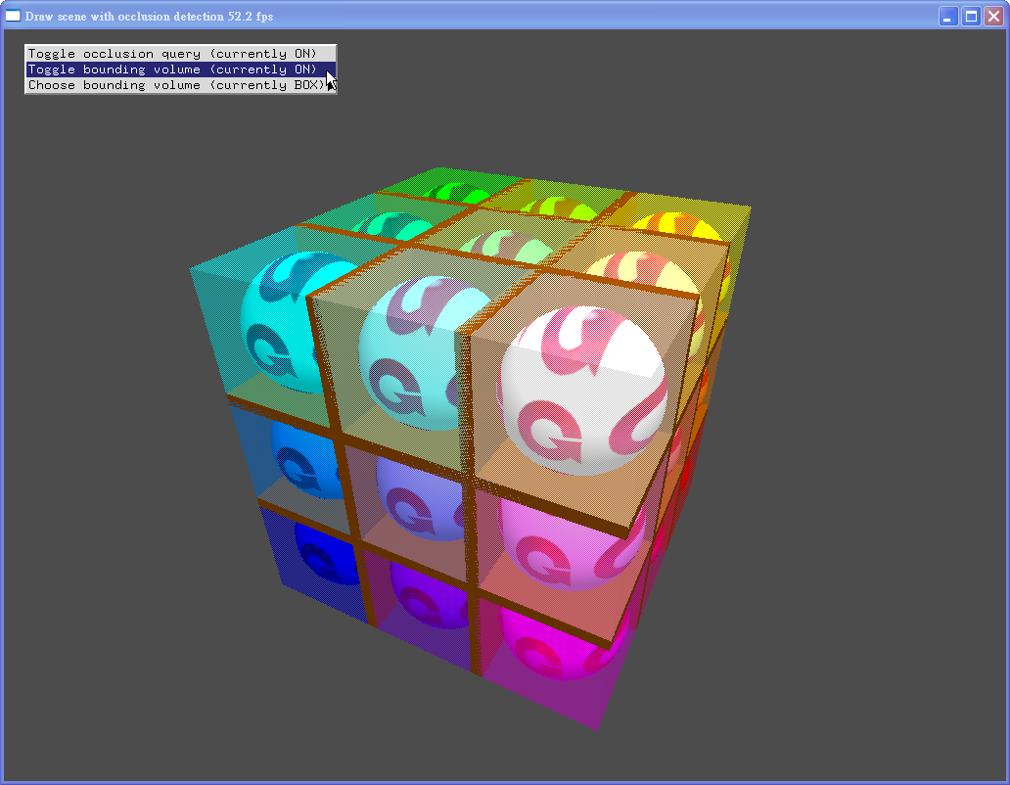
queryIDs
18
21
24
19
22
25
20
23
15
26
16
11
14
6
17
7
2
5
8
glBeginQuery(GL_SAMPLES_PASSED, queryIDs[(r*9)+(g*3)+b]);

Slide 11
Check if it would be occluded
glGetQueryObjectiv(
queryIDs[sphereNum],
GL_QUERY_RESULT,
&passingSamples);
if (passingSamples == 0)
occluded = GL_TRUE;

Slide 12
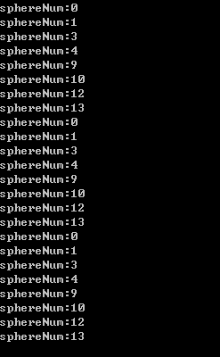
Check if it would be occluded
if (!occluded)
{
glutSolidSphere(50.0f, 200, 200);
}
else
{
printf("sphereNum:%d\n",sphereNum);
}

Slide 13
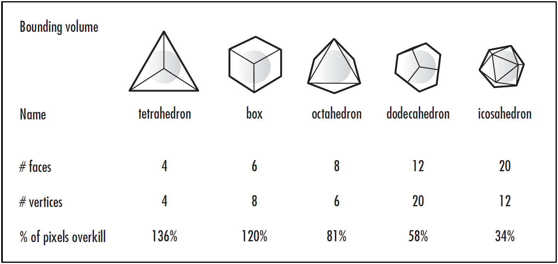
Bounding Boxes

Slide 14
Bounding Boxes - Box

Slide 15
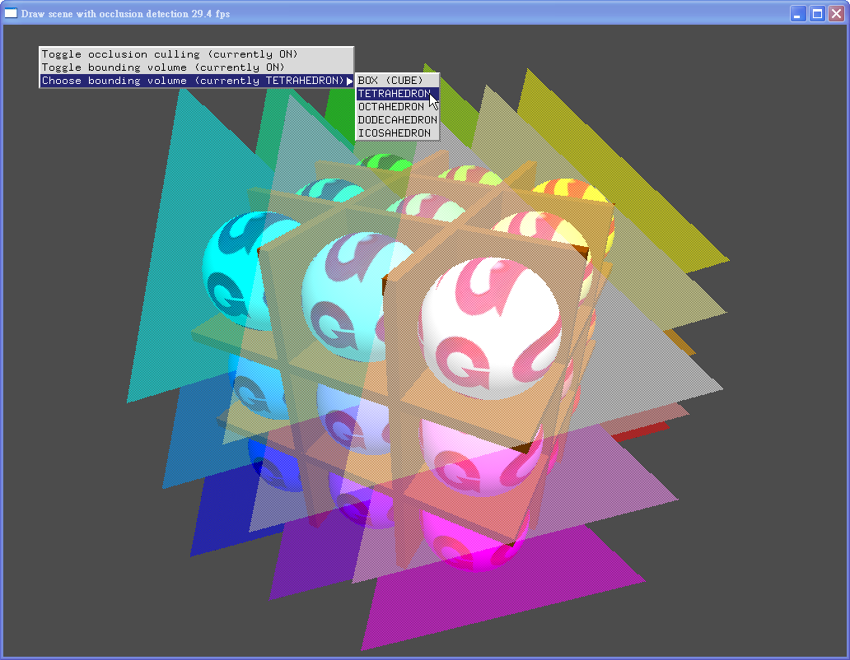
Bounding Boxes - Tetrahedron

Slide 16
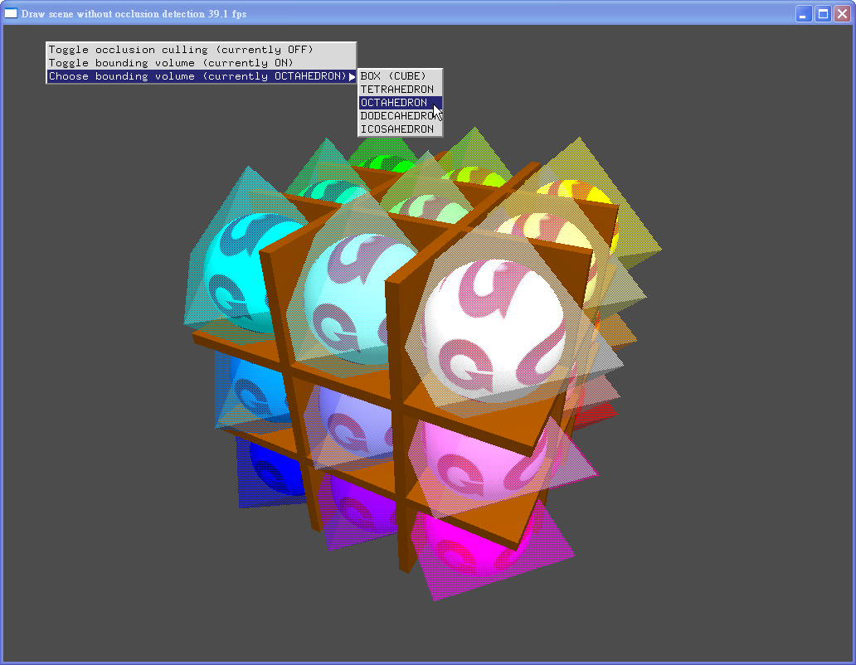
Bounding Boxes - Octahedron

Slide 17
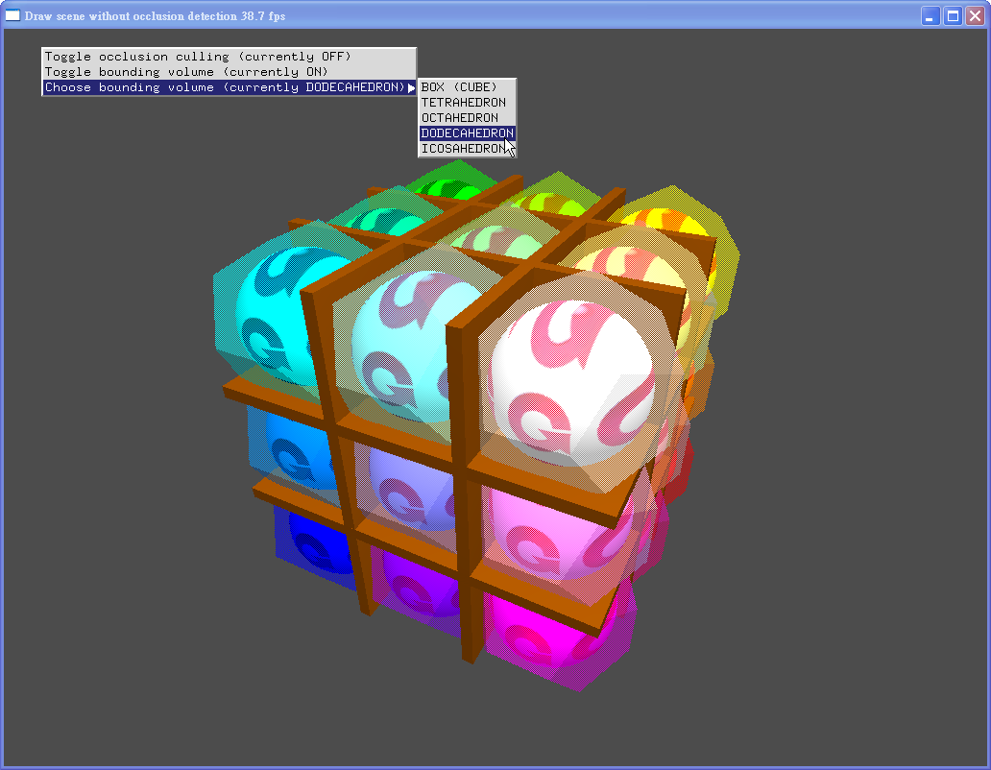
Bounding Boxes - Dodecahedron

Slide 18
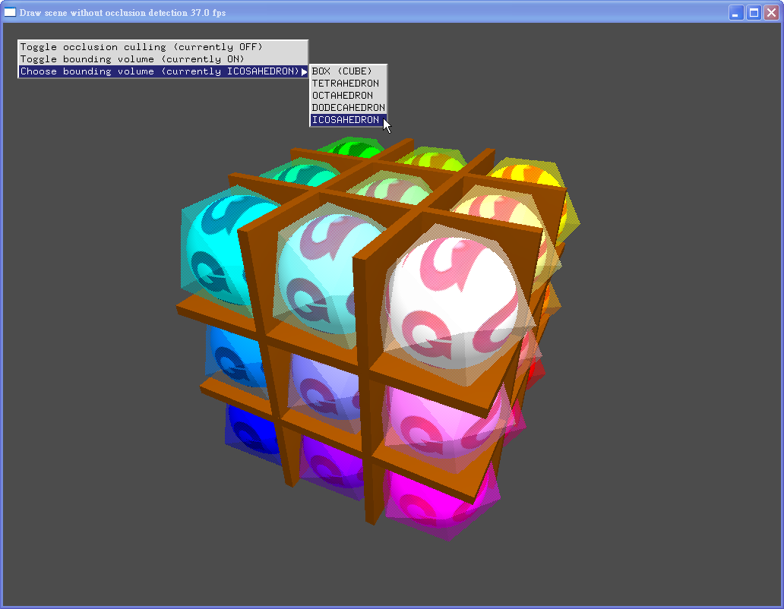
Bounding Boxes - Icosahedron

