Slide 1
Chapter 14
Depth Textures and Shadows
Chih-Kuo Yeh

Slide 2
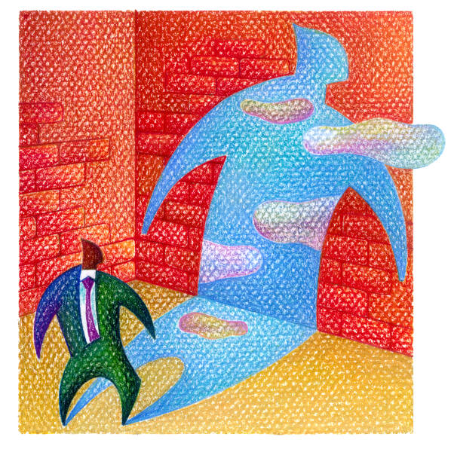
Shadow

Slide 3
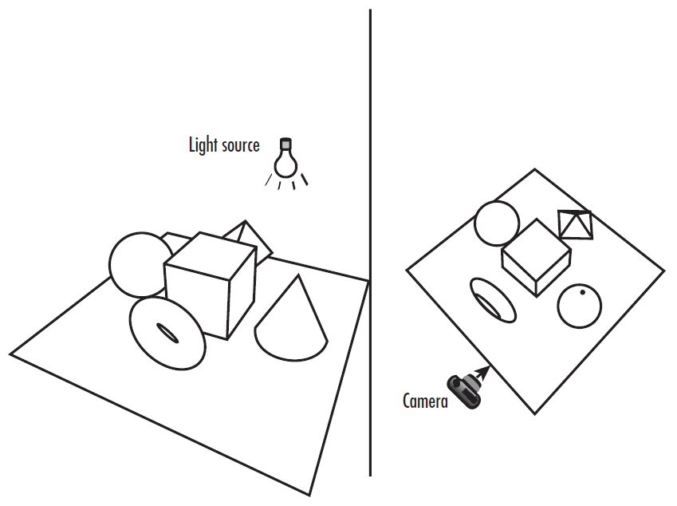
Camera and light

Slide 4
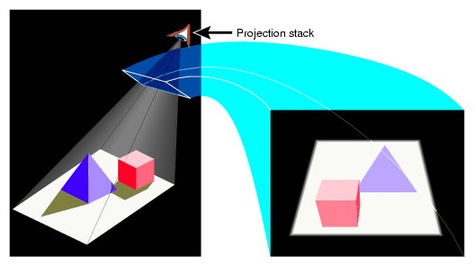
Rendering From the Light Source Point of View

Slide 5
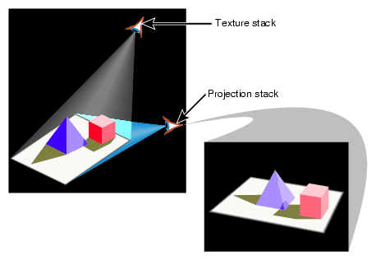
Rendering From Normal Viewpoint

Slide 6
Be That Light
void RegenerateShadowMap(void)
{
glMatrixMode(GL_PROJECTION);
glLoadIdentity();
gluPerspective(fieldOfView, 1.0f, nearPlane, nearPlane +
(2.0f * sceneBoundingRadius));
glMatrixMode(GL_MODELVIEW);
glLoadIdentity();
gluLookAt(lightPos[0], lightPos[1], lightPos[2],
0.0f, 0.0f, 0.0f, 0.0f, 1.0f, 0.0f);
glViewport(0, 0, shadowWidth, shadowHeight);
DrawModels(GL_FALSE);
}

Slide 7
Be That Light
lightToSceneDistance = sqrt(lightPos[0] * lightPos[0] +
lightPos[1] * lightPos[1] +
lightPos[2] * lightPos[2]);
nearPlane = lightToSceneDistance - sceneBoundingRadius;
// Keep the scene filling the depth texture
fieldOfView = (GLfloat)m3dRadToDeg(2.0f *
atan(sceneBoundingRadius / lightToSceneDistance));

Slide 8
Depth buffer

Slide 9
Depth texture
OpenGL 1.4
glCopyTexImage2D(
GL_TEXTURE_2D,
0,
GL_DEPTH_COMPONENT,
0,
0,
shadowWidth,
shadowHeight,
0);

Slide 10
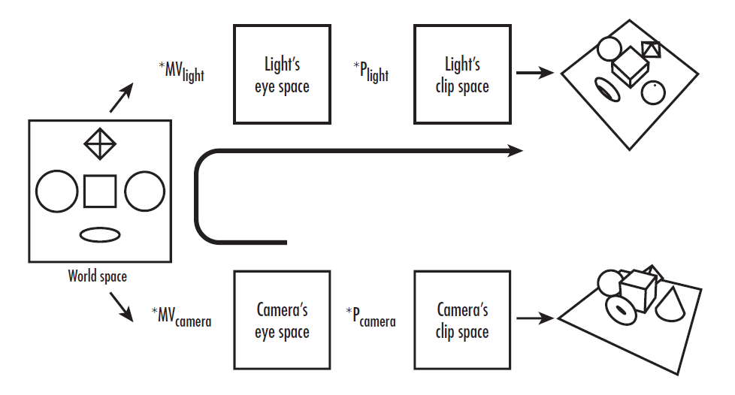
Transformations

Slide 11
Clip sapce
[-1,1] * 1/2 + 1/2 = [0,1]

Slide 12
Math3D Library
m3dLoadIdentity44(in / out);
m3dTranslateMatrix44(in / out, x, y, z);
m3dScaleMatrix44(in / out, x, y, z);
m3dMatrixMultiply44(output, A, B);
m3dTransposeMatrix44(in / out);
Notes:
The q coordinate corresponds to the w geometric coordinate. This is a scaling factor
applied to the other texture coordinates; that is, the actual values used for the texture
coordinates are s/q, t/q, and r/q. By default, q is set to 1.0.

Slide 13
void RegenerateShadowMap(void)
{
glGetFloatv(GL_PROJECTION_MATRIX, lightProjection);
glGetFloatv(GL_MODELVIEW_MATRIX, lightModelview);
M3DMatrix44f tempMatrix;
m3dLoadIdentity44(tempMatrix);
m3dTranslateMatrix44(tempMatrix, 0.5f, 0.5f, 0.5f);
m3dScaleMatrix44(tempMatrix, 0.5f, 0.5f, 0.5f);
m3dMatrixMultiply44(textureMatrix, tempMatrix, lightProjection);
m3dMatrixMultiply44(tempMatrix, textureMatrix, lightModelview);
// transpose to get the s, t, r, and q rows for plane equations
m3dTransposeMatrix44(textureMatrix, tempMatrix);
}
Notes:
[-1,1] * 1/2 + 1/2 = [0,1]

Slide 14
Set up the eye plane
void RenderScene(void)
{
glEnable(GL_TEXTURE_GEN_S);
glEnable(GL_TEXTURE_GEN_T);
glEnable(GL_TEXTURE_GEN_R);
glEnable(GL_TEXTURE_GEN_Q);
glTexGenfv(GL_S, GL_EYE_PLANE, &textureMatrix[0]);
glTexGenfv(GL_T, GL_EYE_PLANE, &textureMatrix[4]);
glTexGenfv(GL_R, GL_EYE_PLANE, &textureMatrix[8]);
glTexGenfv(GL_Q, GL_EYE_PLANE, &textureMatrix[12]);
// Draw objects in the scene, including base plane
DrawModels(GL_TRUE);
}

Slide 15
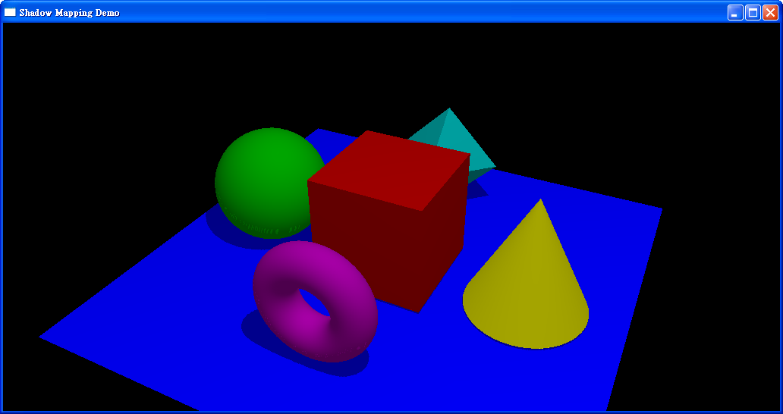

Slide 16
Shadow Comparison
glTexParameteri(
GL_TEXTURE_2D,
GL_TEXTURE_COMPARE_MODE,
GL_COMPARE_R_TO_TEXTURE);
D’ = (R <= D) ? 1 : 0
R: Distance from the light source to the surface of the object.
D: Depth value

Slide 17
PolygonOffset
Please add
glPolygonOffset(factor, 0.0f);

Slide 18
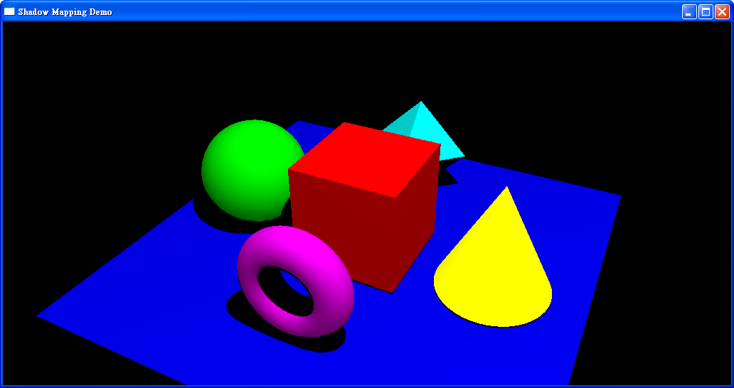
Alpha test
Please add
glAlphaFunc(GL_GREATER, 0.9f);

Slide 19
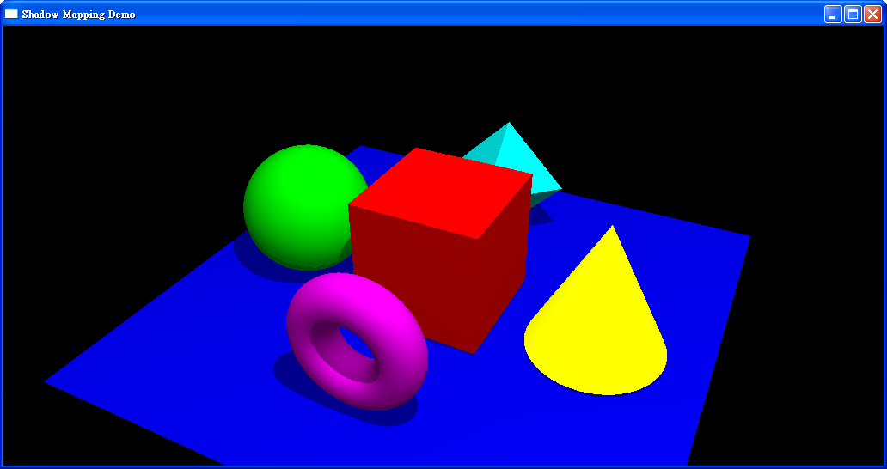
Final Result

Slide 20
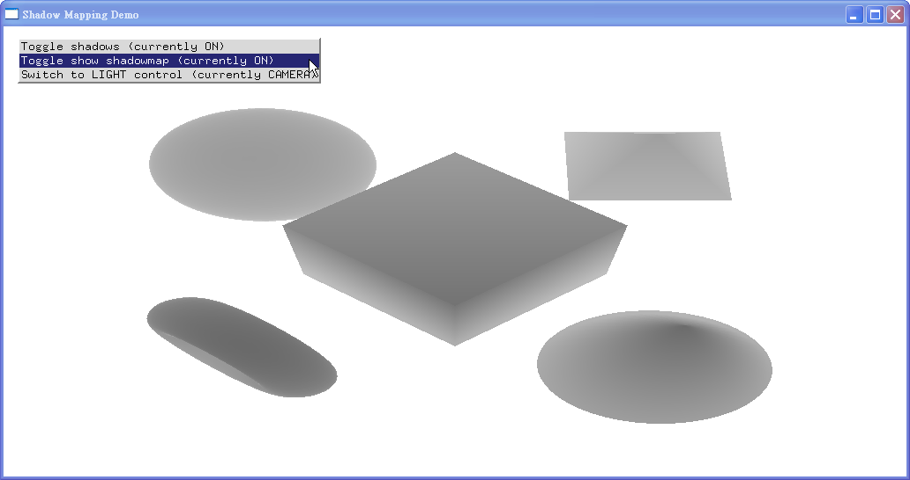

Slide 21
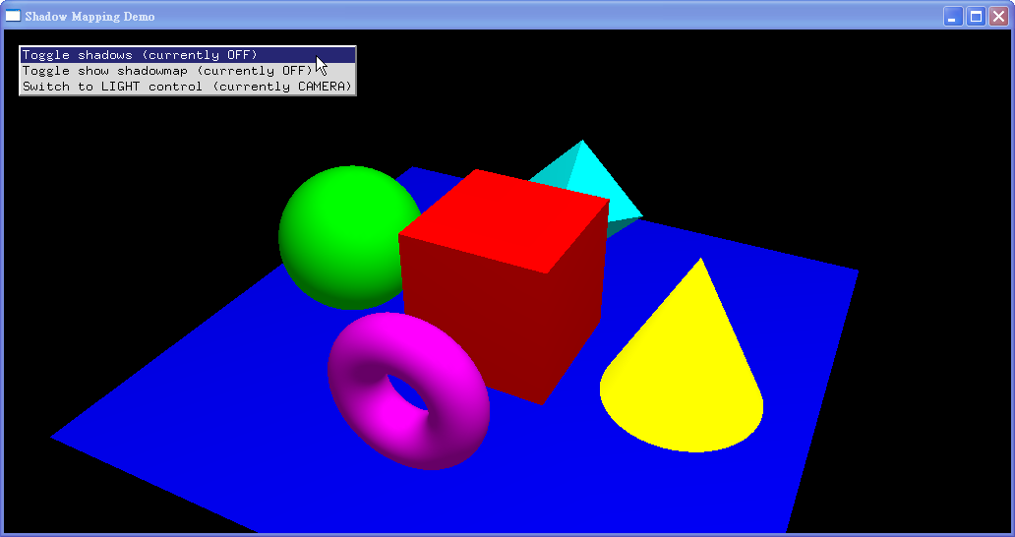

Slide 22
