Slide 1
Computer Graphics
Present by Garrett 2010.10.04

Slide 2
Outline
History of Computer Graphics
Computer Graphics Pipeline
Introduction to Computer Animation
The Evolution of Video Games

Slide 3
History of Computer Graphics
A introduction
萌芽期
(60’s~mid 70’s)
發展期
(late 70’s~80’s)
成熟期
(90’s~00’s)

Slide 4
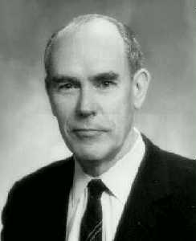
History
SAGE system, WWII
Air defense system
Dr. Ivan Sutherland (MIT), 1963
Invent Sketchpad
Interactive design on vector graphics
The origin of computer graphics
(60’s~mid 70’s)
(late 70’s~80’s)
(90’s~00’s)

Slide 5
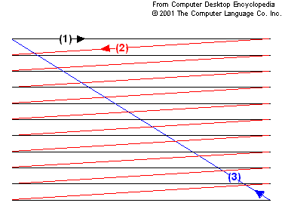
History
First raster display, 1966
What is raster scan?
Display or capture image line by line
(60’s~mid 70’s)
(late 70’s~80’s)
(90’s~00’s)

Slide 6
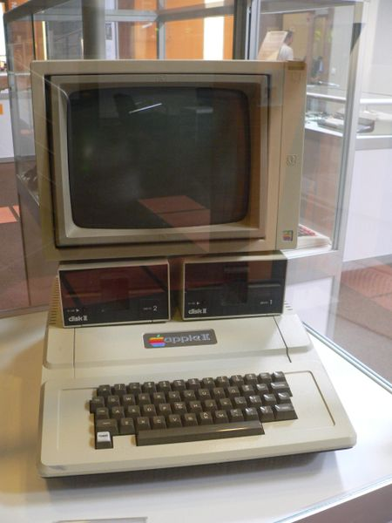
History
Apple II, 1977
帶起PC革命
彩色圖形介面 (GUI)
Graphics user interface
(60’s~mid 70’s)
(late 70’s~80’s)
(90’s~00’s)

Slide 7
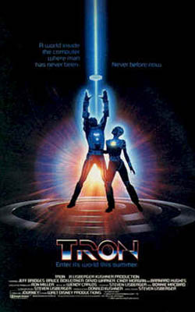
History
Tron, 1982, Disney
中文翻譯 “電子世界爭霸戰”
第一部運用動畫手法拍攝的電影
創造了電影史上第一個數位角色 “Tron”
在迪士尼頻道有播出過
(60’s~mid 70’s)
(late 70’s~80’s)
(90’s~00’s)

Slide 8
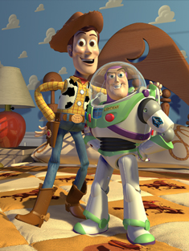
History
Toy Story, 1995, Pixar
第一部3D動畫長片
Woody跟Buzz Lightyear之間的愛恨情仇
(60’s~mid 70’s)
(late 70’s~80’s)
(90’s~00’s)

Slide 9
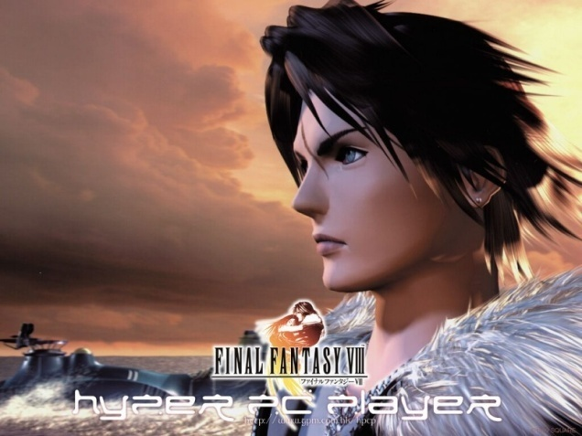
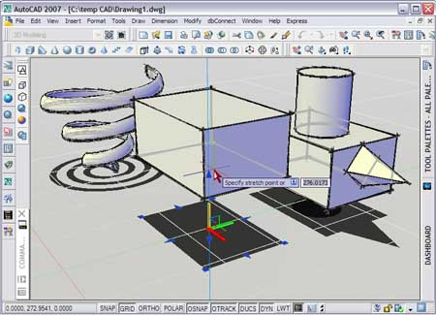
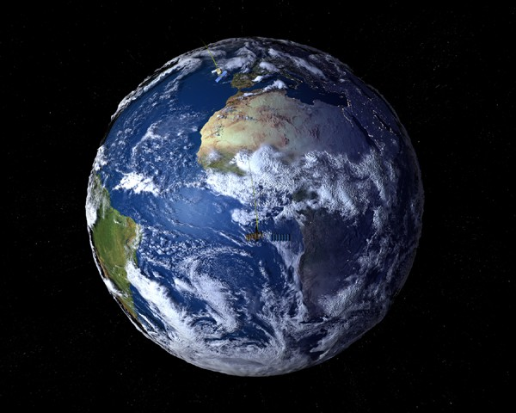
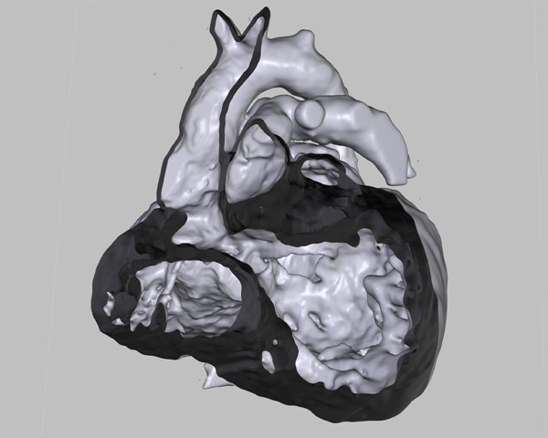
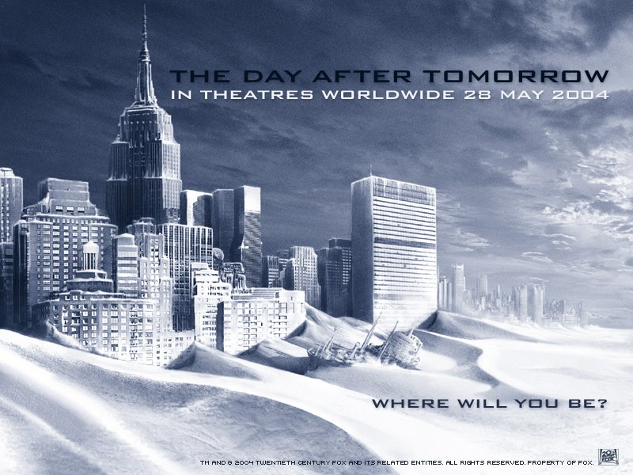
History
Related application
Animation, Cartoon and Game
Realistic film / special effect
Arts & Computer Aided Design
Interactive environment
Scientific Simulation
Medical visualization …

Slide 10
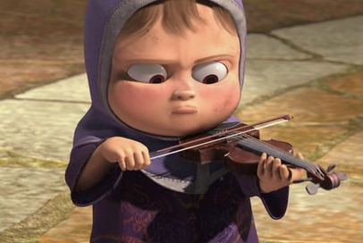
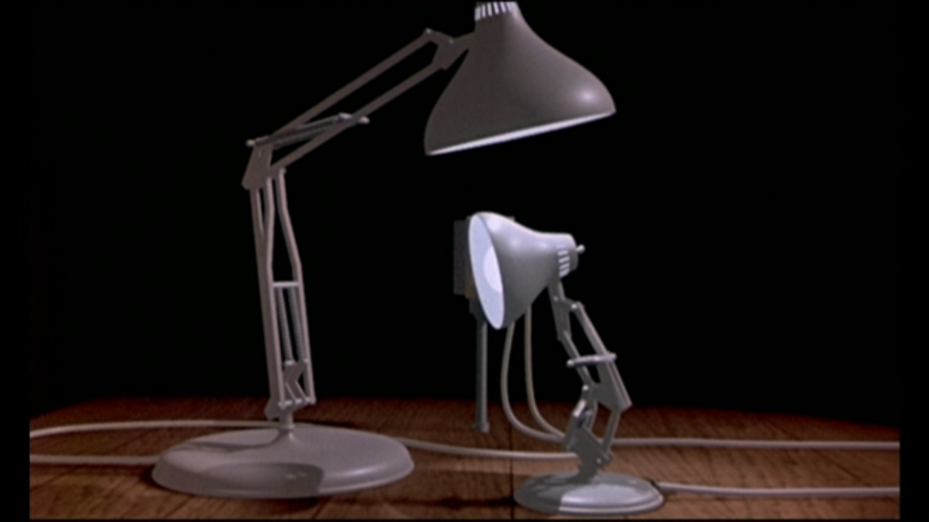
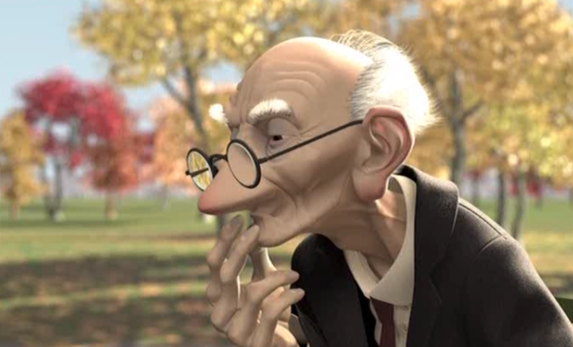
Pixer Demos
2006
(1986) - 頑皮跳跳燈 (Luxo Jr)
(1997) - 棋逢敵手 (Geri's Game)
(2006) - 許願池 (One Man Band)
1986
1997
Check this !!! http://vslab.csie.ncku.edu.tw/course/CG/movs/

Slide 11
The End
Thanks for your attention

