Slide 1
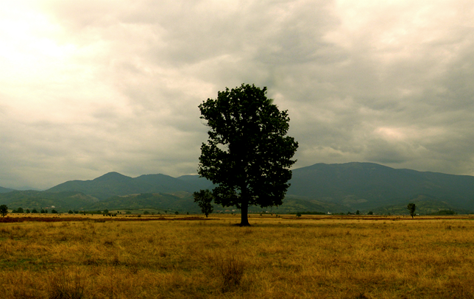
HOMEWORK III

Slide 2
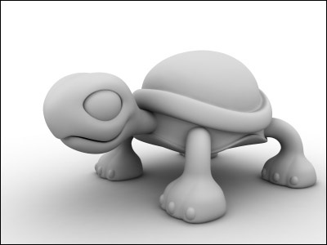
TOPICs
High performance rendering
Use display list or vertex array with some tricks to cooperate with geometry selection
A tool of geometric primitive selection
color/highlight the selected one.

Slide 3
REQUIREMENTs
Render a specific high resolution mesh (>100k triangle) and display the frame rate in realtime.
Provide a navigation tool for viewing it.
Zoom in/out
Track ball (rotation)
Provide a selection tool for user to select a point or triangle. (optional : edge selection / vertex 1-ring display)

Slide 4
NOTEs
The accuracy of selection is the basic requirement. / The performance is the most important stuff in this homework.
Note: if the frame rate of your program > 60 fps, you may need to disable vertical sync on your program to show the real fps of your program. (btw, it is meaningless to render frames over screen refresh rate)
We will use several meshes with different resolution to test your program. Please check our website (a dragon model with 4 different resolution)

Slide 5
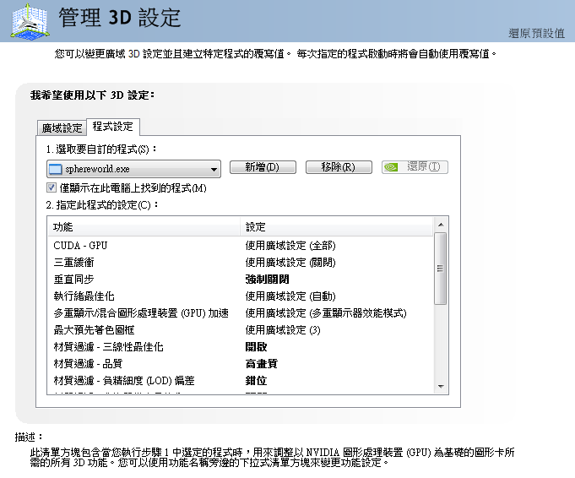
HOWTO: disable vertical sync

Slide 6
Q & A

