Slide 1

OPENGL
Return of the Survival Guide

Slide 2
Buffers

Slide 3
Buffers
OpenGL holds the buffers in a coordinate system such that the origin is the lower left corner
(0,0)

Slide 4
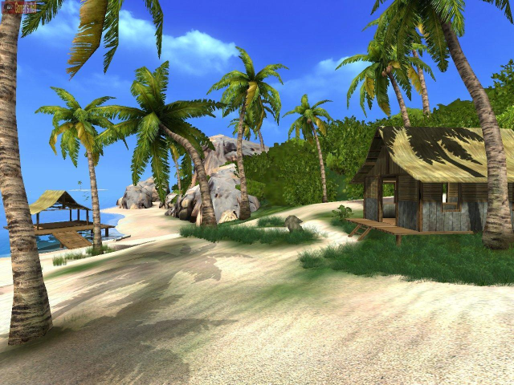
Color Buffer
The image that you see on screen.

Slide 5
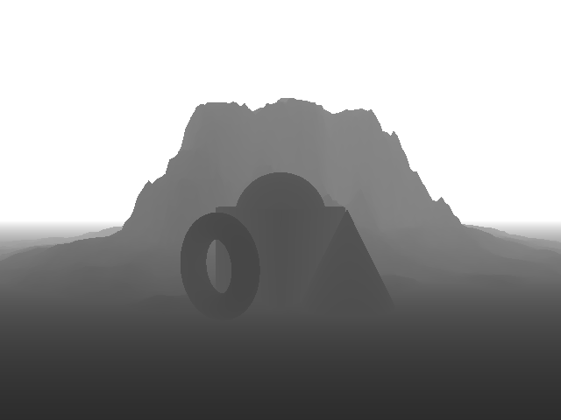
Depth Buffer
The depth values of the image

Slide 6
Stencil & Accumulation Buffers
Stencil buffer is basically a mask that tells us which pixels can be modified and which can’t.
Accumulation buffer does what the name says, accumulates information.

Slide 7
Clear Value
void glClearColor(red, green, blue, alpha);
void glClearIndex(index);
void glClearDepth(depth);
void glClearStencil(s);
void glClearAccum(red, green, blue, alpha);
Set the clear value of the appropriate buffer.

Slide 8
Speeding Up Rendering
Working a bit Faster

Slide 9
Clearing the Buffers
void glClear(GLbitfield mask);
Clears the specified buffers. The value of mask is the bitwise logical OR of some combination of:
GL_COLOR_BUFFER_BIT, GL_DEPTH_BUFFER_BIT, GL_STENCIL_BUFFER_BIT, GL_ACCUM_BUFFER_BIT.

Slide 10
Writing / Reading
void glDrawBuffer(GLenum mode);
void glReadBuffer(GLenum mode);
These commands tell OpenGL to which buffer should it write, from which buffers should it read (no actual read / write are done).

Slide 11
Enable / Disable
void glColorMask(red, green, blue, alpha);
void glDepthMask(flag);
void glStencilMask(mask);
Enables / Disables writing to the specified buffers or field in the buffer.

Slide 12
Scissor Test
void glScissor(x, y, width, height);
Sets the location and size of the scissor rectangle. The parameters define the lower-left corner (x, y), and the width and height of the rectangle (must be enabled first).
Buffer
Scissor Box
(x,y)

Slide 13
Alpha Test
void glAlphaFunc(func, ref);
Sets the reference value and comparison function for the alpha test. The reference value ref is clamped to be between zero and one.

Slide 14

Alpha Test

Slide 15
Stencil Test
void glStencilFunc(func, ref, mask);
Sets the comparison function, reference value, and a mask for use with the stencil test. The reference value is compared to the value in the stencil buffer using the comparison function, but the comparison applies only to those bits where the corresponding bits of the mask are 1.
void glStencilOp(fail, zfail, zpass);
Specifies how the data in the stencil buffer is modified when a fragment passes or fails the stencil test. The three functions fail, zfail, and zpass can be GL_KEEP, GL_ZERO, GL_REPLACE, GL_INCR, GL_DECR, or GL_INVERT.

Slide 16
Stencil Test

Slide 17
Depth Test
void glDepthFunc(GLenum func);
Sets the comparison function for the depth test.

Slide 18
Accumulation Buffer
Won’t go into specifics but here are a few applications:
Soft Shadows
Motion Blurs
Depth of Field

Slide 19
Speeding Up Rendering
After Deciding What to Draw

Slide 20
Need More Time
We want to render our complex models at interactive frame rates.
Here when we say render we mean the decision process of deciding what to render and the actual rendering.
30 fps ⬄ 33 msec per frame.

Slide 21

Thing that Have to be Done
The decision process includes:
Visibility calculations
Character animation
Collision detection
LOD determination
Shadows
Reflections …
All this and the actual rendering have to be done on time.

Slide 22
Display Lists
Method One

Slide 23
Display Lists
A display list is a convenient and efficient way to name and organize a set of OpenGL commands.
glCallList( wheel_id );
modelview transformation
glCallList( wheel_id );
modelview transformation
glCallList( wheel_id );

Slide 24
Display Lists
To optimize performance, an OpenGL display list is a cache of commands rather than a dynamic database.
In other words, once a display list is created, it can't be modified.

Slide 25
What does Cache Mean?
glRotate(35.0, 1.0, 0.0, 0.0):
Matrix Computed by the Function
Computation Result
We Store This Matrix in Memory

Slide 26
Getting Display Lists ids
GLuint glGenLists(GLsizei range);
Allocates range number of contiguous, previously unallocated display-list indices. The integer returned is the index that marks the beginning of a contiguous block of empty display-list indices.
void glDeleteLists(GLuint list, GLsizei range);
Deletes range display lists, starting at the index specified by list.

Slide 27
Creating a List
void glNewList (GLuint list, GLenum mode);
Specifies the start of a display list. OpenGL routines that are called subsequently are stored in a display list, except for a few restricted OpenGL routines that can't be stored.
Mode can be GL_COMPILE or GL_COMPILE_AND_EXECUTE.
void glEndList (void);
Marks the end of a display list.

Slide 28
Rendering Context
Display Lists are rendering context sensitive.
If you are working in a rendering context that is not the one that the display list was created in, it will probably not work!!!

Slide 29
Not Allowed
Vertex Array Stuff
Display List Stuff
glVertexPointer()
glColorPointer()
glNormalPointer()
glTexCoordPointer()
glEdgeFlagPointer()
glIndexPointer()
glInterleavedArrays()
glEnableClientState()
glDisableClientState()
glDeleteLists()
glGenLists()
glIsList()
Selection Stuff
glRenderMode()
glSelectBuffer()
glFeedbackBuffer()
And a Few Others…

Slide 30
Using a Display List
void glCallList (GLuint list);
This routine executes the display list specified by list. The commands in the display list are executed in the order they were saved, just as if they were issued without using a display list.

Slide 31
Vertex Arrays
Method Two

Slide 32
The Basic Idea
Vertices Stored in an Array
E
H
0
0
0
0
0
1
1
0
F
G
1
1
0
0
0
1
0
0
D
A
1
1
1
1
1
1
1
0
C
Vertex G
B
Indices of Quads into the vertex array
A
B
C
D
A
B
F
E
B
C
G
F
E
F
G
H
A
D
H
E
D
C
G
H

Slide 33
Enable / Disable
void glEnableClientState (GLenum array)
void glDisableClientState(GLenum array);
Specifies the array to enable / disable.
GL_VERTEX_ARRAY | Vertices
GL_COLOR_ARRAY | Colors
GL_INDEX_ARRAY | Indexed Colors
GL_NORMAL_ARRAY | Normals
GL_TEXTURE_COORD_ARRAY | Texture Coordinates
GL_EDGE_FLAG_ARRAY | Edge Type

Slide 34
Specifying Data
void glVertexPointer(size, type, stride, *pointer);
Specifies where spatial coordinate data can be accessed. Pointer is the memory address of the first coordinate of the first vertex in the array. Type specifies the data type of each coordinate in the array. Size is the number of coordinates per vertex. Stride is the byte offset between consecutive vertexes.

Slide 35
Using the Vertex Arrays
void glArrayElement( ith )
void glDrawElements(mode, count, type, *indices);
Defines a sequence of geometric primitives using count number of elements, whose indices are stored in the array indices. Type indicates the data type of the indices array. Mode specifies what kind of primitives are constructed
void glDrawArrays(mode, first, count);
Constructs a sequence of geometric primitives using array elements starting at first and ending at first+count-1 of each enabled array.

Slide 36
Which One is Better?
Depends on the Implementation

Slide 37
A Few Words About Cards
Not Really OpenGL

Slide 38
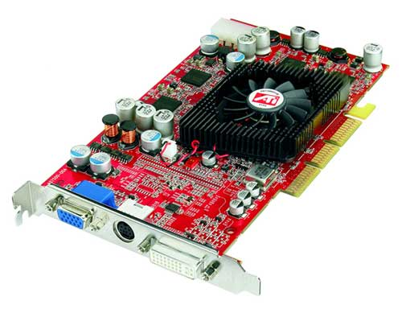
Graphics Hardware
New hardware has further capabilities for rendering …
OpenGL extensions, for example VBO.

Slide 39
OpenGL Extensions
Vertex Buffer Object is basically the same idea as the Vertex Array only it is implemented on the graphics hardware. The use is pretty much the same, the difference is that the data is stored directly on the graphics hardware.

Slide 40
This is the End of the Talk
Bye-Bye

