Slide 1
Setup OpenGL Environment
with GLUT / freeglut
2010.09.16 I-Cheng Yeh

Slide 2
Resource
This slides and resource
http://vslab.csie.ncku.edu.tw/course/CG/
Super Bible 4th
http://www.starstonesoftware.com/OpenGL/fourthEdition.htm
NEHE :
http://nehe.gamedev.net/
http://vision.csie.ncku.edu.tw/~ichenyeh/public/nehe/
Game Tutorial :
http://www.gametutorials.com/

Slide 3
About GLUT
The OpenGL Utility Toolkit (GLUT)
originally written by Mark Kilgard, ported to Win32 (Windows 95,98,Me,NT,2000,XP) by Nate Robins.
Latest version
http://www.xmission.com/~nate/glut.html
glut-3.7.6-bin.zip (117 KB) GLUT for Win32 dll, lib and header file (everything you need to get started programming with GLUT).
Ours

Slide 4
Setup GLUT in Visual Studio 2005
Global setting
glut.h
Header file of GLUT
$(MSDevDir)\VC\PlatformSDK\Include\gl
glut.lib
Precompiled versions of the import library
$(MSDevDir)\VC\PlatformSDK\Lib
glut.dll
Precompiled versions of the DLL
%WinDir%\System or %WinDir%\System32
$(MSDevDir) = C:\Program Files\Microsoft Visual Studio 8\
%WinDir%\= C:\WINDOWS
Global Version

Slide 5
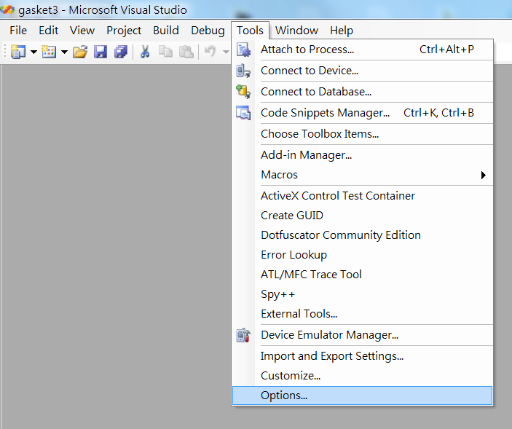
Setup GLUT in Visual Studio 2005_{cont}
Global setting – open “options” page
Global Version

Slide 6
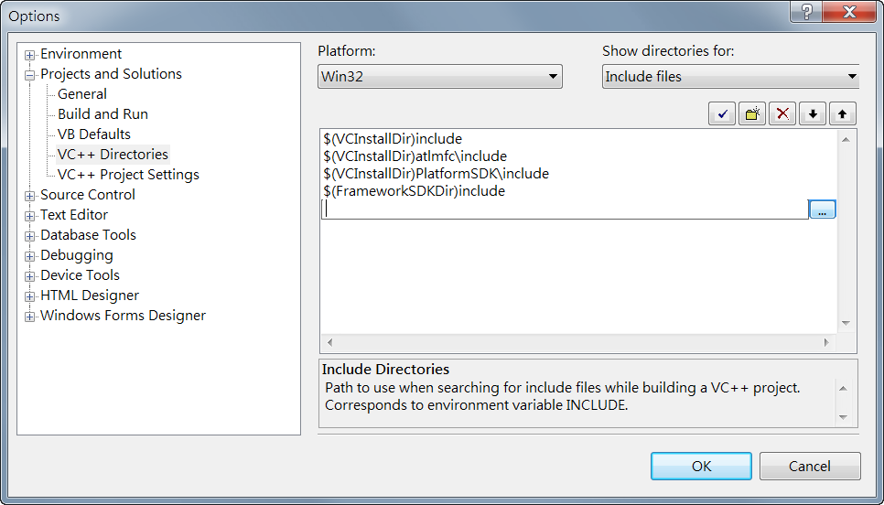
Setup GLUT in Visual Studio 2005_{cont}
Global setting – edit include files
C:\openGL\OpenGLSDK\include
Global Version

Slide 7
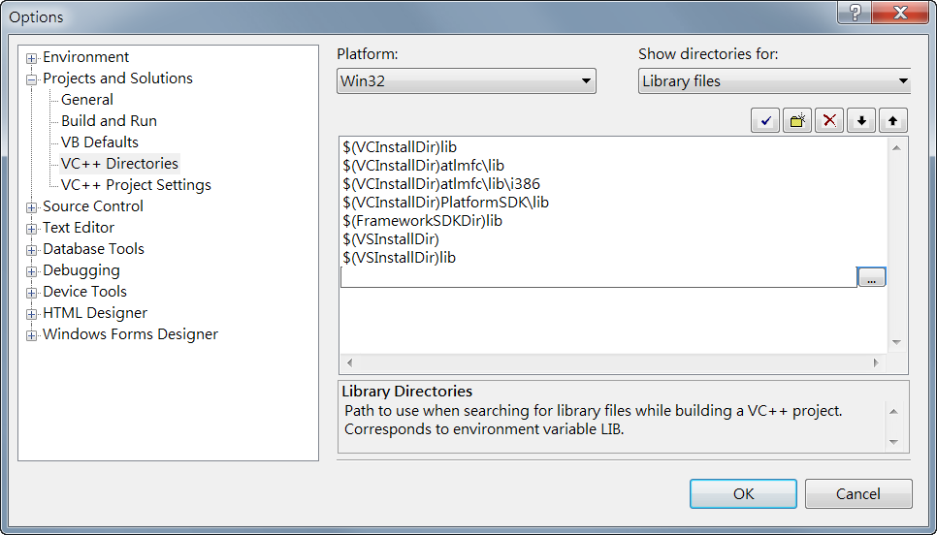
Setup GLUT in Visual Studio 2005_{cont}
Global setting – edit library files
C:\openGL\OpenGLSDK\lib
Global Version

Slide 8
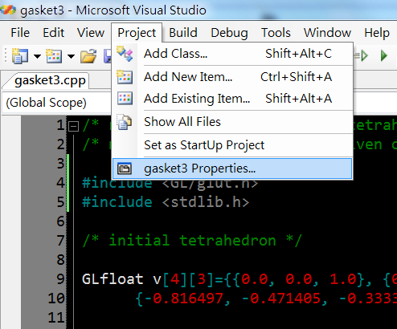
Setup GLUT in Visual Studio 2005_{cont}
Local setting – Properties page
Local Version

Slide 9
Setup GLUT in Visual Studio 2005_{cont}
Local setting – add additional include directories
Local Version

Slide 10
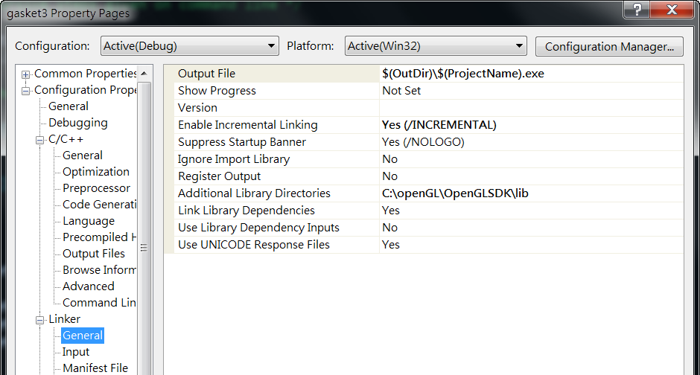
Setup GLUT in Visual Studio 2005_{cont}
Local setting – add additional library directories
Local Version

Slide 11
ERROR
Compiler message
error C2381: 'exit' : redefinition; __declspec(noreturn) differs $(MSDevDir)\VC\include\stdlib.h 406
Solution 1
Open glut.h in Line 146
Change
extern _CRTIMP void __cdecl exit(int);
To
extern _CRTIMP __declspec(noreturn) void __cdecl exit(int);
Solution 2
Correct the order of including list
#include <stdlib.h>
#include <GL/glut.h>

Slide 12
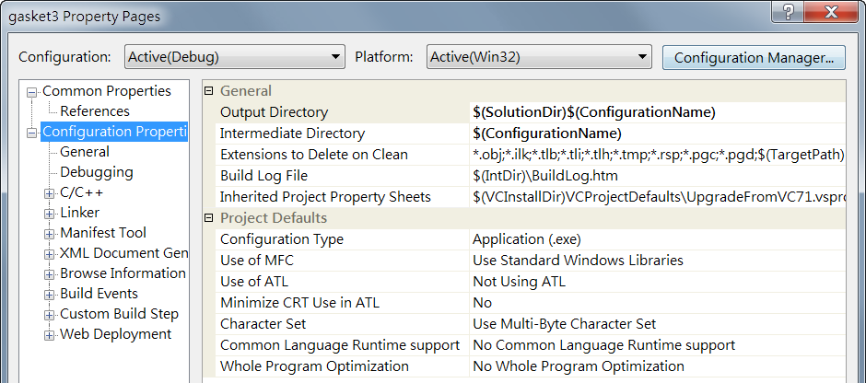
Attention
Local setting – add additional library directories

Slide 13
Setup GLUT in Visual Studio 6
Extract OpenGLSDK.zip to Disk (e.q.: c:\OpenGLSDK\)
Copy glut.dll (in C:\OpenGLSDK\LIB\) to %WinDir%\System or %WinDir%\System32
Get in “VC6->Tool->Option”
Select page: ”Directory”
Select ”Include file” ,and add two path
C:\openGL\OpenGLSDK\include\
C:\openGL\OpenGLSDK\include\gl\
Select page: ”Library file”
Add path
C:\openGL\OpenGLSDK\LIB\

Slide 14
About freeglut ??
The “freeglut”
Open Sourced alternative to the OpenGL Utility Toolkit (GLUT)
Originally written by Pawel W. Olszta with contributions from Andreas Umbach and Steve Baker. Steve is now the official owner/maintainer of freeglut.
Latest version
http://freeglut.sourceforge.net/ (ver. 2.6)

Slide 15
Getting Start
#include <GL/glut.h>
# pragma comment (lib, "opengl32.lib")
/* link with Microsoft OpenGL lib */
# pragma comment (lib, "glu32.lib")
/* link with Microsoft OpenGL Utility lib */
# pragma comment (lib, "glut32.lib")
/* link with Win32 GLUT lib */

Slide 16
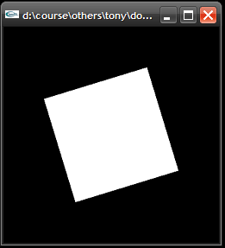
Program 1 (double)
Left Click
Active Rotation Function
Right Click
Disable Rotation Function

Slide 17
glutMouseFunc
glutMouseFunc(mouse); //put this line into main() function
void mouse(int button, int state, int x, int y)
{
switch (button) {
case GLUT_LEFT_BUTTON:
if (state == GLUT_DOWN)
glutIdleFunc(spinDisplay);
break;
case GLUT_MIDDLE_BUTTON:
case GLUT_RIGHT_BUTTON:
if (state == GLUT_DOWN)
glutIdleFunc(NULL);
break;
default:
break;
}
}

Slide 18
glutKeyboardFunc
glutKeyboardFunc(keyboard); //put this line into main() function
void keyboard (unsigned char key, int x, int y)
{
switch (key) {
case 'x': case 'X':
glutIdleFunc(rotDisplayX);
break;
case 'y': case 'Y':
glutIdleFunc(rotDisplayY);
break;
case 'z': case 'Z':
glutIdleFunc(rotDisplayZ);
break;
default:
break;
}
}

Slide 19
Draw Triangle
void displays(void)
{
//Clear color
glClear (GL_COLOR_BUFFER_BIT);
//Draw 2D Rectangle
glRectf (-25.0, -25.0, 25.0, 25.0);
glFlush(); //Refresh
}
//Draw 2D Triangle
glBegin(GL_TRIANGLES);
glVertex3d(-25.0, -25.0, 0.0);
glVertex3d(0.0, 0.0, 0.0);
glVertex3d(-25.0, 0.0, 0.0);
glEnd();
(-25,0,0)
(0,0,0)
CCW = Counterclockwise
(-25,-25,0)

Slide 20
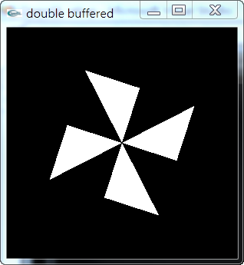
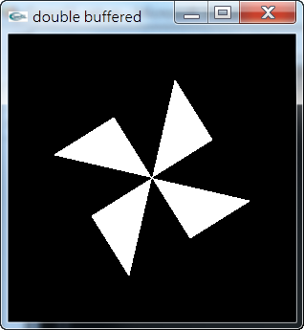
Exercise ! (double)

Slide 21
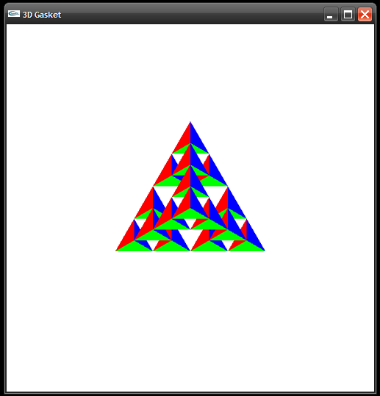
Exercise 2! (gasket3)

Slide 22
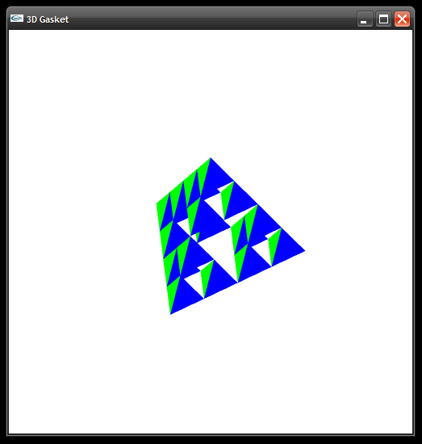
Exercise 2! (gasket3)
Press Z
Rotate by Z-Axis
Press X
Rotate by X-Axis
Mouse Click
Stop ALL
Z
X

Slide 23
DEMO, Q&A
?

