Slide 1
Introduction to
Computer Graphics
Instructor:
Prof. Tong-Yee Lee
李同益
Dr. Chih-Kuo Yeh
葉智國

Slide 2
Open Graphics Library
(OpenGL)

Slide 3

OpenGL
Created in 1991 by Silicon Graphics. Now it is managed by the Khronos consortium
Application programming interface (API) for rendering 2D\3D graphics
The API interacts with the graphics processing unit (GPU)
Language-independent: has many bindings, e.g., WebGL.
Platform-independent: works on Win/Linux/..

Slide 4
Software Organization
application program
OpenGL Motif
widget or similar
GLUT
GLX, AGL
or WGL
GLU
X, Win32, Mac O/S
GL
software and/or hardware

Slide 5
OpenGL – Design
A library of functions (e.g., glDrawArrays) and constants (e.g., GL_TRIANGLES)
Language-independent: has many bindings, e.g., WebGL.
Platform-independent: works on Win/Linux/..

Slide 6
OpenGL – Libraries
OpenGL doesn’t support input or windowing
GLUT (or freeglut) is used to create a context
Platform-dependent extensions can be provided by vendors. Identified by ARB, EXT, ..
GLEW wraps the extraction of functionality

Slide 7
OpenGL – History
OpenGL 1 (1992): Fixed pipeline
OpenGL 2 (2004): Programmable shaders (GLSL)
OpenGL 3: Deprecated the fixed functionality
OpenGL 3.1 (2009): Removed completely the fixed pipeline
..
OpenGL 4.5 (2014):
Notes:
最初這個功能是以組合語言撰寫著色器來達到的。組合語言對開發者的使用是不直觀而複雜的。OpenGL ARB 建立了 OpenGL 著色語言，為 GPU 的程式設計提供更加直觀的方法，當維護開放標準的時候，就有助於帶動 OpenGL 的歷史。
最初 OpenGL 1.5 是以擴充形式引入，後來 OpenGL ARB 在 OpenGL 2.0 核心中正式納入 GLSL。自 1992 年建立的OpenGL 1.0 起，OpenGL 2.0 是第一個 OpenGL 的大修改版。
使用 GLSL 有如下好處：
具有跨平台的相容性，包括 Macintosh、Windows 和 Linux 等作業系統。
所有支援 OpenGL 著色語言的繪圖卡，都可以用來編寫著色器。
允許廠商為特定的繪圖卡產生最佳化的代碼。

Slide 8
OpenGL 1.X Functions
Primitives
  Points
  Line Segments
  Polygons
Attributes
Transformations
  Viewing
  Modeling
Control
Input (GLUT)

Slide 9
OpenGL 1.X State
OpenGL is a state machine
OpenGL functions are of two types
  Primitive generating
    Can cause output if primitive is visible
    How vertices are processes and appearance of primitive are controlled by the state
  State changing
    Transformation functions
    Attribute functions

Slide 10
Lack of Object Orientation
OpenGL is not object oriented so that there are multiple functions for a given logical function, e.g. glVertex3f, glVertex2i, glVertex3dv,…..
Underlying storage mode is the same
Easy to create overloaded functions in C++ but issue is efficiency

Slide 11
OpenGL function format
function name
glVertex3f(x,y,z)
x,y,z are floats
belongs to GL library
glVertex3fv(p)
p is a pointer to an array

Slide 12
OpenGL #defines
Most constants are defined in the include files gl.h, glu.h and glut.h
  Note #include <glut.h> should automatically include the others
  Examples
  glBegin(GL_POLYGON)
  glClear(GL_COLOR_BUFFER_BIT)
include files also define OpenGL data types: GLfloat, GLdouble,….

Slide 13
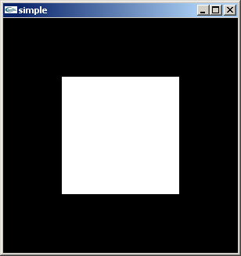
A Simple Program
Generate a square on a solid background

Slide 14
simple.c
#include <glut.h>
void mydisplay(){
glClear(GL_COLOR_BUFFER_BIT);
glBegin(GL_POLYGON);
glVertex2f(-0.5, -0.5);
glVertex2f(-0.5, 0.5);
glVertex2f(0.5, 0.5);
glVertex2f(0.5, -0.5);
glEnd();
glFlush();
}
int main(int argc, char** argv){
glutInit(&argc,argv);
glutCreateWindow("simple");
glutDisplayFunc(mydisplay);
glutMainLoop();
}

Slide 15
Event Loop
Note that the program defines a display callback function named mydisplay
  Every glut program must have a display callback
  The display callback is executed whenever OpenGL decides the display must be refreshed, for example when the window is opened
  The main function ends with the program entering an event loop

Slide 16
Defaults
simple.c is too simple
Makes heavy use of state variable default values for
  Viewing
  Colors
  Window parameters
Next version will make the defaults more explicit

Slide 17
Compilation on Windows
Visual C++
  Get glut.h, glut32.lib and glut32.dll from web
  Create a console application
  Add path to find include files (GL/glut.h)
  Add opengl32.lib, glu32.lib, glut32.lib to project settings (for library linking)
  glut32.dll is used during the program execution. (Other DLL files are included in the device driver of the graphics accelerator.)

Slide 18
Programming with OpenGL
Part 2: Complete Programs

Slide 19
Objectives
Refine the first program
  Alter the default values
  Introduce a standard program structure
Simple viewing
  Two-dimensional viewing as a special case of three-dimensional viewing
Fundamental OpenGL primitives
Attributes

Slide 20
Program Structure
Most OpenGL programs have a similar structure that consists of the following functions
  main():
    defines the callback functions
    opens one or more windows with the required properties
    enters event loop (last executable statement)
  init(): sets the state variables
    viewing
    Attributes
  callbacks
    Display function
    Input and window functions

Slide 21
Simple.c revisited
In this version, we will see the same output but have defined all the relevant state values through function calls with the default values
In particular, we set
  Colors
  Viewing conditions
  Window properties

Slide 22
main.c
#include <GL/glut.h>
int main(int argc, char** argv)
{
glutInit(&argc,argv);
glutInitDisplayMode(GLUT_SINGLE|GLUT_RGB);
glutInitWindowSize(500,500);
glutInitWindowPosition(0,0);
glutCreateWindow("simple");
glutDisplayFunc(mydisplay);
init();
glutMainLoop();
}
includes gl.h
define window properties
display callback
set OpenGL state
enter event loop

Slide 23
GLUT functions
glutInit allows application to get command line arguments and initializes system
gluInitDisplayMode requests properties of the window (the rendering context)
  RGB color
  Single buffering
  Properties logically ORed together
glutWindowSize in pixels
glutWindowPosition from top-left corner of display
glutCreateWindow create window with title “simple”
glutDisplayFunc display callback
glutMainLoop enter infinite event loop

Slide 24
init.c
void init()
{
glClearColor (0.0, 0.0, 0.0, 1.0);
glColor3f(1.0, 1.0, 1.0);
glMatrixMode (GL_PROJECTION);
glLoadIdentity ();
glOrtho(-1.0, 1.0, -1.0, 1.0, -1.0, 1.0);
}
black clear color
opaque window
fill with white
viewing volume

Slide 25
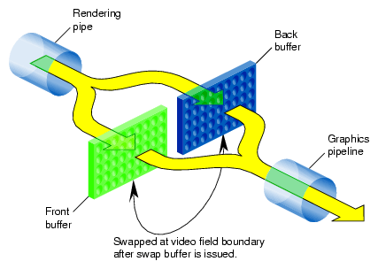
Double-Buffered Animation

Slide 26
Double-Buffered Animation
#include <GL/glut.h>
int main(int argc, char** argv)
{
glutInit(&argc,argv);
glutInitDisplayMode(GLUT_DOUBLE|GLUT_RGB);
glutInitWindowSize(500,500);
glutInitWindowPosition(0,0);
glutCreateWindow("simple");
glutDisplayFunc(mydisplay);
init();
glutMainLoop();
}

Slide 27
Double-Buffered Animation
void mydisplay(){
glClear(GL_COLOR_BUFFER_BIT);
glBegin(GL_POLYGON);
glVertex2f(-0.5, -0.5);
glVertex2f(-0.5, 0.5);
glVertex2f(0.5, 0.5);
glVertex2f(0.5, -0.5);
glEnd();
glFlush();
glutSwapBuffers();
}

Slide 28
OpenGL – History
OpenGL 1
OpenGL 2
OpenGL 3
OpenGL 3.1
..
OpenGL 4.5
State Machine
Data flow model

Slide 29
No Fixed Function
Built-In matrix-functions/stacks:
  glMatrixMode, glMult/LoadMatrix,
  glRotate/Translate/Scale, glPush/PopMatrix…
Immediate Mode:
  glBegin/End, glVertex, glTexCoords…
Material and Lighting:
  glLight, glMaterial, …
Attribute-Stack:
  glPush/PopAttrib, …

Slide 30
OpenGL – Coding
The API is obtained by including freeglut:
Extensions are accessed through GLEW:
#include <GL/freeglut.h>
#include <GL/glew.h>
glewInit();

Slide 31
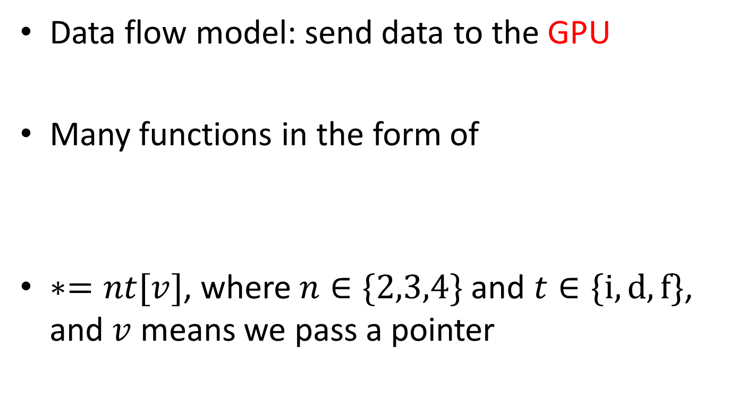
OpenGL – Coding
Data flow model: send data to the GPU
Many functions in the form of
$∗=nt[v]$, where $n∈\{2,3,4\}$ and $t∈\{i,d,f\}$, and $v$ means we pass a pointer
glSomeFunction*();

Slide 32
OpenGL – Coding
Examples:
Later, we will see how to transfer matrices
glUniform1f(..);
glUniform3iv(..);

Slide 33
OpenGL – Coding
Send the array points to the GPU
Name and create a vertex array object (VAO)
GLuint abuffer;
glGenVertexArrays(1, &abuffer);
glBindVertexArray(abuffer);

Slide 34
OpenGL – Coding
Next, we create a vertex buffer object (VBO)
This is how data is actually stored
GLuint buffer;
glGenBuffers(1, &buffer);
glBindBuffer(GL_ARRAY_BUFFER, buffer);
glBufferData(GL_ARRAY_BUFFER,sizeof(points),
points, GL_STATIC_DRAW);

Slide 35
OpenGL – Coding
Rendering our data can be done simply by
Thus, a simple display method is
glDrawArrays(GL_TRIANGLES,0,sizeof(points));
void display(void)
{
  glClear(GL_COLOR_BUFFER_BIT);
  glDrawArrays(GL_TRIANGLES,0,sizeof(points));
  glFlush();
}

Slide 36
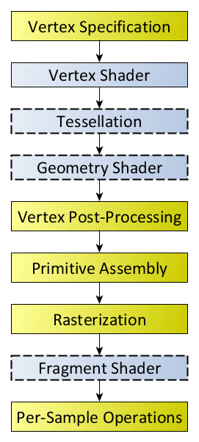
GLSL Rendering Pipeline
Similar to our software renderer
Your program will consist of shaders
  No default shaders
  You must at least supply vertex and fragment shaders

Slide 37
OpenGL – Shaders
Vertex shader:
  Send a vertex location to the rasterizer
  …
Fragment shader:
  Its input is a fragment inside the clipping volume
  Output a color to the fragment
  …

Slide 38
GL Shading Language (GLSL)
C-like language
Need to compile and link in runtime
Create a program object with shader objects
Connect shader’s entities to our program

Slide 39
OpenGL – Coding
Create a program object with shader objects
Connect shader’s entities to our program
GLuint program;
program = InitShader("vsource.glsl", "fsource.glsl");
GLuint loc;
loc = glGetAttribLocation(program, "vPosition");
glEnableVertexAttribArray(loc);
glVertexAttribPointer(loc, 2, GL_FLOAT,
GL_FALSE, 0, 0);

Slide 40
OpenGL – Example
static char*
readShaderSource(const char* shaderFile) {
…
}
Gluint InitShader(const char* vShaderFile, const char* fShaderFile) {
…
}

Slide 41
OpenGL – Example
void init(void) {
  …
  points = …;
  …
  GLuint program = InitShader( "vshader.glsl",
  "fshader.glsl" );
  glUseProgram( program );
  GLuint vao;
  glGenVertexArrays( 1, &vao );
  glBindVertexArray( vao );

Slide 42
OpenGL – Example
  GLuint buffer;
  glGenBuffers( 1, &buffer );
  glBindBuffer( GL_ARRAY_BUFFER, buffer );
  glBufferData( GL_ARRAY_BUFFER, sizeof(points),
  points, GL_STATIC_DRAW );
  GLuint loc = glGetAttribLocation( program, "vPosition" );
  glEnableVertexAttribArray( loc );
  glVertexAttribPointer(loc,2,GL_FLOAT,GL_FALSE,0,0)
  glClearColor( 1.0, 1.0, 1.0, 1.0 );
}

Slide 43
OpenGL – Example
void display(void) {
  glClear( GL_COLOR_BUFFER_BIT );
  glDrawArrays( GL_POINTS, 0, sizeof(points) );
  glFlush( void );
}

Slide 44
OpenGL – Example
int main( int argc, char **argv ) {
  glutInit( &argc, argv );
  glutInitDisplayMode( GLUT_RGBA );
  glutInitWindowSize( 512, 512 );
  glutInitContextVersion( 3, 2 );
  glutInitContextProfile( GLUT_CORE_PROFILE );
  glutCreateWindow( “Example" );
  glewInit( void );
  init( void );
  glutDisplayFunc( display );
  glutMainLoop( void );
  return 0; }

Slide 45
OpenGL – Example
#version 150
in vec4 vPosition;
void main() {
gl_Position = vPosition;
}
#version 150
out vec4 fColor;
void main() {
fColor = vec4( 1.0, 0.0, 0.0, 1.0 );
}

Slide 46

A Simplified Pipeline Model
Application
GPU Data Flow
Framebuffer
Vertices
Vertices
Fragments
Pixels
Vertex
Processing
Rasterizer
Fragment Processing
Vertex
Shader
Fragment
Shader
Notes:
To begin, let us introduce a simplified model of the OpenGL pipeline. Generally speaking, data flows from your application through the GPU to generate an image in the frame buffer. Your application will provide vertices, which are collections of data that are composed to form geometric objects, to the OpenGL pipeline. The vertex processing stage uses a vertex shader to process each vertex, doing any computations necessary to determine where in the frame buffer each piece of geometry should go. The other shading stages we mentioned – tessellation and geometry shading – are also used for vertex processing, but we’re trying to keep this simple.
After all the vertices for a piece of geometry are processed, the rasterizer determines which pixels in the frame buffer are affected by the geometry, and for each pixel, the fragment processing stage is employed, where the fragment shader runs to determine the final color of the pixel.
In your OpenGL applications, you’ll usually need to do the following tasks:
specify the vertices for your geometry
load vertex and fragment shaders (and other shaders, if you’re using them as well)
issue your geometry to engage the OpenGL pipeline for processing
Of course, OpenGL is capable of many other operations as well, many of which are outside of the scope of this introductory course. We have included references at the end of the notes for your further research and development.

Slide 47
Representing Geometric Objects
Geometric objects are represented using vertices
A vertex is a collection of generic attributes
  positional coordinates
  colors
  texture coordinates
  any other data associated with that point in space
Position stored in 4 dimensional homogeneous coordinates
Vertex data must be stored in vertex buffer objects (VBOs)
VBOs must be stored in vertex array objects (VAOs)
Notes:
In OpenGL, as in other graphics libraries, objects in the scene are composed of geometric primitives, which themselves are described by vertices. A vertex in modern OpenGL is a collection of data values associated with a location in space. Those data values might include colors, reflection information for lighting, or additional coordinates for use in texture mapping. Locations can be specified on 2, 3 or 4 dimensions but are stored in 4 dimensional homogeneous coordinates.
Vertices must be organized in OpenGL server-side objects called vertex buffer objects (also known asVBOs), which need to contain all of the vertex information for all of the primitives that you want to draw at one time. VBOs can store vertex information in almost any format (i.e., an array-of-structures (AoS) each containing a single vertex’s information, or a structure-of-arrays (SoA) where all of the same “type” of data for a vertex is stored in a contiguous array, and the structure stores arrays for each attribute that a vertex can have). The data within a VBO needs to be contiguous in memory, but doesn’t need to be tightly packed (i.e., data elements may be separated by any number of bytes, as long as the number of bytes between attributes is consistent).
VBOs are further required to be stored in vertex array objects (known as VAOs). Since it may be the case that numerous VBOs are associated with a single object, VAOs simplify the management of the collection of VBOs.

Slide 48
OpenGL’s Geometric Primitives
All primitives are specified by vertices
4
1
0
3
1
3
3
1
2
0
5
2
0
2
6
GL_POINTS
GL_LINES
GL_LINE_STRIP
GL_LINE_LOOP
7
6
2
4
5
5
5
4
3
0
1
2
3
3
2
0
4
1
GL_TRIANGLES
1
GL_TRIANGLE_FAN
0
GL_TRIANGLE_STRIP
Notes:
To form 3D geometric objects, you need to decompose them into geometric primitives that OpenGL can draw. OpenGL only knows how to draw three things: points, lines, and triangles, but can use collections of the same type of primitive to optimize rendering.

Slide 49
static const glm::vec2 VertexData[VertexCount] =
{
glm::vec2(-0.90f, -0.90f), // Triangle 1
glm::vec2(0.85f, -0.90f),
glm::vec2(-0.90f, 0.85f),
glm::vec2(0.90f, -0.85f), // Triangle 2
glm::vec2(0.90f, 0.90f),
glm::vec2(-0.85f, 0.90f),
};

Slide 50
Vertex Array Objects (VAOs)
VAOs store the data of an geometric object
Steps in using a VAO
  generate VAO names by calling glGenVertexArrays()
  bind a specific VAO for initialization by calling glBindVertexArray()
  update VBOs associated with this VAO
  bind VAO for use in rendering
This approach allows a single function call to specify all the data for an objects
  previously, you might have needed to make many calls to make all the data current
Notes:
Similarly to VBOs, vertex array objects (VAOs) encapsulate all of the VBO data for an object. This allows much easier switching of data when rendering multiple objects (provided the data’s been set up in multiple VAOs).
The process for initializing a VAO is similar to that of a VBO, except a little less involved.
First, generate a name VAO name by calling glGenVertexArrays()
Next, make the VAO “current” by calling glBindVertexArray(). Similar to what was described for VBOs, you’ll call this every time you want to use or update the VBOs contained within this VAO.

Slide 51
VAOs in Code
Create a vertex array object
GLuint vao;
glGenVertexArrays( 1, &vao );
glBindVertexArray( vao );
Notes:
The above sequence calls shows how to create and bind a VAO. Since all geometric data in OpenGL must be stored in VAOs, you’ll use this code idiom often.

Slide 52
Storing Vertex Attributes
Vertex data must be stored in a VBO, and associated with a VAO
The code-flow is similar to configuring a VAO
  generate VBO names by calling glGenBuffers()
  bind a specific VBO for initialization by calling
  glBindBuffer( GL_ARRAY_BUFFER, … )
  load data into VBO using
  glBufferData( GL_ARRAY_BUFFER, … )
  bind VAO for use in rendering glBindVertexArray()
Notes:
While we’ve talked a lot about VBOs, we haven’t detailed how one goes about creating them. Vertex buffer objects, like all (memory) objects in OpenGL (as compared to geometric objects) are created in the same way, using the same set of functions. In fact, you’ll see that the pattern of calls we make here are similar to other sequences of calls for doing other OpenGL operations.
In the case of vertex buffer objects, you’ll do the following sequence of function calls:
Generate a buffer’s name by calling glGenBuffers()
Next, you’ll make that buffer the “current” buffer, which means it’s the selected buffer for reading or writing data values by calling glBindBuffer(), with a type of GL_ARRAY_BUFFER. There are different types of buffer objects, with an array buffer being the one used for storing geometric data.
To initialize a buffer, you’ll call glBufferData(), which will copy data from your application into the GPU’s memory. You would do the same operation if you also wanted to update data in the buffer
Finally, when it comes time to render using the data in the buffer, you’ll once again call glBindVertexArray() to make it and its VBOs current again. In fact, if you have multiple objects, each with their own VAO, you’ll likely call glBindVertexArray() once per frame for each object.

Slide 53
VBOs in Code
Create and initialize a buffer object
  GLuint buffer;
  glGenBuffers( 1, &buffer );
  glBindBuffer( GL_ARRAY_BUFFER, buffer );
  glBufferData( GL_ARRAY_BUFFER,
  sizeof(vPositions) + sizeof(vColors),
  NULL, GL_STATIC_DRAW );
  glBufferSubData( GL_ARRAY_BUFFER, 0,
  sizeof(vPositions), vPositions );
  glBufferSubData( GL_ARRAY_BUFFER, sizeof(vPositions),
  sizeof(vColors), vColors );
Notes:
The above sequence of calls illustrates generating, binding, and initializing a VBO with data. In this example, we use a technique permitting data to be loaded into two steps, which we need as our data values are in two separate arrays. It’s noteworthy to look at the glBufferData() call; in this call, we basically have OpenGL allocate an array sized to our needs (the combined size of our point and color arrays), but don’t transfer any data with the call, which is specified with the NULL value. This is akin to calling malloc() to create a buffer of uninitialized data. We later load that array with our calls to glBufferSubData(), which allows us to replace a subsection of our array. This technique is also useful if you need to update data inside of a VBO at some point in the execution of your application.

Slide 54
Connecting Vertex Shaders with Geometric Data
Application vertex data enters the OpenGL pipeline through the vertex shader
Need to connect vertex data to shader variables
  requires knowing the attribute location
Attribute location can either be queried by calling glGetVertexAttribLocation()
Notes:
The final step in preparing you data for processing by OpenGL (i.e., sending it down for rendering) is to specify which vertex attributes you’d like issued to the graphics pipeline. While this might seem superfluous, it allows you to specify multiple collections of data, and choose which ones you’d like to use at any given time.
Each of the attributes that we enable must be associated with an “in” variable of the currently bound vertex shader. You retrieve vertex attribute locations was retrieved from the compiled shader by calling glGetAttribLocation(). We discuss this call in the shader section.

Slide 55
Vertex Array Code
Associate shader variables with vertex arrays
  do this after shaders are loaded
  GLuint vPosition =
  glGetAttribLocation( program, “vPosition" );
  glEnableVertexAttribArray( vPosition );
  glVertexAttribPointer( vPosition, 4, GL_FLOAT,
  GL_FALSE, 0,BUFFER_OFFSET(0) );
  GLuint vColor =
  glGetAttribLocation( program,"vColor" );
  glEnableVertexAttribArray( vColor );
  glVertexAttribPointer( vColor, 4, GL_FLOAT,
  GL_FALSE, 0, BUFFER_OFFSET(sizeof(vPositions)) );
Notes:
To complete the “plumbing” of associating our vertex data with variables in our shader programs, you need to tell OpenGL where in our buffer object to find the vertex data, and which shader variable to pass the data to when we draw. The above code snippet shows that process for our two data sources. In our shaders (which we’ll discuss in a moment), we have two variables: vPosition, and vColor, which we will associate with the data values in our VBOs that we copied form our vertex positions and colors arrays.
The calls to glGetAttribLocation() will return a compiler-generated index which we need to use to complete the connection from our data to the shader inputs. We also need to “turn the valve” on our data by enabling its attribute array by calling glEnableVertexAttribArray() with the selected attribute location.
This is the most flexible approach to this process, but depending on your OpenGL version, you may be able to use the layout construct, which allows you to specify the attribute location, as compared to having to retrieve it after compiling and linking your shaders. We’ll discuss that in our shader section later in the course.
BUFFER_OFFSET is a simple macro defined to make the code more readable
#define BUFFER_OFFSET( offset ) ((GLvoid*) (offset))

Slide 56
Drawing Geometric Primitives
For contiguous groups of vertices
glDrawArrays( GL_TRIANGLES, 0, NumVertices );
Usually invoked in display callback
Initiates vertex shader
Notes:
In order to initiate the rendering of primitives, you need to issue a drawing routine. While there are many routines for this in OpenGL, we’ll discuss the most fundamental ones. The simplest routine is glDrawArrays(), to which you specify what type of graphics primitive you want to draw (e.g., here we’re rending a triangle strip), which vertex in the enabled vertex attribute arrays to start with, and how many vertices to send.
This is the simplest way of rendering geometry in OpenGL Version 3.1. You merely need to store you vertex data in sequence, and then glDrawArrays() takes care of the rest. However, in some cases, this won’t be the most memory efficient method of doing things. Many geometric objects share vertices between geometric primitives, and with this method, you need to replicate the data once for each vertex. We’ll see a more flexible, in terms of memory storage and access in the next slides.

Slide 57
Shaders and GLSL

Slide 58
Shader-compilation command sequence

Slide 59
For each shader object:
Create a shader object.
Compile your shader source into the object.
Verify that your shader compiled successfully

Slide 60
Then
Create a shader program.
Attach the appropriate shader objects to the shader program.
Link the shader program.
Verify that the shader link phase completed successfully.
Use the shader for vertex or fragment processing.

Slide 61
Getting Your Shaders into OpenGL
Shaders need to be compiled and linked to form an executable shader program
OpenGL provides the compiler and linker
A program must contain
  vertex and fragment shaders
  other shaders are optional
Create Program
glCreateProgram()
Create
Shader
glCreateShader()
These steps need to be repeated for each type of shader in the shader program
Load Shader Source
glShaderSource()
Compile Shader
glCompileShader()
Attach Shader to Program
glAttachShader()
Link Program
glLinkProgram()
Use Program
glUseProgram()
Notes:
Shaders need to be compiled in order to be used in your program. As compared to C programs, the compiler and linker are implemented in the OpenGL driver, and accessible through function calls from within your program. The diagram illustrates the steps required to compile and link each type of shader into your shader program. A program can contain either a vertex shader (which replaces the fixed-function vertex processing), a fragment shader (which replaces the fragment coloring stages), or both. If a shader isn’t present for a particular stage, the fixed-function part of the pipeline is used in its place.
Just a with regular programs, a syntax error from the compilation stage, or a missing symbol from the linker stage could prevent the successful generation of an executable program. There are routines for verifying the results of the compilation and link stages of the compilation process, but are not shown here. Instead, we’ve provided a routine that makes this process much simpler, as demonstrated on the next slide.

Slide 62
GLSL Data Types
Scalar types: float, int, bool
Vector types: vec2, vec3, vec4
ivec2, ivec3, ivec4
bvec2, bvec3, bvec4
Matrix types: mat2, mat3, mat4
Texture sampling: sampler1D, sampler2D,
sampler3D, samplerCube
C++ Style Constructors
  vec3 a = vec3(1.0, 2.0, 3.0);
Notes:
As with any programming language, GLSL has types for variables. However, it includes vector-, and matrix-based types to simplify the operations that occur often in computer graphics.
In addition to numerical types, other types like texture samplers are used to enable other OpenGL operations. We’ll discuss texture samplers in the texture mapping section.

Slide 63
Operators
Standard C/C++ arithmetic and logic operators
Overloaded operators for matrix and vector operations
    mat4 m;
    vec4 a, b, c;
    b = a*m;
    c = m*a;
Notes:
The vector and matrix classes of GLSL are first-class types, with arithmetic and logical operations well defined. This helps simplify your code, and prevent errors.
Note in the above example, overloading ensures that both a*m and m*a are defined although they will not in general produce the same result.

Slide 64
Components and Swizzling
Access vector components using either:
  [ ] (c-style array indexing)
  xyzw, rgba or strq (named components)
For example:
  vec3 v;
  v[1], v.y, v.g, v.t - all refer to the same element
Component swizzling:
vec3 a, b;
  a.xy = b.yx;
Notes:
For GLSL’s vector types, you’ll find that often you may also want to access components within the vector, as well as operate on all of the vector’s components at the same time. To support that, vectors and matrices (which are really a vector of vectors), support normal “C” vector accessing using the square-bracket notation (e.g., “[i]”), with zero-based indexing. Additionally, vectors (but not matrices) support swizzling, which provides a very powerful method for accessing and manipulating vector components.
Swizzles allow components within a vector to be accessed by name. For example, the first element in a vector – element 0 – can also be referenced by the names “x”, “s”, and “r”. Why all the names – to clarify their usage. If you’re working with a color, for example, it may be clearer in the code to use “r” to represent the red channel, as compared to “x”, which make more sense as the x-positional coordinate

Slide 65
Qualifiers
in, out
  Copy vertex attributes and other variable into and out of shaders
    in vec2 texCoord;
    out vec4 color;
uniform
  shader-constant variable from application
    uniform float time;
    uniform vec4 rotation;
Notes:
In addition to types, GLSL has numerous qualifiers to describe a variable usage. The most common of those are:
in qualifiers that indicate the shader variable will receive data flowing into the shader, either from the application, or the previous shader stage.
out qualifier which tag a variable as data output where data will flow to the next shader stage, or to the framebuffer
uniform qualifiers for accessing data that doesn’t change across a draw operation

Slide 66
Functions
Built in
  Arithmetic: sqrt, power, abs
  Trigonometric: sin, asin
  Graphical: length, reflect
User defined
Notes:
GLSL also provides a rich library of functions supporting common operations. While pretty much every vector- and matrix-related function available you can think of, along with the most common mathematical functions are built into GLSL, there’s no support for operations like reading files or printing values. Shaders are really data-flow engines with data coming in, being processed, and sent on for further processing.

Slide 67
Built-in Variables
gl_Position
  (required) output position from vertex shader
gl_FragCoord
  input fragment position
gl_FragDepth
  input depth value in fragment shader
Notes:
Fundamental to shader processing are a couple of built-in GLSL variable which are the terminus for operations. In particular, vertex data, which can be processed by up to four shader stages in OpenGL, are all ended by setting a positional value into the built-in variable, gl_Position.
Additionally, fragment shaders provide a number of built-in variables. For example, gl_FragCoord is a read-only variable, while gl_FragDepth is a read-write variable. Later versions of OpenGL allow fragment shaders to output to other variables of the user’s designation as well.

Slide 68
Simple Vertex Shader for Cube Example
  #version 430
  in vec4 vPosition;
  in vec4 vColor;
  out vec4 color;
  void main()
  {
  color = vColor;
  gl_Position = vPosition;
  }
Notes:
Here’s the simple vertex shader we use in our cube rendering example. It accepts two vertex attributes as input: the vertex’s position and color, and does very little processing on them; in fact, it merely copies the input into some output variables (with gl_Position being implicitly declared). The results of each vertex shader execution are passed further down the OpenGL pipeline, and ultimately end their processing in the fragment shader.

Slide 69
The Simplest Fragment Shader
  #version 430
  in vec4 color;
  out vec4 fColor; // fragment’s final color
  void main()
  {
  fColor = color;
  }
Notes:
Here’s the associated fragment shader that we use in our cube example. While this shader is as simple as they come – merely setting the fragment’s color to the input color passed in, there’s been a lot of processing to this point. In particular, every fragment that’s shaded was generated by the rasterizer, which is a built-in, non-programmable (i.e., you don’t write a shader to control its operation). What’s magical about this process is that if the colors across the geometric primitive (for multi-vertex primitives: lines and triangles) is not the same, the rasterizer will interpolate those colors across the primitive, passing each iterated value into our color variable.

Slide 70
Associating Shader Variables and Data
Need to associate a shader variable with an OpenGL data source
  vertex shader attributes → app vertex attributes
  shader uniforms → app provided uniform values
OpenGL relates shader variables to indices for the app to set
Two methods for determining variable/index association
  specify association before program linkage
  query association after program linkage
Notes:
OpenGL shaders, depending on which stage their associated with, process different types of data. Some data for a shader changes for each shader invocation. For example, each time a vertex shader executes, it’s presented with new data for a single vertex; likewise for fragment, and the other shader stages in the pipeline. The number of executions of a particular shader rely on how much data was associated with the draw call that started the pipeline – if you call glDrawArrays() specifiying 100 vertices, your vertex shader will be called 100 times, each time with a different vertex.
Other data that a shader may use in processing may be constant across a draw call, or even all the drawing calls for a frame. GLSL calls those uniform varialbes, since their value is uniform across the execution of all shaders for a single draw call.
Each of the shader’s input data variables (ins and uniforms) needs to be connected to a data source in the application. We’ve already seen glGetAttribLocation() for retrieving information for connecting vertex data in a VBO to shader variable. You will also use the same process for uniform variables, as we’ll describe shortly.

Slide 71
Determining Locations After Linking
Assumes you already know the variables’ names
  GLint loc = glGetAttribLocation( program, “name” );
  GLint loc = glGetUniformLocation( program, “name” );
Notes:
Once you know the names of variables in a shader – whether they’re attributes or uniforms – you can determine their location using one of the glGet*Location() calls.
If you don’t know the variables in a shader (if, for instance, you’re writing a library that accepts shaders), you can find out all of the shader variables by using the glGetActiveAttrib() function.

Slide 72
Initializing Uniform Variable Values
Uniform Variables
    glUniform4f( index, x, y, z, w );
    GLboolean transpose = GL_TRUE;
    // Since we’re C programmers
    GLfloat mat[3][4][4] = { … };
    glUniformMatrix4fv( index, 3, transpose, mat );
Notes:
You’ve already seen how one associates values with attributes by calling glVertexAttribPointer(). To specify a uniform’s value, we use one of the glUniform*() functions. For setting a vector type, you’ll use one of the glUniform*() variants, and for matrices you’ll use a glUniformMatrix *() form.

Slide 73
Homework

Slide 74
Install
MinGW (Optional, you can either use g++ or Visual Studio C++)
cmake
GLEW (The OpenGL Extension Wrangler Library)
GLFW
GLM

Slide 75
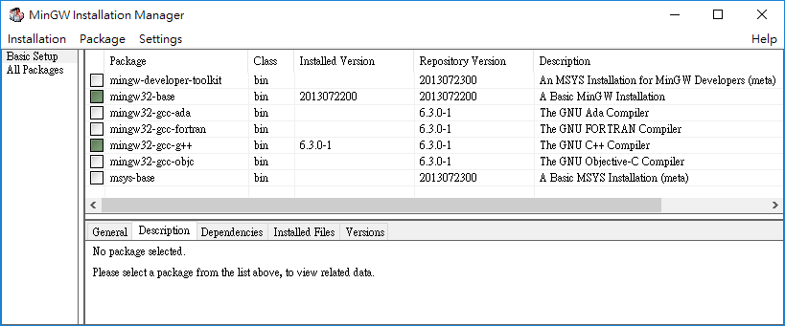
Install MinGW

Slide 76
Build GLFW
mkdir build
cd build
cmake .. -G "MinGW Makefiles"
mingw32-make

Slide 77
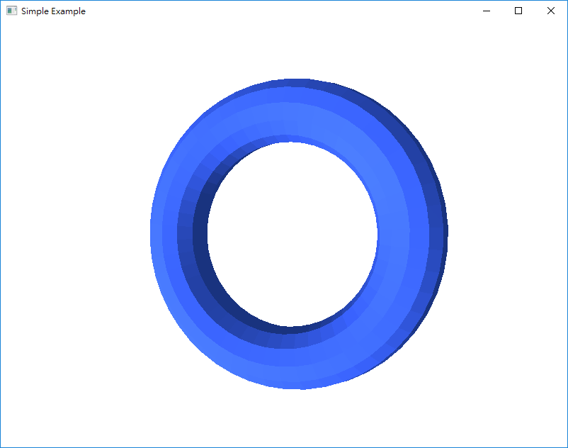
Homework
Modify ObjRender project and write a program to generate a torus instead of load obj file.

