Slide 1
Presentation Paper
“Learning the Change for Automatic Image Cropping”
The paper of CVPR2013
Student: Le Thi Ngoc Hanh
Id: P76077052

Slide 2
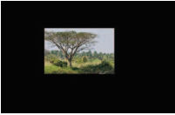
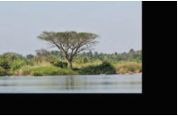
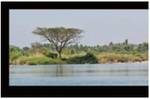
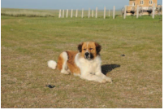
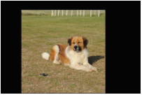
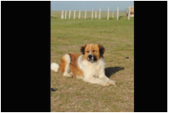
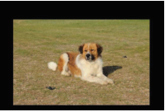
Introduction

Slide 3
Previous work
attention - based
aesthetics - based
Method | (1) Focus on main subject or principle region (2) Search for a crop window | Center on composition – related image properties

Slide 4
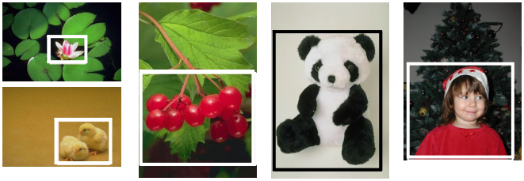
Related works: attention -based
[6] G. Ciocca, C. Cusano, F. Gasparini, and R. Schettini. SelfAdaptive Image Cropping for Small Displays. IEEE Trans.Consumer Electronics
Detect a subject region based on human faces, skin color and/or high saliency map values
→ place a bounding box around it
Notes:
Some works search for region with the highest attention score and place the crop window around it
Some methods search for a crop window that would receive the greatest attention

Slide 5
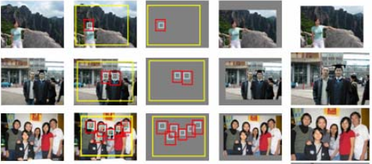
Related works: attention -based
[26] M. Zhang, L. Zhang, Y. Sun, L. Feng, and W. Ma. Auto cropping for digital photographs. In ICME, 2005
Use face detection to find regions of interest, and then crop the image in a manner that aligns the faces according to one of 14 predefined templates
Notes:
Some works search for region with the highest attention score and place the crop window around it
Some methods search for a crop window that would receive the greatest attention

Slide 6
Related works
attention - based
aesthetics - based
Method | (1) Focus on main subject or principle region (2) Search for a crop window | Center on composition – related image properties

Slide 7
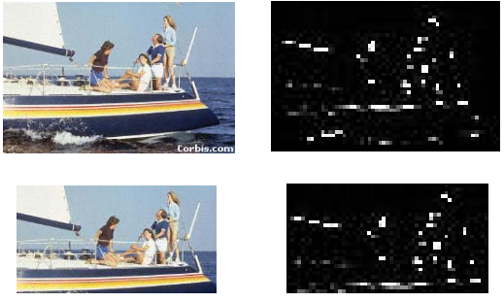
Related works: attention -based
[21] B. Suh, H. Ling, B. B. B., and D. W. Jacobs. Automatic thumbnail cropping and its effectiveness. In ACM Symp. UIST, pages 95–104, 2003
Determined crops based on the summed saliency values of candidate windows
Notes:
While the attention-based approach to image cropping helps to remove unnecessary content from an image, it gives little consideration to overall image composition, and thus may lead to a result that is not visually pleasing

Slide 8
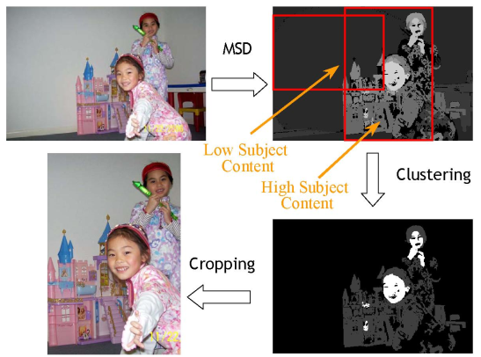
Related works: attention -based
[12] J. Luo. Subject content-based intelligent cropping of digital photos. In ICME, pages 2218–2221, 2007
Computed a subject belief map and found the window that maximizes subject content
Notes:
While the attention-based approach to image cropping helps to remove unnecessary content from an image, it gives little consideration to overall image composition, and thus may lead to a result that is not visually pleasing

Slide 9
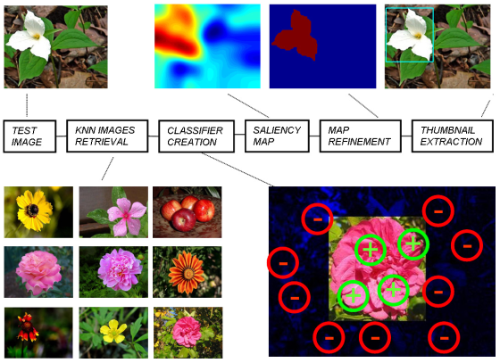
Related works: attention -based
[16] L. Marchesotti, C. Cifarelli, and G. Csurka. A framework for visual saliency detection with applications to image thumbnailing. In ICCV, pages 2232–2239, 2009
Trained a classifier based on an annotated image database to determine salient regions and selected the largest, most central region as a thumbnail
Notes:
While the attention-based approach to image cropping helps to remove unnecessary content from an image, it gives little consideration to overall image composition, and thus may lead to a result that is not visually pleasing

Slide 10
Related works
attention - based
aesthetics - based
Method | (1) Focus on main subject or principle region (2) Search for a crop window | Center on composition – related image properties

Slide 11
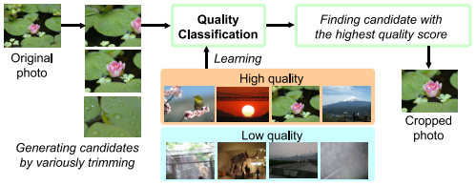
Related works: aesthetics -based
[17] M. Nishiyama, T. Okabe, Y. Sato, and I. Sato. Sensationbased photo cropping. In ACM Multimedia, 2009
Trained an SVM to label subject regions of a photo as high or low quality, then find the cropping candidate with the highest quality score

Slide 12
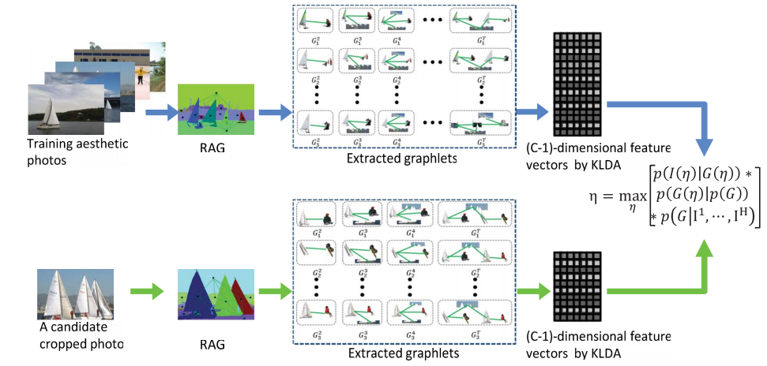
Related works: aesthetics -based
[25] L. Zhang, M. Song, Q. Zhao, X. Liu, J. Bu, and C.Chen. Probabilistic graphlet transfer for photo cropping. IEEE Trans. Image Proc., 2012
Learned local aesthetic features based on position relationships among regions, and used this to measure the quality of cropping candidates

Slide 13
Previous work
attention - based
aesthetics - based
Method | (1) Focus on main subject or principle region (2) Search for a crop window | Center on composition – related image properties
Weakness | While the attention-based approach to image cropping helps to remove unnecessary content from an image, it gives little consideration to overall image composition, and thus may lead to a result that is not visually pleasing | It may change an image differently than a human would, place crop boundaries through regions that are better included or removed as a whole, or maintain distracting content

Slide 14
Proposed approach
Present the technique that directly accounts for aesthetic evaluation in determining the crop boundaries of an input image.
The features that model what is removed or changed in an image by a crop.

Slide 15
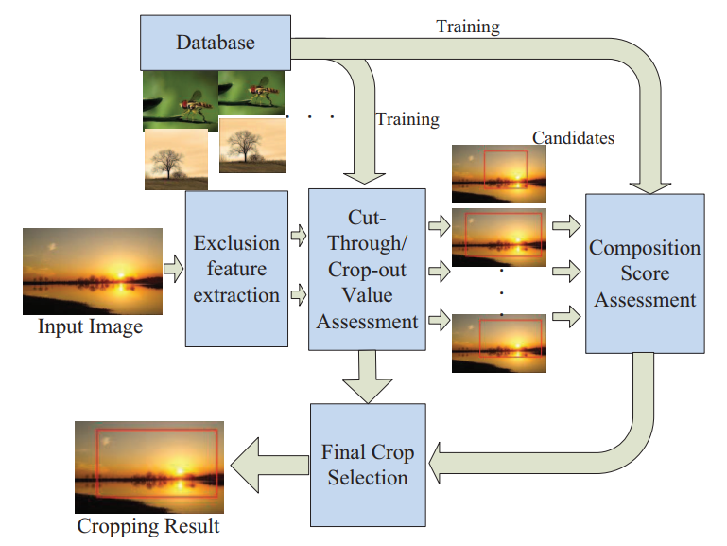
Proposed approach - Block Diagram

Slide 16
Training set construction
Each image is manually cropped by 3 expert photographers
Each crop → record the upper left corner (x₁, y₁) and lower right corner (x₂, y₂)
Providing up to 3 reasons for choosing the crop window

Slide 17
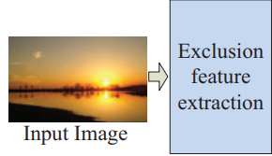
Feature extraction
Image decomposition
Exclusion feature
Composition feature
[ To obtain the foreground region]
[ To specify what type of regions are often exclude from final crops]
[ Related feature such as: visual balance, the rule of thirds]

Slide 18
Image decomposition
Augment the foreground detection by incorporating a human face detector into the saliency map computation
The remainder of the image is then segmented using the graph-based

Slide 19
Feature extraction
Image decomposition
Exclusion feature
Composition feature
[ To obtain the foreground region]
[ To specify what type of regions are often exclude from final crops]
[ Related feature such as: visual balance, the rule of thirds]

Slide 20
Exclusion feature
crop-out value
/* Indicates the likelihood that a region with a certain set of features will be cropped out of an image */
Exclusion features
cut-through value
/* represents the chance that a crop boundary will pass through a region with certain properties */

Slide 21
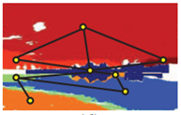
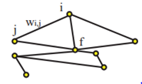
Exclusion feature
To isolate a region from the foreground
→ construct a graph for all the regions in the image
The link cost is calculated as:
w_{i,j}: the connection weight between region i & j
DH_{i,j}: texture distance between region i & j
DC_{i,j}: color distance between region i & j
M_{i}, M_{j}: areas of region i & j respectively
Notes:
Color distance: Compute the Euler distance between regions → the minimum colors distance to any of those regions is used
Texture distance: Histograms of oriented gradients for human detection
Then, texture differences are calculated as the Euler distance between the HOG features of two regions

Slide 22
Shape complexity
The shape complexity of a region → deciding whether to crop it out or cut it through
Use the high-frequency component of the region’s boundary, computed as the sum of all Fourier descriptors except for the first six

Slide 23
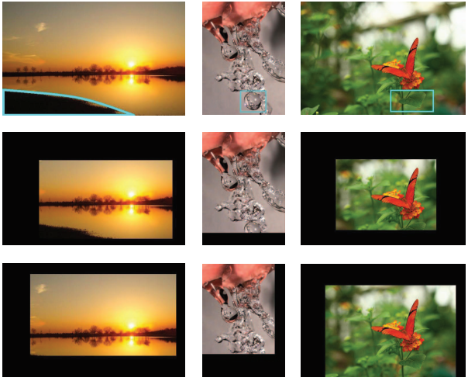
Sharpness
A region with a complex shape may be more desirable to cut through than one with a simpler

Slide 24
Sharpness
The sharpness of a region → influence region exclusion
Model region sharpness by taking the ratio of the region’s high frequency power to its total power

Slide 25
Composition feature
Positive examples: expert crops from training set
Negative example:
Then use SVM regression to predict the probability of a given crop to be a positive example → composition score
Notes:
Composition means the organization of all the graphic elements inside a photo. Good composition can clearly show the audience the photo’s topic and effectively express photographer’s feeling
Contrast between light and dark, between shapes, colors, and even sensations, is the basis for composing a photo

Slide 26
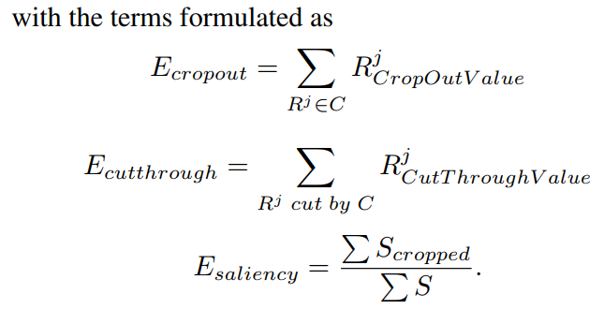
Crop selection
Utilize exclusion features to identify a set of candidates

Slide 27
Crop selection
Evaluate each of candidate:
The crop that minimizes E_{final} is selected as the final crop

Slide 28
Result

Slide 29
Result

Slide 30
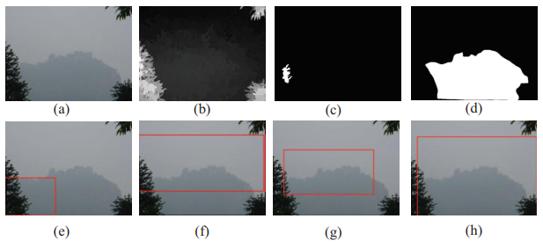
Discussion
An incorrect foreground detection result, which is generally caused by poor saliency map estimation, will lead to low cropping quality

