Slide 1
Selecting Suitable Image Retargeting Methods with Multi-instance Multi-label Learning
Muyang Song, Tongwei Ren, Yan Liu, Jia Bei, and Zhihong Zhao

Slide 2
Introduction

Slide 3
Introduction
Image retargeting methods:
  Seam carving
  Non-homogeneous warping
  Scale-and-Stretch method
  Multi-operator method
  Shift map method
  Streaming video method
Each image retargeting method succeeds on some images but fails on others.

Slide 4
Introduction
An institutive strategy is generating target images with different image retargeting methods, and selecting the good results from them.
A better strategy is selecting the suitable methods from all candidate methods, and generating the target images by the selected methods.

Slide 5
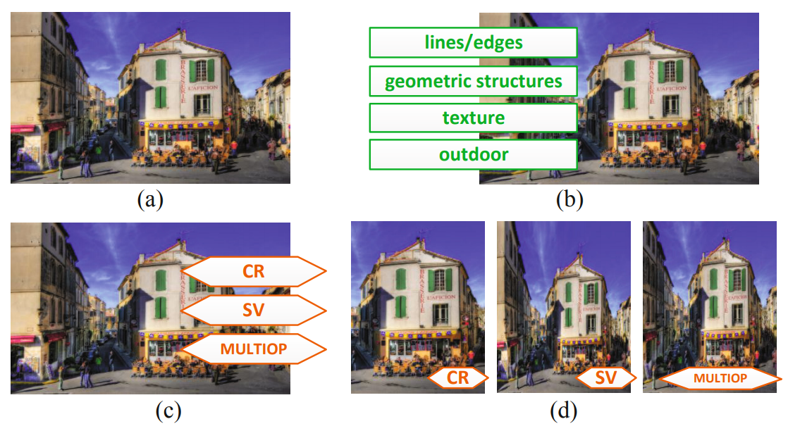
Introduction

Slide 6
Image Retargeting Methods Selection

Slide 7
Image Characteristic Analysis
Designate some easy-to-find features and ask the users to manually annotate these features to represent original image characteristic accurately.

Slide 8
Selection Using Multi-instance Multi-label Learning
Treat an image feature as an instance and a suitable retargeting method as a label.
Each image may have multiple features and multiple suitable retargeting methods.
The selection of suitable image retargeting methods can be represented as a multi-instance multi-label learning problem.

Slide 9
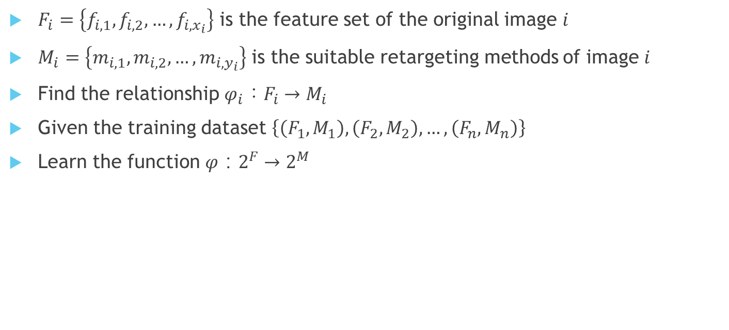
Selection Using Multi-instance Multi-label Learning
$F_{i}=\left\{f_{i,1}, f_{i,2}, …, f_{i,x_{i}}\right\}$ is the feature set of the original image $i$
$M_{i}=\left\{m_{i,1}, m_{i,2}, …, m_{i,y_{i}}\right\}$ is the suitable retargeting methods of image $i$
Find the relationship $φ_{i}：F_{i}→M_{i}$
Given the training dataset $\left\{\left(F_{1},M_{1}\right), \left(F_{2},M_{2}\right), …, \left(F_{n},M_{n}\right)\right\}$
Learn the function $φ：2^{F}→2^{M}$

Slide 10

Selection Using Multi-instance Multi-label Learning
This paper solve the problem with MIMLSVM algorithm
  Zhou, Z.H., Zhang, M.L., Huang, S.J., Li, Y.F.: Multi-instance Multi-label Learning. Artificial Intelligence 176(1), 2291–2320 (2012)
Collect all $F_{i}$ from the training dataset and put them into a dataset $F_{train}$
Carry out k-medoids clustering on $F_{train}$ using Hausdorff distance

Slide 11
K-Medoids Clustering
給定k的值，隨機挑選k個點作為每一個群(cluster)的中心點(medoids)
計算剩下的每個點和每個群的中心點的距離，距離哪個群的中心點最近，那個點就會被分到那個群
重新計算每個群的中心點：將群中的點兩兩算出距離，新的中心點就是與其它點的距離和最小的那一個
重複第二和第三個步驟，直到整個群不再變化

Slide 12

Hausdorff Distance
描述兩組點集合之間相似程度的一種量度
  假設有兩組集合$A=\left\{a_{1}, …, a_{p}\right\}$和$B=\left\{b_{1}, …, b_{q}\right\}$
  $H\left(A,B\right)=max\left\{h\left(A,B\right), h(B,A)\right\}$
  $h\left(A,B\right)=\max_{aεA}\left\{\min_{bεB}\left\{d(a,b)\right\}\right\}$

Slide 13
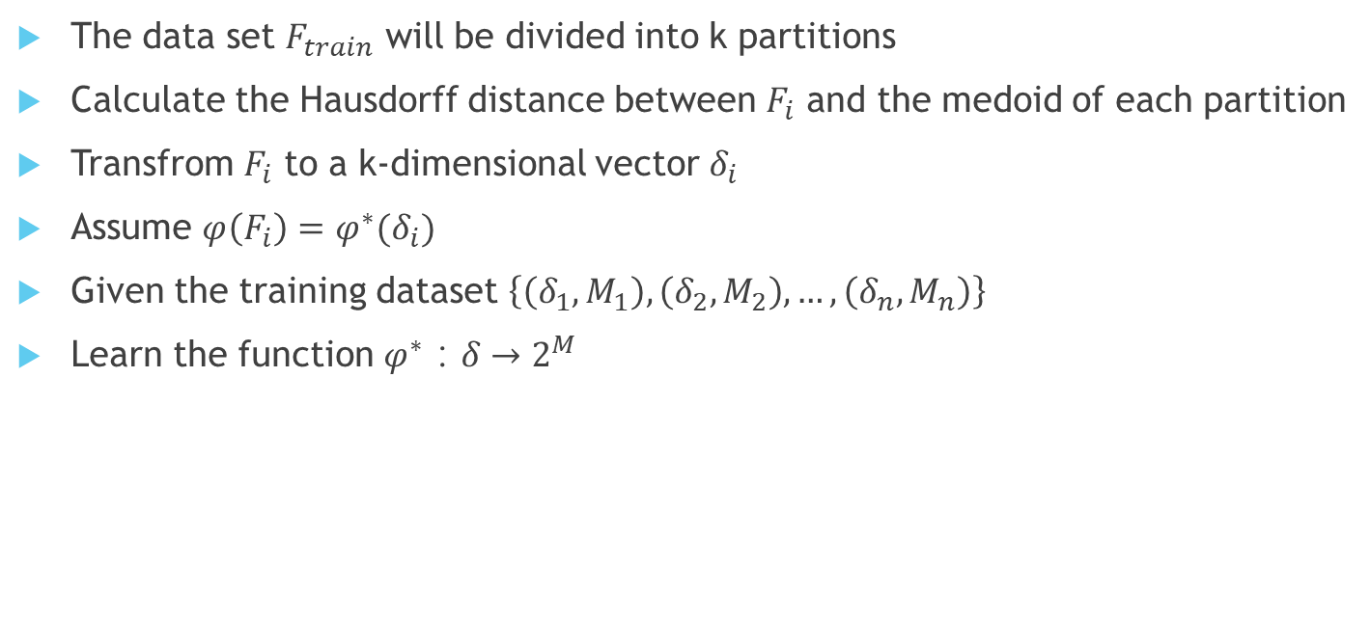
Selection Using Multi-instance Multi-label Learning
The data set $F_{train}$ will be divided into k partitions
Calculate the Hausdorff distance between $F_{i}$ and the medoid of each partition
Transfrom $F_{i}$ to a k-dimensional vector $δ_{i}$
Assume $φ\left(F_{i}\right)=φ^{∗}(δ_{i})$
Given the training dataset $\left\{\left(δ_{1},M_{1}\right), \left(δ_{2},M_{2}\right), …, \left(δ_{n},M_{n}\right)\right\}$
Learn the function $φ^{∗}：δ→2^{M}$

Slide 14
Experiments

Slide 15
Dataset
RetargetMe
Randomly divide the dataset into 10 groups, use 9 groups as training data and the other group as testing data

Slide 16
Dataset
Features:
  Lines/edges
  Faces/people
  Texture
  Foreground objects
  Geometric structures
  Symmetry
  Outdoors
  Indoors

Slide 17
Dataset
Image retargeting methods:
  Seam carving (SC)
  Non-homogeneous warping (WARP)
  Scale-and-stretch (SNS)
  Multi-operator (MULTIOP)
  Shift-maps (SM)
  Streaming video (SV)
  Uniform scaling (SCL)
  Manual cropping (CR)

Slide 18
Results
RetargetMe provides manual evaluation results of target image quality.
For each original image, if the number of votes of a target image is not less than 80% of the highest vote of all the target images generated from it, this paper will treat the corresponding image retargeting method as a suitable method for this original image.

Slide 19
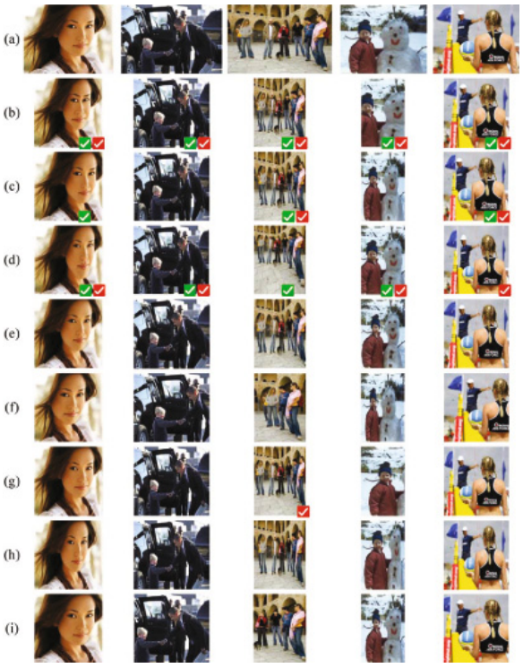
Results
(a) Original image
(b) Seam carving (SC)
(c) Non-homogeneous warping (WARP)
(d) Scale-and-stretch (SNS)
(e) Multi-operator (MULTIOP)
(f) Shift-maps (SM)
(g) Streaming video (SV)
(h) Uniform scaling (SCL)
(i) Cropping (CR)

Slide 20
Comparison
Compare the proposed approach with automatic quality assessment based selection strategy
  Bidirectional similarity (BDS)
  Bidirectional warping (BDW)
  Edge histogram (EH)
  Color layout (CL)
  SIFT-flow (SIFTflow)
  Earth-mover’s distance (EMD)
Calculate precision, recall F1 measure and hit-rate of each method

Slide 21
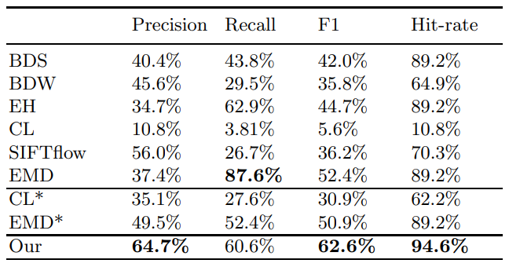
Comparison

Slide 22
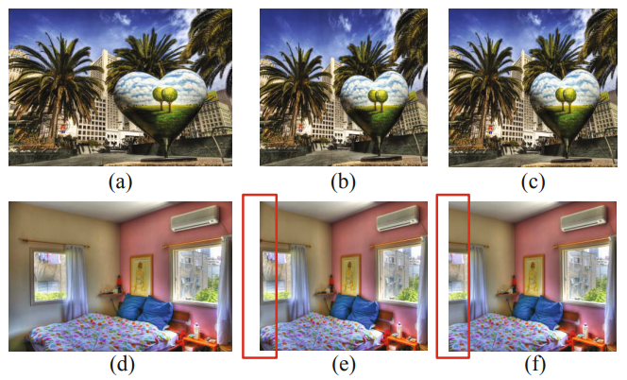
Discussion

Slide 23
Conclusion

Slide 24
Conclusion
In this paper, we propose an image retargeting method selection approach based on the characteristics of original image.
Select the suitable image retargeting methods for a given image based on several simple features of the original image.
The future work will focus on enlarging the dataset and re-label the ground truth of suitable retargeting method manually.

