Slide 1
Paper Presentation – CG Fall 2019

Slide 2
Published in: 2016 IEEE International Conference on Acoustics, Speech and Signal Processing (ICASSP)
Presenter: Le Ngoc Hanh

Slide 3
Outline
Introduction
Geometric change estimation
Aspect Ratio Similarity (ARS)
Conclusion

Slide 4
Outline
Introduction
Geometric change estimation
Aspect Ratio Similarity (ARS)
Conclusion

Slide 5
1. Introduction
(*): Content Aware Image Retargeting
CAIR* operator
Retargeted image
Size: h’ x w’
Requirements
Original image
Size: H x W
Preserve visually important content and structure
Limit the visual distortions

Slide 6
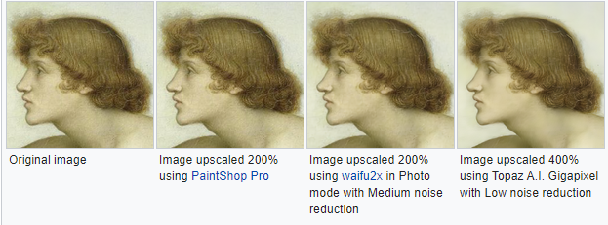
1. Introduction
(*): source from wikipedia
From its beginning, traditional resizing methods:
(*)
Drawback: poor viewing
(*)
Drawback: the context information may get lost

Slide 7
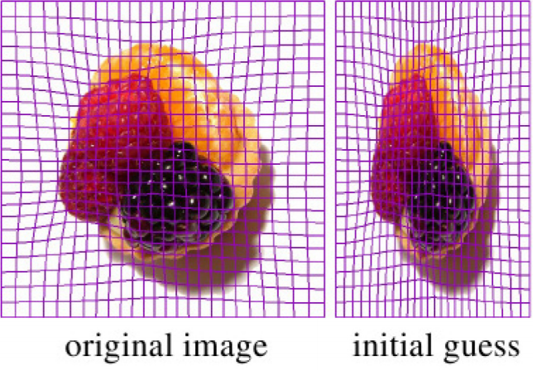
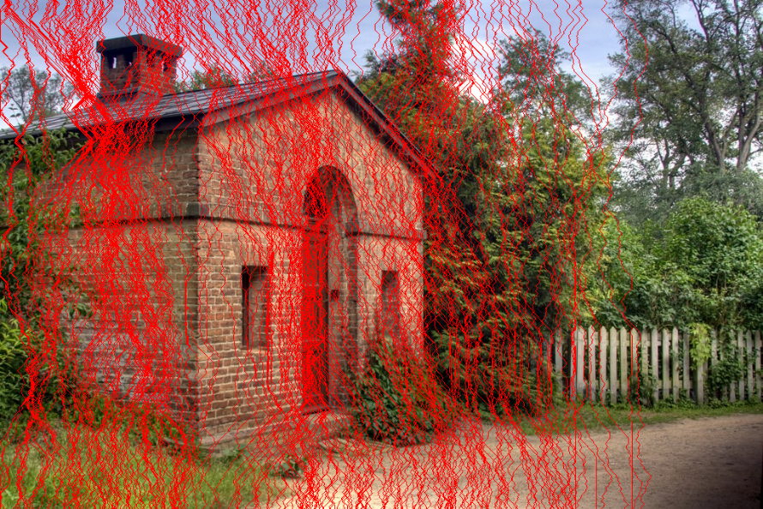
1. Introduction
CAIR operators
Discrete methods:
Treat images as pixels → the deformation is mainly due to the retention or discarding of content.
[Seam Carving, Cropping, Shift-Map]
Continuous methods:
Add a deformed mesh → then resize the mesh under constraint equations.
[Scaling, Scale-and-Stretch, Streaming Video, Warping]

Slide 8
1. Introduction
(*): Content Aware Image Retargeting
CAIR* operator
Retargeted image
Size: h’ x w’
Requirements
Original image
Size: H x W
Preserve visually important content and structure
Limit the visual distortions
Quality for the images after retargeting!!!

Slide 9
1. Introduction
Some previous works related to measuring the quality of the Image Retargeting.

Slide 10
1. Introdution

Slide 11
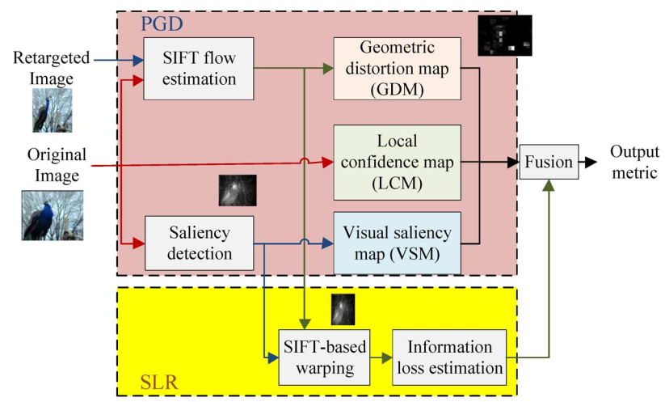
1. Introduction

Slide 12
1. Introduction

Slide 13
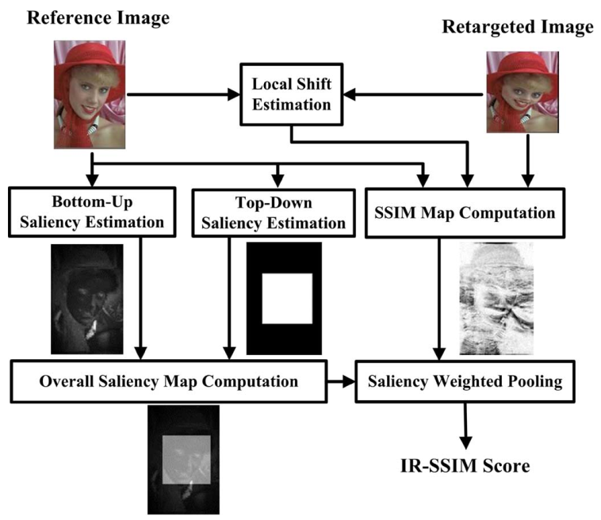
1. Introduction

Slide 14
1. Introduction
Major drawback of these works:
The removed or squeezed image content in original image are allowed to be matched with pixles in the retargeted image .
→ they are not necessary and inhibit the estimation of real geometric change.

Slide 15
Outline
Introduction
Geometric change estimation
Aspect Ratio Similarity (ARS)
Conclusion

Slide 16
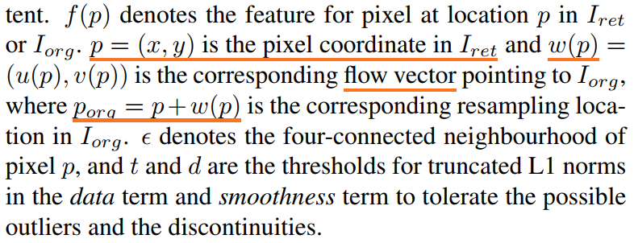
2. Geometric change estimation
$$I_{org}$$
Find resampling location for each pixel
$$I_{ret}$$
Matching energy function: consider about the data term and smoothness term.

Slide 18
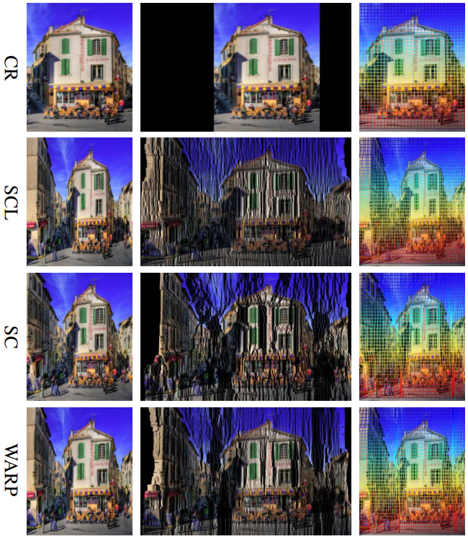
Base on the geometric change, we can:
Estimate the cropping window ideally for CR;
Find out the uniform squeeze for SCL;
Effectively recover the removed seams for SC;
Estimate the seriously warped region for WARP.

Slide 19
2. Geometric change estimation
Base on the geometric change, we can:
Estimate the cropping window ideally for CR;
Find out the uniform squeeze for SCL;
Effectively recover the removed seams for SC;
Estimate the seriously warped region for WARP.
Almost all the quality degradation in the retargeted image is related to the geometric change .
Based what we estimate, the visual quality of the retargeted image can be effectively evaluated

Slide 20
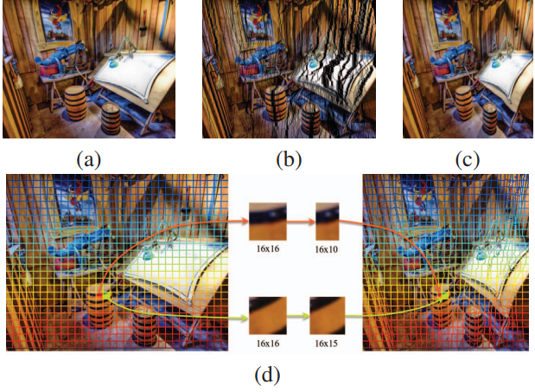
2. Geometric change estimation
Geometric change is the major reason for quality degradation of the retargeted image (IR).
→ Propose a measurement of quality of IR based on the estimation and evaluation of the geometric change.

Slide 21
Outline
Introduction
Geometric change estimation
Aspect Ratio Similarity (ARS)
Conclusion

Slide 22
3. Aspect Ratio Similarity (ARS)
Original image (O)
Retargeted image(R)
Estimate locations for all the pixels in (R)
Establish the local geometric change from (O) to (R) by dividing (O) and (R) into blocks. The ARS of each block pair indicate its information loss and visual distortion.

Slide 23
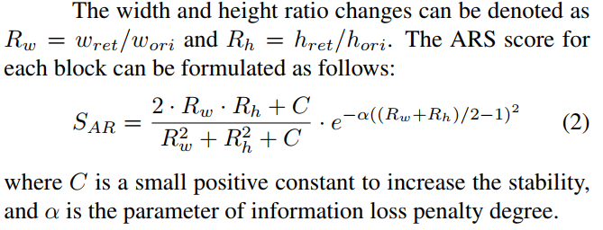
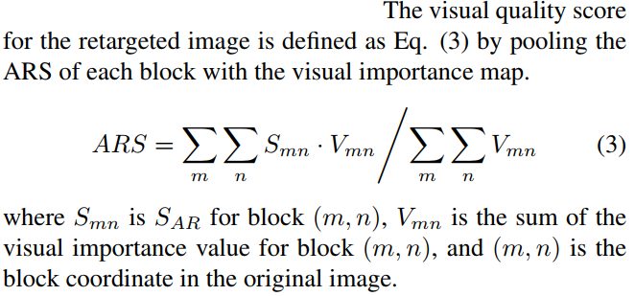
3. Aspect Ratio Similarity (ARS)
Define the saliency map → to obtain the perceptual quality for the whole image

Slide 24
3. Aspect Ratio Similarity (ARS)
close or equal to zero, it indicates that the retargeted block is suffering from serious information loss and distortion or even removed totally .
close to 1, the block content in original image is generally kept in high quality in retargeted image.

Slide 25
Outline
Introduction
Geometric change estimation
Aspect Ratio Similarity (ARS)
Conclusion

Slide 26
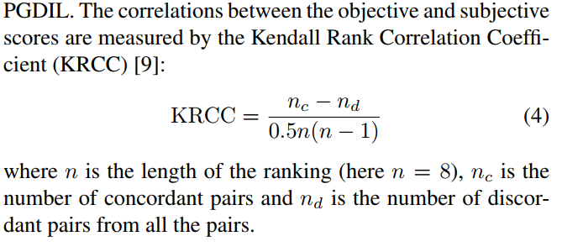
4. Conclusion

Slide 27
4. Conclusion
Contributions:
All the quality degradation in the retargeted image is related to the geometric change → this paper propose an ARS metric on the estimation and evaluation of the geometric change during image retargeting.
Compared to other state-of-the-art methods in the widely used dataset, the ARS metric yields statistically better results in the prediction accuracy.
Drawback:
ARS does not detect the overall structure change of the image → this evalution is not comprehensive.
What if the saliency map method employed in this research is not good?

Slide 28
End.
Thanks for your listening

