Slide 1
BendSketch: Modeling Freeform Surfaces Through 2D Sketching
CHANGJIAN LI, The University of Hong Kong and Microsoft Research Asia HAO PAN, YANG LIU, and XIN TONG, Microsoft Research Asia
ALLA SHEFFER, University of British Columbia
WENPING WANG, The University of Hong Kong

Slide 2
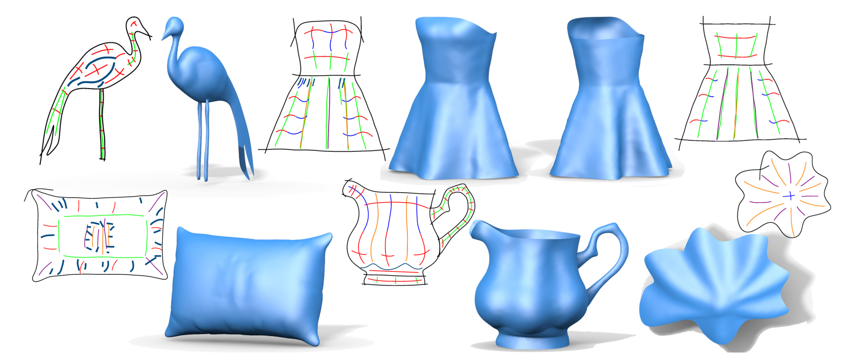
Introduction
Sketch-based modeling provides a powerful paradigm for geometric modeling
While existing sketching tools, they are not well suited for designing free form surface with complex curvature patterns

Slide 3
Surface Sketching Pipeline
Notes:
the input strokes parsed with labeling of convexity (red/blue for convex/concave)
the 2D domain mesh
the 2D 4-direction field modeling curvature directions
the finally solved 2D curvature field with curvature directions and magnitudes (red/blue for positive/negative curvatures)
the solved surface

Slide 4
Stroke Types
Boundry
Bending stroke
Sharp feature
Ridge/Valley
Flat stroke
Contour
Notes:
• boundary - where the surface discontinues,
• bending stroke - projection of a principal curvature line of the spatial surface, can represent convex/concave surface curvature,
• sharp feature - a curve across which the normal vectors change discontinuously with convex/concave angles,
• ridge/valley - a curve across which the surface always bends back/forward,
• flat stroke - a curve along which the surface has no bending,
• contour - boundary with known surface normal directions, or object silhouette

Slide 5
Stroke Parsing
Simple Stroke : given a stroke $s{\left(t\right)}_{ },t∈$ $[0,1]$ $,$ the signed curvature $k\left(t\right)=\frac{\det\left(s^{′}\left(t\right),s^{′′}\left(t\right)\right)}{{\left\|s^{′}\left(t\right)\right\|}^{3}}$ ; if $k≥0$ (planar convex) or $k≤0$ (planar concave) , the stroke is a simple stroke, denote as $sⅈgn\left(s,\vec{T}\right)∈\left\{+,−\right\}$
The input stroke are first segmented into simple strokes, a graph $G=\left(v,ε\right)$ is built. $v$ : simple strokes, $ε$ : relation of two simple strokes
Then we solve the following standard graph labeling problem:
$$min .E{\left(x\right)}^{ }=\sum_{s∈V}{θ\left(x_{s}\right)}+\sum_{\left(s,t\right)∈ε}{θ\left(x_{s},x_{t}\right)} (1)$$
$$x_{s}∈\left\{0,1\right\}$$
$$θ(0)=0.4$$
$$θ(1)=0.6$$
$$θ\left(0,0\right)=θ\left(1,1\right)=0.0$$
$θ\left(1,0\right)=θ\left(0,1\right)=$ 1.0
Notes:
給定一個2d bending strokes集合散佈在sketching domain
我們要如何知道stroke的特性
如上所示 一條stroke的curvature算法為:
我們可以選擇沿著特定方向走 然後算出來的k>0就說是planar convex反之亦然
我們可以透過觀察得到以下stroke之間的特性:
a simple stroke is slightly more likely to be convex (the convex prior);
two sequential simple strokes with the same/opposite planar convexity are likely to have the same/opposite convexity properties;
two parallel simple strokes with the same planar convexity are likely to have the same convexity property.
where the labeling xs ∈ {0, 1} denotes if the stroke s is convex or concave.

Slide 6
Relation of Convex/Concave Properties
Notes:
這裡可以看到s0 s2兩條連續的stroke
S0, s1則是平行的兩條stroke
確認兩條stroke關係的條件為$α0=α2=$15度
Alpha1= 20度
d = D/30, D代表bounding box的對角線長度

Slide 7
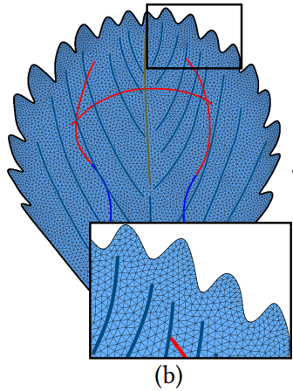
Domain Triangulation
Triangulate the 2d domain $Ω$ defined by the boundary curves $Γ$ into a planar mesh $M$
Use the Delaunay Refinement Algorithm to generate mesh [CGA 2016]
Notes:
we triangulate the 2D
domain Ω dened by the boundary curves Γ into a planar mesh M,

Slide 8
Surface from curvature fieild
Problem formulation. Let the spatial surface be parameterized as Monge patch over the 2D domain
Spatial surface $z=f\left(x,y\right),\left(x,y\right)∈Ω$
The Weingarten shape operator $ⅆN:w→w^{′},w,w^{′}∈R^{2}$
$ⅆN=−ІІG^{−1},G$ : first fundamental forms of the surface, $ІІ$ : second fundamental forms of the surface
As such, given a curvature field we can infer the surface shape through minimizing the following energy:
$$E_{match}\left(z\right)≡\frac{1}{\left|Ω\right|}\int_{Ω}^{ }{{\left\|ⅆN⋅u−λ_{u}u\right\|}^{2}+{\left\|ⅆN⋅v−λ_{v}v\right\|}^{2}ⅆσ} (2)$$
Notes:
假定spatial surface 被參數化成monge patch 定義如上
dN那一串: 是一個 linear mapping 把右下角那些性質encode起來 也就是w就是右下角這個性質
包含principal curvature direction / magnitude

Slide 9
Curvature Field Computation
Curvature direction field : regulate the principal curvature directions of a smooth surface as projected on a plane [Iarussi et al. 2015]
Curvature magnitude field : regulate the principal curvature values through minimizing the following energy
$$E_{bend_field}\left(u,v\right)≡\frac{1}{\left|Ω\right|}\int_{Ω}^{ }{{\left\|∇_{u}v\right\|}^{2}}+{\left\|∇_{v}u \right\|}^{2}ⅆσ$$
$$E_{λ}\left(λ_{u},λ_{v}\right)≡\frac{1}{\left|Ω\right|}\int_{Ω}^{ }{{\left\|∇_{u}λ_{v}\right\|}^{2}}+{\left\|∇_{v}λ_{u}\right\|}^{2}+β\left({\left\|∇_{u}λ_{u}\right\|}^{2}+{\left\|∇_{v}λ_{v}\right\|}^{2}\right)ⅆσ$$
Notes:
接下來我們要在給定bending stroke的前提下算curvature field
The curvature direction field {u, v} is defined as a piecewise constant
non-orthogonal 4-direction field over M, and
the curvature magnitude field {λu, λv } is defined similarly as two
piecewise constant scalar fields.

Slide 10
Joint Optimization of Surface and Curvature
We solve the height field surface and curvature magnitudes through two major step
Initial guess of the surface shape
Iteratively update both the curvature value along the stroked and the surface shape
Initialization
Initial estimation of the surface to escape the trivial solution of a flat surface
For each simple bending stroke, assign to the whole stroke a constant absolute spatial curvature value $μ>0$
Joint optimization (iterative process)
(1) Estimate principal curvatures by analyzing the lifted strokes
(2) Diffuse curvature values through minimizing $E_{λ}$
(3) Update surface shape by minimizing $E_{match}$ for one iteration
Notes:
有 initial guess才不會有平面的結果產生(這會使得E match的term得到最小值)
Init玩了以後開始解E bend field跟 E lambda 根據bending strok的constraint
但因為我們只要init guess的平面 non-linear的E match並不會在這一個階段完全解完
得到init的平面後才是joint opt
被兩個因素影響 : 1.stroke的spatial shape(會嵌入在表面中)2.表面的orientation相對於projection direction

Slide 11
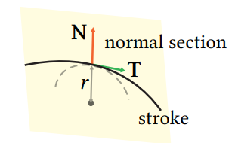
Estimating Principal Curvatures
To estimate the principal curvature along a bending curve, we lift the planar curve to the current spatial surface
For each point in the lifted curve, the normal
section plane is spanned by the surface nor-
mal N at the point and the curve tangent T.
On which we project a neighborhood of the spatialcurve, and fit a circle to the projected image.
Notes:
The neighborhood size to estimate curvature with should be chosen:
if the neighborhood is too big, the estimated curvature can be too conservative and inexible,
while a size too small causes instability and inaccuracy due to the locally noisy shape of the lifted stroke
For fast computation, we simply divide a lifted stroke into segments of approximate length D/30
and estimate the curvature for each segment
which is then assigned to stroke points belonging to the segment
To carry out the circle tting for curvature estimation,
we minimize the standard geometric tting error, plus a regularization of radius for robustness:
最後一張圖片(公式)的註解:
where {pi } are the points to be tted,
(c,r) dene the circle,
and µ = 2 ×10−5 is a very small weight.
This optimization is a nonlinear least square problem with only 3 variables and is solved by GaussNewton iterations.

Slide 12
User Adjustment
Surface may differ from user expectation
Stroke are sketch with insufficient accuracy
The bas-relief ambiguity
Modification of sketched strokes
When the curvature along selected parts of stroked are scaled, the curvature magnitude field is recomputed by minimizing $E_{λ}$ under new constraints, and the surface is updated by fully optimizing $E_{match}$

Slide 13
Boundary Conditions
To determine a unique surface, we still need sufficient boundary constraints
Positional constraint – all boundary points should be close to the drawing plane or a specified boundary curve $z_{0}\left(p\right)$, which amounts to penalizing $\frac{ω_{0}}{\left|Γ\right|}\int_{p∈Γ}^{ }{{\left(z\left(p\right)−z_{0}\left(p\right)\right)}^{2}}ⅆp$, where $z_{0}\left(p\right)=0$ for planar boundary.
Regularity constrant – the boundary curve should be smooth in space, by penalizing the variation of heights $\frac{ω_{1}}{\left|Γ\right|}\int_{p∈Γ}^{ }{{z^{′}\left(p\right)}^{2}}ⅆp$
Notes:
Here ω0,ω1 > 0 are weights, |Γ| is the length of boundary curve.
The sum of the two terms denoted Ebdry , a quadratic function of z, is added to Ematch when solving for the height eld surface

Slide 14
Result

Slide 15
Result

Slide 16
Result

Slide 17
Result

Slide 18
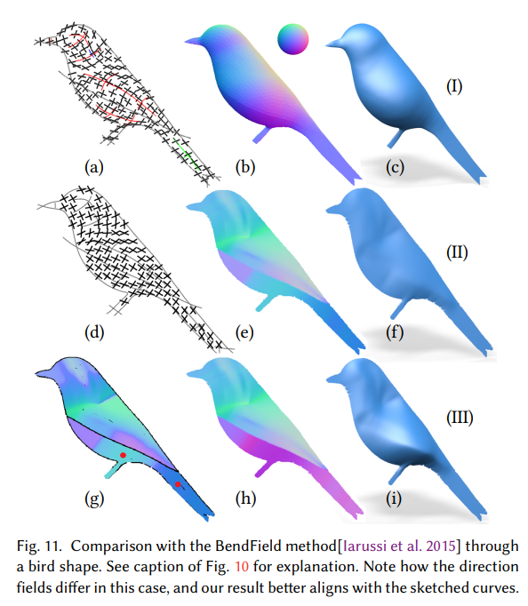
Comparison

Slide 19
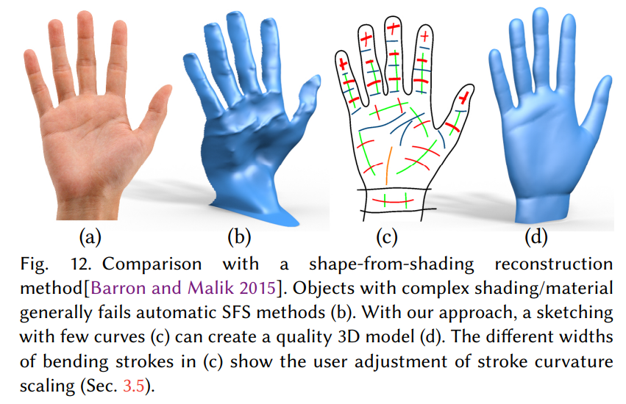
Comparison

Slide 20
Comparison

Slide 21
Appendix
Discretization of $ⅆN$
For each triangle $Δ_{ijk}∈M$ with vertices indexed by i, j, k, the gradient of height field function over the triangle is
$$∇f={\left(f_{x}^{′},f_{y}^{′}\right)}^{T}=\left(f_{j}−f_{i}\right)\frac{{\left(x_{i}−x_{k}\right)}^{⊥}}{2A_{ijk}}+\left(f_{k}−f_{j}\right)\frac{{\left(x_{j}−x_{i}\right)}^{⊥}}{2A_{ijk}}$$

Slide 22
Appendix

