Slide 1
Modeling of Clouds from a Single Photograph

Slide 2
Introduction
Two major approaches to modeling clouds:
- Procedural approach
Low computational cost
Parameters have to be determined manually by trial and error
- Physically based approach
High cost
Only simulating the physical process

Slide 3
Introduction
GOAL：use the photograph as a guide to synthesize that look similar to those in the photograph. (Not reproduce exactly the same clouds.)
Three types of cloud：
Cirrus(卷雲)、Altocumulus(高積雲)、Cumulus(積雲)
Cirrus is generally thin and self-shadows are seldom observed. Therefore, cirrus is modeled as a two-dimensional texture.
Altocumulus and cumulus possess volumetric features and three-dimensional density distributions must be generated.

Slide 4
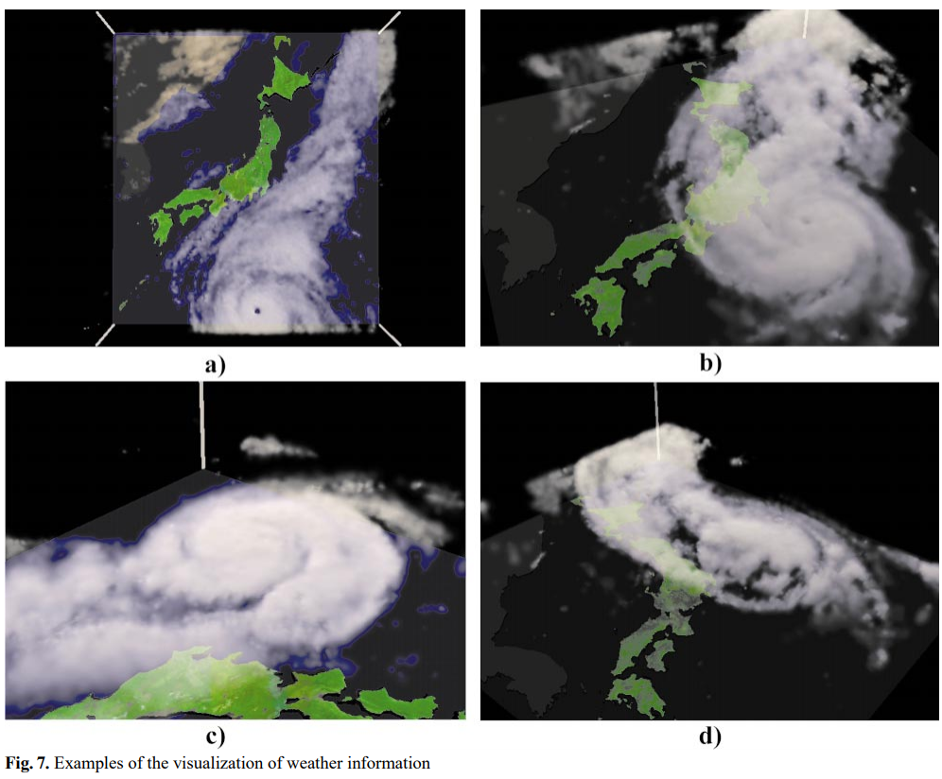
Related Work
DOBASHI Y., NISHITA T., YAMASHITA H., OKITA T.: Using metaballs to modeling and animate clouds from satellite images. The Visual Computer 15, 9 (1998), 471–482.

Slide 5
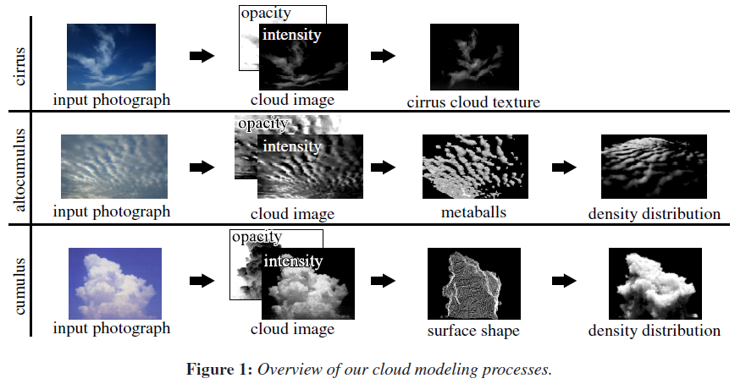
Overview

Slide 6
Calculation of cloud image
The first process is to create the sky image by estimating sky colors behind the clouds in the input image.
Then, the intensity and the opacity of the clouds are calculated by comparing the input photograph with the sky image.

Slide 7
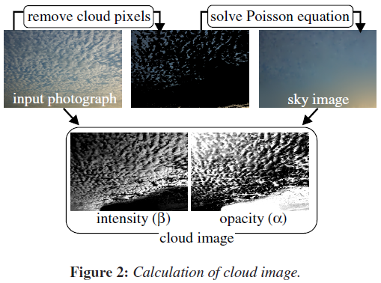
Calculation of cloud image
Calculation of sky image
To create the sky image, each pixel in the input image is roughly classified into either a cloud pixel or a sky pixel, and the cloud pixels are removed
The sky image is created by extending the colors of the surrounding sky pixels into the removed cloud areas

Slide 8
Calculation of cloud image
Intensity of pixel p ：I(p,λ)(λ = R,G,B) ; Threshold：$ε_{c}$
If S(p) < $ε_{c}$ , then pixel p is labeled as a cloud pixel.
Next, the sky image is created by interpolating the colors of the cloud pixels from the surrounding sky colors.Use Poisson image editing to solve for cloud pixel p_{c}

Slide 9
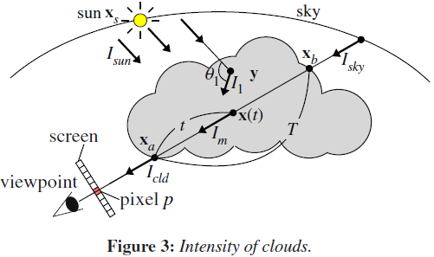
Calculation of cloud image
Calculation of Cloud Intensity and Opacity
The intensity of light reaching point y from the sun and scattered into direction ω is represented by :
λ = wavelength
I_{sun} = sunlight intensity
$ρ$ = density of clouds
F = phase function
θ₁ = phase angle (between sunlight direction and ω)
g(x_{s}, y) = attenuation ratio between Xs and y

Slide 10
Calculation of cloud image
Calculation of Cloud Intensity and Opacity
The intensity of light for k(> 1)th order scattering can be represented by the following recursive equations :
ω’ = direction from y to x
G = the form factor calculated by the geometric
relation between x and y
θ_{k} = angle between ω and ω’
Vc = all the points within the cloud volume

Slide 11
Calculation of cloud image
Calculation of Cloud Intensity and Opacity

Slide 12
Calculation of cloud image
Calculation of Cloud Intensity and Opacity
The intensity of light reaching the viewpoint is obtained by accumulating I_{m} along the viewing ray
The light of the sky behind the clouds also reaches the viewpoint after being attenuated by the cloud particles
T = the thickness of the clouds

Slide 13
Calculation of cloud image
I_{sun}(λ) = i_{sun} c_{sun}(λ)
Combine Eq. (3) and Eq. (4)
α = opacity
β = intensity

Slide 14
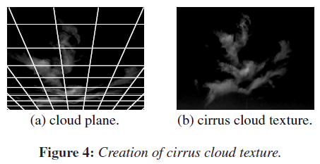
Modeling of clouds
Cirrus(卷雲)
User assumed

Slide 15
Modeling of clouds
Altocumulus(高積雲)
Typically consist of many small cloud cells
The basic idea is to generate a set of metaballs to approximate the cloud image

Slide 16
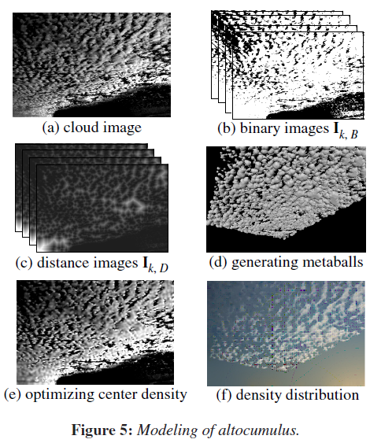
Modeling of clouds
Altocumulus(高積雲)
(b) a set of binary images I_{k,B}(k = 1,2,···,n) are
created by using a set of thresholds for α
(c) a distance transform is applied to each of
I_{k,B} and a distance image, I_{k,D} is created
(d) Each pixel in I_{k,D} stores the distance to the
nearest black pixel. Metaballs are then
generated at the locations of all white pixels of I_{k,B}

Slide 17
Modeling of clouds
Altocumulus(高積雲)
(e) In order to make the synthetic clouds look like those in the input photograph, the center densities of the metaballs are determined so that the cumulative density at each pixel becomes the same as the cloud intensity β(p).
(f) With a similar method to that used for cirrus clouds, the cloud plane is specified by the user, and the center positions of the metaballs are projected onto the plane

Slide 18
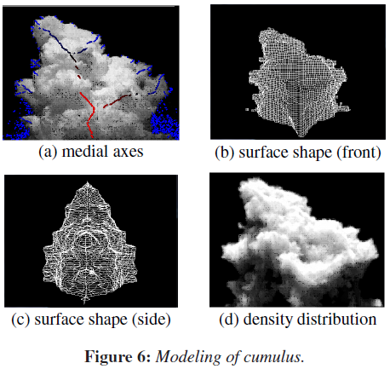
Modeling of clouds
Cumulus(積雲)
(a)
Cloud image is converted into binary image.
Distance transform is applied to the binary image and medial axes are extracted.
The colors of the medial axes correspond to the distances: the blue color corresponds to zero and the red color to the longest distance.
(b) (c)
Minimize the energy function

Slide 19
Modeling of clouds
Cumulus(積雲)
(d) The density distribution inside the surface shape is generated by invoking the Perlin Noise.
First, a binary volume is created by subdividing the bounding box of the surface shape into a regular grid.
Then, the three-dimensional version of the distance transform is applied to the binary volume.
Next, the distance is normalized so that the maximum distance becomes 1.
Use the product of the Perlin noise and the normalized distance as the density at each grid point.

Slide 20
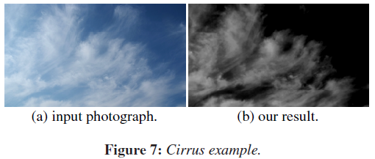
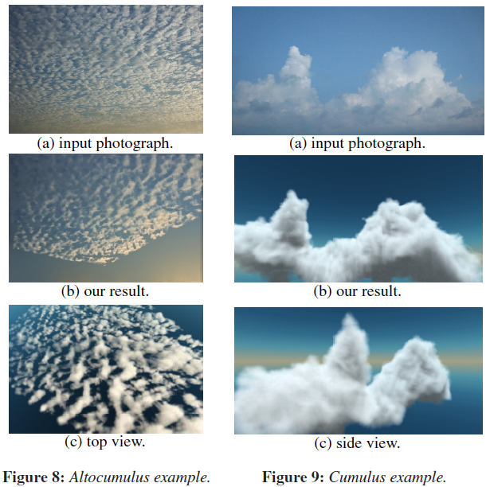
Results

