Slide 1
Opengl implementation
caramelyo

Slide 2
outline
Create a window for OpenGL
Glfw setting
Read an obj file
VAO, VBO and EBO
Rendering
Others
Difference between old and new OpenGL

Slide 3
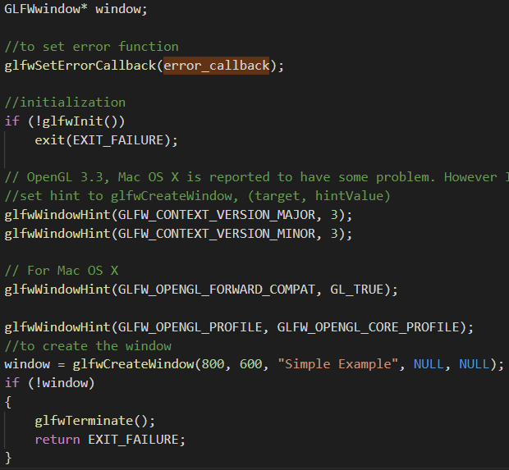
Glfw setting
glfw window initial setting
width && height
end of glfw

Slide 4
Glfw setting
Set current window
How to use glew

Slide 5
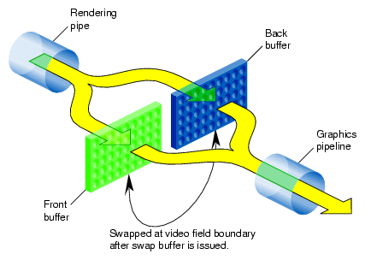
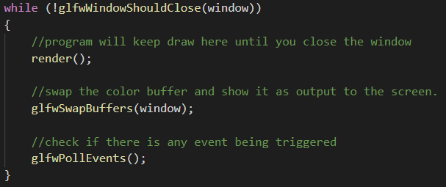
Glfw setting
glfwSwapInterval : set the number of screen updates to wait from the time glfwSwapBuffers was called before swapping the buffers and returning
glfwSwapBuffers : swap frame buffer

Slide 6
Glfw setting
Set key callback(key event)

Slide 7
Glfw setting
Poll events when rendering
The end of glfw

Slide 8
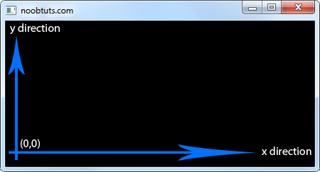
Glfw setting
Set glfw window reshaping callback(optional)
start point
render range

Slide 9
VAO, VBO and EBO
Read an object with tiny_obj_loader

Slide 10
VAO, VBO and EBO
How to specify an object in OpenGL ?
Use VAO, VBO and EBO

Slide 11
VAO, VBO and EBO
VBO : Vertex buffer object. It can store a large number of vertices in the GPU’s memory
It usually stores something like positions, texture coordinates, normal vectors or indices

Slide 12
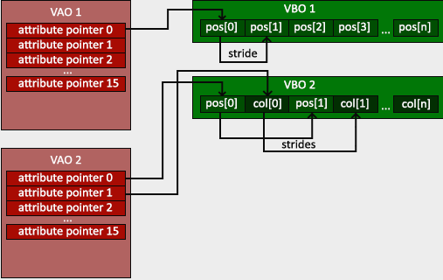
VAO, VBO and EBO
VAO : Vertex array object. It can be bound vertex buffer objects

Slide 13
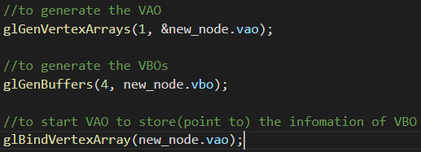
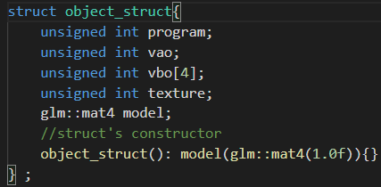
VAO, VBO and EBO
VBO : Vertex buffer object. It can store a large number of vertices in the GPU’s memory
VAO : Vertex array object. It can be bound vertex buffer objects

Slide 14
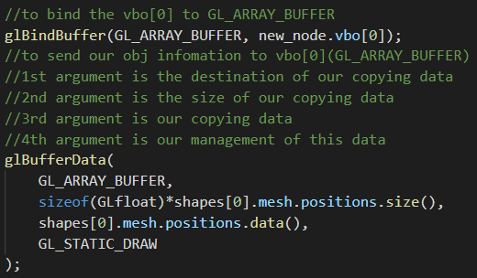
VAO, VBO and EBO
Send data to VBO

Slide 15
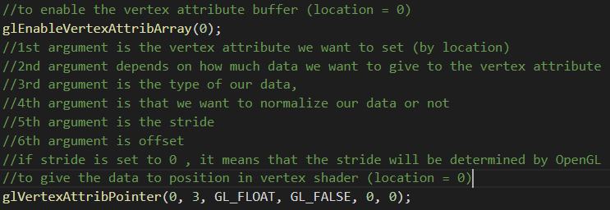
VAO, VBO and EBO
Enable the vertex attribute (it’s disable by default) and then specify how OpenGL should interpret the vertex data
It’s related to vertex shader, which we will talk about in later class

Slide 16
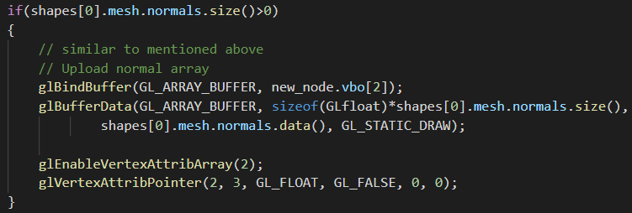
VAO, VBO and EBO
So as normal vectors

Slide 17
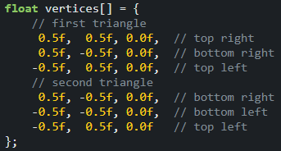
VAO, VBO and EBO
Something else
When we try to draw a rectangle, there is some overlap on the vertices specified !!
duplicate!!!

Slide 18
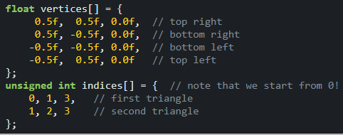
VAO, VBO and EBO
A better way is to store only the unique vertices and then specify the order at which we want to draw these vertices
Use element buffer object(EBO)

Slide 19
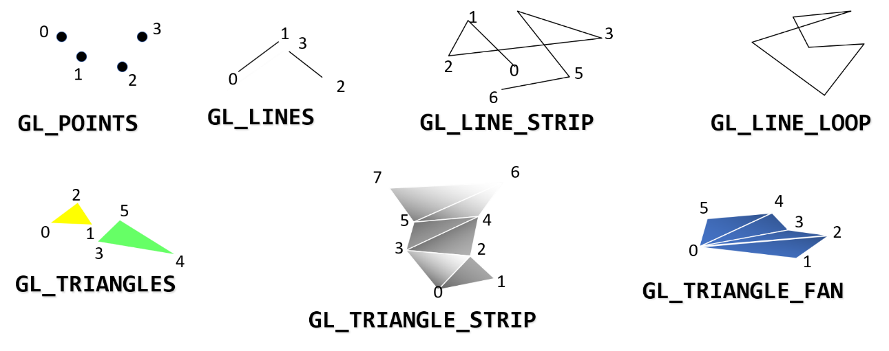
VAO, VBO and EBO
How to use EBO

Slide 20
VAO, VBO and EBO
Draw an object with EBO

Slide 21
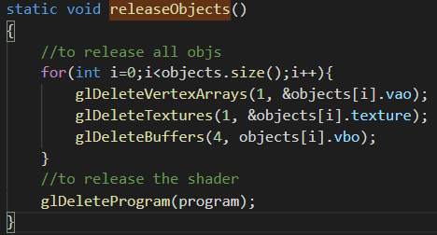
VAO, VBO and EBO
Release those objects we load

Slide 22
rendering
Basic rendering sample

Slide 23
rendering
Rendering function (self-defined)

Slide 24
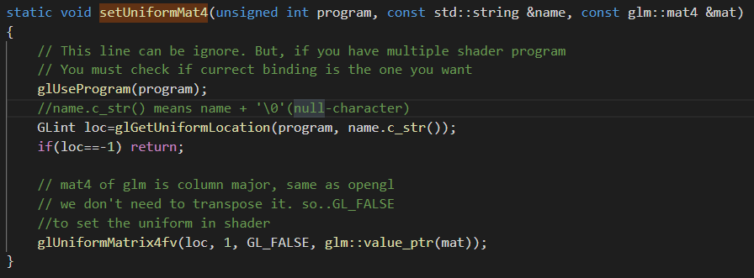
rendering
Set a value to vertex shader

Slide 25
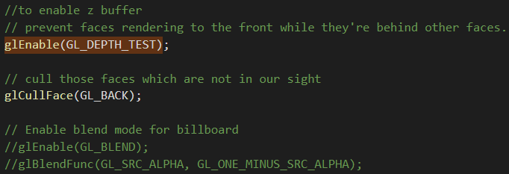
others
It can be set before rendering

Slide 26
Difference between old and new OpenGL
glutMainLoop
You cannot define the rendering function
PushMatrix and PopMatrix
Shader

Slide 27
Any questions?

