Slide 1
Present paper – CGAP (Spring, 2019)

Slide 2
Present paper – CGAP (Spring, 2019)

Slide 3
Outline
Introduction
Related work
Method
Results
Discussion

Slide 4
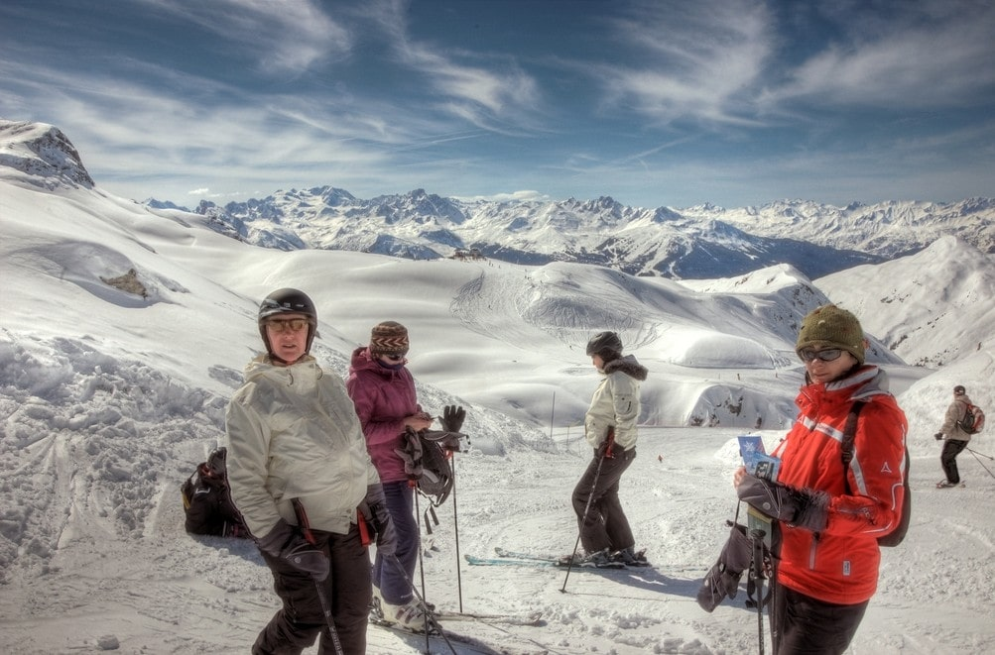
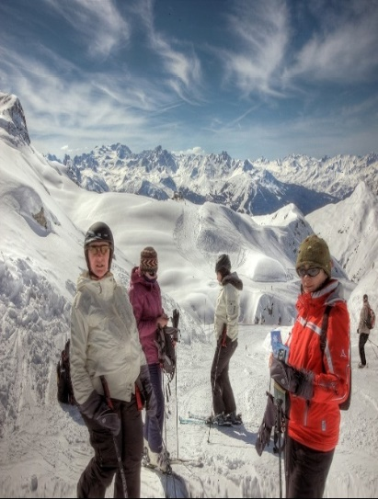
1. Introduction
Image retargeting work is stated as:
Given an image I of size m × n and a new size m’ × n’, the goal is to produce a new image I’ of size m’ × n’ that will be a good representative of the image I

Slide 5
1. Introduction
Traditional image resizing methods usually work in pixel space and use various saliency measures
(Source image: K. P. M. T. N. G. Daniel Vaquero, Matthew Turk. A survey of image retargeting techniques. volume 7798, pages 7798 – 7798 – 15, 2010)
Challenges:
1. Common saliency measures account for low-level features only 2. Current resizing operators do not directly account for the second quality measure of maintaining the natural look of the resulting image

Slide 6
2. Related work
Image Retargeting work
Image Processing Techniques
Deep learning Techniques

Slide 7
2. Related work 2.1 Image Processing Technique
Image Processing Techniques
Discrete methods
Continuous methods

Slide 8
2. Related work 2.1 Deep learning techniques

Slide 9
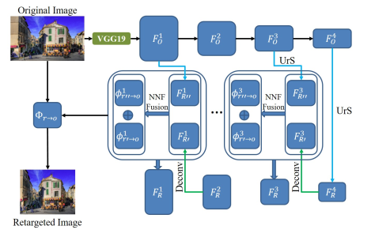
2. Related work 2.1 Deep learning techniques

Slide 10
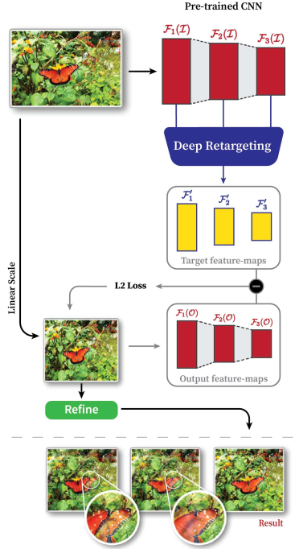
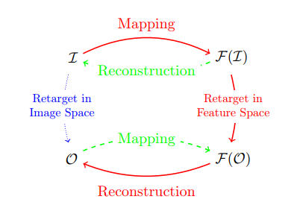
3. Method
Propose new method:
Resizing is applied in feature space and the results are mapped back into image space by reconstruction.

Slide 11
3. Method 3.1 Feature Maps resizing
?
Input image
I(h, w)
Target
feature maps

Slide 12
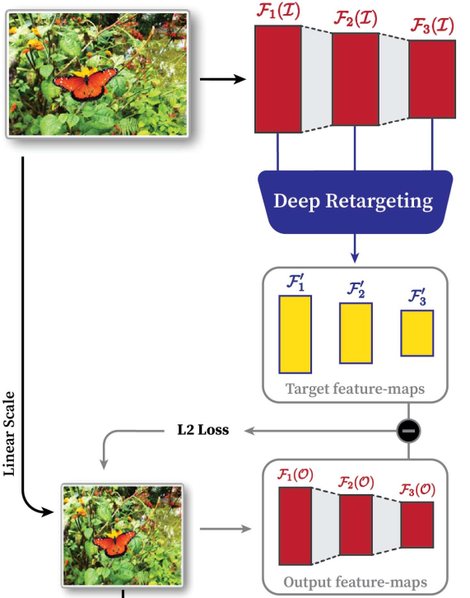
3. Method 3.1 Feature Maps resizing
VGG19
Resizing task in feature-space
For each level I, $F_{i}^{′}$ matches the dimension of i-th feature map $F_{i}$(O)
i.e: dimension of $F_{i}^{′}$ are $h_{i}^{O}$, $w_{i}^{O}$, $c_{i}^{}$) but
contains the most important information in $F_{i}$(I)

Slide 13
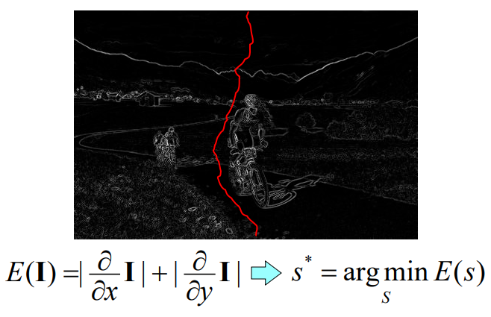
3. Method 3.1 Feature Maps resizing
Basic idea of Seam Carving: remove unimportant pixels from the image, i.e pixels with less “energy”:
Finding seams:

Slide 14
3.1 Feature Maps resizing Deep Seam Carving
Current study defines seam carving in a feature map instead of an image:
Instead of removing pixels from an image we remove neurons from the CNN layer of the feature-map
Using a hierarchical method to define the importance-map of each layer to find minimal seams on feature-maps

Slide 15
3.1 Feature Maps resizing Deep Seam Carving
Starting from the deepest, smallest in resolution, level which contains high-level semantic information, we move to shallower, larger resolution, layers that contain low-level features and refine the seams from previous layers consistently.

Slide 16
3.1 Feature Maps resizing Deep Seam Carving
The important map of each layer at position (i, j) is defined as:

Slide 17
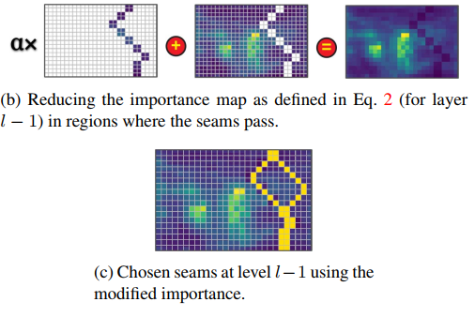
3.1 Feature Maps resizing Deep Seam Carving
Hierarchical method: define the important map of the deepest layer L at
level l→ move up from level l to level l – 1; keep track of all seams that were removed from $F_{i}$(I)
Define the minimal seams on $F_{l−1}$(I)

Slide 18
3.1 Feature Maps resizing Grid warping
Grid warping in image space is applied by first dividing the image to a grid of cells and then scaling each cell linearly using a different scaling factor
The scaling factor is defined as:
Target width

Slide 19
3.1 Feature Maps resizing Deep multi-operator
The combination of deep seam carving and grid-warping is done by preventing deep seam carving from removing seams with semantic content → terminate the seam removal once the next seam’s total importance is above a given threshold.
Once deep seam-carving is terminated, and the image is reconstructed.

Slide 20
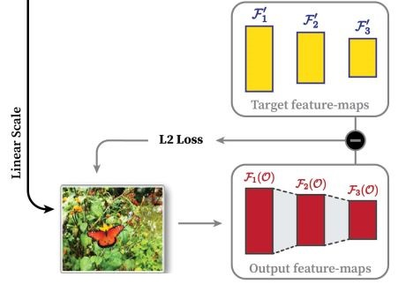
3. Method 3.2. Image Reconstruction
Use the target feature – maps to reconstruct desired output by iteratively applying back-propagation to change the values of an image.
Update O by minimizing the total loss:

Slide 21
3. Method 3.3. Image Refinement
Regions defined by the target feature-maps will most likely be preserved and reconstructed properly
Some artifacts such as checkerboard patterns and noisy pixels still appear in the resulting reconstructed image
Artifacts appear because content removed from the original image is causing discontinuities between better-preserved important regions and such locations accumulate gradients more than others

Slide 22
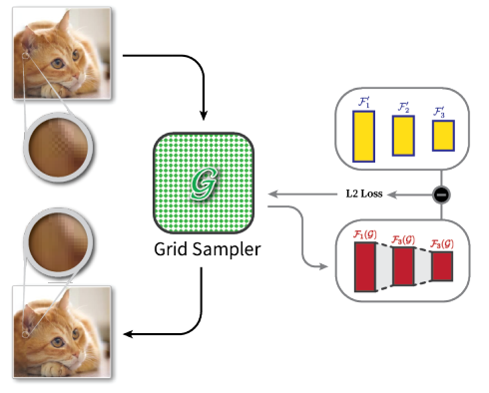
3. Method 3.3. Image Refinement
Utilized a grid sampler layer G to overcome the mentioned artifacts.
Grid sampling layer learns a mapping from positions of neurons in its input to positions in the output.
Place such a layer as the first layer of the network, modifying the input to the network to be G(O) instead of O

Slide 23
4. Results

Slide 24
4. Results

Slide 25
4. Results

Slide 26
5. Discussion - Limitations
VGG19 was trained for the purpose of object detection, and DNR relies on its ability to detect semantic regions and objects. However, the network doesn’t always succeed in providing semantic information on important regions.
Choosing the correct threshold to switch from seam-carving to warping in our multi-operator scheme.
The time to produce results using DNR is still large → is it possible to extent of DNR to videos

Slide 28
End
Thanks for your listening

