Slide 1
3D Shape Segmentation via Shape Fully Convolutional Networks
Article: Science Direct
Submitted: 2017
Accepted: 2018
State Key Lab for Novel Software Technology, Nanjing University
Author: Pengyu Wang, Yuan Gan, Panpan Shui, Fenggen Yu , Yan Zhang , Songle Chen, Zhengxing Sun
By: 藍晧

Slide 2
Outline:
Introduction & Abstract
Methods
Results
Experimental Discussion and Comparison
Conclusion
Notes:
這是我要講的outline.
首先從介紹講到方法。
接著講他們的結果以及限制。
最後再講結論。
2

Slide 3
Introduction & Abstract

Slide 4
Introduction
The results obtained from shape segmentation can be applied to various fields of computer graphics, such as shape editing, deformation, and modelling.
Fully convolutional network (FCN) can train pixel-to-pixels on semantic segmentation, with no requirement over the size of the input image.
Motivation: Want to combine the concept of fully convolutional network with 3D shape instead of 2D image.
Challenge: Data structure of a 3D shape is irregular, so it cannot be directly represented as the data structure of an image.

Slide 5
Brief Method
Design and implement a new FCN architecture that operates directly on 3D shapes by converting 3D shape into a graph structure.
Combine two methods:
1. FCN process of convolution and pooling
2. Existing methods of Graph Convolutional Neural Networks (GCNN).
Using the existing methods and concepts, the author design a new shape fully convolutional network architecture and named it Shape Fully Convolutional Network (SFCN)
Main devise:
A novel trained triangles-to-triangles model for shape segmentation
Use the multiple features of the shape to complete the training on the SFCN.

Slide 6
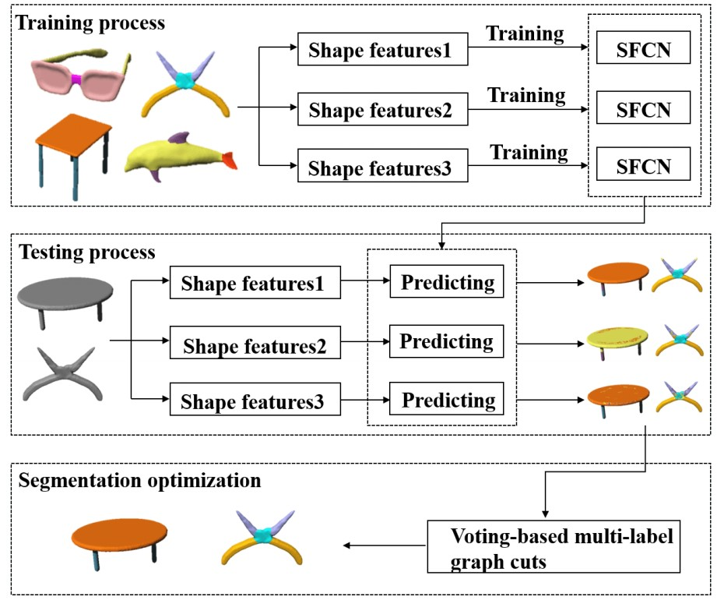
Pipeline

Slide 7
Contribution
Design a fully convolutional network architecture named SFCN, and is able to achieve effective convolution and pooling operations on the 3D shapes.
Present the shape segmentation and labelling based on SFCN. It can be triangles-to-triangles by three low-level geometric features.
Excellent segmentation results on training and predicting mixed datasets of different categories of shapes are achieved.

Slide 8
Methods

Slide 9
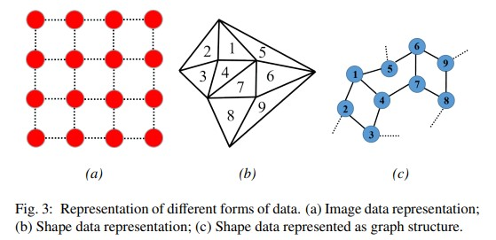
By analogy with images, triangles of the 3D shape can be seen as pixels on the image, but unlike pixels, triangles of the shape have no ordered sequence rules.
Each 3D shape can be represented as G=(V,E) with vertex v V for a triangle and edge e E for the connection of adjacent triangles.
$$∈$$
$$∈$$

Slide 10
Geometric Feature Extraction
Three low-level features:
Average geodesic distance (AGD)
Shape context (SC)
Spin Image (SI)

Slide 11
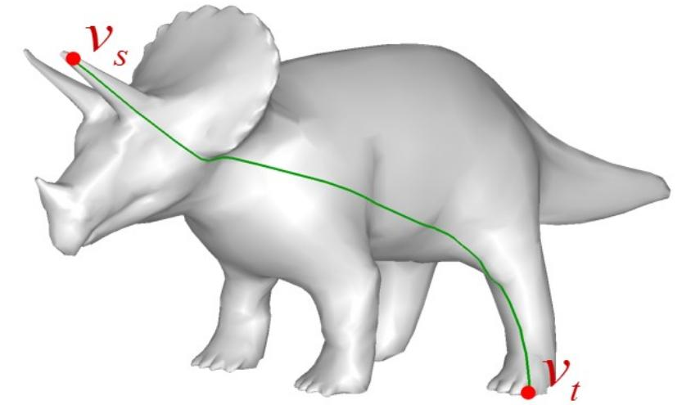
Geometric Feature Extraction
Average geodesic distance (AGD): Find shortest path from point to point and compute the average

Slide 12
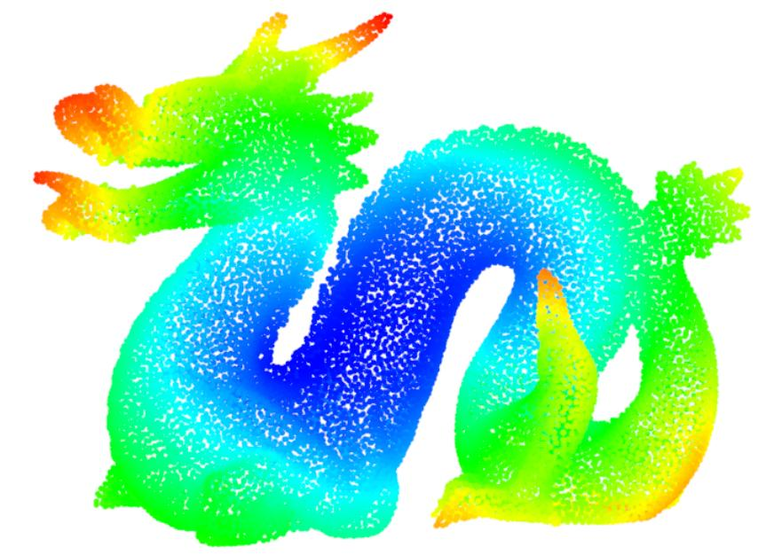
Geometric Feature Extraction

Slide 13
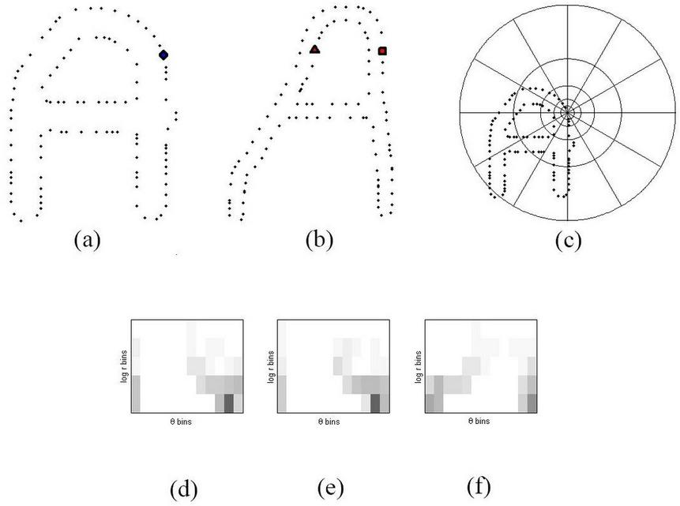
Geometric Feature Extraction
Shape context (SC): A way of describing shapes that allows for measuring shape similarity and the recovering of point correspondences.

Slide 14
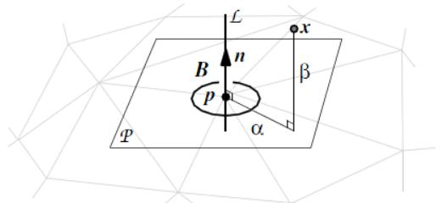
Geometric Feature Extraction
Spin Image (SI): Describe feature description based on point cloud. Largely used for surface matching and object recognition in 3D scenes.

Slide 15
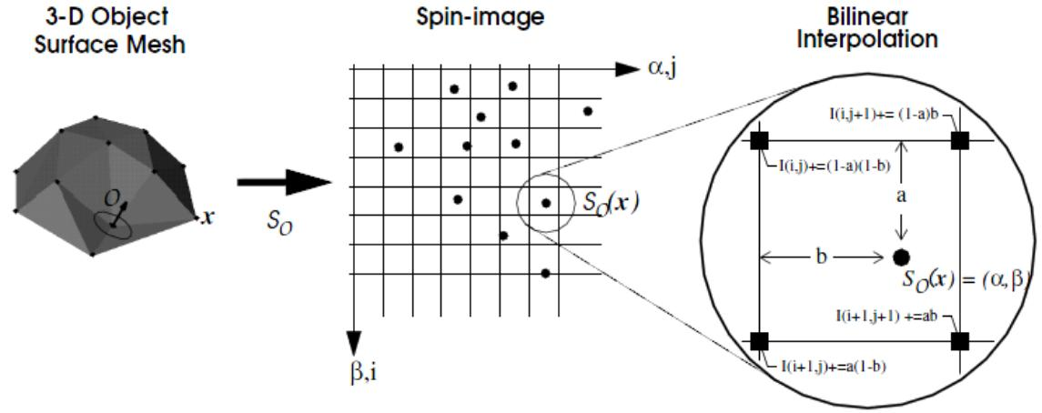
Geometric Feature Extraction

Slide 16
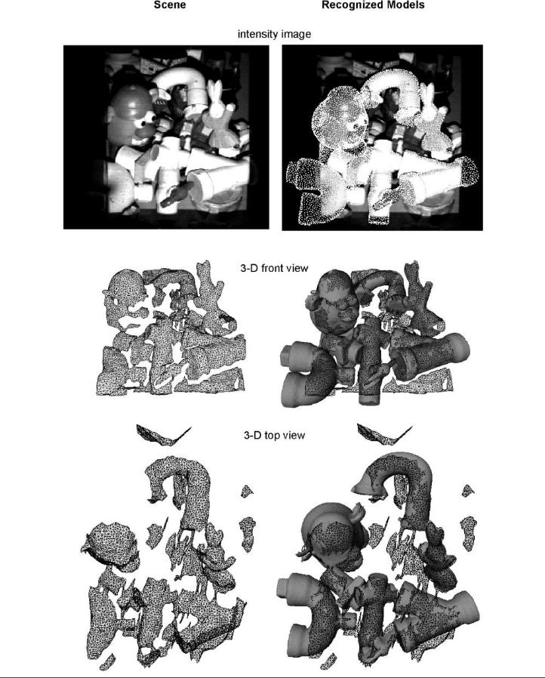
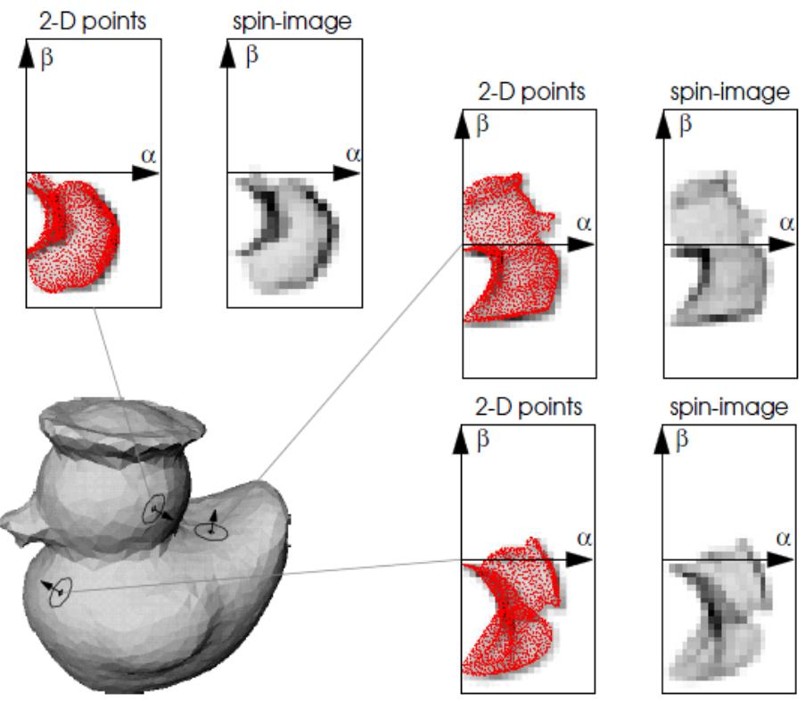

Slide 17
Convolution
Keypoints:
Breadth-first search
Receptive field

Slide 18
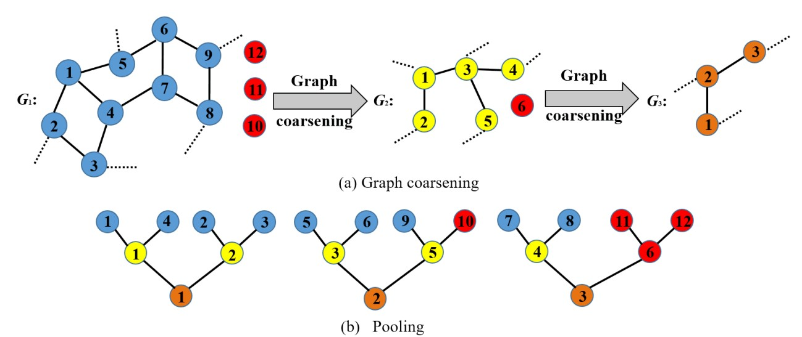
Pooling
Keypoints:
Graph coarsening = 2
Pooling size = 4
Pooling method: max pooling

Slide 19
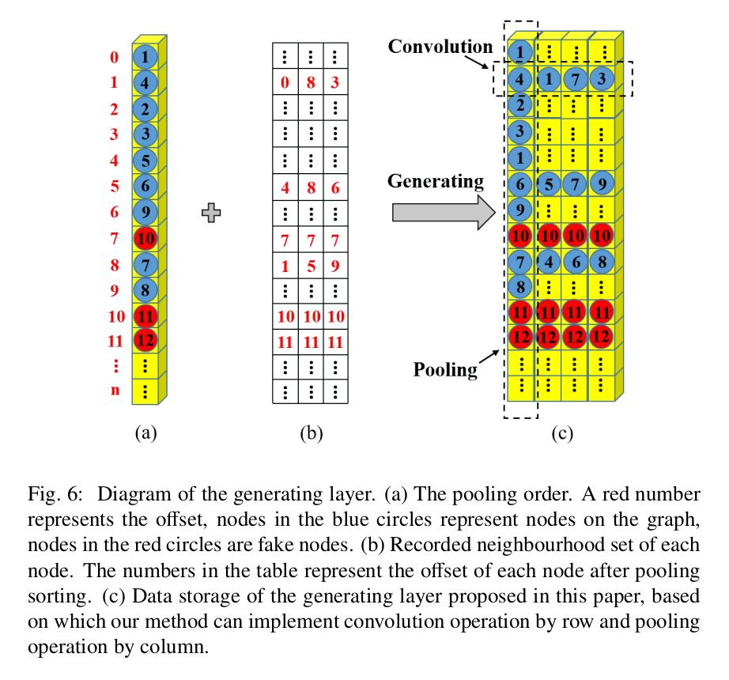
Generating Layer

Slide 20
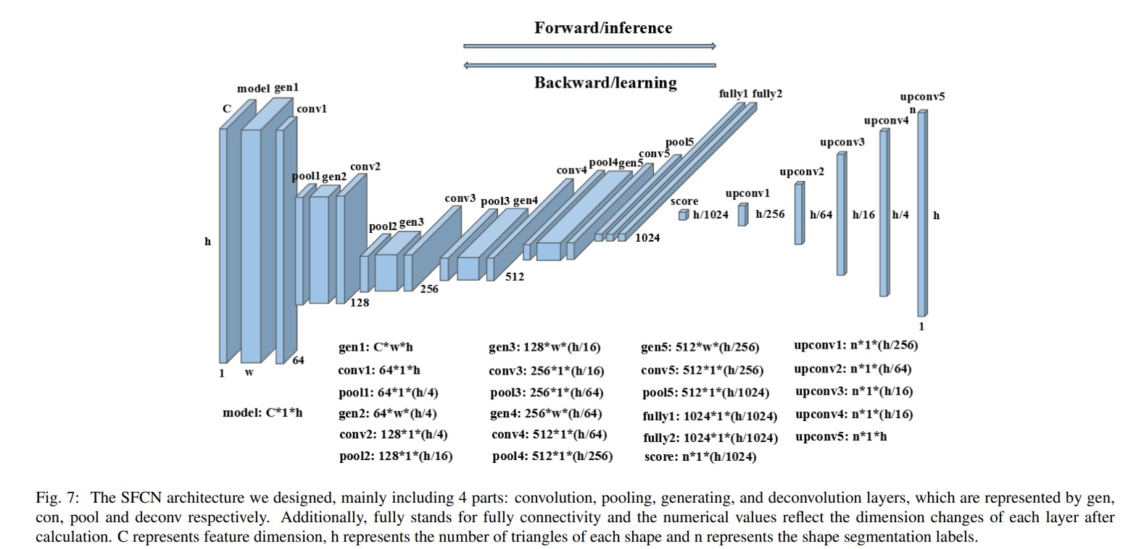
Model → convolution → pooling → generating → deconvolution

Slide 21
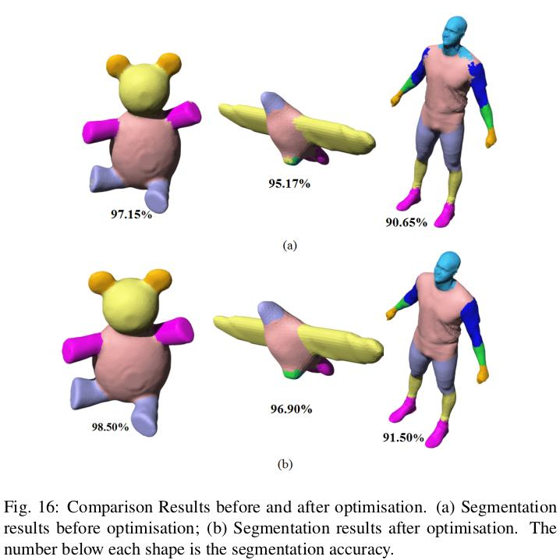
Optimization: Multi-label graph cuts method

Slide 22
Results

Slide 23
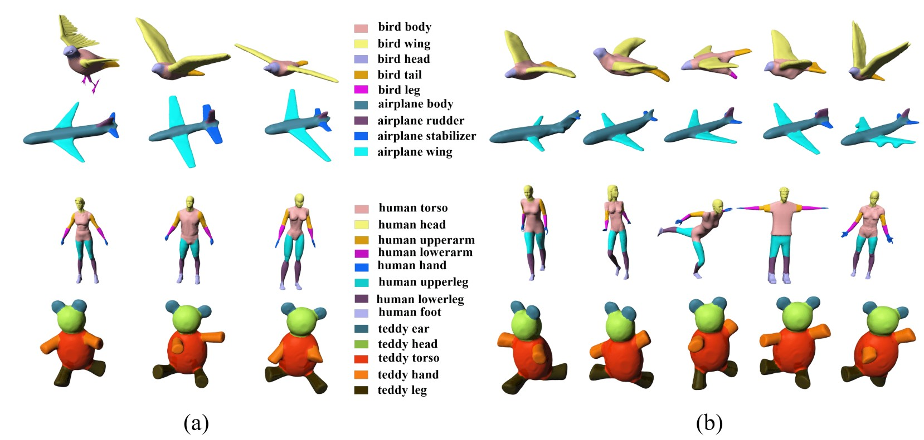
(a) Training result (b) Testing result

Slide 24
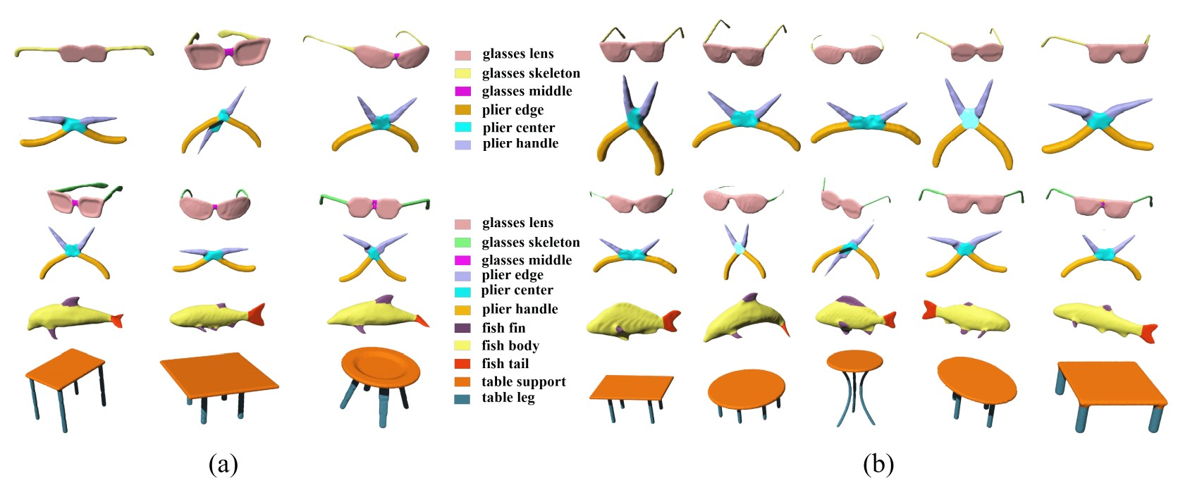
(a) Training result (b) Testing result

Slide 26
Experimental Discussion and Comparison

Slide 27
Computation Time and Comparison
Intel(R) Xeon(R) CPU E5- 2620 v3 @ 2.40GHz with 12 cores and NVIDIA GeForce TITAN X GPU.
Used 50 shapes for training and triangles of each shape range from 1000~5000 takes 2 hours.
From COSEG large dataset, selected:
50 shapes for training from the chair dataset.
20 shapes for training from the vase dataset.

Slide 28
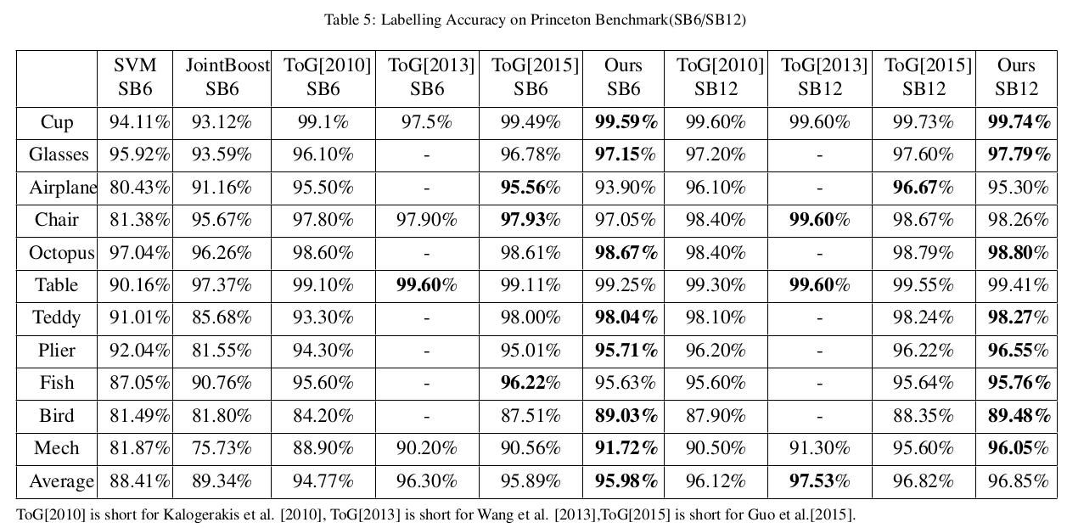
Accuracy Comparison
Princeton Benchmark: Randomly selected N=6 and N=12 shapes for training process.

Slide 29
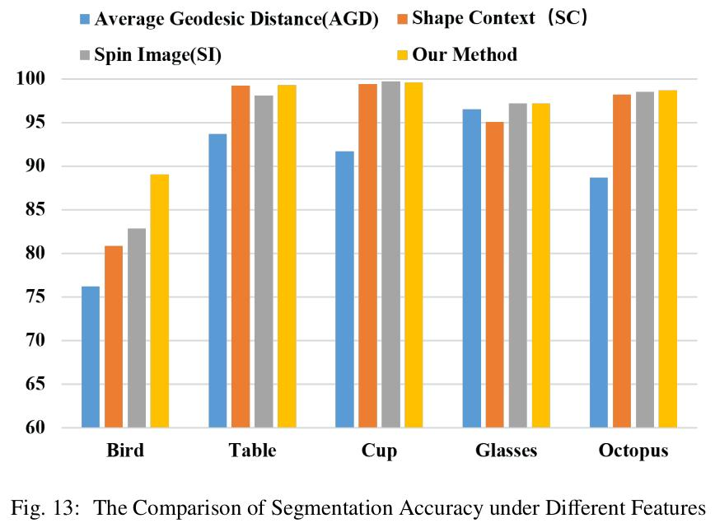
Feature Sensibility
In this paper, the author combines average geodesic distance, shape context, and spin image to produce the shape segmentation.
To verify the validity of the combination, they tried to classify the accuracy of each dataset of PSB under a single feature.

Slide 30
Limitation

Slide 31
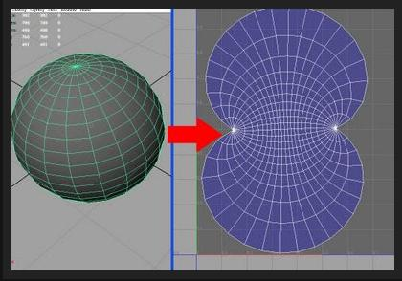
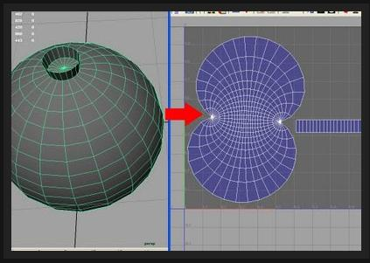
Limitation
1. Shapes involved in the calculation must be manifold meshes, for they can easily determine the connection between triangles.
2. No feature selection function.
Future work: making it possible for automatic feature selection and build end-to-end structure.

Slide 32
Conclusion

Slide 33
Conclusions
Design a novel shape fully convolutional network architecture which can automatically carry out triangles-to-triangles learning and prediction, and complete segmentation task with high quality.
For more accurate segmentation results, they optimize the segmentation results using multi-label graph cut method, which can also improve the local smoothness of triangle labels.
Obtain good results from both large and small datasets with small number of features.

