Slide 1
Learn
OpenGL
卞正冠 P76094703@gs.ncku.edu.tw
姚勝翊 ND8081018@gs.ncku.edu.tw

Slide 2
Introduction

Slide 3
Introduction
Mainly considered as a specification for rendering 2D and 3D vector graphics.
Created in 1991 by Silicon Graphics, Inc. Now it is managed by Khronos Group.

Slide 4
Introduction
Cross-platform
Linux
Windows
etc.
Cross-Language
C & C++
Java
Python
etc.

Slide 5
Environment
(Windows, C++)

Slide 6
Requirement
In this slide, we will use the specification:
OpenGL version 3.3 or above.
With the requirement listed below:
Visual Studio - Integrated development environment (IDE)
GLFW - OpenGL utility library
GLEW - OpenGL Extension Wrangler Library

Slide 7
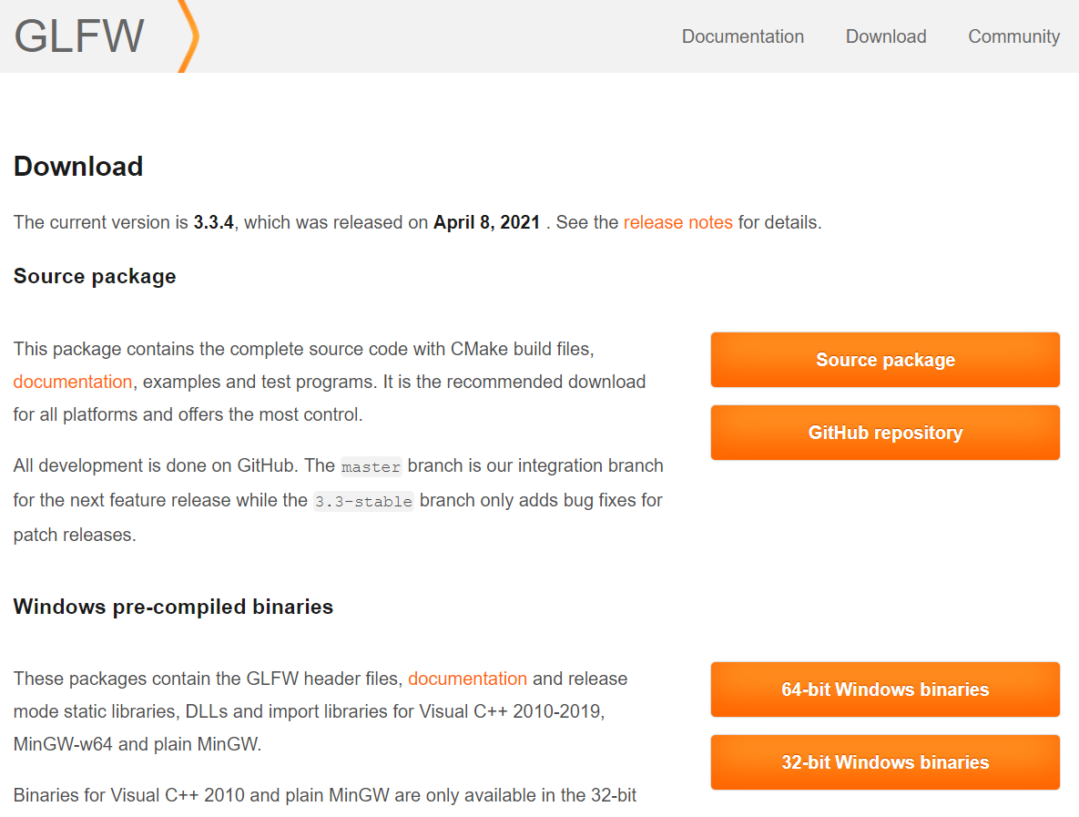
GLFW
https://www.glfw.org/download.html

Slide 8
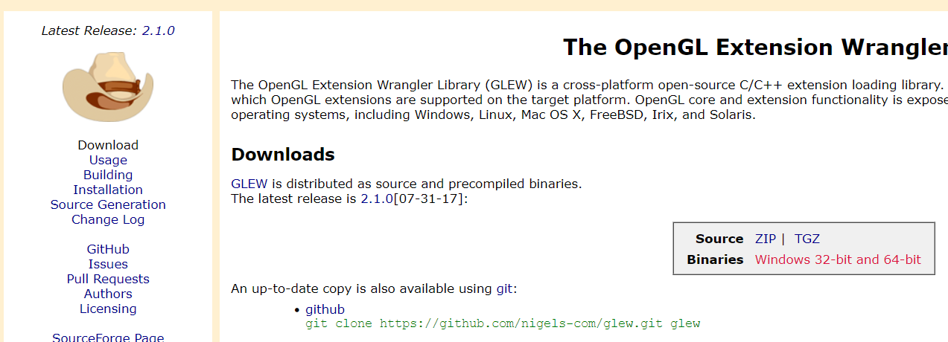
GLEW
http://glew.sourceforge.net/

Slide 9
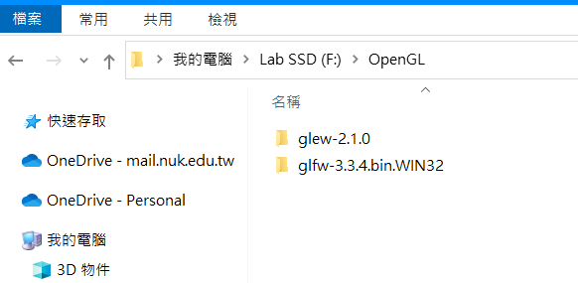
GLFW & GLEW

Slide 10
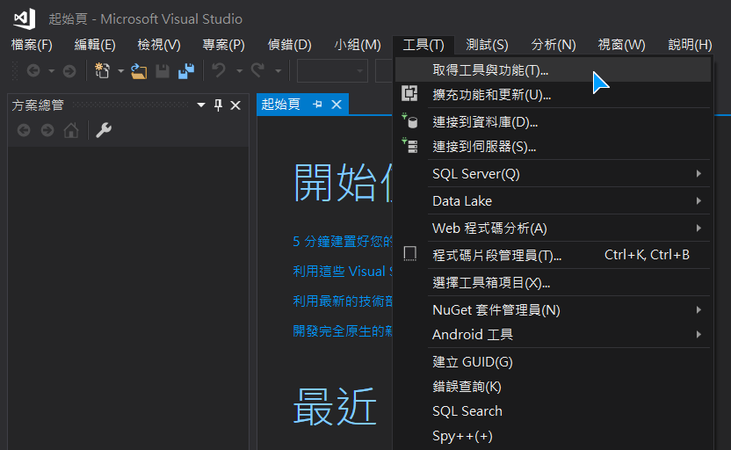
Visual Studio

Slide 11
Visual Studio

Slide 12
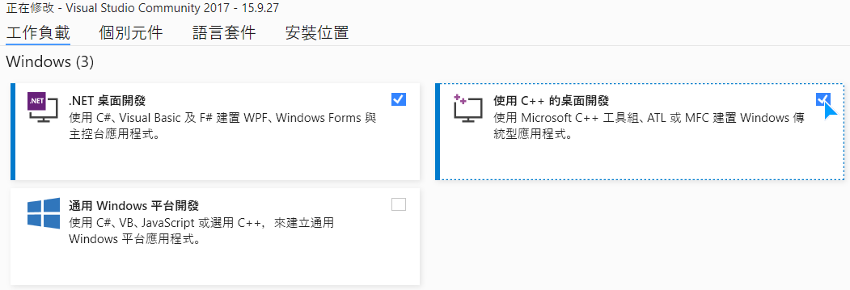
Visual Studio

Slide 13
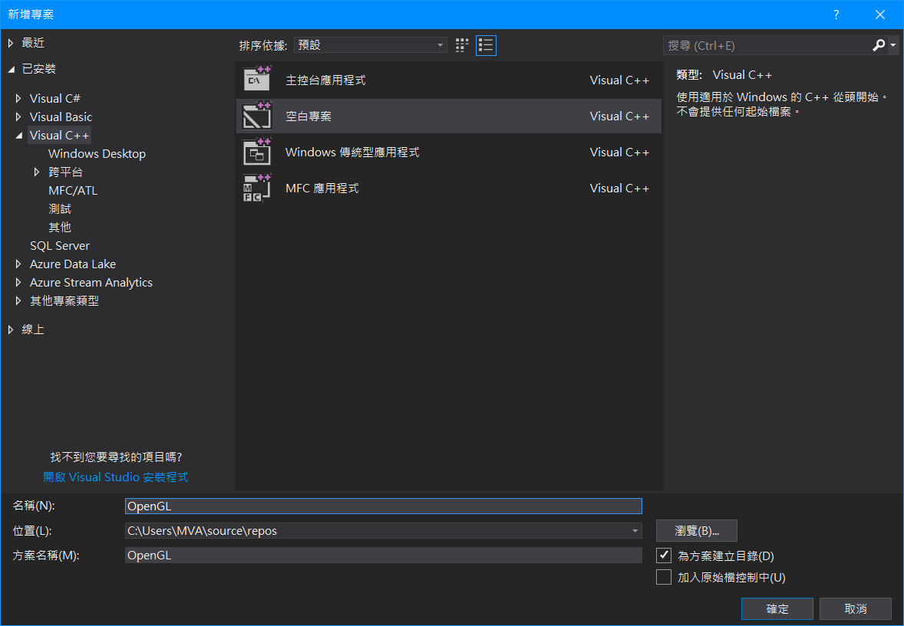
Visual Studio

Slide 14
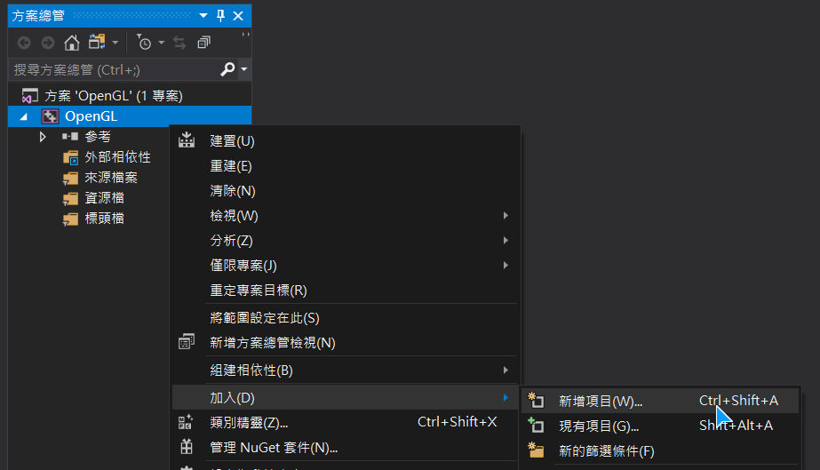
Visual Studio

Slide 15
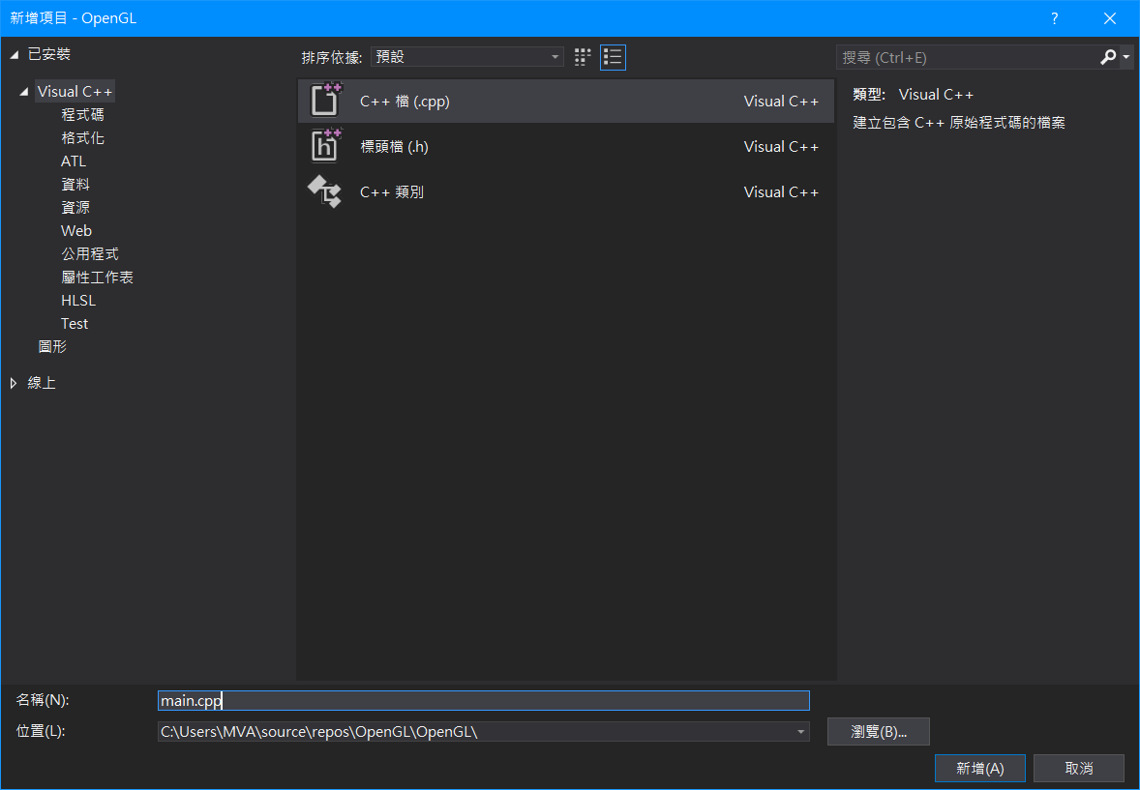
Visual Studio

Slide 16
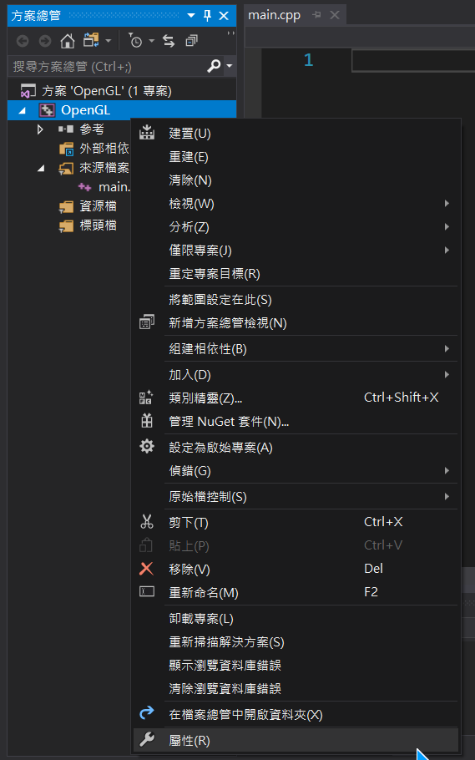
Visual Studio

Slide 17
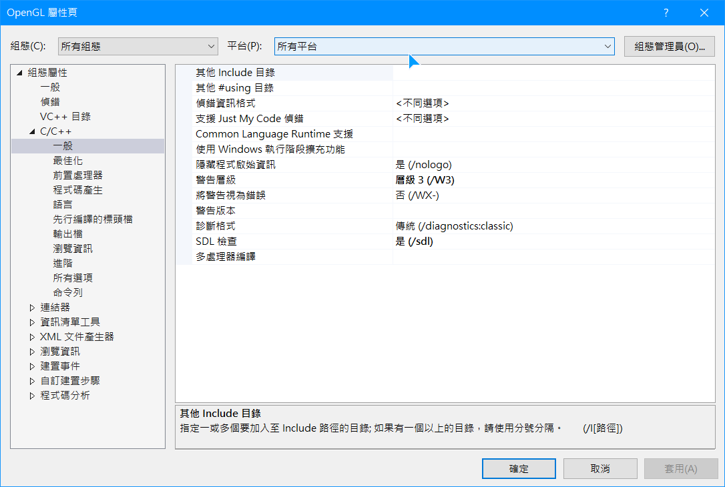
Visual Studio

Slide 18
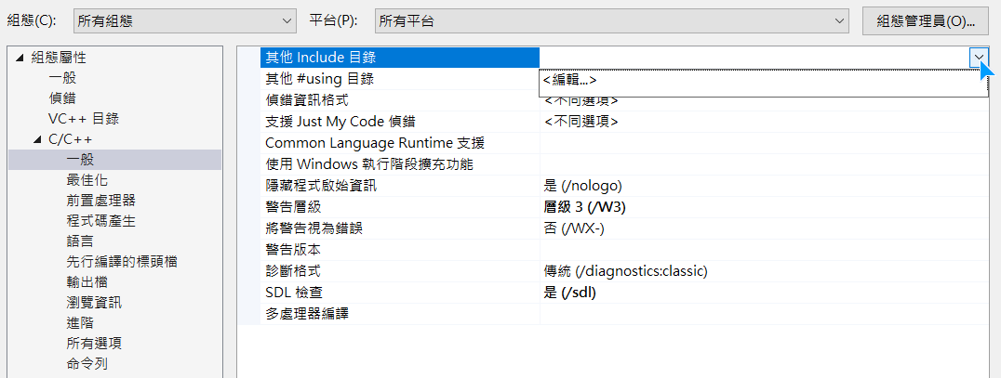
Visual Studio

Slide 19
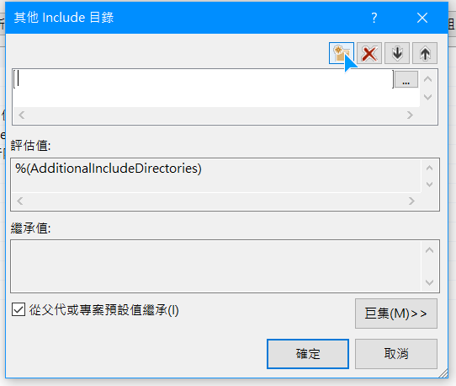
Visual Studio

Slide 20
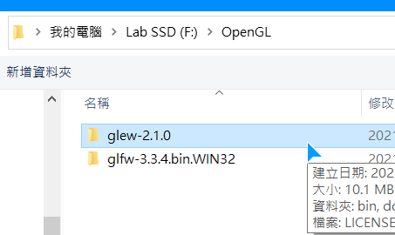
Visual Studio

Slide 21
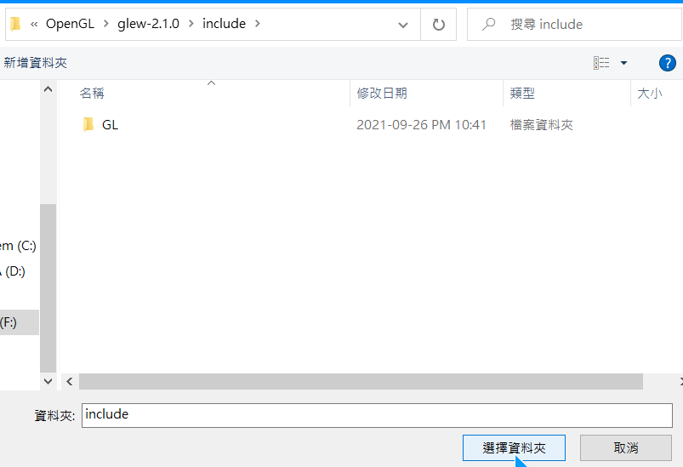
Visual Studio

Slide 22
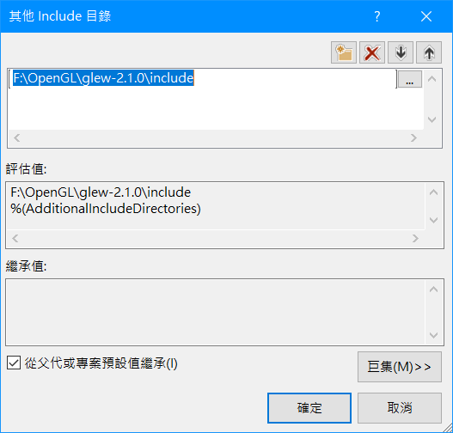
Visual Studio

Slide 23
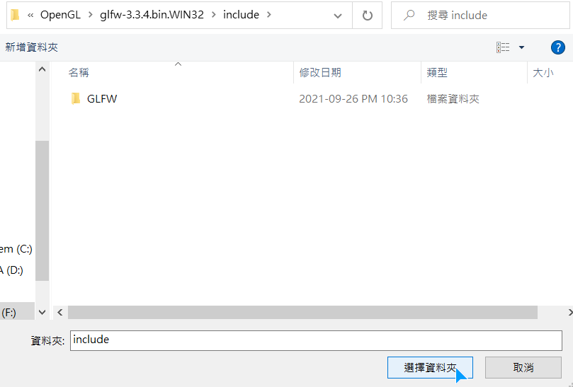
Visual Studio

Slide 24
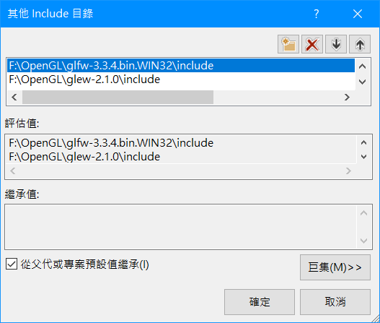
Visual Studio

Slide 25
Visual Studio

Slide 26
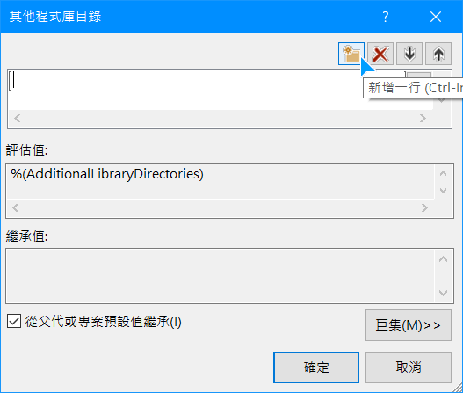
Visual Studio

Slide 27
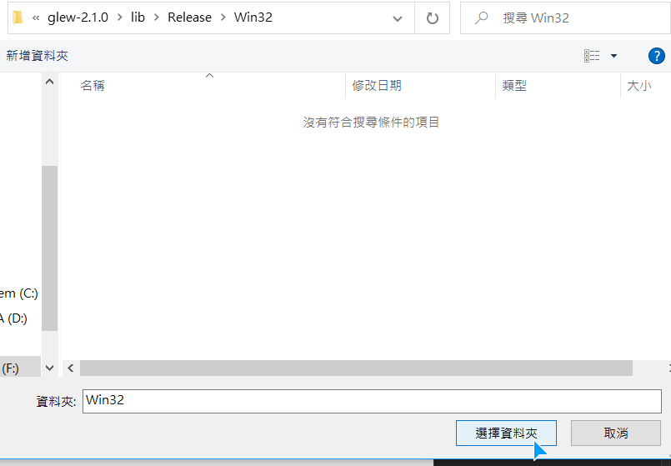
Visual Studio

Slide 28
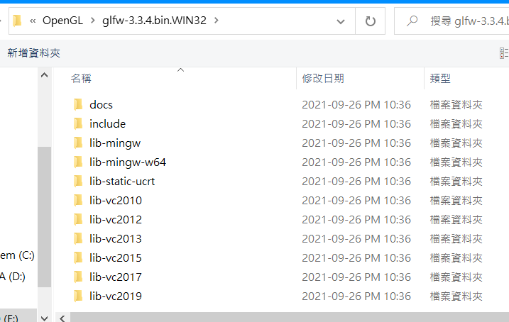
Visual Studio

Slide 29
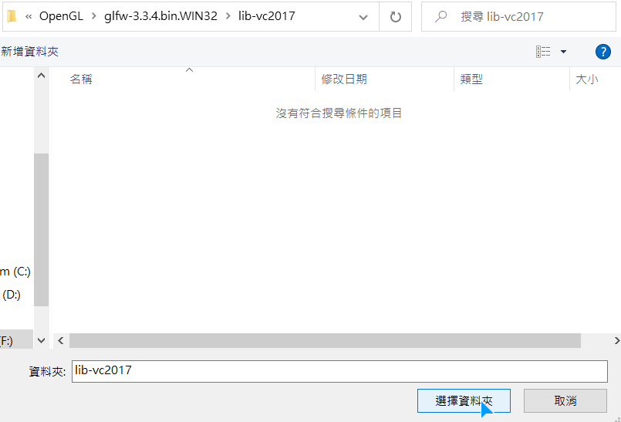
Visual Studio

Slide 30
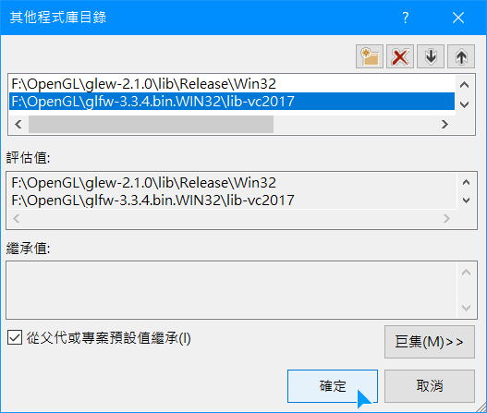
Visual Studio

Slide 31
Visual Studio

Slide 32
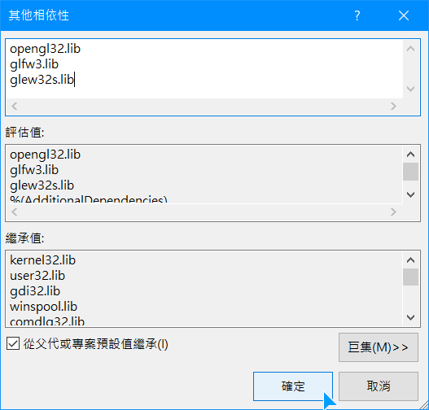
Visual Studio

Slide 33
Creating
a window

Slide 34
Include
Notes:
引入glfw和glew的函示庫

Slide 35
Init GLFW
Notes:
初始化GLFW
設定opengl版本(3.3)
主版本號3
次版本號3
OpenGL profile: core profile
最後一行：mac才需要

Slide 36
Create a window object
Notes:
建立一個window object
設定為800*600

Slide 37
Init GLEW
Notes:
初始化GLEW

Slide 38
Viewport
Notes:
設定window可以繪製的範圍

Slide 39
Render loop
Notes:
建立一個render loop，偵測是否要關閉視窗
glfwSwapBuffers will swap the color buffer (a large 2D buffer that contains color values for each pixel in GLFW's window) that is used to render to during this render iteration and show it as output to the screen.
glfwPollEvents 偵測使用者的操作（ex:鍵盤、滑鼠）

Slide 40
End of the main function
Notes:
離開render loop後，將配置的資源delete/clean

Slide 41
Input
Notes:
glfwPollEvents會得到window中使用者的輸入
glfwGetKey判斷是否按下ESC，如果有就將window關閉

Slide 42
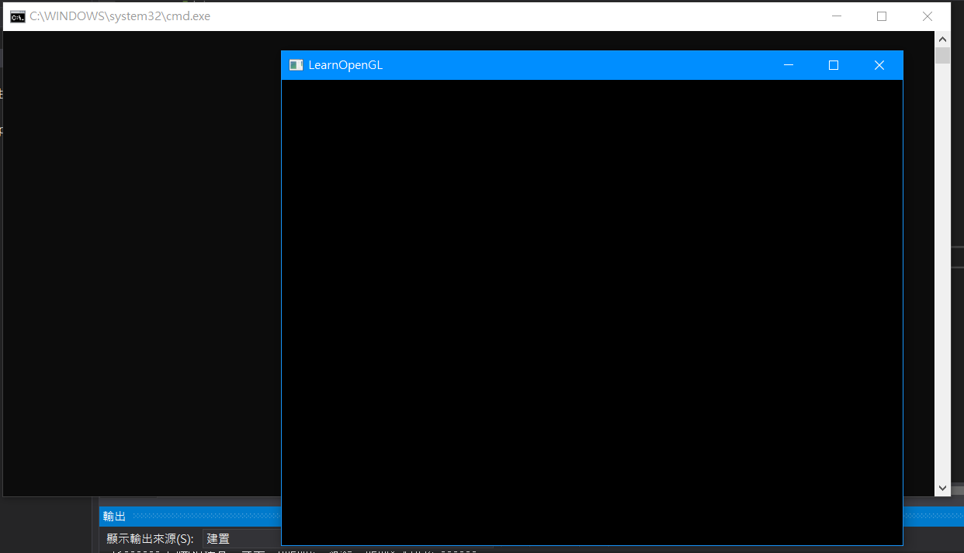
Create a window
Notes:
建立一個render loop，偵測是否要關閉視窗
glfwSwapBuffers will swap the color buffer (a large 2D buffer that contains color values for each pixel in GLFW's window) that is used to render to during this render iteration and show it as output to the screen.
glfwPollEvents 偵測使用者的操作（ex:鍵盤、滑鼠）

Slide 43
Render pipeline

Slide 44
Pipeline
The graphics pipeline can be divided into two large parts: the first transforms your 3D coordinates into 2D coordinates and the second part transforms the 2D coordinates into actual colored pixels.

Slide 45
Shader
Graphics cards process your data within the graphics pipeline.
The processing cores run small programs on the GPU for each step of the pipeline. These small programs are called shaders.

Slide 46
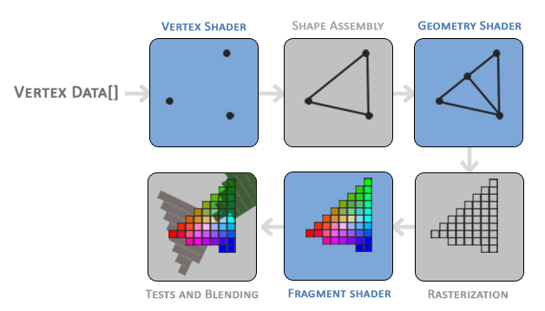
Pipeline

Slide 47
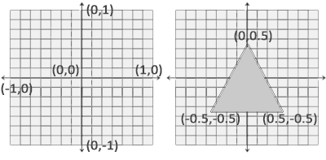
Normalized Device Coordinate(NDC)
Once your vertex coordinates have been processed in the vertex shader, they should be in normalized device coordinates which is a small space where the x, y and z values vary from -1.0 to 1.0.

Slide 48
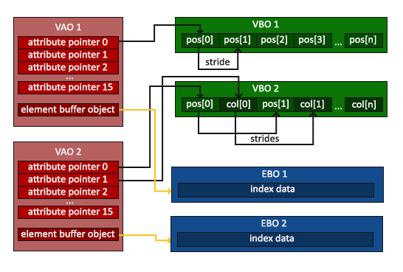
Vertex Specification
Vertex specification is the procedure of setting up rendering objects.
Submit the vertex stream data into the rendering pipeline.
Tell the program how the data stream is represented.

Slide 49
VBO
It can be used as a source of vertex array data for OpenGL context.
Usually stores some vertex attributes like position, normal.

Slide 50
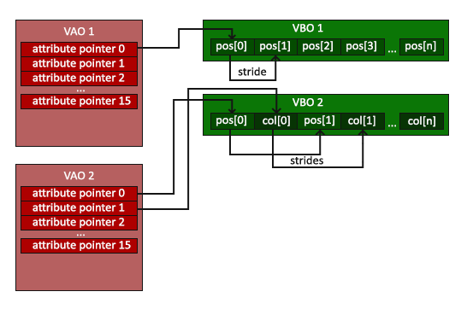
VAO
Vertex array object (VAO)
It stores the necessary state for object data.
It normally stores the format of the data and the VBO provided the data.

Slide 51
EBO
An EBO is a buffer, just like a vertex buffer object, that stores indices that OpenGL uses to decide what vertices to draw.

Slide 52
Vertex Shader
Vertex shader handles the manipulation of the individual vertex.
It determines the final attribute of the single vertex.
Each input vertex must map to a specific output vertex.

Slide 53
Fragment Shader
Manipulate the fragment into colors and depth value.
Determine the color of the fragment.

Slide 54
Render
Code
https://learnopengl.com/Getting-started/Hello-Window

Slide 55
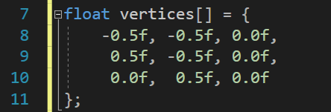
Vertex data
An array containing 3d position data belonging to 3 vertices:
{ {-0.5, -0.5, 0}, {0.5, -0.5, 0}, {0, 0.5, 0} }

Slide 56
Generate the OpenGL object

Slide 57
Bind
Bind the VAO.
Bind the buffer object to vertex array object and specify the data (copy them into OpenGL context memory).

Slide 58
Shader
Shaders are written in the OpenGL Shading Language (GLSL).

Slide 59
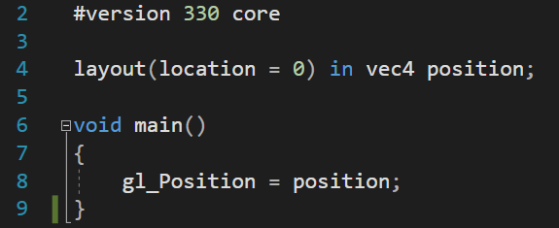
Vertex Shader

Slide 60
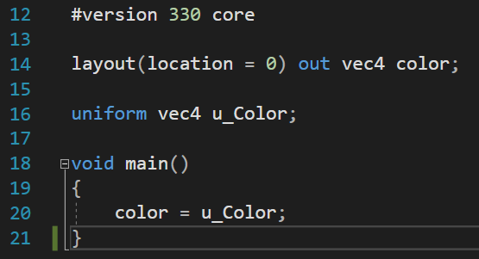
Fragment Shader

Slide 61
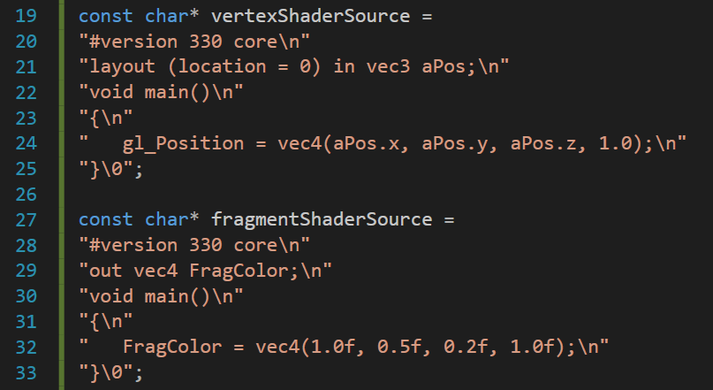
Shader

Slide 62
Compile Shader

Slide 63
Create Shader Program
Create a shader program object to link the shader.

Slide 64
Vertex attribute array
Enable and specify the generic vertex attribute array.

Slide 65
Render the mesh in render loop
Clear the render buffer.
Bind the correct vertex array object and texture.
Use the proper shader program.
Draw the mesh.

Slide 66
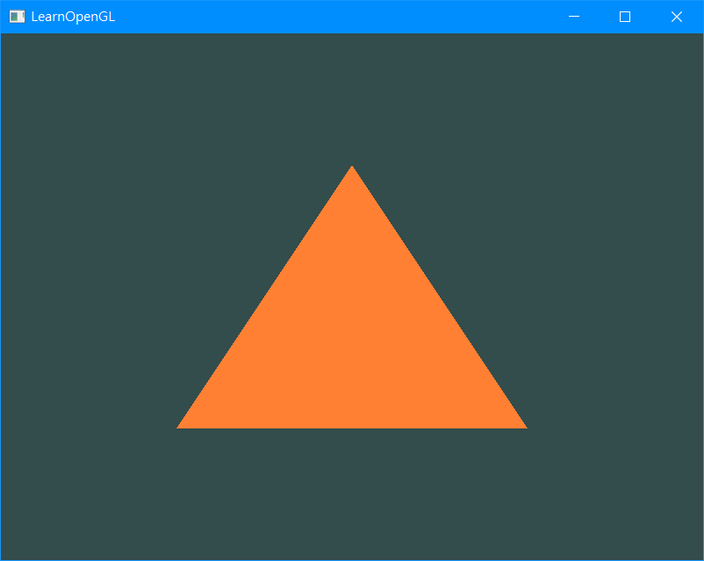
Draw a triangle

Slide 67
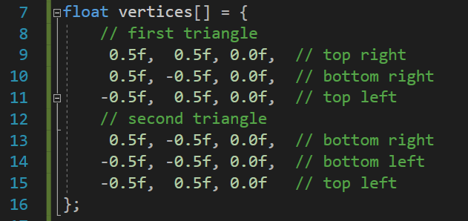
Draw more triangle

Slide 68
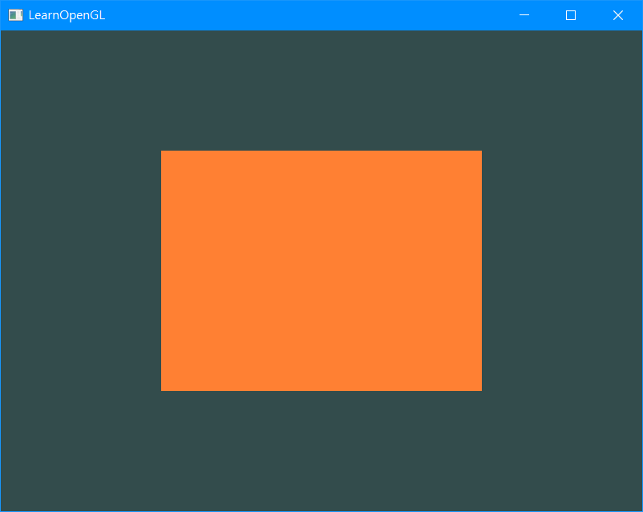
Draw more triangle

Slide 69
Draw more triangle
As you can see, there is some overlap on the vertices specified. We specify bottom right and top left twice!

Slide 70
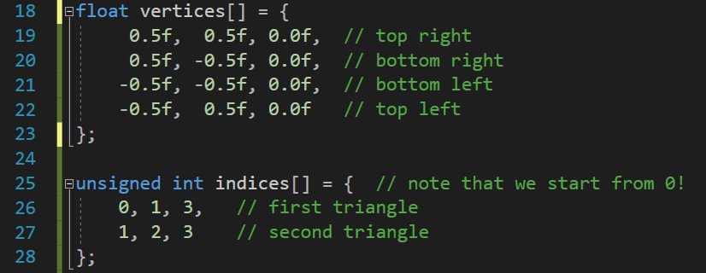
Vertex & index data

Slide 71
Generate the OpenGL object

Slide 72
Bind
Bind the VAO.
Bind the buffer object to vertex array object and specify the data (copy them into OpenGL context memory).

Slide 73
Render the mesh in render loop

Slide 74
Draw more triangle (EBO)

