Slide 1
Motion Representations for Articulated Animation
Aliaksandr Siarohin, Oliver J. Woodford, Jian Ren, Menglei Chai, Sergey Tulyakov
CVPR 2021

Slide 2
Outline
Introducion
Method
Evaluation
Conclusion

Slide 3
01. Introduction

Slide 4
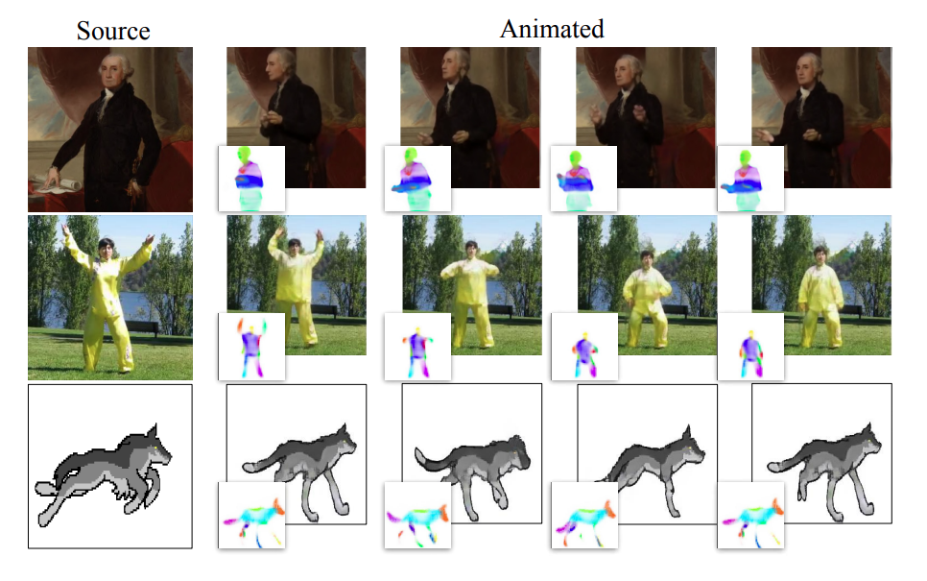
Animation - Bringing Static Objects to Life
Identify object parts from an image and animate them using motion in a driving video.

Slide 5
Limitation of Previous Works
Data-driven methods
  Require ground truth pose and shape data to be available during training.
Unsupervised method
  How to represent the parts of an articulated or non-rigid moving object, including their shapes and poses.
  Given the object parts, how to animate them using the sequence of motions in a driving video.

Slide 6
02. Method

Slide 7
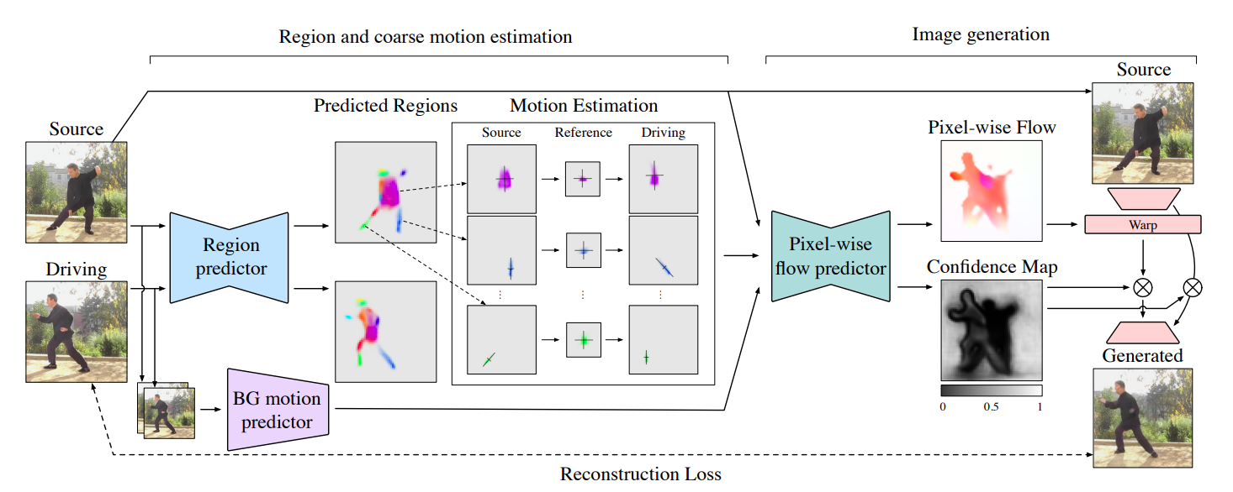
Overview of Model

Slide 8
Method
Three contributions over First Order Motion Model
PCA-based motion estimation
Background motion representation
Animation via disentanglement

Slide 9
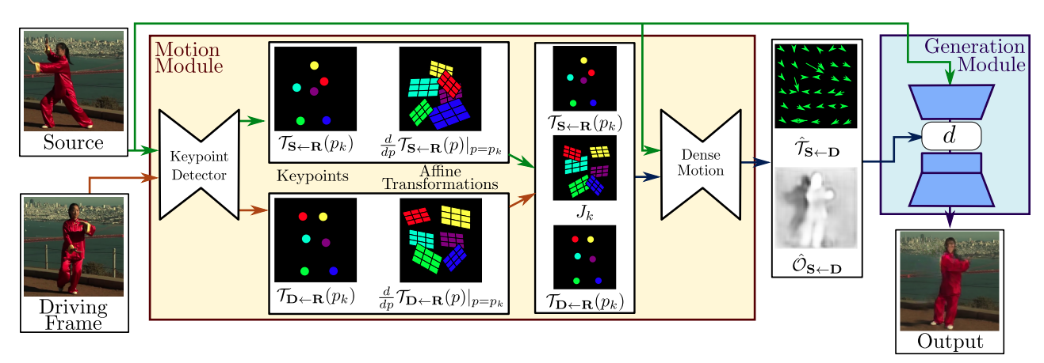
2.1. First Order Motion Model (FOMM)
Motion estimation
  Coarse motion estimation
  Dense motion prediction
Image generation

Slide 10

2.1.1. FOMM - Coarse Motion Estimation
Extract source frame S and driving frame D from the same video
Motions for each object part are represented by affine transformations

Slide 11



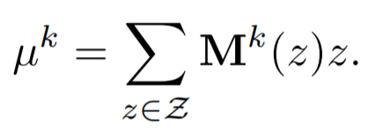
2.1.1. FOMM - Coarse Motion Estimation
An U-Net architecture estimates K heatmaps, followed by softmax
The translation component of affine transformation can be estimated using softargmax

Slide 12

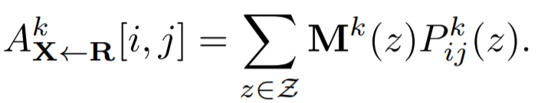
2.1.1. FOMM - Coarse Motion Estimation
The remaining affine parameters are regressed per pixel and form 4 additional channels
Estimate using weighted pooling

Slide 13
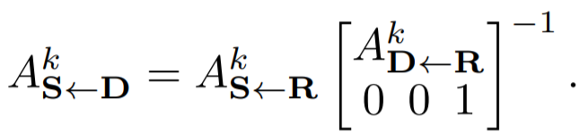
2.1.1. FOMM - Coarse Motion Estimation
Motion between D and S are computed via reference frame R

Slide 14


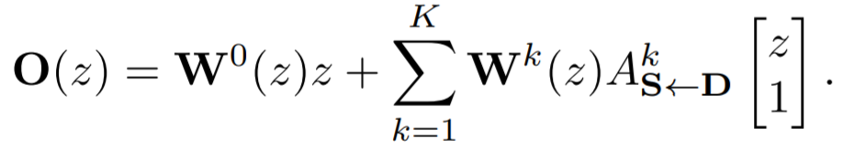
2.1.2. FOMM - Dense Motion Prediction
The flow predictor outputs K + 1 assignment maps (plus background)
Optical flow per pixel is computed

Slide 15

2.1.2. FOMM - Dense Motion Prediction
A confidence map is also predicted

Slide 16
2.1.3. FOMM - Image Generation
S is passed through an encoder, followed by warping the resulting feature map using the optical flow and multiplied by the confidence map

Slide 17
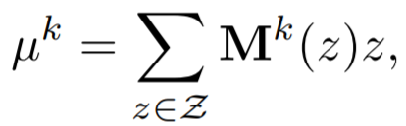
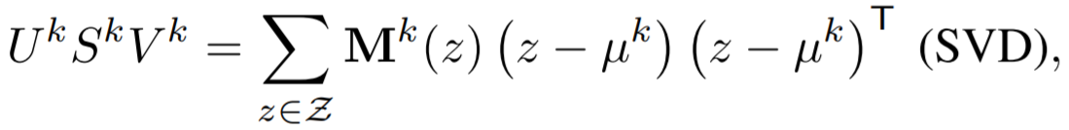
2.2. PCA-based Motion Estimation
Compute the translation as before
Rotation and scaling are computed via PCA of heatmap

Slide 18
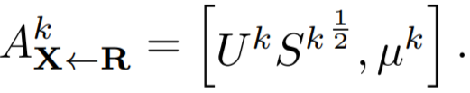
2.2. PCA-based Motion Estimation
The affine transformation of the k-th region

Slide 19

2.3. Background Motion Estimation
FOMM does not treat background motion separately
  Additional network capacity is required
  Overfitting to the training set
Affine background transformation

Slide 20
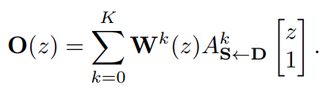
2.4. Image Generation
Dense flow predictor generator

Slide 21
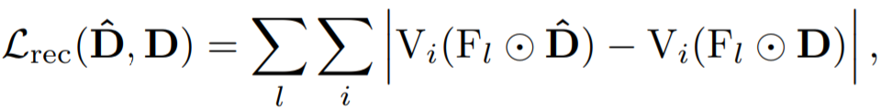

2.5. Training
Multi-resolution reconstruction loss
Equivariance loss

Slide 22
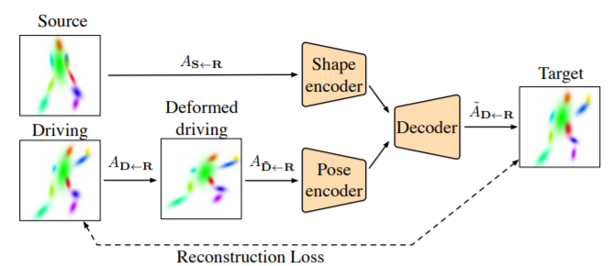
2.6. Animation via Disentanglement
Random horizontal and vertical scaling deformations are applied to the driving motions during training.

Slide 23
03. Evaluation

Slide 24
Benchmarks
Datasets
  VoxCeleb
  TaiChiHD
  MGif
  TED-talks
Metrics
  L1 error
  Average Keypoint Distance (AKD)
  Missing Keypoint Rate (MKR)
  Average Euclidean Distance (AED)

Slide 25
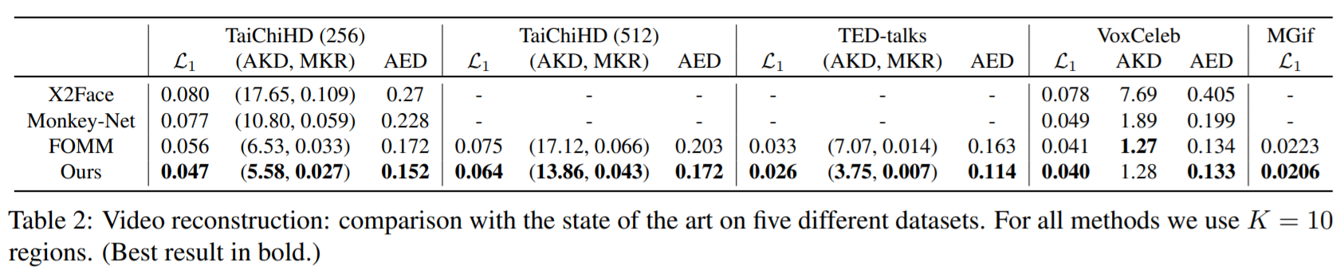
Reconstruction Quality

Slide 26
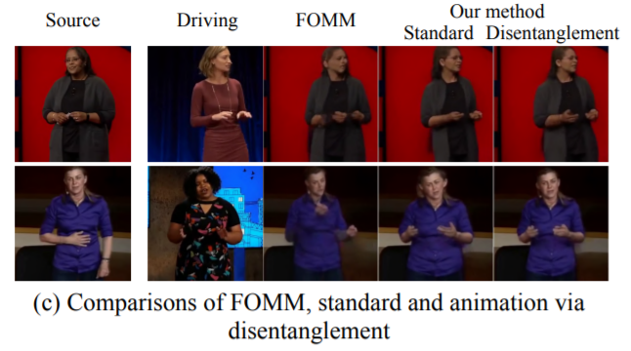
Animation Quality

Slide 27
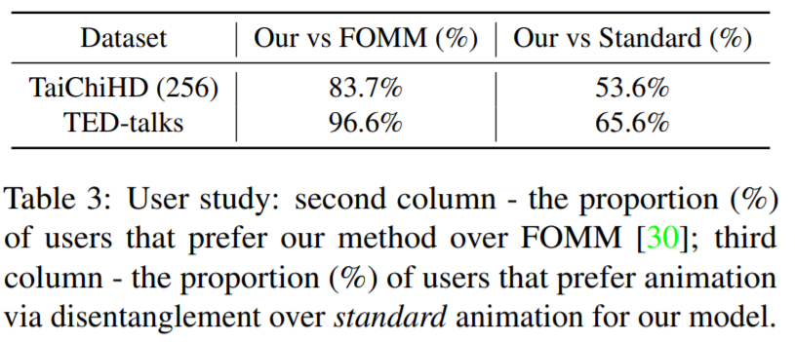
Animation Quality

Slide 28
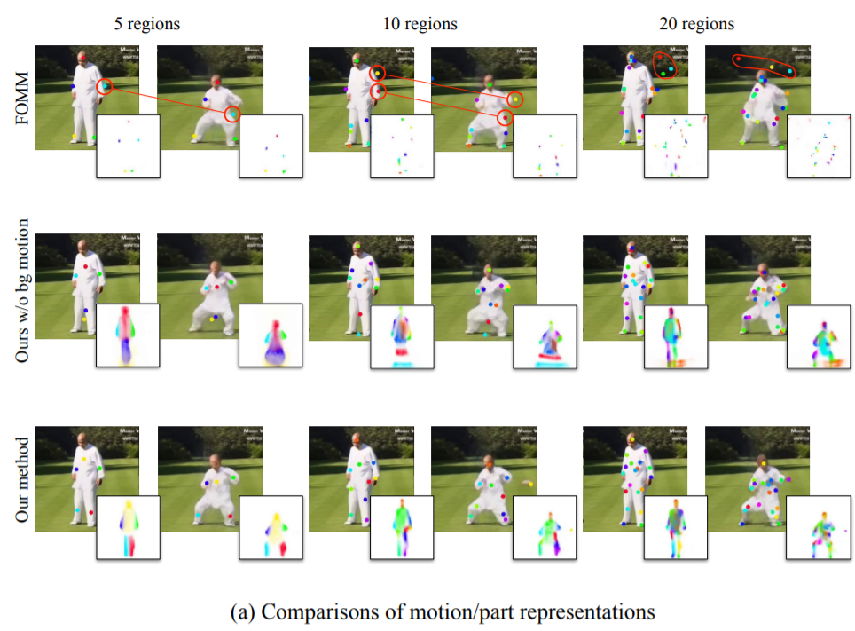
Ablations - PCA-based vs. Regression-based

Slide 29
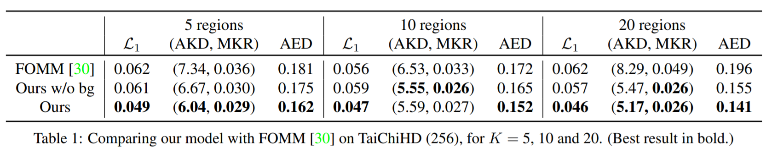
Ablations - PCA-based vs. Regression-based

Slide 30
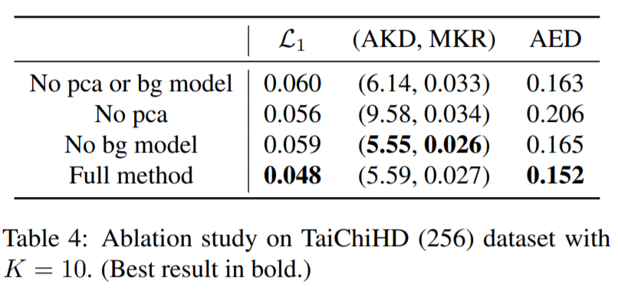
Ablations - Modeling Background Motion

Slide 31
04. Conclusion

Slide 32
Conclusion
We propose a new, PCA-based, region motion representation.
We propose a background motion estimation module to decouple foreground and background motion.
We introduce a new dataset, TED-talks.
Qualitative and quantitative results
Improved region distribution and stability
Improved reconstruction accuracy and user perceived quality.

Slide 33
Thanks for listenting!

