Slide 1
Paper Report
Squeeze-and-Excitation Networks
Jie Hu, Li Shen, Samuel Albanie, Gang Sun, Enhua Wu
journal version of the CVPR 2018 paper

Slide 2
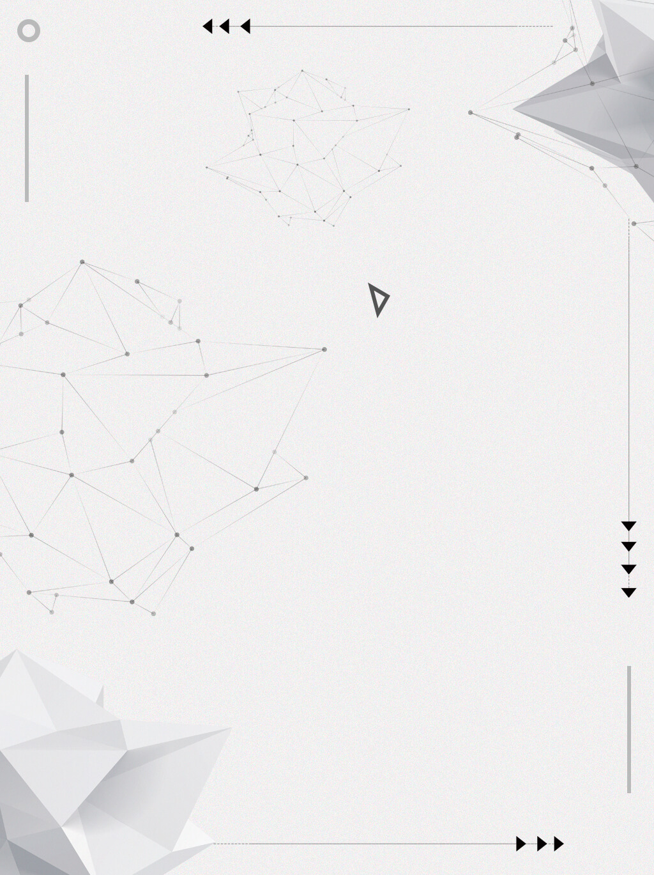
CONTENTS
01 Abstract
02 Introduction
03 Model and Computational Complexity
04 EXPERIMENTS
05 CONCLUSION

Slide 3
Abstract
In this work, we focus instead on the channel relationship and propose a novel architectural unit, which we term the “Squeeze-and-Excitation”(SE) block, that adaptively recalibrates channel-wise feature responses by explicitly modelling interdependencies between channels.

Slide 4
Introduction
The Squeeze-and-Excitation(SE) block, with the goal of improving the quality of representations produced by a network by explicitly modelling the interdependencies between the channels of its convolutional features.

Slide 5
Introduction
We propose a mechanism that allows the network to perform feature recalibration, through which it can learn to use global information to selectively emphasise informative features and suppress less useful ones.

Slide 6
Introduction

Slide 7
Introduction
Squeeze
經過Fsq找出channel中的global information，透過Global Average Pooling ，將原本shape為H*W*C的資料，轉換為1*1*C，意思是每個channel都變為一個值(channel descriptor)。

Slide 8
Introduction
Global Average pooling(GAP)

Slide 9
Introduction
使用GAP的原因
因為進行Convolution得到的輸出與前一層的每個channel都有複雜的關係，使用GAP簡化後，得到的每一點都只與一個channel有對應關係。

Slide 10
Introduction
Excitation
透過Fex學習每個channel descriptor的重要程度，包含兩層全連接層。

Slide 11
Introduction
Excitation
兩層全連接層，先降維再升維，以降低模型複雜度。

Slide 12
Introduction

Slide 13
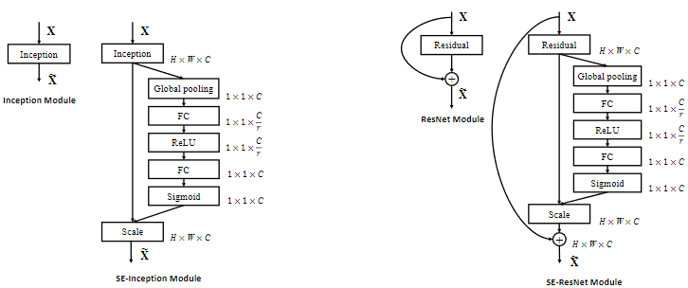
Introduction
Instantiations

Slide 14
Model and Computational Complexity
這部分會比較含有SE block的Model與原本Model的架構和複雜度（ResNet、SE-ResNet-50和SE-ResNeXt-50）。

Slide 15
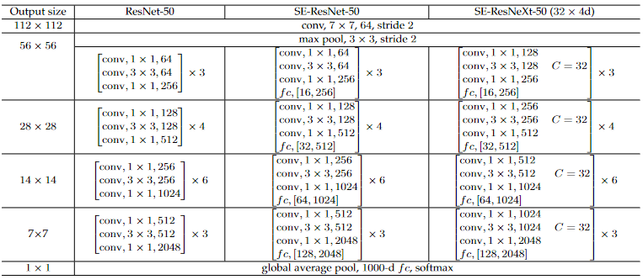
Model and Computational Complexity

Slide 16
Model and Computational Complexity

Slide 17
Model and Computational Complexity
模型加入SE block後，所增加的參數量為
r : reduction ratio
S : number of stages
Cs : dimension of the output channels
Ns : number of repeated blocks for stage s

Slide 18
Model and Computational Complexity

Slide 19
Experiments
In this section, we conduct experiments to investigate the effectiveness of SE blocks across a range of tasks, datasets and model architectures.

Slide 20
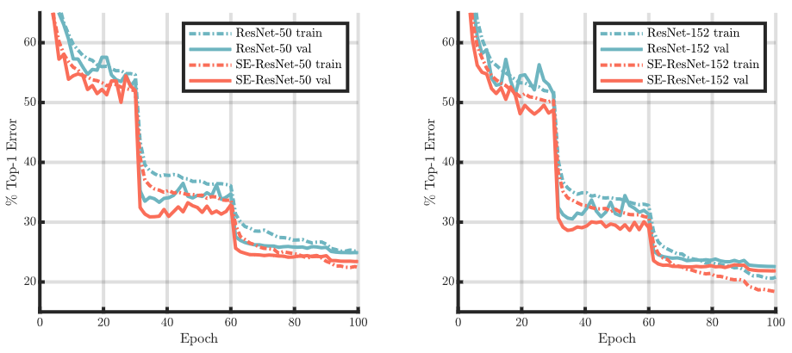
Experiments
Network depth

Slide 21
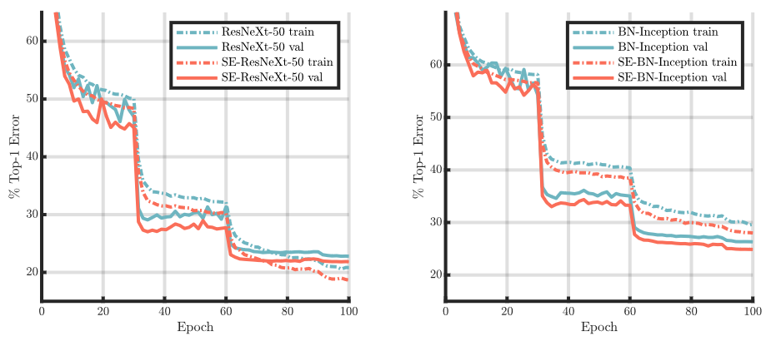
Experiments
Integration with modern architectures

Slide 22
Experiments
Integration with modern architectures

Slide 23
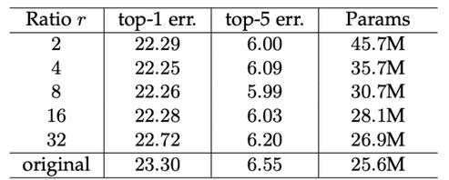
Ablation Study
Reduction ratio
測試SE Block中Excitation的全連接層降維多少效果會最好。

Slide 24
Ablation Study
Squeeze Operator
比較使用Global Average Pooling和Global Maximum Pooling，發現GAP結果較好。
Excitation Operator
比較Excitation全連接層第二層的activation function使用ReLU、tanh和sigmoid，發現sigmoid最好，ReLU最差。

Slide 25
Ablation Study
Different stages
比較在model不同的stage加入SE block，有什麼差別。

Slide 26
Ablation Study
Effect of Squeeze
測試將Squeeze中的GAP層換成1 x 1 conv層並比較結果（代表不同channel還是會互相影響）。

Slide 27
Conclusion
本篇論文提出的SENets，使用SE block這種新單元，用來加入其他現有的model，找出哪些channel擁有更重要的特徵，以達到更好的效果，並且只需要少量的計算，就能大幅提升model的表現。

