Slide 1
TilinGNN: Learning to Tile with Self-Supervised Graph Neural Network
SIGGRAPH 2020

Slide 2
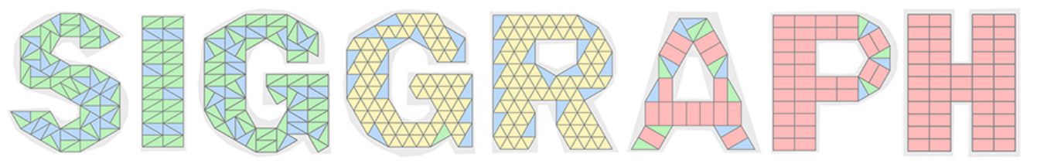
abstract
Non-periodic tiling of an arbitrary 2D shape using one or more types of tiles
First neural optimization framework to solve the tiling problem
Reformulate tiling as a graph problem
The runtime of TilinGNN is roughly linear to the number of candidate tile locations

Slide 3
Introduction
Many geometry processing tasks in computer graphics require solving discrete and combinatorial optimization problems
A traditional approach to solving the problem would search over the space of tile selection and placement
COINOR/BC and Gurobi(programming solver) are alternatives to solving our tiling problem, however very time-consuming, possibly with trial-and-error and backtracking in the solution search

Slide 4
Introduction
With the rapid adoption of machine learning, an intriguing question is whether difficult combinatorial problems involving geometric primitives can be effectively and efficiently solved using a machine learning approach
We model our tiling problem as an instance of graph learning, which can produce very good, while not necessarily optimal, solutions at much greater efficiency
At test time, the learned patterns would guide the tile placement, leading runtime linear to the number of candidate tile locations
TilinGNN represents the first attempt at generating non-periodic tilings using a deep neural network

Slide 5

Related Work
Decomposition
  A line of works that bears some resemblance to tiling follows the principle of design by composition
  Not fixed shape even deformable
  Shape collage
Assemblies of fixed blocks
  Assembling a shape using a small set of building blocks may also be viewed as a form of tiling
  Solved by integer programming (IP) solver which is time-consuming or heuristic search which is may not be general for solving problems of different forms

Slide 6
Related Work
Graph neural networks (GNNs)
  A natural extension from regular grid processing to deal with irregularly structured data is to utilize graph representations
  MeshGNN, StructureNet
Neural combinatorial optimization
  Optimization explore data-driven and learning-based schemes for solving discrete and combinatorial problems
  Alpha Go, traveling salesman(classic NP-hard problems)
  The common insight of these works is to train a neural network to predict selection probabilities over discrete options, and use a simple selection strategy (e.g., greedy) to incrementally construct a solution, as guided by the probabilities

Slide 7
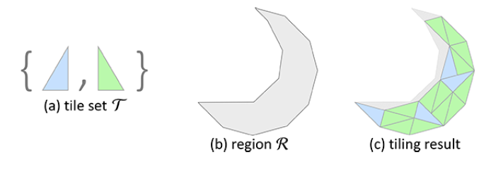
Problem Definition
Given a set T of a few simple 2D shapes representing the input tile types, and a connected region R in 2D, we aim to arrange instances of tiles from T over R without overlap or hole between the tile instances, such that the resulting tiling can maximally cover the interior of R without exceeding its boundary.
Since the shape of R is arbitrary and the tile set is limited, completely filling the entire R may not be always possible

Slide 8
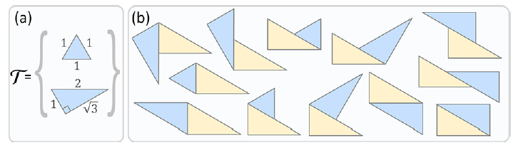
Modeling the tiling problem
Tile set and Tile placement –
  Note that we can rotate and translate the tiles, but not flip or scale them
  The tile set and tile connection rules together should induce a finite number of candidate tile locations inside a finite region, since TilinGNN is a selection network

Slide 9
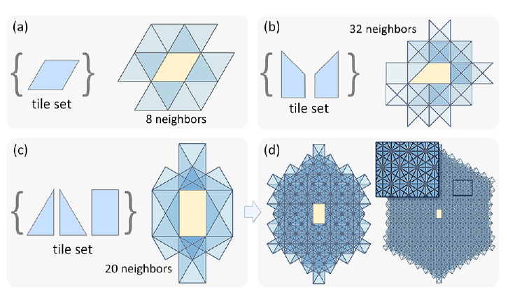
Modeling the tiling problem
Candidate tile placements
  Based on the above tile connection rule, we can determine a finite set of candidate tile placement locations over a given region. We denote such a set as P.
Superset of T

Slide 10
Modeling the tiling problem
Modeling Tiling as a Graph Problem –
  Each tile as a node (V)
  2 types of edge between nodes(tiles)
    Neighbor edge – No overlap between 2 candidate tiles
    Overlap edge – overlap between 2 candidate tiles

Slide 11
Modeling the tiling problem
G = {V, Eovl, Enbr}
Finding a (maximum) subset of nodes in G, such that all adjacent nodes are connected by edges in Enbr and no two nodes are connected by any edge in Eovl.

Slide 12
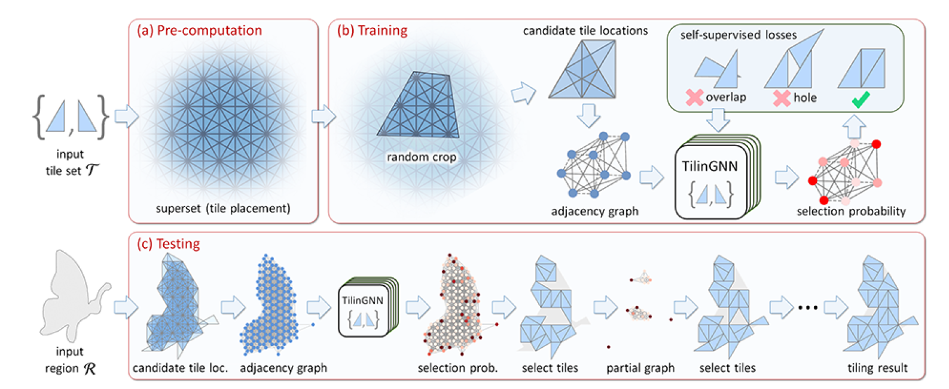
System overview

Slide 13
Network input
G = {V, Eovl, Enbr}
Per-node vectors{vi} – (N+1)-dimension vector, i-th tile area + tile type(one-hot vector)
Per-neighbor-edge vectors{ej} – (Np+1)-dimension vector, shared edge with neighbor + Np relative poses that the j-th neighbor edge associates with(one-hot vector)
Normalized by largest tile area
vi = [0.5 , 1, 0, 0]
ej = [0.6 , 0, 0, 1,…….,0]
20
Normalized by longest tile perimeter
N=number of tile type in set T, Np relative poses in set P

Slide 14
Network Architecture
TilinGNN is a two-branch graph convolutional neural network
Output the probability of each node to select
N = number of node, C =64, L=20
Concatenate result from all layer N*C*(L+1)
Network input
Neighbor edge info to each layer
NxC
Overlap edge info to each layer
N-dimension. The probability to select the node

Slide 15


Network Architecture
(Edge condition convolution)
Neighbor –
Overlap –
Both use residual connections to avoid problem of vanishing gradient

Slide 16
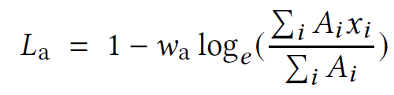
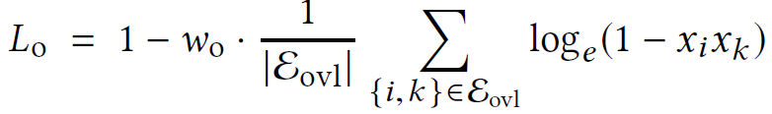
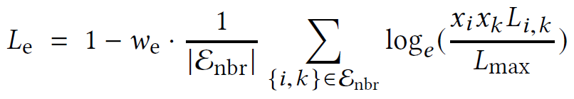
Loss function
Maximize the tiling area
Minimize the overlap
Maximize total length of the contacting edge
Between those connected with neighbor edge
the overall loss = product of L_{a}, L_{o}, and L_{e}
W_{o} = 10, w_{a} = 1, w_{e} = 0.02, x_{i} = probability to select node_{i}

Slide 17
Tiling Generation
Step one:
  Randomly sample 6 rotation angles in [0, θ) and 9 translation vectors in [0, Δx) and [0, Δy) to put R on the superset. Pick top-K configurations that lead to the largest total tile area and make the adjacency graph (k=4~20, depends on the task)
  Or by interactive UI
Step two:
  Make all we need for the network and get the probability vector on the candidate tile locations
  Sort the vector then tile until an overlap occur

Slide 18
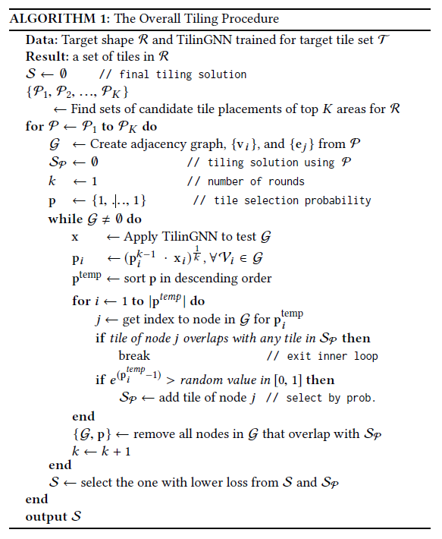
Tiling Generation

Slide 19
Result and Experiments
Training detail –
  12000 random shapes for cropping(3~20 vertices, area 0.3~0.8, no self-intersection)
  Optimizer: Adam
  Learning rate: 1e-3
  Training epoches: stop when loss stopped reduce(20~80, 2~5days)

Slide 20
Result and Experiments
Tiling generation
  107 silhouette images from MPEG-7 data set and animal shapes
  Tiling multiple times, select the largest tiling coverage or the one with a larger total length of contacting edge segments(if multiple results produce the same coverage area)
  Average tiling time 23.5s

Slide 23
Our approach can generate interesting tiling solutions for the shapes and reproduced some featured regions using different tile arrangements; see particularly the wings of the different Doves and the tail of the different Cats for examples

Slide 24
Evaluation
Compare with
  Random search framework that uses above algorithm but replaces the TilinGNN output probabilities with random values in [0, 1]
  A greedy strategy that follows existing shape packing methods(PAD)
  A specialized integer programming solver, Gurobi(has been shown to perform fast in many combinatorial optimization problems)
  A branch & cut mixed integer solver (Coin-BC)
Compare
  8 different size (20%~90% of tile superset)
  2 shapes – cat and moon
  10 times and take average

Slide 25
Evaluation
Converage
Hole?
Time
and
candidate
Result

Slide 26
Evaluation
Gurobi grow rapidly, TilingGNN linearly

Slide 27
Human performance

Slide 28
Network Analysis

Slide 29
Conclusion
The first deep-learning-based approach to generate non-periodic tilings on given 2D shapes
Contribution
  Model tiling as a graph problem with nodes and edges representing the candidate tile locations and tile connectivity
  Design TilinGNN, a two-branch graph convolutional neural network
  Formulate these criteria as loss terms defined on the network outputs
We performed various experiments to evaluate the quality of our approach
Since this form of tiling is only one particular instance of the more general problem setting of “learning to select” over a graph structure, we believe that our approach can bring insights and open up new directions for solving other similar combinatorial problems in computer graphics research

Slide 30
Limitations
TilinGNN is a selection network that learns to select from a finite set of candidate tile locations, so we consider tile sets that the induced candidate tile locations form periodic grids
TilinGNN cannot deal with all kinds of tile sets
Results from TilinGNN may not always avoid gaps and holes
The tiling results may miss shape structures that are typically thin, if the shape does not fully cover surrounding candidate tile locations in the cropping

