Slide 1
TransMoMo: Invariance-Driven Unsupervised Video Motion Retargeting
Zhuoqian Yang, Wentao Zhu, Wayne Wu, Chen Qian, Qiang Zhou, Bolei Zhou, Chen Change Loy
(CVPR 2020)

Slide 2
Outline
Introduction
Related Works
Methods
  Motion Retargeting Network
  Invariance-Driven Disentanglement
Experiments
  Representation Disentanglement
  Comparisons to State-of-the-Art Methods
  Ablation study
Conclusion

Slide 3
1. Introduction

Slide 4
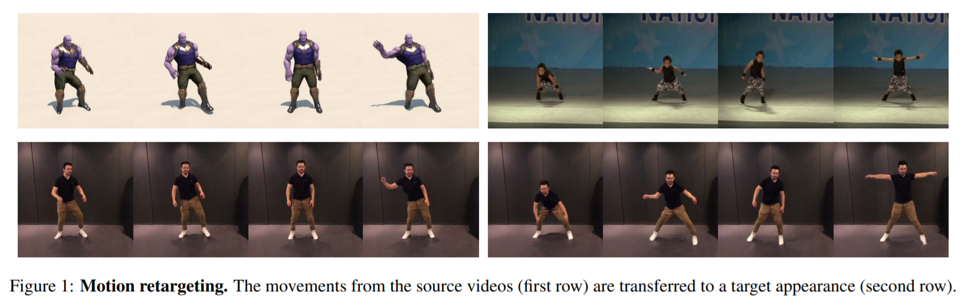
Introduction
Transferring motion of a person in a source video realistically to another video of a target person.

Slide 5
Challenge
It is difficult to learn a direct person-to-person mapping at the pixel level.
No corresponding image pairs of two different subjects performing the same motion.
Human motion is highly articulated and complex.

Slide 6
Address the Challenge
Decompose the translation process into three steps
  Skeleton Extraction
  Motion retargeting on skeleton
  Skeleton-to-video rendering
Exploit the invariance property of three factors
  Motion should be invariant despite structural and view-angle perturbations
  Structure of one skeleton sequence should be consistent across time and invariant despite view-angle perturbations
  View-angle of one skeleton sequence should be consistent across time and invariant despite structural perturbations

Slide 7
Contributions
Propose a novel Motion Retargeting Network in 2D skeleton space, which can be trained end-to-end with unlabeled web data.
We introduce novel loss functions based on invariance to endow the proposed network with the ability to disentangle representation in a purely unsupervised manner.
Extensive experiments demonstrate the effectiveness of our method over other state-of-the-art approaches, especially under in-the-wild scenarios where motion are complex.

Slide 8
2. Related Works

Slide 9
Related Works
Motion Retargeting
  The performance of traditional methods degrades when large variations happened between two individuals.
Unsupervised Representation Disentanglement
  The performance of traditional methods are not satisfactory on human videos.
Person Generation
  The generation process could be conditionally guided by skeleton keypoints and style codes.

Slide 10
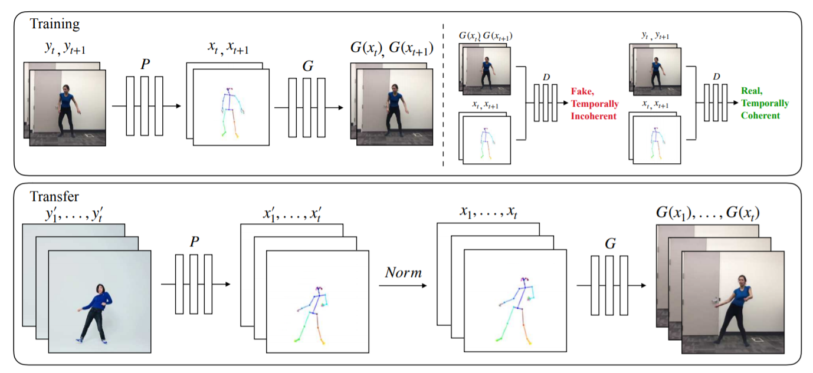
Related Works
Everybody Dance Now [ICCV 2019]

Slide 11
3. Methods

Slide 12
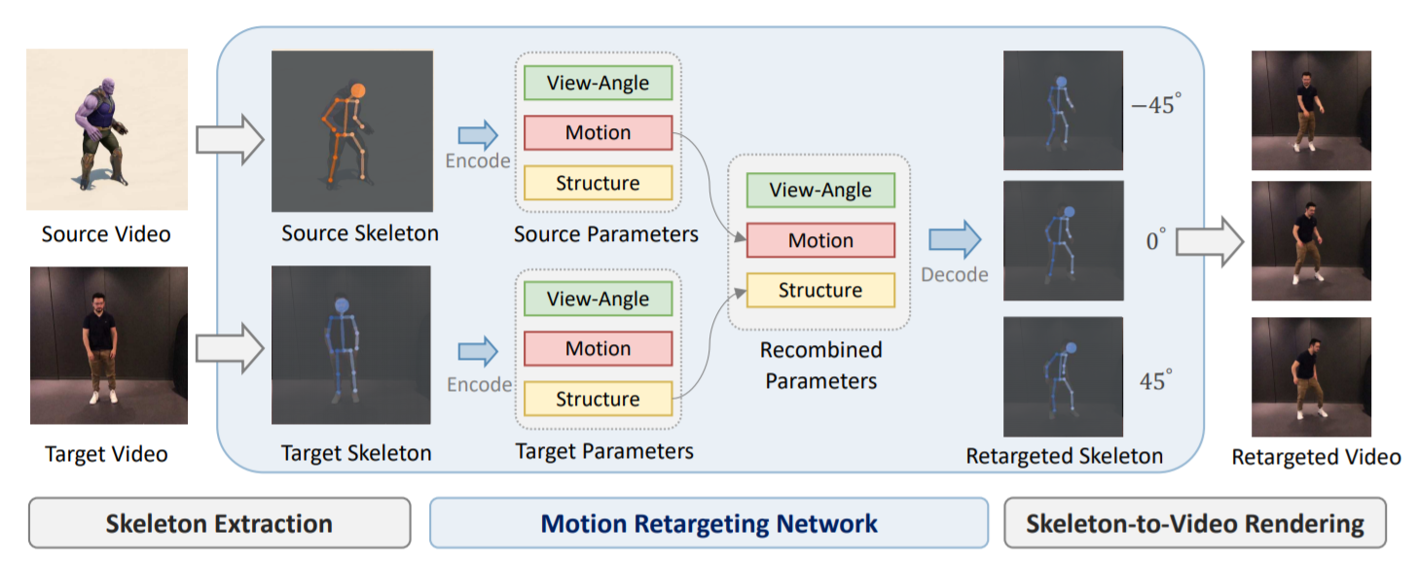
3.1. Motion Retargeting Network

Slide 13



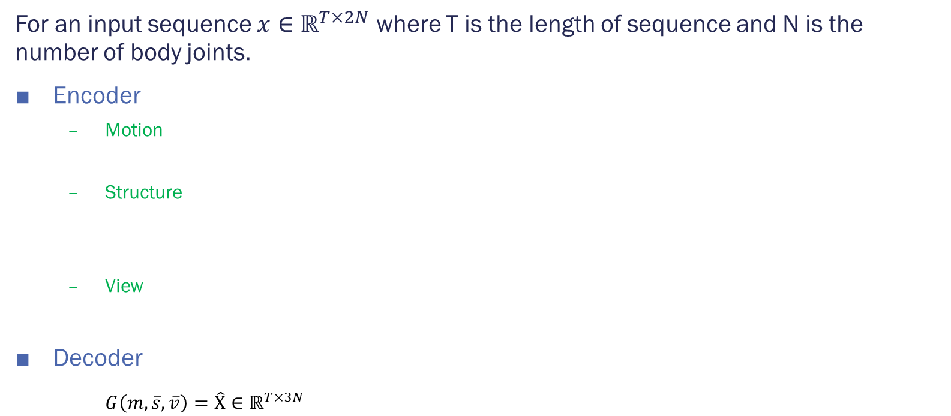
3.1. Motion Retargeting Network
For an input sequence $x∈ℝ^{T×2N}$ where T is the length of sequence and N is the number of body joints.
Encoder
  Motion
  Structure
  View
Decoder
$G\left(m,\overline{s},\overline{v}\right)=\hat{Χ}∈ℝ^{T×3N}$

Slide 14
3.2. Invariance-Driven Disentanglement
Limb Scaling as Structural Perturbation
3D Rotation as View Perturbation

Slide 15

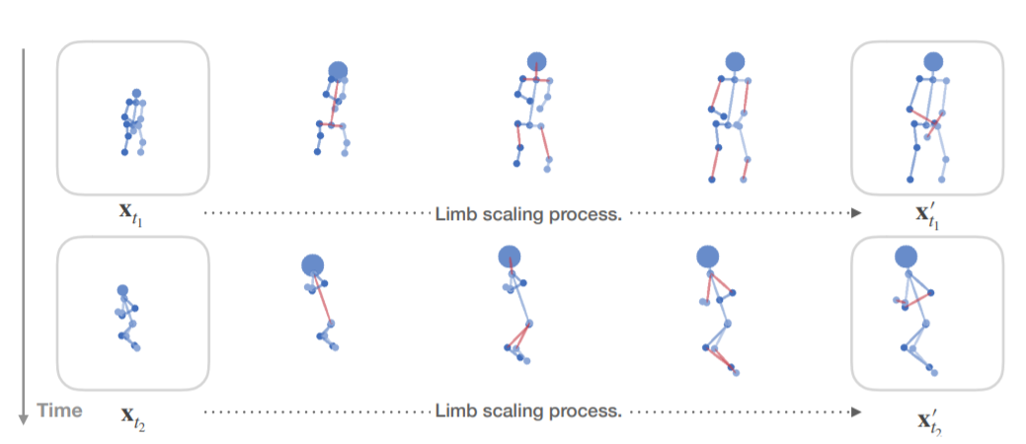
Limb Scaling as Structural Perturbation
δ is the limb scaling function

Slide 16
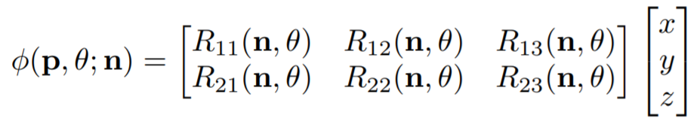
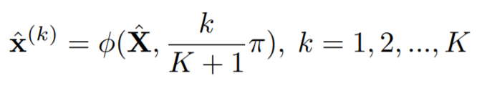
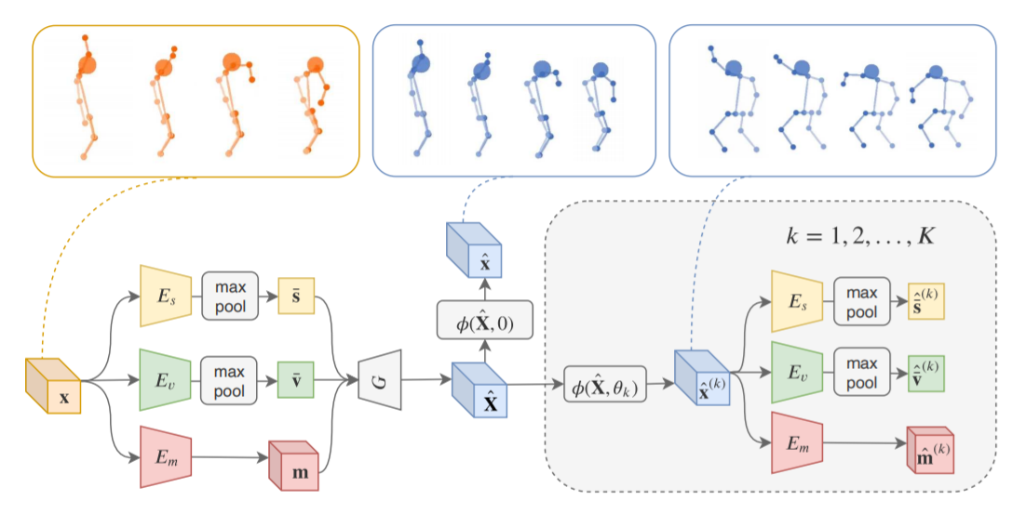
3D Rotation as View Perturbation
Φ is a rotate-and-project function
R is a rotation matrix

Slide 17
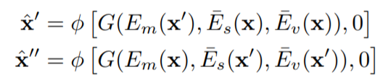
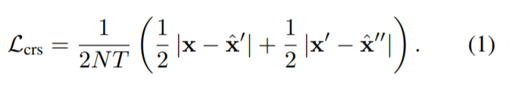
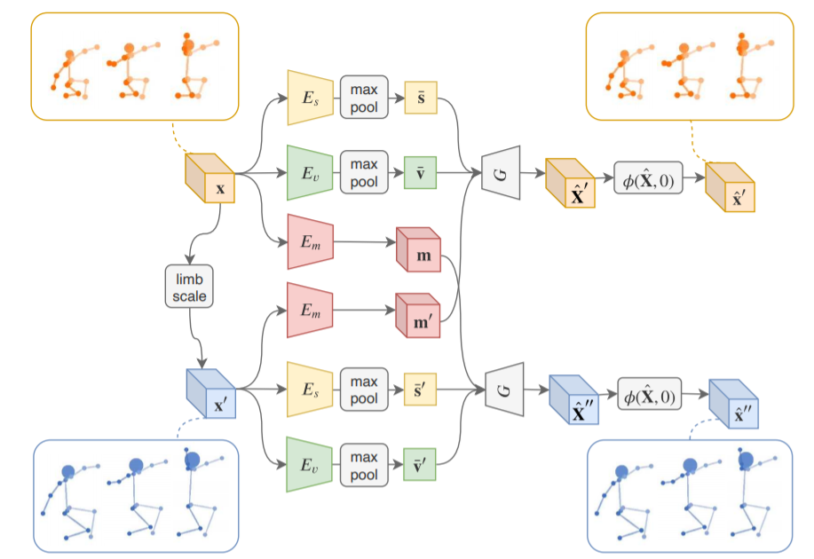

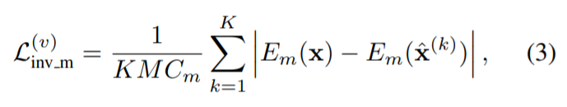
3.2.1. Invariance of Motion
Cross Reconstruction Loss
Structural Invariance Loss
Rotation Invariance Loss

Slide 18

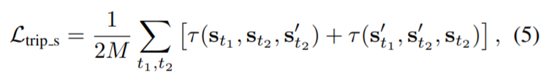
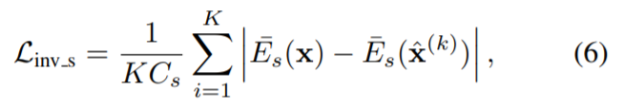
3.2.2. Invariance of Structure
Triplet Loss
  s(·,·) denotes the cosine similarity function
Rotation Invariance Loss

Slide 19
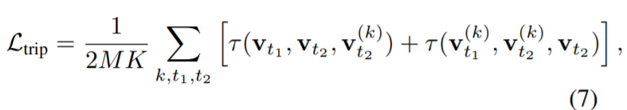

3.2.3. Invariance of View-Angle
Triplet Loss
Structural Invariance Loss

Slide 20

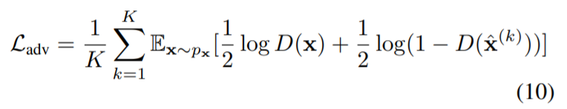
3.2.4. Training Regularization
Reconstruction Loss
Adversarial Loss

Slide 21
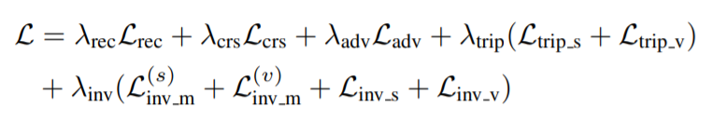
3.2.5. Total Loss

Slide 22
4. Experiments

Slide 23
Representation Disentanglement
Motion retargeting
  Extract the desired motion from the source skeleton sequence, then retarget the motion to the target person.
Novel-view synthesis
  We can explicitly manipulate the view of decoded skeleton in the 3D space, rotating it before projecting it down to 2D.
Latent space interpolation
  The learned latent representation is meaningful when interpolated. Both the motion and the body structure change smoothly between the videos.

Slide 24
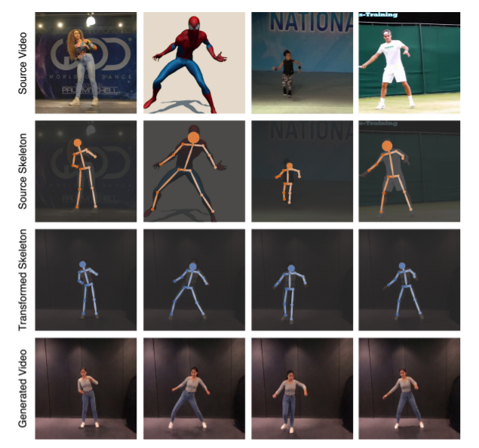
Motion Retargeting

Slide 25
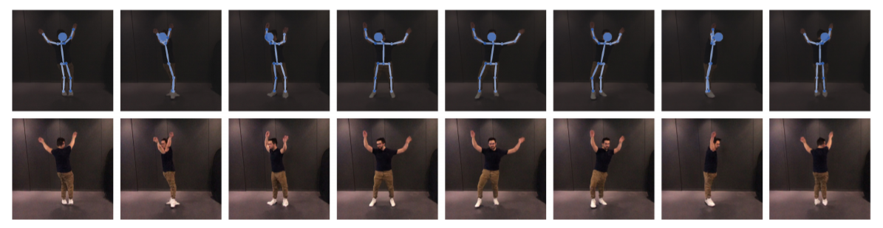
Novel-View Synthesis

Slide 26
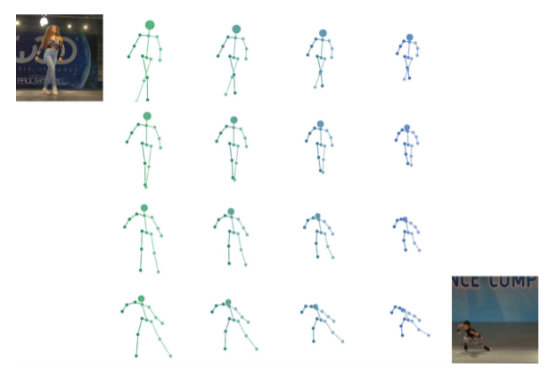
Latent Space Interpolation

Slide 27
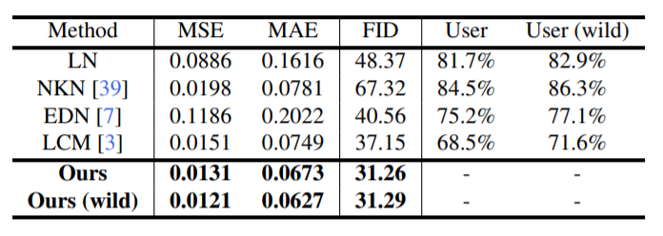
Comparison to State-of-the-Art Methods
Metrics
  MSE and MAE measure joint position errors
  FID measure the quality of rendered images
Dataset
  Mixamo
  Solo-Dancer from online videos (wild)

Slide 28
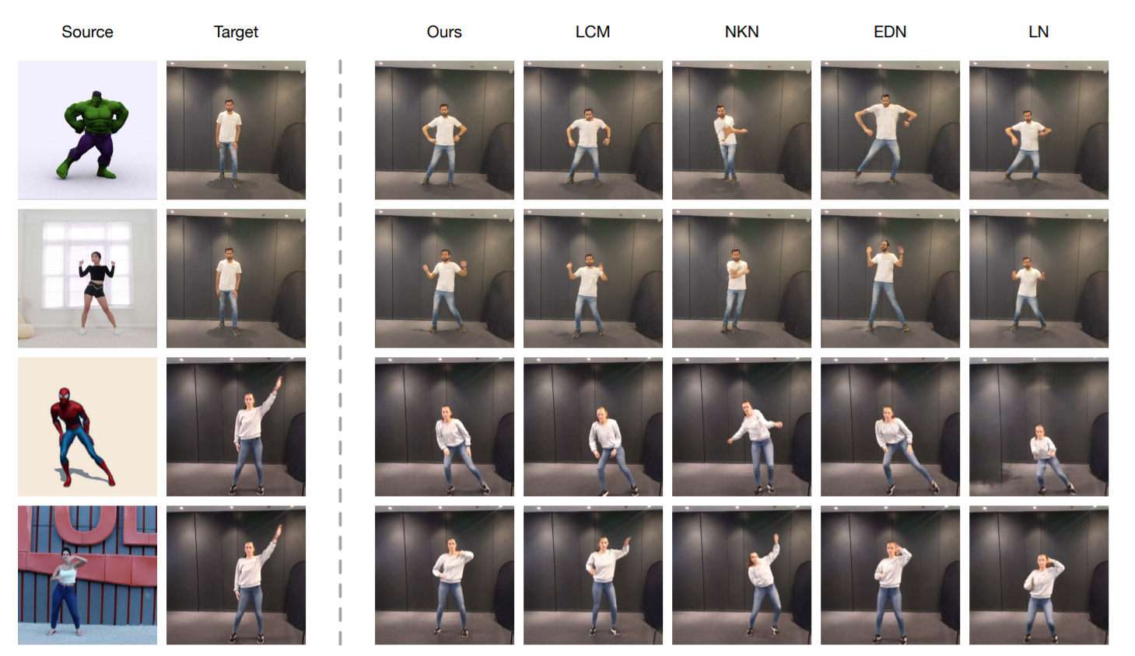
Qualitative Comparison

Slide 29
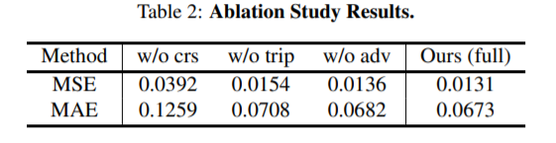
Ablation Study
The w/o crs model
  Without cross reconstruction loss
The w/o trip model
  Without triplet loss
The w/o adv model
  Without adversarial loss

Slide 30
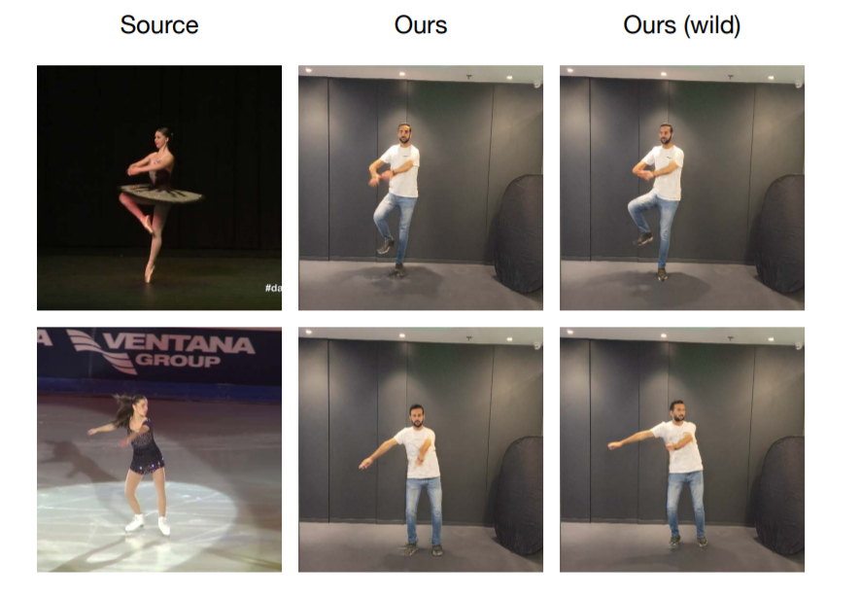
Results of In-the-wild Trained Model

Slide 31
5. Conclusions

Slide 32
Conclusions
Propose a novel video motion retargeting approach, in which motion can be successfully transferred in scenarios where large variations of body-structure exist between the source and target person.
The proposed motion retargeting network runs on 2D skeleton input only, makes it a lightweight and plug-and-play module.
Leveraging three inherent invariance properties in temporal sequences, the proposed network can be trained with unlabeled web data end-to-end.

Slide 33
Thank you for listening

