Slide 1
Vision Transformer for NeRF-Based View Synthesis from a Single Input Image
UC San Diego, MIT, Google, NVIDIA
2022/12/14 陸品潔

Slide 2
Contents
01
Related Works
02
Novel View Synthesis From a Single Image
03
Experimental Results

Slide 3
01
Related Works

Slide 4
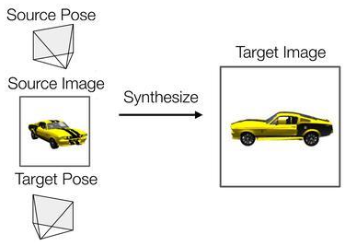
Novel View Synthesis
Synthesize a target image with an arbitrary target camera pose from given source images and their camera poses.
Notes:
新視角合成任務 (Novel View Synthesis)
給定源圖像 (Source Image) 、源姿態 (Source Pose)、目標姿態 (Target Pose)
渲染生成目標姿態對應的的圖片 (Target Image)
補足不存在於原始資料的視角
傳統Nerf要達到的目標

Slide 5
Neural Radiance Fields (NeRFs) for View Synthesis
Notes:
NeRF的核心精神
將物體與場景的資訊，編碼 (encode) 進 MLP (multi-layer perceptron)中。
使用 computer graphics中的 volume rendering將 MLP中的資訊投影出來。
NeRF的訓練
NeRF 所需要的是某個物體與場景的 multi-view影像，將資訊 encode進 NeRF。
之後就可以對這個物體與場景 render出連續、不存在於原始資料的視角。

Slide 6
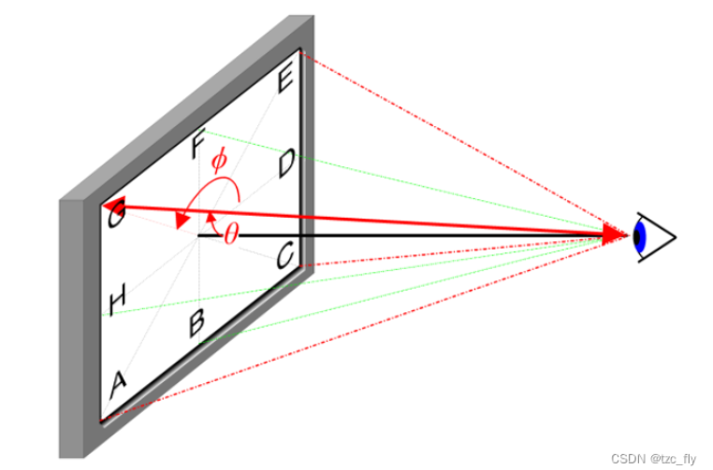
Neural Radiance Fields (NeRFs) - Training
Field quantities producing
Sample a ray r(t) = o + td
MLP: (x, y, z, θ, $∅$) ➔ (R,G,B,σ)
Volume rendering
Accumulate (R,G,B,σ) into a 2D image
Notes:
neural field variations, fully connected neural networks encode objects or scenes' properties.
one network needs to be trained to encode (capture) a single scene.
1）重建：用 MLP 網路學 Scene Representation。
輸入源圖像對應的三維空間座標和視角 (x,y,z,θ,ϕ) ；輸出 (R,G,B,σ) ，分別表示RGB 顏色值和體素密度 。
(volume density可以解釋為這條射線會停在這個 3D位置的機率，而 emitted color指的是由某個視角看出去這個 3D位置的顏色。)
2）渲染：由 Volume Rendering 生成預測的 2D image。
預測的 2D image 和 ground truth image 之間算 L2 loss。
假設現在要從某個位置與角度渲染一張圖，那就是從相機中心對每個 pixel射出射線，接著
射線中的每個點 (經過 stratified sampling) 都丟進 NeRF網路得到 emitted color 與 volume density，最後用 Quadrature積分起來就是這個 pixel的顏色了。
至於訓練的時候就簡單了，對於存在於 training data中的圖片都從 NeRF網路中渲染一張出來，然後直接計算他們兩個之間的 L2 loss。

Slide 7
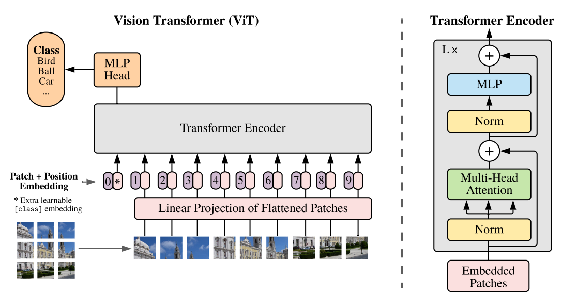
Vision Transformer(ViT)
Model for image classification
Applying a transformer to a sequence of patches
Notes:
分為兩部分，一部分是特徵提取部分，另一部分是分類部分
特徵提取部分在圖片中的對應區域是Patch+Position Embedding和Transformer Encoder。
Patch+Position Embedding的作用主要是對輸入進來的圖片進行分塊處理，每隔一定的區域大小劃分圖片塊。然後將劃分後的圖片塊組合成序列。在獲得序列資訊後，傳入Transformer Encoder進行特徵提取，這是Transformer特有的Multi-head Self-attention結構，通過自注意力機制，關注每個圖片塊的重要程度。
在分類部分，利用提取到的特徵進行分類。在進行特徵提取的時候，我們會在圖片序列中新增上Class Token，該Token會作為一個單位的序列資訊一起進行特徵提取，提取的過程中，該Class Token會與其它的特徵進行特徵互動，融合其它圖片序列的特徵。最終，我們利用Multi-head Self-attention結構提取特徵後的Class Token進行全連線分類。

Slide 8
02
Novel View Synthesis From a Single Image

Slide 9
Novel View Synthesis in Occluded Regions
Notes:
Why用ViT? 因為in Occluded Regions…
using ViT to learn the long-range dependencies between features.
Recent works infer the 3D shape and appearance by projecting the input image features on the queried 3D point to predict the color and density(未對資料加以處理)
rendering target views close to the input view → 表現好
否則 → 隨著角度差越多越退化
PixelNeRF , query features along the ray, which corresponds to the car’s window in the input view (red cross).
Our method uses self-attention to learn long-range dependencies, which is able to find the most related features in the source view (green dot) for rendering a clear target view.

Slide 10
Process
Given: a single image $Is$
Task: novel view $It$
Determination: occluded or not ?
No → $Is(π(x))$
Yes → 3 solutions
1D latent code
2D spatially-variant image feature
3D volume-based approaches
Notes:
已知: single image Is at camera s
目標: novel view It at camera t.
If a 3D point x is visible in the source image?
Yes → use the color Is(π(x)) (π denotes the projection to source view,)
No → 3 solutions
1D latent code
2D spatially-variant image feature
3D volume-based approaches
Our approach

Slide 11
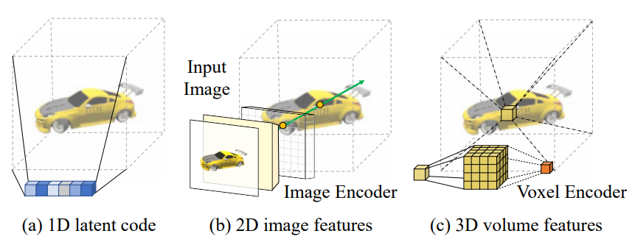
Novel View Synthesis in Occluded Regions
1D latent code :
$(σ, c) = ℱ_{1D} (z; x; d)$
Limited inductive bias
2D spatially-variant image feature
$(σ, c) =ℱ_{2D}(W(π(x)); x_{c}; d_{c})$
Better rendering quality in visible areas / more computationally efficient
3D volume-based approaches
$(σ, c) =ℱ_{3D}(W(π(x_{n}));x_{n})$
Faster in rendering / Limited rendering resolution
Notes:
1D latent code
x and d denotes the spatially-varying sampling position and viewing direction
different 3D points share the same latent code
inductive bias(在機器學習中，很多學習演算法經常會對學習的問題做一些關於目標函數的必要假設)
2D spatially-variant image feature
xc is the 3D position and dc is the ray direction
any 3D point along a ray xt ∈ r would share the same feature W(π(xt)). This representation encourages better rendering quality in visible areas, and is more computationally efficient
3D volume-based approaches
xn denotes the set of neighboring voxels of x
3D CNN can utilize information from neighboring voxels to infer geometry and appearance at x
1D approach
enjoys a holistic view on the object
is able to encode the overall shape in a compact(小的) format
2D method
offers better visual quality around input views
3D method
refines the shape
suffers from limited rendering resolution due to the voxel size and limited receptive fields

Slide 12
Novel View Synthesis in Occluded Regions
ViT architecture :
$\text{L}\text{earn} \text{global} \text{information}$
2D CNN module:
$\text{E}\text{xtract} \text{local} \text{image} \text{features}$
$$W_{G}$$
$W$(per-pixel feature)
$$W_{L}$$
Notes:
Our method
combines the advantage of 2D-based method that condition on local image features, and 1D-based methods that encode global information.
our method does not require a canonical coordinate system to utilize the global features. Our method enjoys the benefits of high-resolution image features from 2D-CNN, while improving the receptive fields(卷積神經網路的每一層輸出的特徵圖（Feature map）上的圖元點在原圖像上映射的區域大小) through ViT encoder.
divide W into two parts:
(i) global feature maps WG
(ii) local feature maps WL

Slide 13
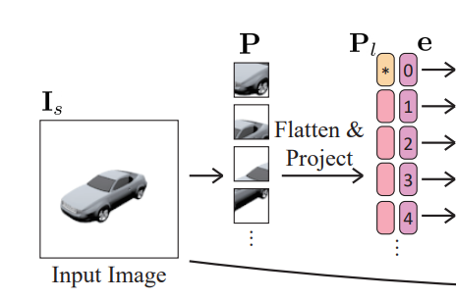
Global Features from Vision Transformer
Flatten and project
Reshape $Is$into a sequence of flattened 2D patches $P$
Project the patches with a trainable linear layer to produce $P_{l}$
Concatenate learnable class token to the image tokens
Add learnable positional embeddings
Notes:
Our model takes as an input a single image Is ∈ R H×W×3
reshaped into a sequence of flattened 2D patches P ∈ R N×P 2×3 , where N = HW P 2 is the number of patches, P denotes the patch size
project the patches with a trainable linear layer to produce Pl ∈ R N×D
learnable class token is usually concatenated to the image tokens to incorporate global information that is not grounded in the input image
add learnable positional embeddings e to distinguish between different spatial patches: P i e = P i l + e i .

Slide 14
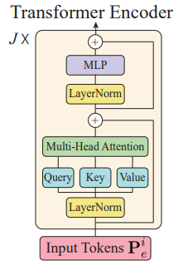
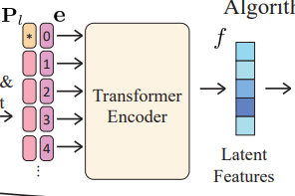
Global Features from Vision Transformer
Transformer encoder
Compose of multiheaded self-attention (MSA) and MLP layers
Notes:
The tokens {P 0 e , P 1 e , ..., P N e } undergo J transformer layers to generate latent features f j , where j denotes the output of the j-th transformer layer.
The transformer layer is composed of multiheaded self-attention (MSA) and MLP layers. The MSA block performs self-attention on the images
the transformer encoder has a global receptive field in all the layers, which can easily learn long-range dependency between different image patches

Slide 15
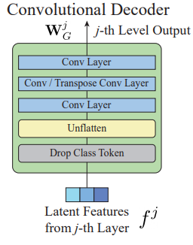
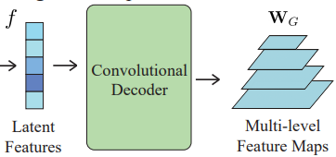
Global Features from Vision Transformer
Convolutional decoder
Drop the class token
Unflatten the image
Construct the multi-level feature maps with a set of convolutional decoders
w
Notes:
promote the latent features into multi-level feature maps. These multi-level feature maps extract coarse-to-fine global information and allow us to concatenate with the local appearance features in the final rendering stage
To generate the feature maps, we first drop the class token. The class token is useful during the self-attention stage but does not have physical meaning when unflattened . Consequently, we define the operation as O : R (N+1)×D → R N×D.
After dropping the class token, we unflatten the image by U : R N×D → R H P × W P ×D.
Now we have a set of feature patches Pf = {P 0 f , ..., P J f }, where P j f ∈ R H P × W P ×D. We then construct the multi-level feature maps with a set of convolutional decoders.
The convolutional decoders are defined as D : R H P × W P ×D → R Hj×Wj×Dj
where the feature patches are
(i) first convolved with a 1×1 convolution layer,
(ii) resampled with a strided convolution or transposed convolution to have size Hj × Wj
(iii) convolved with a 3 × 3 convolution layer to have Dj channels
Wj G = (D ◦ U ◦ O)(f j ), where j ∈ {0, 1, ..., J}.

Slide 16
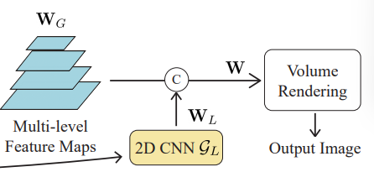
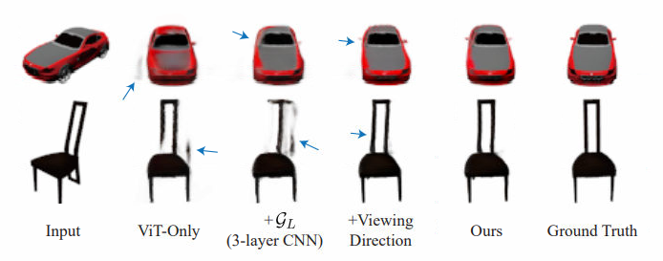
Local Features from Convolutional Networks
Improve the color and appearance consistency in the visible regions
w
Use a convolutional layer $G$ to fuse the information from $W_{G}$ & $W_{L}$
w

Slide 17
Volumetric Rendering with NeRF
Extract $W$as W(π(x)) to be the input of MLP
Drop the
Render the target view into a 2D image
C
Adopt a L2 norm loss to compare the rendered pixel against the ground-truth pixel
s
Notes:
We denote a 3D sample location as x, which can be projected onto the source image with coordinate π(x) with known camera parameters.

Slide 18
03
Experimental Results

Slide 19
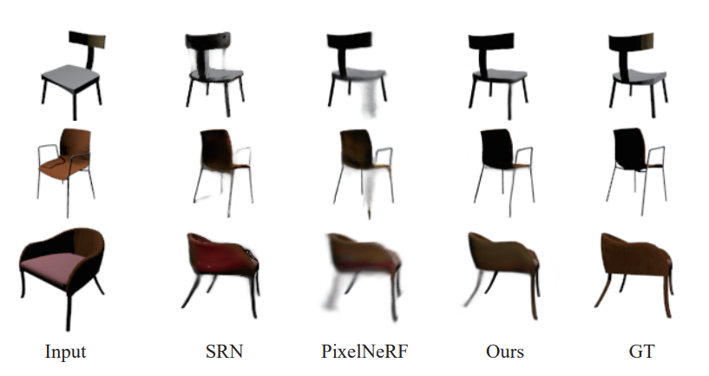
Category-specific View Synthesis
Chairs

Slide 20
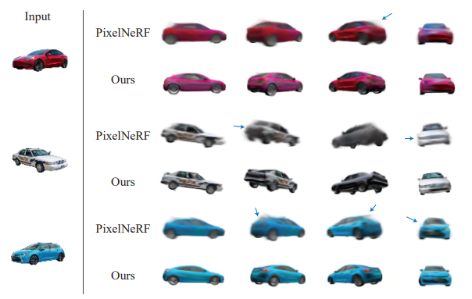
View Synthesis on Real Images
Notes:
use our model trained on the ShapeNet car dataset to test on real car images from the Stanford cars dataset

