Slide 1
Denoising Diffusion Probabilistic Models
https://arxiv.org/abs/2006.11239

Slide 2
Outline
Introduction
Method
Experiment
4. Conclusion

Slide 3
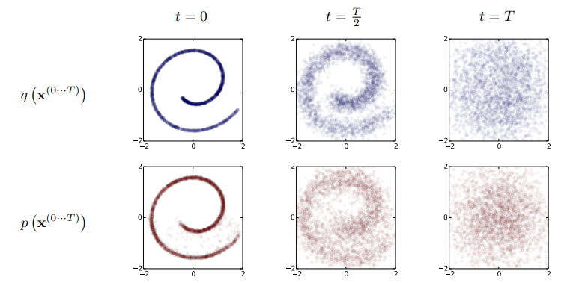
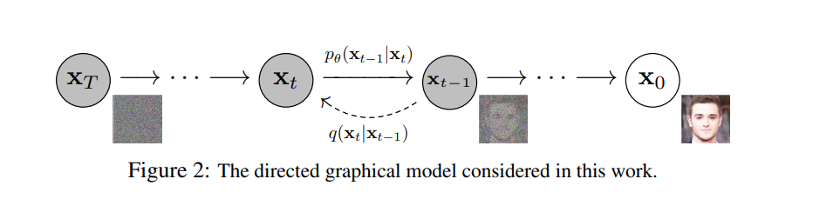
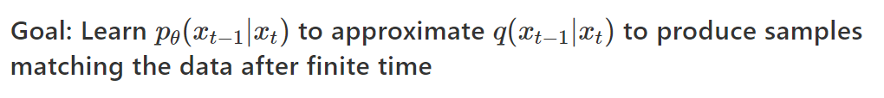
Introduction

Slide 4
Method

Slide 5
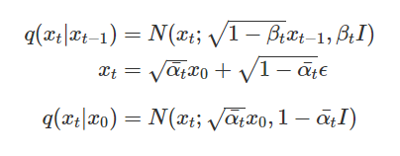

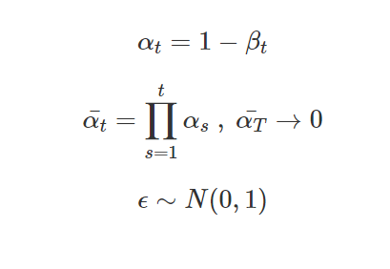
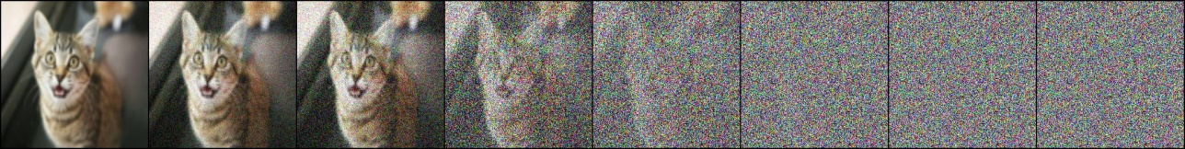

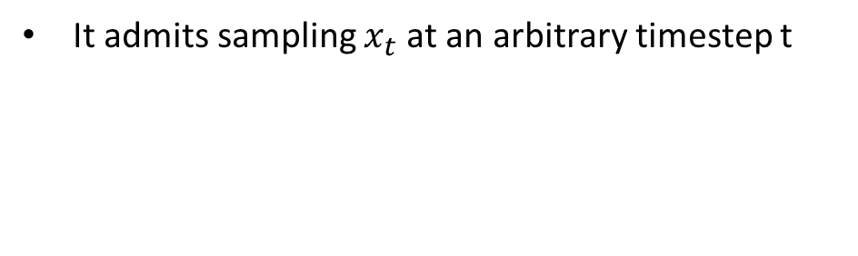
Forward Process
Variancec schedule
linear from 0.0001 ~ 0.02
Timestep
T = 1000
Notation
It admits sampling $x_{t}$at an arbitrary timestep t
Reparameterization
${ x}_{0}$ ${ x}_{50}$ ${ x}_{100}$ $x_{300}$ ${ x}_{500}$ ${ x}_{700}$ ${ x}_{900}$ ${ x}_{1000}$

Slide 6
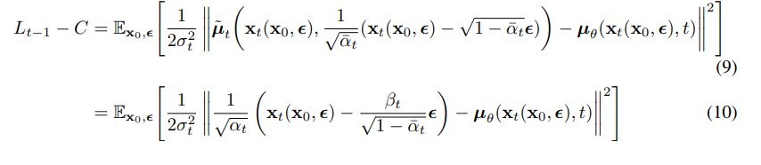


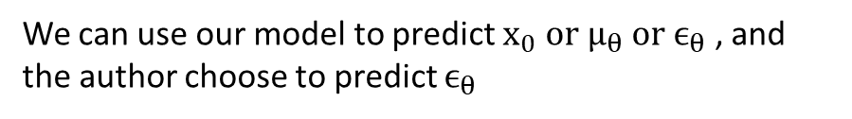
Training Objective
We can use our model to predict $x_{0} or μ_{θ} or ϵ_{θ}$ , and the author choose to predict $ϵ_{θ}$
Note:

Slide 7
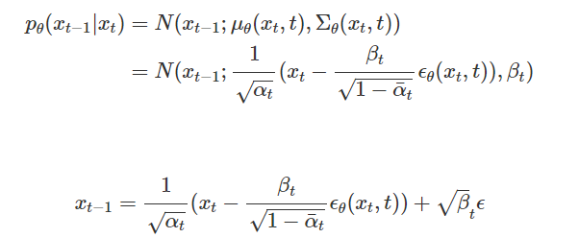

Reverse Process
${ x}_{1000}$ ${ x}_{800}$ ${ x}_{400}$ ${ x}_{200}$ ${ x}_{150}{{ x}_{100} x}_{50}$ ${ x}_{0}$

Slide 8
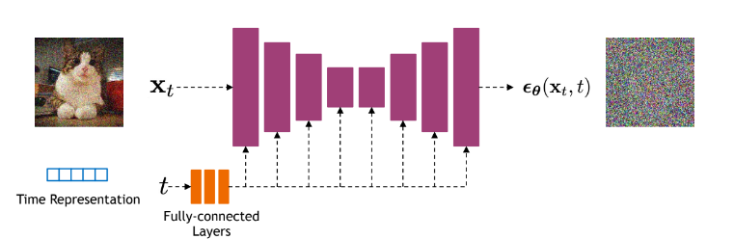
Network Architecture
Ref: https://cvpr2022-tutorial-diffusion-models.github.io/
Unet with residual block and self-attention and add time embeding to conditioned with time step

Slide 9
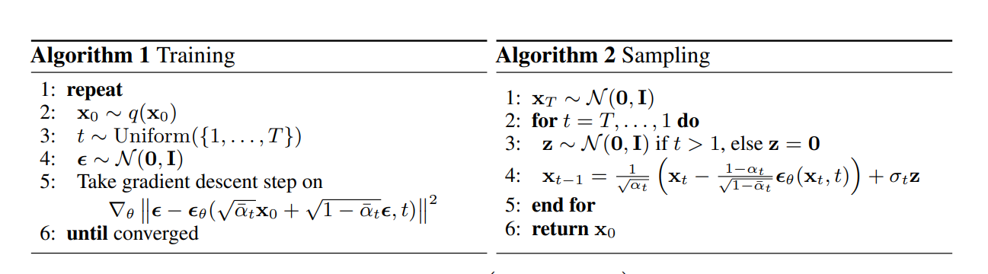
Training and Sampling
Forward Process
Loss Function
Reverse Process

Slide 10
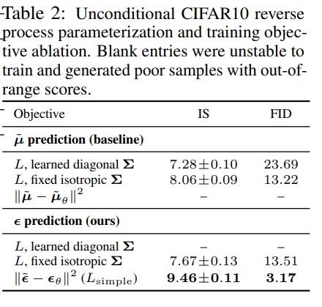
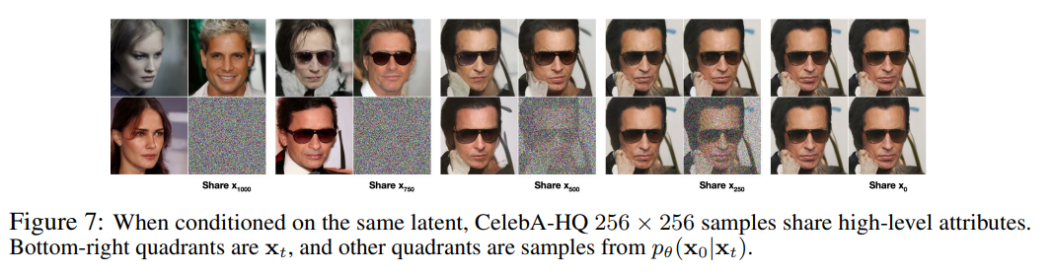
Experiment

Slide 11
Conclusion
achieved high quality image generation without adversarial training
Aquire simple training objective , Reverse process predict ε instead of µ
Many follow-up research Improve diffusion base model based on this architecture

Slide 12
Thanks for your listening

