Slide 1
Endless Loops: Detecting and Animating Periodic Patterns in Still Images
SIGGRAPH 2021
Tavi Halperin, Hanit Hakim, Orestis Vantzos, Gershon Hochman, Netai Benaim, Lior Sassy, Michael Kupchik, Ofir Bibi, Ohad Fried

Slide 2
Content
01
Introduction
04
Extensions
02
Related Works
05
Result and Evaluation
03
Method
06
Conclusion

Slide 3
Introduction

Slide 4
Introduction
One specific type of surreal manipulation is called a cinemagraph — a video in which most areas are static, and some areas contain seamless repeating motion.
The input is a single image rather than a video.
(2) The desired output is a surreal visual such as a moving building.

Slide 5
Introduction
A fast two stage algorithm for detecting repeating patterns suitable for animated motion. The first stage efficiently solves a reduced 1D matching problem, and the second stage is extending that result to 2D using a CRF formulation.
A system that generates looping videos from a single image, that can create surreal motion which cannot be observed in datasets of real video.
An interactive mobile app for cinemagraph creation, usable by novices and experts alike.

Slide 6
Related work

Slide 7
Related work
Cinemagraphs
Animating Pictures with Eulerian Motion Fields.
Aleksander Holynski, Brian Curless, Steven M Seitz, and Richard Szeliski. 2020
Pattern Recognition
Image completion using efficient belief propagation via priority scheduling and dynamic pruning
Nikos Komodakis and Georgios Tziritas. 2007
Shift-map image editing
Yael Pritch, Eitam Kav-Venaki, and Shmuel Peleg. 2009.

Slide 8
Method

Slide 9
Overview
Detect image repetitions along a 1D curve, centered in the mask and aligned with the specified direction of motion.
Calculate a fixed set of displacement vectors from the offsets obtained in (1), to act as labels for a CRF. Solve the CRF to assign a suitable vector for each pixel inside the mask.
For each frame of the output video, perform two warps of the input image, one a suitable distance along the calculated displacement field and a second one along its inverse, and blend

Slide 10
3.1 Calculating the Displacement Field
First, we solve an easier problem in 1D, identifying suitable displacement vectors along a single curve.
Subsequently, these vectors are used to determine a small set of candidate 2D displacement vectors, that serve as the labels of a dense CRF problem, to assign one such displacement to each active pixel in the image.

Slide 11
3.1.1 1D Repetitions
We solve this using a dynamic programming formulation
We first build a self-similarity matrix D_{ij} = ∥c_{i} − c_{j}∥ between the columns c_{i}, and look for a path (i₁, j₁), (i₂, j₂), . . . spanning the main diagonal of the matrix that minimizes the total cost $\sum_{k}{D{ikjk}^{}}$subject to the following constraints:
Continuity: successive points on the path are 8-connected, |i_{k} – i_{k+1}| ≤ 1
Monotonicity: the indices of the points are non-decreasing, i_{k} ≤ i_{k+1}
Bounded slope: the path can not stay on the same matrix row or column for more than two entries, i_{k-1} ≠ i_{k+1}

Slide 12
3.1.1 1D Repetitions
We wish instead to find a non-trivial path of minimal cost, which we expect to correspond to a match between successive similar segments of the sample. To this end, we modify the self-similarity matrix so that nearby columns are artificially considered highly dissimilar: e = 8

Slide 13
3.1.2 Displacement Assignment with CRF
At this stage our goal is to determine a dense vector field, by assigning a displacement vector to each pixel inside the area to be animated. This assignment should be close to the 1D assignment, but also more flexible, while keeping relative smoothness.
To this end, we formulate the problem as a global CRF optimization and encode our constraints as a suitable combination of unary and pairwise potentials. We collect the various motion vectors we obtained from solving for 1D displacements, every (i, j) pair in the optimal path corresponding to a displacement vector along the sampled curve, and use them as the set of labels for CRF.

Slide 14
3.1.2 Displacement Assignment with CRF
We make further use of the 1D displacement vectors, by (nearest-neighbor) extrapolating them from the sampled line out to the rest of the image, assigning to each pixel pi an initial displacement vector gi .
Every pixel p_{i} is associated with a random variable x_{i} , taking values from the set of labels, and the objective is to minimize the following error function:
The unary data term is a perceptual distance between each pixel p_{i} and its displacement
We use the first two convolutional layers (before downsampling) of VGG-16 [Simonyan and Zisserman 2014] as a feature extractor, concatenated to a 128-dimensional vector F_{pi} for every pixel. The constant λ is set experimentally to 0.1.

Slide 15
3.1.2 Displacement Assignment with CRF
The pair-wise potential promotes smoothness, by measuring the similarity between the labels of nearby pixels
The exponential bilateral weight vanishes quickly as the distance ∥pi −pj ∥ between the pixels increases beyond θα = 10; it also becomes essentially zero if the pixels have different mask values mi and mj , as we set θβ = 10⁻⁵ ≪ 1, essentially disconnecting the different components of the mask from each other.
The factor µ(x_{i}, x_{j} ) is the label compatibility function. We use the cosine similarity measure raised to the 1/2 power. The exponent 1/2 produced less noisy labeling in our experiments.

Slide 16
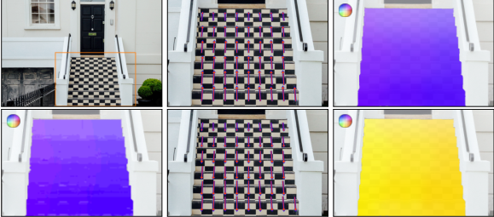
3.1.3 Post-processing the Displacement Field
To achieve a sufficiently smooth flow we apply a Gaussian kernel and subsample to get a sparse field; to densify it, we then interpolate the flow to all pixels using a polyharmonic spline with radial basis function ϕ(r) = r.
By inverting the sparse set of vectors and then densifying with the polyharmonic spline, we arrive at a smooth dense field that serves as a good approximation of the inverse flow, without the holes or collisions that we would get from directly inverting the displacement vectors of the raw CRF output

Slide 17
3.2 Generation of Video Frames
Using for stability the forward field for positive time stamps and the inverted one for negative, and setting V₀ = I, we consider the following animation V_{t} , t ∈ [−1, 1]:
V₋₁ and V₁ are not exactly equal but rather similar to the input image, as the periodic patterns are shifted backwards/forwards by one unit of repetition
The frames that are blended together from the two animations are always similar (corresponding approximately to a unit shift for any periodic image patterns).
Each animation is multiplied with a zero blend factor exactly at the time of its discontinuity

Slide 18
3.2 Generation of Video Frames
The part of the new texture inside the mask, which is identical to the input image, is first extrapolated to the rest of the texture using inpainting [Telea 2004]. We then warp from inside the mask to the outside with both forward and backward flows and clone that into the inpainted texture with Poisson blending [Pérez et al. 2003].

Slide 19
Extensions

Slide 20
4.1 Multiple Disconnected Masks
Since the directional input is not necessarily associated with a spatial location, we might wish to apply a single input direction to multiple masks simultaneously.
Running the entire algorithm on each mask independently usually improves results over computing a single set of CRF labels, as the pattern inside each mask might have a different orientation and/or periodicity.

Slide 21
4.2 Multiple Directions
We split the mask into Voronoi cells centered at these locations and independently run the algorithm to obtain a CRF-generated displacement field on each one of these cells. We then follow the procedure of Section 3.1.3 to combine the individual fields into a single smooth dense displacement field, that can be used to animate the image.

Slide 22
4.3 Video as Input
To make the output consistent with the motion in the video we estimate a planar homography transformation of the masked pixels from the first frame of the input video to all other frames, and use these homographies to warp the moving object in future frames. To get highly accurate homographies we use the restart tracking scheme introduced by Halperin et al. [2019].

Slide 23
4.4 Automatic Estimation of the Main Direction
We extract a descriptor F_{p} for every pixel p (with the same features used to compute the unary potentials of the CRF in Section 3.1.2) and use it to compute bidirectional nearest neighbors, a procedure also known as best buddies similarity [Dekel et al. 2015].

Slide 24
4.5 Gradual Motion Attenuation Near the Mask Boundary
We observe in many images that hard masking, where the motion field drops sharply to zero at the boundary of the mask, generates a visible motion edge.
We achieve this effect by placing artificial anchor points with zero displacement around the mask and including them in the interpolation of the displacement field (Section 3.1.3).

Slide 25
Results and Evaluation

Slide 26
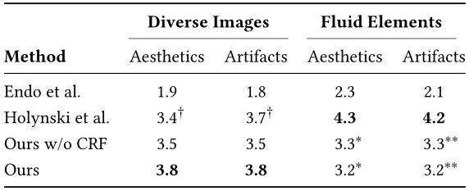
5 User Studies
We compare our method quantitatively to those of Holynski et al. [2020] and Endo et al. [2019] via a user study.

Slide 27
Result

Slide 28
Result

Slide 29
Result

Slide 30
Conclusions

Slide 31
6. Conclusion
Another interesting direction would be to explicitly incorporate 3D priors and 3D knowledge about the scene. This can improve visual quality, and also produce better sequences when using challenging videos as input.
Lastly, in our current implementation the user is required to draw a mask. While we do not want to decide on a mask completely automatically (since we want the user to exert artistic control), it would be interesting to automatically detect several possible masks and suggest them to the user to facilitate exploration.

Slide 32
THANK YOU

