Slide 1
Weakly Supervised Video Moment Retrieval From Text Queries
Niluthpol Chowdhury Mithun* , Sujoy Paul* , Amit K. Roy-Chowdhury Electrical and Computer Engineering, University of California, Riverside

Slide 2
Outline
Introduction
Approach
Experiments
Conclusions

Slide 3
Introduction

Slide 4
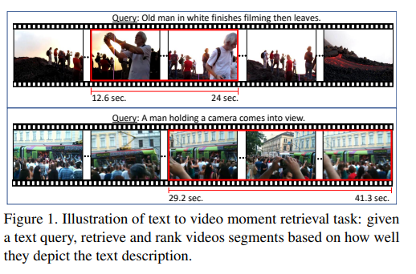
Illustration of text to video moment retrieval task

Slide 5
Weakly Supervised
The weak nature of the supervision is because, during training, we only have access to the video-text pairs rather than the temporal extent of the video to which different text descriptions relate. We propose a joint visual-semantic embedding-based framework that learns the notion of relevant segments from video using only video-level sentence descriptions.

Slide 6
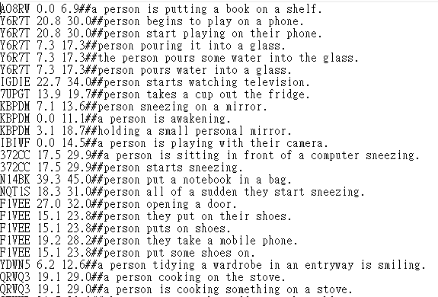
Weakly Supervised
The weak nature of the supervision is because, during training, we only have access to the video-text pairs rather than the temporal extent of the video to which different text descriptions relate. We propose a joint visual-semantic embedding-based framework that learns the notion of relevant segments from video using only video-level sentence descriptions.

Slide 7
Approach
Network Structure and Features
Text-Guided Attention
Training Joint Embedding

Slide 8
3.1. Network Structure and Features
Network Structure

Slide 9
3.1. Network Structure and Features
Text Representation

Slide 10
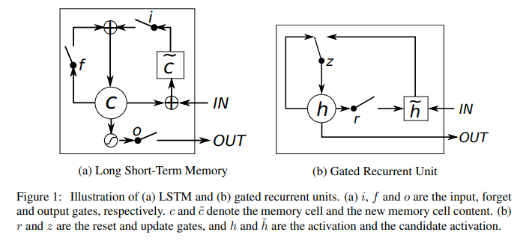
3.1. Network Structure and Features
Text Representation
GRU

Slide 11
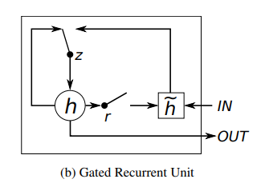
3.1. Network Structure and Features
GRU
The activation $h_{t}^{j}$ of the GRU at time t is a linear interpolation between the previous activation $h_{t−1}^{j}$ and the candidate activation ${\tilde{h}}_{t}^{j}$
$$h_{t}^{j}=\left(1 − z_{t}^{j}\right)h_{t−1}^{j}+z_{t}^{j}{\tilde{h}}_{t}^{j}$$

Slide 12
3.1. Network Structure and Features
GRU
$h_{t}^{j}=\left(1 − z_{t}^{j}\right)h_{t−1}^{j}+z_{t}^{j}{\tilde{h}}_{t}^{j}$
where an update gate $z_{t}^{j}$decides how much the unit updates its activation, or content. The update gate is computed by
$$z_{t}^{j}= {σ(W_{z}x_{t}+U_{z}h_{t−1})}^{j}$$

Slide 13
3.1. Network Structure and Features
GRU
$h_{t}^{j}=\left(1 − z_{t}^{j}\right)h_{t−1}^{j}+z_{t}^{j}{\tilde{h}}_{t}^{j}$
$z_{t}^{j}= {σ(W_{z}x_{t}+U_{z}h_{t−1})}^{j}$
where $r_{t}$is a set of reset gates and is an element-wise multiplication.
$${\tilde{h}}_{t}^{j}= {tanh(Wx_{t}+U(r_{t}⨀h_{t−1}))}^{j}$$

Slide 14
3.1. Network Structure and Features
GRU
$h_{t}^{j}=\left(1 − z_{t}^{j}\right)h_{t−1}^{j}+z_{t}^{j}{\tilde{h}}_{t}^{j}$
$z_{t}^{j}= {σ(W_{z}x_{t}+U_{z}h_{t−1})}^{j}$
${\tilde{h}}_{t}^{j}= {tanh(Wx_{t}+U(r_{t}⨀h_{t−1}))}^{j}$
The reset gate $r_{t}^{j}$is computed similarly to the update gate:
$$r_{t}^{j}={σ(W_{r}x_{t}+U_{r}h_{t−1})}^{j}$$

Slide 15
3.1. Network Structure and Features
Text Representation
Video Representation
We utilize pre-trained convolutional neural network models as the expert network for encoding videos.
we utilize C3D model for feature extraction from every 16 frames of video for the Charades-STA dataset. A 16 layer VGG model is used for frame-level feature extraction in experiments on DiDeMo dataset.

Slide 16
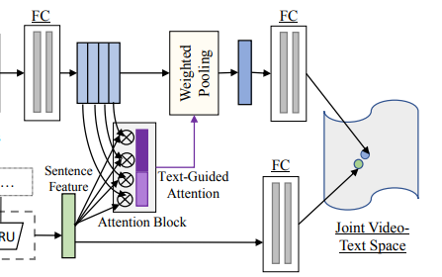
3.2. Text-Guided Attention
After the feature extraction process, we have a training set
where $n_{d}$ is the number of training pairs
$w_{j}^{i}$ represents the $j^{th}$ sentence feature of $i^{th}$video
$v_{k}^{i}$represent the video feature at the $k^{th}$time instant of the $i^{th}$video
${nw}_{i}$ and ${nv}_{i}$ are the number of sentences in the text description and video time instants for the $i^{th}$video in the dataset.
$$𝒟= {\left\{{\left\{w_{j}^{i}\right\}}_{j=1}^{{nw}_{i}},{\left\{v_{k}^{i}\right\}}_{k=1}^{{nv}_{i}}\right\}}_{i=1}^{n_{d}}$$

Slide 17
3.2. Text-Guided Attention
If some portion of the video frames corresponds to a particular sentence, we would expect them to have similar features
Thus, the cosine similarity between text and video features should be higher in the temporally relevant portions and low in the irrelevant ones.
Moreover, as the sentence described a part of the video rather than individual temporal segments, the video feature obtained after pooling the relevant portions should be very similar to the sentence description feature.
We employ this idea to learn the joint video-text embedding via an attention mechanism based on the sentence descriptions, which we name Text-Guided Attention (TGA).

Slide 18
3.2. Text-Guided Attention
We first apply a Fully Connected (FC) layer with ReLU and Dropout on the video features at each time instance to transform them into the same dimensional space as the text features.
The similarity between the $j^{th}$ sentence and the $k^{th}$ temporal feature of the $i^{th}$ training video can be represented as follows,
$$s_{kj}^{i}= \frac{{w_{j}^{i}}^{T}v_{k}^{i}}{\left\|w_{j}^{i}\right\|\left\|v_{k}^{i}\right\|}$$
$w_{j}^{i}$ represents the $j^{th}$sentence feature of $i^{th}$video
$v_{k}^{i}$represent the video feature at the $k^{th}$time instant of the $i^{th}$video

Slide 19
3.2. Text-Guided Attention
Once we obtain the similarity values for all the temporal locations, we apply a softmax operation along the temporal dimension to obtain an attention vector for the $i^{th}$video as follows,
$$a_{kj}^{i}= \frac{exp⁡(s_{kj}^{i})}{\sum_{k=1}^{{nv}_{i}}{exp⁡(s_{kj}^{i})}}$$
We use the attention to obtain the pooled video feature for the sentence description $w_{j}^{i}$ as follows,
$$f_{j}^{i}=\sum_{k=1}^{{nv}_{i}}{a_{kj}^{i}v_{k}^{i}}$$

Slide 20
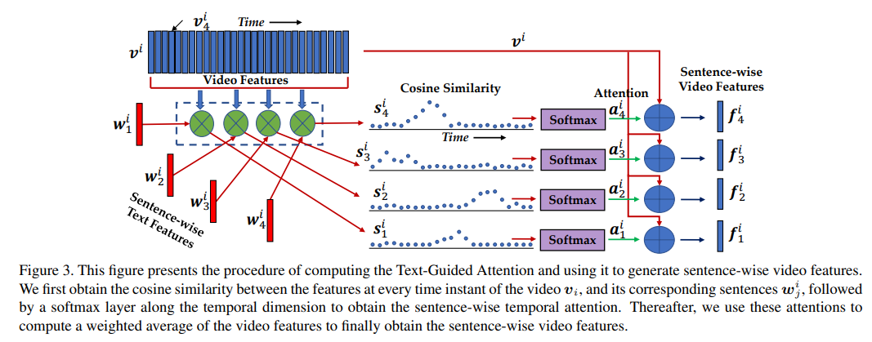
3.2. Text-Guided Attention
$$s_{kj}^{i}= \frac{{w_{j}^{i}}^{T}v_{k}^{i}}{\left\|w_{j}^{i}\right\|\left\|v_{k}^{i}\right\|} , a_{kj}^{i}= \frac{exp⁡(s_{kj}^{i})}{\sum_{k=1}^{{nv}_{i}}{exp⁡(s_{kj}^{i})}} , f_{j}^{i}=\sum_{k=1}^{{nv}_{i}}{a_{kj}^{i}v_{k}^{i}}$$

Slide 21
3.3. Training Joint Embedding
The projection for the video feature on the joint space can be derived as
$$v_{p}= W^{\left(v\right)}f(v_{p} ∈ ℝ^{D})$$
Similarly, the projection of paired text vector in the embedding space can be expressed as
$$t_{p}= W^{\left(t\right)}f(t_{p} ∈ ℝ^{D})$$
Here, $W^{\left(v\right)}$ ∈ $ℝ^{D×V}$ is the transformation matrix that projects the video content into the joint embedding and D is the dimensionality of the joint space. Similarly, $W^{(t)}$ ∈ $ℝ^{D×T}$maps input sentence/caption embedding to the joint space

Slide 22
3.3. Training Joint Embedding
Using these pairs of feature representation of both videos and corresponding sentence, the goal is to learn a joint embedding such that the positive pairs are closer than the negative pairs in the feature space. Now, the video-text loss function $ℒ_{VT}$ can be expressed as follows,
$$ℒ_{VT}=\sum_{(v_{p},t_{p})}{\left\{\sum_{t_{\overline{p}}}{max\left[0,△−S\left(v_{p},t_{p}\right)+S\left(v_{p},t_{\overline{p}}\right)\right]}\right.}$$
$$+\sum_{v_{\overline{p}}}{max⁡[0,△−S\left(t_{p},v_{p}\right)+S(t_{p},v_{\overline{p}})]}$$
where $t_{\overline{p}}$is a non-matching text embedding for video embedding $v_{p}$, and $t_{p}$ is the matching text embedding. This is similar for video embedding $v_{p}$ and non-matching image embedding $v_{\overline{p}}$.
∆ is the margin value for the ranking loss. The scoring function $S\left(t_{p},v_{p}\right)$measures the similarity between the image embedding and text embedding in the joint space

Slide 23
Experiments

Slide 24
4.1. Datasets and Evaluation Metric
Charades-STA
“R@n, IoU=m”
$R\left(n,m\right)= \frac{1}{N}\sum_{i=1}^{N}{r(n,m,s_{i})}$
Jiyang Gao, Chen Sun, Zhenheng Yang, and Ram Nevatia. Tall: Temporal activity localization via language query. In ICCV, pages 5277–5285, 2017.
DiDeMo
our final score for a prediction P and four human annotations A using metric M is:
score(P, A) = $\max_{A′∈\left({A \atop 3}\right)}\frac{1}{3}\sum_{a∈A′}{M(P,a)}$
Lisa Anne Hendricks, Oliver Wang, Eli Shechtman, Josef Sivic, Trevor Darrell, and Bryan Russell. Localizing moments in video with natural language. In ICCV, pages 5803– 5812, 2017.

Slide 25
4.2. Quantitative Result
4.2.1 Charades-STA Dataset

Slide 26
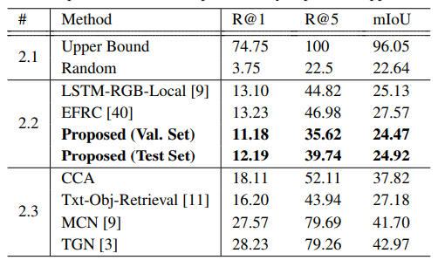
4.2. Quantitative Result
4.2.2 DiDeMo Dataset

Slide 28
Conclusions

Slide 29
Conclusions
In the weakly supervised paradigm, as we do not have access to the temporal boundaries associated with a sentence description, we utilize an attention mechanism to learn the same using only video-level sentences.
Our formulation of the task makes it more realistic compared to existing methods in the literature which require supervision as temporal boundaries or temporal ordering of the sentences.
The weak nature of the task allows it to learn from easily available web data, which requires minimal effort to acquire compared to manual annotations.

Slide 30
Thanks

