Slide 1
Autocomplete Element Fields
Chen-Yuan Hsu, Li-Yi Wei, Lihua You, Jian Jun Zhang
CHI '20: Proceedings of the 2020 CHI Conference on Human Factors in Computing Systems April 2020
The new version of Brushing Element Fields(published in : SIGGRAPH Asia 2018 Technical Briefs)

Slide 2
CONTENTS
01
02
03
Introduction
System
Formulation
04
05
06
Limitations and
future work
Solver
Evaluation

Slide 3
Introduction
01

Slide 4
Introduction
Aggregate elements are ubiquitous in natural and man-made objects. Interactively authoring these elements with varying anisotropy and deformability can require high artistic skills and manual labor. To reduce input workload and enhance output quality, they present an autocomplete system that can help users distribute and align such elements over different domains.

Slide 5
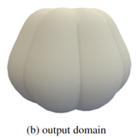
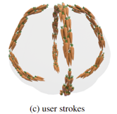
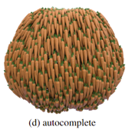
Introduction
Through a brushing interface, users can select and even mix distinct type of elements from an element palette, brush the selected elements over the output domain, and let their system automatically populate more elements for the remaining output.
Aggregate elements often require proper direction/scalar fields for proper arrangements, but fully specifying such fields across entire domains can be difficult or inconvenient for ordinary users.
They formulate element fields that can smoothly orient all the elements following partial inputs (e.g. user strokes) based on inter- and intra-element relationships

Slide 6
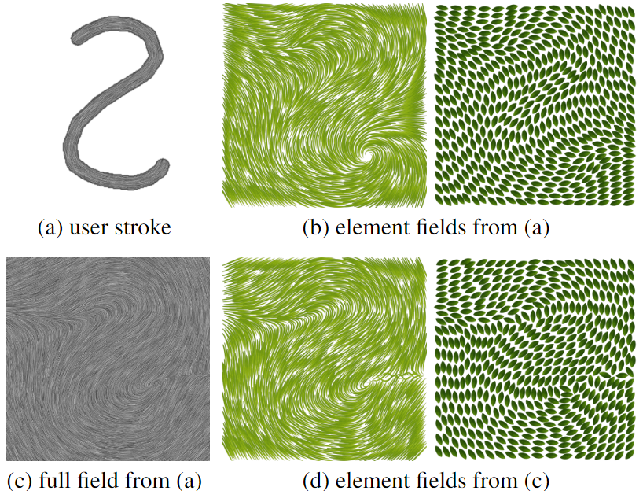
Introduction
The developed system, centered on the idea of element fields, can handle elements with general shapes, distributions, and alignments, offer more usability and interactivity than existing practices and enable users to create compelling artwork like left Figure without requiring significant expertise or efforts.

Slide 7
System
02

Slide 8
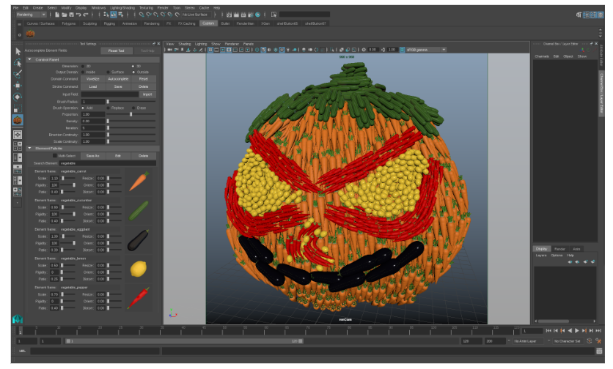
System
User interface
Their brushing interface is directly implement into Autodesk Maya to leverage its all system manipulation.
User can choose and mix different elements form the element palette, tune relative parameters from the control panel, and perform corresponding brush operations to create desired works through the brushing canvas

Slide 9
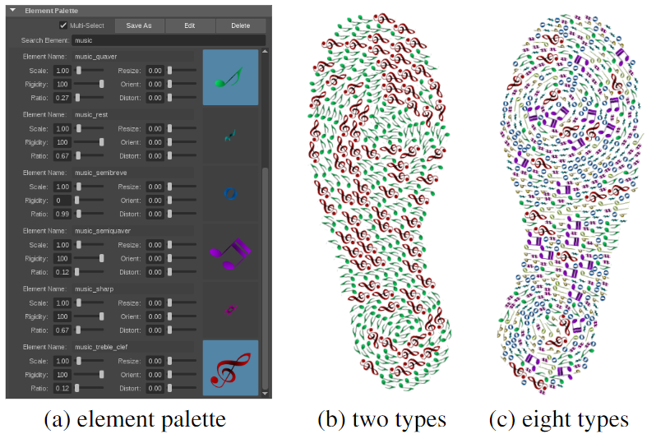
System
Element palette
User can directly select single or mix
multiple input elements and set various
properties such as scale and rigidity
respectively via the element palette.
The combination of the selected elements can be saved as a new palette entry for further use and analogous to color palettes.

Slide 10
System
Brush operations
In their system, offer add, erase, replace brush operations for interactive authoring.
For automatic completion, the user-specified strokes can indicate the intended overall element orientations and scales, and instead of keeping these strokes unchanged, our autocomplete system optimizes the entire inter- and intra-element relationships to improve total synthesis quality and produce smoother results while adequately observing and reflecting the original user intention.

Slide 11
Formulation
03

Slide 12
Formulation
Target
Given input element exemplars , an output domain
, and a partially specified direction or scalar field over . The target is to
automatically compute an output composed of such that all
Elements are well distributed within and have coherent orientations or scales with .

Slide 13
Formulation
Element representation
Represent Each element by a set of samples . The number and locations of these samples are important, they adopt fewer weight samples to better characterize distinct types of elements and use a graph to indicate the connectivity among samples and their relationship with element shapes.

Slide 14
Formulation
Sample attributes
The black dots indicates the sample positions. The radii of yellow circles represent the sample weights . The blue line denote the element graphs.
Each sample s contains individual attributes such as position ,
orientation matrix and scale . These are variable to optimize for element synthesis.

Slide 15
Formulation - Element distribution
Element distribution
In order to well distribute aggregate elements, they devise a distribution objective to effectively handle both inter- and intra-element relationships. consists of a sample distribution term, a conflict check term, and a graph similarity term.
and measure the quality of inter-element distributions, and preserves the intra-element connections for elements composed of multiple samples.

Slide 16
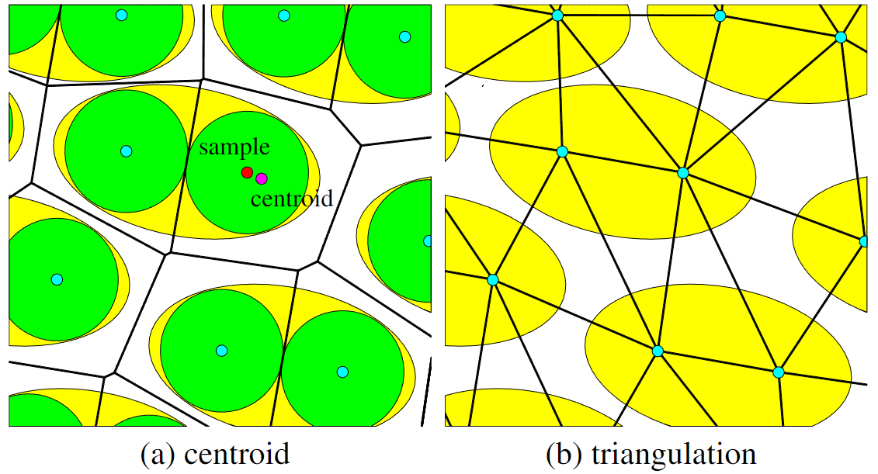
Formulation - Element distribution
Sample distribution
They utilize a power diagram that partitions the domain based on the weighted samples of elements to obtain a potential position for each sample. Analogous to general Lloyd-like methods, we can move each sample to the centroid of its power cell to acquire evenly-distributed samples.
Where represents the centroid of ‘s power cell.

Slide 17
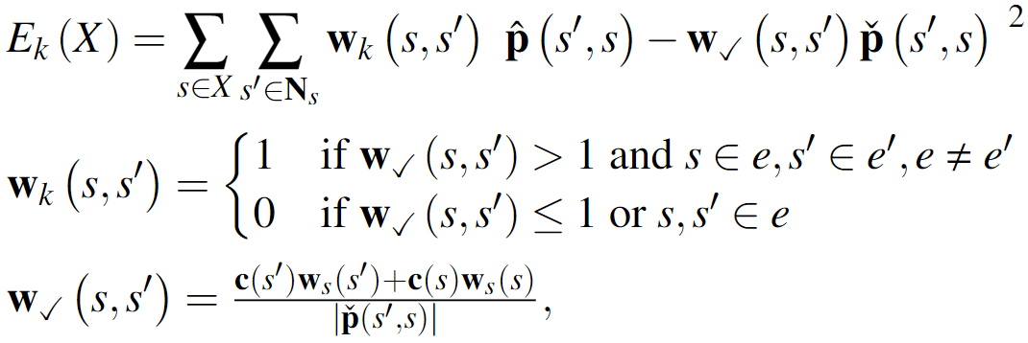
Formulation - Element distribution
Conflict check
In order to increase synthesis quality for arbitrary mixtures, is exploited to avoid the conflicts between samples by checking the distances between the weighted samples. Since the distance between two samples should not be less than the sum of their weights, we can formulate the conflict check term as:
Where denotes a set of all neighboring samples of s derived from a triangulation.
is the displacement between and we want to solve.
means the current displacement between c and , treated as a constant.

Slide 18
Formulation - Element distribution
Graph similarity
To appropriately preserve the intra-element connections for elements, we can measure the distance between the current graph and the original graph for each sample to consistently maintain the graph structure of each element.
Where denotes a set of all connected samples of .
is the displacement we want to solve.
represents the displacement between and in the original graph.

Slide 19
Formulation - Element distribution
Element distribution
Putting the above terms together, we have :
Where + means that and are minimized together, indicates that is minimized separately during optimization, and is a relative weight set to 100 from our experiment to firmly restructure the graphs form unexpected sample distribution.

Slide 20
Formulation – Element fields
Element fields
In addition to forming well-distributed elements, these synthesized elements should also match the user-specified field while behaving reasonably well in the unspecified portions of the output domain .
They design a field objective for both scalar and direction fields to include : a field alignment term to effectively align the elements with in the specified areas; a field continuity term to smoothly orient all the elements over ; an element rigidity term to determine the element deformability.

Slide 21
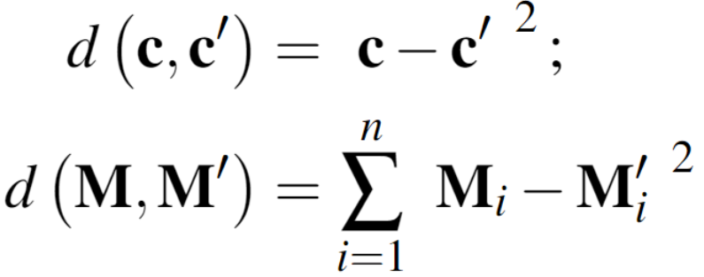
Formulation – Element fields
Element fields
Here first define the distance between two scale and for scalar fields and the distance between two orientation matrices and for direction fields as:
Where n denotes the domain dimension, and 、 represent the i-th column vectors of respectively.
below mainly detail the direction field objective and then briefly describe the scalar field objective .

Slide 22
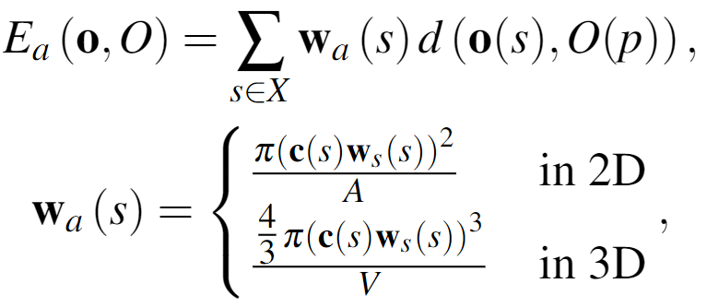
Formulation – Element fields
Field alignment
Since each sample is associated with a local orientation , the sample orientation in the specified domain should be properly aligned with the given field orientation , where means the orientation matrix of at which is the closest specified domain point to sample . Hence, the distance between and should be minimized.
Where is a confident weight which means larger samples dominating larger domain spaces should contribute more influences than smaller samples, and A and V are the 2D area and 3D volume of a domain unit (e.g. pixel/voxel) respectively.

Slide 23
Formulation – Element fields
Field continuity
To fully complete the element alignments (including regions with or without user-specified ), they orient nearby samples as similarly as possible. Additionally, the effect of field continuity for each pair of samples with a closer distance or similar orientations should be increased accordingly in order to smoothly fit all the samples with their nearby samples.
Where is used to adaptively adjust the effect according to , aims to better orient samples with their nearby samples which have similar orientation, represents the i-th column vector of , denotes the i-th column vector of the current orientation matrix of a sample

Slide 24
Formulation – Element fields
Element rigidity
If the element is rigid, all samples should have identical local orientations If e is deformable, all samples might have different local orientations. Hence, to distinguish between rigid and deformable elements, the element rigidity term is consequently formulated as:
Where is the weight of element rigidity which can be defined by users via the element palette (e.g. 0 for deformable elements and 100 for rigid elements in our implementation).

Slide 25
Formulation – Element fields
Element fields
Since they define the local orientation as a rotation matrix, in order to penalize the deviation of to well keep a pure rotation matrix during the optimization, they apply an extra constraint term for the direction field objective :
Where
are the corresponding column vectors of .

Slide 26
Formulation – Element fields
Element fields
By the proposed formulas, the direction field objective is :
Replace the by in the three formulas(page 22、23、24) and removing from the formula of field continuity, we represent the scalar field objective as follows:
Note that α and β (both default values =1) are parameters that users can tune for specific scenarios/applications.

Slide 27
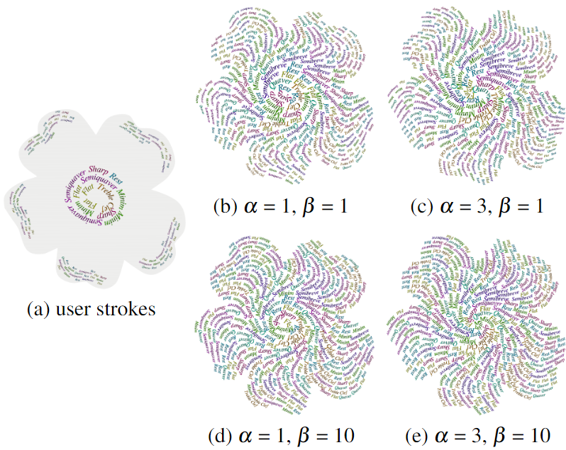
Formulation – Element fields
Element fields
By increasing α and β via interface, it can encourage smoother element orientations and scales.

Slide 28
Solver
04

Slide 29
Solver
Solver
They optimize the set of samples for the objectives and respectively through a combination of the Lloyd-like method and gradient-based optimization in an iterative way.

Slide 30
Solver
Initialization
They randomly place individual elements into the output domain, and the orientations and scales of samples of each element are initially set to the stroke direction and brush size captured in the closest user-specified domain point to the element.

Slide 31
Solver
Iterations
In each iteration, they take a distribution step, an orientation step, and a scale step for different objectives, and each step optimizes only one variable(p, o, or c) at a time.
At the beginning, each sample’s neighborhood is built via the power diagram. Based on this, they first carry out the scale step for and then run the orientation step for . The distribution step is fulfilled for at the end of each iteration.

Slide 32
Solver
Iterations
In the scale step, is the variable, and we can directly solve via linear least squares; In the orientation step, is the variable, and due to the term, we optimize via the Levenberg-Marquardt method [52] to solve this nonlinear least squares problem; in the distribution step, is the variable, first solve together to optimally rearrange the inter-element distribution via linear squares. To precisely structure the intra-element connections, multiplied by can be solved according to the optimized positions, orientations and scales of samples via linear least squares as well.

Slide 33
Evaluation
05

Slide 34
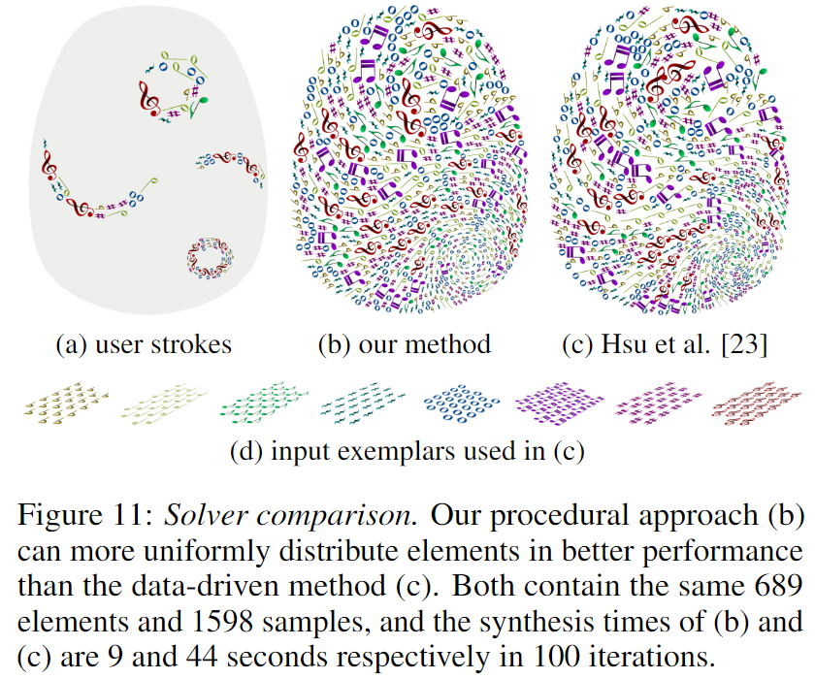
Evaluation
Element manipulation
Their procedural approach can enable users to individually mix distinct types of elements from the element palette without the necessity of preparing the input exemplars in advance and directly bring novel mixtures into existence as users desire as possible in high quality and efficiency without requiring extra schemes.

Slide 35
Evaluation
Distribution manipulation
Due to algorithmic limitations (e.g. computational cost), prior approaches cannot let users interactively manipulate element distributions, while their system enables user to freely form diverse composition, such as spatially-varying element distribution.

Slide 36
Evaluation
Field manipulation
As exemplified in page.24, by tuning α and β from the interface can affect the field continuity to build the different outputs.
Moreover, incoherent user strokes can be well tackled by their method without incorporating any extra processes.

Slide 37
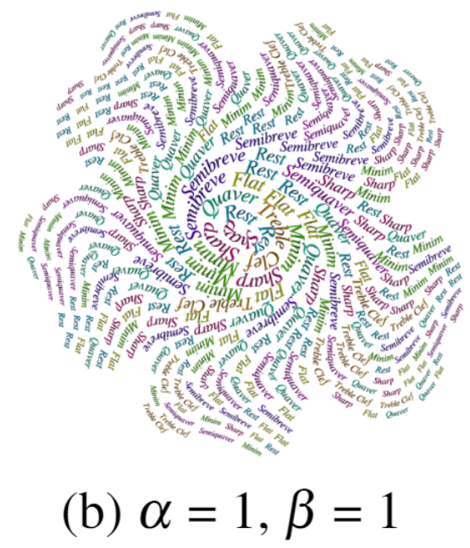
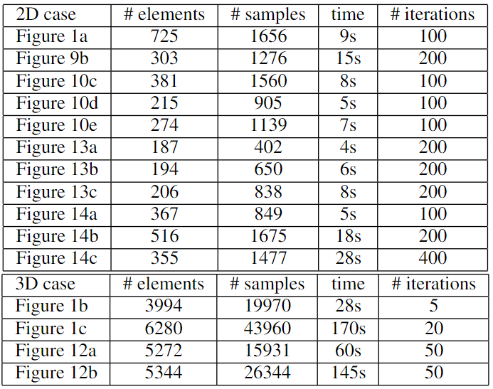
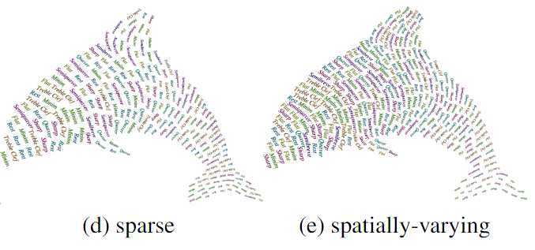
Evaluation
Performance
Figure 9
The synthesis times of their representative works are reported in below.
Figure 10

Slide 38
Limitations and
future work
06

Slide 39
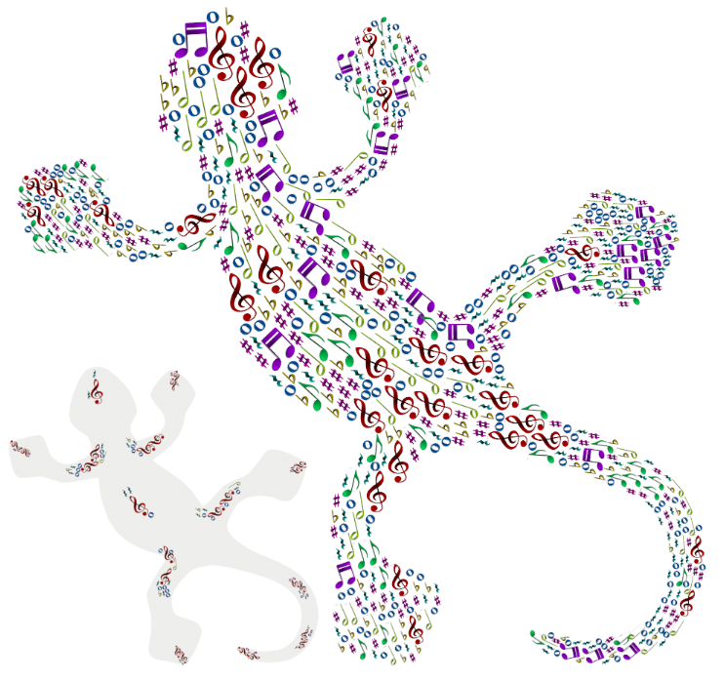
Limitations and future work
Limitations
Since they randomly place elements into the output domain for fast initialization, the distribution optimization might be trapped in a local minimum when the elements are highly anisotropic and the domain is irregular.
In addition, their approach cannot entirely avoid interpenetrations or floating elements.

Slide 40
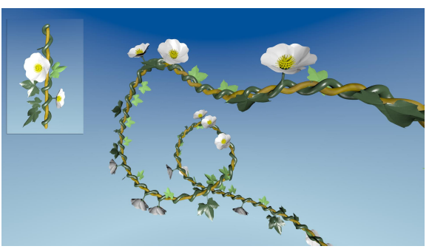
Limitations and future work
Future work
our current prototype does not consider continuous elements due to the difficulty of mixing such elements, a potential direction is to extend algorithm with [Example Based Repetitive Structure Synthesis] for continuous element synthesis.
Additionally, they plan to implement their method under VR and offer a user interface for interactive authoring in immersive environments.

Slide 41
Thanks

