Slide 1
IEEE TRANSACTIONS ON CIRCUITS AND SYSTEMS FOR VIDEO TECHNOLOGY
LGGD+: Image Retargeting Quality Assessment by Measuring Local and Global Geometric Distortions
Zhenyu Peng, Qiuping Jiang, Member, IEEE,
Feng Shao, Member, IEEE,
Wei Gao, Member, IEEE, and Weisi Lin, Fellow, IEEE
20220321 陳顗汝

Slide 2
INTRODUCTION
Background
With the emerging of different terminal devices, images are usually required to be resized to adapt various displays with different aspect ratios. To meet this demand, a number of image retargeting algorithms have been proposed during the past years.
It is therefore necessary to conduct image retargeting quality assessment to benchmark different image retargeting results both on-line and off-line.
Intuitively, human subjective rating is the most reliable way for IRQA. However, it is usually criticized to be time consuming and labor tedious; Thus, much research focus has moved toward objective IRQA algorithms.

Slide 3
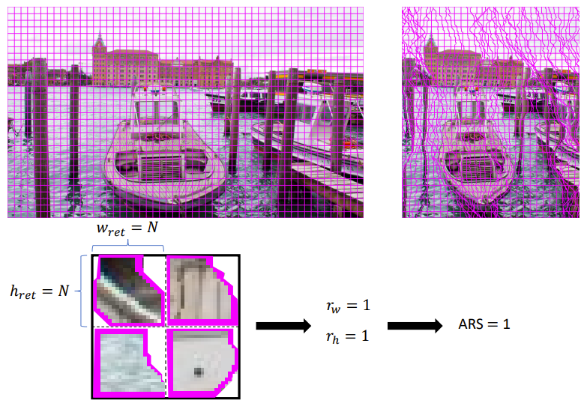
INTRODUCTION
Main Challenge
The most important quality degradation issue is the evaluation of geometric distortion.
Aspect ratio similarity (ARS)
$Q_{g}= \frac{2 ∙ r_{w} ∙ r_{h} + C}{r_{w}^{2} + r_{h}^{2} + C}$
$r_{w} = \frac{w_{ret}}{w_{src}}$
$r_{h} = \frac{h_{ret}}{h_{src}}$

Slide 4
INTRODUCTION
Main Challenge
Most existing IRQA metrics highlight the importance of geometric distortion appeared in visually salient areas while underemphasizing the distortions in non-salient regions.
Human visual system (HVS) perception is highly dependent on edges and geometric distortion in image retargeting usually deform the edges.
The non-salient regions in the source image will become salient in the retargeted image once they are deformed after retargeting (this phenomena is known as “attention shift”).

Slide 5
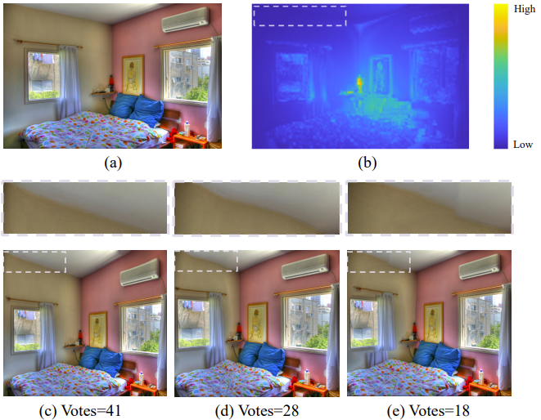
INTRODUCTION
Main Challenge
Most existing IRQA metrics highlight the importance of geometric distortion appeared in visually salient areas while underemphasizing the distortions in non-salient regions.

Slide 6
INTRODUCTION
Main Challenge
Existing IRQA metrics rarely compare the retargeted and source images from a global perspective, and thus the global-to-local quality perception mechanism of the human visual system (HVS) have not been well characterized.
Different image retargeting operators with different principals resize source images in different fashions, and thus diverse quality degradations such as geometric distortion, content loss, image composition change, and image aesthetics reduction can be introduced after image retargeting. It is challenging to design a sufficiently comprehensive metric that is able to well characterize all those aspects.

Slide 7
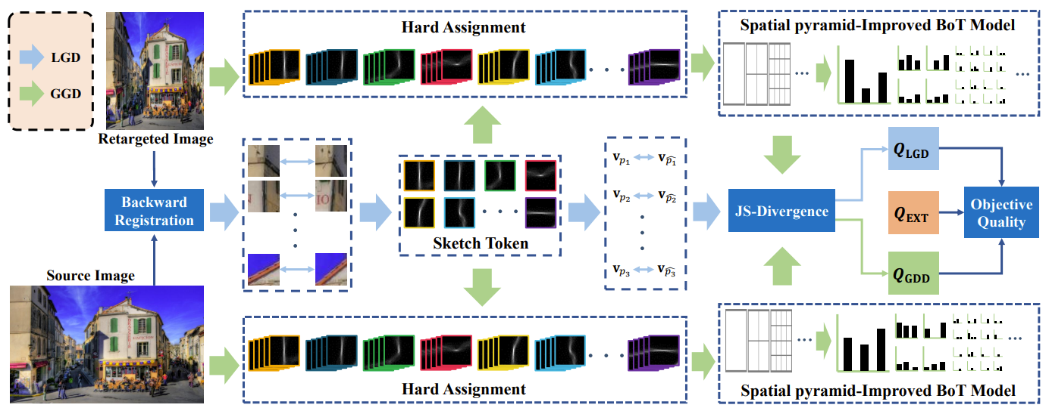
INTRODUCTION
Solution
This paper specifically focus on geometric distortion based on which a new objective IRQA method is introduced by measuring both local and global geometric distortions using a novel sketch token-based local edge descriptor to represent the geometric-aware features.

Slide 8
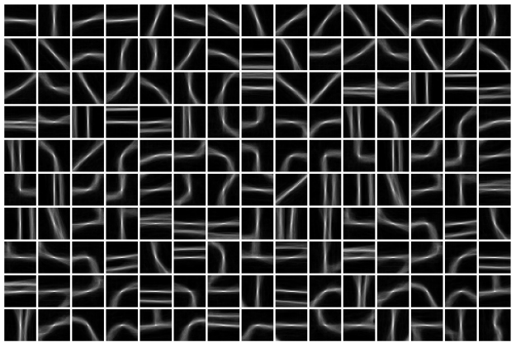
METHODOLOGY
For an image patch, its associated edge pattern can be characterized by estimating the probability that this patch belongs to each token class.
The estimated probability values associated with all token classes, i.e., the ST-LED feature vector, are used to represent the geometric structure of this patch.
$V_{p}=(v_{p}^{(1)}，v_{p}^{(2)}，⋯，v_{p}^{(k)}，⋯，v_{p}^{(K)})$
$\sum_{k=1}^{K}{v_{p}^{(k)}=1}$
Adopt a random forest classifier pre-trained on the Berkeley Segmentation Dataset to predict the probability that this patch belongs to the k-th token.

Slide 9
METHODOLOGY
First perform backward registration to build dense correspondence between the source and retargeted images and then compute the ST-LED feature distance between a patch pair centered at the matched pixels to measure the LGD. Then, the LGD map is pooled into a single LGD score.

Slide 10
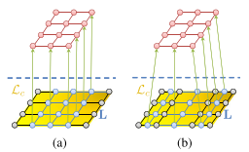
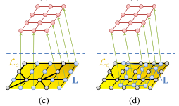
METHODOLOGY
Backward registration
Based on the uniqueness assumption and the ordering assumption, the pixel backward registration problem can be approximated by minimizing the energy function defined as :
$E = E_{d}+ λE_{s}= \sum_{p}{{\left\|f\left(p\right)−f(l_{p})\right\|}_{1}+λ\sum_{(p,q)∈ε}{\min\left(α\left|x_{p}−x_{q}\right|,d\right)+\min\left(α\left|y_{p}−y_{q}\right|,d\right)}}$

Slide 11
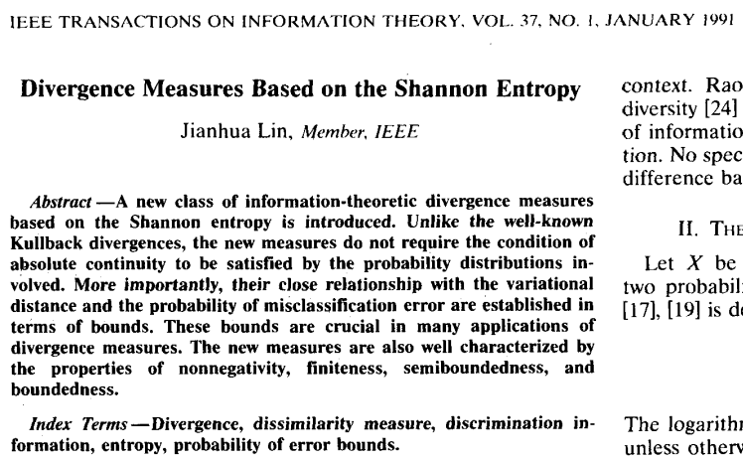
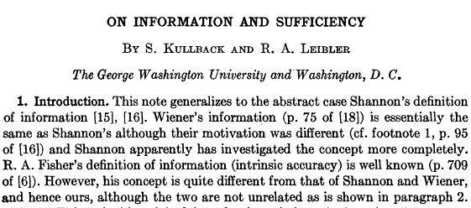
METHODOLOGY
LGD score
Use the Jensen-Shannon (JS) divergence as the distance metric
$$d_{JS}\left(V_{p},V_{\hat{p}}\right)= \frac{1}{2}d_{KL}\left(V_{p},\overline{V}\right)+\frac{1}{2}d_{KL}(V_{\hat{p}},\overline{V})$$
$$\overline{V}= \frac{1}{2}\left(V_{p}+V_{\hat{p}}\right)$$
$d_{KL}(∙)$ is the Kullback-Leibler divergence
$$d_{KL}\left(V_{1},V_{2}\right)= \sum_{k}{v_{1}^{(k)}\log{\frac{v_{1}^{(k)}}{v_{2}^{(k)}}}}$$

Slide 12
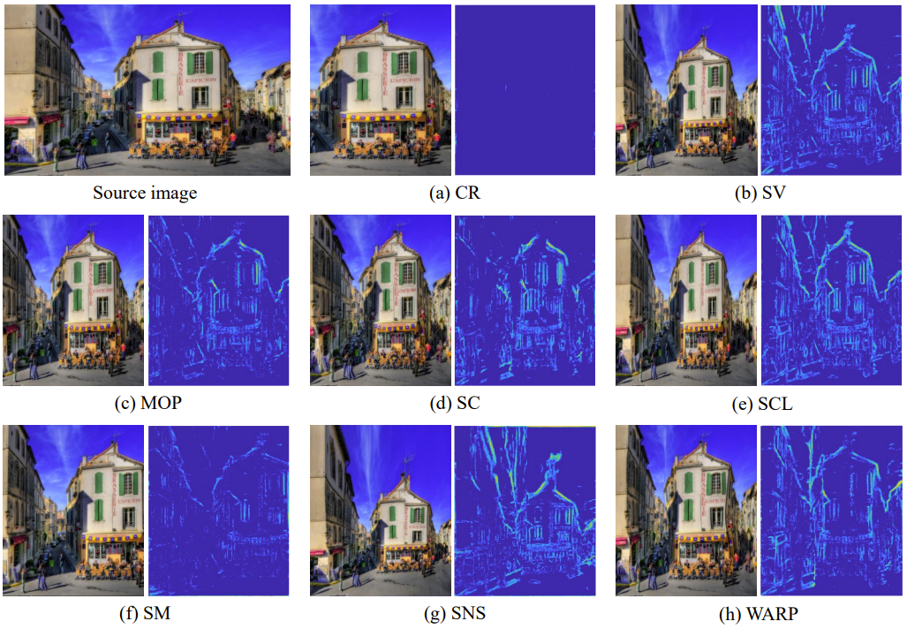
METHODOLOGY
LGD map

Slide 13
METHODOLOGY
LGD score
Propose a edge strength-based weighting factor to pool the LGD map into a final LGD score
$Q_{LGD}= \frac{1}{N_{I}} ∙{\left(\sum_{p∈I}{{(ω_{p}∙d_{JS}(V_{p},V_{\hat{p}}))}^{β}}\right)}^{\frac{1}{β}}$
$ω_{p}$ is defined as the edge strength of pixel
$ω_{p}=\frac{\sum_{k=0}^{K−1}{v_{p}^{(k)}}}{\sum_{p∈I}{\sum_{k=0}^{K−1}{v_{p}^{(k)}}}}$

Slide 14
METHODOLOGY
Separately convert the source and retargeted images into the same "Token domain" and represent the global geometric structure with a spatial pyramid-improved bag-of-token model to enable measuring a single GGD score.

Slide 15
METHODOLOGY
Bag-of-Token (BoT) Model
Given an image I, its corresponding edge pattern set can be expressed as :
, where $p(h,w)$ denotes the edge pattern of the patch centered at pixel (h, w).
To further compress the feature space dimension, we directly use $t_{k}(h,w)$ to represent $p(h,w)$,where $t_{k}$ represents the k-th token and k is determined by $k=\arg{\max{v_{p(h,w)}^{(k)}}}$.
$${\text{𝔼}}_{I}=\left\{\begin{matrix}p(1,1) & p\left(1,2\right) & ⋯ \\ \begin{aligned}p(2,1) \\ ⋮\end{aligned} & \begin{aligned}p(2,3) \\ ⋮\end{aligned} & \begin{aligned}⋯ \\ ⋱\end{aligned} \\ p(H,1) & p(H,2) & ⋯\end{matrix}\begin{matrix} p(1,W) \\ p(2,W) \\ \begin{aligned} ⋮ \\ p(H,W)\end{aligned}\end{matrix}\right\}$$
$𝔼_{I}= \left\{\left\{t_{1},t_{1},⋯,t_{1}\right\},\left\{t_{2},t_{2},⋯,t_{2}\right\},⋯,\left\{t_{k},t_{k},⋯,t_{k}\right\},⋯,\left\{t_{K},t_{K},⋯,t_{K}\right\}\right\}$
$$c_{1}$$
$$c_{2}$$
$$c_{k}$$
$$c_{K}$$

Slide 16
METHODOLOGY
Bag-of-Token (BoT) Model
Get the global geometric feature vector $C_{I}$ defined as follows:
$C_{I}= \left\{c_{1},c_{2},c_{3},⋯,c_{k},⋯,c_{K−1}\right\}$
Measure the GGD score using a global distribution distance measurement
$Q_{GGD}^{′} = d_{JS}(C_{I}, C_{\hat{I}})$

Slide 17
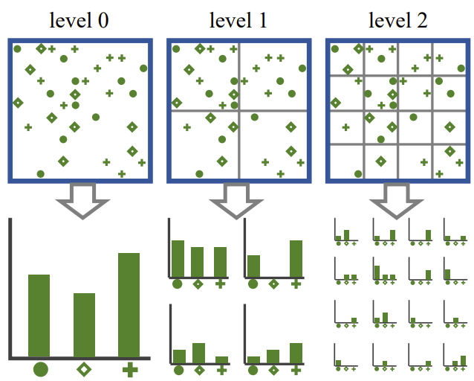
METHODOLOGY
Spatial Pyramid-Improved BoT Model
Construct a sequence of cells at multiple levels {0, · · · , L−1} and the l-th level has $2^{l}×2^{l}$ cells in total.
$D\left(C_{I}^{l},C_{\hat{I}}^{l}\right)=\frac{1}{2^{l}×2^{l}}\sum_{i=1}^{2^{l}×2^{l}}{d_{JS}\left(C_{I}\left(i\right),C_{\hat{I}}\left(i\right)\right)}$
$Q_{GGD}=\frac{1}{2^{L}}D^{0}+\sum_{i=0}^{L−1}{\frac{1}{2^{L−l+1}}}D^{l}$

Slide 18
METHODOLOGY
EXT score
Upgrade LGGD metric by incorporating with a relatively well-performed IRQA metric (EXT) proposed in the literature to build a final version called LGGD+ for IRQA.

Slide 19
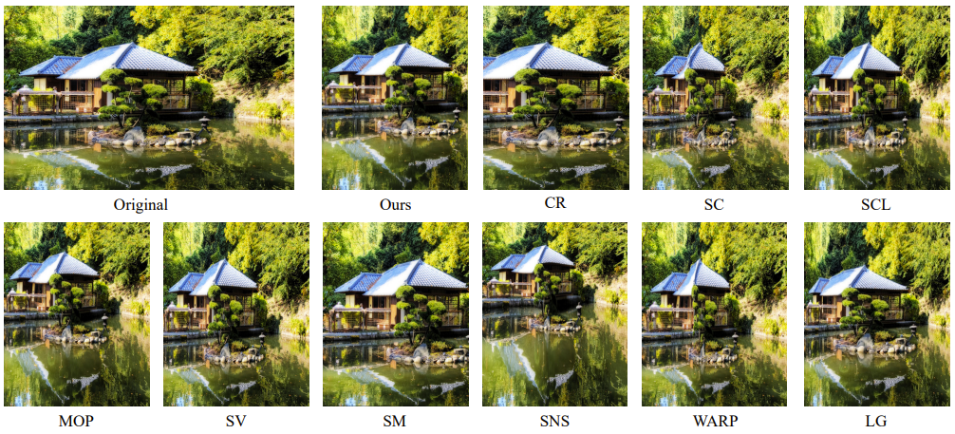
EXPERIMENTS
Application to Multi-operator Image Retargeting
Besides assessing the quality of retargeted images, another important application of an objective IRQA metric is to guide the optimization of image retargeting algorithms.
Choose four simple retargeting operators, i.e. discrete operators including cropping and seam carving, continuous operators including scaling and scale-and-stretch.

