Slide 1
Differentiable Rendering
黃慧光
Homepage: https://shuangz.com/projects/psdr-sg20/

Slide 2
Rendering pipeline
OpenDR(2014)
Soft Rasterizer(2019)
pytorch3D(2020)

Slide 3
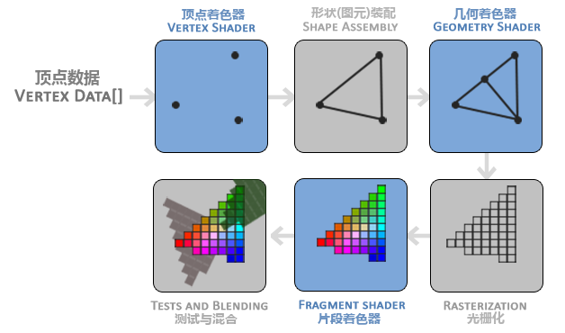
Rendering pipeline
https://learnopengl-cn.github.io/01%20Getting%20started/04%20Hello%20Triangle/

Slide 4
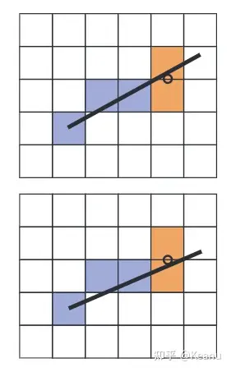
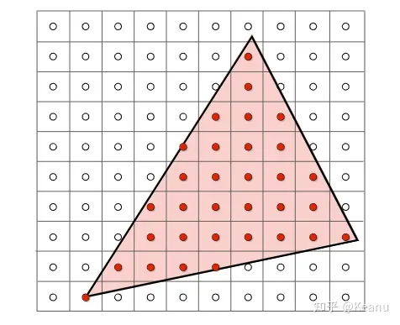
Rasterization
“The process of finding all the pixels in an image that are occupied by a geometric primitive is called rasterization”
Line drawing
Triangle Rasterization
https://zhuanlan.zhihu.com/p/449289345

Slide 5
Test and Blending : Z-buffering

Slide 6
OpenDR:an approximate differentiable renderer (ECCV 2014)
GT
GT& initial scene
difference
final result

Slide 7
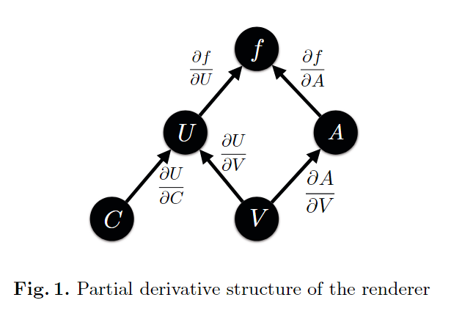
Forward rendering
Appearance (A)：per-vertex brightness
Geometry (V )：vertex locations
Camera (C)：camera parameters
intermediate variable
Projection coordinates（U）： The coordinates of the vertex in screen space after coordinate transformation (can be understood as the output of the vertex shader)
https://zhuanlan.zhihu.com/p/584510853

Slide 8
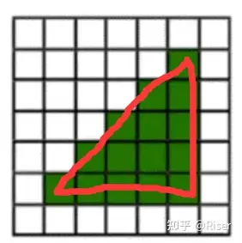
three classifications for a pixel
Interior: a pixel contains no occlusion boundaries.
OpenDR perform horizontal filtering with the kernel $\frac{1}{2} [−1, 0, 1]$
Effectively it's like calculating $[f(x+1) − f(x−1)] / 2$
On pixels neighboring an occlusion boundary on the left, we use $[0, −1, 1]$for horizontal filtering;
with pixels neighboring occlusion boundaries on the right, we use $[−1, 1, 0]$
https://zhuanlan.zhihu.com/p/631670088

Slide 9
Interior/Boundary: a pixel is intersected by one occlusion boundary
OpenDR use image-space filtering with kernel $\frac{1}{2} [−1, 0, 1]$ and its transpose.
Many-Boundary : more than one occlusion boundary is present in a pixel.
While object space methods provide exact derivatives for such pixels at the expense of modeling all the geometry, we treat this as an interior/boundary case.

Slide 10
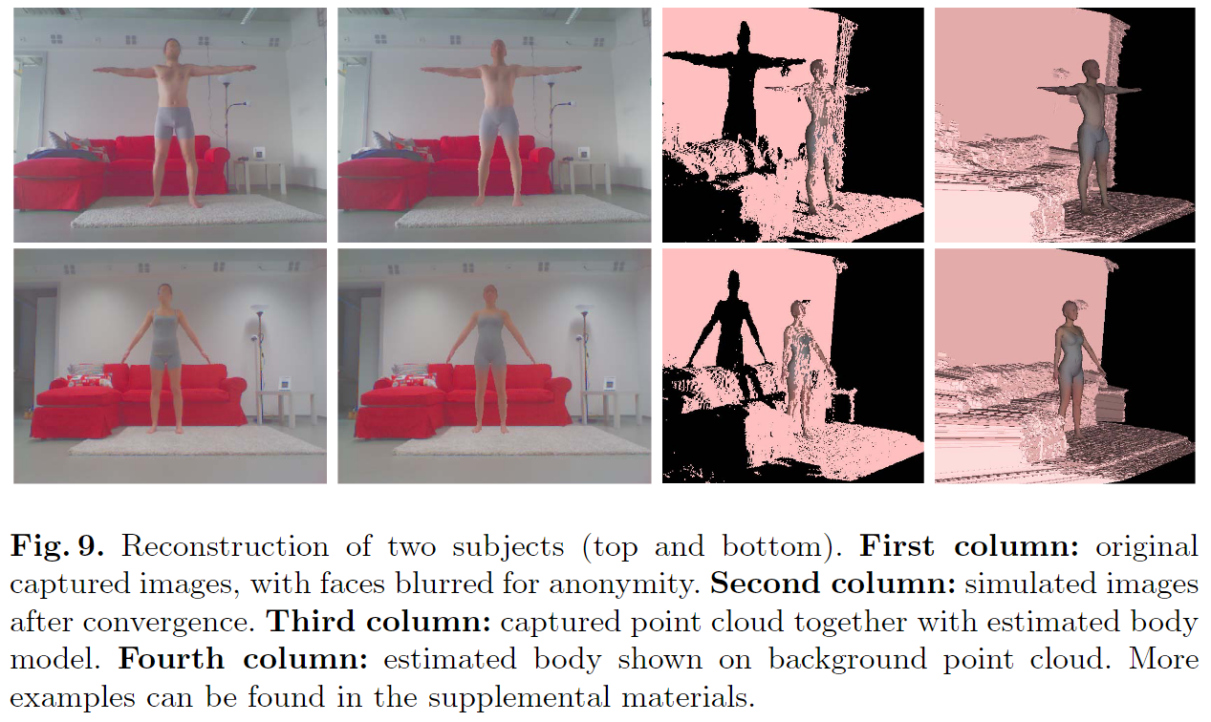

Slide 11
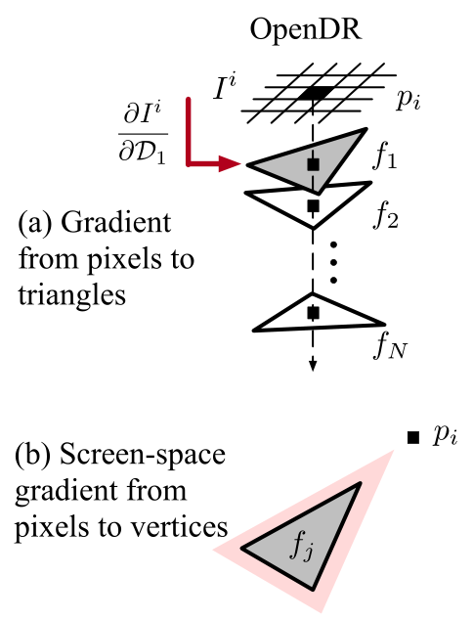
Limitations:
1. Inconsistency between forward and reverse processes
2.Unable to pass gradient into occluded triangle
3. Vertices can only receive gradients from adjacent
pixels within a short distance
https://zhuanlan.zhihu.com/p/585346760

Slide 12
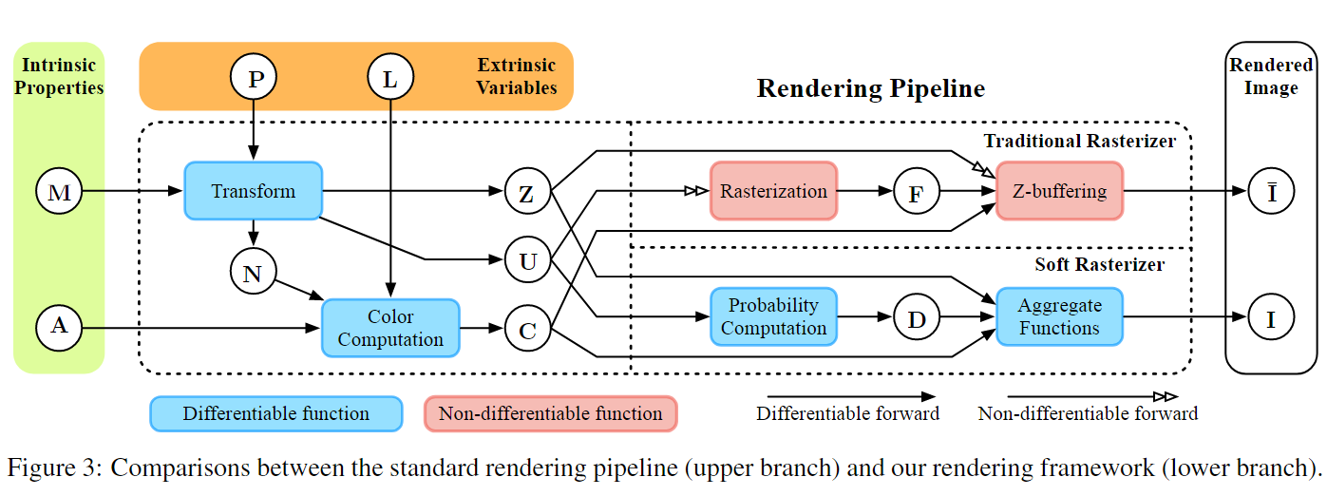
Soft Rasterizer: A Differentiable Renderer for Image-based 3D Reasoning (ICCV 2019)
https://zhuanlan.zhihu.com/p/585346760
https://zhuanlan.zhihu.com/p/540768426

Slide 13
Differentiable formulation
We propose two major components, namely probability maps $D = \left\{D_{j}\right\}$ that model the probability of each pixel staying inside a specific triangle fj
and aggregate function $A(·)$that fuses per-triangle color maps based on $\left\{D_{j}\right\}$ and the relative depths among triangles

Slide 14
Probability Map Computation
Probability maps of a triangle under Euclidean metric. (a) definition of pixel-to-triangle distance; (b)-(d) probability maps generated with different σ.

Slide 15
where σ is a positive scalar that controls the sharpness of the probability distribution while $δ_{j}^{i}$ is a sign indicator $δ_{j}^{i}$ = {+1, if $p_{i}$ ∈ $f_{j}$ ; −1, otherwise}.
We set σ as 1×10−4 unless otherwise specified. $d(i, j)$is the closest distance from $p_{i}$ to $f_{j}$ 's edges. A natural choice for $d(i, j)$ is the Euclidean distance. However, other metrics, such as barycentric or L1 distance, can be used in our approach.
Figure 4 shows $D_{j}$ of a triangle with varying σ using Euclidean distance. Smaller σ leads to sharper probability distribution while larger σ tends to blur the outcome. This design allows controllable influence for triangles on image plane. As σ → 0, the resulting probability map converges to the exact shape of the triangle, enabling our probability map computation to be a generalized form of traditional rasterization.

Slide 16
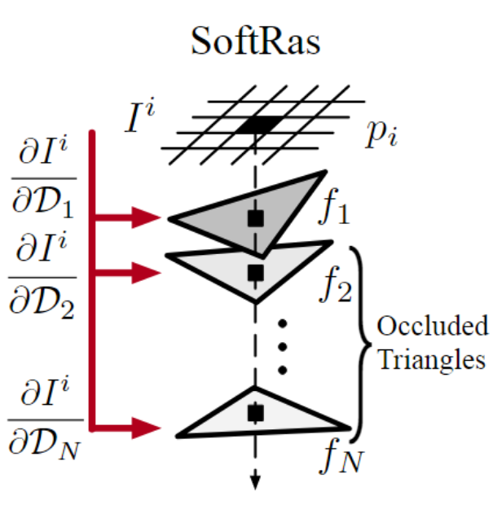
Aggregate Function
For each mesh triangle $f_{j}$ , we define its color map $C_{j}$ at pixel $pi$ on the image plane by interpolating vertex color using barycentric coordinates.
Inspired by the softmax operator, we define an aggregate function $A_{S}$ as follows:

Slide 17
where $z_{j}^{i}$ denotes the normalized negative depth of the 3D point on fi whose 2D projection is $p_{i}$;
є is small constant that enables the background color while γ (set as 1 × 10−4 unless otherwise specified) controls the sharpness of the aggregate function.
Note that $w_{j}$ is a function of two major variables: $D_{j}$ and $z_{j}$ . Specifically, $w_{j}$ assigns higher weight to closer triangles that have larger $z_{j}$ .
As γ → 0, the color aggregation function only outputs the color of nearest triangle, which exactly matches the behavior of z-buffering.

Slide 18
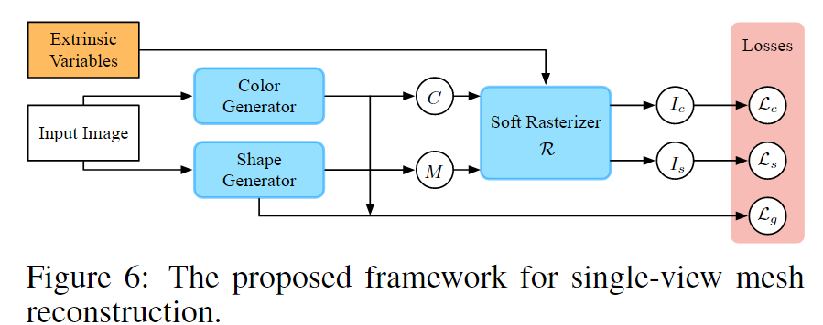
Experiments: Image-based 3D Reasoning
Single-view Mesh Reconstruction
Given an input image, our shape and color generators generate a triangle mesh M and its corresponding colors C, which are then fed into the soft rasterizer. The SoftRas layer renders both the silhouette $I_{s}$ and color image $I_{c}$ and provide rendering-based error signal by comparing with the ground truths.
We leverage a similar idea of synthesizing 3D model by deforming a template mesh.

Slide 19
Losses
The reconstruction networks are supervised by three losses: silhouette loss $L_{s}$, color loss $L_{c}$ and geometry loss $L_{g}$
Let $\hat{I_{s}}$and $I_{s}$ denote the predicted and the ground-truth silhouette respectively
The silhouette loss
The color loss
To achieve appealing visual quality, we further impose a geometry loss $L_{g}$ that regularizes the Laplacian of both shape and color predictions
$$IOU= \frac{Area \text{of} \text{Overlap}\text{​ }}{Area of Union}$$

Slide 20
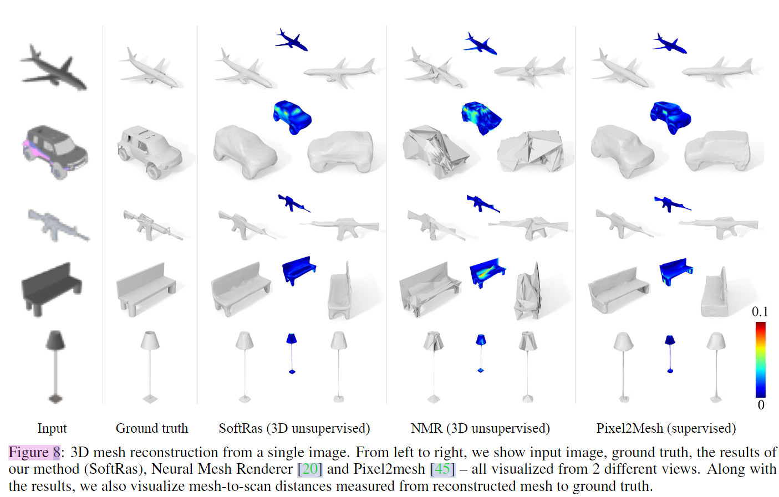
Single-view Mesh Reconstruction

Slide 21
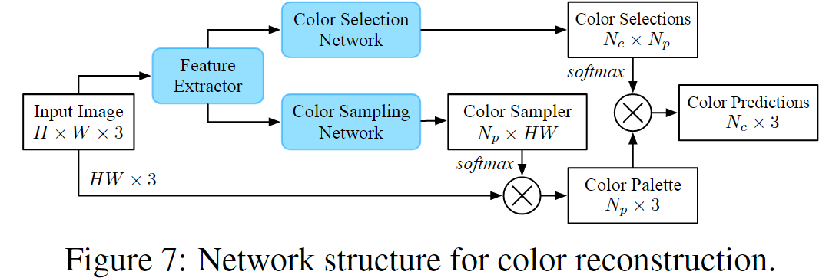
Color Reconstruction
Instead of directly regressing the color value, our color generator formulates color reconstruction as a classification problem that learns to reuse the pixel colors in the input image for each sampling point.

Slide 22
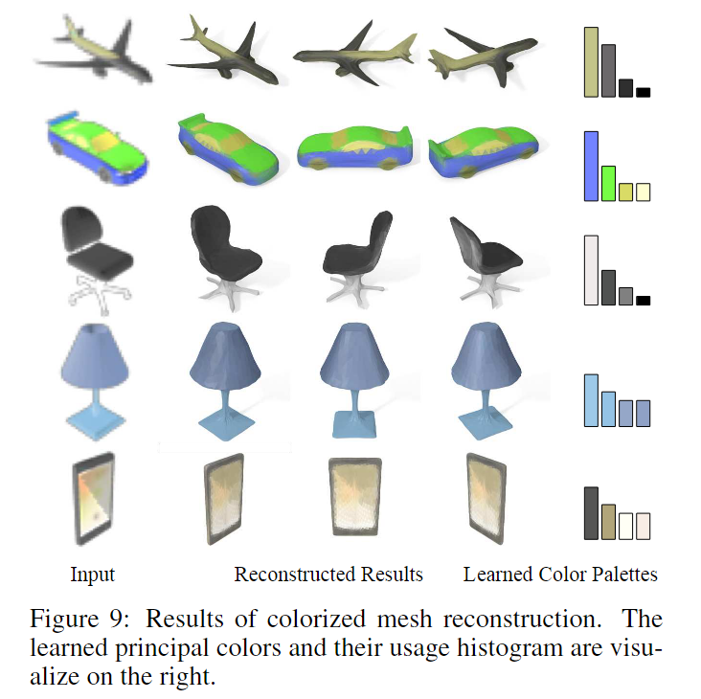
Color Reconstruction

Slide 23
Accelerating 3D Deep Learning with PyTorch3D (2020 Facebook AI Research )

Slide 24
3D operators
Chamfer loss is a common metric that quantifies agreement between point clouds P and Q. Formally
PyTorch3D avoids this inefficiency (and supports heterogeneity) by using our efficient KNN to compute neighbors. Figure 1a compares ours against the naïve approach with B = 32, |P | = 1000, and varying |Q|. The naïve approach runs out of memory for |Q| > 10k, while ours scales to large point clouds and reduces time and memory use by more than 12×.
https://medium.com/maochinn/pytorch3d-%E4%BB%8B%E7%B4%B9-4dae8b8db6ad

Slide 25
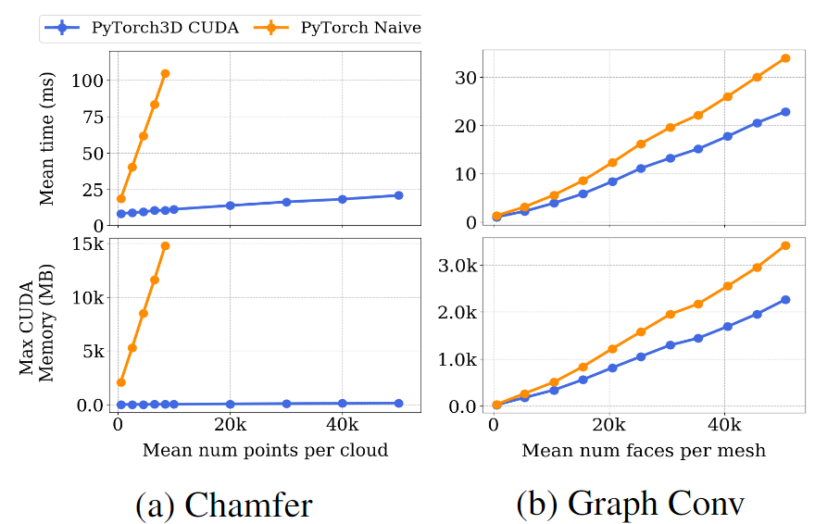
Graph convolution is commonly used for processing 3D.
Given feature vectors $f_{v}$ for each vertex $v$, it computes new features
where $N (v)$ are the neighbors of v in the mesh and $W_{0}$, $W_{1}$ are learned weight matrices.
Figure 1b shows that this improves speed and memory use by up to 30% compared against a pure PyTorch implementation.

Slide 26
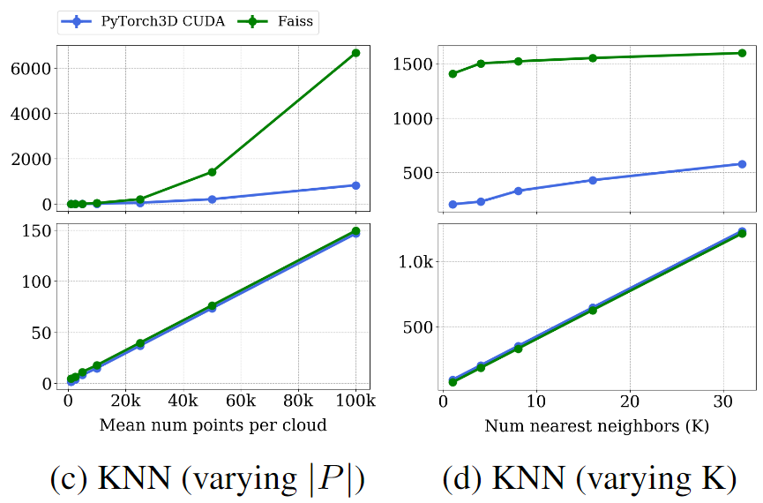
K Nearest Neighbors for D-dimensional points are used in Chamfer loss, normal estimation, and other point cloud operations
We implement exact KNN with custom CUDA kernels that natively handle heterogeneous batches.
Figures $1c$ and $1d$ show that we outperform Faiss by up to 5× for batched 3D problems.

Slide 27
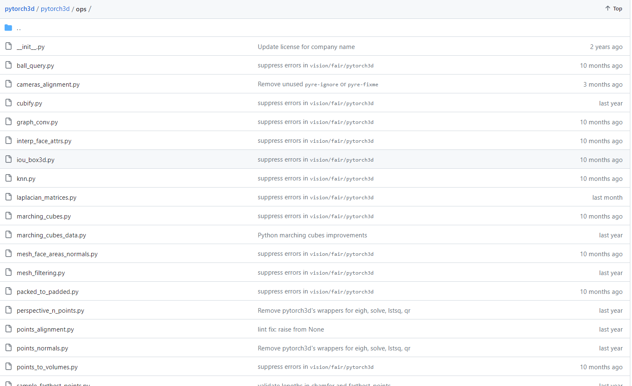

Slide 28
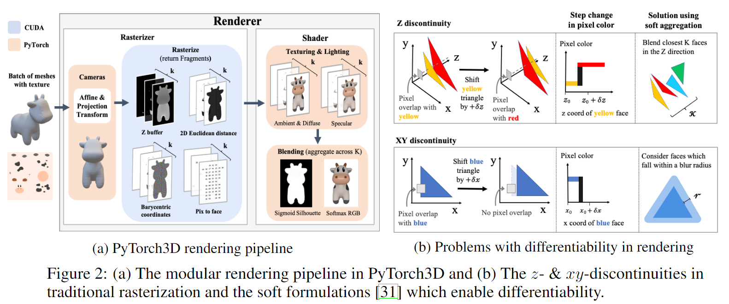
Differentiable mesh renderer

Slide 29
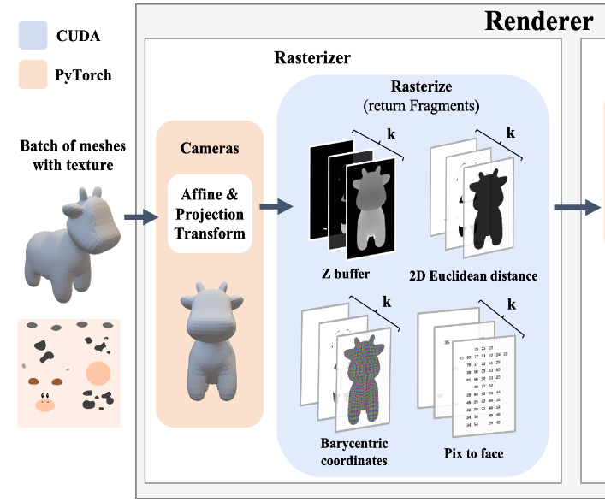
Rasterizer
Pytorch3D’s rasterizer departs from [Soft Rasterizer] in three ways to improve efficiency and modularity.
In [Soft Rasterizer], pixels are influenced by every face they intersect in the xy-plane; in contrast we constrain pixels to be influenced by only the nearest K faces along the z-axis, computed using per-pixel priority queues.
Shaders
This design is highly modular, as users can easily implement new shaders to customize the renderer.

Slide 30
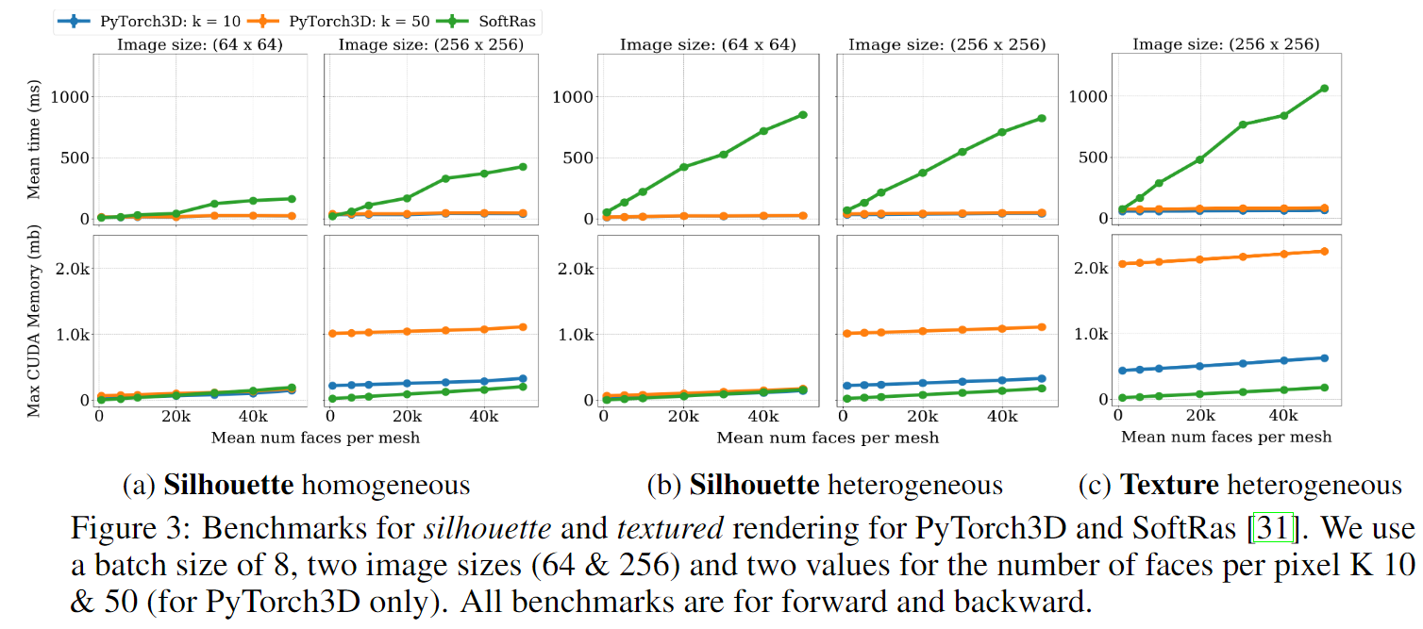
Performance

Slide 31
Differentiable point cloud renderer
PyTorch3D also provides an efficient and modular point cloud renderer following the same design as the mesh renderer.
Each point is splatted to a circular region in screen-space whose opacity decreases away from the region's center
In our experiments we consider two blending methods: Alpha-compositing and Normalized weighted sums
Alpha-compositing uses the depth ordering of points , Norm ignores the depth order

Slide 32
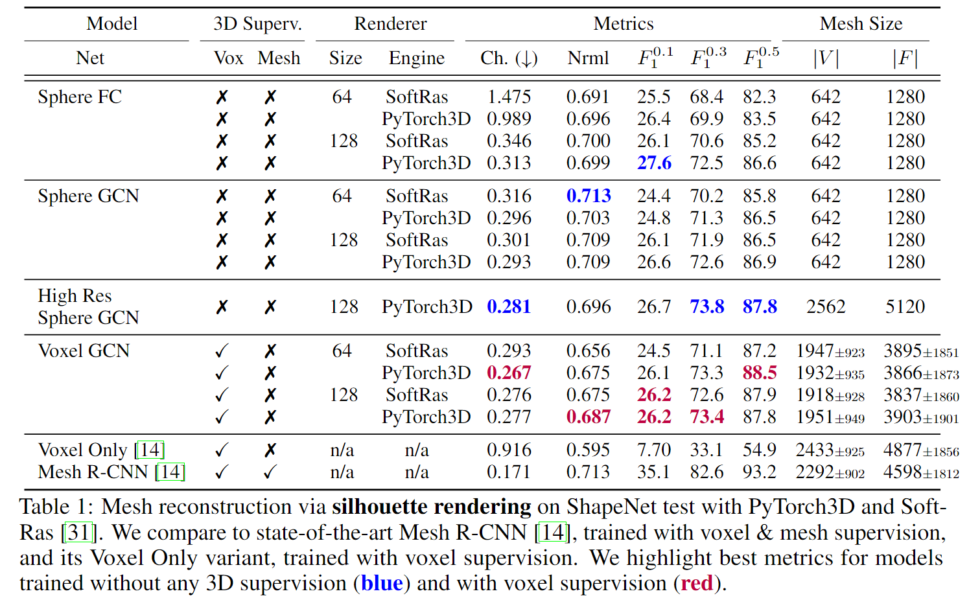
Experiments

Slide 33
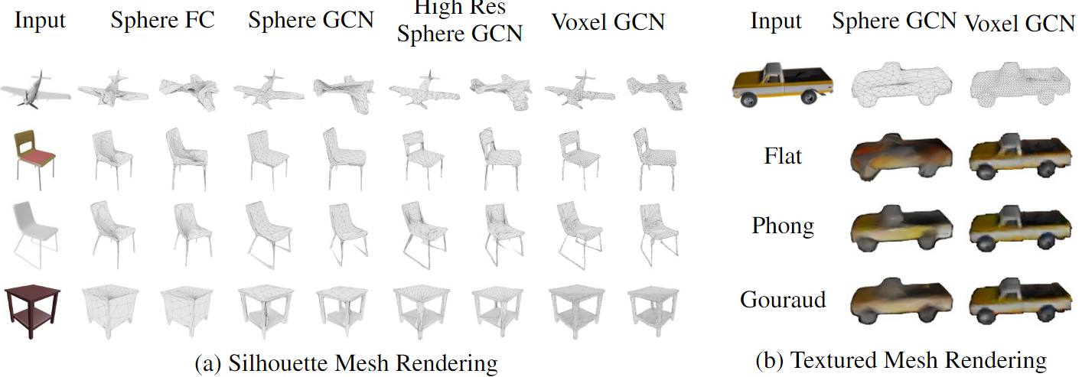

Slide 34
Thanks

