Slide 1
GaussianDreamer: Fast Generation from Text to 3D Gaussians by Bridging 2D and 3D Diffusion Models
莊卓彥

Slide 2
Contents
Introduction
Related Works
3D Pretrained Diffusion Models
Lifting 2D Diffusion Models to 3D
3D Representation Methods
Method
Experiments
Conclusion

Slide 3
Introduction(1)
3D asset generation has been an expensive and professional work in conventional pipelines. Recently, diffusion models have achieved great success in creating high-quality and realistic 2D images. Many research works try to transfer the power of 2D diffusion models to the 3D field for easing and assisting the process of 3D assets creation,

Slide 4
Introduction(2)
e.g. the most common text-to-3D task.
(i) training a new diffusion model with 3D data (namely the 3D diffusion model) (ii) lifting the 2D diffusion model to 3D.

Slide 5
Related Works(1)
3D Pretrained Diffusion Models.
These models are trained on text-3D pairs, allowing them to generate 3D assets directly from text prompts. Examples like Point-E and Shape-E can generate 3D assets quickly.

Slide 6
Related Works(2)
Lifting 2D Diffusion Models to 3D.
This approach doesn't require specific 3D pretraining. It leverages abundant 2D image data for diverse and high-quality asset generation. Techniques like SDS and SJC are used to update the 3D representation model using 2D diffusion models.

Slide 7
Related Works(3)
3D Representation Methods.
This section discusses various 3D representation methods, including NeRF, DMTET, point clouds, meshes, and 3D Gaussian Splatting. These methods are used to represent 3D scenes and assets. NeRF and its variants are notable for their impressive results. Additionally, 3D Gaussian Splatting is introduced as a method for real-time rendering and generating detailed 3D assets.

Slide 8
Method(1)
In this section, we first review 2D and 3D diffusion models and the 3D representation method known as 3D Gaussian Splatting. We give an overview of the whole framework in Section 3.2. Then, in Section 3.3, we describe the process of initializing the 3D Gaussians with the assistance of 3D diffusion models. The further optimization of 3D Gaussians using the 2D diffusion model is described in Section 3.4.

Slide 9
Method(2)
Preliminaries
DreamFusion:
It optimizes the 3D representation using the Score Distillation Sampling (SDS) loss with a pre-trained 2D diffusion model ϕ. It uses MipNeRF as the 3D representation method and employs a scoring estimation function to predict noise levels.
3D Gaussian Splatting (3DGS):
Unlike implicit representation methods like NeRF, which render images based on volume rendering, 3D-GS renders images through splatting, achieving real-time speed. It represents the scene using a set of anisotropic Gaussians, defined with center position µ∈R^3, covariance Σ∈R^7, color c∈R^3, and opacity α∈R^1. It employs a typical neural point-based rendering method to compute the color of each pixel.

Slide 10
Method(3)
Overall Framework
The overall framework consists of two parts: initialization with 3D diffusion model priors and optimization with the 2D diffusion model. For initialization with 3D diffusion model priors, 3D diffusion models F3D are used, instantiated with text-to-3D and text-to-motion diffusion models, to generate a triangle mesh based on the text prompt. The generated point clouds are then used to initialize the 3D Gaussians θb after noisy point growing and color perturbation. For better quality, the 2D diffusion model F2D is utilized to further optimize the initialized 3D Gaussians θb via SDS with prompts, resulting in the final 3D Gaussians θf. The target instance can be rendered in real time by splatting the generated Gaussians.

Slide 11
Method(4)
Gaussian Initialization with 3D Diffusion Model Priors
This section focuses on initializing the 3D Gaussians with 3D diffusion model priors. Two types of 3D diffusion models are employed to generate 3D assets: text-to-3D and text-to-motion diffusion models.
Text-to-3D Diffusion Model: Text-based 3D generation models use multi-layer perceptrons (MLPs) to predict SDF values and texture colors. The triangle mesh is constructed by querying SDF values at vertices, and texture colors are obtained for each vertex. These vertices and colors are converted into point clouds after which noisy point growing and color perturbation are applied to improve initialization quality.

Slide 12
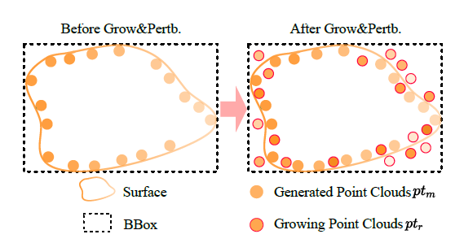
Method(5)
Gaussian Initialization with 3D Diffusion Model Priors
Text-to-Motion Diffusion Model: A sequence of human body motions is generated from text, and a human pose matching the given text is selected. This pose is converted into the SMPL model, represented as a triangle mesh. The mesh is then converted into point clouds, and noisy point growing and color perturbation are applied to enhance initialization quality.

Slide 13
Method(6)
Optimization with the 2D Diffusion Model
To enrich details and improve the quality of the 3D asset, the 3D Gaussians initialized with 3D diffusion model priors are further optimized using the 2D diffusion model F2D. The Score Distillation Sampling (SDS) loss is employed for optimization, and the final 3D instance θf achieves high quality and fidelity on top of the 3D consistency provided by the 3D diffusion model F3D.

Slide 14
Experiments(1)
Implementation Details (Sec. 4.1):
This part discusses the technical implementation details of the method.
Quantitative Comparisons (Sec. 4.2):
In this section, the document delves into numerical comparisons to assess the method's performance in comparison to others.
Visualization Results (Sec. 4.3):
Section 4.3 presents visual outcomes generated by the method and compares them with results produced by alternative approaches.
Ablation Experiments (Sec. 4.4):
This subsection describes a series of experiments conducted to systematically assess and verify the method's effectiveness.

Slide 15
Experiments(2)
Two 3D diffusion models, Shap-E and MDM, are employed in the method. Specifically, the Shap-E model, fine-tuned on Objaverse, is loaded into Cap3D.
For the 2D diffusion model, stabilityai/stablediffusion-2-1-base is utilized with a guidance scale of 100.
Timestamps are sampled uniformly in the range of 0.02 to 0.98 before 500 iterations and later adjusted to the range of 0.02 to 0.55 after 500 iterations.
Various learning rates are applied for different aspects of the 3D Gaussians, including opacity (α), position (μ), color (c), and covariance, with specific values mentioned.
Camera parameters, such as radius, azimuth, and elevation, are defined for rendering purposes.
The method's training process comprises a total of 1200 iterations, and it demonstrates efficient performance on a single RTX 3090 GPU with a batch size of 4.
Resolution settings for rendering are provided, with the ability to optimize at a lower resolution for real-time rendering..

Slide 16
Experiments(3)
The results are compared with other methods like Instant3D, Shap-E, DreamFusion, and Prolific Dreamer. For evaluation, they use a specific setup involving camera settings and select images from different viewpoints. The authors note a disadvantage their method faces due to some failed generations in other methods' evaluations. They use two models to calculate CLIP similarity, finding their method superior to most except Prolific Dreamer, but significantly faster in generation speed.

Slide 17
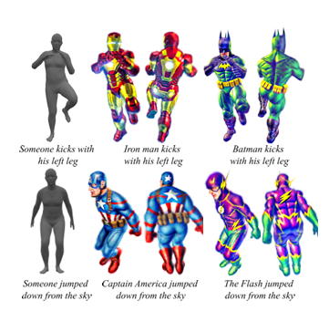
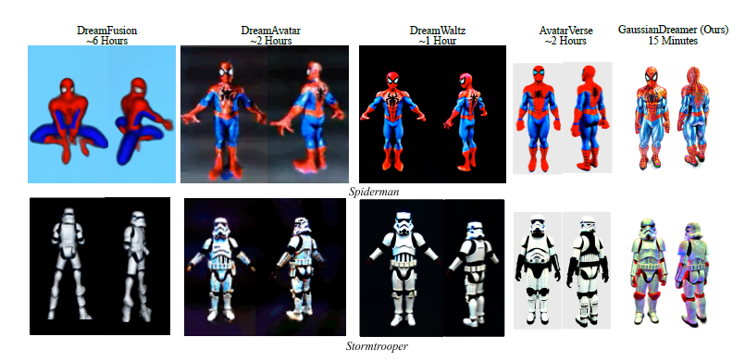
Experiments(4)
Initialization with Text-to-3D Diffusion Model:
Compares GaussianDreamer with other methods like DreamFusion, Magic3D, and ProlificDreamer.
Highlights GaussianDreamer's ability to effectively combine objects in a prompt (e.g., a plate with cookies).
Initialization with Text-to-Motion Diffusion Model:
Discusses comparison results with methods like DreamFusion and DreamAvatar.
Emphasizes the speed and quality of GaussianDreamer in generating 3D avatars with specific body poses.

Slide 18
Experiments(5)
Ablation Study and Analysis:
Evaluates the role of initialization in improving 3D consistency.
Compares Shap-E results with GaussianDreamer, highlighting the advantages of the latter.
Noisy Point Growing and Color Perturbation:
Examines the impact of these techniques on detail enhancement.
Initialization with Different Text-to-3D Diffusion Models:
Tests with models like Shap-E and Point-E to validate the framework's effectiveness.
Limitations:
Discusses challenges like generating sharp edges and large-scale scenes.

Slide 19
Experiments(5)
Ablation Study and Analysis:
Evaluates the role of initialization in improving 3D consistency.
Compares Shap-E results with GaussianDreamer, highlighting the advantages of the latter.
Noisy Point Growing and Color Perturbation:
Examines the impact of these techniques on detail enhancement.
Initialization with Different Text-to-3D Diffusion Models:
Tests with models like Shap-E and Point-E to validate the framework's effectiveness.
Limitations:
Discusses challenges like generating sharp edges and large-scale scenes.

