Slide 1
Generation of advanced Escher-like spiral tessellations 生成先進的埃舍爾式螺旋鑲嵌圖案
王語麟 2023.11.15

Slide 2
Outline
Introduction
Related work
method
Result

Slide 3
Introduction
Introduction
Related work
method
Result

Slide 4
Escher-like spiral tessellations
Escher‘s spiral art gained popularity in the 1950s but was challenging to achieve such exact repetition due to hand-drawing limitations.
This paper introduces a direct method for constructi-ng precise symmetrical Escher-like spiral tilings using shaders.

Slide 5
Related work
Introduction
Related work
method
Result

Slide 6
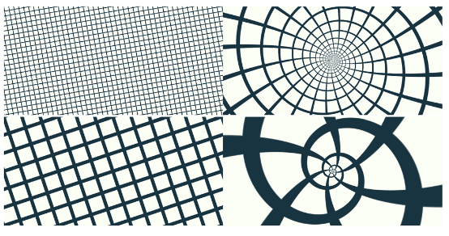
Kaplan's thoughts
In the first step, an image with a periodic tiling is generated
In the second step, the image is transformed by the antiMercator mapping
Escher-like spiral tessellations by
the antiMercator mapping

Slide 7
Method
Introduction
Related work
method
Result

Slide 8
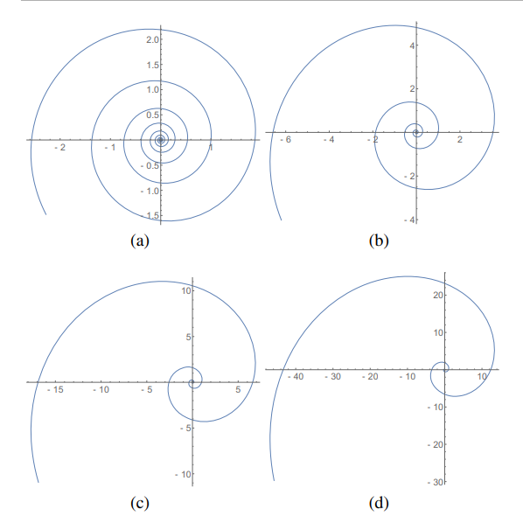
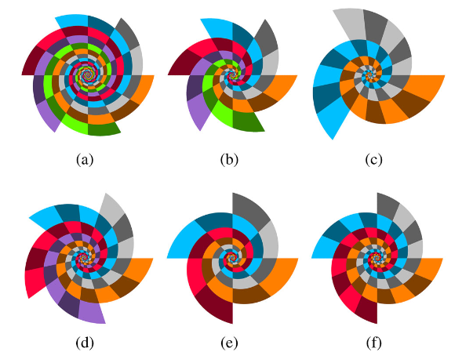
Cyclic spiral tilings
Logarithmic Spirals
Transformations and Rotations under an Abelian Symmetry Group
Changing Escher-like Spiral Tessellations in Structure
Notes:
循环螺旋平铺：
对数螺线
阿贝尔对称群的变换和旋转
类埃舍尔的螺旋镶嵌改变结构

Slide 9
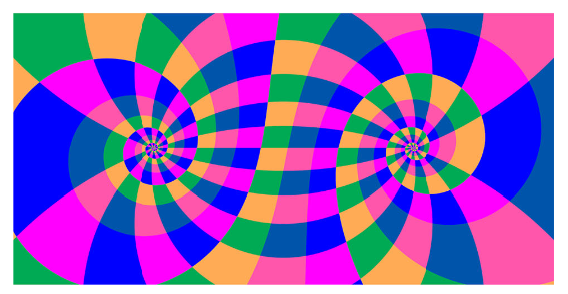
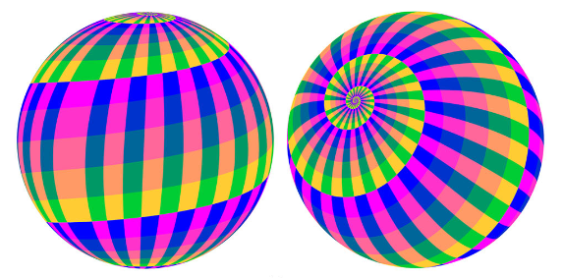
Derived spiral tilings
Conformal Mapping
three specific conformal mappings and their application to construct derived spiral tilings.
Stereographic Projection
from a unit sphere to the complex plane, transforming origins and infinities

Slide 10
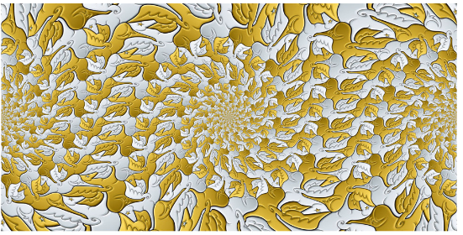
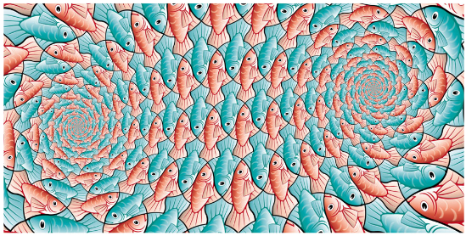
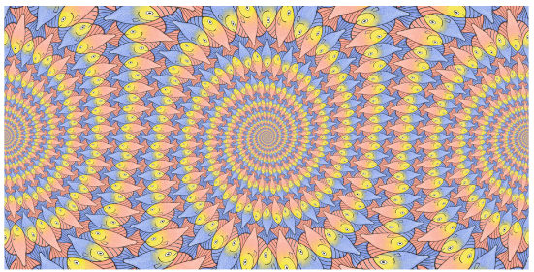
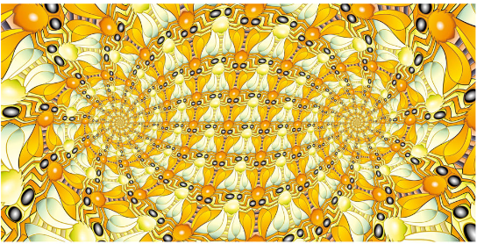
Method
Pre-designed Wallpaper Templates
Created Within a Specified Area

Slide 11
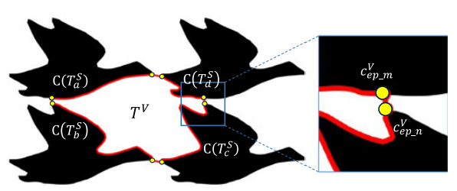
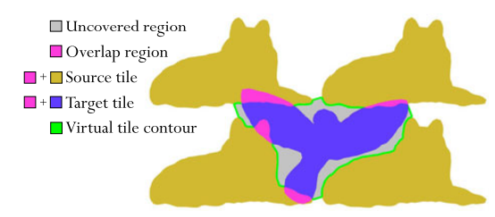
Generation of Escher-like spiral tessellations

Slide 12
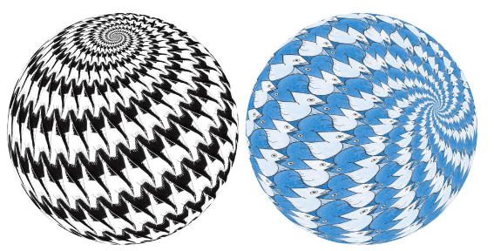
Method
Generate stereo images under different templates through stereo projection method

Slide 13
Result
Introduction
Related work
method
Result

Slide 14
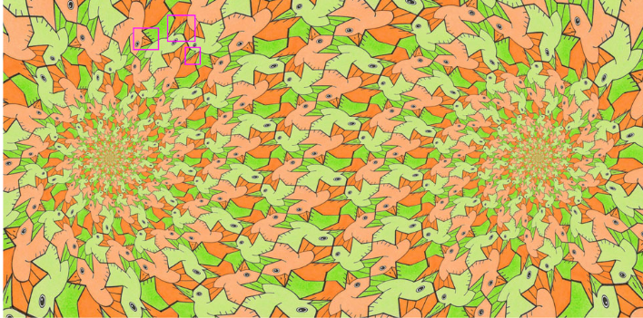
Compare with hand-designed templates
Do not strictly satisfy the translational symmetry

Slide 15
Compare with Kaplan
Kaplan's method is only a line pattern, while the author's method creates more diverse spiral tessellations with deco-rative elements like lines and colors.
Kaplan’s Method→
This Paper's Method→

Slide 16
Compare with Kaplan(cont.)
Kaplan's method permits the use of different plane patterns for di-verse outcomes, whereas the author's method employs the same type of pattern.

Slide 17
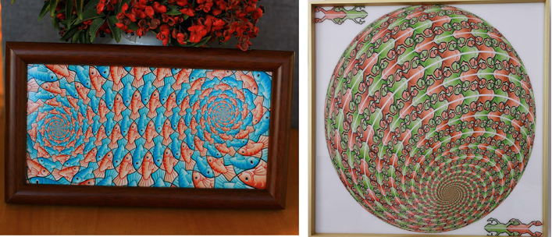
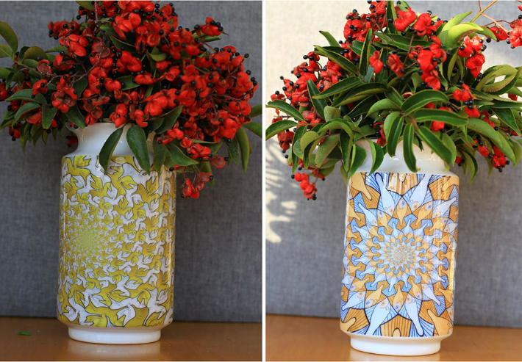
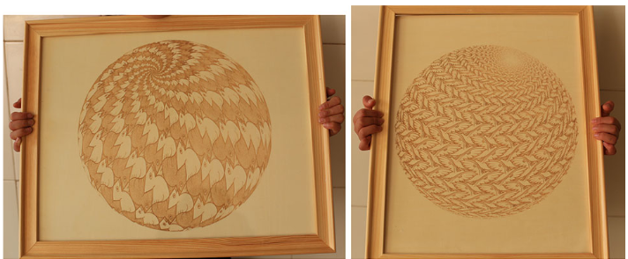
Application
Have good aesthetic value and commercial potential.
porcelain paintings, vases, and woodcuts rendered by spiral tessellations

Slide 18
謝謝

