Slide 1
Texture Mapping
Drawing Pictures on Polygons

Slide 2
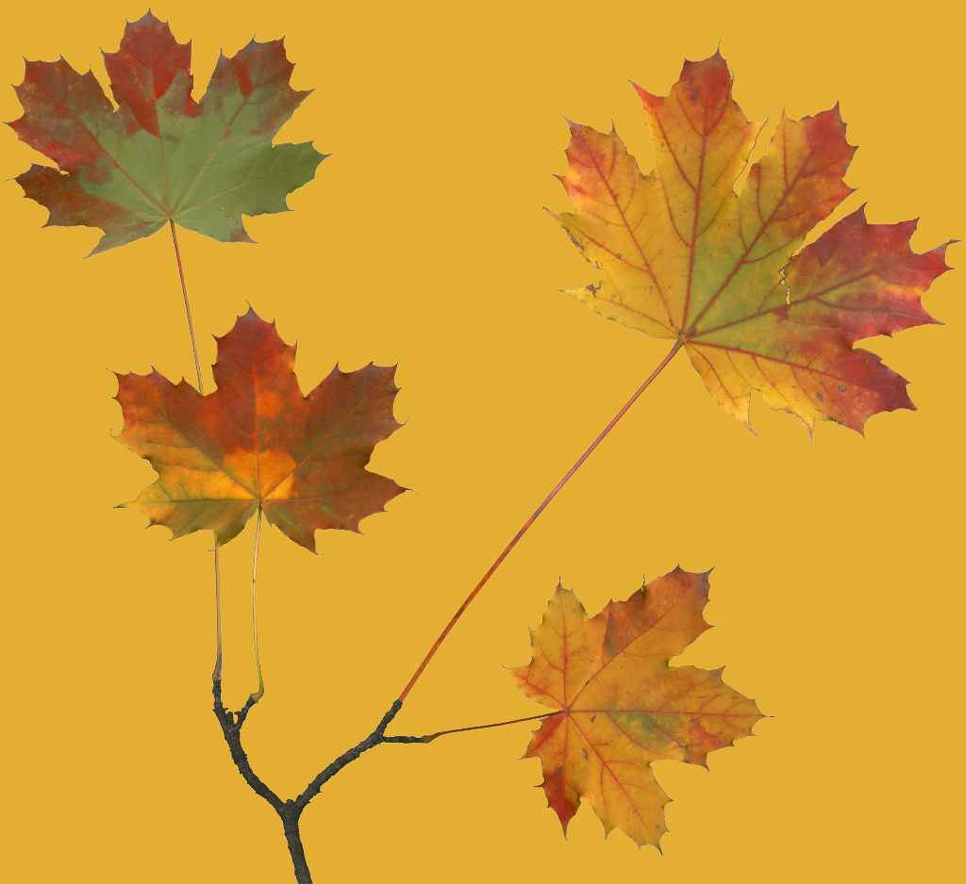
Texture Mapping

Slide 3
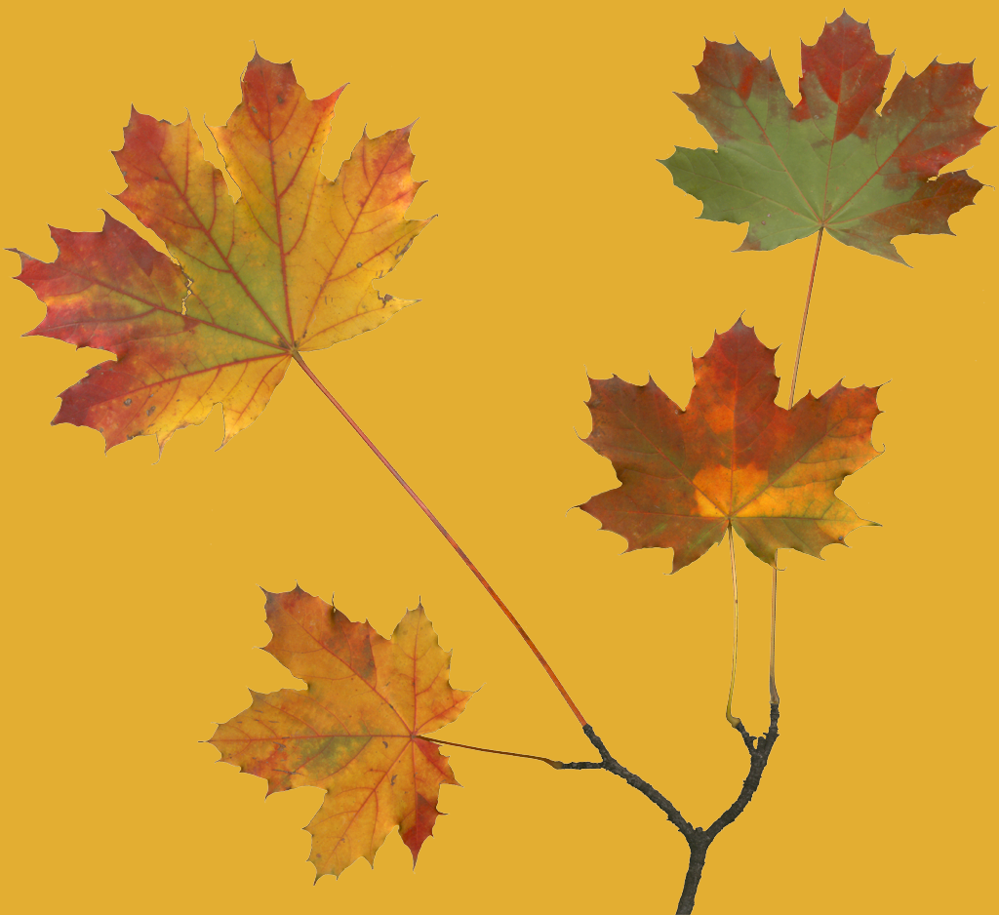
Texture Mapping

Slide 4

Texture Coordinates
(0,1)
(1,1)
(0,0)
(1,0)

Slide 5
How Do We Use Textures?
Specify a texture from the input image.
Indicate how the texture is to be applied to each pixel.
Enable texture mapping.
Draw the scene, supplying both texture and geometric coordinates.

Slide 6
Sample code - setup
void myinit(void)
{
glClearColor (0.0, 0.0, 0.0, 0.0);
glEnable(GL_DEPTH_TEST);
glDepthFunc(GL_LEQUAL);
makeCheckImage();
glPixelStorei(GL_UNPACK_ALIGNMENT, 1);
glTexImage2D(GL_TEXTURE_2D, 0, 3, checkImageWidth,
checkImageHeight, 0, GL_RGB, GL_UNSIGNED_BYTE,
&checkImage[0][0][0]);
glTexParameterf(GL_TEXTURE_2D, GL_TEXTURE_WRAP_S, GL_CLAMP);
glTexParameterf(GL_TEXTURE_2D, GL_TEXTURE_WRAP_T, GL_CLAMP);
glTexParameterf(GL_TEXTURE_2D, GL_TEXTURE_MAG_FILTER,
GL_NEAREST);
glTexParameterf(GL_TEXTURE_2D, GL_TEXTURE_MIN_FILTER,
GL_NEAREST);
glTexEnvf(GL_TEXTURE_ENV, GL_TEXTURE_ENV_MODE, GL_DECAL);
glEnable(GL_TEXTURE_2D);
glShadeModel(GL_FLAT);
}

Slide 7
Sample code - rendering
void display(void)
{
glClear(GL_COLOR_BUFFER_BIT | GL_DEPTH_BUFFER_BIT);
glBegin(GL_QUADS);
glTexCoord2f(0.0, 0.0); glVertex3f(-2.0, -1.0, 0.0);
glTexCoord2f(0.0, 1.0); glVertex3f(-2.0, 1.0, 0.0);
glTexCoord2f(1.0, 1.0); glVertex3f(0.0, 1.0, 0.0);
glTexCoord2f(1.0, 0.0); glVertex3f(0.0, -1.0, 0.0);
glTexCoord2f(0.0, 0.0); glVertex3f(1.0, -1.0, 0.0);
glTexCoord2f(0.0, 1.0); glVertex3f(1.0, 1.0, 0.0);
glTexCoord2f(1.0, 1.0); glVertex3f(2.41421, 1.0, -1.41421);
glTexCoord2f(1.0, 0.0); glVertex3f(2.41421, -1.0,-1.41421);
glEnd();
glFlush();
}

Slide 8
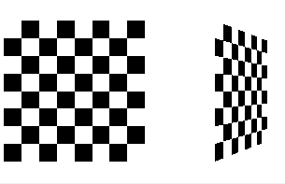

Slide 9
Specifying a Texture

Slide 10
Specifying a Texture
void glTexImage2D( GLenum target,
GLint level,
GLint internalFormat,
GLsizei width,
GLsizei height,
GLint border,
GLenum format,
GLenum type,
const GLvoid *pixels);

Slide 11
Specifying a Texture
width and height specify the size of the texture. border indicates the width of the border which can be either 0 or 1 (to be explained soon).
The dimensions of the texture MUST be: width = 2^{n} + 2b ( where b is the )
height = 2^{m} + 2b ( border width ).

Slide 12
Border

Slide 13
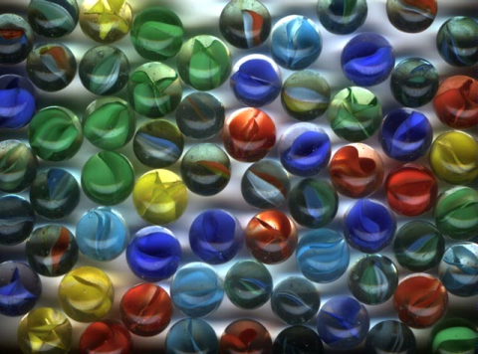
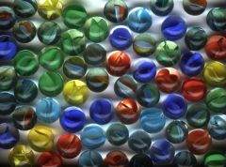


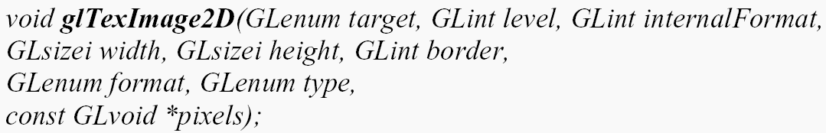
Multiple level of Detail
Mipmaps (SIGGRAPH83) – many things in a small place
1/2
1/2

Slide 14
Specifying a Texture
level specifies the mipmapping level of the current texture.
0 - is the base level (highest resolution).
n - is the n^{th} level of resolution.
When using mipmaps ALL levels from the highest resolution to a 1x1 map MUST be defined

Slide 15
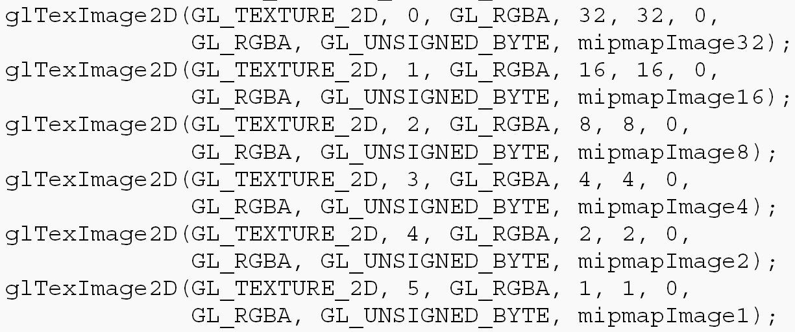
Construct Mipmaps

Slide 16
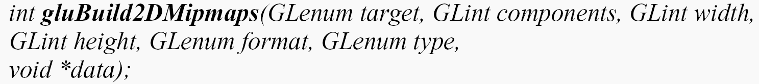
Construct Mipmaps
Automatically construct a series of mipmaps and calls glTexImage*D() to load images
Not need powers of 2 about image dimensions

Slide 17
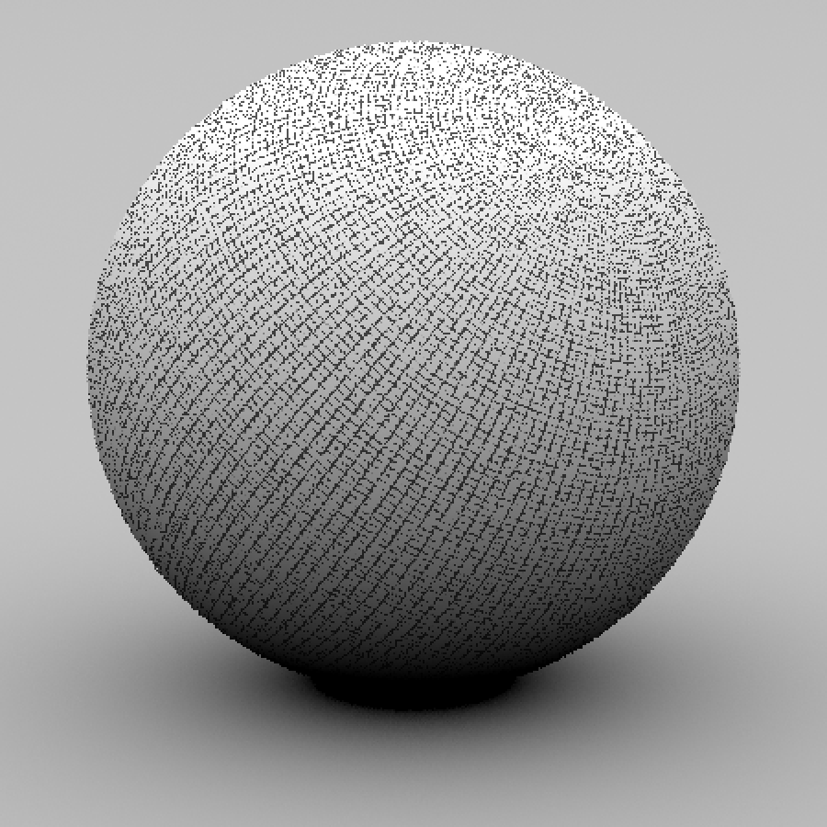
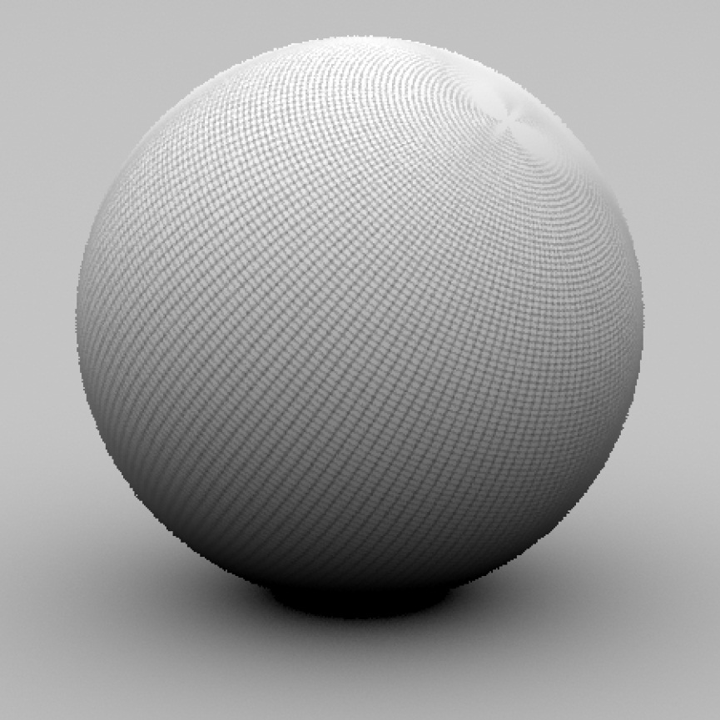
Filtering

Slide 18
Filtering
Why?
Texture
Polygon
Texture
Polygon
Magnification
Minification

Slide 19
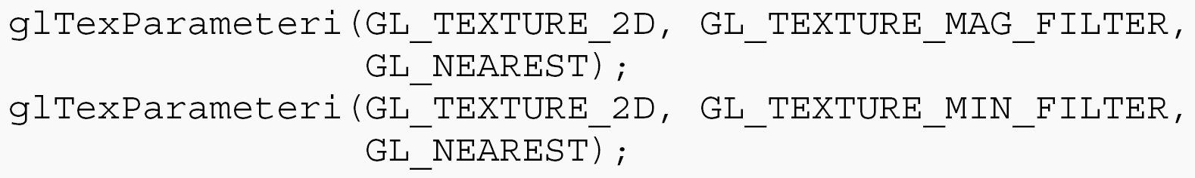
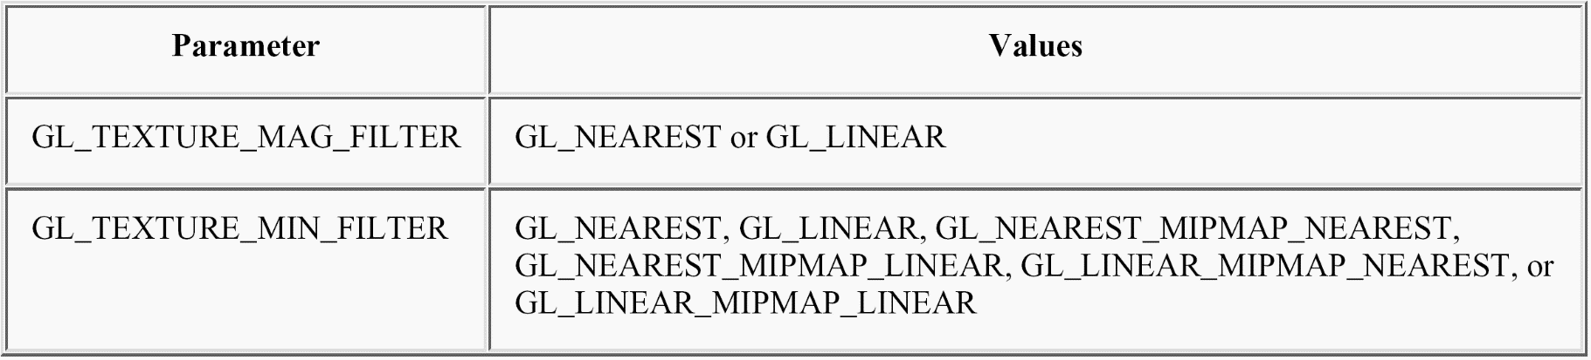
Filtering

Slide 20
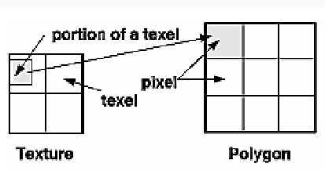
Filtering
Mipmaps level

Slide 21
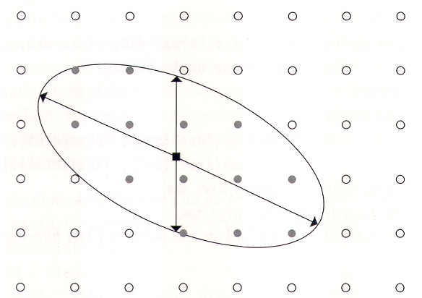
EWA
Elliptically weighted average filtering
The screen space partial derivatives of the texture coordinates define the axes of the ellipse(X, Y axes project to texture space)
X
Y

Slide 22
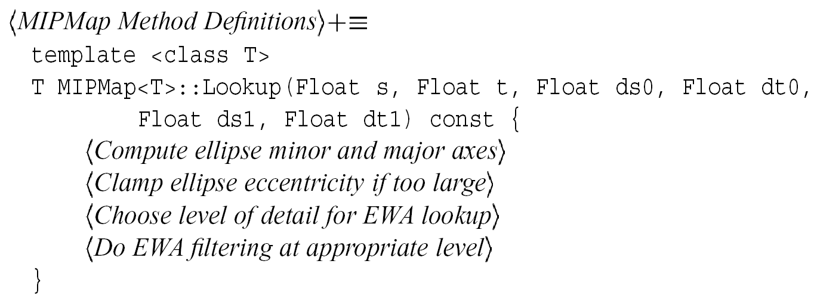
EWA
Level = nLevels – 1 + Log2(minorLength)

Slide 23
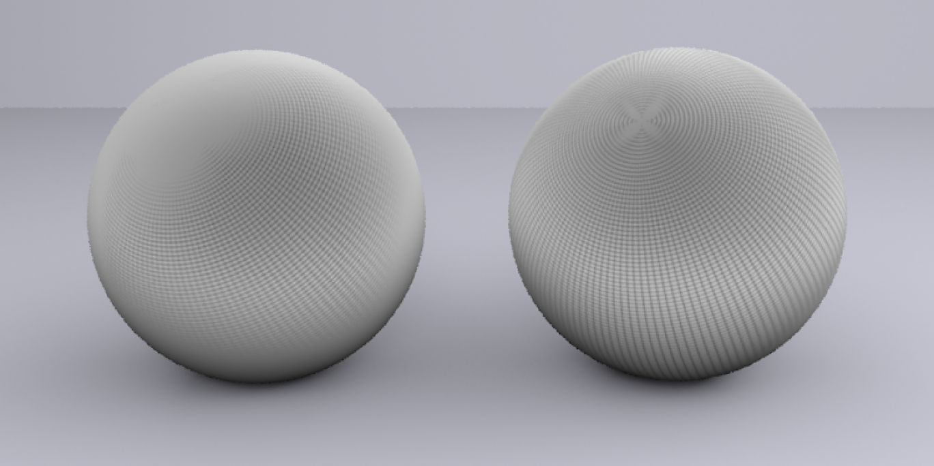
Mipmaps
trilinear
EWA

Slide 24
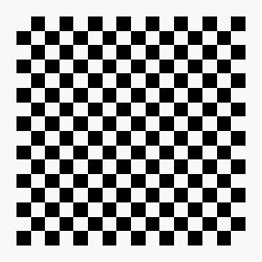
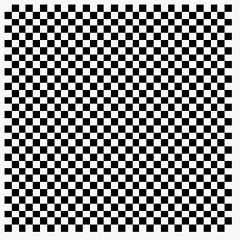

Wrapping Mode
Example:
  glTexParameteri( GL_TEXTURE_2D,
  GL_TEXTURE_WRAP_S, GL_CLAMP )
  glTexParameteri( GL_TEXTURE_2D,
  GL_TEXTURE_WRAP_T, GL_REPEAT )
t
s
GL_REPEAT
wrapping
GL_CLAMP
wrapping
texture

Slide 25
Texture Functions
You can specify how the texture-map colors are used to modify the pixel colors
  glTexEnvi(GL_TEXTURE_ENV,GL_TEXTURE_ENV_MODE, mode);
  mode values:
    GL_REPLACE: replace pixel color with texture color
    GL_DECAL: replace pixel color with texture color for GL_RGB texture
    GL_BLEND: C = Cf(1-Ct) + CcCt,
      Cf is the pixel color, Ct is the texture color, and Cc is some constant color
    GL_MODULATE: C = CfCt
    More on OpenGL programming guide
Example: Texture is applied after lighting, so how do you adjust the texture’s brightness?
  Make the polygon white and light it normally
  Use glTexEnvi(GL_TEXTURE_ENV, GL_TEXTURE_ENV_MODE, GL_MODULATE)
  Then, texture color is multiplied by surface (fragment) color and appears lighted

Slide 26
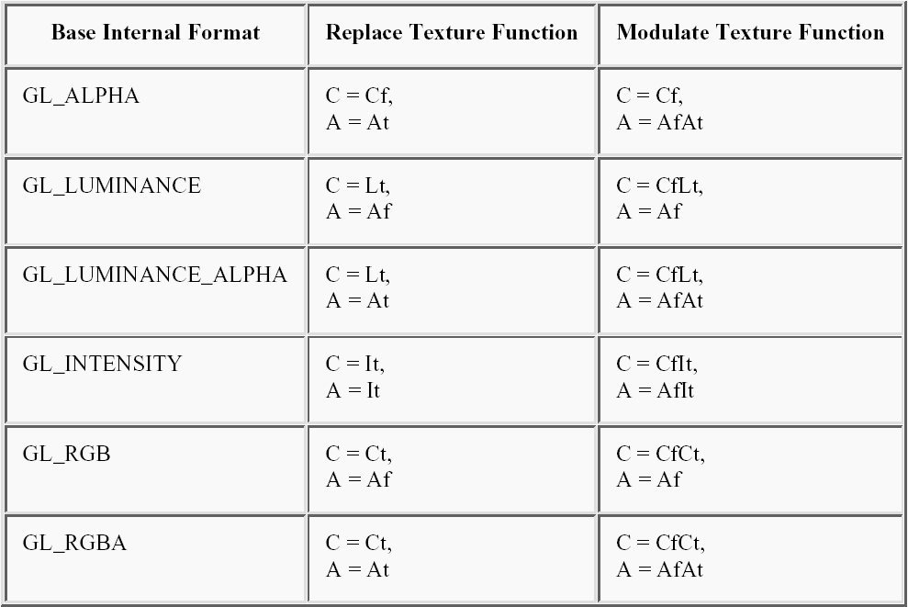
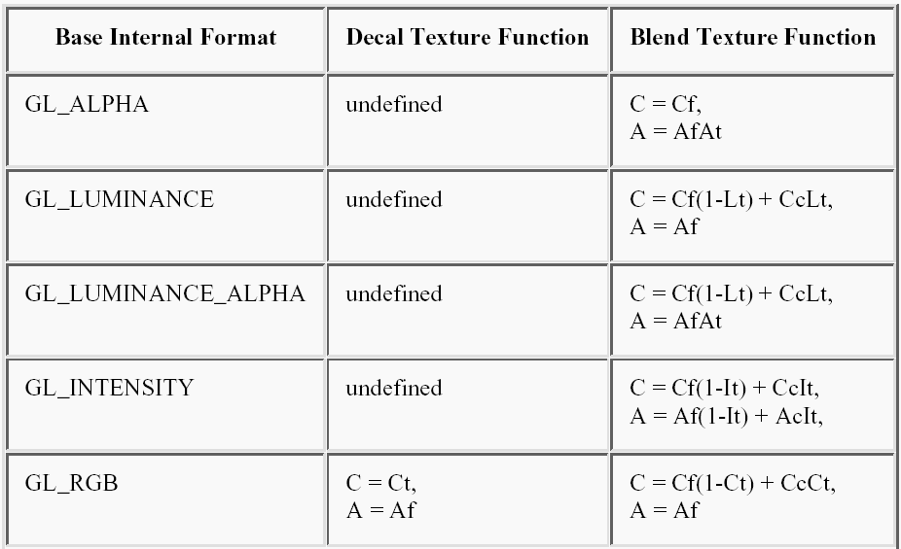
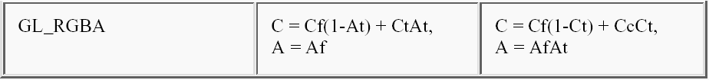

Slide 27
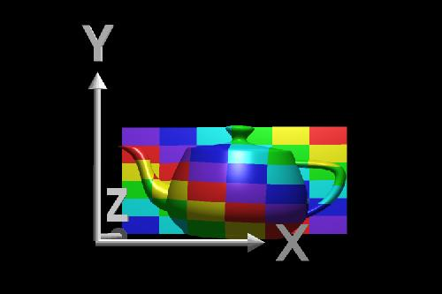
Texture coordinates
We’ll discuss map shapes first. For a map shape that’s planar, we take an (x,y,z) value from the object and throw away (project) one of the components, which leaves us with a two-dimensional (planar) coordinate. We use the planar coordinate to look up the color in the texture map.

Slide 28
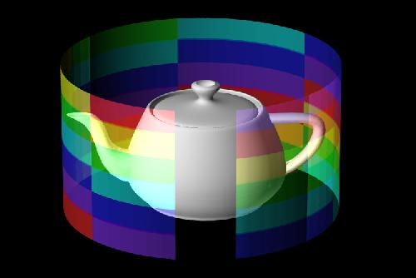
A second shape used in texture mapping is a cylinder. An (x,y,z) value is converted to cylindrical coordinates of (r, theta, height). For texture mapping, we are only interested in theta and the height. To find the color in two-dimensional texture map, theta is converted into an s-coordinate and height is converted into a t-coordinate. This wraps the two-dimensional texture map around the object.
y
s,t
θ
height

Slide 29

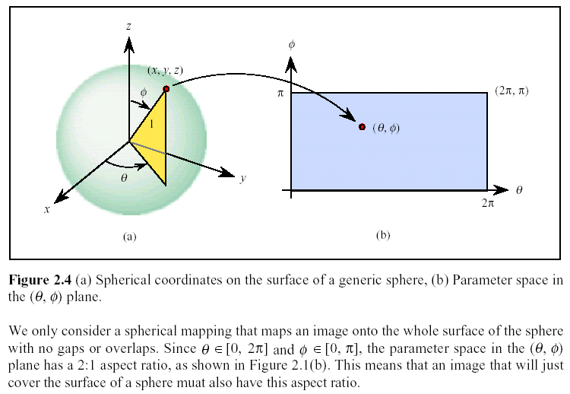
Spherical Mapping
Sphere with r=1

Slide 30
Mesh Parameterization
Piponi and Borshukov, SIGGRAPH
Notes:
The parameterization is a process to flatten the 3D mesh into a 2D planar domain

Slide 31
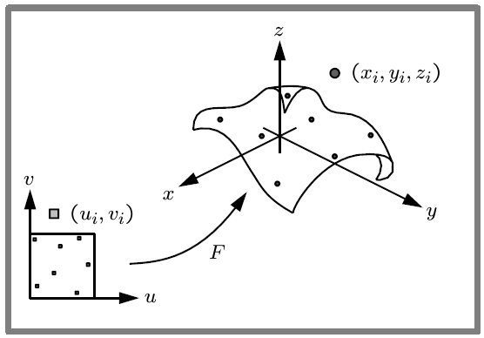


Assign a parameter value
$$V_{i}:(X_{i},Y_{i},Z_{i})$$
$$v_{i}:(x_{i},y_{i})$$
Greiner and Hormann
Notes:
The parameterization is a mapping(or function) between 3D mesh and 2D planar domain

Slide 32
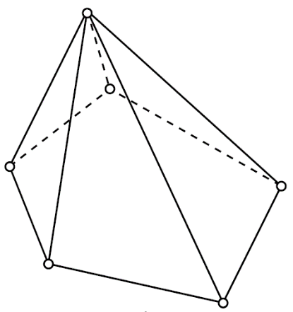
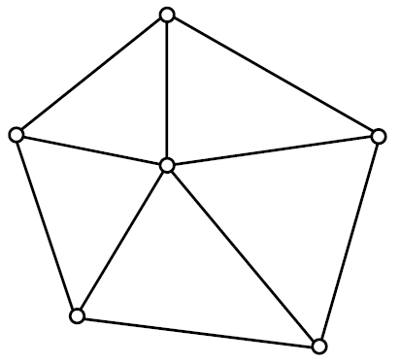
Good parameterization?
Preserve geometry length, angle, area, ...
  Isometric parameterization
Keep the distortion as small as possible
3D
2D
Greiner and Hormann
Notes:
The parameterization usually introduces distortion, such that the goal is to minimize the distortion

Slide 33
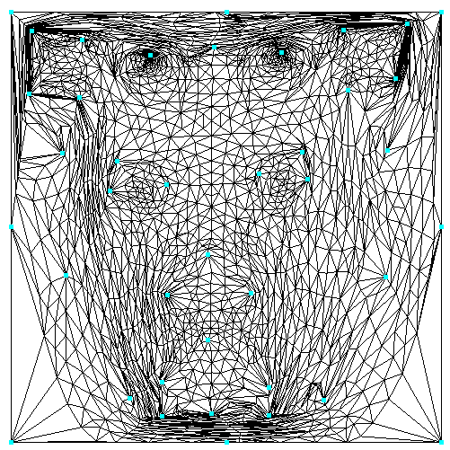

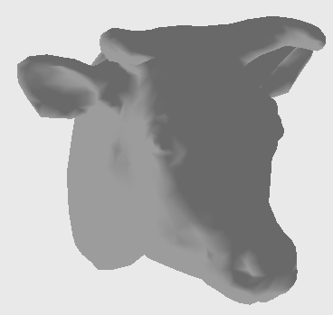
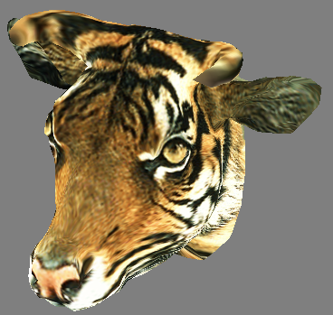
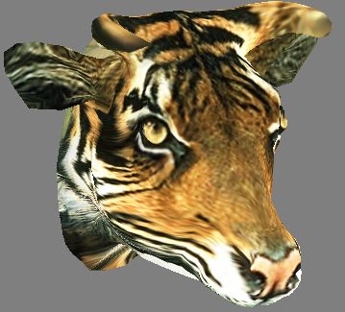
Applications
Texture mapping

Slide 34
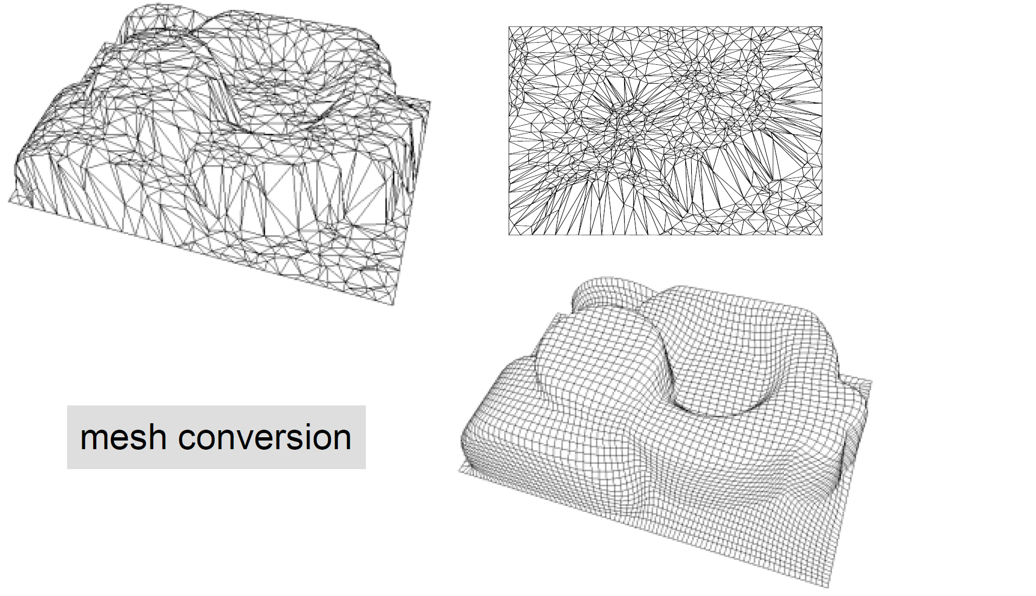
Applications
Remesh
2D parameter space
3D mesh
Resample from the
2D parameter space
Greiner and Hormann

Slide 35
Applications
Morphing
Schreiner et al.

Slide 36
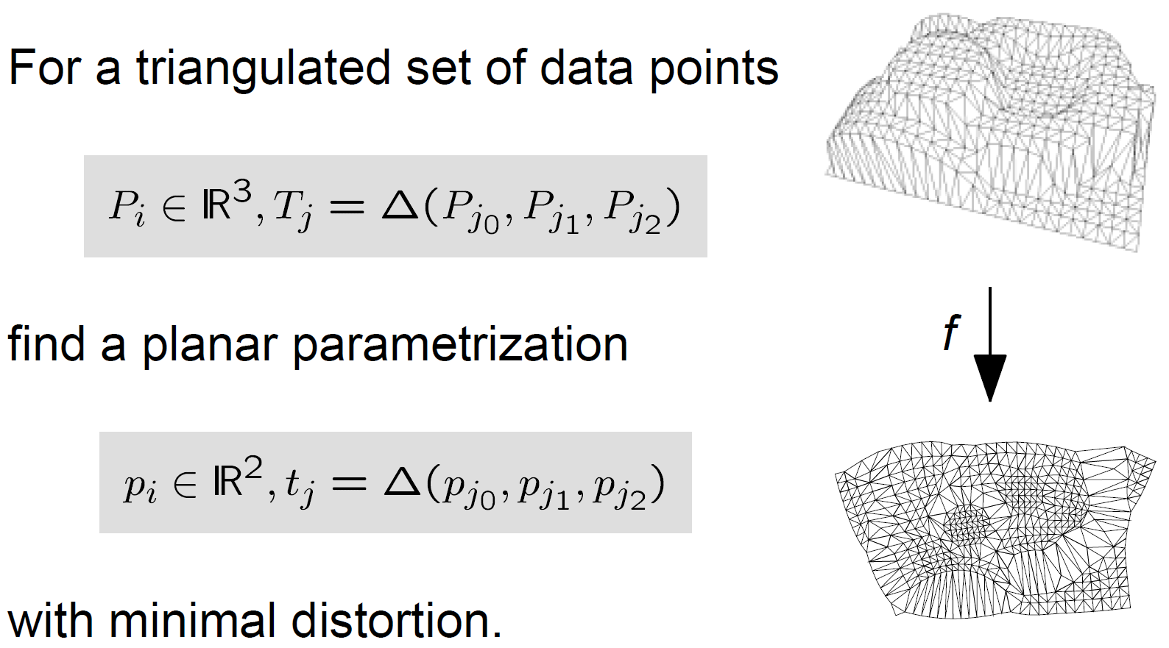


Parameterization
$$V_{i}∈ℝ^{3}, T_{j}=△(V_{j_{0}},V_{j_{1}},V_{j_{2}})$$
$$v_{i}∈ℝ^{2}, t_{j}=△(v_{j_{0}},v_{j_{1}},v_{j_{2}})$$
Greiner and Hormann

Slide 37
Parameterization - projection method
The mesh vertices are projected to the intermediate surface to get the texture coordinates
Greiner and Hormann, Lévy

Slide 38
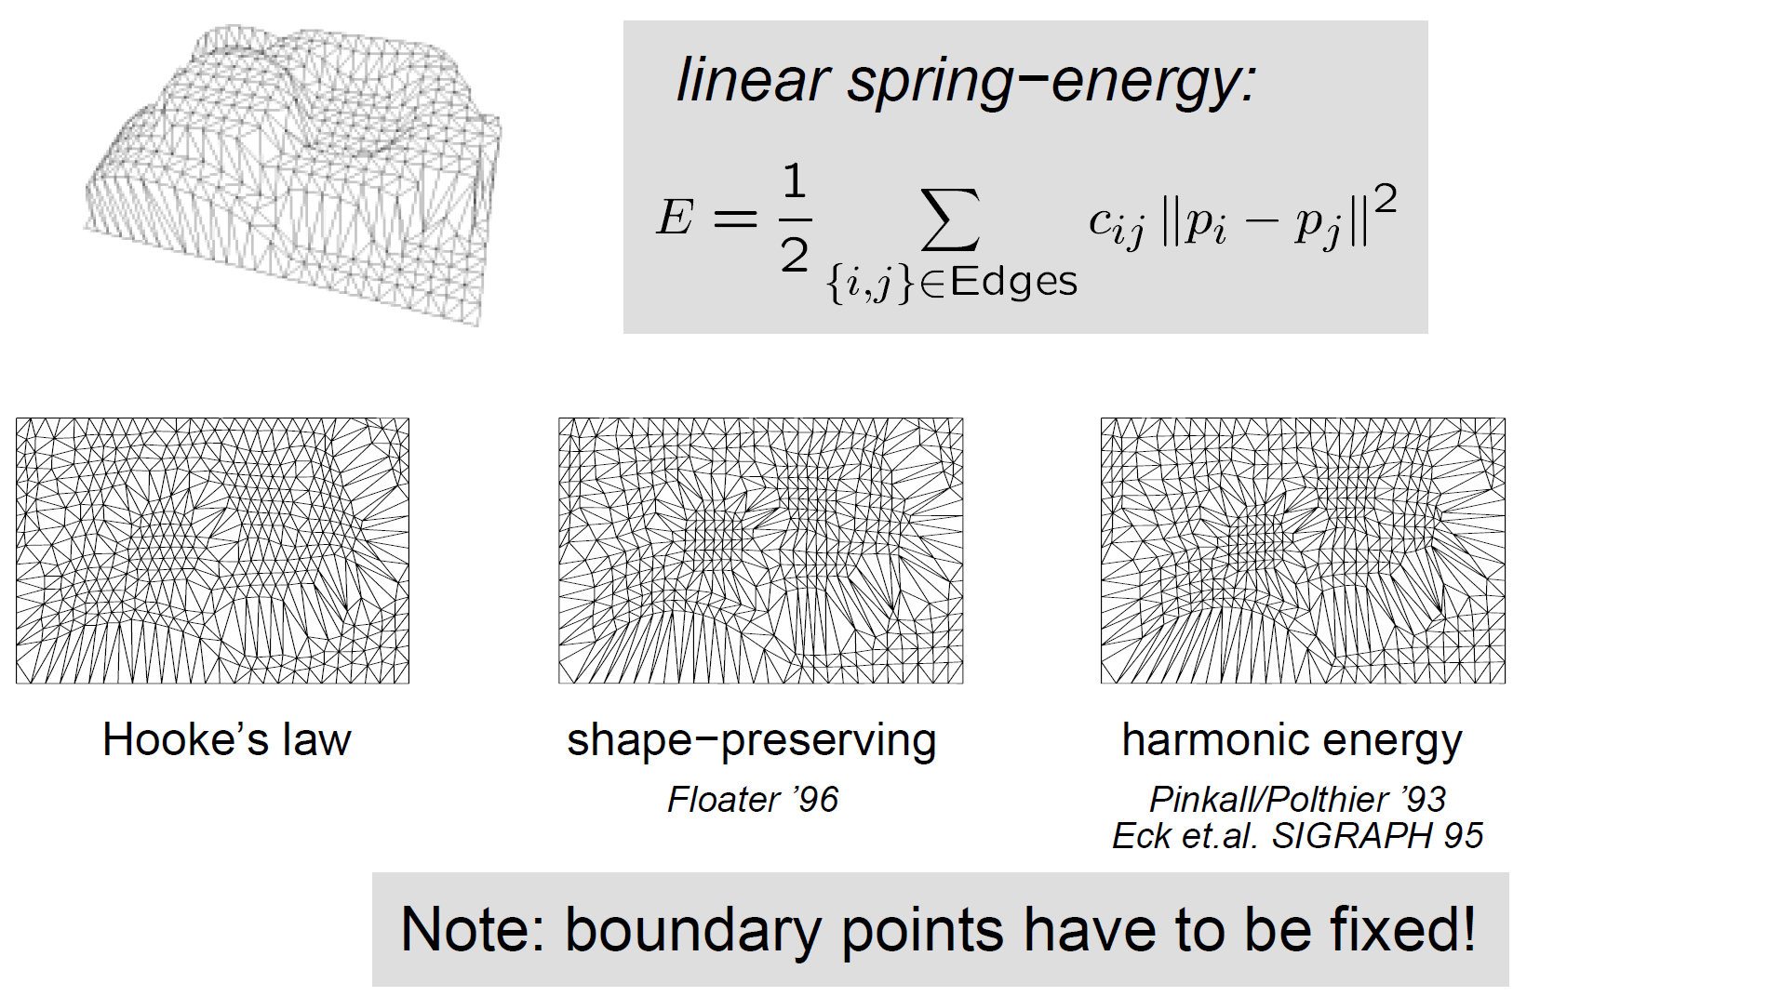
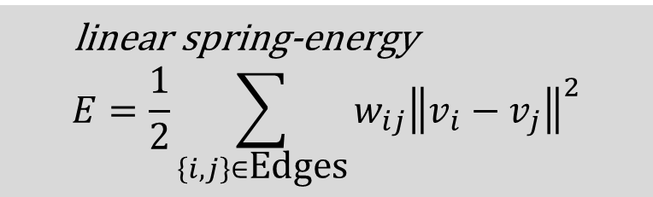
Parameterization - linear energy method
linear spring-energy
$$E=\frac{1}{2}\sum_{\left\{i,j\right\}∈\text{E}\text{dges}}{w_{ij}{\left\|v_{i}−v_{j}\right\|}^{2}}$$
Greiner and Hormann
Notes:
The equation E is the spring energy like Hooke’s law. The wij can be different because of the different consideration of energy design. The vi and vj are denoted as points in 2D parameter space.

Slide 39
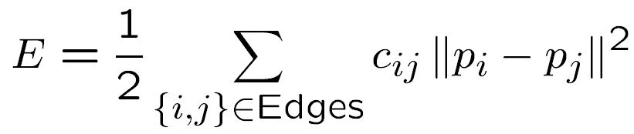
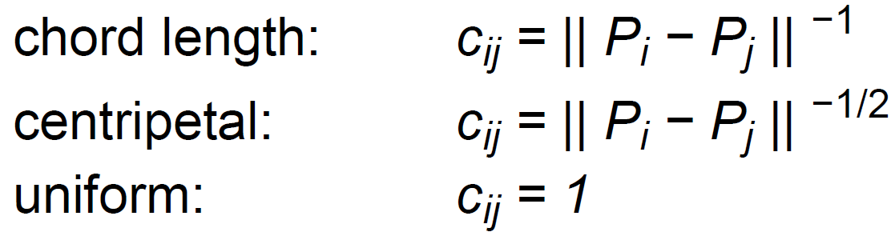

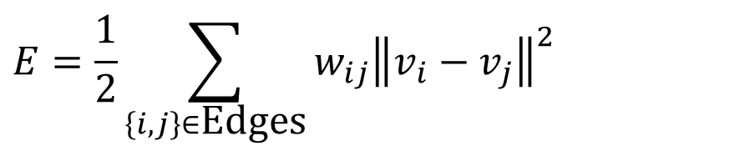
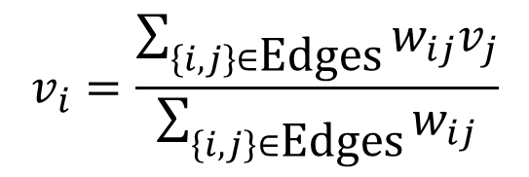
Parameterization - linear method
$$E=\frac{1}{2}\sum_{\left\{i,j\right\}∈\text{E}\text{dges}}{w_{ij}{\left\|v_{i}−v_{j}\right\|}^{2}}$$
$$w_{ij}={\left\|V_{i}−V_{j}\right\|}^{−1}$$
$$w_{ij}=1$$
$$v_{i}=\frac{\sum_{\left\{i,j\right\}∈\text{E}\text{dges}}{w_{ij}v_{j}}}{\sum_{\left\{i,j\right\}∈\text{E}\text{dges}}{w_{ij}}}$$
Greiner and Hormann
Notes:
To minimize the energy E, we can compute the derivative of E. Then we can get the solution of vi like the bottom equation. We will introduce the implementation of linear method using the vi equation in the end of related work.

Slide 40
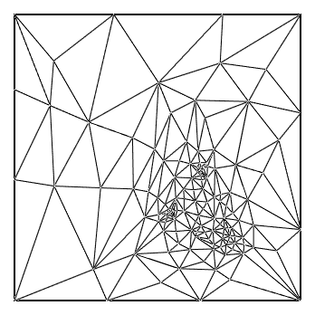
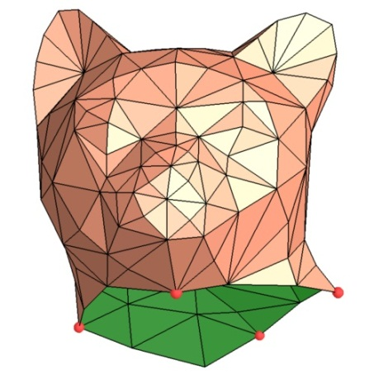
Parameterization – texture stretch metric method
length-preserving (isometric) γ = Γ = 1
angle-preserving (conformal) γ = Γ
area-preserving γ Γ = 1
linear map
2D texture domain
surface in 3D
singular values: γ , Γ
γ
Γ
Sander et al.
Notes:
When a triangle is mapped from 2D to 3D, we can measure the maximum deformation (little gamma) and the minimum deformation (big gamma). Isometric is the ideal case that means no distortion is introduced.

Slide 41
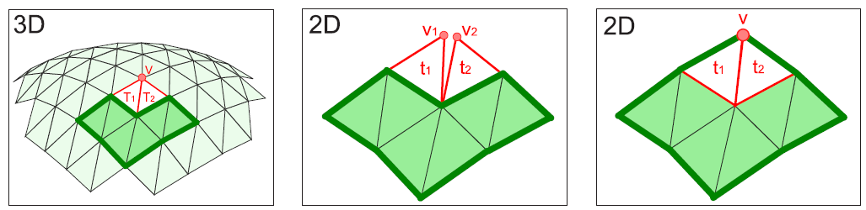
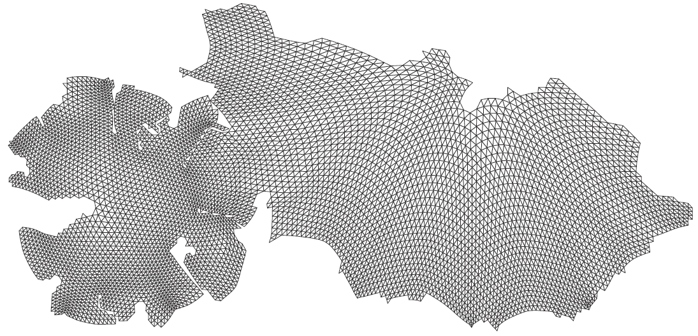
Parameterization - unfold triangle method
Start from a seed triangle
Sorkine et al.
Notes:
This method start from a seed triangle. And then choose a neighbor triangle to unfold in 2D domain. The upper figures(middle and right figures) demonstrate the unfold of two adjacent triangles t1 and t2. the vertices v1 and v2 should be merged like right figure.

Slide 42
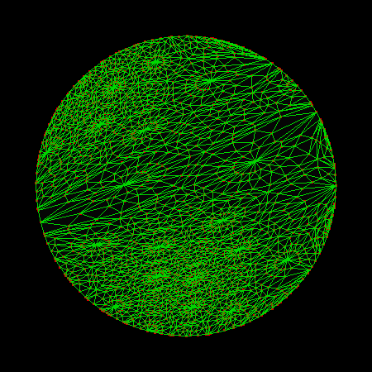
Parameterization – virtual points
……
……
……
Virtual Boundary

Slide 43
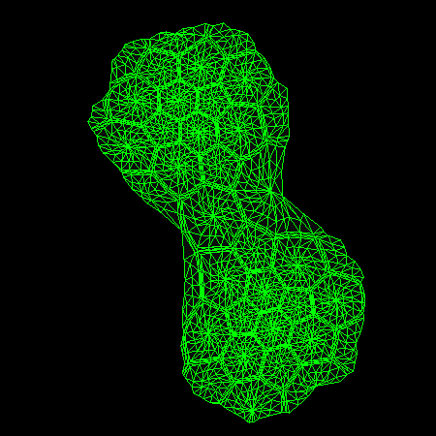
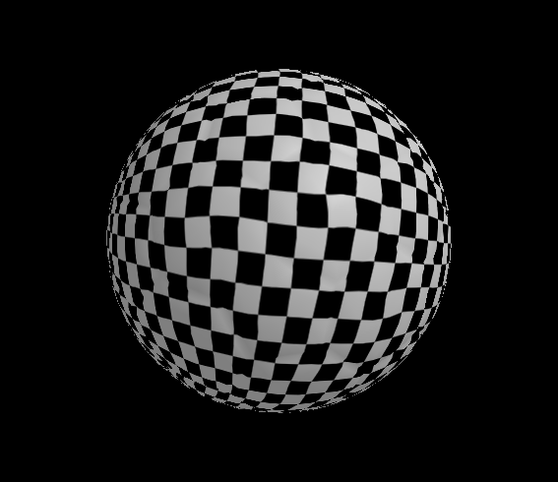
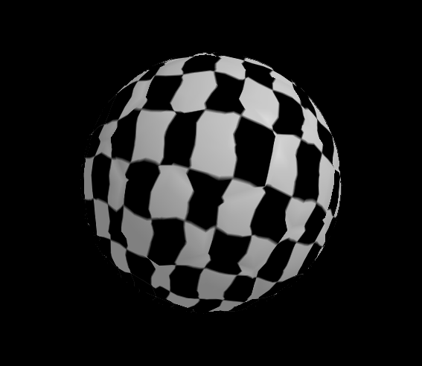
Parameterization – virtual points

Slide 44
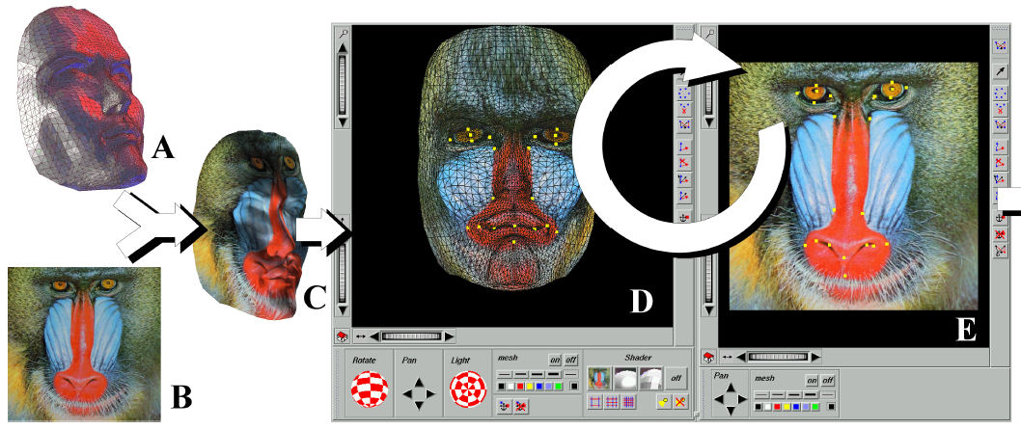
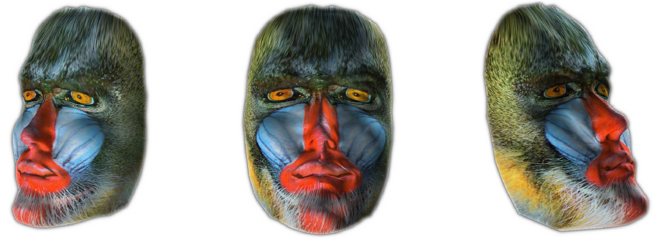
Parameterization -
Positional constraints method 1
Lévy
Notes:
While some feature vertices are allowed to pin at user-defined positions, we can have feature corresponding texture mapping results. This figure was proposed by Levy in SIGGRAPH 2001. In this method, the constraint is called soft constraint, i.e., the position in 2D parameter space is not the same with user-defined positions.

Slide 45

Parameterization -
Positional constraints method 2
Kraevoy et al.
Notes:
The Matchmaker proposed in SIGGRAPH 2003. The core idea is to build the compatible connections between the 2D parametric map (c) and the texture image (d). However, the method may fail at some feature vertices configuration.

Slide 46

Parameterization –
Positional constraints method 3
Notes:
This is our constrained texture mapping method. The key step is warping of feature points, such that we can align each feature point to user-defined position.

Slide 47


Parameterization –
Positional constraints method 3
Feature warping by using edge swap properly
Notes:
The edge(path) swap step is used to remove the possible blocking situation.

Slide 48

Parameterization –Linear method implementation using iteration
First, place all boundary vertices on a convex 2D polygon, ex. on the circle
Place the inner vertices on the center (0, 0)
Y
X
3D polygon
2D plane

Slide 49




Parameterization –Linear method implementation using iteration
$$V_{i}:(X_{i},Y_{i},Z_{i})$$
$$v_{i}:(x_{i},y_{i})$$
$$v_{i}=\frac{\sum_{\left\{i,j\right\}∈\text{E}\text{dges}}{w_{ij}v_{j}}}{\sum_{\left\{i,j\right\}∈\text{E}\text{dges}}{w_{ij}}}=\frac{\sum_{\left\{i,j\right\}∈\text{E}\text{dges}}{w_{ij}v_{j}}}{W_{i}}$$
$$W_{i}v_{i}=\sum_{\left\{i,j\right\}∈\text{E}\text{dges}}{w_{ij}v_{j}}$$
Notes:
We can solve the unknown inner vertices by using the vi equation derived from the previous slides. To simplify vi the equation, the summation of wij is denoted as Wi.

Slide 50
Parameterization –Linear method implementation using iteration
Compute the inner vertices by following equations iteratively until convergence
Y
X
3D polygon
2D plane
Notes:
At each iteration, each inner vertex is pulled by its 1-ring neighbor vertices. We can get final solution of inner vertices while the positions of inner vertices are convergence.

Slide 51

Parameterization –Linear method implementation using iteration
3D polygon
initial state
1st iteration
2nd iteration

Slide 52












Parameterization –Linear method implementation using iteration
W. T. Tutte [1960] – barycentric map
M. Eck et al. [1995] – harmonic map
M. S. Floater [2003] – mean value coordinates
$$V_{j+1}$$
$$V_{i}$$
$$w_{ij}=1$$
$$γ_{j}$$
$$α_{j}$$
$$w_{ij}=\cot{γ_{j−1}}+\cot{γ_{j}}$$
$$α_{j−1}$$
$$w_{ij}=\frac{\tan\left(α_{j−1}/2\right)+\tan\left(α_{j}/2\right)}{\left\|V_{i}−V_{j}\right\|}$$
$$γ_{j−1}$$
$$V_{j}$$
$$V_{j−1}$$
Notes:
wij = 1 in barycentric map is a very simple weight setting. However the quality is bad since this method is not a shape or angle preservation for parameterization. The 2nd equation is for harmonic map. In this map, the angle between 3D and 2D is preserved. However foldover may occur since the cot function may have negative value. The 3rd equation is for mean value coordinates. This map is angle preserved and there is no foldover situation since the weight is always positive.

Slide 53
Parameterization –Linear method implementation using linear solution
Y
X
AX=B, X=A⁻¹B
Notes:
In the middle red box, we can reorder the equations for inner vertices by moving the unknown(inner) vertices to the left hand side and moving the boundary vertices to the right hand side. These equations can be rewritten in matrix form AX=B. And we can solve the unknown X by the linear system solver library that can be easy found in the internet (ex. TAUCS and Eigen C or C++ library).

Slide 54
Linear System Library – Eigen
AX=B, the matrix A is a sparse matrix, so we can use the conjugate gradient stabilized solver
Eigen LIBRARY, Eigen::BiCGSTAB
https://eigen.tuxfamily.org/dox/classEigen_1_1BiCGSTAB.html

Slide 55
Linear System Library – Eigen
int n = 10000;
VectorXd x(n), b(n);
SparseMatrix<double> A(n,n);
/* ... fill A and b ... */
BiCGSTAB<SparseMatrix<double> > solver;
solver.compute(A);
x = solver.solve(b);
std::cout << "#iterations: " << solver.iterations() << std::endl;
std::cout << "estimated error: " << solver.error() << std::endl;
/* ... update b ... */
x = solver.solve(b); // solve again

Slide 56
Linear System Library – Eigen
Filling a sparse matrix
typedef Eigen::Triplet<double> T;
std::vector<T> tripletList;
tripletList.reserve(estimation_of_entries);
for(...)
{
// ...
tripletList.push_back(T(i,j,v_ij));
}
SparseMatrixType mat(rows,cols);
mat.setFromTriplets(tripletList.begin(), tripletList.end());
Triplet<double> is a small structure to hold a non zero matrix element (i,j,value)
https://eigen.tuxfamily.org/dox/group__TutorialSparse.html

Slide 57
Parameterization-texture stretch metric
[Texture Mapping Progressive Meshes, SIGGRAPH]
length-preserving (isometric) γ = Γ = 1
angle-preserving (conformal) γ = Γ
area-preserving γ Γ = 1
linear map
2D texture domain
surface in 3D
singular values: γ , Γ
γ
Γ
Sander et al.

Slide 58

Parameterization -
Texture stretch implementation
γ
Γ
2D texture domain
surface in 3D

Slide 59





Parameterization -
Texture stretch implementation
L²(T) is the texture stretch metric (distortion of parameterization)

Slide 60
Parameterization -
Texture stretch implementation
For each vertex v, randomly select a direction D, move v along D within 1-ring
If distortion(v) is large than the last iteration, restore v
Repeat this process until convergence

Slide 61

Planar Parameterization - CGAL
https://doc.cgal.org/latest/Surface_mesh_parameterization/index.html

Slide 62

Planar Parameterization - CGAL
Other parameterization methods can easily be swapped in by simply replacing the lines

