Slide 1
Learning Crowd Motion Dynamics with Crowds
BILAS TALUKDAR, YUNHAO ZHANG, TOMER WEISS,
New Jersey Institute of Technology, USA
publication date: May 2024

Slide 2
OUTLINE
INTRODUCTION
RELATED WORK
METHOD
RESULT
CONCLUSION

Slide 3
INTRODUCTION
Crowd simulations are applied in urban planning, behavioral science, robotics.
Traditional methods find it difficult to predict all navigation events and cannot fully simulate real crowd behavior. Many existing RL methods fail to simulate natural crowd behavior.
DRL uses neural networks to learn the relationship between input states and output actions, capturing complex behaviors.
This paper proposes a new method to simulate crowd movements, including rewards for natural movements and a position-based dynamics training environment.
Bayesian inference is used to select the hyperparameters of RL policies for optimal simulation results.

Slide 4
RELATED WORK
Reinforcement Learning
Reinforcement learning has garnered attention due to its ability to adapt to dynamic environments in multi-dimensional decision spaces, particularly in simulating the behavior of multi-agent crowds on a 2D plane.
The advantage of using deep neural networks to simulate crowd behavior lies in its freedom from fixed rules. Instead, it learns navigational behavior through reward guidance, capable of capturing intricate navigation details in various situations.
Compared to Deep Reinforcement Learning (DRL), there are still limitations, such as less generality in strategies, the need for manual encoding of group behaviors like selecting leaders, and a lack of predictive collision avoidance.

Slide 5
RELATED WORK
Other Approaches
The study mentions various methods for simulating crowds, with our paper primarily treating crowds as particles, abstracting agents as particles driven by physical forces. Other aspects like trajectory prediction, path planning, or comprehensive whole-body motion control are crucial for crowd research but are outside the scope of this paper, which focuses on dynamic crowd simulation.
Early research found that crowd flows resemble fluids. Subsequently, researchers proposed various physics-inspired approaches to control crowd behavior, including social forces, time-based collision avoidance, and position constraints.
Another approach is to simulate crowd behavior based on velocity, which is popular due to its ease of use in robot navigation.

Slide 6
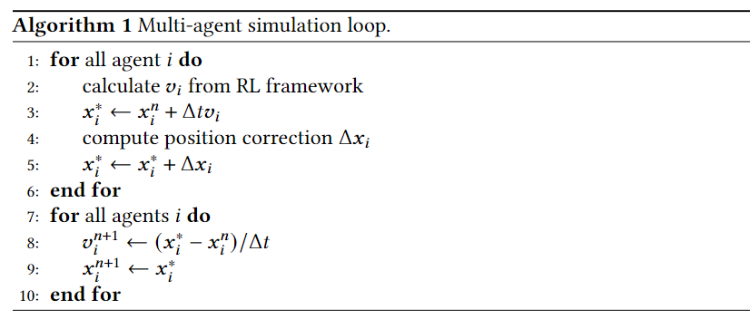
METHOD
Environment
Given this velocity, each agent moves towards a predicted position
short-range PBD collision avoidance constraint

Slide 7
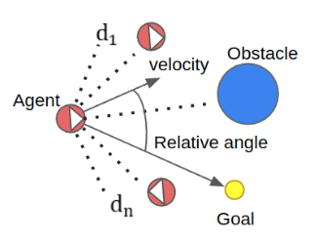
METHOD
Velocity Selection
Action space
(𝒗, 𝜔)
|𝒗| ∈ (𝑣min, 𝑣max) and |𝜔 | ∈ (𝜔min, 𝜔max)
State space
𝑠in, 𝑠ext

Slide 8
METHOD
Policy Optimization
We adopt PPO (Proximal Policy Optimization), a model-free strategy optimization method that learns strategies through trial and error without the need to understand the underlying system rules in advance.
The PPO implementation comprises two main neural network models: the Actor and the Critic. The Actor model is responsible for selecting actions for agents and updating the policy (𝜋), while the Critic model evaluates the effectiveness of the policy chosen by the Actor.
The Actor network receives observed states as input and outputs a set of probabilities, with each action corresponding to a probability. The Critic network, on the other hand, takes the state as input and outputs a number representing the estimated state value, used to evaluate the effectiveness of the Actor's policy.

Slide 9
METHOD
Network Architecture
Both the Actor and Critic networks are deep neural networks used to learn and optimize the agent's policy and value function.
The Actor network consists of two networks, processing two types of state information and outputting two-dimensional action data; meanwhile, the Critic network evaluates the effectiveness of actions generated by the Actor.
ELU activation units are used for all hidden layers, and the Critic network also includes an additional Actor network.

Slide 10
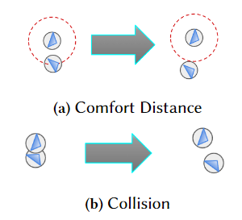
METHOD
Reward Design
Progress to goal
Collision avoidance
Steering quality
Personal Space
Velocity Blending

Slide 11
RESULT
Scenarios

Slide 12
RESULT
Comparison

Slide 13
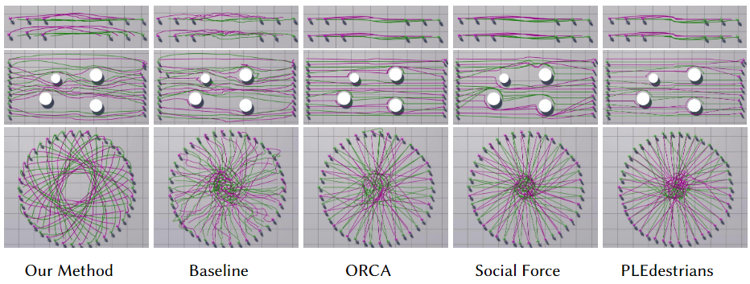
RESULT
Comparison

Slide 14
CONCLUSION
The paper proposes a learning-based crowd simulation method, inferring optimal parameters through a group-based Bayesian framework and comparing navigation strategies resulting from different hyperparameters.
The optimization of navigation behavior is achieved by rewarding agents for collision avoidance, maintaining personal space, and controlling sharp changes in velocity or acceleration. The method's robustness is demonstrated in multiple crowd navigation scenarios and compared quantitatively and qualitatively with existing works.
Future work includes simulating diverse behaviors of heterogeneous agents in pedestrian scenarios to enhance realism, as well as incorporating visual perception elements to achieve more varied crowd behaviors through the integration of the latest learning methods.

Slide 15
THANKS!

