Slide 2
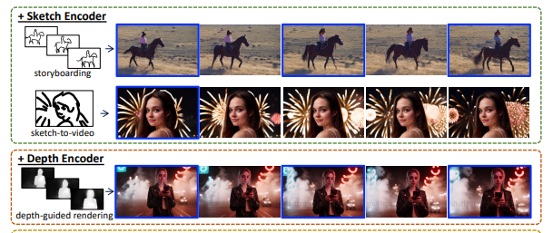
Introduction
T2V rely solely on text prompts results in ambiguous frame composition
Previous works focus on using dense structure signals to control T2V model(e.g., per-frame edge sequence)
SparseCtrl requires only one or few inputs
Notes:
1. 現有Text to video模型只使用文字控制，無法生成更準確結果，需要加入更多更精確的影像資訊
2. 現有的方法多為dense signals，也就是逐真提供資訊，例如提供每一針的邊界，生成動畫
3. SparseCtrl則是可以透過提供一張或少許資訊，生成完整的影片
使用於草圖，深度和RGB生成，可生成故事，渲染，關鍵真動畫或插植

Slide 3
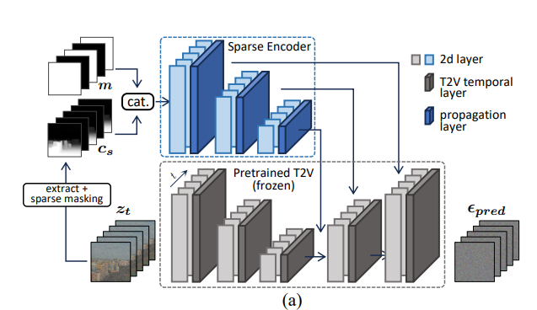
Method
Notes:
Recent T2V model typically extend a pre-trained T2I generator for videos by incorporating temporal layers between the 2D image layers

Slide 4
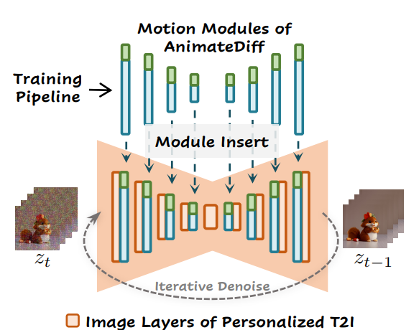
T2V model
Notes:
T2V model使用的是pretrained weight，不需跟著SparseCtrl做訓練，通常T2V model是由一個T2I加上temporal layer，temporal layer可用於保持貞與真之間的連續性
以這篇論文實作是使用AnimateDiff的weight
Recent T2V model typically extend a pre-trained T2I generator for videos by incorporating temporal layers between the 2D image layers

Slide 5
Notes:
模型分為兩部分
需要訓練的部分
Recent T2V model typically extend a pre-trained T2I generator for videos by incorporating temporal layers between the 2D image layers

Slide 6
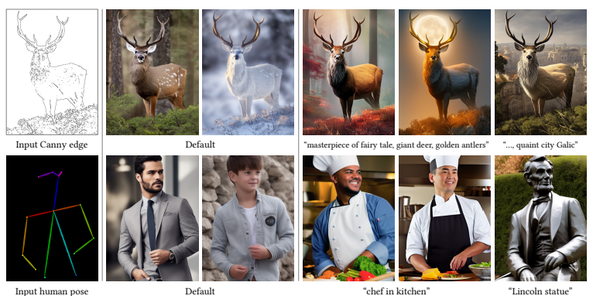
Sparse Encoder
Previous work: ControlNet
Used in T2I domain
Add an encoder to the origin model
Notes:
先前的work
加入額外的encoder，將資訊傳入pretrained T2I model
用於T2I，但可將控制用於逐真做影像生成，然後生成影片

Slide 7
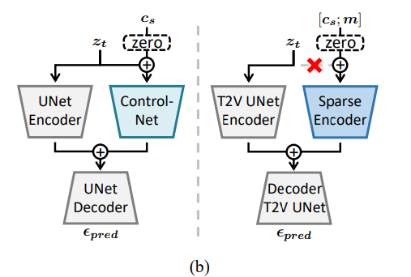
Add zero images for unconditioned frames
Condition propagation across frames
Only feed the condition maps after concatenation
Notes:
直覺作法: 對於沒有資訊的真輸入0 image，模型只有對有條件的真做出反應，無法保證時間連續性
如果前面無法連續，加入跨真條件傳播，讓貞與針尖連續
問題: 原始的ControlNet複製了帶有噪音的樣本，使得訓練過程中依賴噪音 改成只接受拼接後的條件圖

Slide 8
Unifying sparsity via masking
Notes:
為了統一處理不同的稀疏姓，加入mask控制，當該真未受控制，0

Slide 9
Implementation
T2V generator: AnimateDiff
Image backbone: Stable Diffusion V1.5, or personalized generator
Training: WebVid (10M videos)
Notes:
In each iteration, we first randomly sample a number Nc between 1 and N

Slide 10
Result
Notes:
左邊是in-domain的生成結果，右邊是T2I+個性化設置(漫畫風格)
三種實驗結果
無法保持連續性
左，噪音造成的品質下降
完整模型

Slide 11
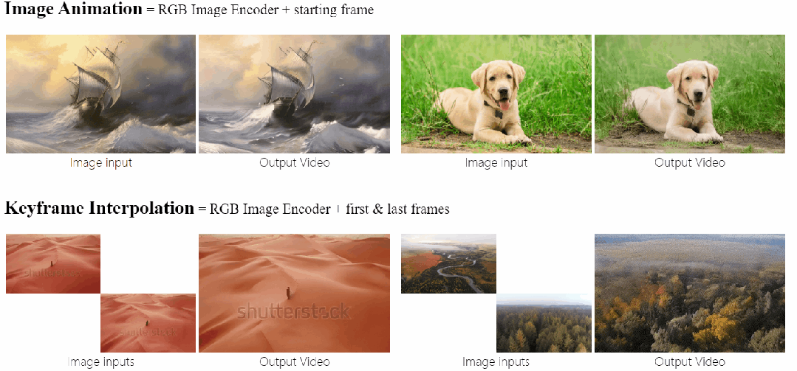

Slide 12
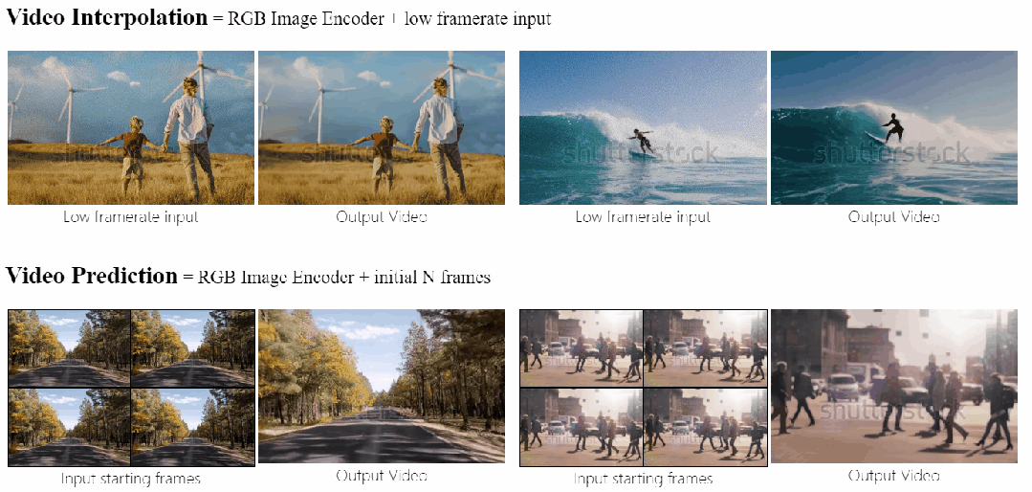

Slide 13
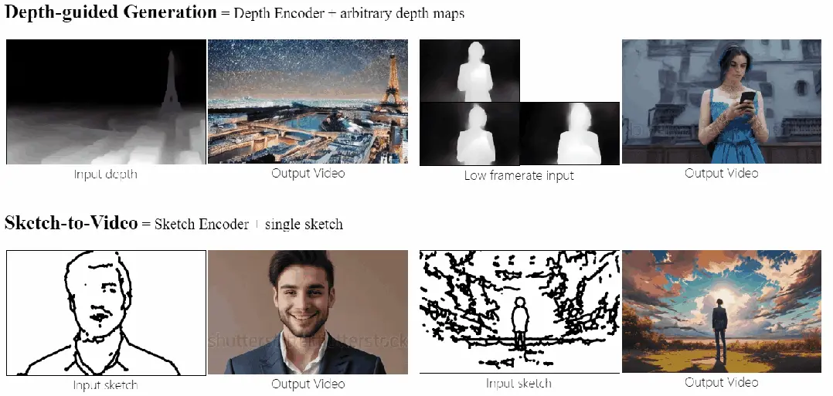

Slide 14
Limitation
Visual quality, semantic composition ability, and domain of the generated results are limited by the pre-trained T2V backbone and training data
Failed on out-of-domain input(e.g., anime image animation)

