Slide 1
DynamiCrafter: Animating Open-domain Images with Video Diffusion Priors
Jinbo Xing, Menghan Xia, Yong Zhang, Haoxin Chen, Wangbo Yu,
Hanyuan Liu, Gongye Liu, Xintao Wang, Ying Shan, Tien-Tsin Wong
From CUHK and Tencent AI Lab.
ECCV 2024

Slide 2
Introduction
Text prompt
bear playing guitar happily, snowing
Result
Result
Input image

Slide 3
Introduction
Introduce an innovative approach for animating open-domain images by leveraging video diffusion prior, significantly outperforming contemporary competitors
A comprehensive analysis on the conditional space of text-to-video diffusion models and propose a dual-stream image injection paradigm to achieve the challenging goal of image animation.
Text-based motion control for open-domain image animation and demonstrate the proof of concept through preliminary experiments.

Slide 4
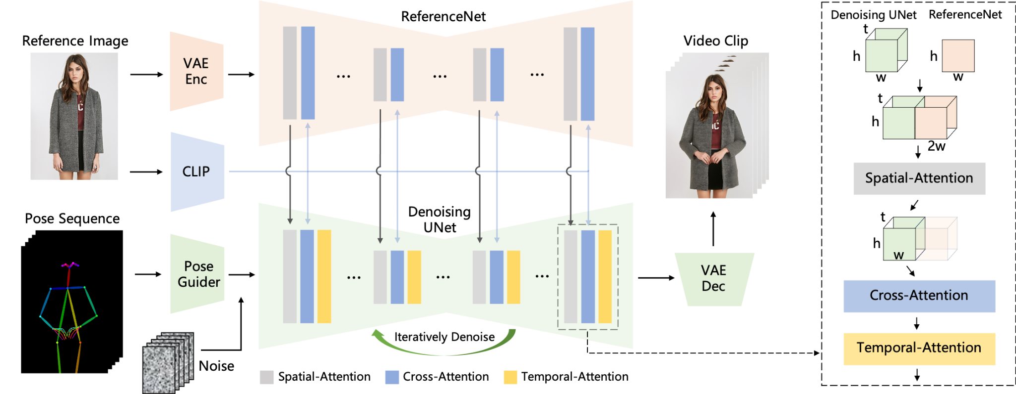
Related Work - Image Animation
Physical simulation-based approaches focus on simulating the motion of specific objects.
Reference-based transfer motion or appearance from reference signals e.g. video, sketch, etc.
The animated object are limited to specific categories (Domain-specific) e.g. human hair, bodies and natural scene.
e.g. AnimateAnyone

Slide 5
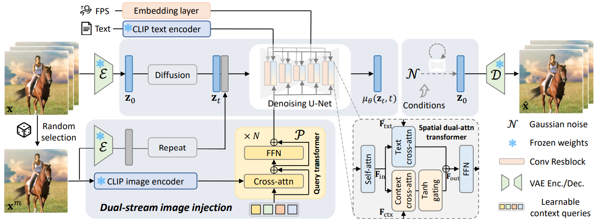
Method - Overview

Slide 6
Method - Input image and text prompt

Slide 7
Method - Visual Detail Guidance

Slide 8
Method - Image and Text Fusion

Slide 9
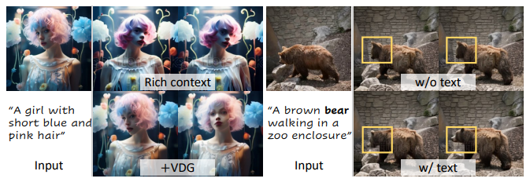
Method - Visual Detail Guidance
Rich Context v.s. +VDG
w/o text v.s. w/ text

Slide 10
Method - Image and Text Fusion
Extract key semantic information from text features.
Extracting detailed visual details from image context features.

Slide 11
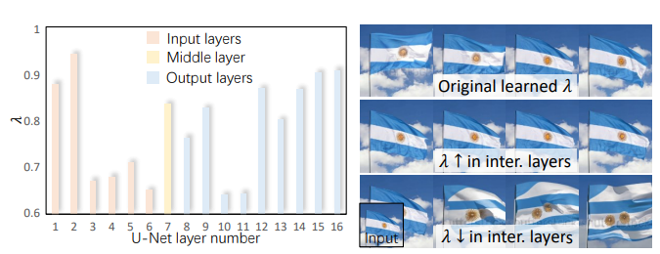
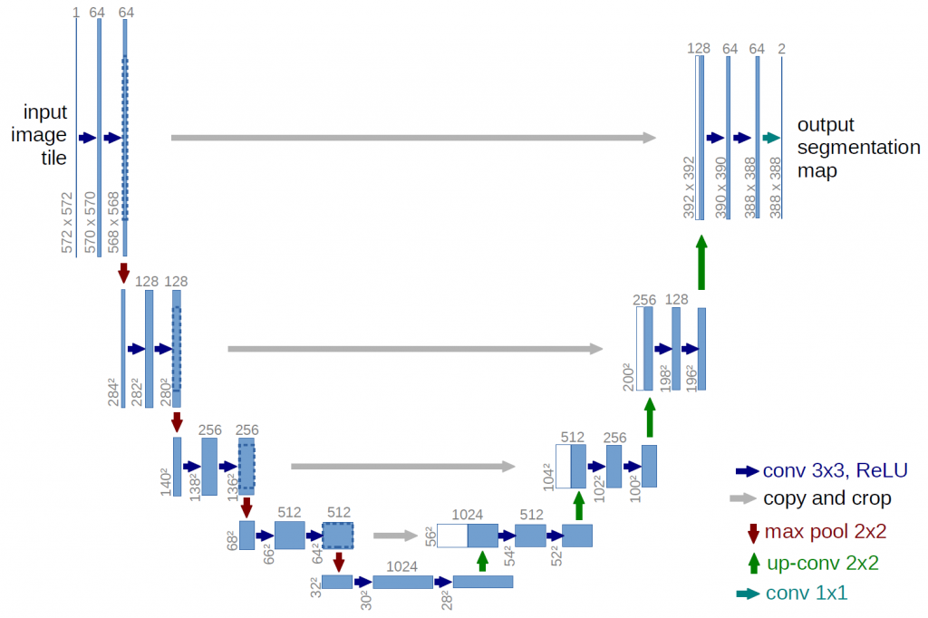
Method - Image and Text Fusion
I/O layer focus on appearance, middle layer focus on object structure
Increasing λ leads to suppressed cross-frame movements, while decreasing λ poses challenges in preserving the object’s shape

Slide 12
Method - System Detail
open-source video LDM VideoCrafter (pre-trained T2V)
Text-aligned context representation (pre-trained CLIP) with Query Transformer (Video Detail Guidance)

Slide 13
Experiment
FVD: Measuring the quality and realism of generated videos
KVD: Measuring the dynamic behavior of generated videos and real videos
PIC: Perceptual consistency of the generated video, specifically how well it matches the input condition

Slide 14
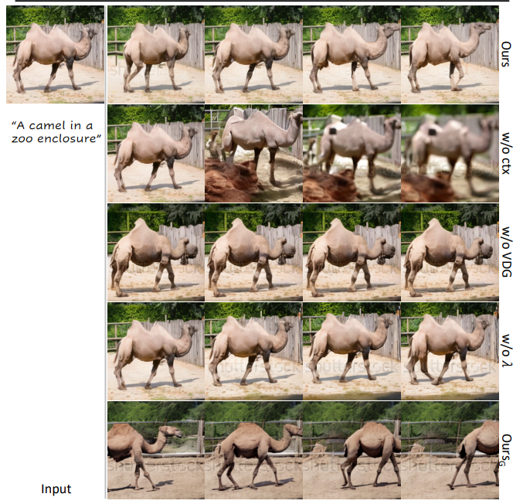
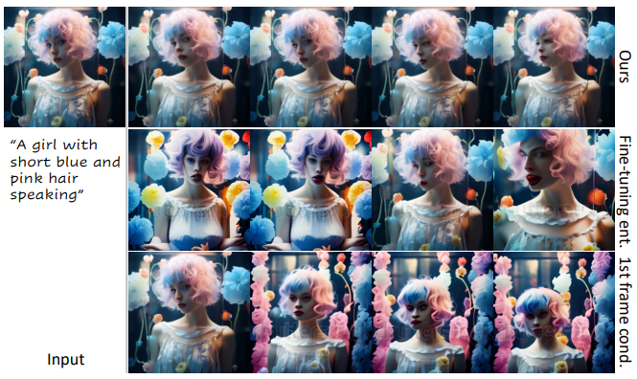
Ablation study

Slide 15
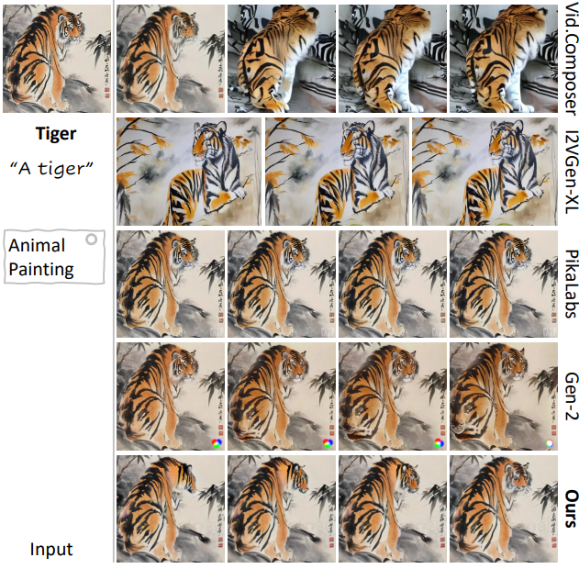
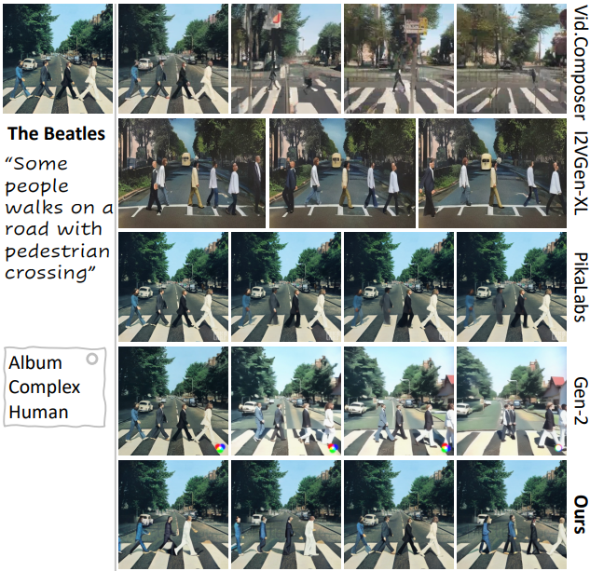
Compare

Slide 16
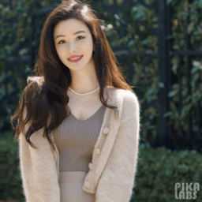
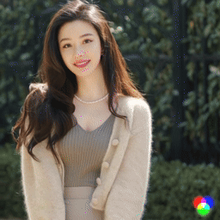
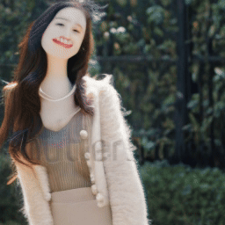
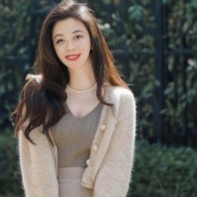
Compare
PikaLabs
Gen-2
DynamiCrafter (Ours)
DynamiCrafter_{DCP} (Ours)
"Girl dancing"
"Man clapping"

Slide 17
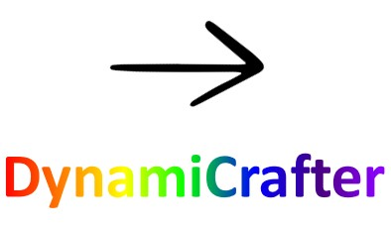
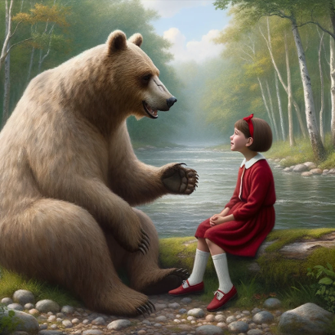
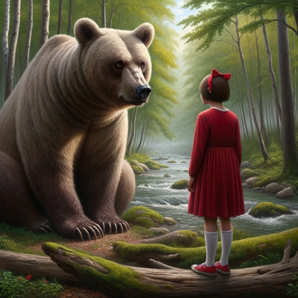
Application
 | "A disheartened bear sat by the lake, hanging its head." | "He is meeting a girl and introducing himself."
"He chatted happily with that girl by the lake." | "Before leaving, the girl told him to be positive."

Slide 18
Conclusion
Innovative Framework: Proposed DynamiCrafter with a dual-stream image injection mechanism for animating static images.
Outstanding Performance: Outperformed existing methods in visual consistency, temporal coherence, and motion quality.
Dynamic Control: Introduced text-guided motion generation for enhanced controllability and diversity in animations.
Future Impact: Lays the foundation for advancements in open-domain image animation and video generation technologies.

