Slide 1
Bridging the Gap: Sketch-Aware Interpolation Network for High-Quality Animation Sketch Inbetweening

Slide 2
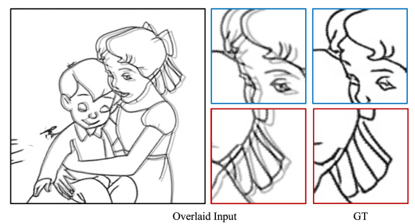
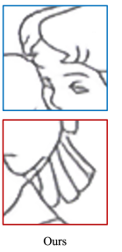
Introduction
Purpose a deep learning method SAIN for sketch interpolation
Adopts a sketch-aware approach that integrates multi-level sketch-related guidance

Slide 3
Related Work
Sketch Interpolation
Stroke-based: Vectorization and deformation of strokes → Requires manual fine-tuning; scalability issues with complex sketches
Image-based: Bypassed vectorization using image registration and interpolation → Using optical flow or distance transform
Notes:
兩種方法
向量
需要使用者調整向量化結果 無法處理較複雜線條
圖片 使用光流捕捉動作
使用distance transform

Slide 4
Animation Interpolation
AnimeInterp: Uses segment-guided matching for color pieces
EISAI: Combines SoftsplatLite (forward-warping) and distance transform
AnimeRun: Provides a benchmark for evaluating optical flow and segment matching in animation

Slide 5
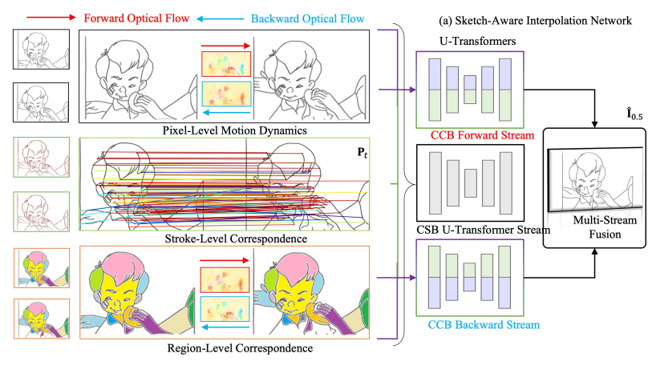
Methodology
Notes:
給1 3做2
三個部分得到資訊
Pixel level: 1 3
Vector: 2

Slide 6
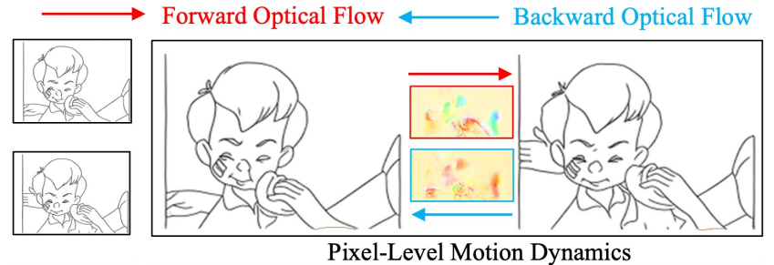
Pixel-Level Motion Dynamics
Objective: Enhance keyframes by capturing detailed motion at the pixel level.
Steps:
Optical Flow Estimation: Compute flows between keyframes (I0, I1) to refine motion dynamics.
Timestamp Prediction: Use bi-directional flows for target timestamp to track pixel motions.
Notes:
在pixel level
使用光流計算pixel level 的位移
計算兩張圖的光流
雙向對應光流
作為第一個資訊

Slide 7
Stroke-Level Correspondence
Objective: Capture sketch-based motion by matching strokes between keyframes.
Step 1. Point-wise matching:
Use algorithms like SuperPoint to find key points in each stroke frame (I0, I1).
Match salient points between keyframes using descriptors.
SuperGlue evaluates matching confidence between point pairs (𝑐𝑖𝑗).
Notes:
在vector上找對應關係
需要兩步驟 Matching tracing
第二部vector方式找對應
做matching (會純)
使用superPoint找各圖的關鍵點，以及提取各點訊息
根據各點位置以及提取出來的訊息找對應關係
Superglue找對應點的matching confidence

Slide 8
Stroke-Level Correspondence
Stroke-Level Correspondence
Step 2. Point-wise tracking:
Track movement of stroke keypoints between frames (I0 and I1) along a linear path.
Notes:
2. 做tracking:
根據前面得到的結果計算keypoint movement

Slide 9
Region-Level Correspondence
Step:
Region Identification: Use segmentation algorithms to identify regions and extract feature
Region Matching: Match regions across keyframes based on coordinates and features
Flows for Region Pairs: Calculate flows (F𝑡¯→1 and F𝑡¯→0) between matched regions to capture motion dynamics.
Notes:
第三個方法
區域對應
1. 分割與取得該區塊feature
2. 跟據得到的資訊找對應關係
3. 做光流

Slide 10
Notes:
三種訊息各自分給不同transformer

Slide 11
Dataset
Source: Based on ATD-12K, 10000 3-frame training data
Process:
Extraction: Sketch Keras produce rough sketches.
Simplification: Simplification techniques remove blurs and refine essential sketch lines.
Notes:
一樣

Slide 12
Training
Training Details
Training Parameters: Batch Size: 4 Epochs: 50
Resolution: 384 × 192
Training Time: NVIDIA A6000 GPU approximately 72 hours.
Loss: L1 loss + perceptual loss
Notes:
感知

Slide 13
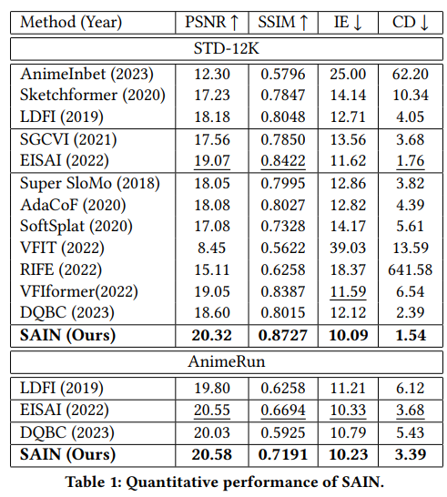
Result
Notes:
Peak Signal-to-Noise Ratio (PSNR),
Structural Similarity Index Measure (SSIM) scores,
Interpolation Error (IE)
Chamfer Distance (CD) > vector
作法: train ATD

Slide 14
