Slide 1
Training-Free Layout Control with Cross-Attention Guidance
Minghao Chen Iro Laina Andrea Vedaldi
Visual Geometry Group, University of Oxford

Slide 2
Outline
Introduction
Related Work
Method
Experiments
Conclusion

Slide 3
Introduction

Slide 4
Introduction
Text-to-image models struggle with complex spatial relationships.
Proposed layout control for image generation without retraining, termed "layout guidance."
Layout guidance offers "forward" and "backward" methods to adjust cross-attention.
"Backward guidance" uses backpropagation for more accurate layout control.
"Backward guidance" performs better in real-image editing tests.

Slide 5
Related Work
Text-to-Image Generation
GANs were the main method for image generation but faced training issues.
Diffusion models are now the focus, producing higher-quality images.
Diffusion models avoid GAN problems and enhance realism using large datasets and transformer models.
Despite their effectiveness, they struggle with complex scenes.

Slide 6
Related Work
Layout Control in Image Generation
Layout control relies on bounding boxes or semantic maps but is limited by fixed vocabularies.
Models like CLIP improve layout control, but text alone can't ensure precision.
Some studies combine text and layout, but results vary.
Methods enhance Stable Diffusion with regional tokens for better accuracy.

Slide 7
Related Work
Diffusion-Based Image Editing
Most methods can't edit generated or real images; changing prompts often causes major changes.
Some techniques edit objects with masks but can't alter layouts.
Prompt-to-Prompt allows in-place edits using cross-attention layers.
Fine-tuning single-image models changes objects but not layouts.
These methods work well in some cases but lack flexible layout editing.

Slide 8
Method
Layout Guidance
Forward guidance
Backward guidance

Slide 9
Method
Forward Guidance
Window Function: Create a bounding box to focus on a specific text token.
Apply Bias: Enhance the model's attention on the area linked to the chosen token.
Normalize Map: Balance the attention map for stable output.
Layer Bias: Repeat the bias across multiple model layers for consistent control.
Limitations: Note that there are still challenges due to token interactions and initial noise.

Slide 10
Method
Backward Guidance
Backward guidance indirectly controls image layout via an energy function.
The energy function encourages focus on a specified region for a text token.
During denoising, gradients of the energy function update latent variables through backpropagation.
Backward guidance adjusts layout without directly altering attention maps.
The generation process alternates between gradient updates and denoising for precise layout control.

Slide 11
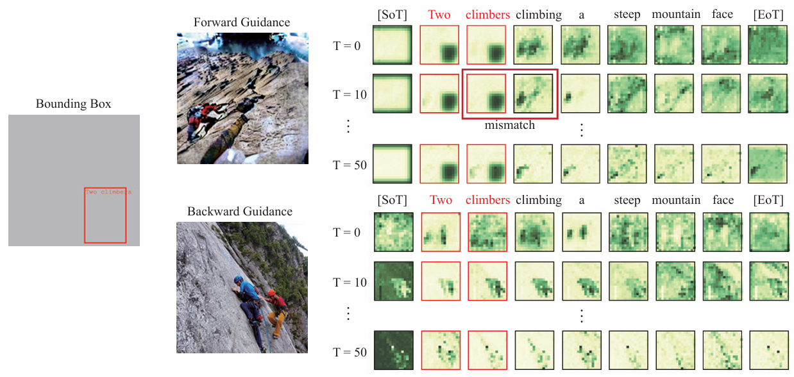
Method
Analysis and Discussion
The Role of Word Tokens
The Role of Special Tokens – [SoT] and [EoT]
The Role of Initial Noise

Slide 12
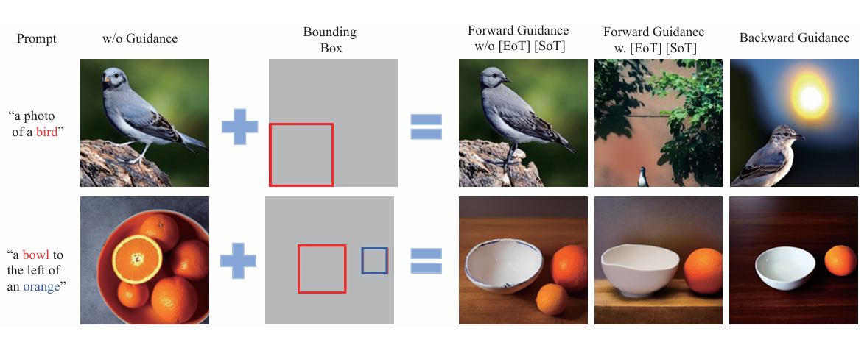
Method
Forward vs. Backward

Slide 13
Experiment
Further Analysis and Applications
Backward guidance changes object pose, position, and more.
It doesn't affect the object's original features.
Cross-attention in up-sampling and middle layers affects layout.
10-20 steps of guidance work best for layout control.
Higher loss scale η strengthens control but may lower realism.

Slide 14
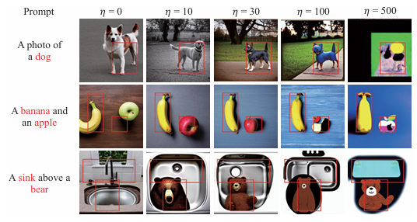
Experiment
Further Analysis and Applications
η： loss scale factor

Slide 15
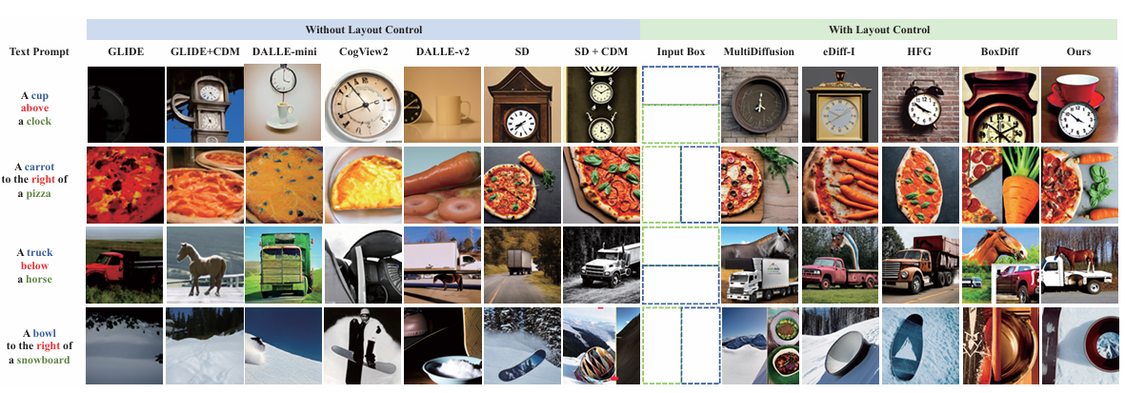
Compare

Slide 16
Experiment

Slide 17
Conclusion
The study manipulates image layouts from text-to-image models without extra training.
Cross-attention maps and initial noise impact layouts significantly.
Special tokens' cross-attention maps provide key semantic and spatial data.
"Backward guidance" is introduced to improve on forward guidance.
The strategy is applicable in real-image layout editing.

Slide 18
Thank you for listening

