Slide 1
2D Gaussian Splatting for Geometrically Accurate Radiance Fields
SIGGRAPH 2024

Slide 2
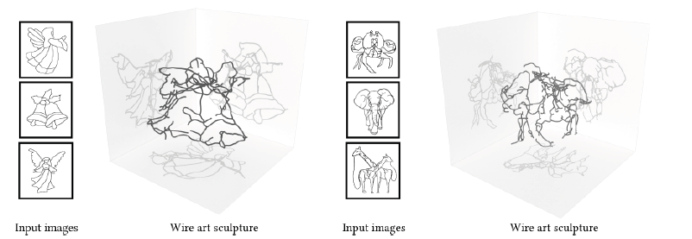
Why this paper?
Advancing multi-view wire art project

Slide 3
Big Picture

Slide 4
Radiance Field Representation Overview
2020 NeRF
NeuS (our current implementation, surface, 2021)
Instant NGP (SIGGRAPH 2022)
Mip-nerf 360 (NeRF quality SOTA, 2022)
D-NeRF: Neural Radiance Fields for Dynamic Scenes (2021)
2023 3DGS
2024 2DGS

Slide 5
Instant NGP

Slide 6
3DGS

Slide 7
3DGS replaces NeRF?
Quality NeRF better: less artifact and capture requirement
Speed 3DGS better
Low resources (smart phone)
SMERF: Streamable Memory Efficient Radiance Fields for Real-Time Large-Scene Exploration (TOG 2024)

Slide 8
Drawback: Hard to optimize
Notes:
Why we need new representation

Slide 9
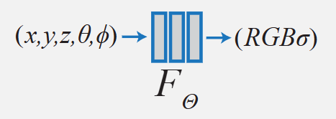
NeRF
Multilayer perceptron =matrices
Input multi-view images:
~100 images

Slide 10
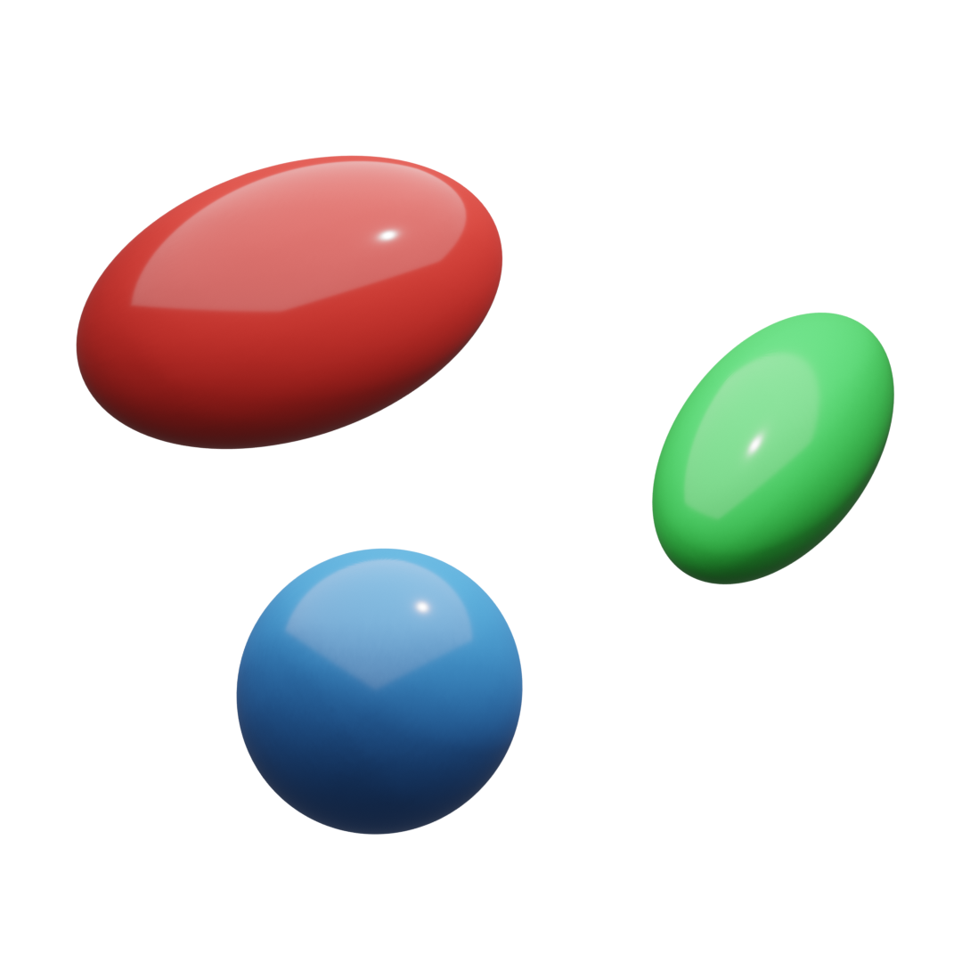
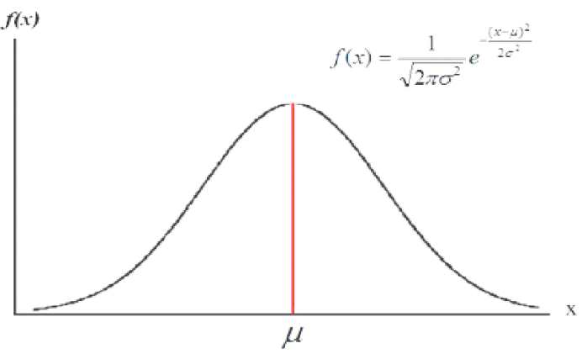
3D Gaussian Scene Representation
High-end point cloud
Translation
Density
Rotation
Scale
Color: Spherical harmonics
position
Gaussian Function:
Credit: https://www.youtube.com/watch?v=Tnij_xHEnXc

Slide 11
NeRF vs 3DGS
 | NeRF | 3DGS
Training speed | 1x | 1x-100x
Render speed | 1x | 10x-1000x
Render method | Ray tracing | Rasterization
Scene representation | Implicit | Explicit
Editability | Hard to edit | Easy to edit
Neural Network | Yes | No
Quality | Good | Good
Quality – In practice | Smarter | Dumb

Slide 12
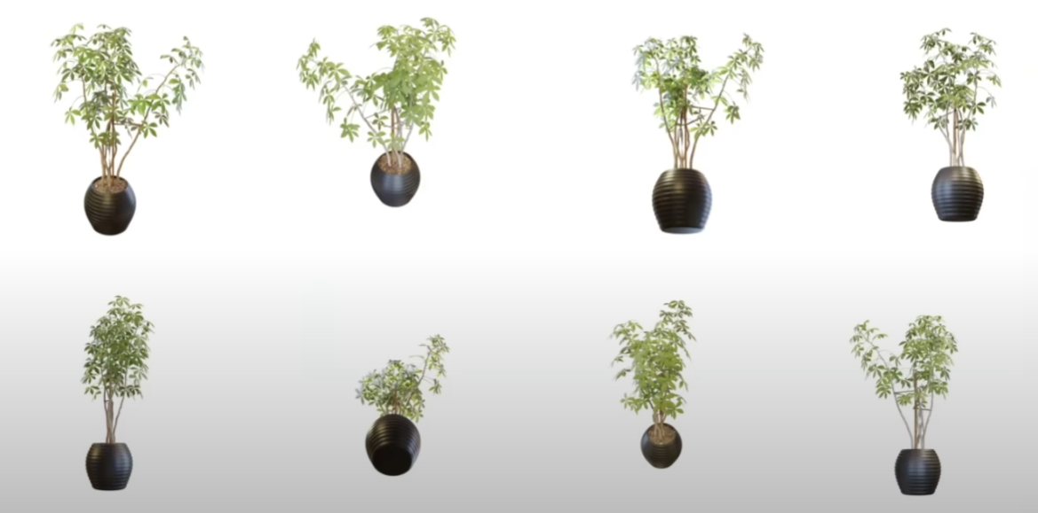
3D Gaussian Representation

Slide 13
Disable color, scale, rotate

Slide 14
Disable scale, rotate

Slide 15
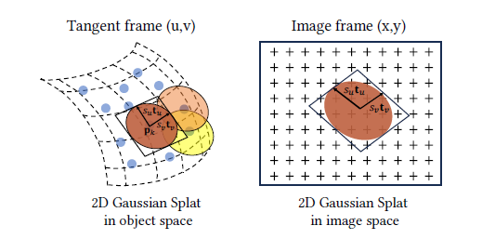
2D Gaussian vs 3D Gaussian
2D Gaussian Disk
3D Gaussian

Slide 16
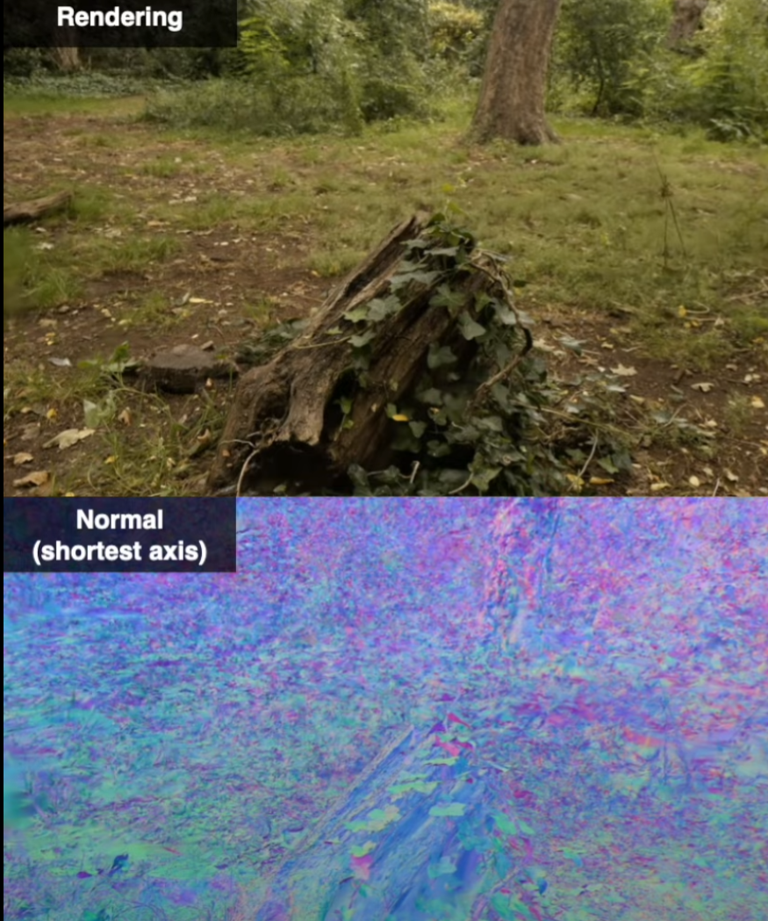
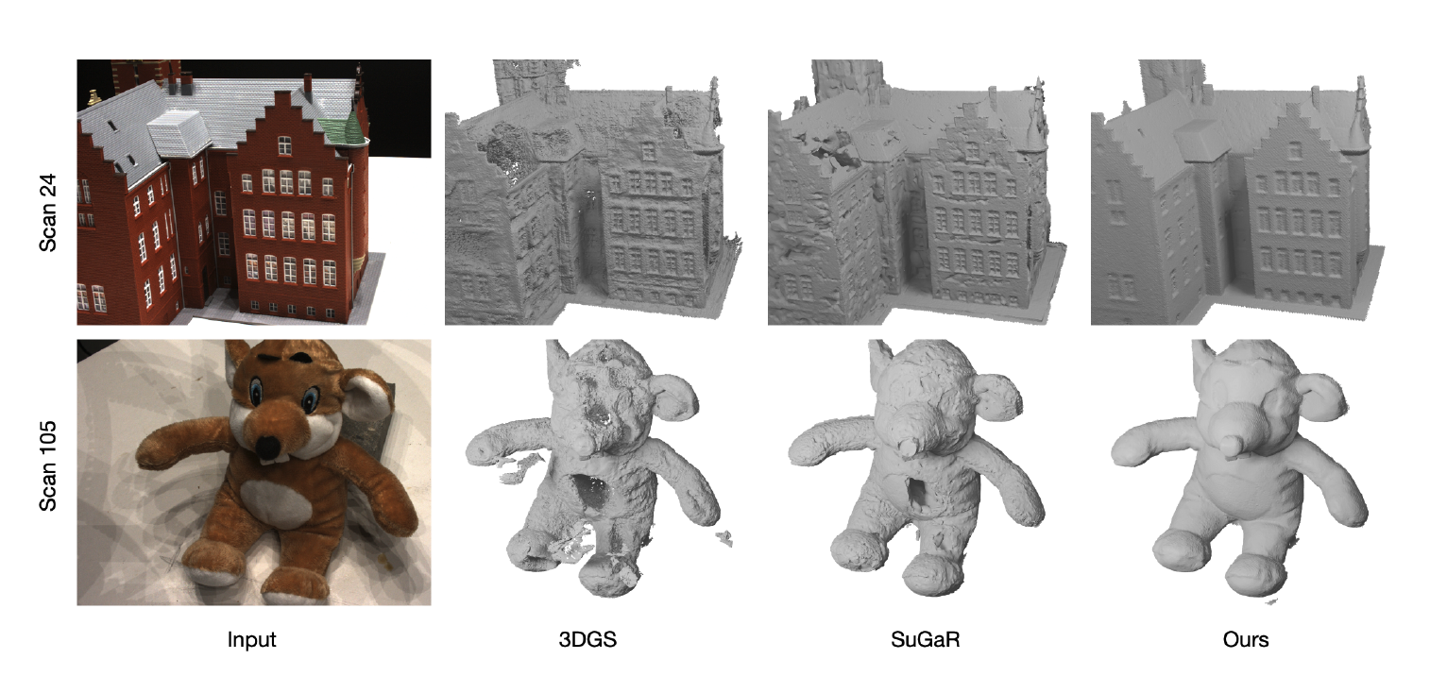
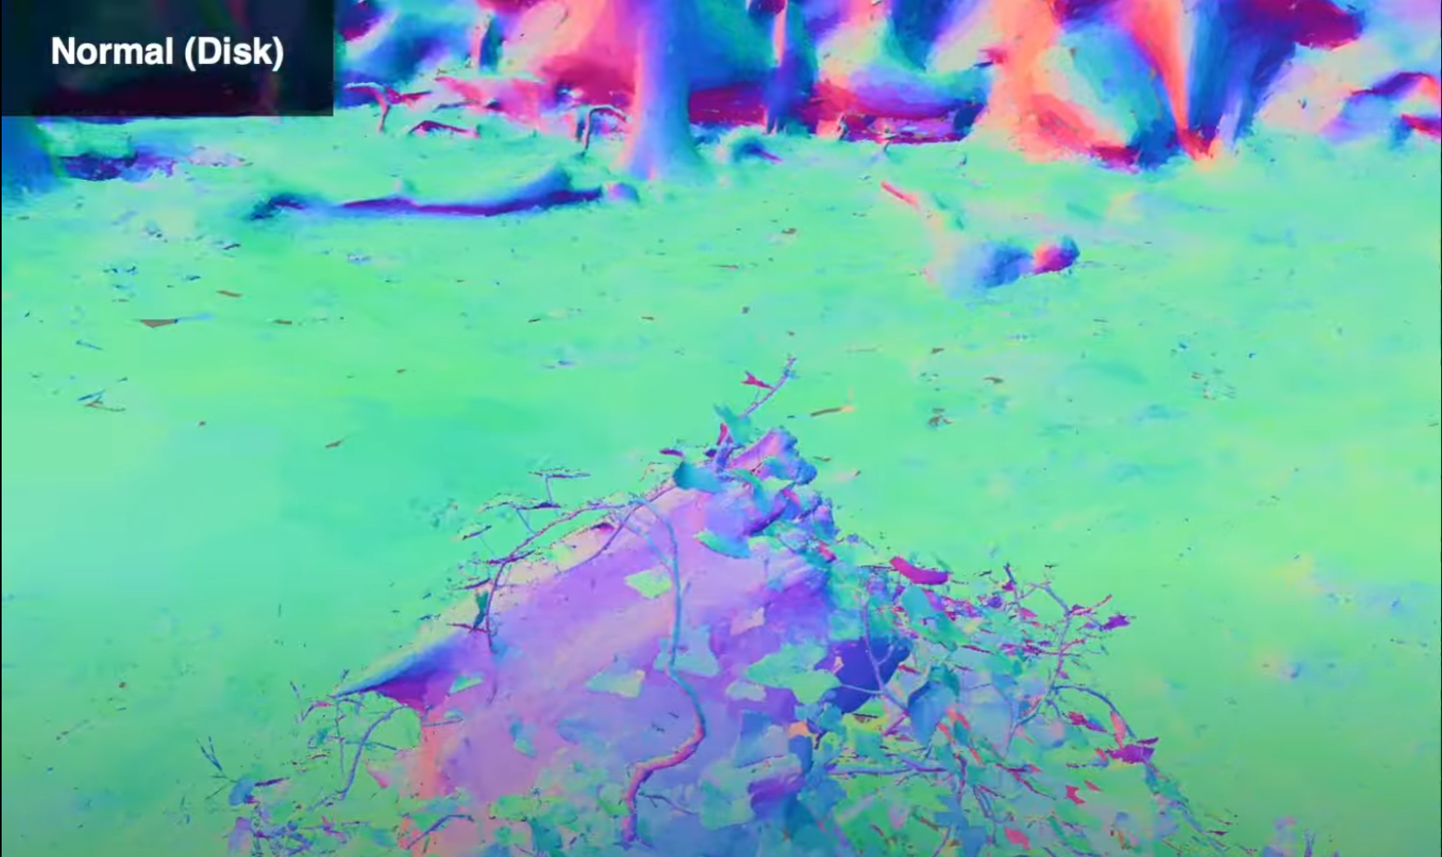
Why 2DGS?
First, the volumetric radiance representation of 3D Gaussians conflicts with the thin nature of surfaces.
Second, 3DGS does not natively model surface normals, essential for high-quality surface reconstruction.
Third, the rasterization process in 3DGS lacks Multiview consistency, leading to varied 2D intersection planes for different viewpoints

Slide 17
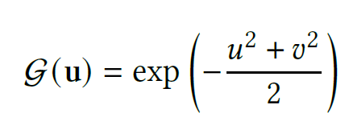
Modeling
$p_{k}$: center
${(s}_{u},s_{v})$: scaling
${(t}_{u},t_{v})$: rotation

Slide 18
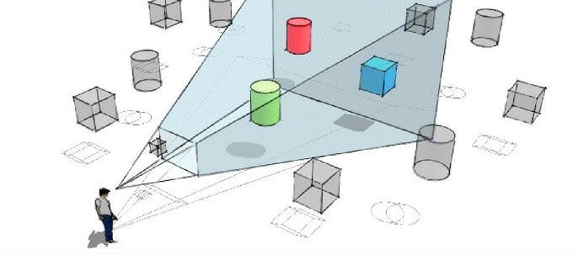
Splatting (Rendering)
Similar to 3DGS or classical rasterization
16
16
Hierarchical Rasterization
View frustrum culling

Slide 19
Splatting (Rendering)
$W∈4×4:$ world-to-screen matrix

Slide 20
Challenges - Instable convergence
Instable convergence
Cause by when gaussian disk degenerate into a line

Slide 21
Solution 1: Ray-splat intersection
Numerically unstable

Slide 22
Solution 2: Low pass filter

Slide 23
Loss functions
Final loss:
Depth Distortion:
Normal Consistency:

Slide 24
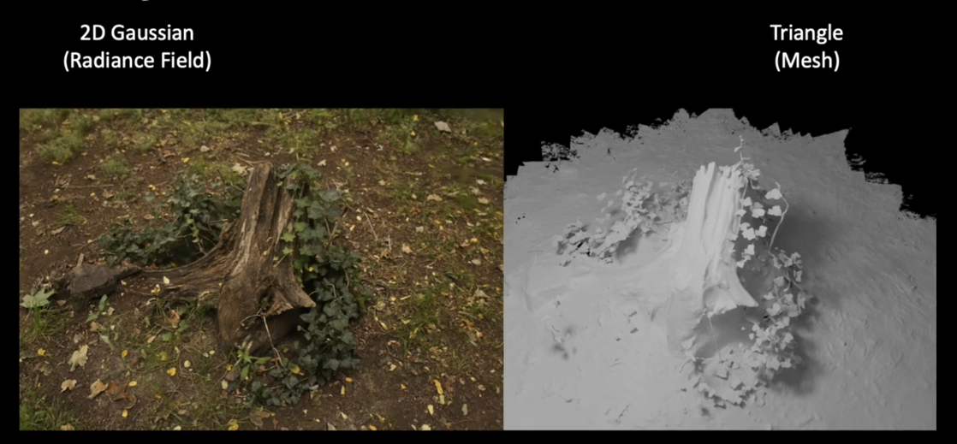
2D Gaussian to mesh
Fuse the reconstruction depth maps, using Open3D [Zhou et al. 2018].

Slide 25
Experiments

Slide 26
Similar novel view quality to 3DGS

Slide 27
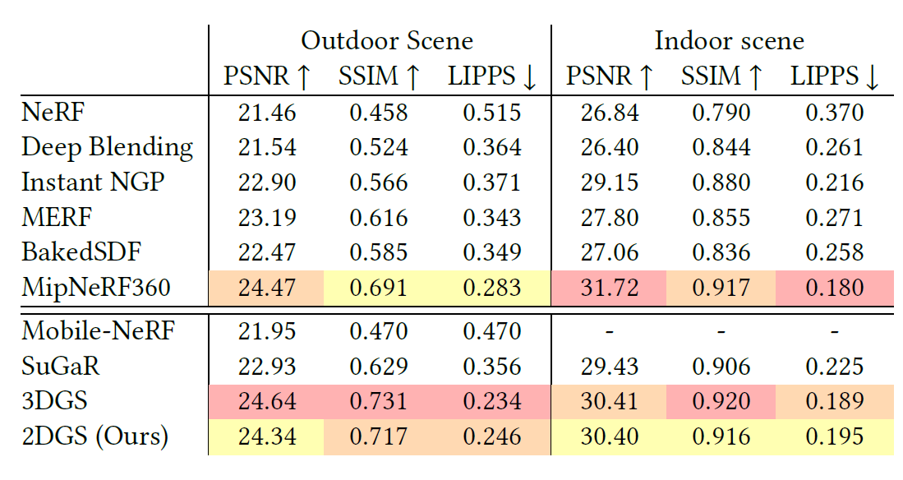

Slide 28
Better surface quality

Slide 29
High quality in significantly less time
DTU Dataset: 15 scene, Single RTX 3090

Slide 30
Application to Our Work
Significant Speed-up
Instant NGP (NeRF) (30 mins -> 5 mins)
3DGS
2DGS: better surface quality

Slide 31
Some Thoughts
NeRF, 3DGS : novel view synthesis
Existing scene -> sensor capture -> recreate scene
Our perspective: as a design tools
Image cue -> create new scene
Implication:
Our setting is simpler: fewer input views, no color
Is NeRF or 3DGS really a suitable representation for our work?
Since model are more powerful, we can add much more functionality to our work, e.g., add color, add more views, dynamics, etc.

Slide 32
The end of the presentation.

