Slide 1
Single image 3D reconstruction
黃慧光
2024/11/27

Slide 2
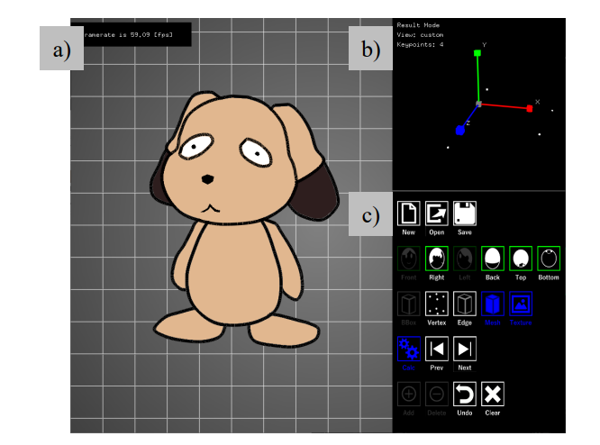
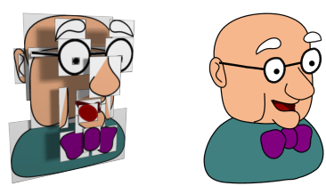
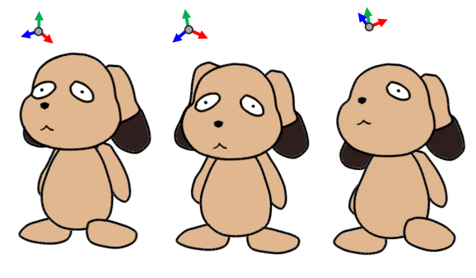
2.5D
2.5D Cartoon Models(TOG 2010)
View-Dependent Formulation of 2.5D Cartoon Models(2021)

Slide 3
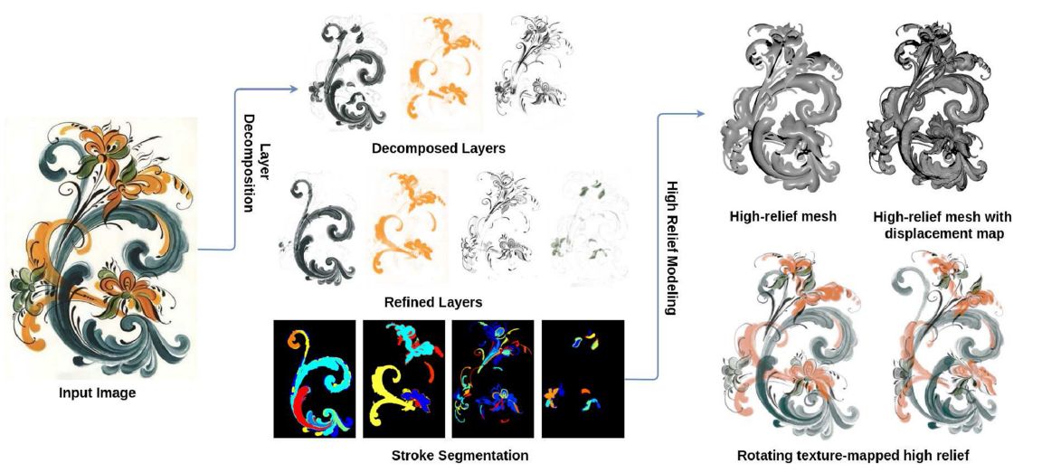
High Relief from Brush Painting(TVCG 2018)
haven't read it yet

Slide 4
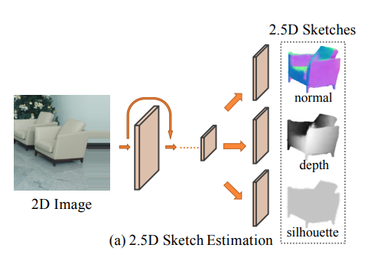
2.5D sketch (3D reconstruction)
MarrNet: 3D Shape Reconstruction via 2.5D Sketches(NIPS 2017)

Slide 5
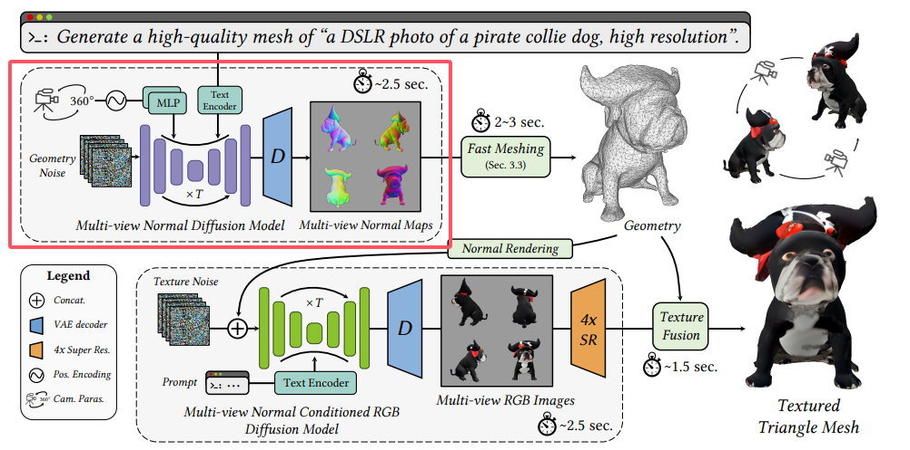
Direct2.5: Diverse Text-to-3D Generation via Multi-view 2.5D Diffusion(CVPR 2024)

Slide 6
Single image 3D reconstruction
Wonder3D: Single Image to 3D using Cross-Domain Diffusion
2023 CVPR
Edify 3D: Scalable High-Quality 3D Asset Generation
2024 NVIDIA

Slide 7
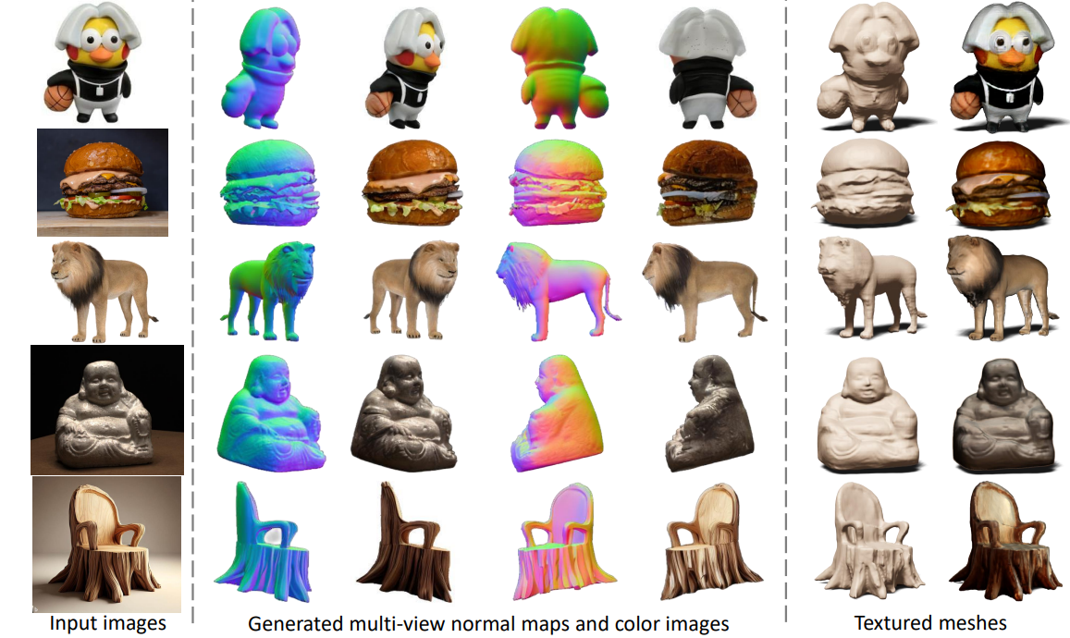
Wonder3D: Single Image to 3D using Cross-Domain Diffusion
CVPR 2023

Slide 8
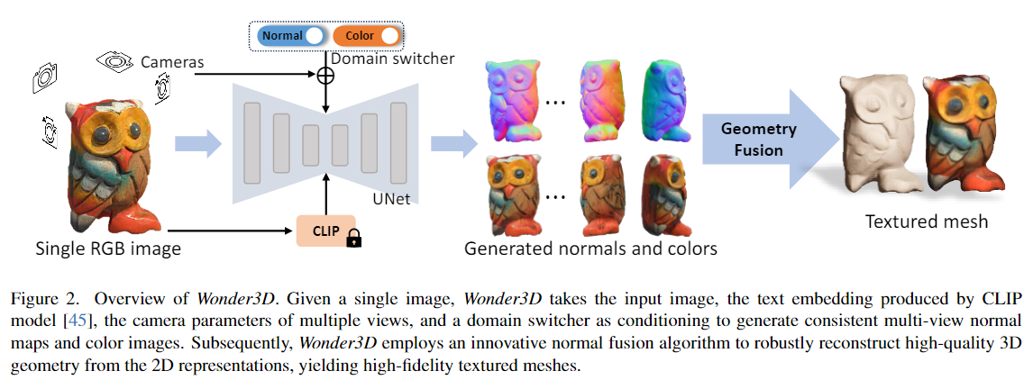
Pipeline of Wonder3D

Slide 9
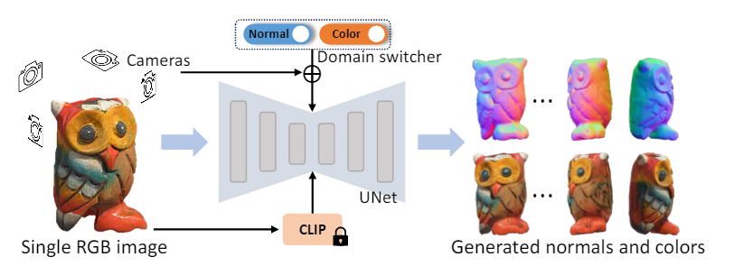
Inputs
a conditional input image y
a set of cameras $\{π_{1},π_{2},…,π_{n}\}$
Learn a model $f$ synthesizes multiple normal maps and color images of a set of camera poses

Slide 10
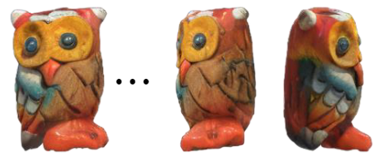
Q1
The prior 2D diffusion models generate each image separately, so that the resulting images are not geometrically and visually consistent across different views

Slide 11
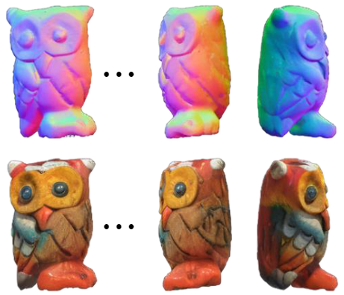
Q2
How to output normal maps

Slide 12
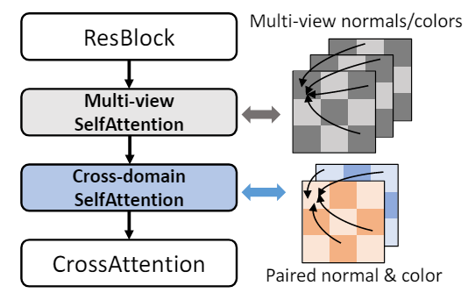
Consistent Multi-view Generation
Related works: SyncDreamer, MVDream
Use attention mechanism to facilitate information propagation across different views, implicitly encoding multi-view dependencies
Q
K,V

Slide 13
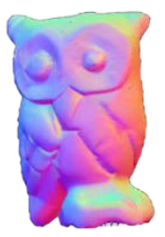
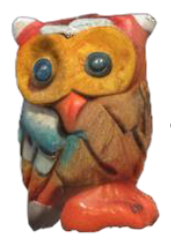
Cross-Domain Diffusion
Naive Solutions 1 :
add more channels to the output of the UNet module
However, they notice that such a design suffers from low convergence speed and poor generalization.
This is because the channel expansion may perturb the pre-trained weights of stable diffusion models and therefore cause catastrophic model forgetting.
network
network
256*256*3
256*256*6

Slide 14
Naive Solutions 2 :
Initially train a diffusion model to generate normal maps and then train another diffusion model to produce color images
The implementation of this two-stage framework introduces certain complications. It not only substantially increases the computational cost but also results in performance degradation
network1
network
network2

Slide 15
Domain Switcher
Domain switcher, denoted as $s$. The switcher $s$ is a one-dimensional vector serving as labels for distinct domains.
And further feed the switcher into the diffusion model as an extra input.
The domain switcher s is first encoded via positional encoding and subsequently concatenated with the time embedding.
This combined representation is then injected into the UNet of the stable diffusion models

Slide 16
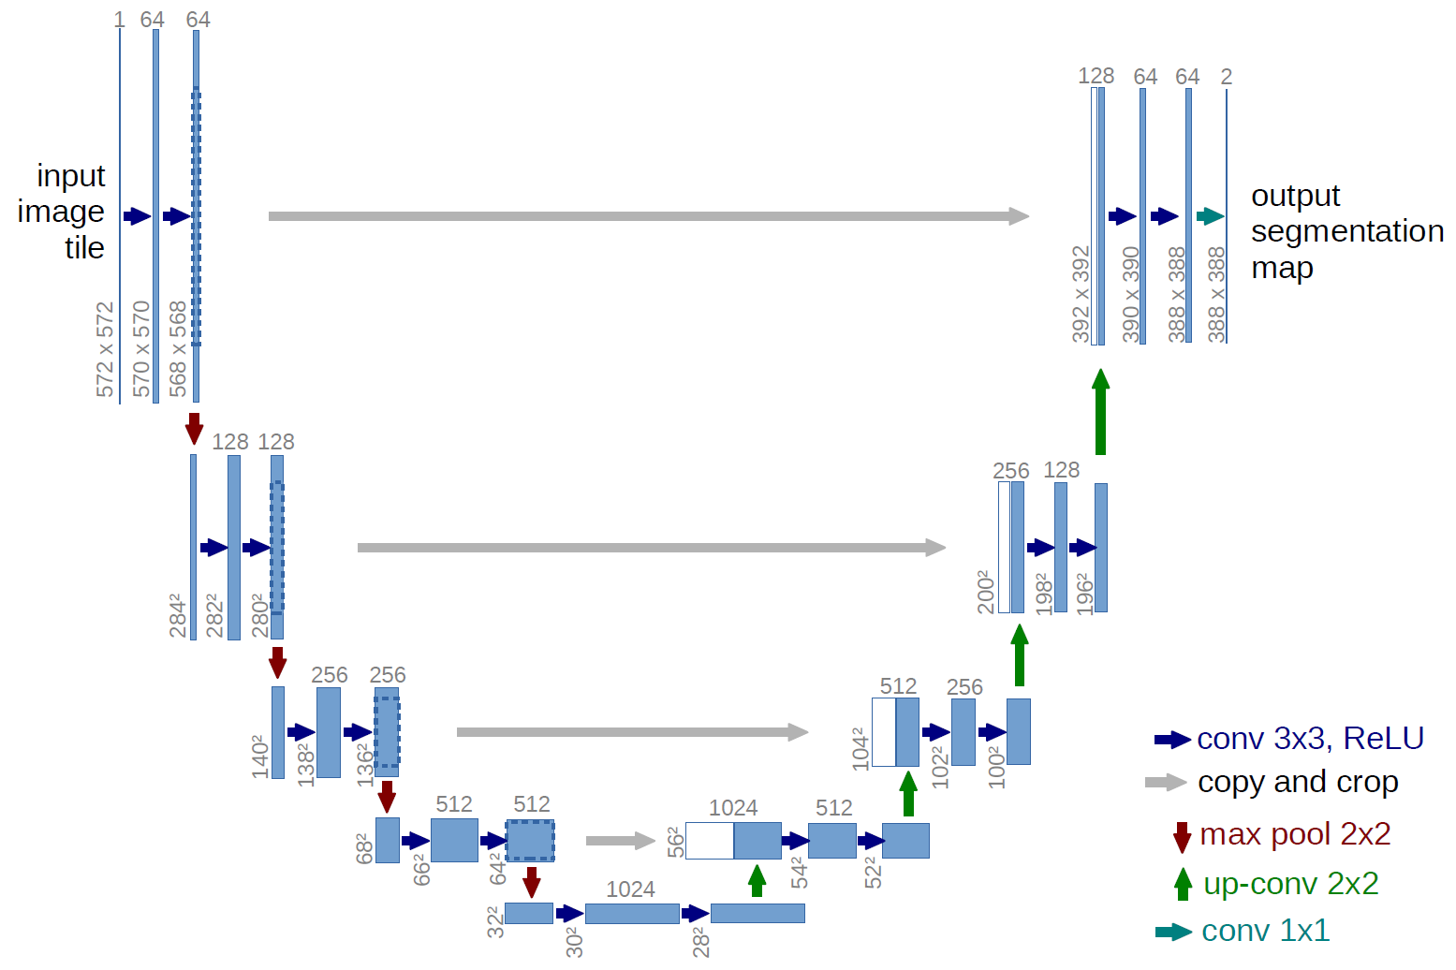
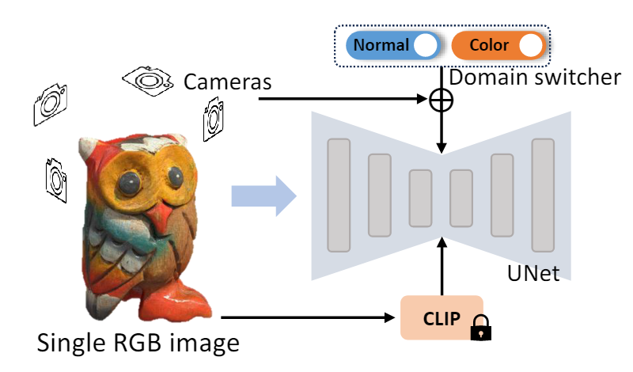
Positional encoding
normal
[256]
[B, 512, H, W] + [B, 256, H, W]
color
[256]
Image feature positional encoding

Slide 17
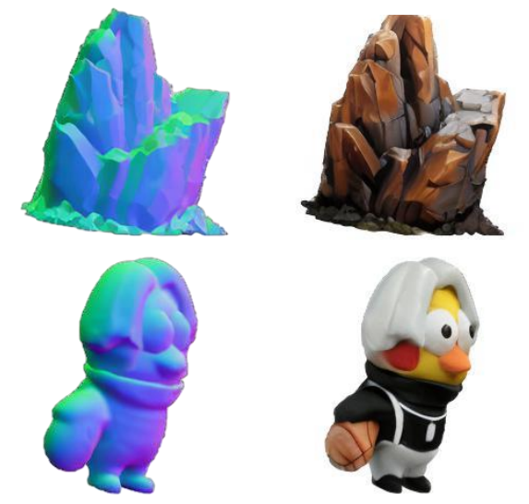
Cross-domain Attention
However, it is important to note that for a single view, there is no guarantee that the generated color image and the normal map will be geometrically consistent

Slide 18
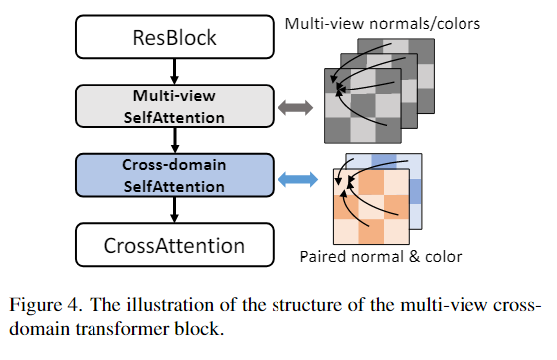
They introduce a crossdomain attention mechanism to facilitate the exchange of information between the two domains

Slide 19
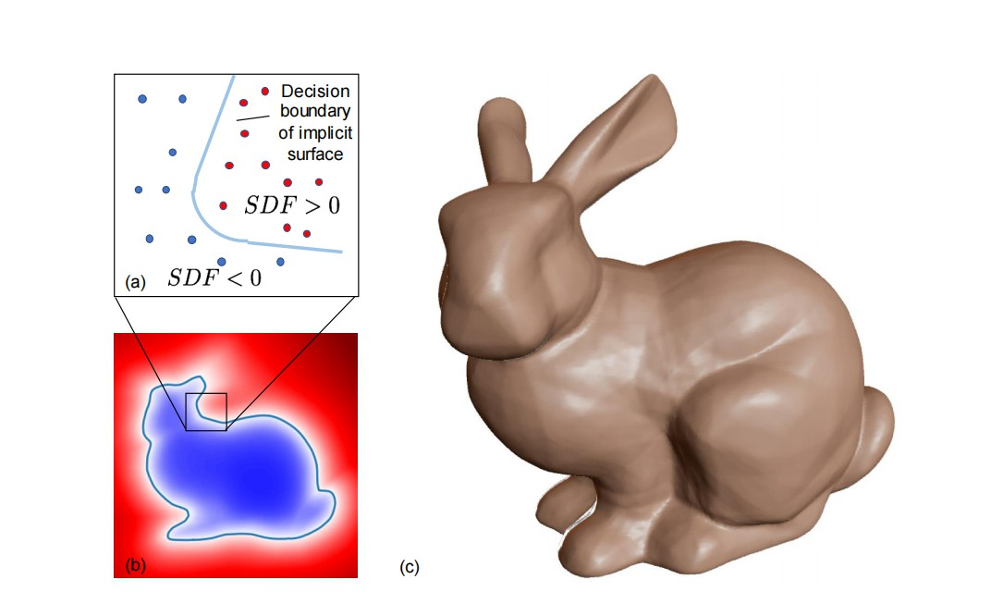
Textured Mesh Extraction
To extract explicit 3D geometry from 2D normal maps and color images, we optimize a neural implicit signed distance field (SDF) to amalgamate all 2D generated data.
SDF offers compactness and differentiability, making them ideal for stable optimization.

Slide 20
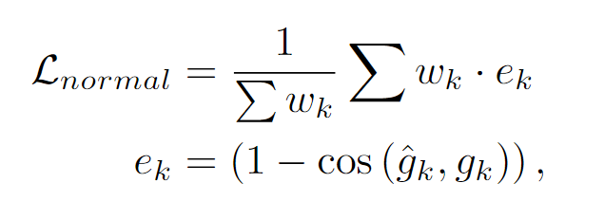
Normal Loss
SDF is differentiable, we can easily extract normal values of the optimized SDF via calculating the second-order gradients of SDF.
To tolerate trivial inaccuracies of the generated normals from different views, they introduce a geometry-aware normal loss

Slide 21
If these multiple normals do not exhibit perfect consistency, the geometric supervision may become somewhat ambiguous, leading to imprecise geometry.
Assign higher weights to normals that form larger angles with the viewing rays

Slide 22
Other losses and regularizations
$L_{rgb}$ : MSE loss
$R_{eik}$ : denotes eikonal regularization term that encourages the magnitude of the SDF gradients to be unit length
$R_{sparse}$ : denotes a sparsity regularization term that avoid floaters of SDF
$R_{smooth}$ : denotes a 3D smoothness regularization term that enforces the SDF gradients to be smooth in 3D space.

Slide 23
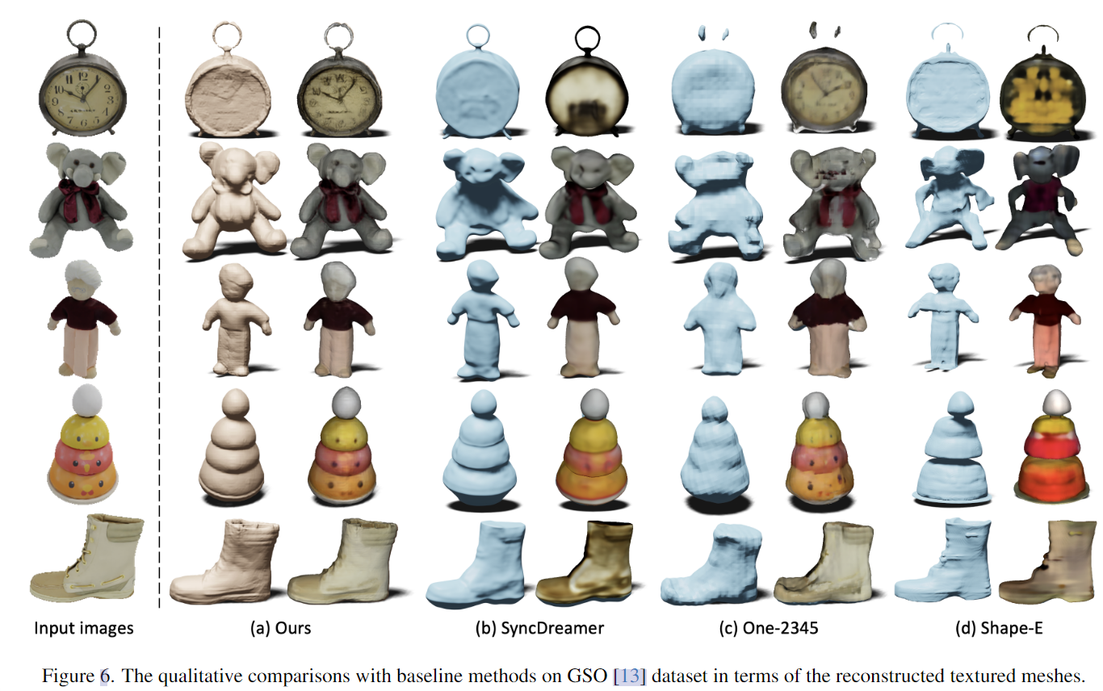
Results

Slide 24
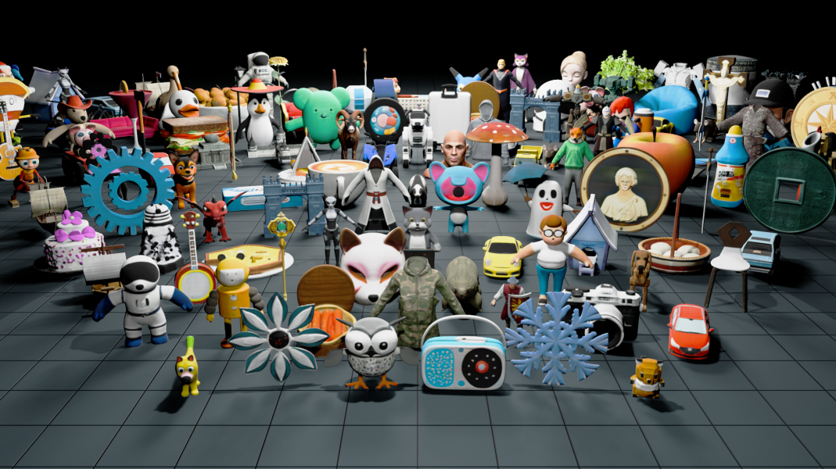
Edify 3D: Scalable High-Quality 3D Asset Generation
NVIDIA 2024

Slide 25
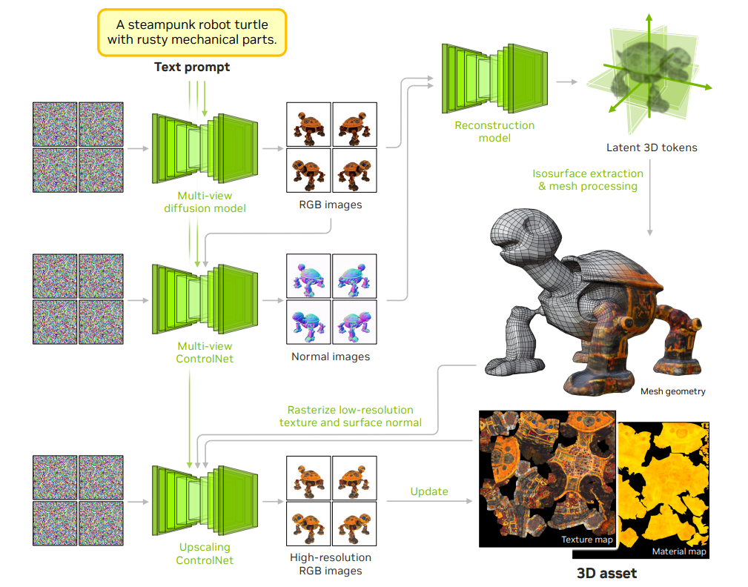

Slide 26
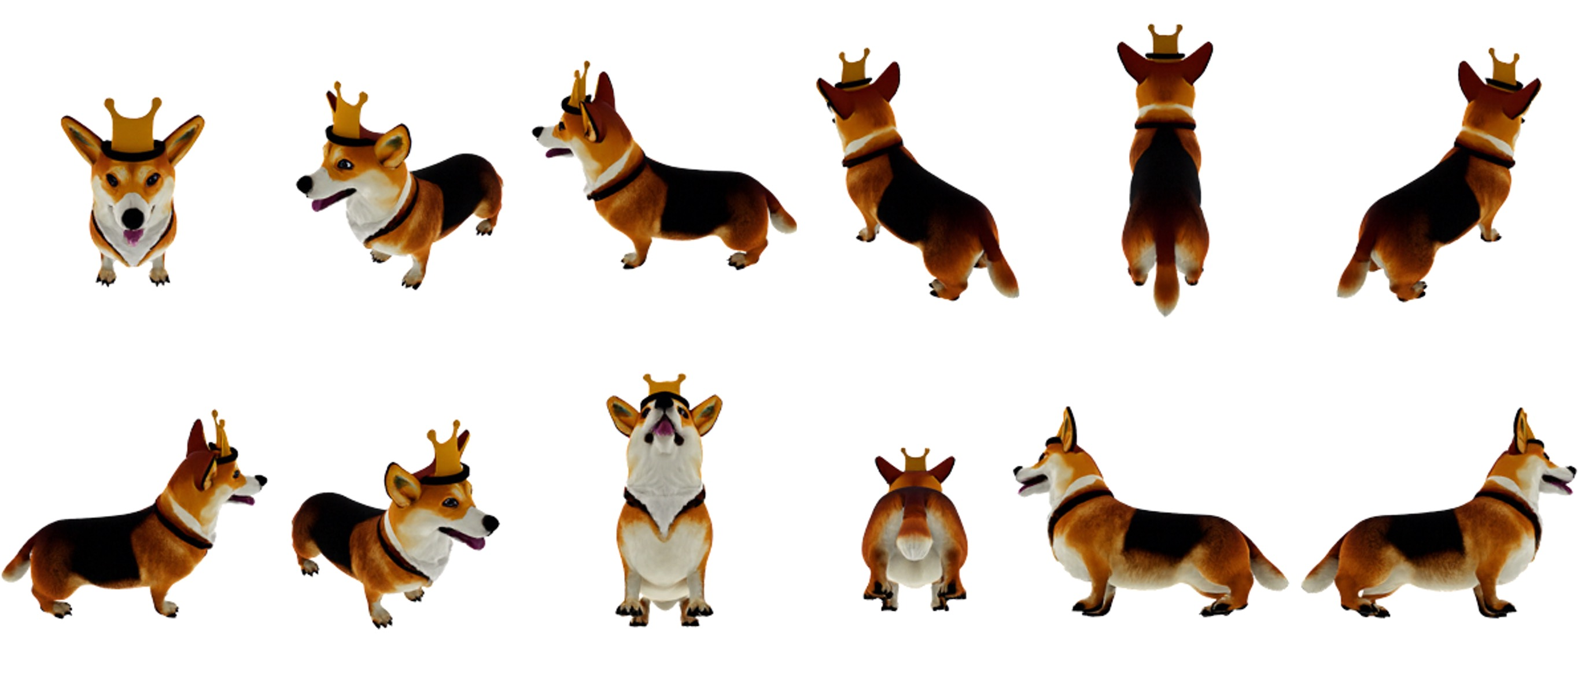
Multi-View Diffusion Model
They finetune text-to-image models into pose-aware multi-view diffusion models by conditioning them with camera poses.
The models take a text prompt and camera poses as input and synthesize the object's appearance from different viewpoints

Slide 27
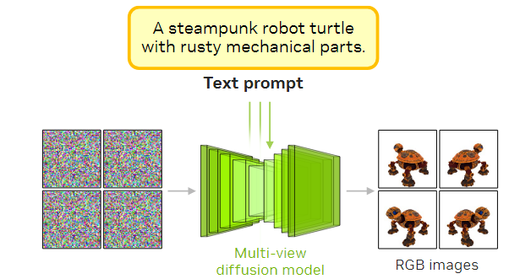
Multi-View Diffusion Model
1. A base multi-view diffusion model that synthesizes the RGB appearance conditioned on the input text prompt as well as the camera poses.

Slide 28
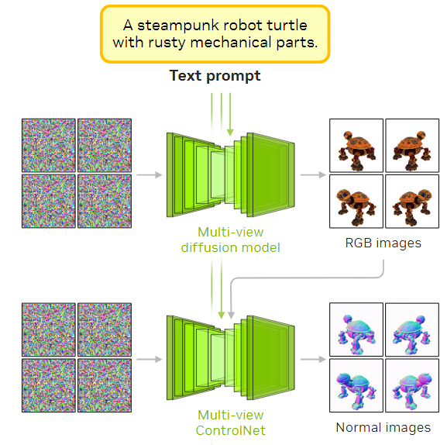
2. A multi-view ControlNet model that synthesizes the object's surface normals, conditioned on both the multi-view RGB synthesis and the text prompt.

Slide 29
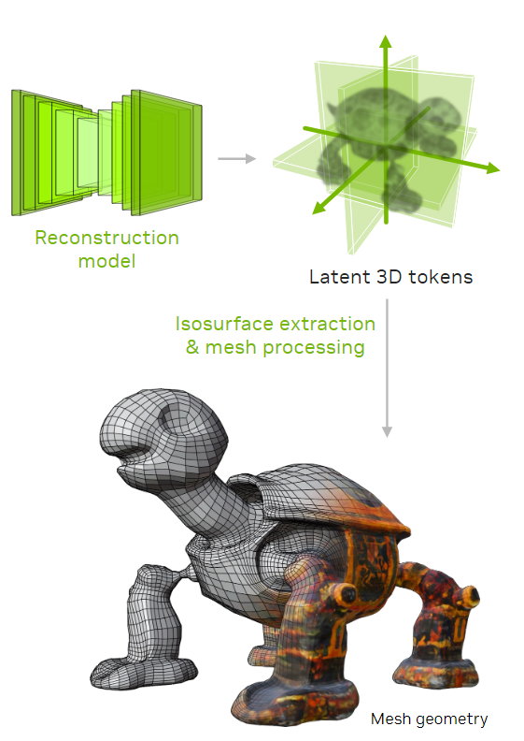
Reconstruction Model
We use a Transformer-based reconstruction model to generate the 3D mesh geometry, texture map, and material map from multi-view images.

Slide 30
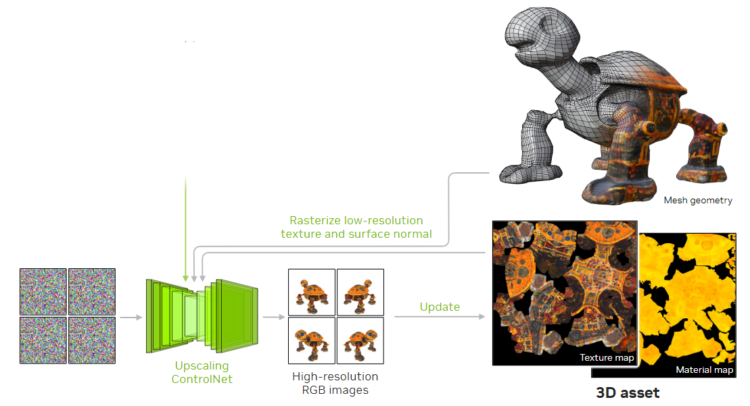
3. A multi-view upscaling ControlNet that super-resolves the multi-view RGB images to a higher resolution, conditioned on the rasterized texture and surface normals of a given 3D mesh.

Slide 31
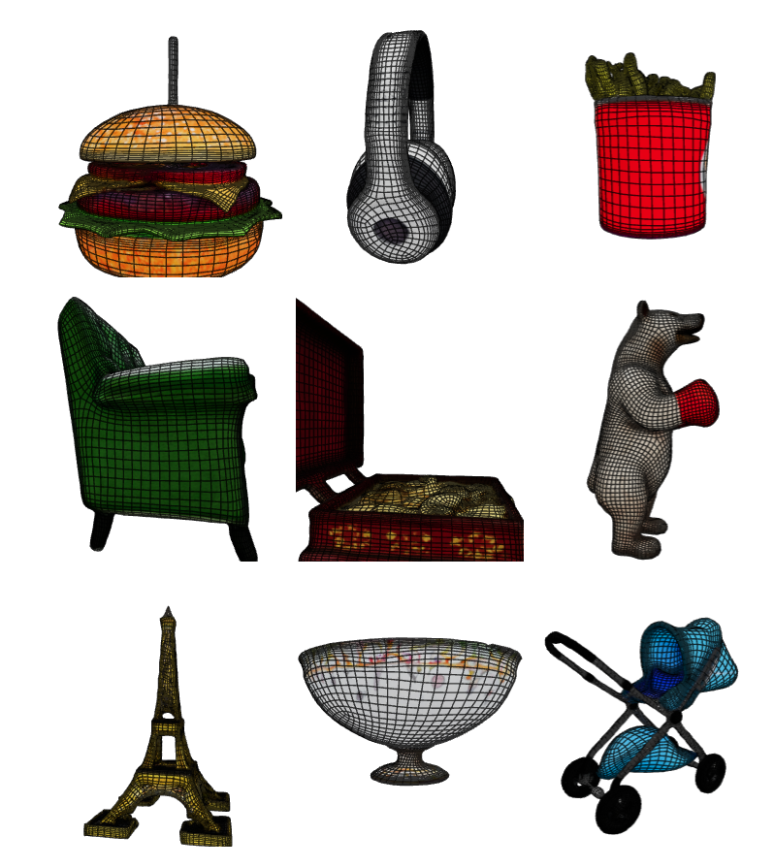
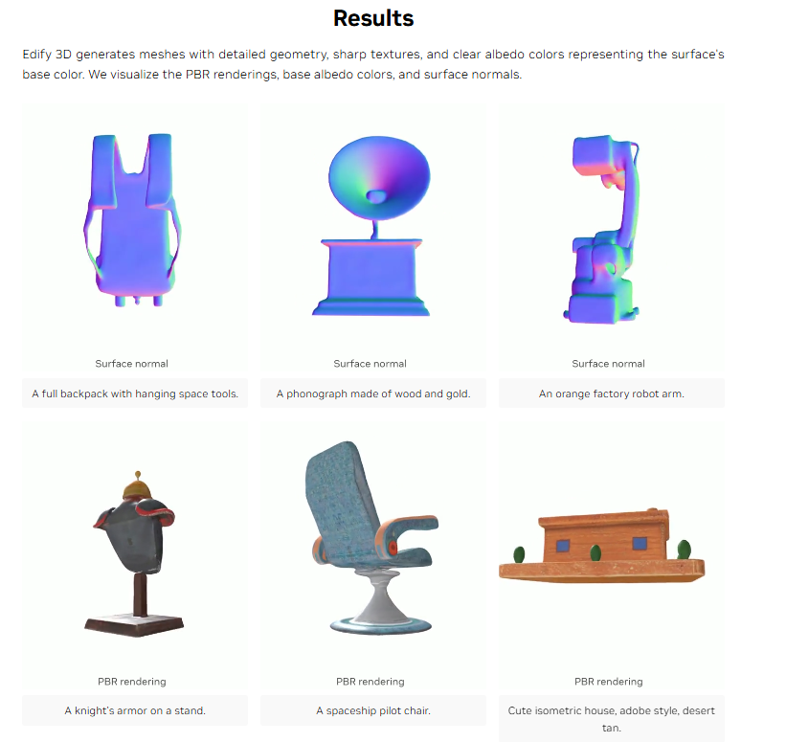
Results
https://research.nvidia.com/labs/dir/edify-3d/

Slide 32
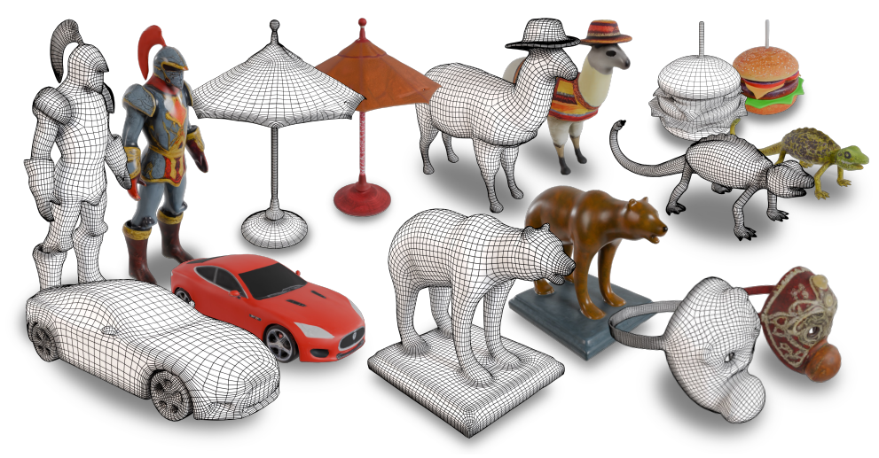

Slide 33
