Slide 1
Grid Diffusion Models for Text-to-Video Generation
T. Lee, S. Kwon, and T. Kim, "Grid Diffusion Models for Text-to-Video Generation," Proceedings of the IEEE/CVF Conference on Computer Vision and Pattern Recognition, pp. 8734-8743, 2024.
Notes:
Grid Diffusion
CVPR2024 提出一種新的影片的架構

Slide 2
Content
System Overview
Introduction
Method
Experiment
Limitation & Conclusion

Slide 3
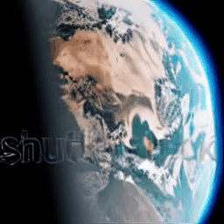
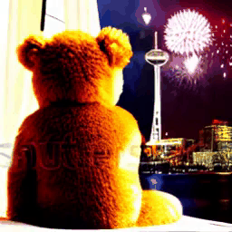
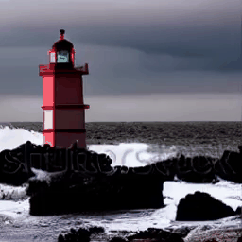
Result
Earth from space, zooming in
Teddy bear looking at the fireworks and Space Needle, 4k high resolution
Waves crashing against a lone lighthouse, ominous lighting
Notes:
Some Experience Result.
可以看到能生成一個有連續動作的影片

Slide 4
1. Introduction

Slide 5
Introduction
It proposes a novel grid-diffusion models
Reduce high temporal dimension of video
Allow high-quality video generation without substantial GPU memory cost and dataset
Model consists of 2 stages:
Key grid image generation
The model represent video as grid image
Autoregressive grid image interpolation
1-step Interpolation
2-step Interpolation
Notes:
提出新的影片生成架構，可以減少時間維度的消耗，使GPU記憶體消耗與資料集需求不會到那麼高。
分為三個部分：
第一個部分將影片視為連續性的圖片，並提取關鍵幀
第二個部分和第三個部分為對關鍵幀進行插值。

Slide 6
Related Works
InstructPix2Pix
https://arxiv.org/pdf/2211.09800
Notes:
InstructPix2Pix可以讓人利用指令對圖像進行編輯。
https://arxiv.org/pdf/2211.09800

Slide 7
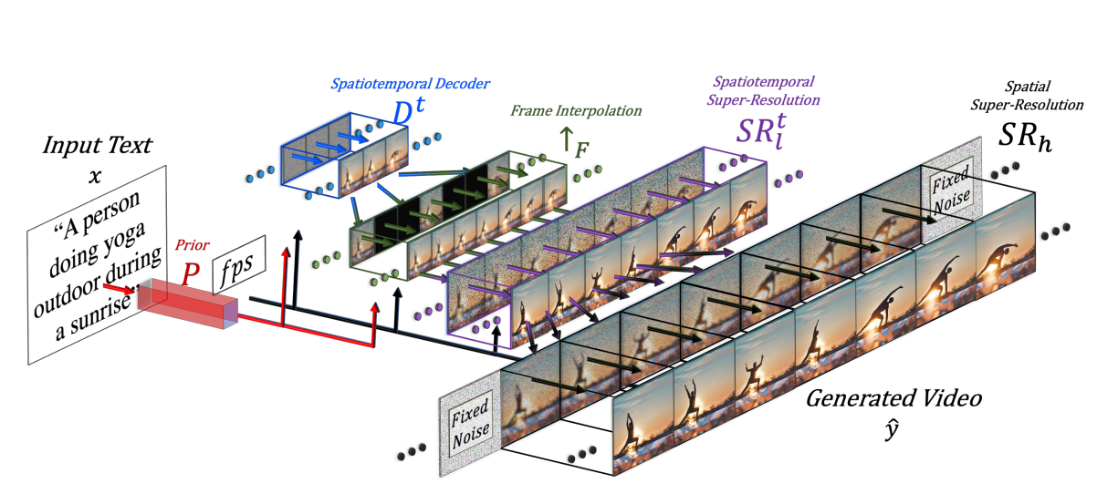
Related Works
Make-A-Video
https://arxiv.org/pdf/2209.14792
Notes:
Expand a diffusion-based T2I model (DALLE2) to T2V by leveraging(利用) joint text-image priors(文本-影像聯合先驗，考慮文本與影像的語意關係).
https://arxiv.org/pdf/2209.14792

Slide 8
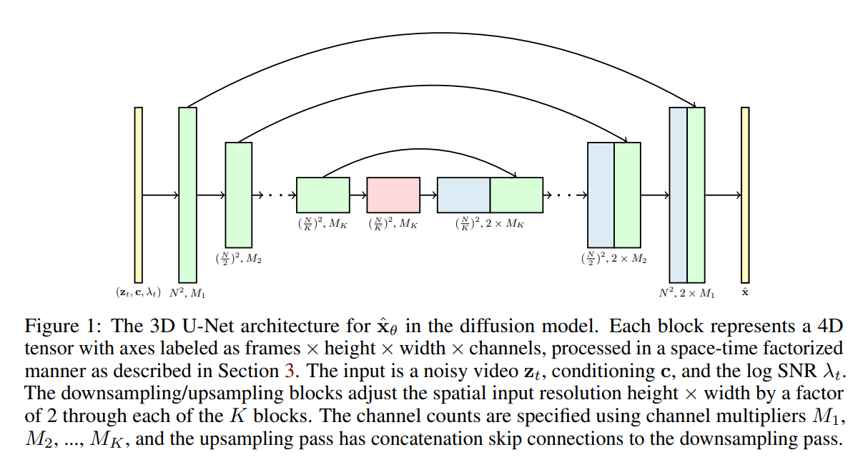
Related Works
Video Diffusion
https://arxiv.org/pdf/2204.03458
Notes:
It trains image and video jointly. With 3D U-Net diffusion model architecture.
https://arxiv.org/pdf/2204.03458

Slide 9
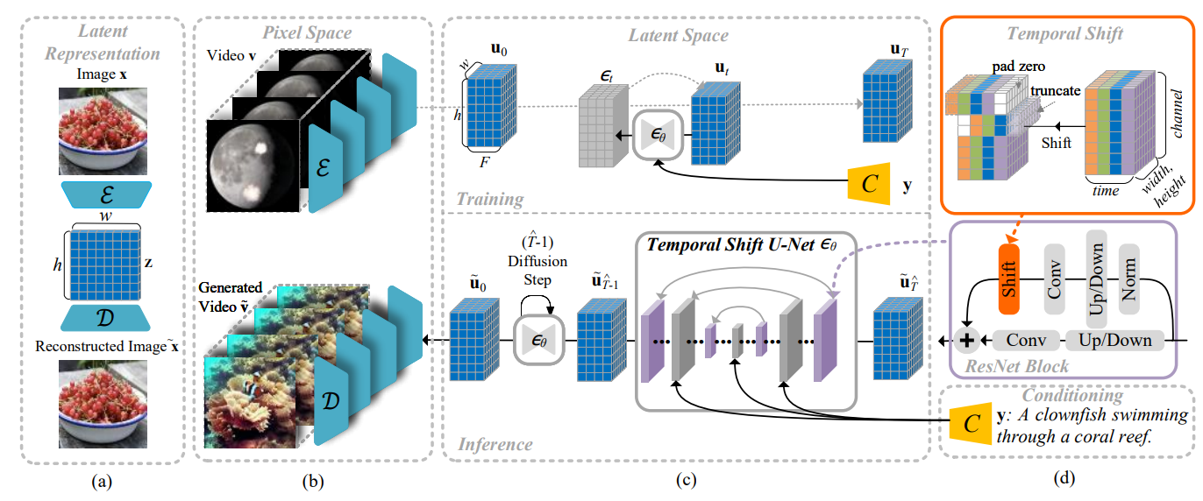
Related Works
Latent Shift
https://arxiv.org/pdf/2304.08477
Notes:
It generates video by shifting the spatial U-Net feature map forward and backward to ensure temporal coherence
https://arxiv.org/pdf/2304.08477

Slide 10
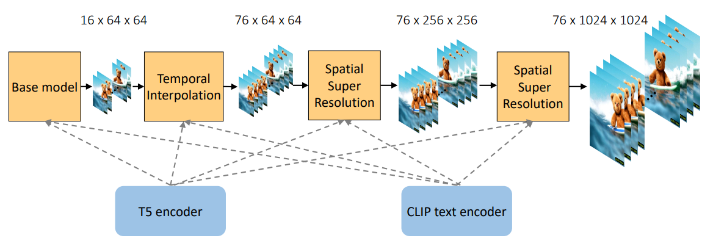
Related Works
PYoCo
https://arxiv.org/pdf/2305.10474
Notes:
It extends T2I model into a 3D dimension and fine-tune a pre-trained diffusion model, and it utilizes a noise prior(噪聲先驗) and a pre-trained eDiff-I model for generating videos
https://arxiv.org/pdf/2305.10474

Slide 11
2. Method

Slide 12
Method Overview
Notes:
Consists of two main stage:
Key grid image generation: generate a key grid image that represent video from text. (可能是關鍵動作幀)
Autoregressive grid image interpolation: interpolate(插值) the generated key grid image to generate the whole video. (去讓動作變化更合乎自然)
This framework enables generating high quality videos with fixed GPU size, and less training data than existing T2V model (ImageVideo, VideoDiffusion, CogVideo, Videofusion, Make-a-video, Godiva), and allow manipulating in the image dimension

Slide 13
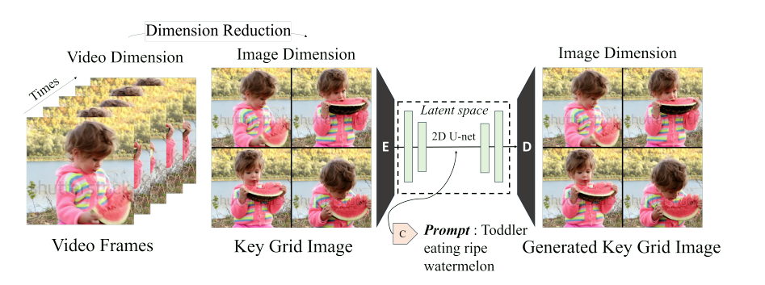
Key Grid Image Generation
Key grid image
Consist of four frames representing primary motion in video.
Ideally, each frame needs to keep temporal consistency.
VAE latent may capture global spatial structure in image and reconstruct image.
Notes:
Frame: 512 x 512
Key Grid Image: 254 x 254
Fine-tune stable diffusion LAION-5B on 0.1 million samples of Webvid-10M
Key Grid: 影片的關鍵幀並合成為一張含有四個格子的影片，理想下這些影片必須保持時間一致性。
訓練的方法是利用把影片也拆成幾個關鍵幀，然後使用VAE可以捕捉圖片全局空間性去重構影片的特性，要求這個模型可以達到依據文字去生成空間幀的效果。

Slide 14
Autoregressive Grid Image Interpolation
More frames is required to generate a video
=> Interpolation model
Notes:
然而只有4 frame是遠遠不及生成影片的，代表需要有個方法可以去生成幀與幀之間的動作聯繫。
論文使用的是插值的方法，即對第一幀與第二幀之間生成中間幀。

Slide 15
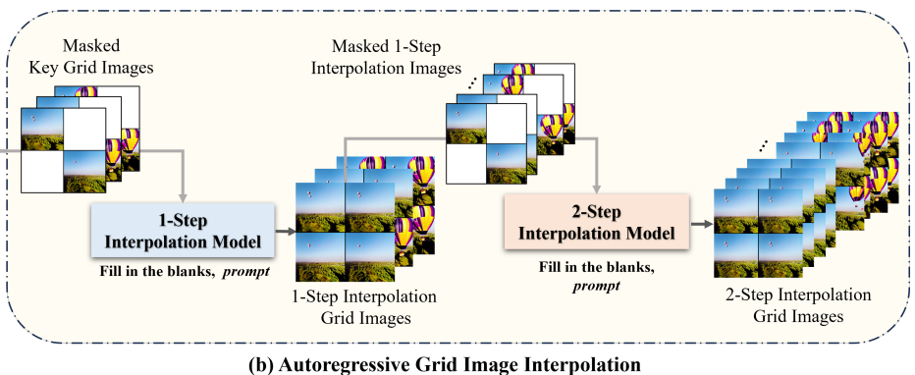
Autoregressive Grid Image Interpolation
Interpolation model are composed of two models: 1-step interpolation and 2-step interpolation
The model is trained by different interval of previous grid images
Notes:
差值的模型被論文分成兩塊：一步差值與兩步差值。兩個模型是差不多的，推論過程會先做一步再做兩步差值。

Slide 16
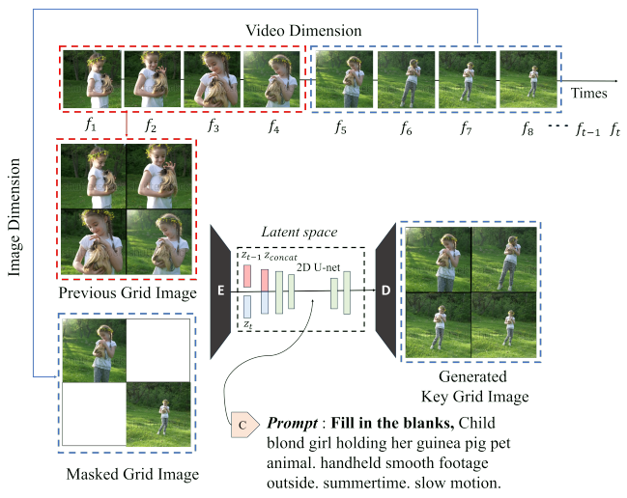
Autoregressive Grid Image Interpolation
A masked grid image on 2nd and 3rd frame is used to train model and generate frames between non-mask frames.
Concatenate previous grid image and masked grid image.
“Fill in the blanks” as prefix instruction and text prompt is fed.
Notes:
Channels in U-net architecture is expanded, as pre-trained on LAION-5B.
Based on InstructPix2Pix approach, see section 3.2.1 on InstructPix2Pix paper.
訓練時是對影片進行訓練，一樣使用VAE。將影片的某連續四幀中的第二第三幀藏起來，讓模型去生成第二第三幀。
另外，為了讓模型可以學到文字與影片中的一些對應關係(Conditioning)，他們將Masked Grid Image的前四幀一同串接後餵入。這部分為參考InstructPix2Pix的方法。

Slide 17
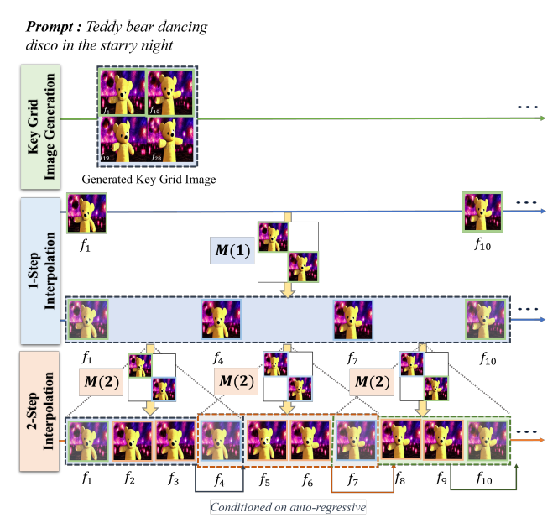
Inference for Video Generation
The inference process consists of 3 steps:
Key Grid Generation
1-step Interpolation
2-step Interpolation
Notes:
三個模型訓練完成後便可以開始進行推論。這邊我們用M(1)表示一步差值，M(2)表示二步差值。

Slide 18
Inference for Video Generation
Model first generate key grid image as (f1, f10, f19, f28)
Use 1-step Interpolation to generate two frames between (f1, f10) => (f4, f7)
Use 2-step Interpolation to generate (f2, f3) by feeding (f4) as conditioning image.
Notes:
4 + 6 + 18 = 28
首先流程中會先根據文字，用Key Grid Image Generation Model生成四個關鍵幀，然後餵入M(1)。這邊以f1, f10, f19, f28代稱。
再來一步差值中，會根據f1, f10間的空格，模型會生成f4, f7的幀並輸出。這樣原本的4幀就會變為共計10幀。
二步差值中，M(1)生成的f4, f7被作為輸入餵進去M(2)，使其可以產生更細部的f2, f3幀。組合起來就變成28幀的影片。

Slide 19
Generate on more frame
To generate video more than 28 frames, a next key grid generation model is trained.
It generates the next key grid image autoregressively, conditioned on the previous key grid image.
Do the same instructions on the next key grid image consequently enabling us to generate more video frames.
Notes:
這個流程可以生成長影片。如果要生成多餘28幀的影片，需要去訓練一個可以預測下一個Key Grid Image的模型，並將原Key Grid Image作為輸入。
這樣只要做同樣的流程就可以以28 + 28這樣子生成長影片。

Slide 20
Extension of the method
Text-guided video manipulation
By reducing video generation to image generation, applying image-based method in video domain is possible.
Interpolation model can generate videos in styles while preserving contents.
Video generation with higher resolution
Generate model is using a T2I model.
A higher resolution model can be applied (ex. SD-XL => 1024x1024) to generate video with resolution of their half. (510 x 510)
Notes:
由於這個模型本質是一個T2I模型，所以可以對模型使用Image Method進行操作。比如增加物件，風格化等等
此外如果想要更高畫質也可以採用更高畫質的模型(論文採用 LAION-5B)，如SD-XL

Slide 21
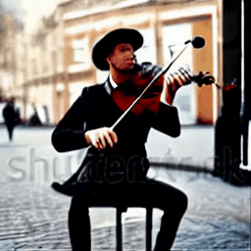
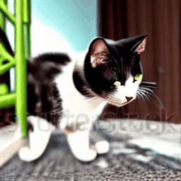
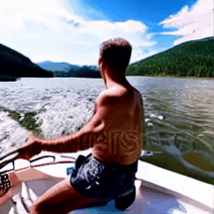
Some Results
A street musician playing a violin in a city center
An animating cat is being zoomed in
A man is enjoying his boat ride here
Notes:
短影片

Slide 22
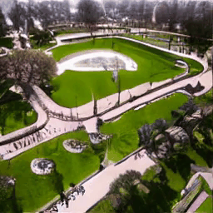
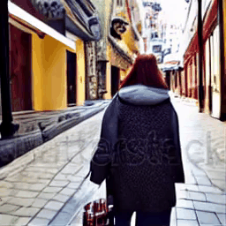
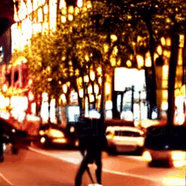
Some Results – on more frames
A 360-degree rotating view of the park during the day
A young woman walk in the city.
4K high resolution
On busy city streets, lights flicker to illuminate the dynamic of life. People rush to their daily lives
Notes:
長影片

Slide 23
3. Experiment

Slide 24
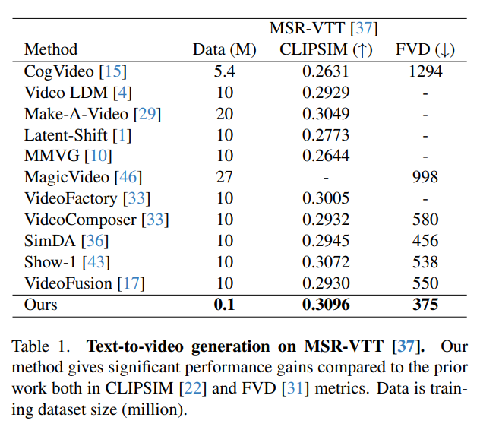
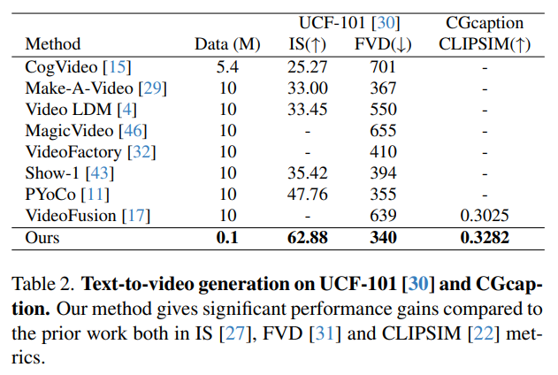
Quantitative Result
MSR-VTT: https://paperswithcode.com/dataset/msr-vtt
UCF-101: https://paperswithcode.com/dataset/ucf101
Notes:
MSR-VTT: Video Captioning
UCF-101: Video Categorizing
IS: Inception Score evaluate quality and variety of picture
FVD: Frechet Video Distance, distance on feature level <-> FID
CLIPSIM: Evaluate correlation between prompt and video
在定量分析中，可以看到在訓練資料量比較少的情況下，在對影片進行Prompt配對、對影片進行分類等任務下，該模型都有比較好的成果。

Slide 25
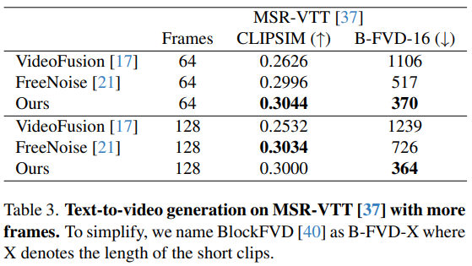
Quantitative Result – on more frame
Generate 64/128 frames
MSR-VTT: https://paperswithcode.com/dataset/msr-vtt
Notes:
MSR-VTT: Video Captioning
UCF-101: Video Categorizing
IS: Inception Score evaluate quality and variety of picture
FVD: Frechet Video Distance, distance on feature level <-> FID
CLIPSIM: Evaluate correlation between prompt and video
在較多frame的任務下，64frame仍高出VideoFusion, FreeNoise等模型。然而在128frame下在CLIPSIM下比FreeNoise略遜一籌。

Slide 26
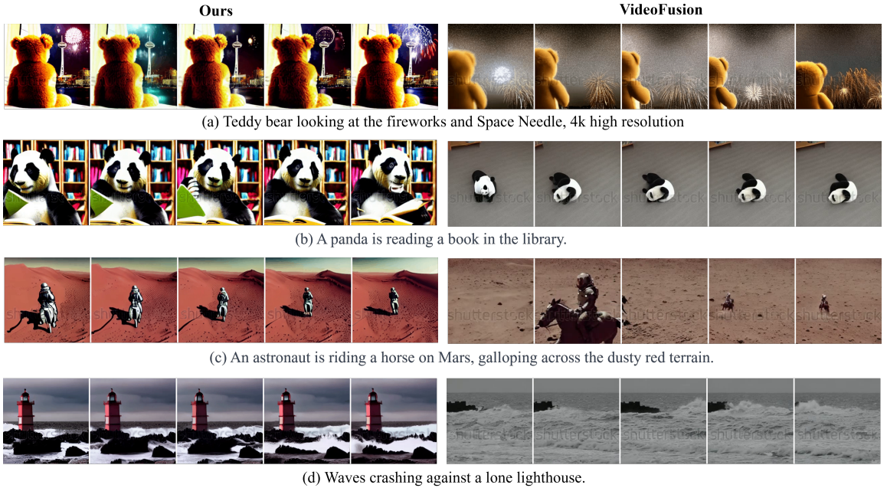
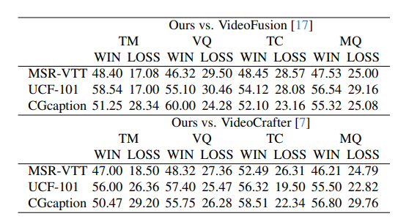
Qualitative Result
Evaluated by human
Notes:
Compare with VideoFusion, VideoCrafter
TM: Text Matching
VQ: Video Quality
TC: Temporal Consistent
MQ: Motion Quality
在定性分析中，該模型可以生成較多的影片動作與細節。此外透過Human Evaluation的方式對兩個模型生成的結果進行評分。雖然使用較少的訓練資料，但保持著較高的時間一致性與動作品質。

Slide 27
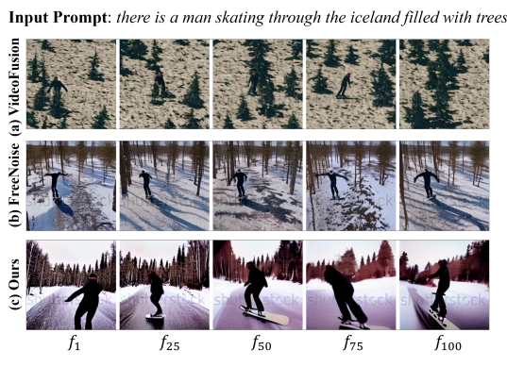
Qualitative Result – on more frame
Generate 64/128 frames
Notes:
Compare with VideoFusion, FreeNoise
模型在較高的幀數也可以保持TC與MQ。而VideoFusion在超過16幀以上時開始生成背景噪音或者較單調的動作變化。可能是因為訓練幀數與推論幀數不同導致。
FreeNoise在25幀以上比較常生成靜態動作，而我們的模型則可以生成較多的動態動作。

Slide 28
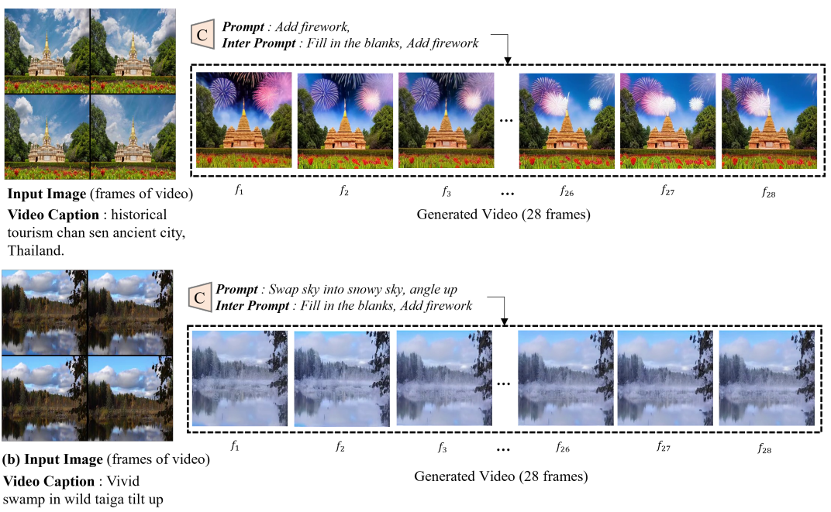
Video Manipulation
Notes:
Add some detail by feeding input image
因為本質此模型是將T2V降維成T2I去做操作，模型可以輕鬆地去操縱影片生成。
比如對上面的城堡添加煙火背景，對下面的湖添加氣候變化，改變視角等等等。

Slide 29
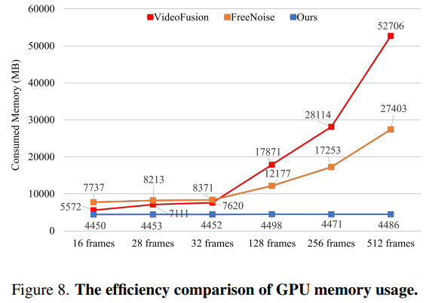
Efficiency Comparison
GPU memory usage is almost the same in GridDiffusion.
Other T2V models require more memory when frame increases
Notes:
在利用GPU記憶體效率上，由於我們對影片的時間進行了降維處理，拆分成28+28幀處理，所以相比於一次產出512幀的模型需要耗掉5萬MB的記憶體，這個模型顯得更為有效率。
在時間效率上，FreeNoise平均用掉1.68(64)~1.62(128)秒處理每幀，我們的模型需要1.71(64)~1.76(128)秒。這代表我們的模型在保有推論時間競爭力下，消耗的GPU記憶體則比FreeNoise少一大截。

Slide 30
4. Limitation & Conclusion

Slide 31
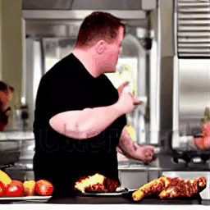
Limitation
Some result doesn’t preserve good motion quality on more frame generation.
Background image flickering is frequently being seen.
A cook in a black t-shirt is making a meatloaf he is convinced will be spectacular
Notes:
會反覆恆跳，有可能是因為Keyframe的關係。

Slide 32
Limitation
If there are foreground subject and background changing showing in the same picture, the model doesn’t behave well preserving background subject.
A snowman sunbathing on a beach

Slide 33
Conclusion
The model can generate high quality of video using a fixed amount of GPU regardless number of frames.
Various method can be applied to the model as video manipulation.
It relies on a pre-train T2I model, but video contains rich visual content.

Slide 34
References
https://arxiv.org/pdf/2404.00234
https://taegyeong-lee.github.io/text2video
https://arxiv.org/pdf/2211.09800 (InstructPix2Pix)

Slide 35
Code References
https://github.com/taegyeong-lee/Grid-Diffusion-Models-for-Text-to-Video-Generation
https://docs.google.com/document/d/1o4eJmRUTBmtujVE19fWeN8gumcZ-ouVn0bEvbaaijH0/edit?tab=t.jig5j1on5kmo

Slide 36
FIN

