Slide 1
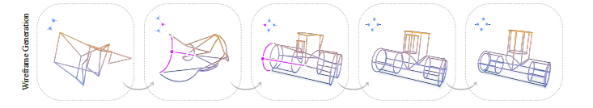
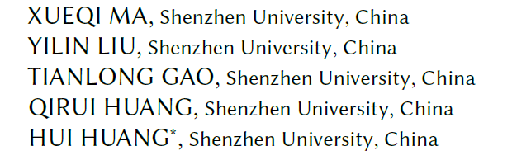
CLR-Wire: Towards Continuous Latent Representations for 3D Curve
Wireframe Generation
SIGGRAPH 2025

Slide 2
Two key parts
CLR-Wire: Towards Continuous Latent Representations for 3D Curve
Wireframe Generation
Notes:
Representations for 3D Curve
Wireframe Generation

Slide 3
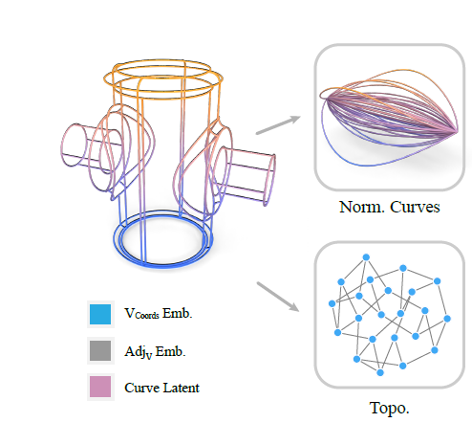
Wireframe
1. Edges
2. Topology

Slide 4
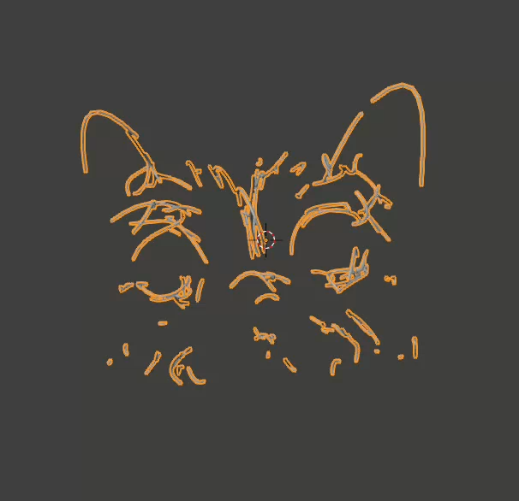
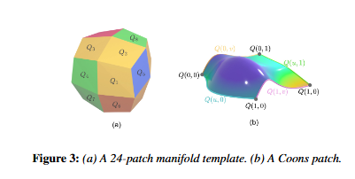
Wire frame Representation
慧光
Fix topology
No topology

Slide 5
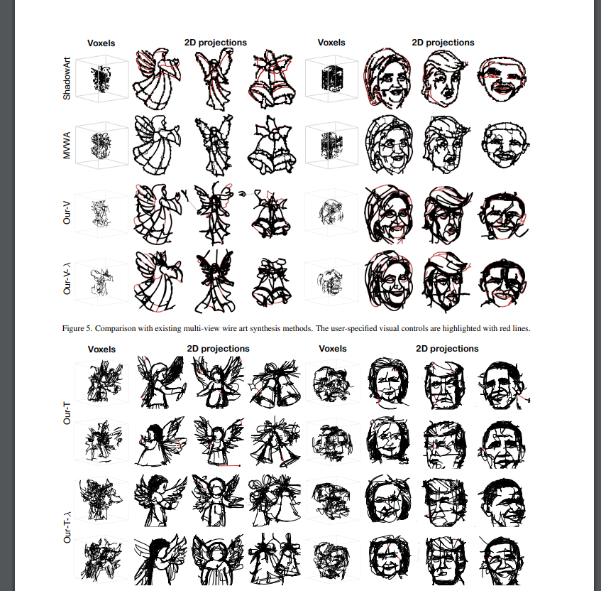
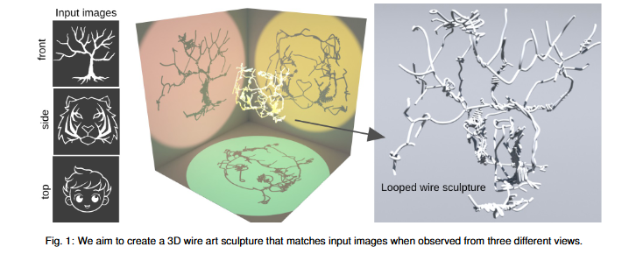
Wire frame Representation
CVPR 2024 Dreamwire
Ours
Ignore topology
Topology when postprocessing

Slide 6
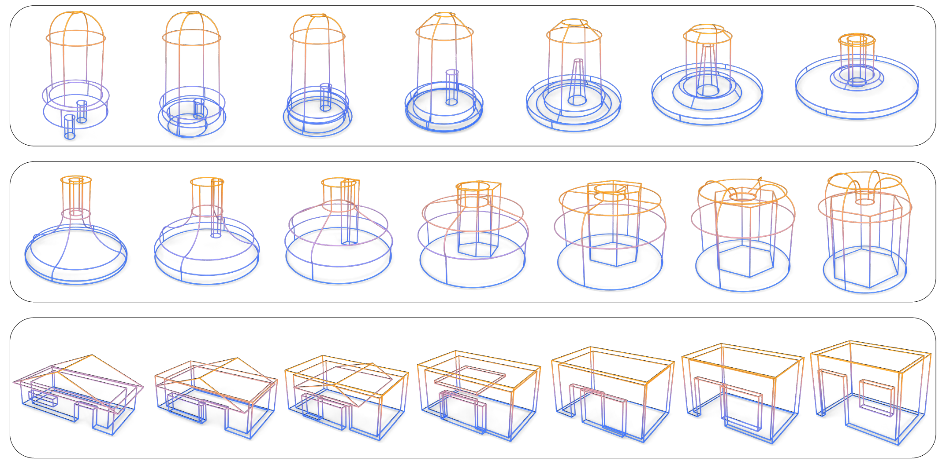
Challenges
Combining continuous geometry (curves) and discrete topology (connectivity).
A
B

Slide 7


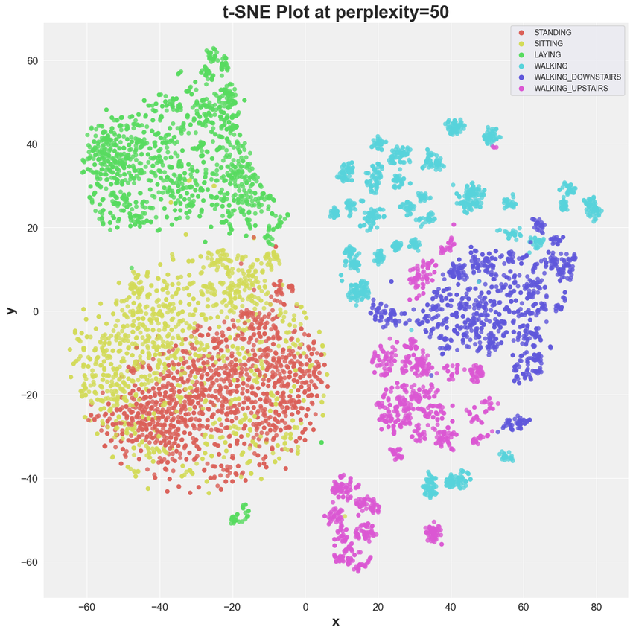
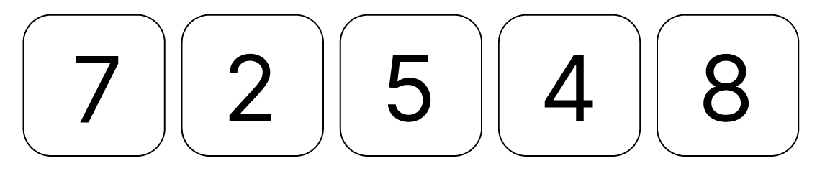

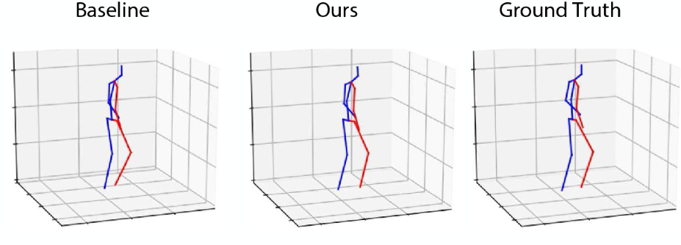
Generation
Unconditional
Conditional
Diffusion Model
High dimensional space: 256*256*3 = 196,608

Slide 8
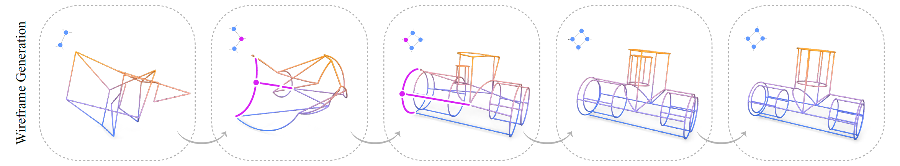
Wire frame generation

Slide 9
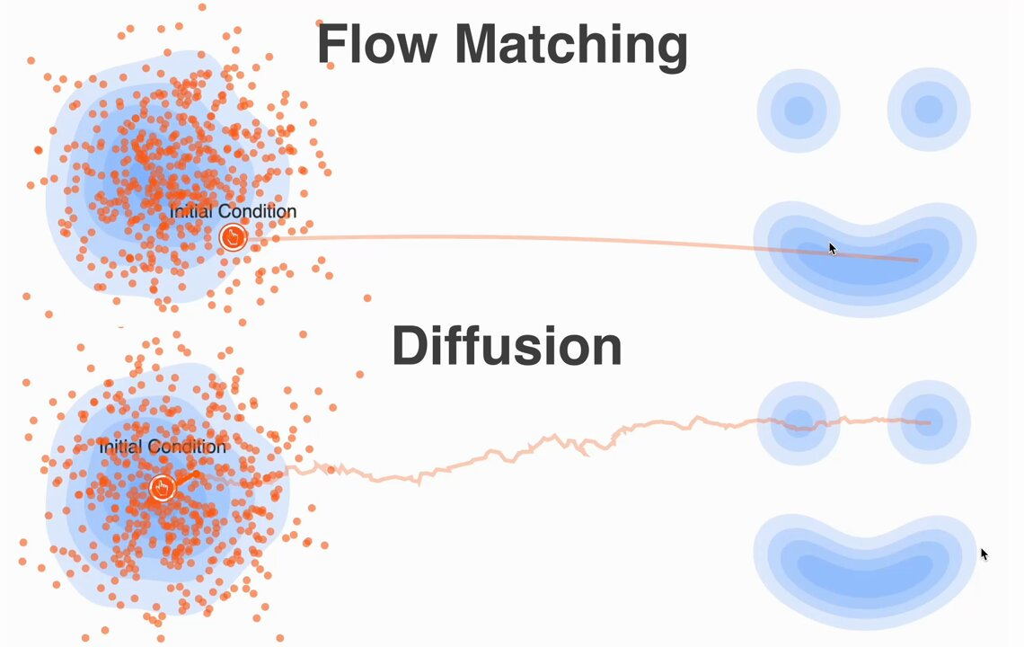
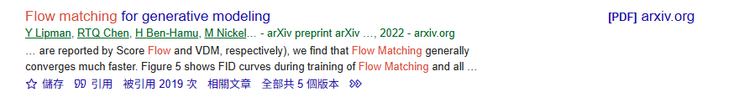
Diffusion vs Flow Matching
Notes:
Gaussian -> image distribution

Slide 10
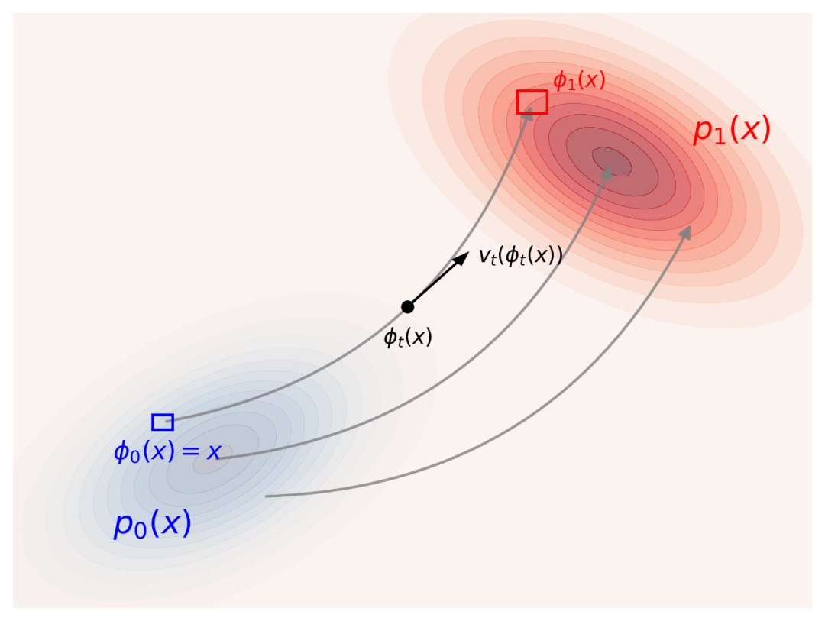
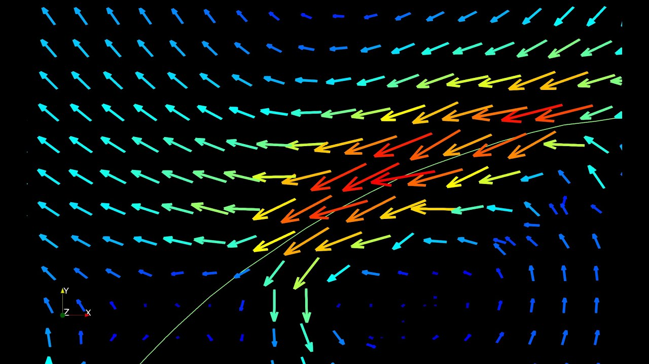
What is Flow Matching?
Velocity field

Slide 11


Why Flow Matching?
Diffusion | Flow Matching
Randomness | Deterministic
natural images (diversity is desirable) | structured data (wireframes, CAD)
interpolated latent meaningless | interpolated latent meaningful
structured data : wire, motion, shape cloud, layout

Slide 12
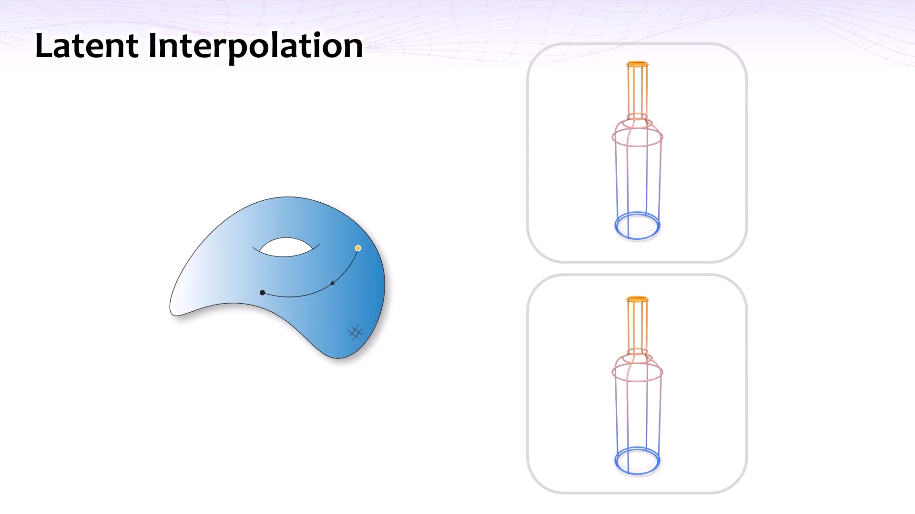

Slide 13

Does Interpolation make sense?
?

Slide 14
Wireframe VAE

Slide 15
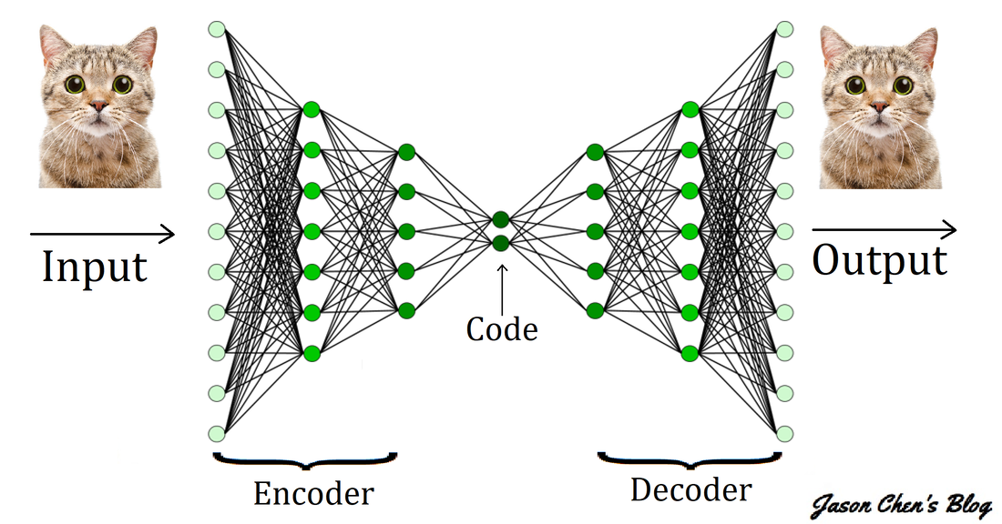
Autoencoder

Slide 16
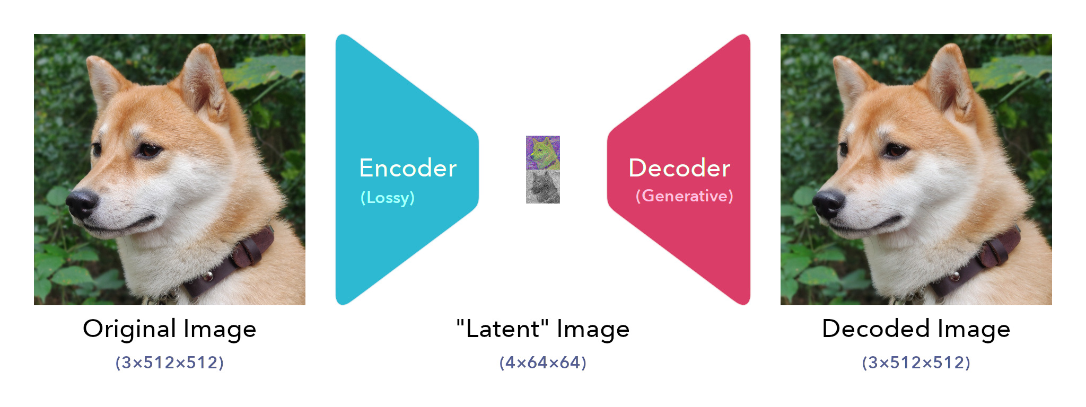
Vae in Stable Diffusion
Notes:
Purpose 壓縮

Slide 17
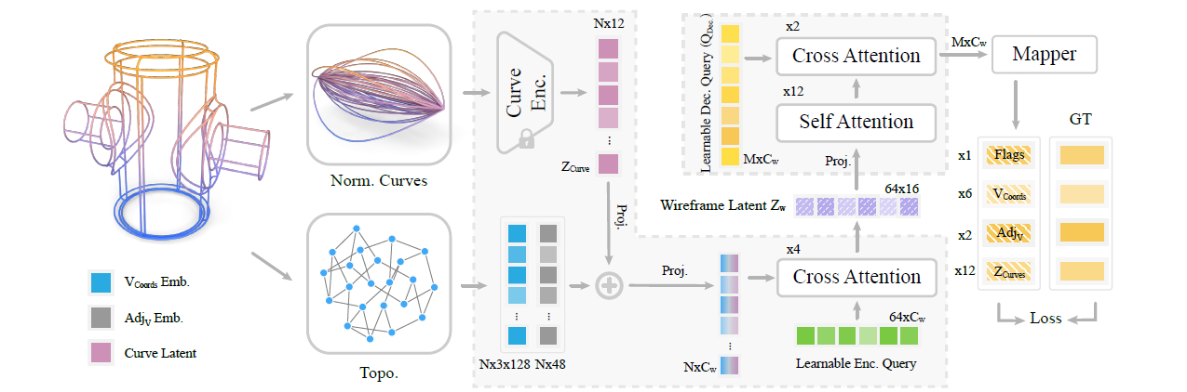
Training Wireframe VAE
Notes:
Purpose 壓縮

Slide 18
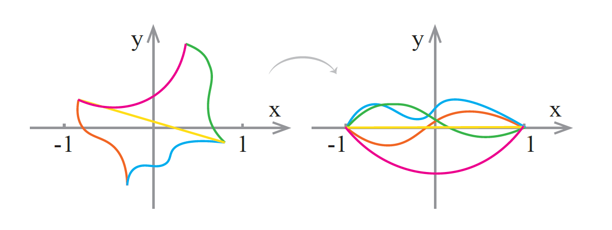
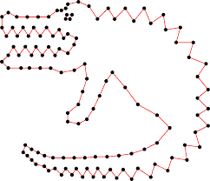
Curve Normalization & Sample

Slide 19
Training Wireframe VAE
Notes:
Purpose 壓縮

Slide 20
Topology representation
Adjacency list: (start, end)
Example:
(1, 2)
(3, 4)
…
End point coordinates : (x1, y1, z1, x2, y2, z2)

Slide 21
Unified Representation

Slide 22
Latent Flow Matching

Slide 23
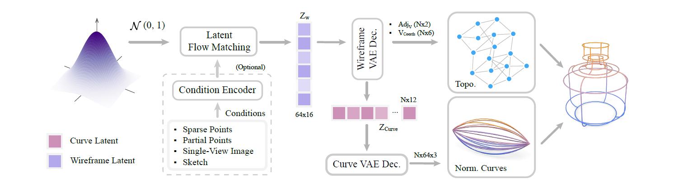
Training Flow Matching Model

Slide 24
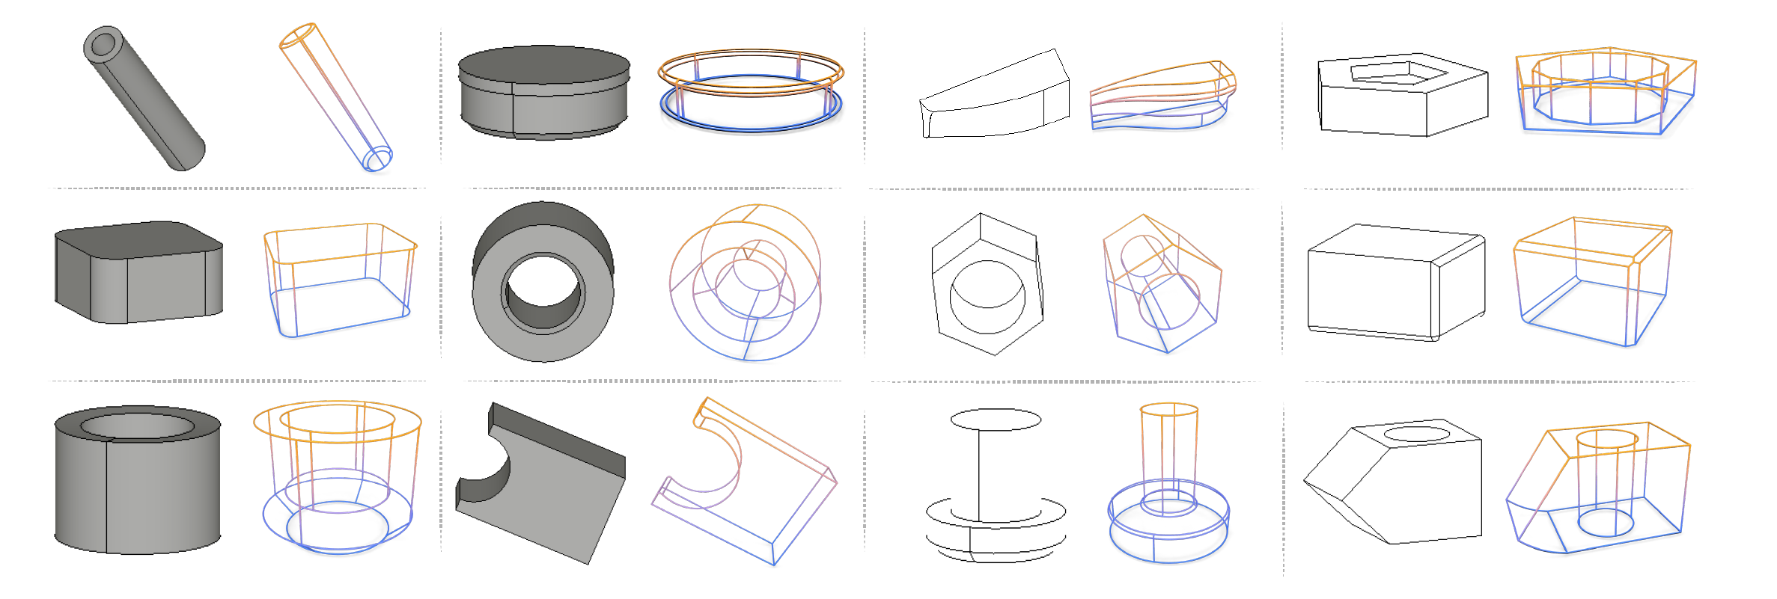
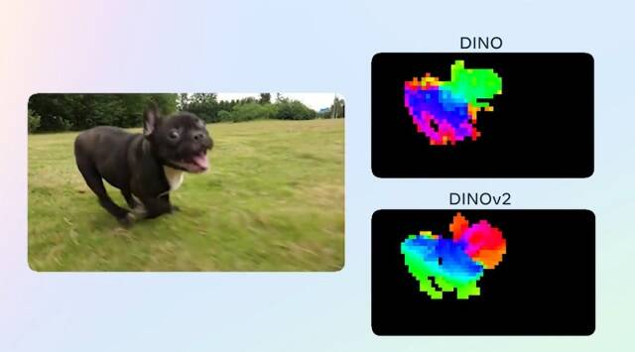
Image / Sketch condition
Single view image
Sketch

Slide 25
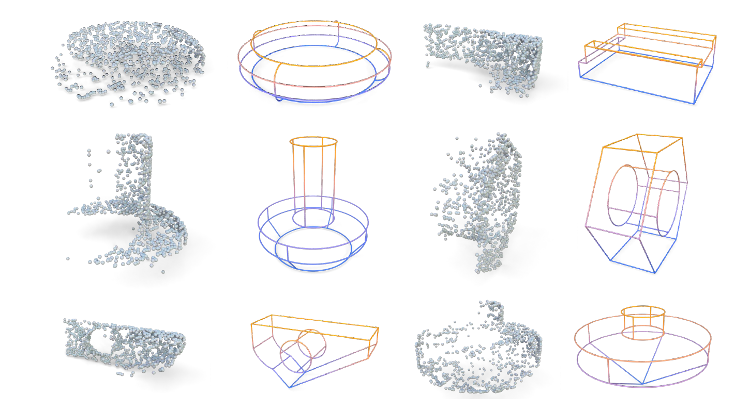
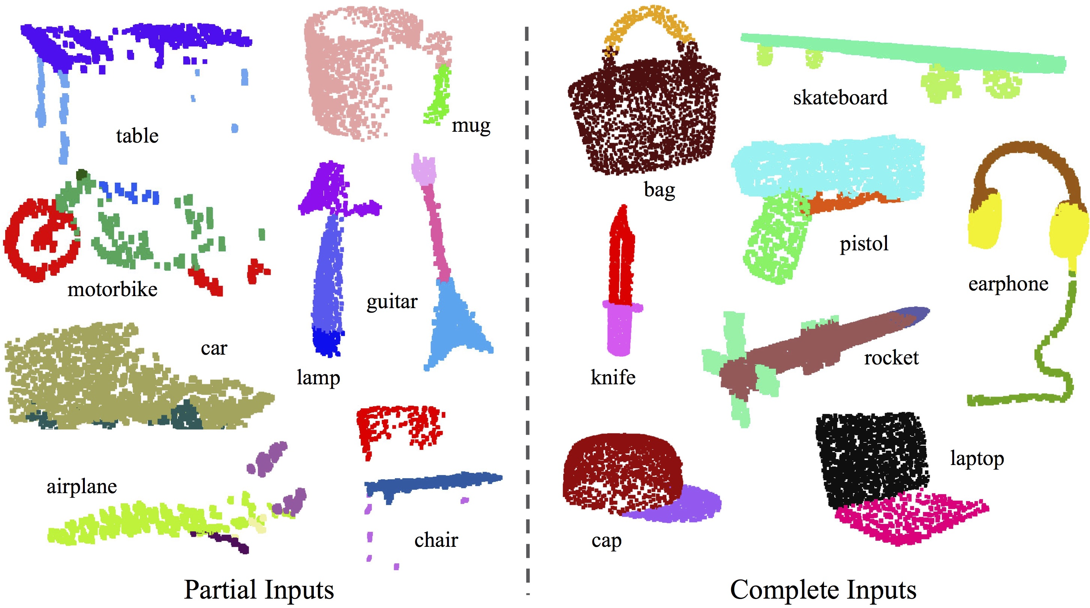
Point cloud condition
PointNet++

Slide 26
Experiments

Slide 27
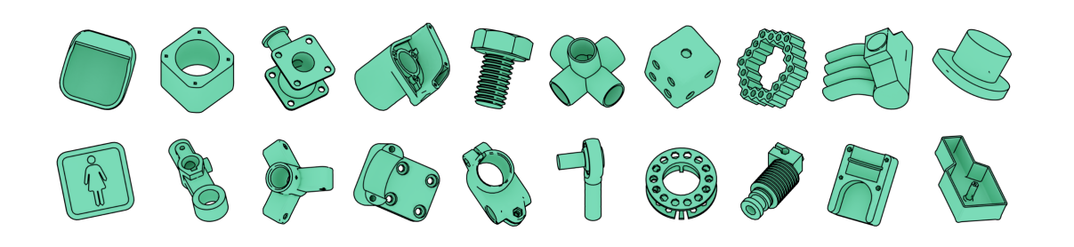
Implementation
Dataset: ABC dataset
8x RTX 4090
Training: VAE 4 days, Flow matching model 5 days

Slide 28
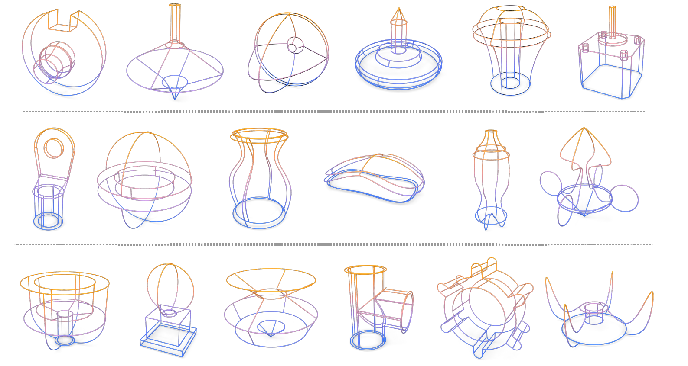
Unconditional Generation -1

Slide 29
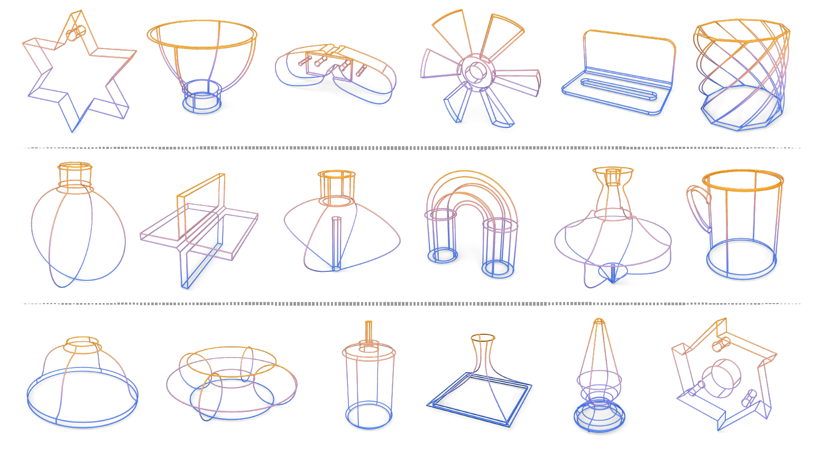
Unconditional Generation -2

Slide 30
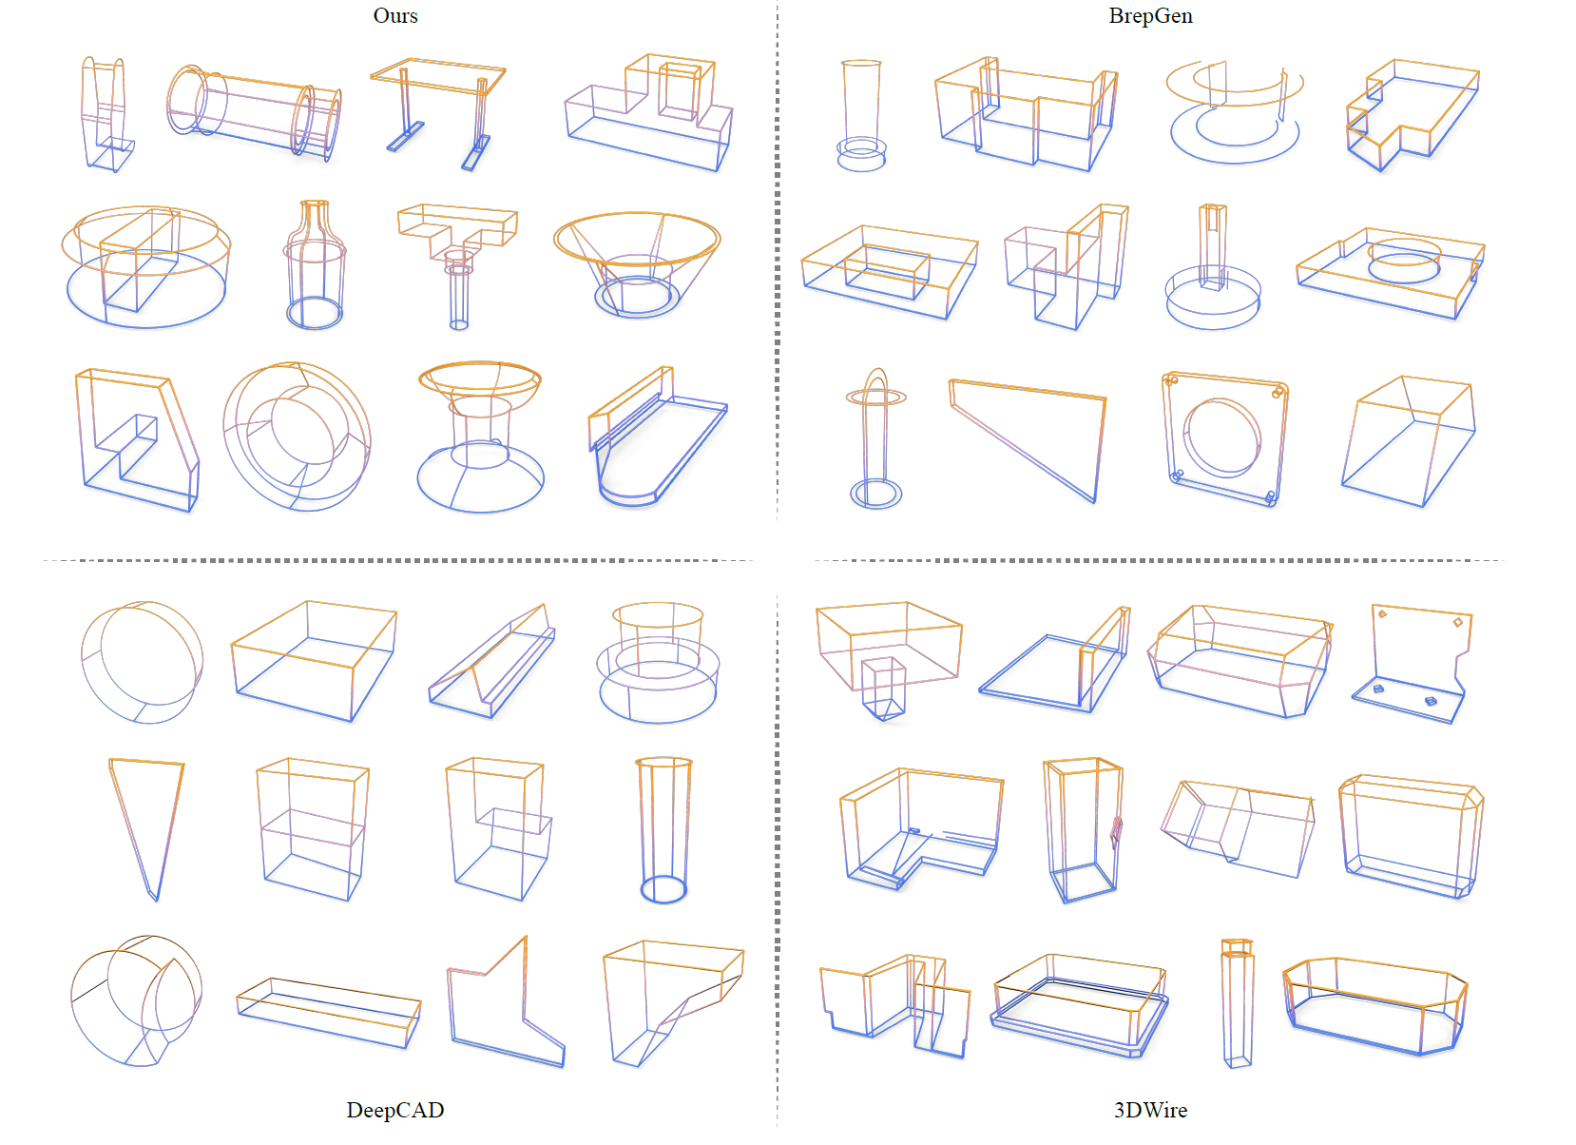
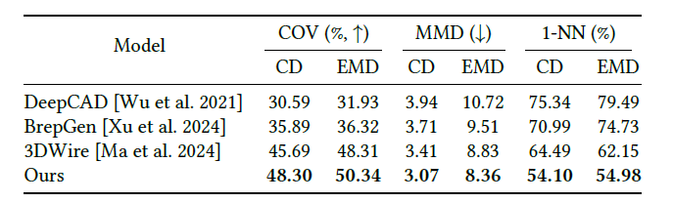
Comparison
COV: Diversity
MMD: Fidelity
1-NN: Distribution similarity
Notes:
3D straight line only, DeepCAD and BrepGen are simple
1) Coverage (COV) to assess the diversity of the generated samples;
2) Maximum Mean Discrepancy (MMD) to evaluate the fidelity of the results and
3) 1-Nearest Neighbor (1-NN) to quantify the similarity between the distributions ofW and ˆW .

Slide 31
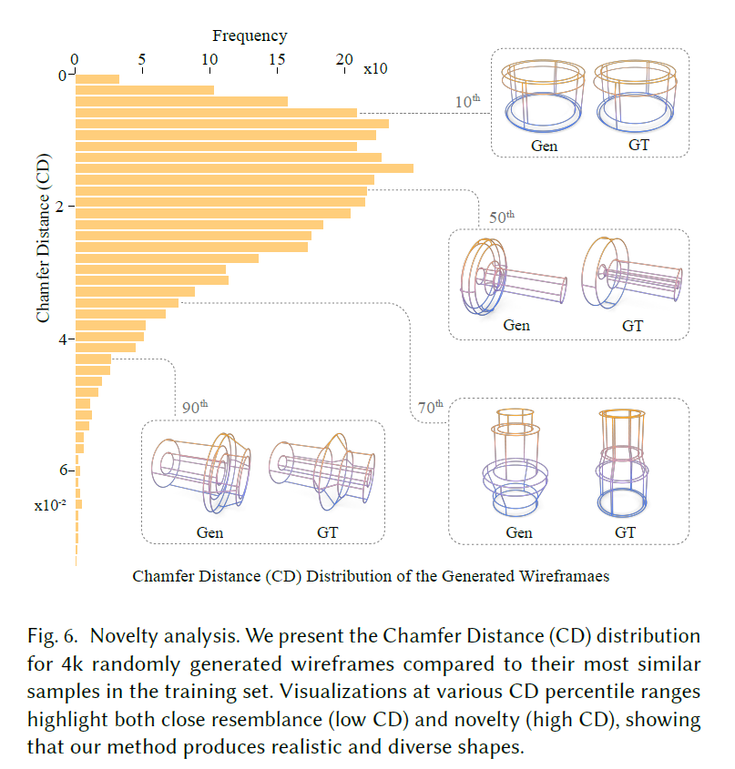
Novel Shapes
7.3% of them have new topological structures

Slide 32
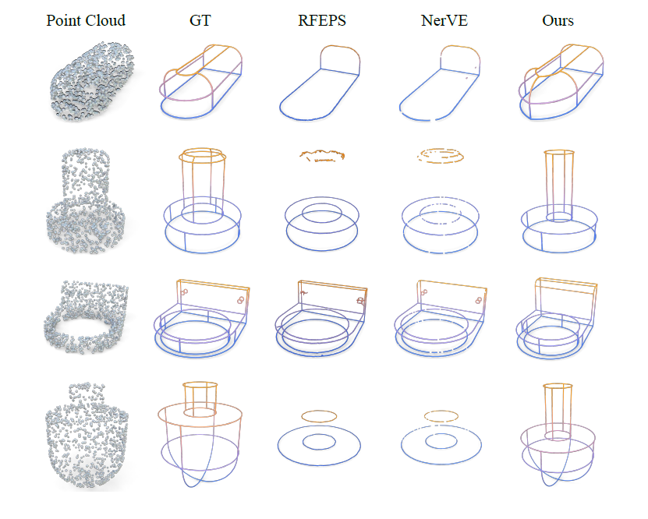
Conditional Generation Point cloud comparison
Notes:
Exist method relie on sharp edges

Slide 33
Conditional Generation – partial point cloud

Slide 34
Conditional Generation – image/sketch
Single view image
Sketch

Slide 35
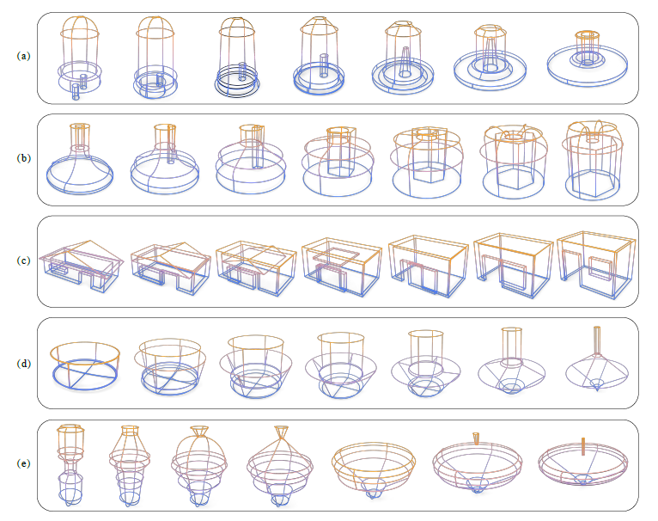
Wireframe Interpolation

Slide 36


