Slide 1
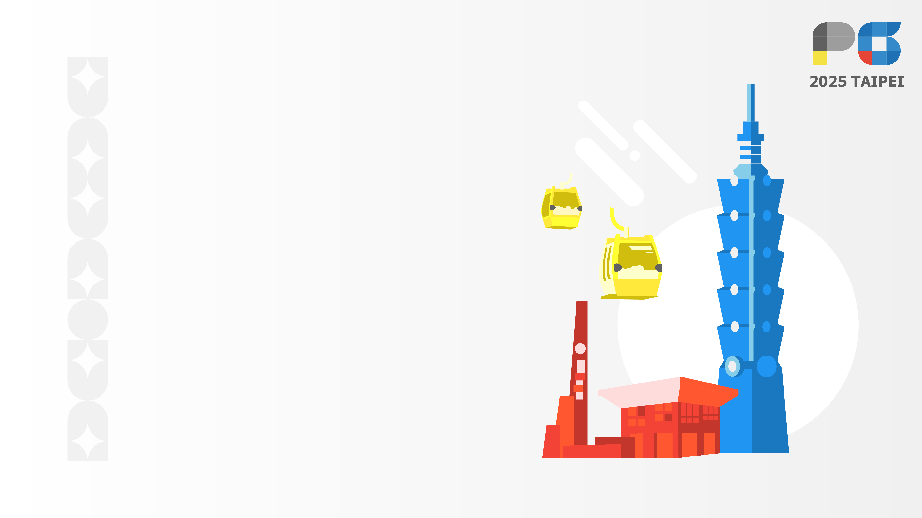
View-Independent Wire Art Modeling via Manifold Fitting
HuiGuang Huang, Dong-Yi Wu, Yulin Wang, Yu Cao, Tong-Yee Lee*
Notes:
Hello everyone, I am Huang Huiguang from National Cheng Kung University.
Our work is View-Independent Wire Art Modeling via Manifold Fitting

Slide 2

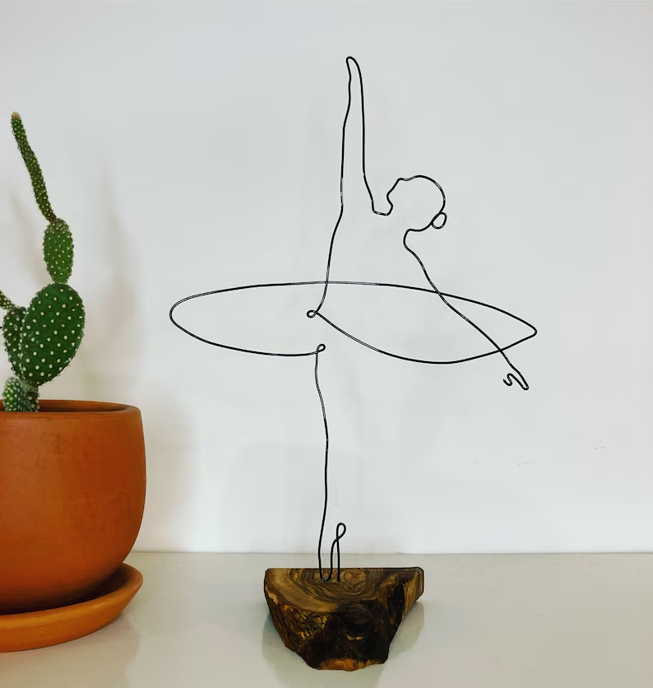
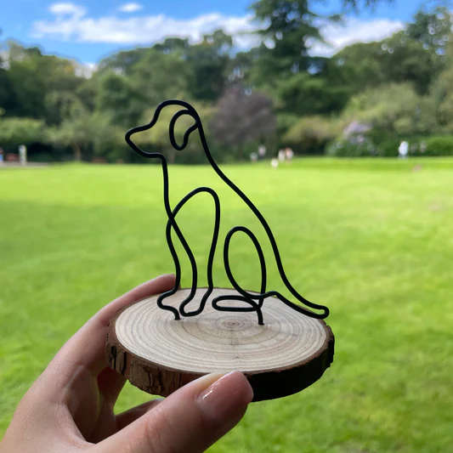
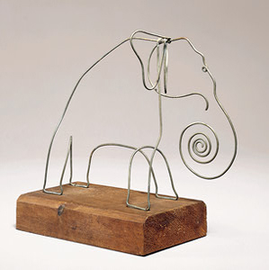
Examples of wire art
Notes:
Let me begin with a brief introduction to wire art. / Here are some wire art pictures/examples
wire art is about turning 3D objects into lines. Artists usually use metal wires to build these shapes in real life. It’s abstract, simplified, but still very expressive.
It captures the essence of the object, while keeping a strong sense of 3D shape.

Slide 3
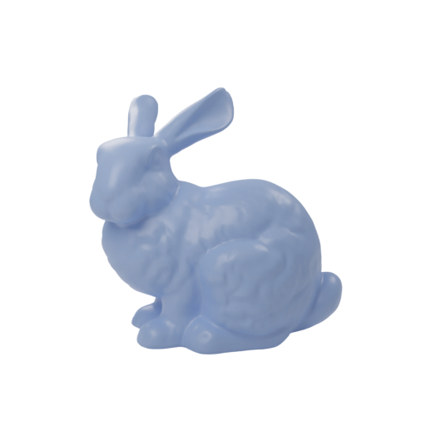
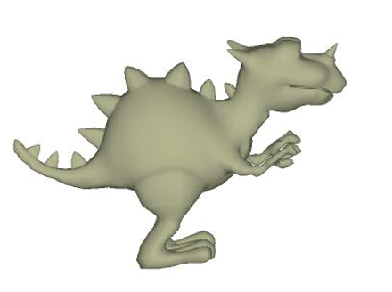
Previous works
Input
2D images
3D mesh
Notes:
let’s take a look at the previous works in this field.
Most of the existing wire art research can be grouped into two categories: works that start from 2D images and works that start from 3D models.

Slide 4
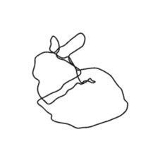
The first category
Reconstruction method
2D images
Result
Notes:
The first category takes 2D images as input. The basic idea here is to reconstruct 3D wire art by combining information from multiple images.

Slide 5
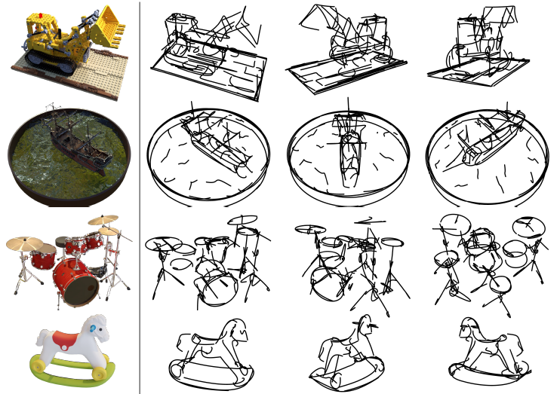
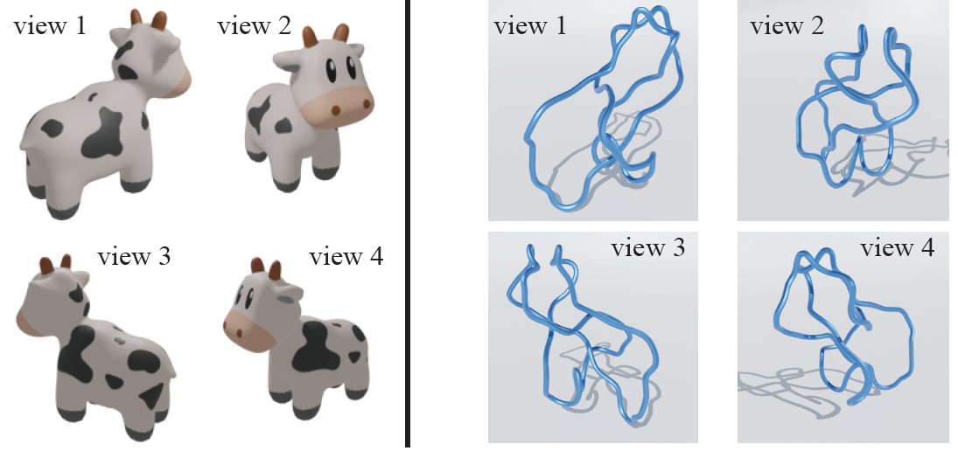
The first category
Fabricable 3D Wire Art
3Doodle
Notes:
For example, Fab3D and 3Doodle，They take 2D images as input
They align different views of an object and try to recover thin structures, or use vision-language models like CLIP to guide how the wires should be arranged.

Slide 6
The first category
Advantages:
Work without a 3D model
Disadvantages:
Sensitive to image quality and camera alignment
Slow optimization with CLIP
Non-manufacturable wires
Notes:
The advantage of these approaches is that they can work even when no 3D model is available.
But the drawback is, the results usually depend on image quantity and camera alignment, and the iteration speed is very slow when you use Clip model.
And some methods result in complex lines that cannot be manufactured

Slide 7
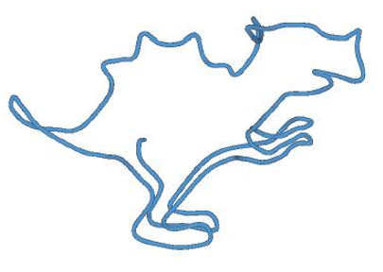
The second category
Mesh-to-Wire Abstraction
3D mesh
Result
Notes:
And the second category is work that takes 3D as input

Slide 8
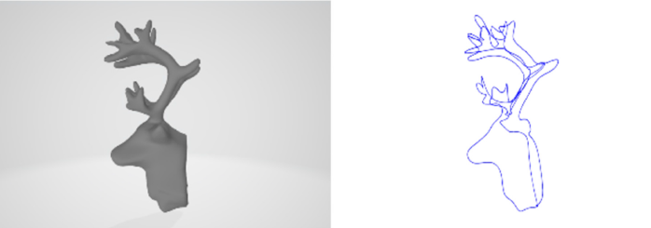
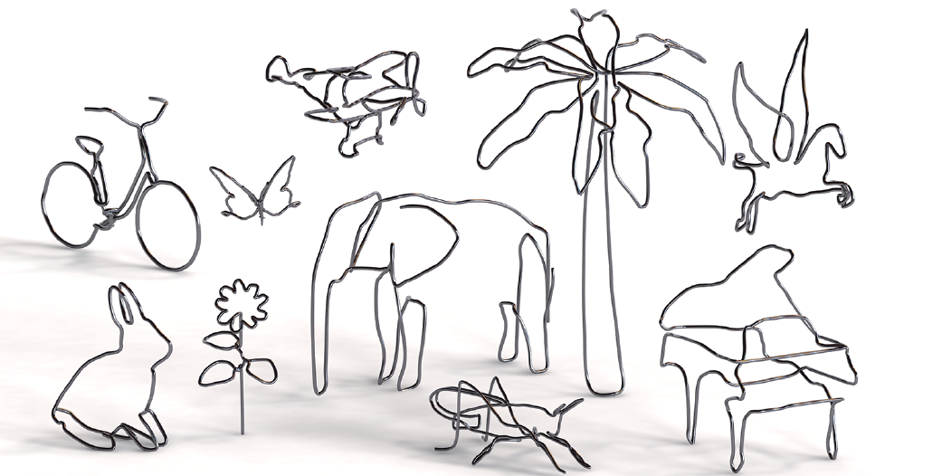
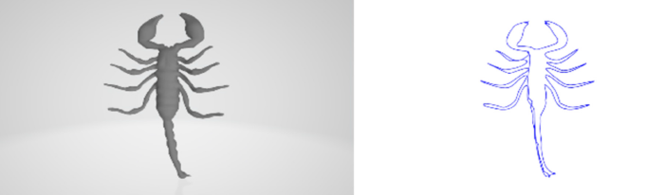
Previous works
Generating Virtual Wire Sculptural Art from 3D Models
WireRoom
Notes:
Some early works extract feature lines from the mesh.
Or simplify the mesh to get the wire art.

Slide 9
Previous works
Advantage:
Accuracy is high.
The lines are very simple
Disadvantages:
Poor multi-view consistency.
Needs user interaction.
Notes:
The advantage here is accuracy — since the mesh already contains the full 3D geometry, these methods can generate wire art that stays very close to the original shape.
But the downside is that most of them do not perform well from multiple viewpoints. The wire art may look fine from one angle, but from other views it often becomes inconsistent or confusing. Another limitation is that many of these approaches still require user interaction or manual tuning, which makes them less automatic and less practical

Slide 10
Challenges
View independent
Simplicity
Accuracy
Automation
Notes:
This is the challenge of this work

Slide 11
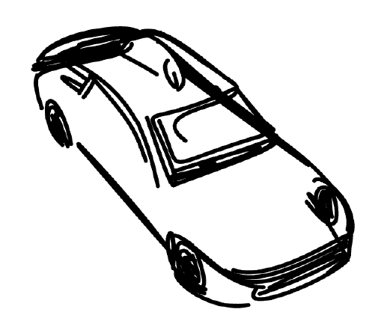
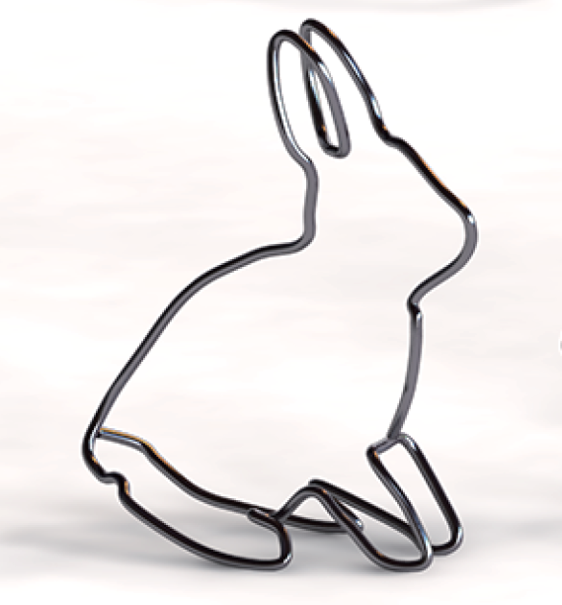
Previous works
Wireroom
Ours
3Doodle
Simple but view-dependent
View-independent but complex
Notes:
We want a method that strikes a balance: It should be simple and abstract — but still look consistent from different views.
The left one is wireroom’s result, xxxxxx ， you can hardly recognize that this is a rabbit from the front.
And the right one is 3Doodle’s result, xxxxxx
And the middle one is our result, simple and view-independet

Slide 12
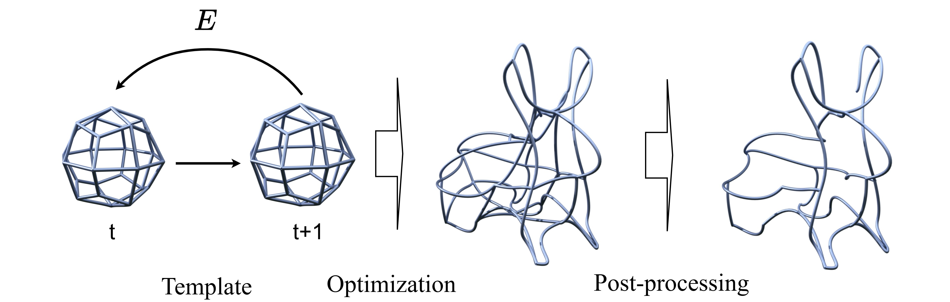
Our methods
Notes:
Now let me give you a simple overview of our pipeline.
Our work mainly consists of three parts: the template, the optimization, and the post-processing.
we start with a predefined wire template, represented by Coons patches.
Then we fit this template to the input point cloud by minimizing the energy functions.
Finally, we remove unnecessary wires, keeping only the ones that truly contribute to the shape. Then we can get the final result

Slide 13
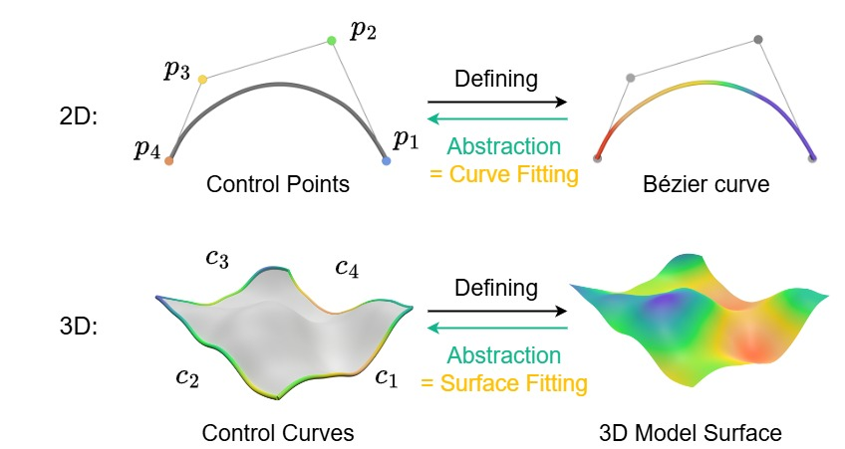
Template and Coons patch
4 control points -> Bezier curve
4 Bezier curves -> Coons patch
N coons patches -> Point cloud
Notes:
First of all, Let me talk about/describe the template we use
We started with a simple observation. Four control points are enough to abstract a Bézier curve. And if four curves can describe one surface patch, then a collection of such patches should be able to capture a full 3D shape.
Based on this inspiration, we choose the Coons patch as our template surface.
~~It gives us a way to represent the geometry, which we can then optimize to fit the point cloud.~~

Slide 14
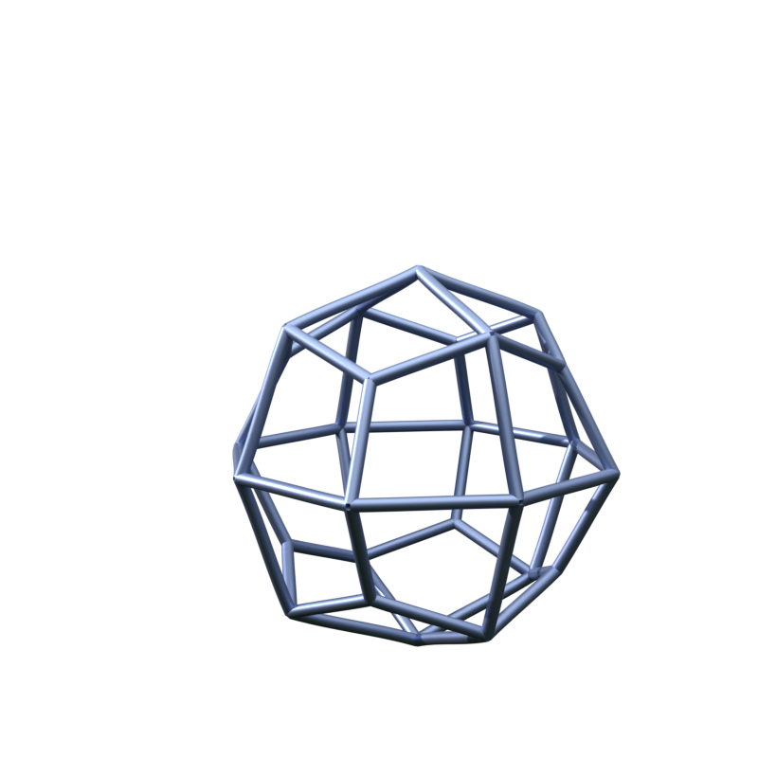
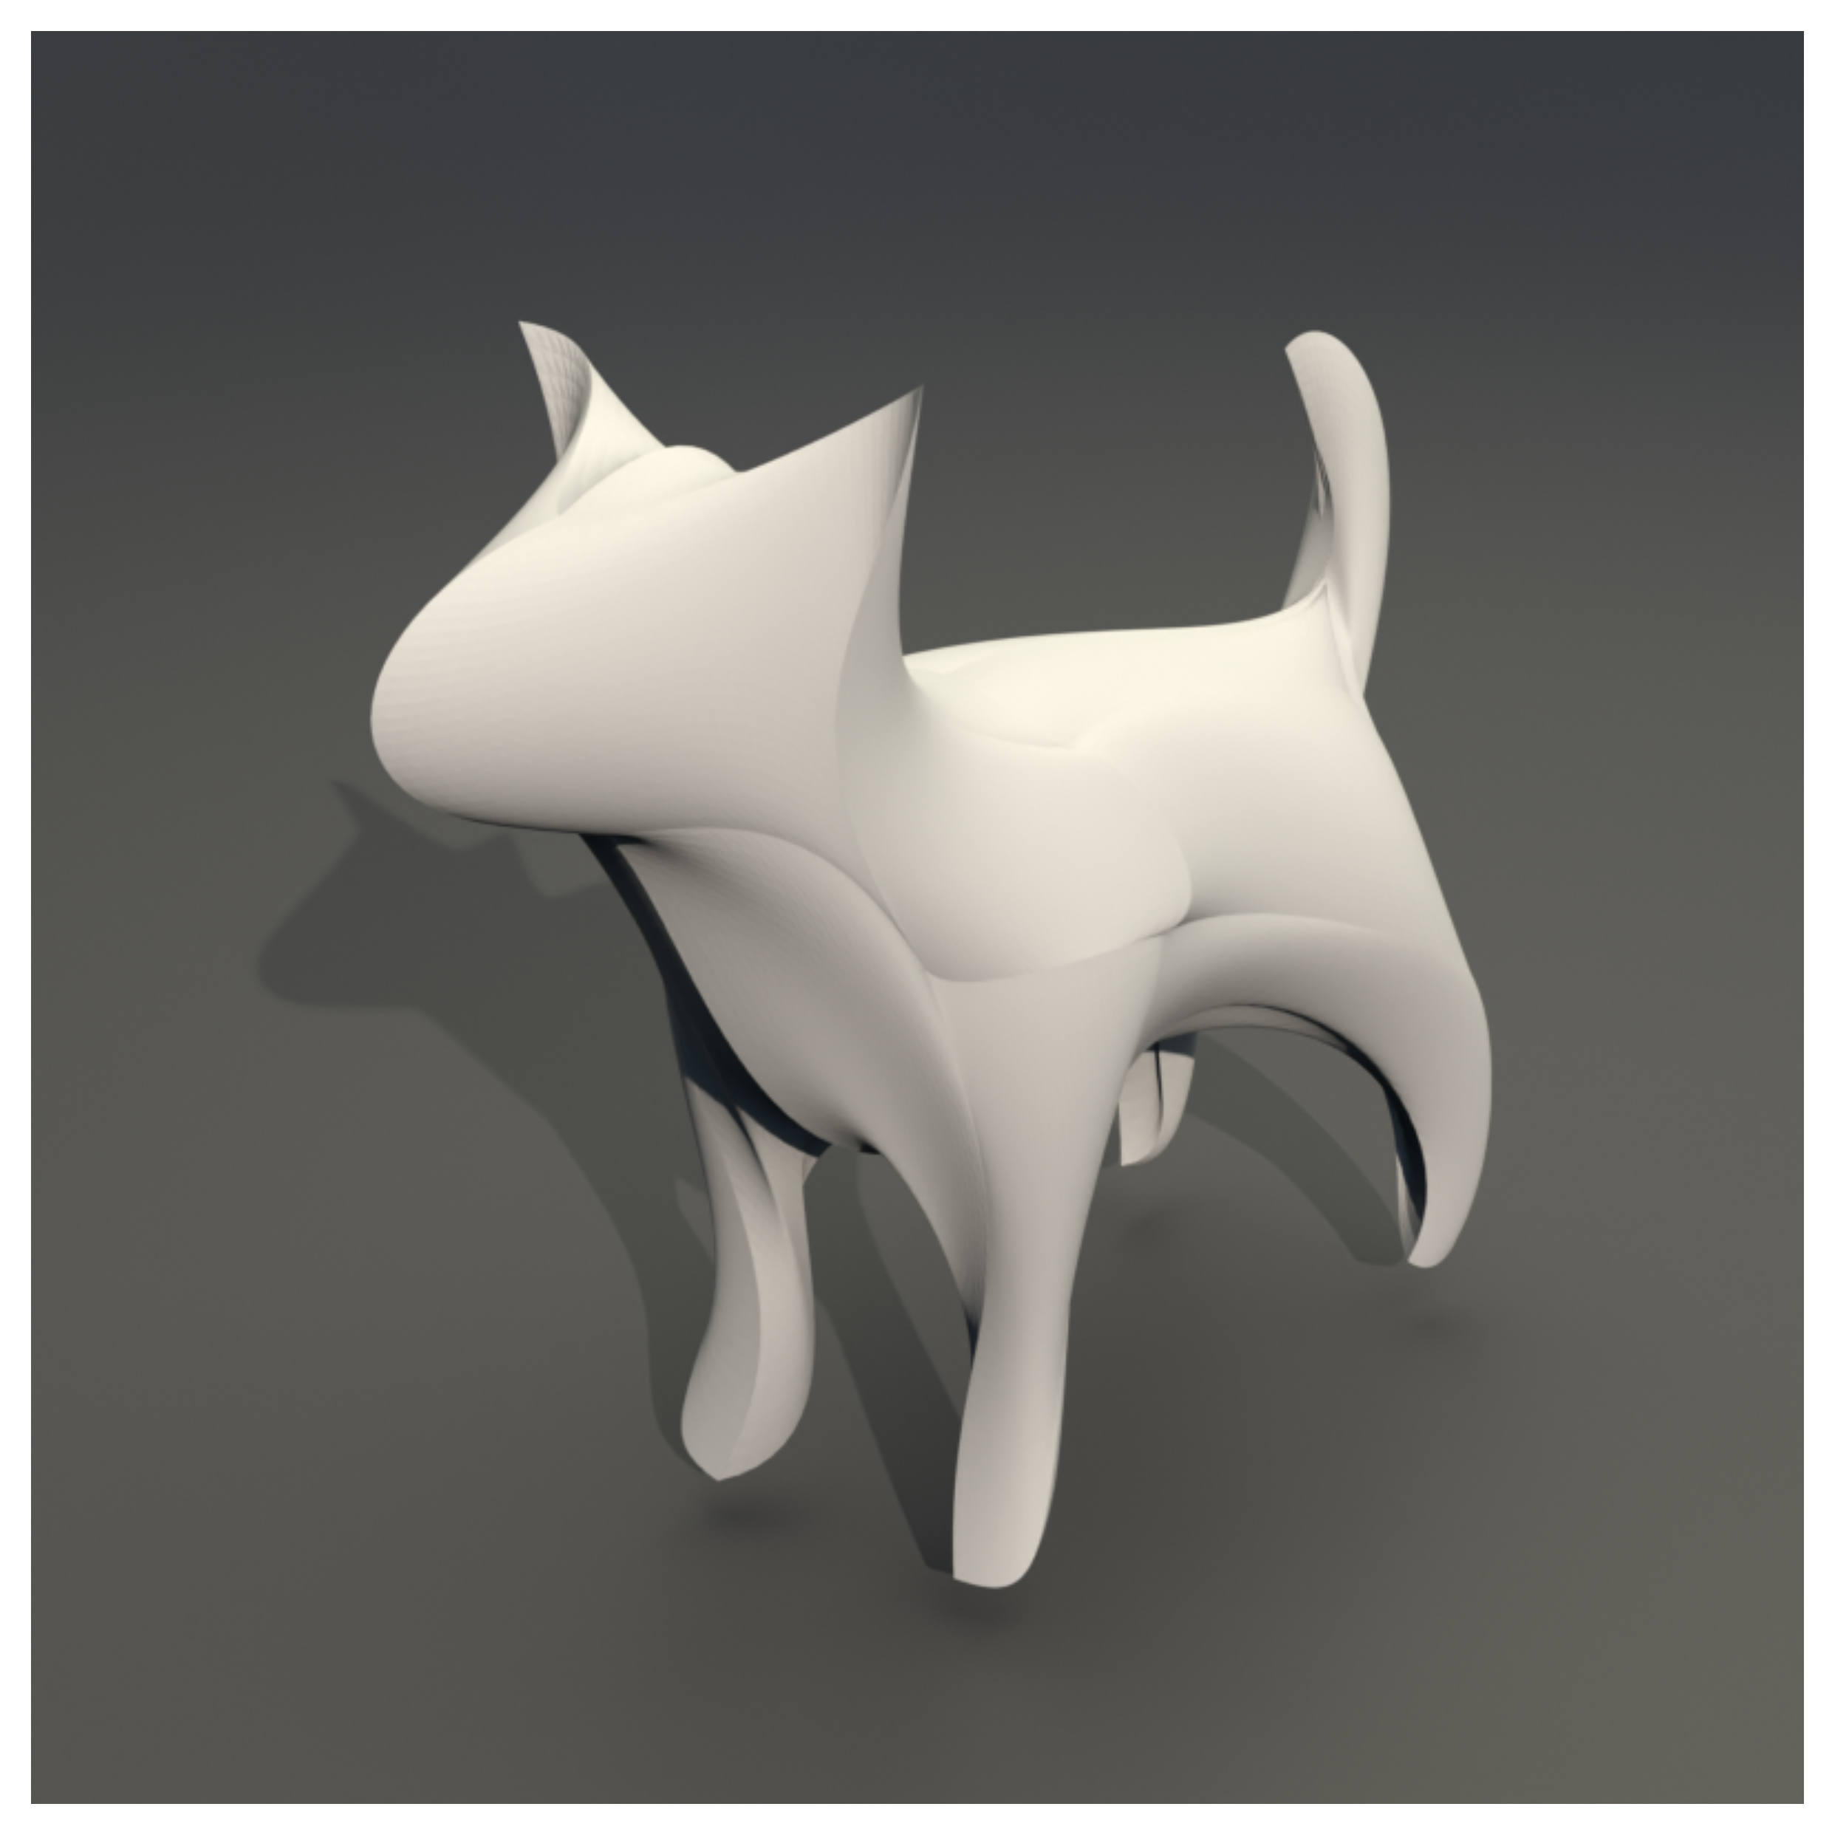
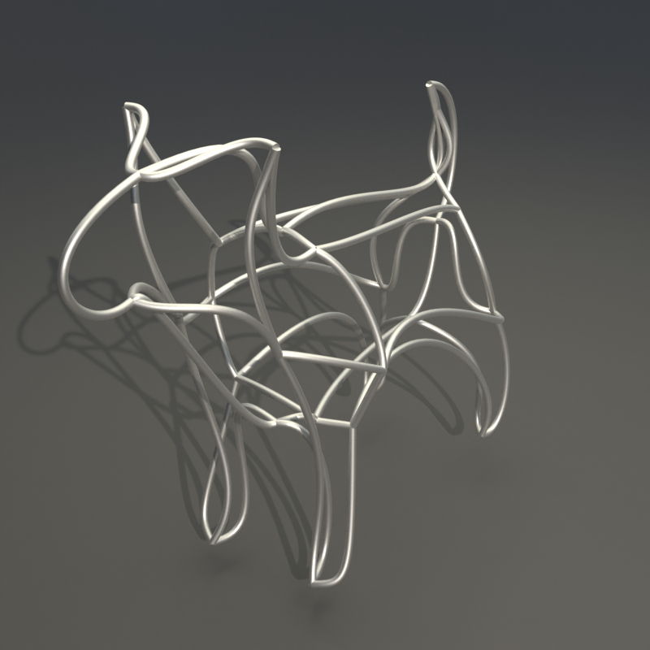
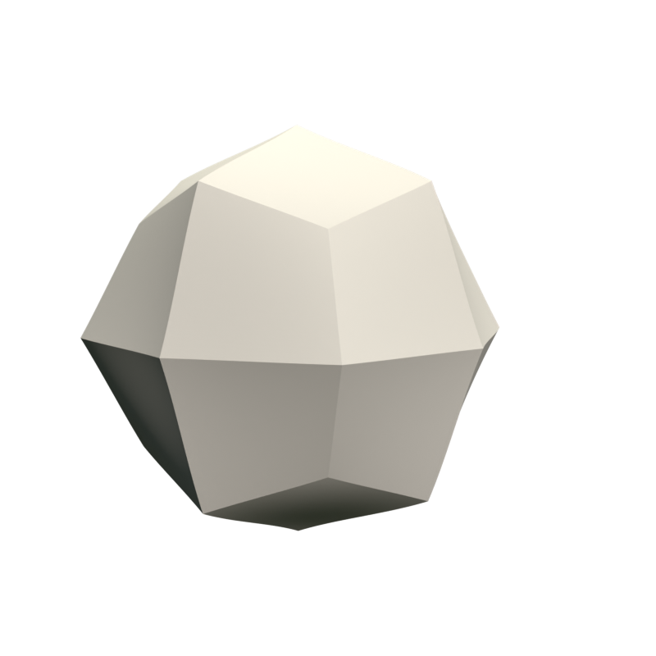
Template and Coons patch
Notes:
这个template需要换成能够看到面的，最右邊的圖應該換成沒有post-processing的樣子
So, a template will eventually fit the point cloud and get our wire art

Slide 15

Coarse-to-Fine Optimization
$$E$$
Optimization
Notes:
Next, let’s see how we optimize the template.
In the experiment, we found that directly optimizing all parameters of the template at once is unstable.
It often gets stuck in local minima.

Slide 16



Coarse-to-Fine Optimization
$$E_{1}$$
$$E_{2}$$
$$E_{3}$$
Coarse Stage
Middle Stage
Fine Stage
Notes:
Therefore, we use Coarse-to-Fine Optimization.
We have 3 stages, In each stage, we use different energy functions. To ensure stable optimization and detail refinement
In the paper we have a table that lists what energy function each stage uses

Slide 17
Modality-specific weighting scheme
$$E_{1}$$
$$E_{2}$$
$$E_{3}$$
Coarse Stage
Middle Stage
Fine Stage
Visual weights
Feature weights
Feature weights
Notes:
Moreover, we propose a modality-specific weighting scheme to guide the coarse-to-fine optimization process
In simple terms, we assign different weights to different points depending on what kind of information we focus on.
We use visual weights for global alignment in the coarse stage,
and feature weights for detailed refinement in the later stages.
So how to find the points we focus on?

Slide 18
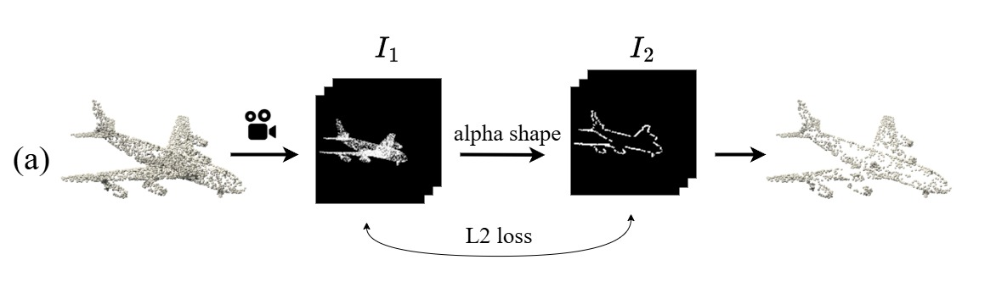
Visual weights
Notes:
For the visual weights, we calculate them using multi-view rendering.
We first render the input point cloud from several different viewpoints using a differentiable renderer.
Then, we extract the silhouettes from these rendered images,
and compute the L2 loss between the rendered result and the silhouettes.
The gradient of this difference gives us a saliency map, We then use these saliency values as visual weights during the coarse optimization stage

Slide 19
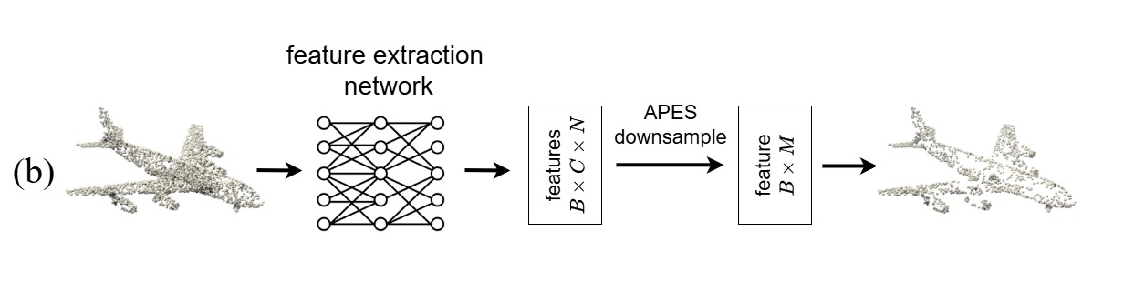
Feature weights
Notes:
And for feature weights,
We use a pretrained feature extraction network to extract geometric features from the point cloud.
Then, based on these features, we perform feature-based downsampling to generate the feature weights used in Middle Stage and fine stage

Slide 20
Energy functions
Total energy function:
$$E=E_{geo}+E_{visual}+E_{aesthetic}$$
geometric energy
Visual energy
Aesthetic energy
Notes:
Now let’s describe our energy functions
Our total energy is made up of three main parts — the geometric energy, the visual energy, and the aesthetic energy.

Slide 21
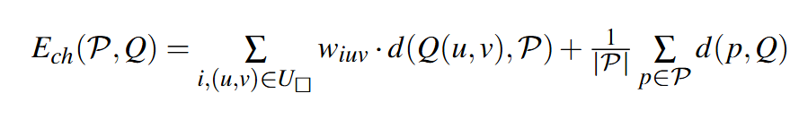
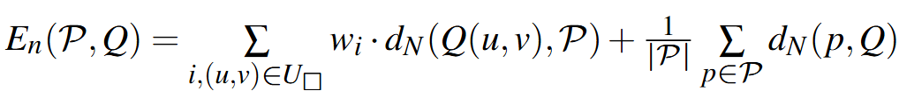
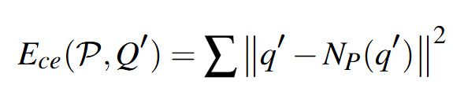

Geometric energy
$$E_{geo}=E_{ch}+E_{n}+E_{ce}$$
Notes:
It has three components
Chamfer Energy, Normal Alignment Energy and Concavity Enhancement Energy
Ch: encourages the surface to stay close to the input point cloud.
Normal Alignment Energy: aligns the surface normal
Concavity Enhancement Energy: helps the surface better fit hollow or concave regions

Slide 22
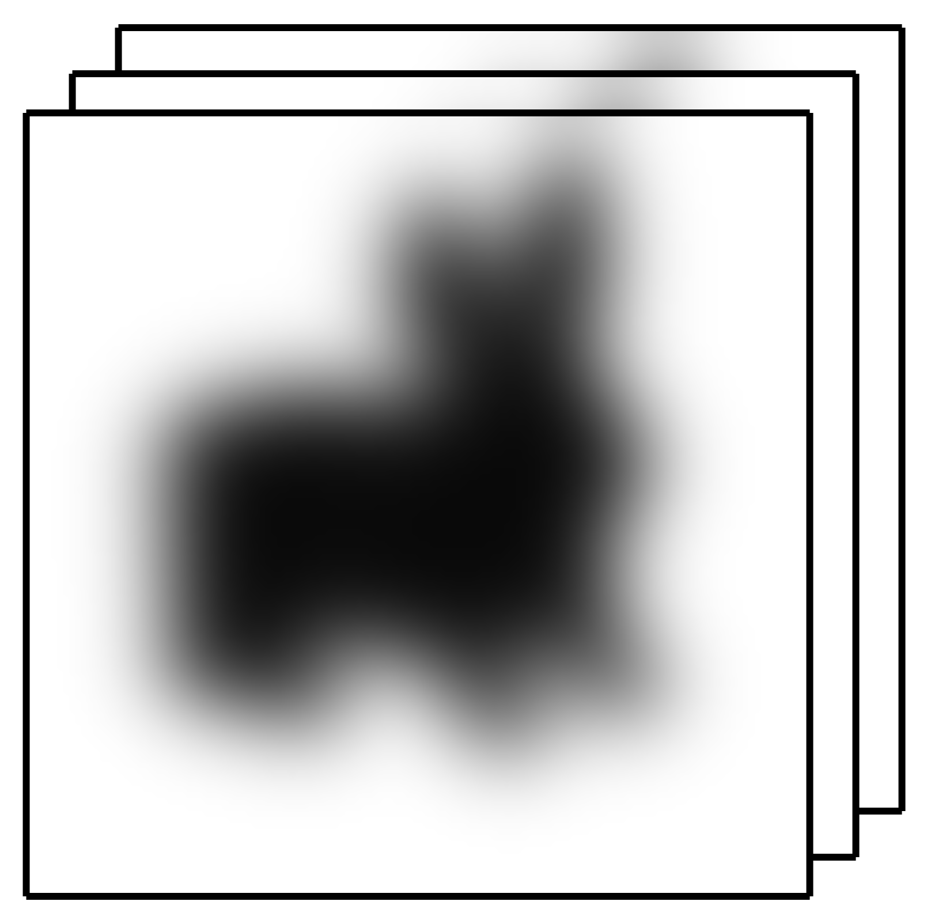
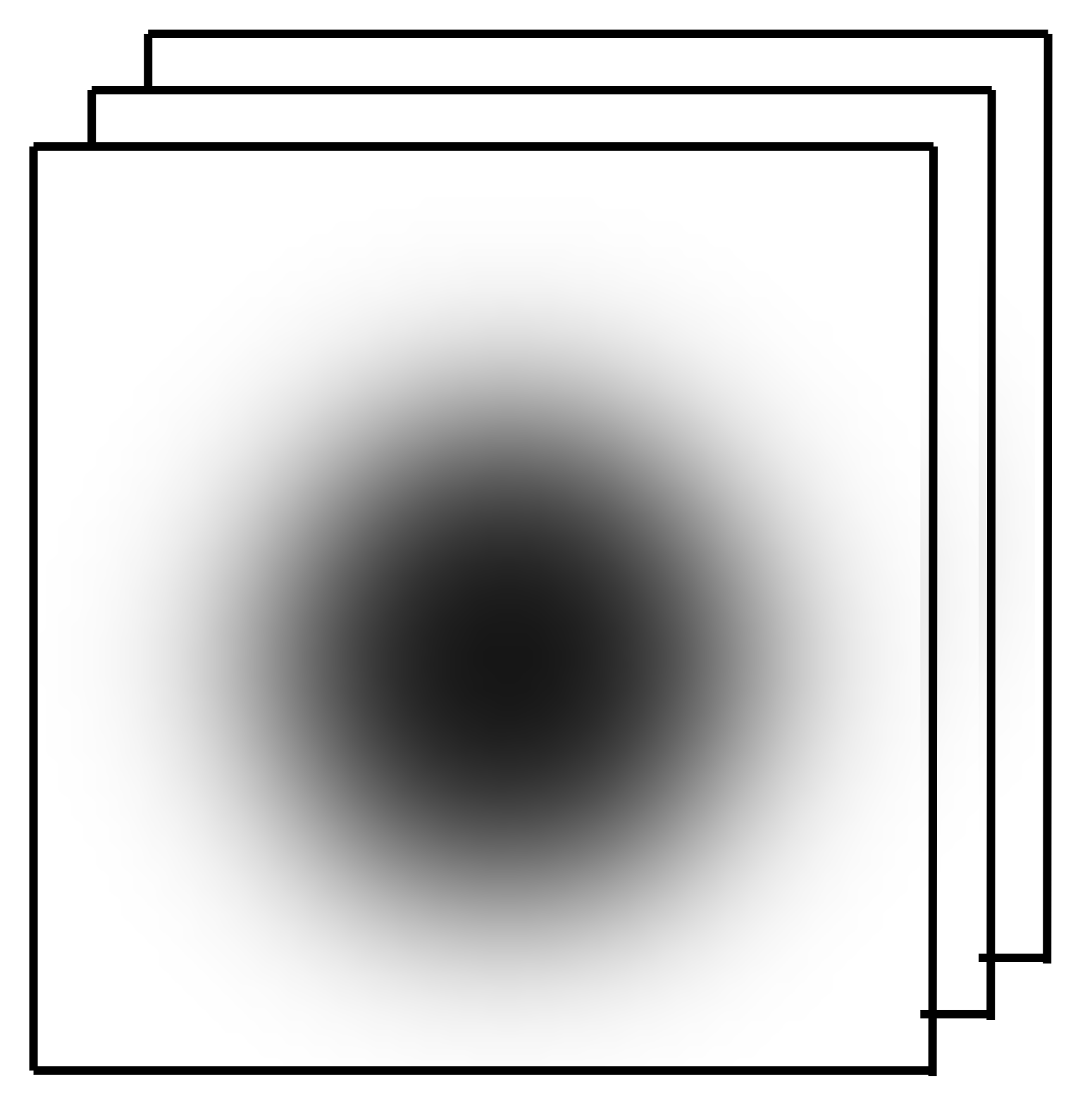

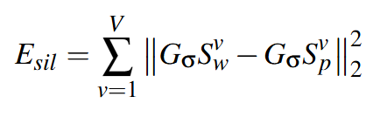
Visual energy
Target shape
Current shape
Notes:
We render the target point cloud and current template from several different views，and apply a Gaussian blur
then compare the silhouettes between our current result and the target shape.

Slide 23
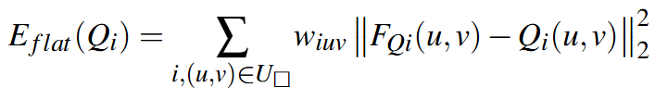
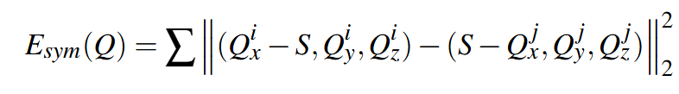
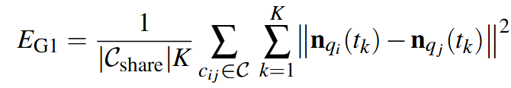

Aesthetic energy
$$E_{aesthetic}=E_{flat}+E_{sym}+E_{G1}$$
Notes:
Finally, we introduce the aesthetic energy,
It includes three parts:"
Flatness Energy: encourages the surface patches to stay flat
Symmetry Energy: enforces symmetry when the object has symmetric geometry
Smoothness Energy (G1 continuity): ensures the wires maintain G1 continuity,

Slide 24
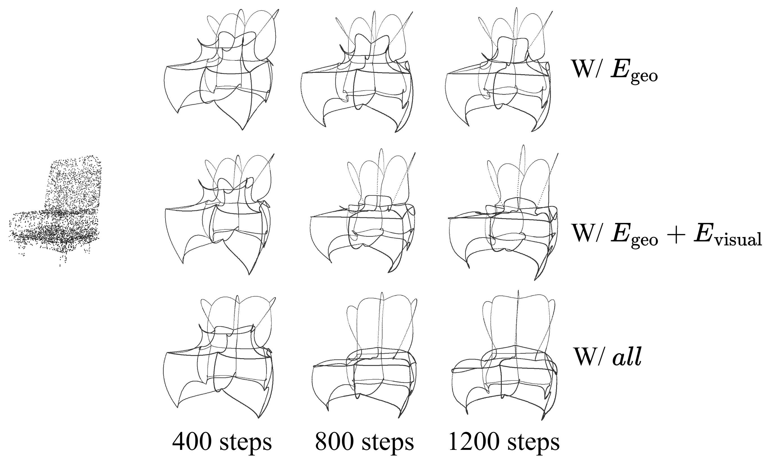
Ablation study
Notes:
Now let me show the ablation study
In the first row, we only use the geometric energy. the optimization converges slowly
In the second row, we add the visual energy. This makes the optimization much stable and faster,
Finally, in the third row, we use all three energies, Now the optimization not only converges quickly, but the wire shapes are also better aligned with the model’s geometry

Slide 25
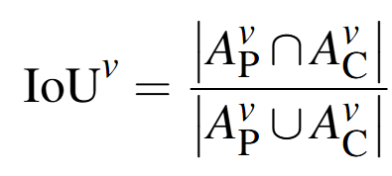
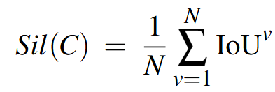
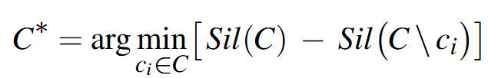
Post-processing
Notes:
after optimization, the wire set may still be a bit dense, so we remove the wires that do not contribute to the shape.
To do this, we render both the target point cloud and our wire result from multiple viewpoints,
and measure how much each wire contributes to the silhouette overlap.
Then, we iteratively delete the wires that have the smallest effect on the silhouette.

Slide 26
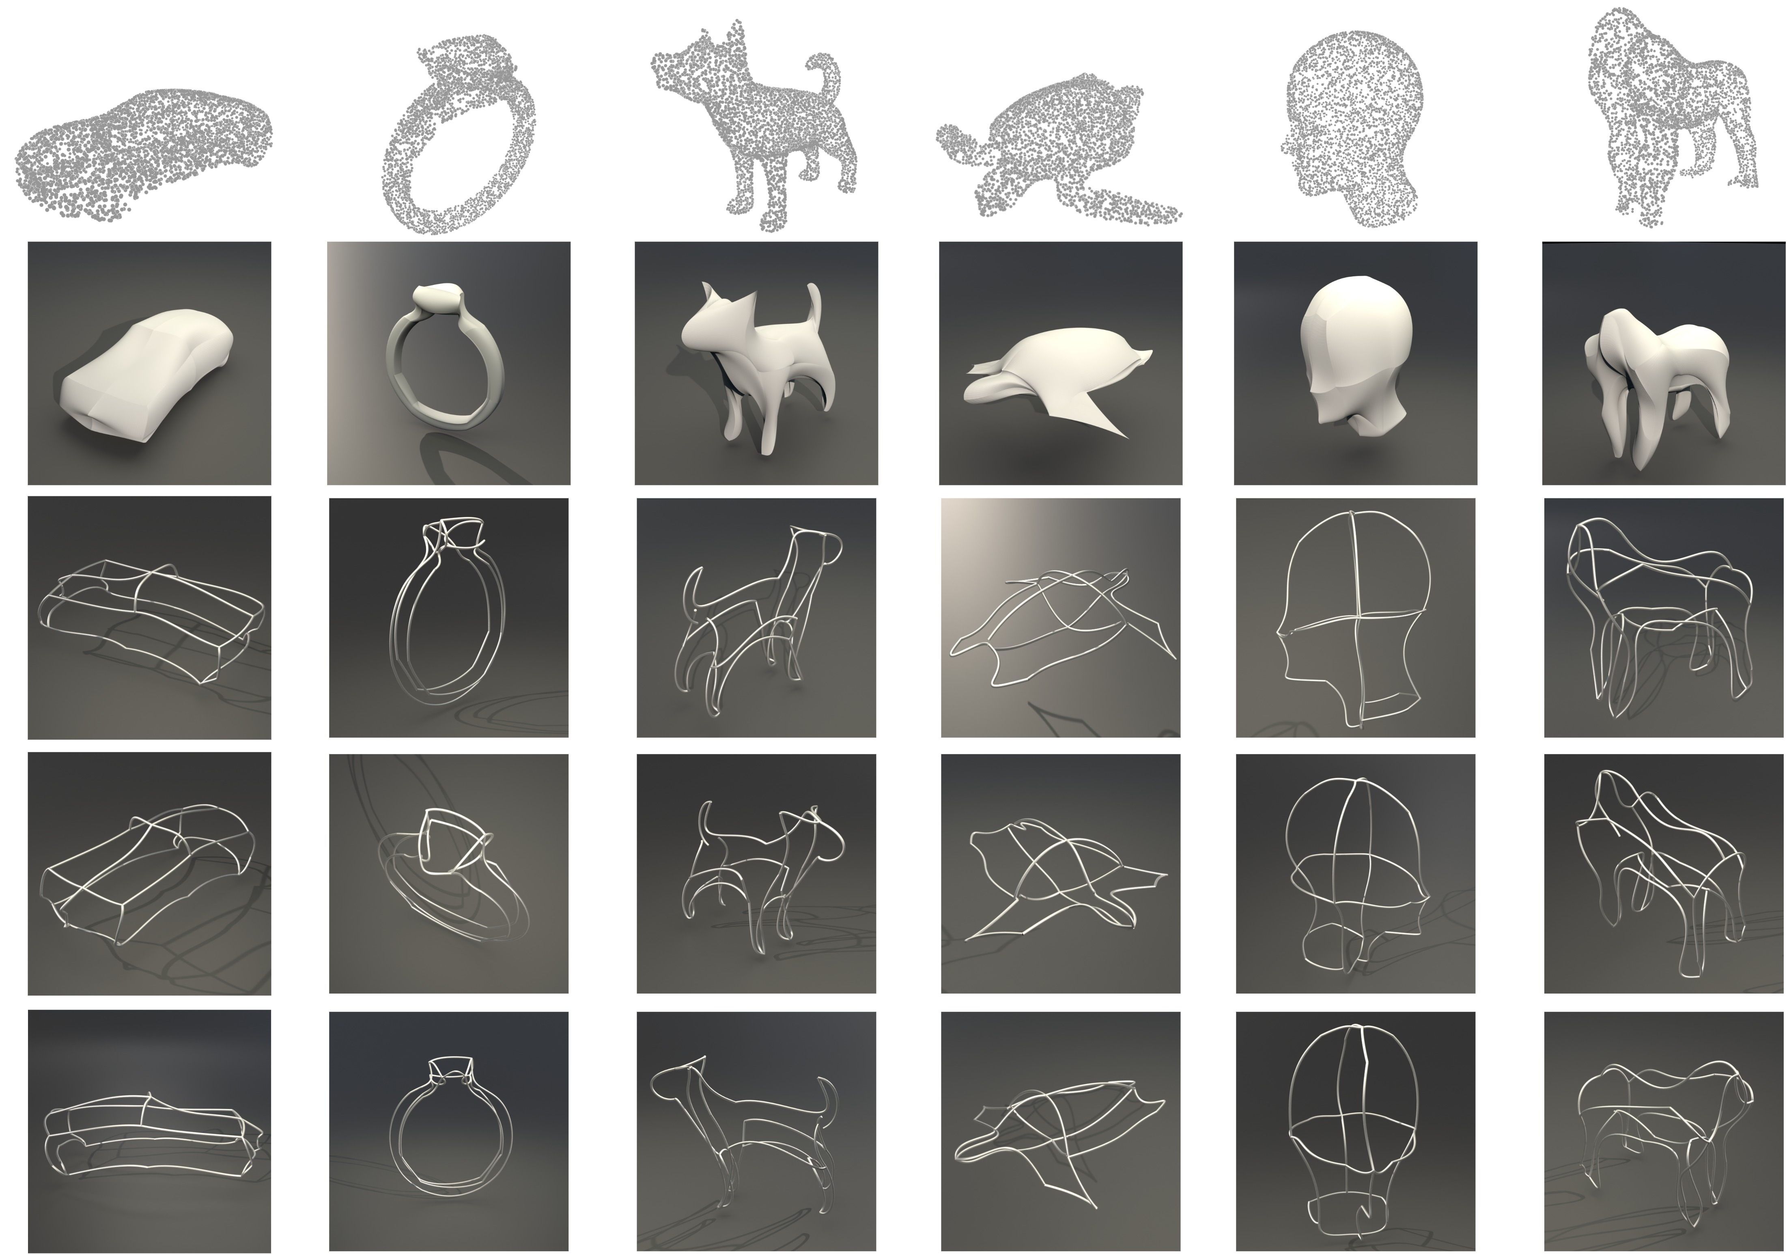
Results
Notes:
This is our results, the top row is our inputs, and the second row is the template surface.
and others are wire art from different view

Slide 27
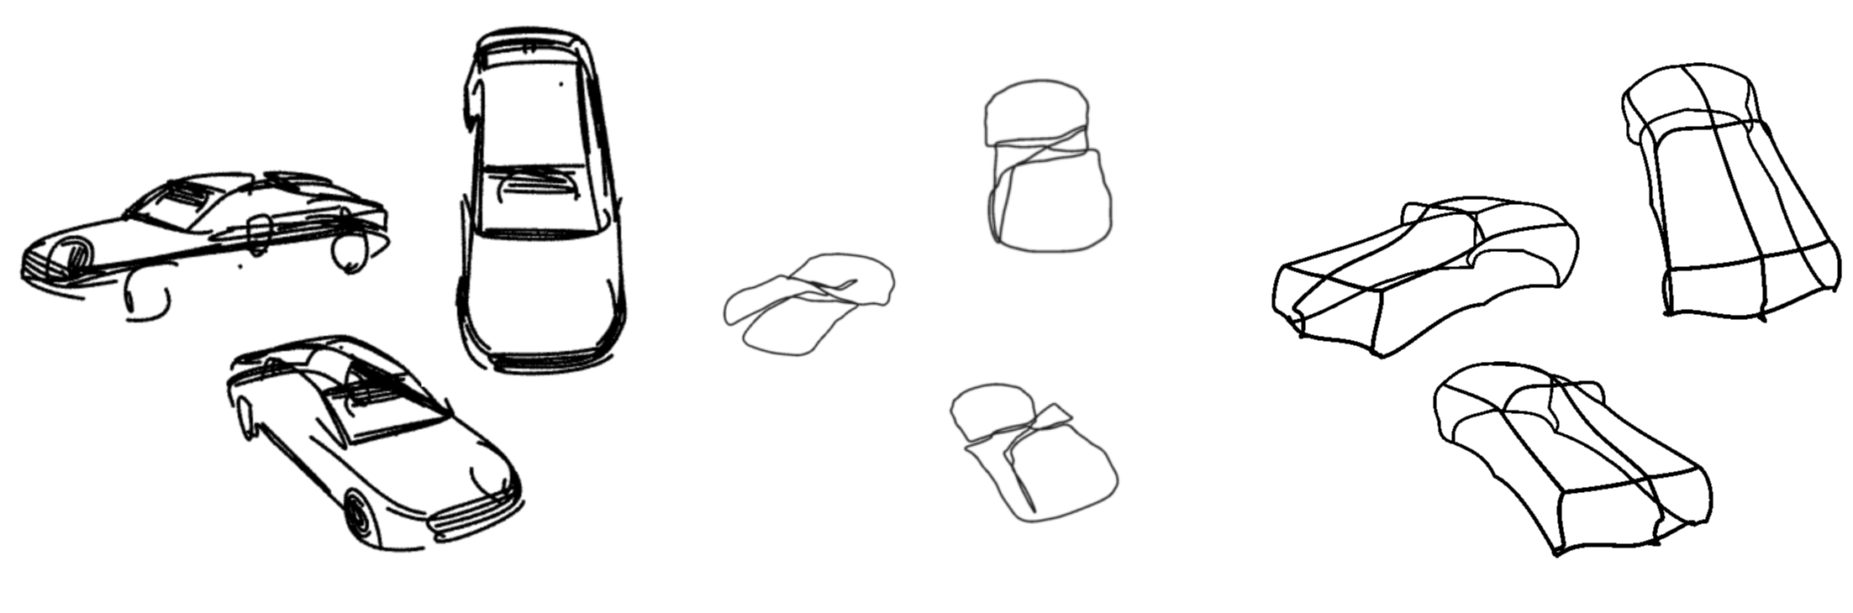
3Doodle
Fabricable 3D Wire Art
Ours
Notes:
Here we show the results of wire art in different styles.
As you can see, our method achieves a good balance between simplicity and visual consistency."

Slide 28
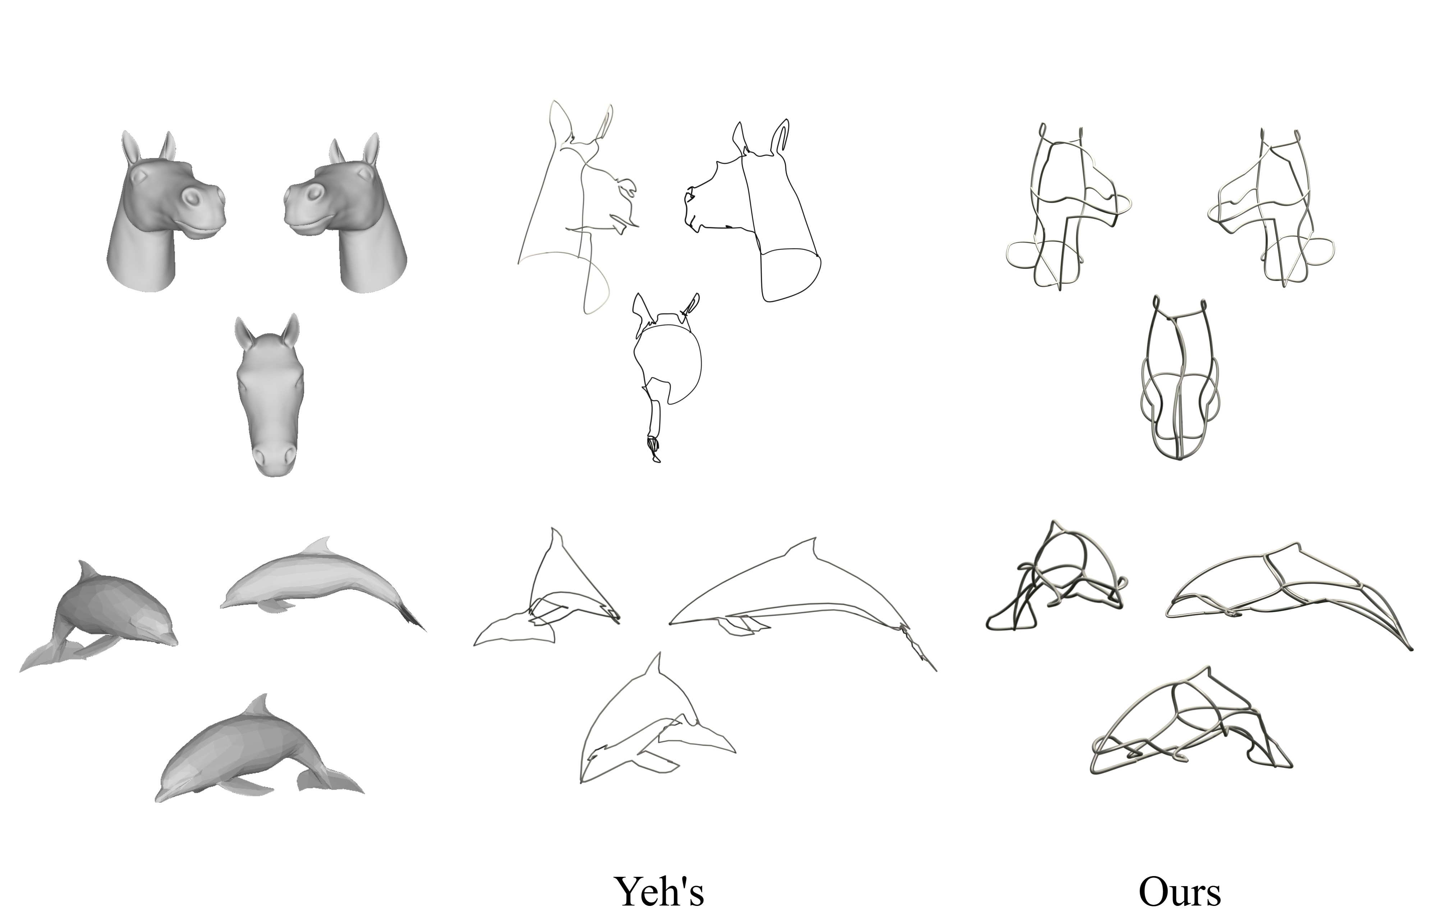
Comparisons
Notes:
And this is the comparison with our previous works.
Yeh’s method generates wire art by simplifying the 3D mesh. It produces very detailed wires
But from some angles, his visual quality is not goog.

Slide 29
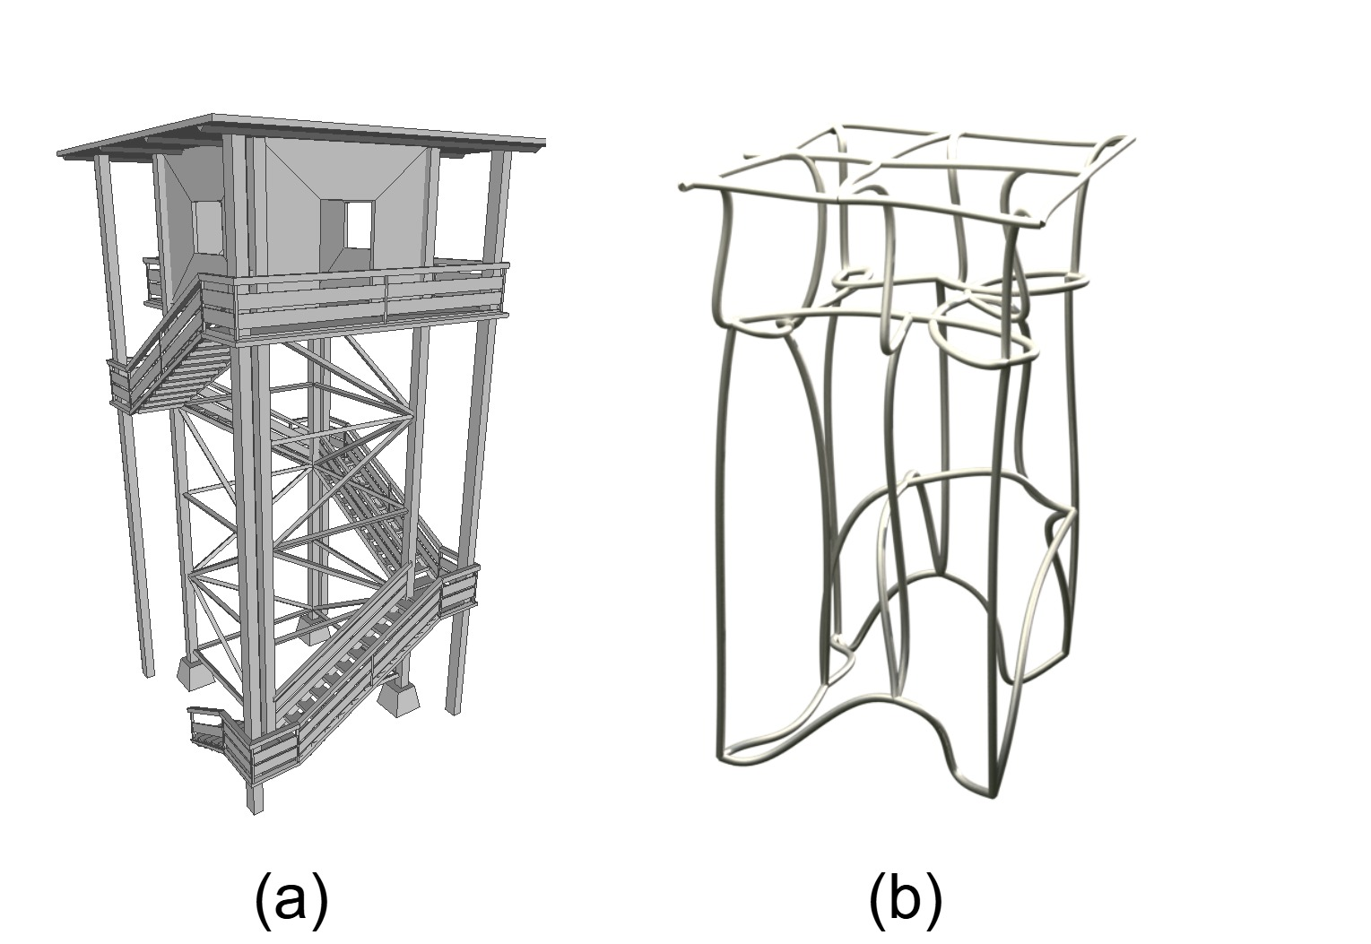
Limitations
Notes:
Finally, let’s talk about the limitations of our method
As you can see, when the input model has a complex internal structure, our method cannot reproduce those inner details

Slide 30
Thanks for your listening

