Slide 1
Image-Space Collage and Packing with Differentiable Rendering
ZHENYU WANG, MIN LU, SIGGRAPH 2025
Notes:
Image-Space Collage
SIGGRAPH 2025

Slide 2
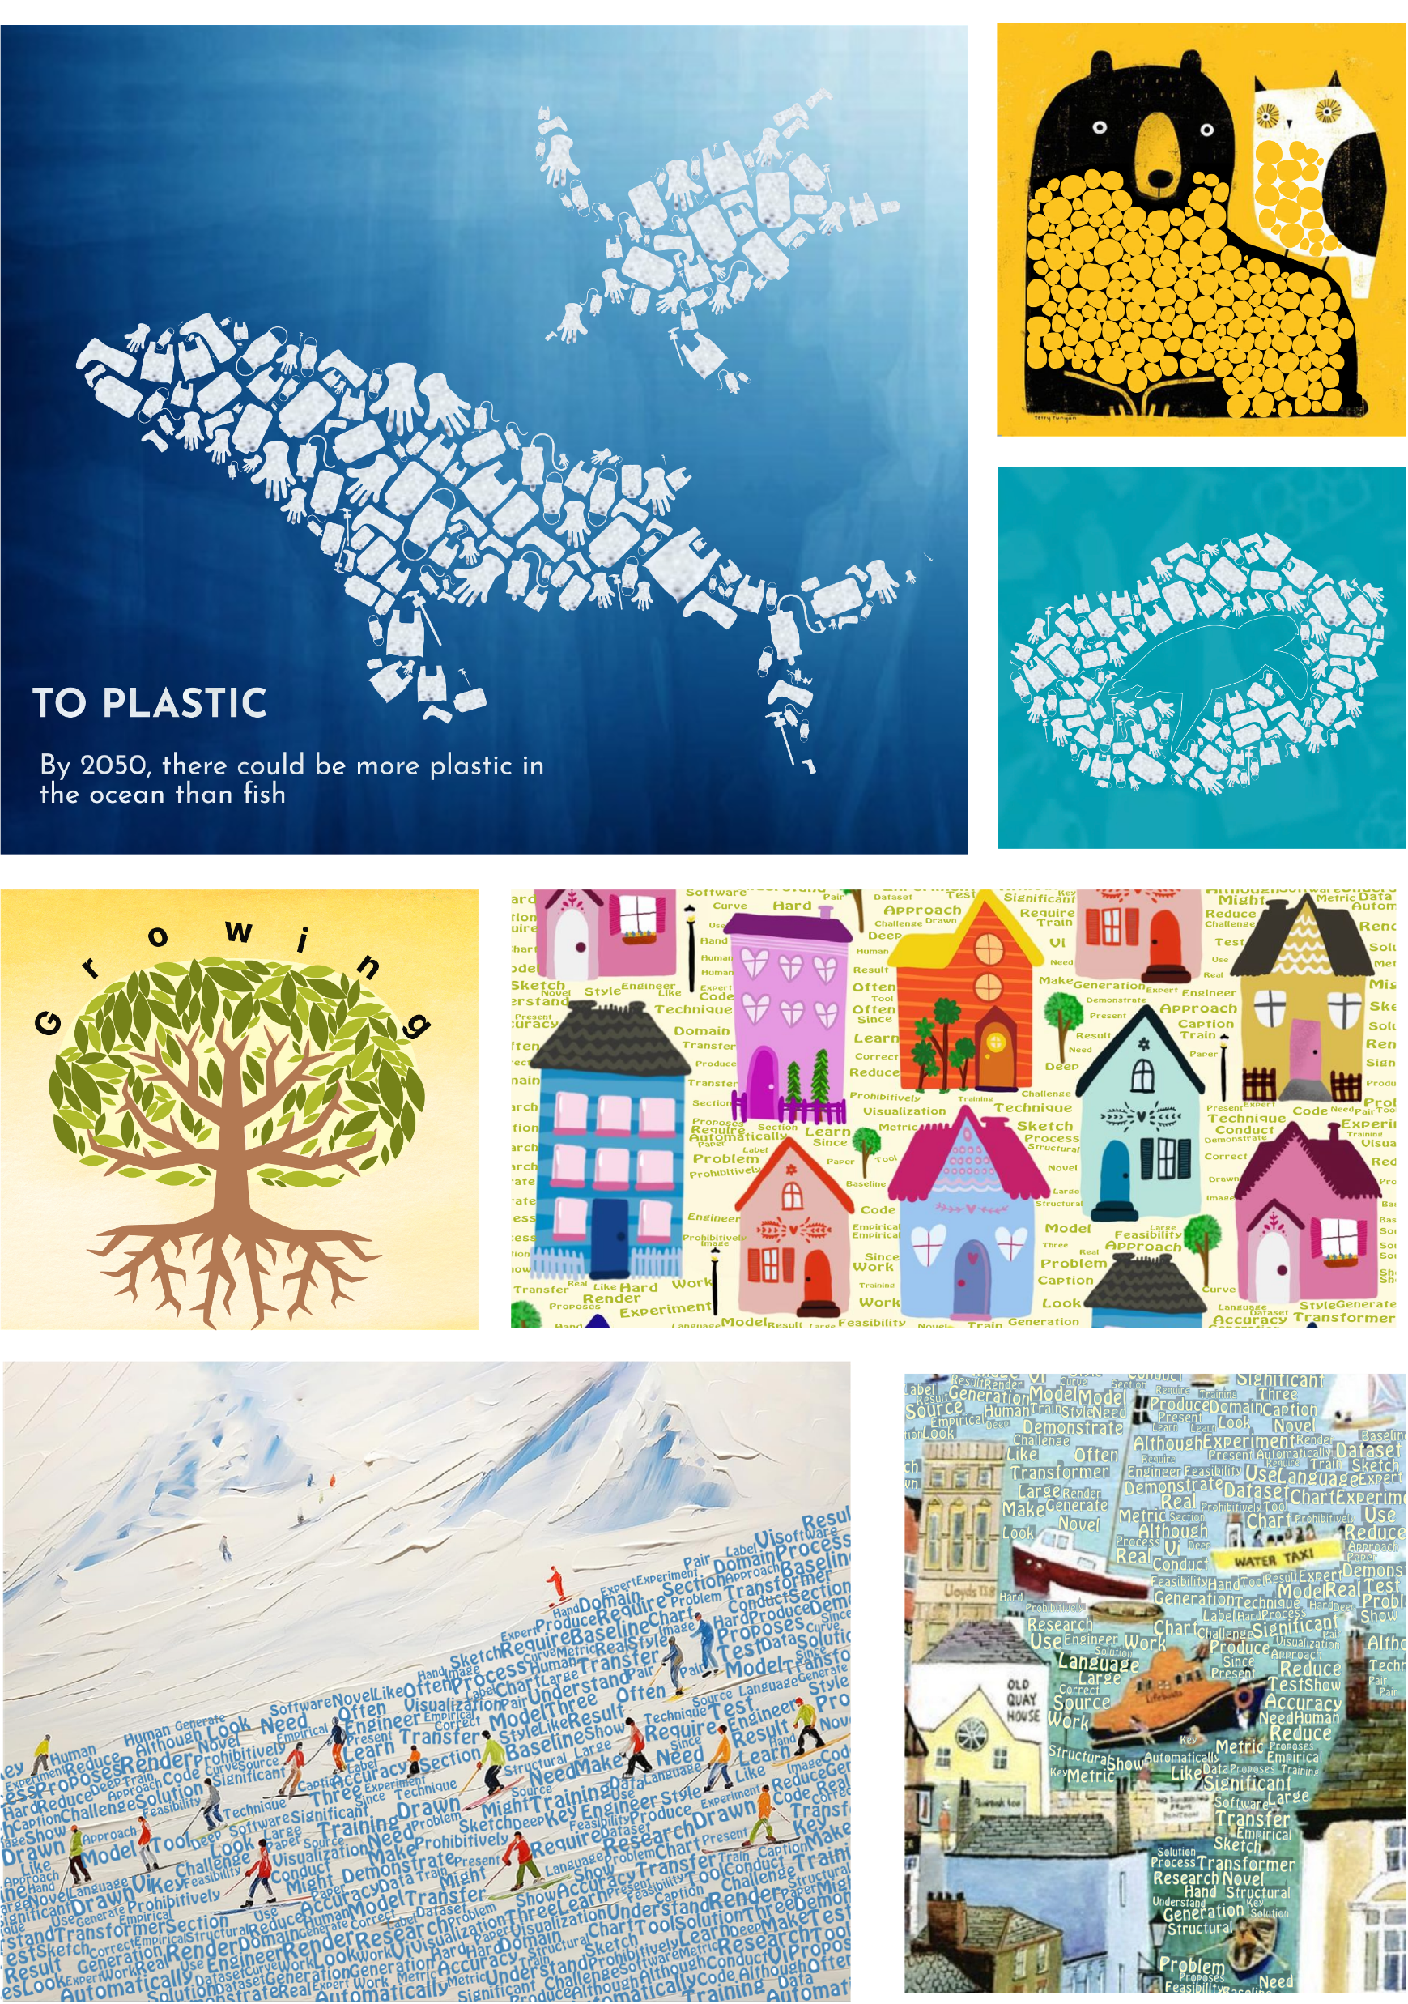
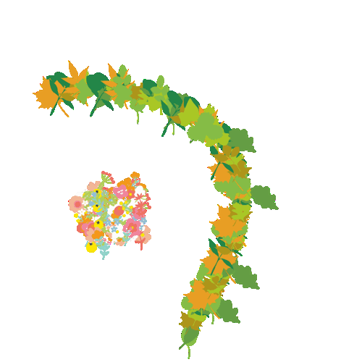
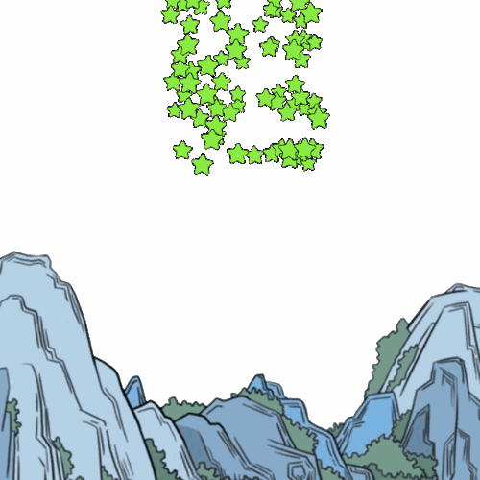
Result
https://szuviz.github.io/pixel-space-collage-technique/
Notes:
https://mostyle.github.io/blog/eg2023/
(a): Key Drawing
(b): Decomposition of Transient Embeddings
(c): In between frames generated by proposed animation system

Slide 3
1. Introduction

Slide 4
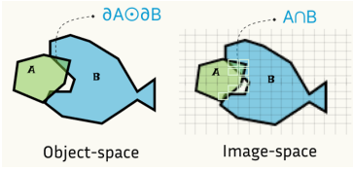
Shape Collage
Technic to fit multiple object into one region.
Majority of existing methods focusing on object-space optimization, which need to reduce overlapping. (𝜕𝐴 and 𝜕B)
This work proposed a paradigm shift by transitioning optimization to image-space (grid of pixels), which are fixed and object-independent complexity.
Notes:
現有拼貼方法主要專注在Object Space上，導致需要計算多個物體的重疊。
此方法將原本Object Space上的運算移轉至Image Space上，藉由其固定和與物件獨立的複雜度，可以利用可微分渲染的力量反向傳播影像空間損失並有效引導拼貼過程。

Slide 5

Shape Collage
This work proposed a paradigm shift by transitioning optimization to image-space (grid of pixels), which are fixed and object-independent complexity.
Therefore, we can leverage Differentiable Rendering to steer collage process.
Notes:
現有拼貼方法主要專注在Object Space上，導致需要計算多個物體的重疊。
此方法將原本Object Space上的運算移轉至Image Space上，藉由其固定和與物件獨立的複雜度，可以利用可微分渲染的力量反向傳播影像空間損失並有效引導拼貼過程。
範例：
- S均勻分布，G線軸引導拼貼、A重力引導、PH開放區域拼貼

Slide 6
2. Preliminaries

Slide 7
Collage Problem
Given a set of 2D items, the goal is to arrange them in a region, where each item may undergo geographic transformation (translate t, scale s, rotate r), and find minimum arrangement quality L, with shape containment and non-overlap.
We also adopt a uniform vector representation for each item, a closed area with N cubic Bézier curves and fitted to the silhouette of the item via differential rendering.
Notes:
給定一組圖形，拼貼問題為找出這組圖形的最小排列品質，且必須非重疊與保持形狀（可經過幾何變換）。
同時對每個圖形採用N個立方貝賽爾曲線表示，並透過可微分渲染擬合到項目的輪廓。

Slide 8
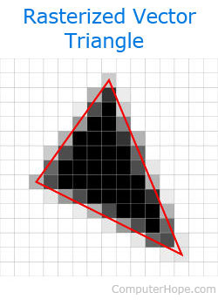
Differential Rendering (DR)
Rasterizing is a mapping from vector graphic to 2D pixel grid, while DR makes rasterizing differentiable, allowing back-propagation from image to vector domain.
Notes:
光柵化是將向量圖轉映至2D網格的技術，而可微分渲染使得這個技術可微，即可從圖像層面反向傳播至向量層面，將碰撞問題轉換為圖像上的重疊問題。

Slide 9
3. Method

Slide 10
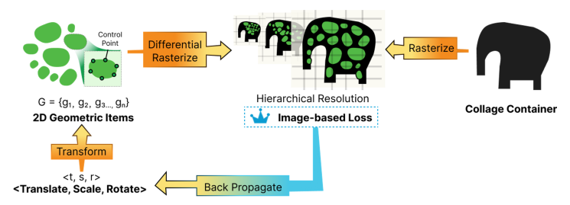
Framework
Notes:
首先給定容器C與群組G，在每一次迭代中item會進行幾何變換，而隨後被光柵化至圖像I (中) 上進行L(排列品質)的計算，隨後會經過梯度下降反向傳播計算新的幾何變換。圖像圖形會逐漸從低解析度轉至高解析度。

Slide 11
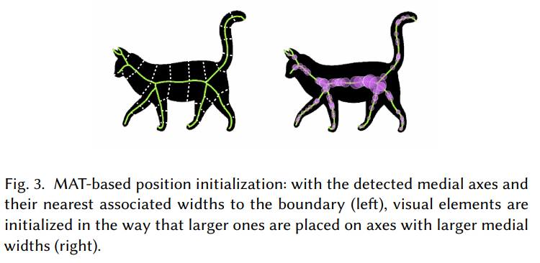
Initialization
This paper proposed a skeleton-base initialization method, Medial Axis Transform (MAT) is used to extract skeleton of target shape.
Notes:
此項目使用MAT (內側軸轉換)方法進行基於骨架的初始化方法，可以保證形狀內元素均勻分布且可以有效處理不良的初始化條件。

Slide 12
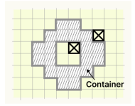
Loss Function
An image-space loss function is designed to ensure three essentials:
Shape Containment: spatial penalty mask is used to enhance MSE loss, i.e., small penalty for item in region while large penalty for item outside region.
Notes:
損失函數依照三個方向設計：
形狀保持：給予形狀內的小懲罰，形狀外的大懲罰機制。

Slide 13
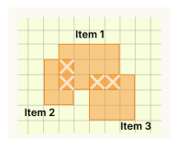
Loss Function
An image-space loss function is designed to ensure three essentials:
Non-overlapping: detecting overlapping in image-space is straightforward and avoids geographic computations. It can be easily acquired by primitively transparency.
Notes:
菲重疊區域：利用統一透明度去檢測重疊區域。

Slide 14
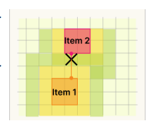

Loss Function
An image-space loss function is designed to ensure three essentials:
Even Distribution: a uniform loss is proposed to deal with uneven distribution through differentiable image dilation.
Total loss
Notes:
均勻分布：透過卷積核(不同大小)作為不同大小的距離場去擴張各個圖像，強調優先減少較大的空間。
總損失函數為此三者做權重的計算。

Slide 15
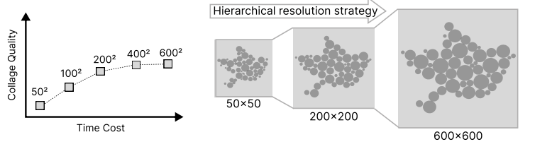
Hierarchical Image Resolution
Low resolution enable faster loss computation but lower precision in detecting overlap and containment.
To balance, a hierarchical strategy is used. Lower resolution for initial computation, higher for refinement.
Notes:
低解析度有更快的運送速度但在偵測重疊與包含上低準確，為了平衡，實驗採用漸進的階層制度。低解析度用作初始設置，高解析度用作精修用途。

Slide 16
4. Result

Slide 17
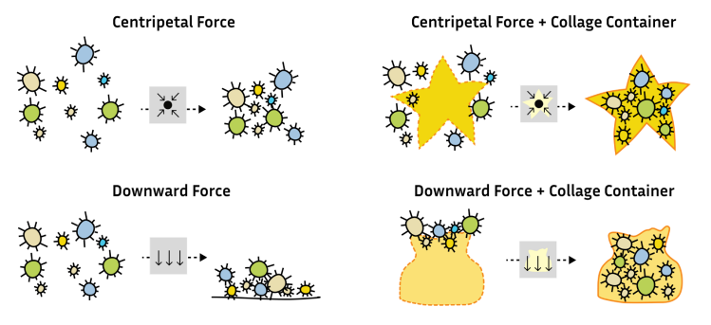
Integration (Force Attention)
Our method can be integrated with Force Attention:
Notes:
此方法可以與力作用進行整合，達成類似的效果。

Slide 18
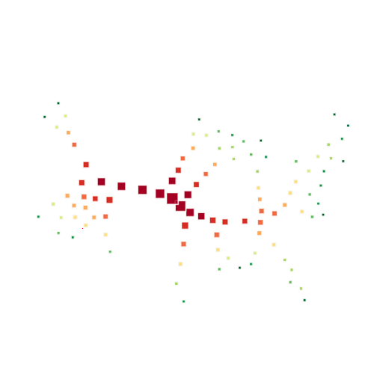
Integration (Animation)
Gradual optimization can produce animation like gravity, expansion etc.
Notes:
拼貼優化過程可以有擴張的效果，加上向下作用力則可以模擬重力，形成動畫效果。
(右圖用到MAT的骨架生成)

Slide 19
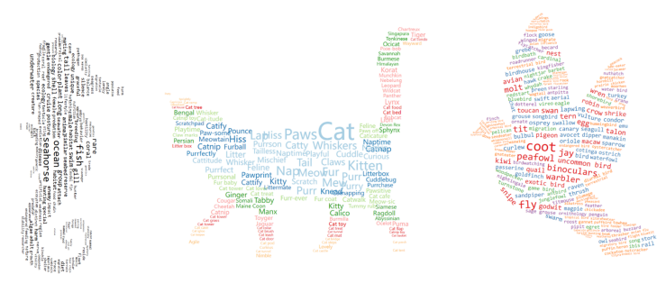
Integration (Word Cloud)
Also, we can perform words in shape:
Notes:
可以向下包容到Word Cloud的生成。

Slide 20
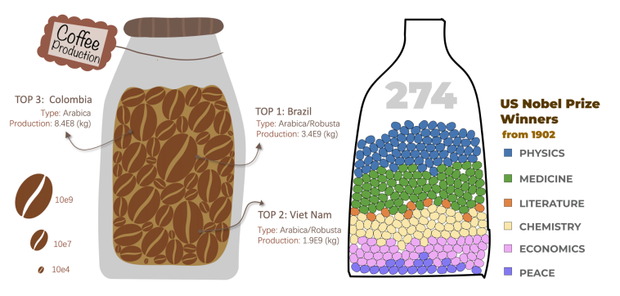
Integration (Data Visualization)
Unit data visualization
Notes:
成分範例：

Slide 21
5. Evaluation

Slide 22
Metric of Collage Quality
Layout Coverage (LC)↑: number of pixel in object / non-object
Object Overlap (OO)↓: overlap area / total area
Exceeding Area (EA)↓: exceed area / total area
Notes:
LC: 使用空間率
OO: 物體重疊率
EA: 物體超出範圍率

Slide 23
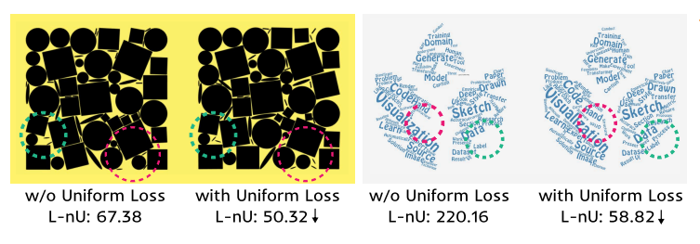
Ablation Study (Uniform Loss)
Notes:
在相對均勻的圖和不均勻地圖上做得比較，可以看到有UL可以顯著降低 L-nU (不平均排版)

Slide 24
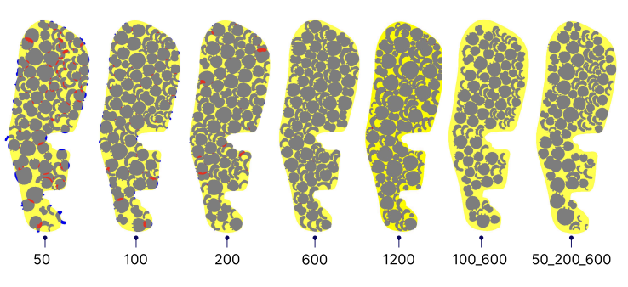
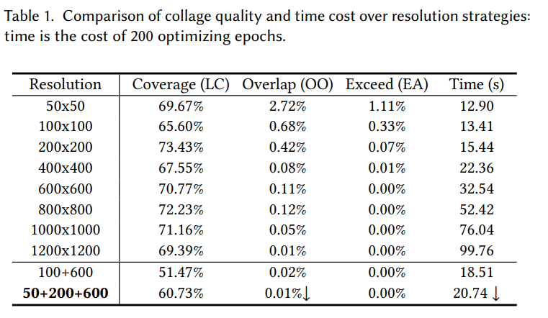
Resolution
Strategy
Notes:
從50~1200共八個解析度，以及100-600、50-200-600兩個階層解析度，在100個物件拼貼任務下進行比較。
可以看到600有較高分數但運送時間最長，階層策略中50-200-600綜合表現最好
紅色是重疊，藍色是超出區域
註：我自己比較不懂LC沒有有效利用，自己個人評估沒有400或600好

Slide 25
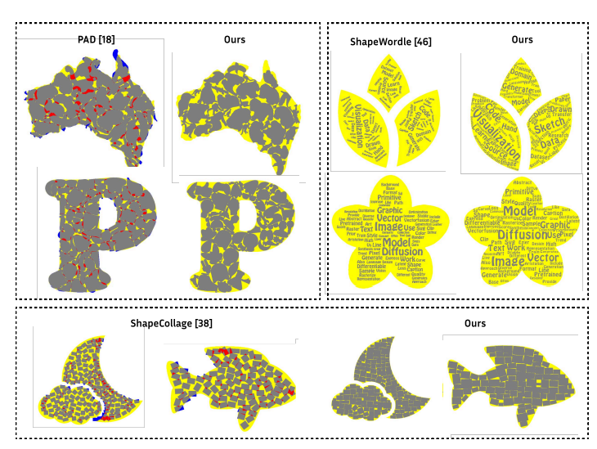
Comparison
Compared with PAD, Minkowski Penalty, ShapeWordle (word), ShapeCollage (shape)
Notes:
PAD和Minkowski敗在複雜度O(n^2)，處理越來越多元素會消耗越長時間。
此方法和Minkowski但在高數量上有更好的效率。
然而，在運用空間上此方法方法不如PAD，但PAD有很多重疊區域。

Slide 26
References
https://szuviz.github.io/pixel-space-collage-technique/
https://arxiv.org/pdf/2406.04008

Slide 27
FIN

