Slide 1


MoCA-Video
Motion-Aware Concept Alignment for Consistent Video Editing
Tong Zhang, Juan C Leon Alcazar, Bernard Ghanem
KAUST

Slide 2

Motivation
Image Domain
- Semantic mixing (e.g., MagicMix)
Video Domain
- Frame-by-frame
- Precise spatial control
- Extensive training.
Editing
Jitter
Notes:
- Has successfully blended disparate concepts in static images. It allows for creative "hybrid" entities, such as mixing a corgi with a coffee machine, by manipulating latent diffusion noise. - Extending this to video is non-trivial. Naively applying image techniques frame-by-frame destroys temporal consistency. Existing video editors often lack precise spatial control or require extensive training.
- Smooth transitions
- Flickering

Slide 3
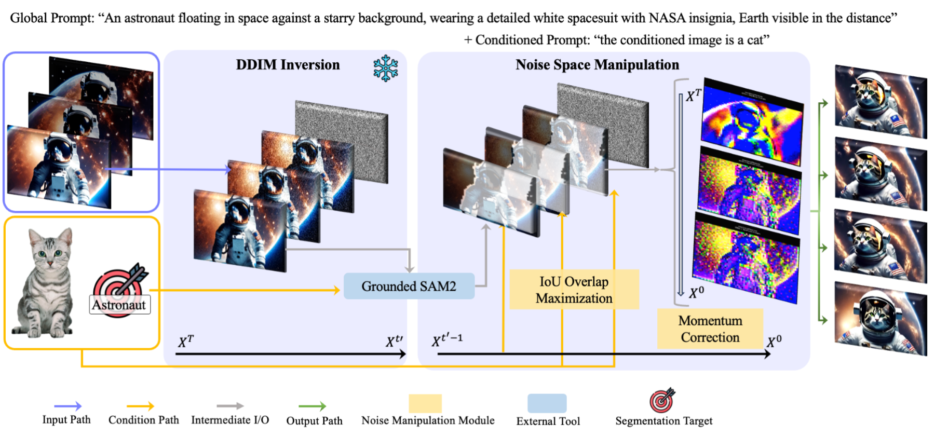
Methodology
A training-free framework that bridges the gap between image semantic mixing and video consistency.
- VideoCrafter2 text-to-video model
- Stable Diffusion 2.1 weights
- FIFO Diffusion Pipeline
- FreeInit
Notes:
- Injects semantic features from a reference image into a target object.
Preserves original motion and visual context.
Operates directly in the latent noise space of a frozen diffusion model.

Slide 4
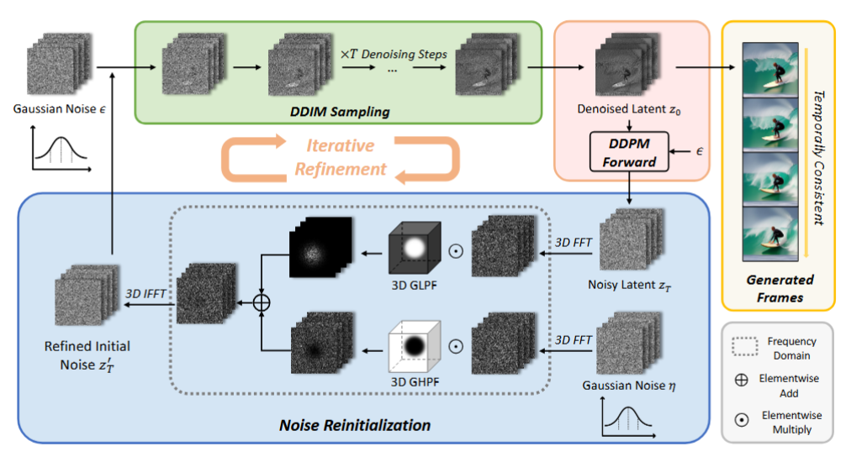
FIFO Diffusion Pipeline & FreeInit
FIFO
- Better than regressive model at producing longer videos
Free Init
- Artifacts
- Improved temporal consistency
Notes:
- However, we find the commonly used diffusion strategy has difficulty in fully
corrupting information from real videos, especially in their spatio-temporal low-
frequency band.
- Corrupted latent obtained through the forward diffusion process from real videos
as initial noise.

Slide 5
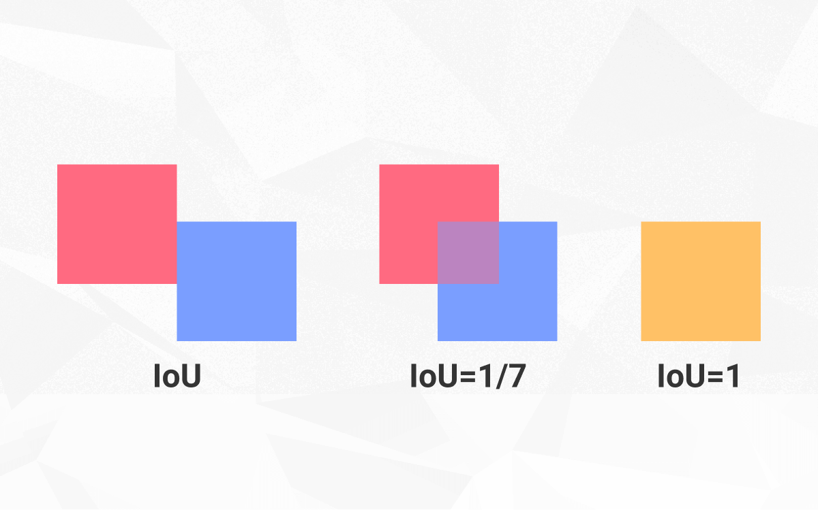

Latent Space Tracking
To ensure the semantic mix only affects the target:
Grounded-SAM2: Uses a class-agnostic segmentation model on decoded latent frames.
IoU Optimization: Tracks the object mask across the temporal sequence by maximizing Intersection over Union (IoU) between frames.
Notes:
(e.g., changing a "cat" to an "astronaut" without affecting the background), MoCA employs robust tracking
where xcondt is a latent derived from the reference image.

Slide 6
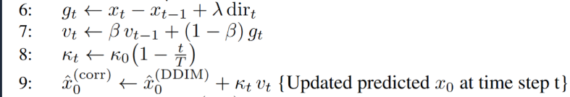
Adaptive Motion Correction
Smoothing Semantic Shifts
Simply injecting features can disrupt the motion trajectory. MoCA introduces a momentum-based correction to the DDIM denoising process.
This approximates the distribution of the hybrid entity, smoothing out abrupt shifts and preventing temporal artifacts (jitter) while maintaining the original motion dynamics.
Notes:
- we introduce a small, time-dependent momentum correction vt into the predicted
clean image
- where the per-timestep weight, decays from 0 at t = T to κ0 = 2.0 at t = 0.
- where xt and xt−1 denote the noisy latents at successive timesteps, dirt is the model’s estimated
motion-direction vector from standard DDIM, λ scales the influence of that directional cue, and
β ∈ [0, 1] controls the momentum decay

Slide 7
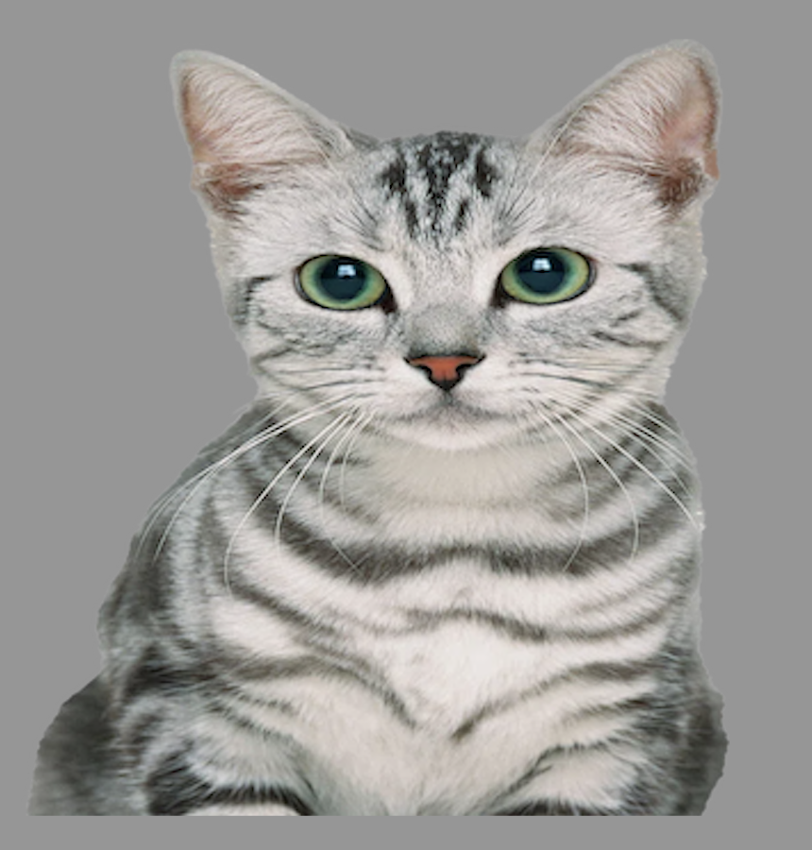



Results

Slide 8
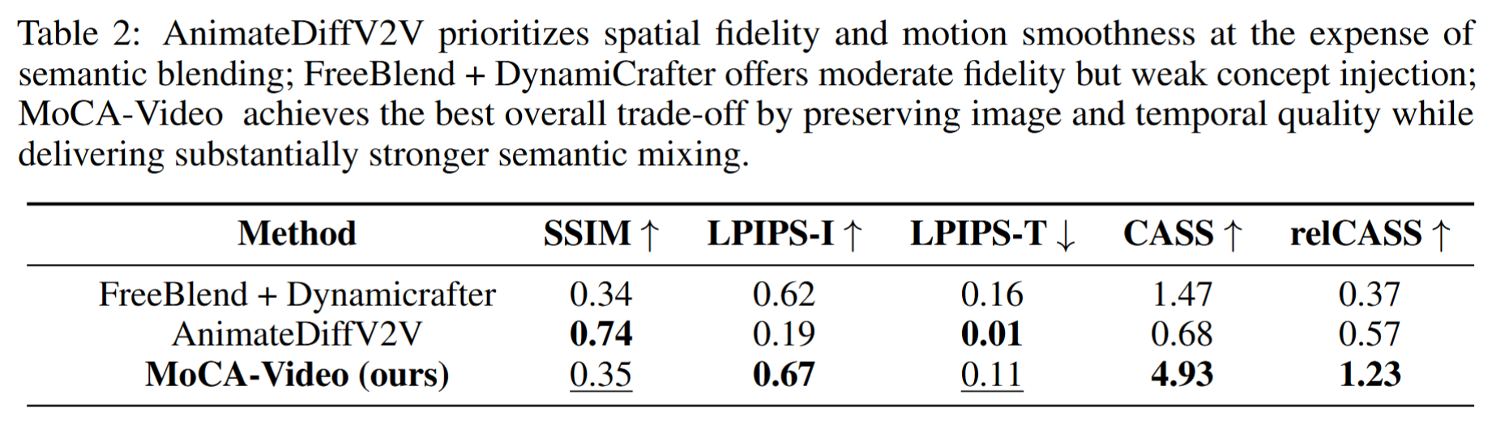
Results

Slide 9
Limitation
Mask Quality
Computation Time
Noun–noun compound

