Slide 1
LayoutFlow:
Flow Matching for Layout Generation
Julian Jorge Andrade Guerreiro(1) , Naoto Inoue(2) , Kento Masui(2) , Mayu Otani(2) , Hideki Nakayama(1)
(1)The University of Tokyo, Japan
(2) CyberAgent, Japan
Accepted by ECCV 2024

Slide 2
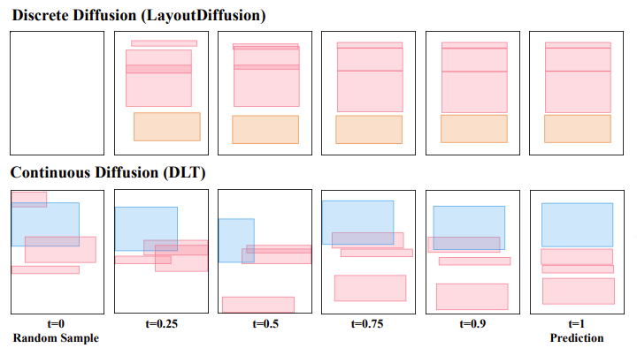
Introduction
Most recent layout generation models are based on the diffusion framework
Notes:
先介绍layout generation, 图片文字的排版
Motivation:圖片、文字）的排列直接影響訊息傳遞與設計效果 目前自動化layout model based on Diffusion

Slide 3
Introduction
Drawbacks of diffusion models
Noisy Trajectory: changes directions due to the added noise.
Longer Inference Time: As a result of the noisy, circuitous path, diffusion models tend to require more sampling steps, leading to longer inference time compared to flow-based models.
Notes:
Diffussion会一直add noise轨迹比较乱
生产过程比较长

Slide 4
Introduction
LayoutFlow: A generative framework based on flow matching
Producing Smooth Trajectories: It generates smooth trajectories for moving the sample from the base distribution to the final layout.
Faster Inference: By requiring fewer sampling steps (due to the smooth, direct path), it achieves shorter inference time.
Notes:
所以想使用Flow matching 取代diffussion 能產生 高品質 (High-Quality) 佈局，且速度 比現有方法更快 (Less Time)。

Slide 5
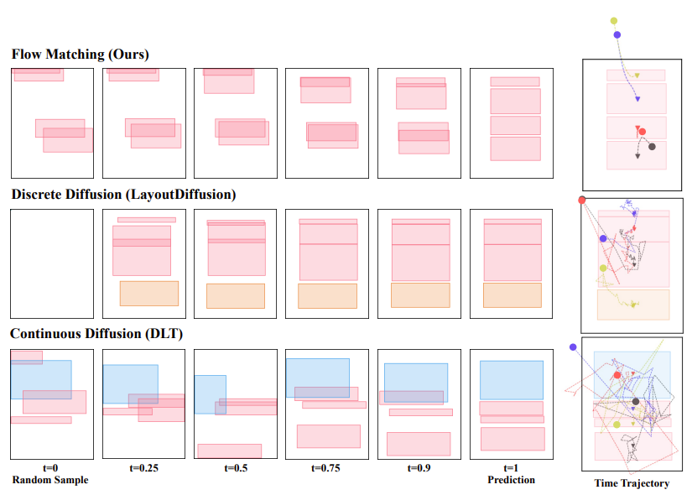
Introduction
Fig.1: Comparison of different layout generation trajectories.
Notes:
先看diffussion路径比较不固定，flow matching路径比较smooth discrete

Slide 6
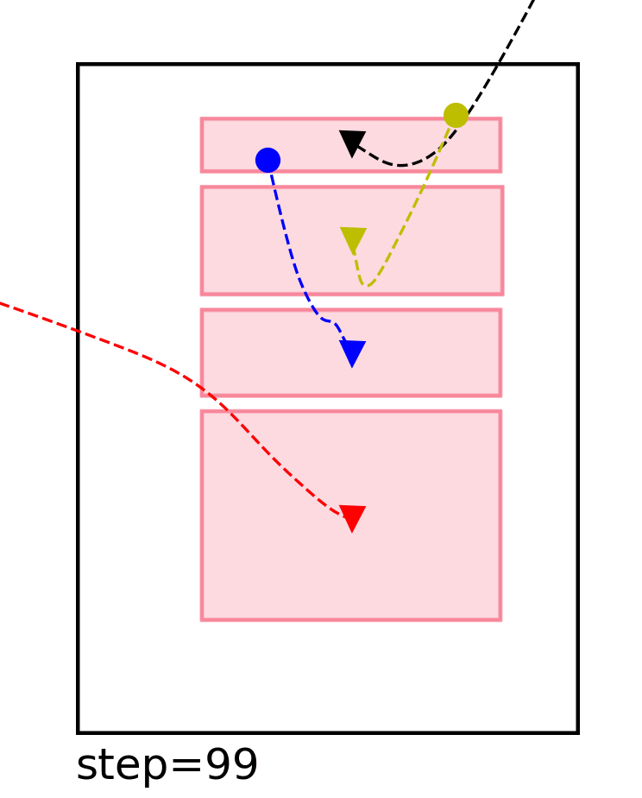
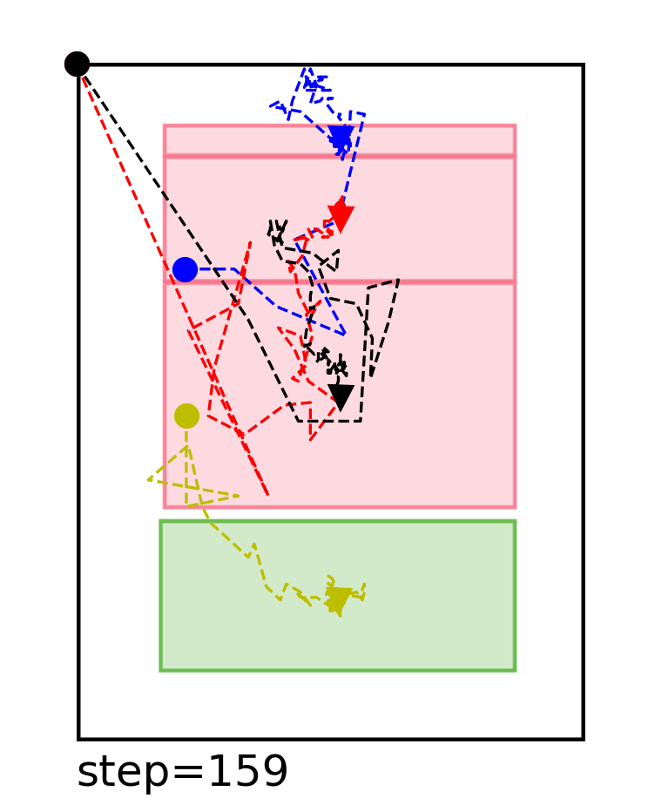
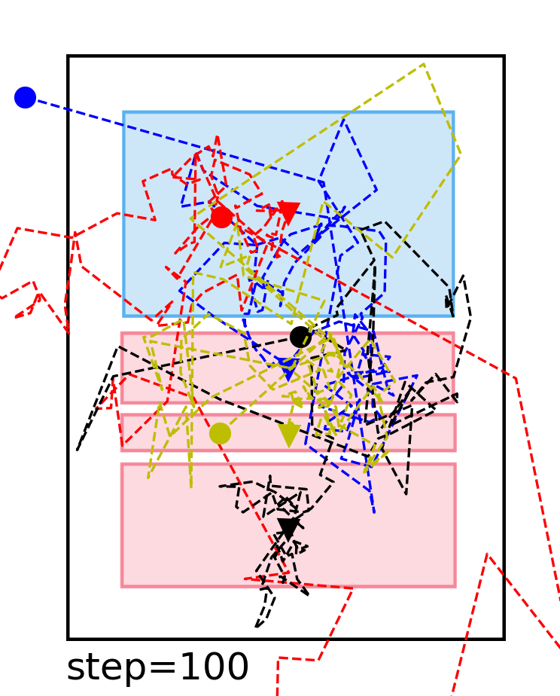
Introduction
Flow Matching
Discrete Diffussion
Continuous Diffussion
Fig.1: Comparison of different layout generation trajectories.

Slide 7
Related Work
Flow Matching & Diffusion Models
defining a path between a simple noise distribution (like Gaussian noise) and the complex data distribution (the final generated layout). The key difference is how they traverse this path.
Diffusion Models: SDE (Stochastic Differential Equation)
Noise is added during the generation process.
Slow because they use the SDE formulation for denoising.
Flow Matching Models: ODE (Ordinary Differential Equation)
No noise is added at any point during this transport.
FAST because they use simpler ODE to solve the generation process.
Notes:
這兩者的目標是一致的，都是要建立一條路徑，把簡單的高斯噪聲 (Noise Distribution) 轉換成複雜的最終佈局 (Data Distribution)。
兩者的起點都是雜訊，終點都是我們想要的佈局，差別在於路徑的走法。
Diffusion Models:基於 SDE (隨機微分方程),生成的過程每走一步都會加random noise,模型必須一直修正方向來慢慢denoise所以慢
Flow Matching:基於 ODE (常微分方程)，傳輸過程中完全不加入任何噪聲，路徑更直觀。因為不需要處理隨機干擾，我們可以用簡單的 ODE Solver 快速求解

Slide 8
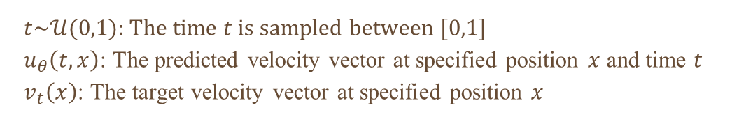
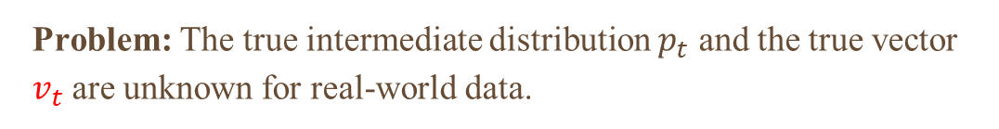
Related Work
Flow Matching
Notes:
目標是學習/找 速度場 (Velocity Field vt),每個时间點移動的速度和方向
簡單來說，只要 Model 知道每一秒該往哪個方向走，那跟著走到底，最終就會變成我們想要的 Distribution（佈局）。
预测时间t=1、在位子x的速度，真实时间t，x点点速度比较
问题是，我们不知道t=1时v是多少
我們不知道實際每個時間點它是怎麼走，沒有ground truth

Slide 9
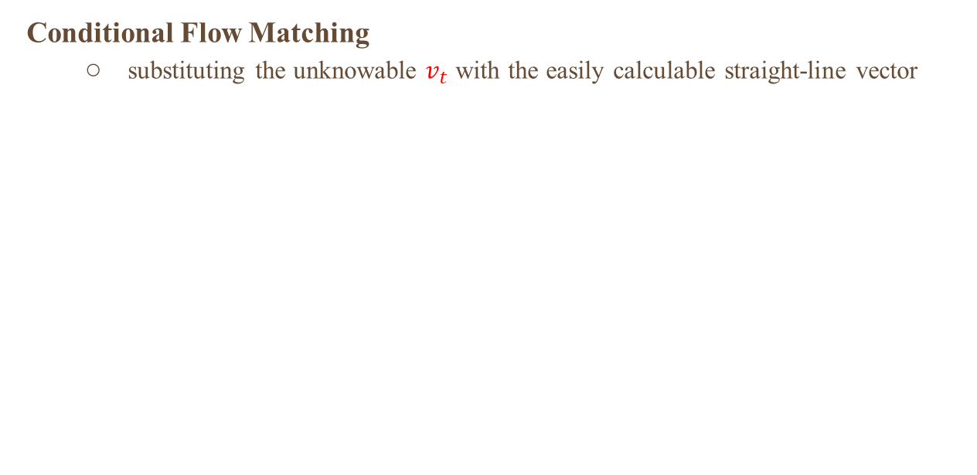
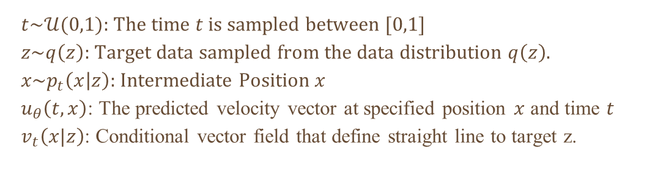
Related Work
Notes:
直線 (Straight Line) 移動到這個目標

Slide 10

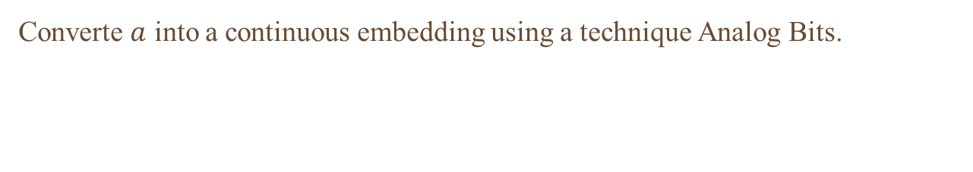
Layout Flow
Data Representation
g = (cx , cy , w , h )
a = category information(e.g., text, image, table)
Notes:
N個data，k第幾個data
Flow Matching 的運作原理是計算微分方程 (ODE)， input要continuous
category information是離散的（非A即B，沒有中間值），use Analog Bits 技術將其轉換成continuous embedding

Slide 11
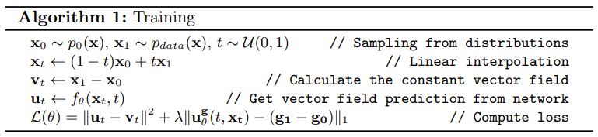
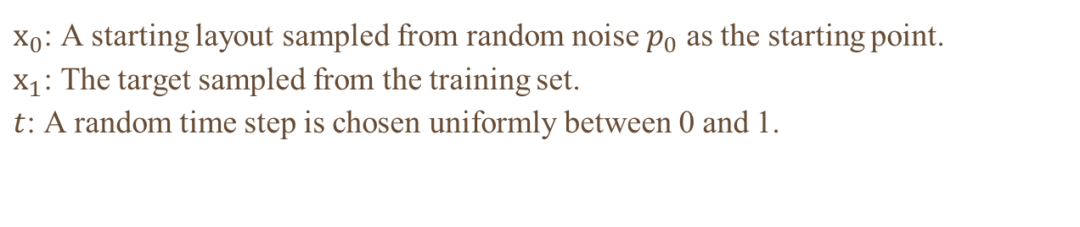
Layout Flow
Training: Sampling the Inputs
Notes:
Random sample layout x0 from prior distribution(gausian noise) 再隨機選t，要求x0在t時間的位子

Slide 12
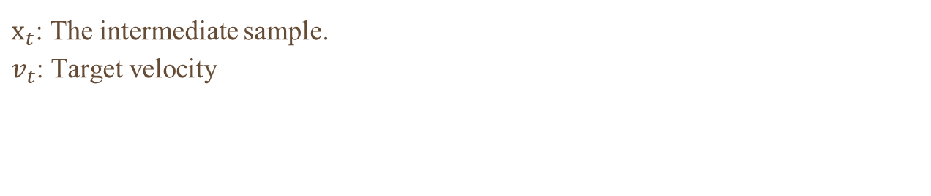
Layout Flow
Training: Define the Target
Notes:
用interpolation找在t時間的xt，再計算target velocity
Define the Target: It calculates the Target Velocity. Since we want a straight path, the correct direction is simply the difference between the End ($\mathbf{x}_1$) and the Start ($\mathbf{x}_0$).

Slide 13
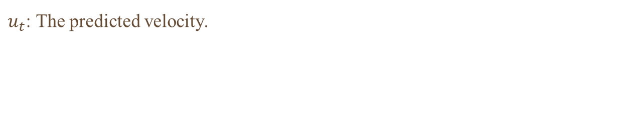
Layout Flow
Training: Compute Loss
Notes:
Compute loss: The system compares the Predicted Velocity with the Target Velocity
MSE is the loss.
MSE不夠 加入L1 regularization

Slide 14
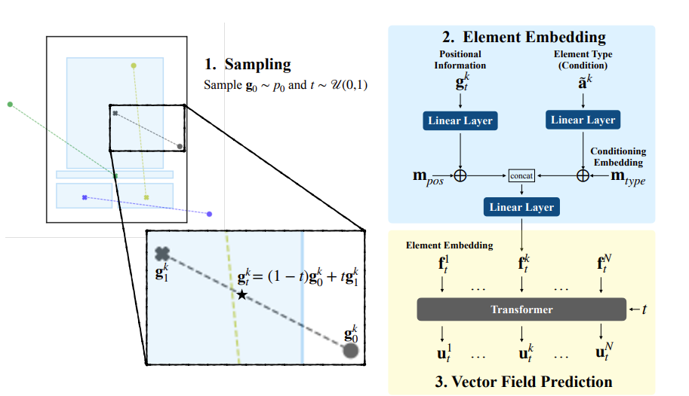
Network Architecture
g = (cx , cy , w , h )
Notes:
sample an initial layout g0 from a base distribution and a time t
linearly interpolating 取得gt=(cx , cy , w , h )
Each intermediate element is embedded jointly with the given element condition
the Transformer architecture takes all the element embeddings to predict a vector field

Slide 15
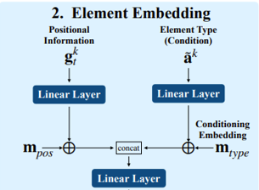
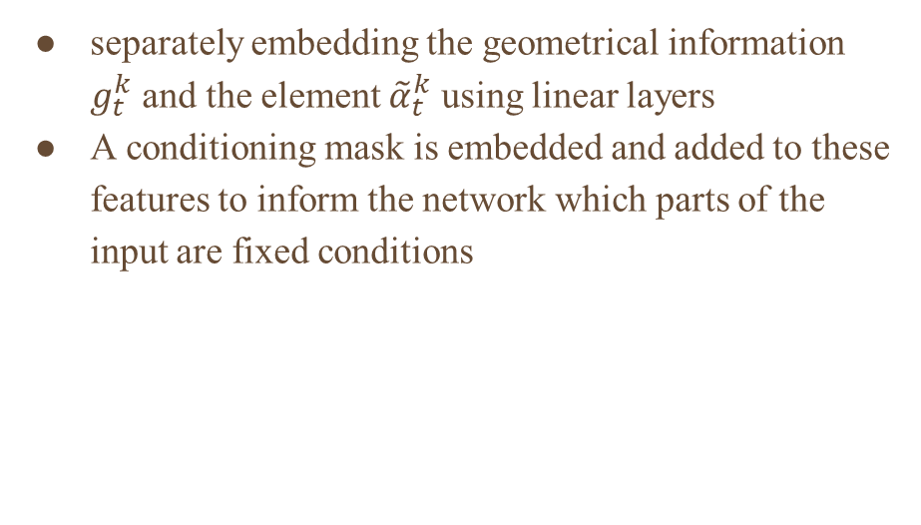
Network Architecture
Element Embedding
Notes:
Why separate？ 1. g (continuous), a(semantic/category) 分開學習理解位置和類別

Slide 16
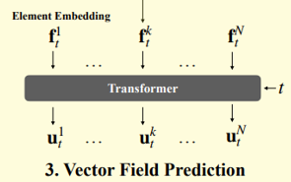
Network Architecture
Vector Field Prediction
Element embeddings are processed by a Transformer Encoder, with temporal information (t) incorporated into every layer of the network.
Notes:
把embedding+t送入transformer 得到預測u （速度） 再算loss

Slide 17
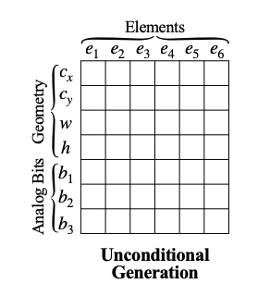
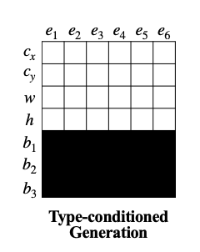
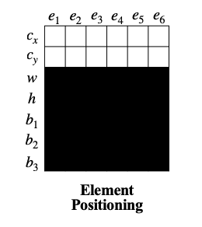
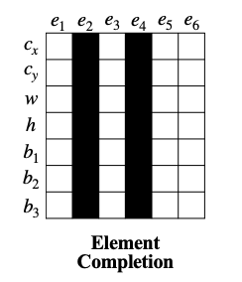
Conditioning Mechanism
mask: known ( given condition)
Notes:
2. 已知元素類型（text，table，image）， 預測cwh
3. 已知元素類型、大小，預測 c
4. 已知某些固定排列（ab固定了），預測其他的元素
每一筆資料要進入 Transformer 之前，我們都會隨機選擇一種遮罩模式 (Mask) 套用上去
強迫這同一個模型，在訓練時就同時學會處理各種不同的任務

Slide 18
Experiments
Experimental Settings
Dataset
RICO (66k, 25 element types)
PubLayNet (350k, 5 elements types)
Model Architecture
4-layer Transformer network, 8 attention heads, model dimension of 512
Optimizer Settings
AdamW optimizer
Learning Rate 0.0005
Loss Function
Total Loss = MSE + 0.2 *L1
Notes:
g = (cx , cy , w , h )
a = category information(e.g., text, image, table)
Conditioning Masks: using fixed element types from the target $x_1$ while generating geometry

Slide 19
Experiments
Evaluation Metrics
Fréchet Inception Distance (FID)
uses a pre-trained neural to extract features from both real layouts and generated layouts, compares these two feature distributions
Alignment
Usually defined as the average minimum distance for each element to its nearest neighbor's alignment line
Overlap
Total area of intersection between bounding boxes of elements
Maximum Intersection over Union (mIoU)
For each generated layout, it finds the "best matching" real layout in the test set
Notes:
FID 越低越好 （差異） mIoU 越高越好
Alignment, overlap追求它們的數值與真實數據集 (Reference Dataset) 的數值接近

Slide 20
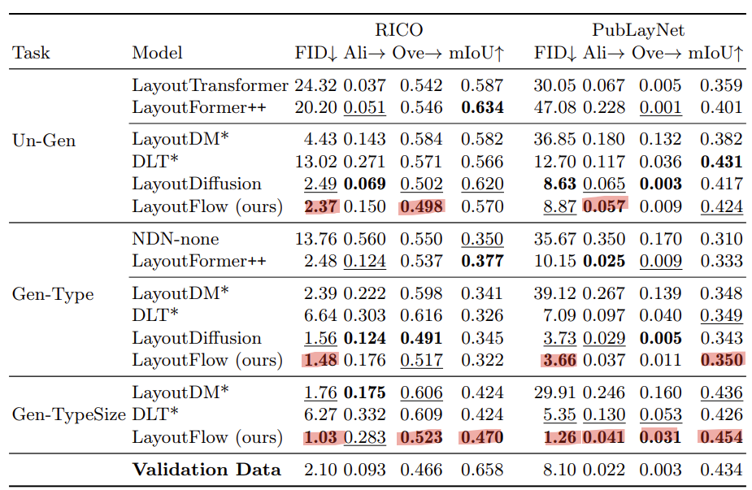
Results
Without any constraints
Given element types
Given elements types and sizes

Slide 21
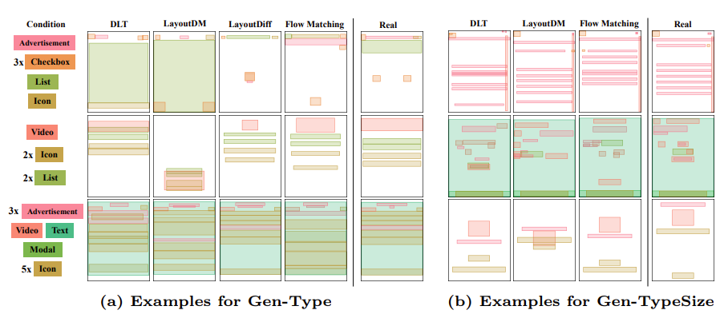
Results

Slide 22
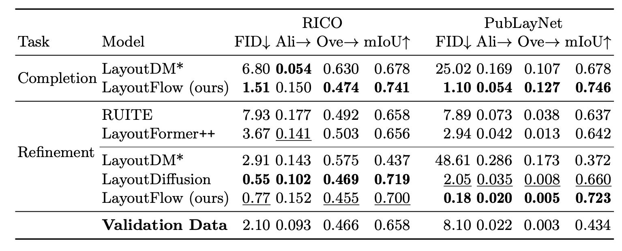
Results
Completion: Partial layout missing up to 20% of its elements

Slide 23
Conclusion
The first works to apply Flow Matching specifically to the task of Layout Generation
They designed a flexible conditioning scheme (using masks) that allows a single model to handle multiple diverse tasks
It addresses the slow inference speed of Diffusion Models.
It solves the issue of noisy and complexed generation paths.
Notes:
FID 越低越好 （差異） mIoU 越高越好
Alignment, overlap追求它們的數值與真實數據集 (Reference Dataset) 的數值接近

Slide 24
Thanks

