Slide 1
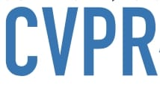


Controllable Animation of Fluid Elements in Still Images
Aniruddha Mahapatra*, Kuldeep Kulkarni*
*Adobe Research India
Presenter : Cheng-Yang Ko
2025/12/31

Slide 2
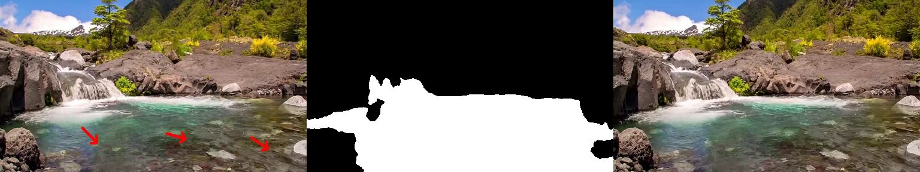
Motivation & Background
Controllable Animation of Fluid Elements in Still Images
CVPR’22
Focusing on elements such as water, smoke, and fire that possess characteristics of "repeating textures" and "continuous movement".
The method is either uncontrollable, or the generated flow field is not stable or realistic enough.

Slide 3
Input data and objectives
Controllable Animation of Fluid Elements in Still Images
CVPR’22
Input data :
Image: A still image.
Mask: The user paints the area they want to move.
Flow Hints: Arrows drawn by the user (representing direction) and their corresponding speeds.
Objectives : Generate a realistic video of N frames.

Slide 4
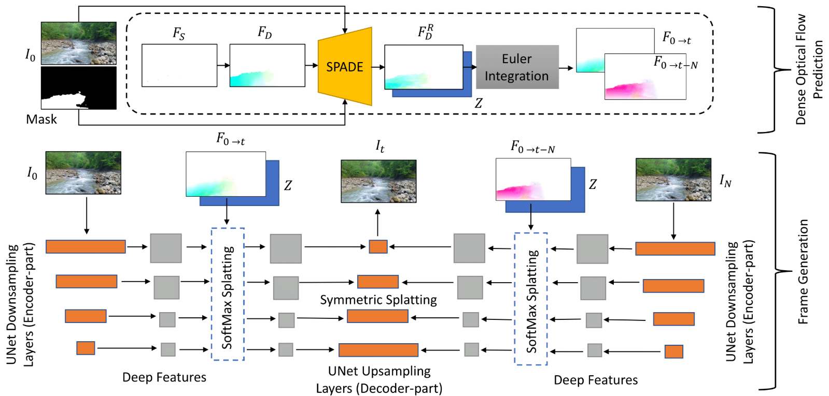
Pipeline
Controllable Animation of Fluid Elements in Still Images
CVPR’22

Slide 5
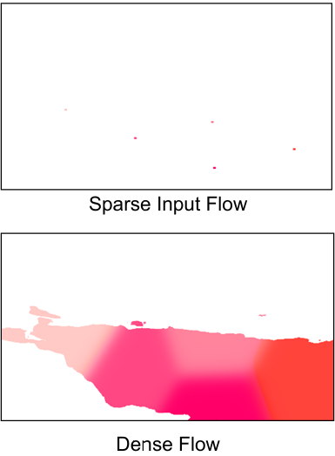
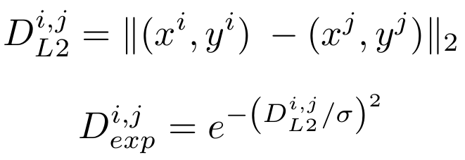
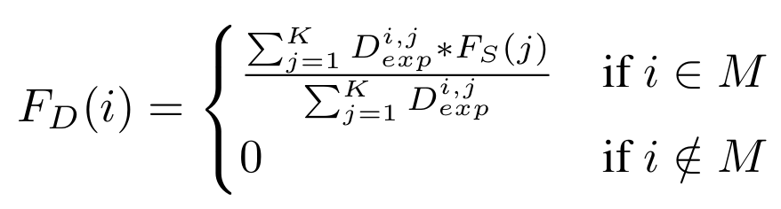
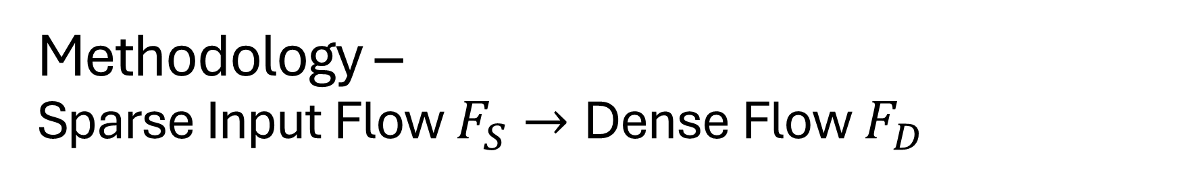
Methodology – Sparse Input Flow $F_{S}$ $→$ Dense Flow $F_{D}$
Controllable Animation of Fluid Elements in Still Images
CVPR’22

Slide 6
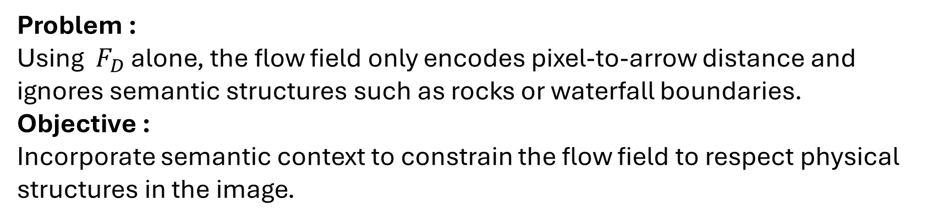
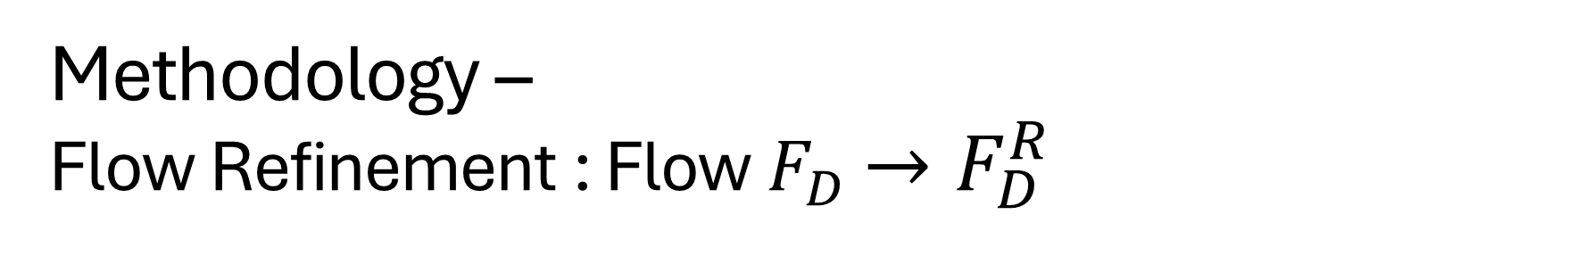
Methodology – Flow Refinement : Flow $F_{D}$ $→F_{D}^{R}$
Controllable Animation of Fluid Elements in Still Images
CVPR’22
Problem :
Using ${ F}_{D}$ alone, the flow field only encodes pixel-to-arrow distance and ignores semantic structures such as rocks or waterfall boundaries.
Objective : Incorporate semantic context to constrain the flow field to respect physical structures in the image.

Slide 7
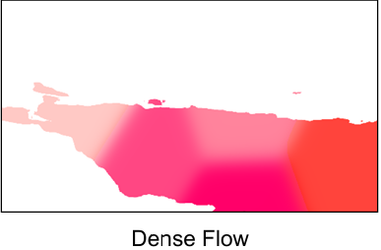
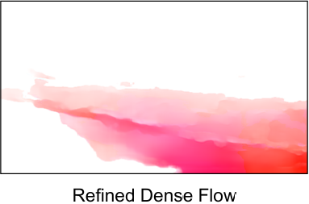
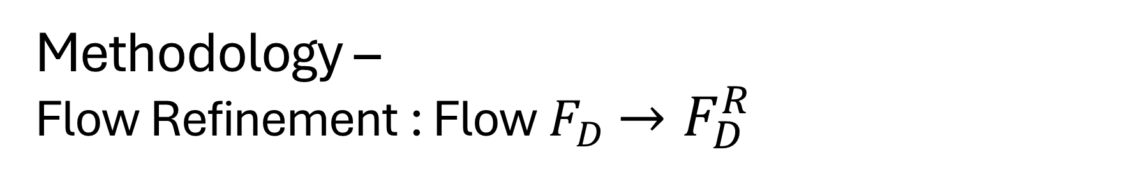
Methodology – Flow Refinement : Flow $F_{D}$ $→F_{D}^{R}$
Controllable Animation of Fluid Elements in Still Images
CVPR’22

Slide 8


Methodology – Eulerian Flow Fields
Controllable Animation of Fluid Elements in Still Images
CVPR’22

Slide 9
Methodology – Symmetric Splatting
Controllable Animation of Fluid Elements in Still Images
CVPR’22

Slide 10
Pipeline
Controllable Animation of Fluid Elements in Still Images
CVPR’22

Slide 11
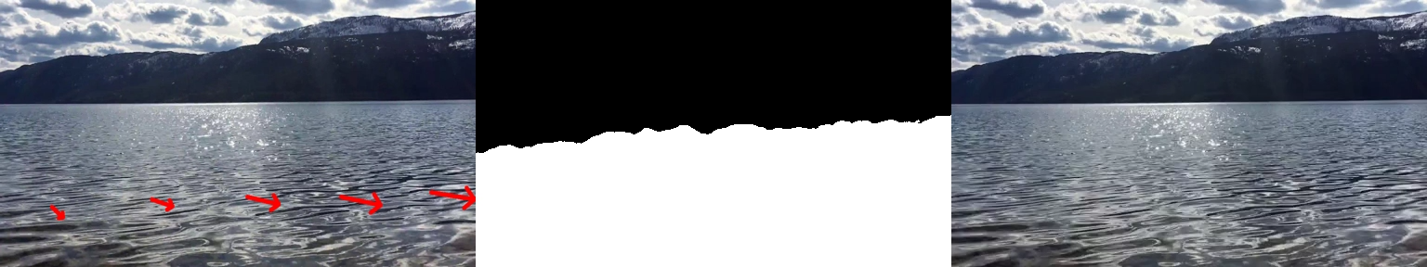
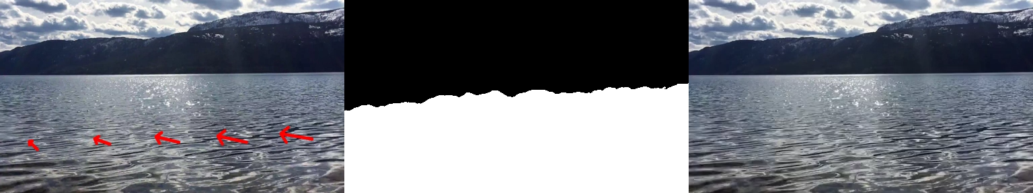
Experiments - Controllable Animation

Slide 12
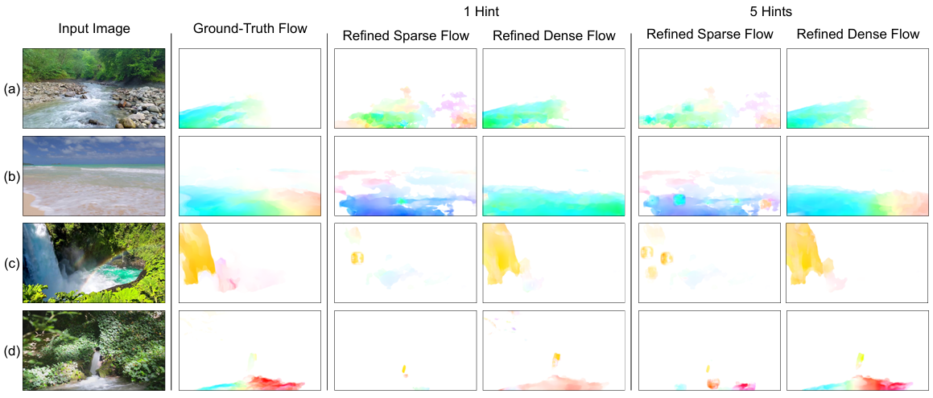
Experiments – w/o Flow Refinement

Slide 13
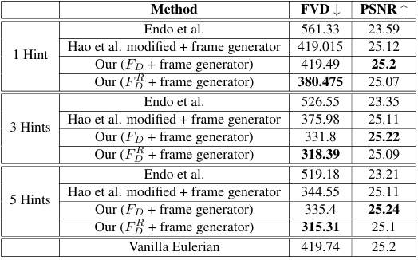
Compare
Controllable Animation of Fluid Elements in Still Images
CVPR’22

Slide 14
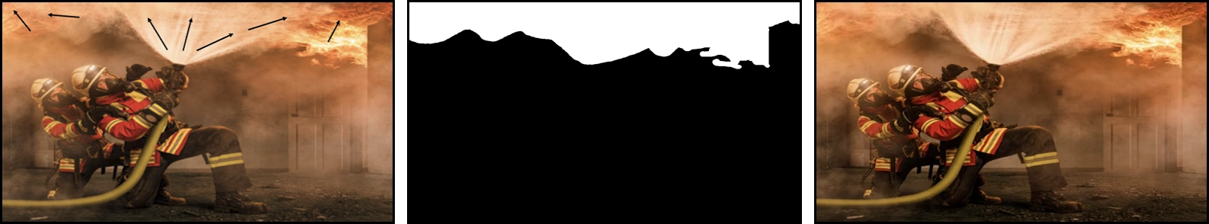
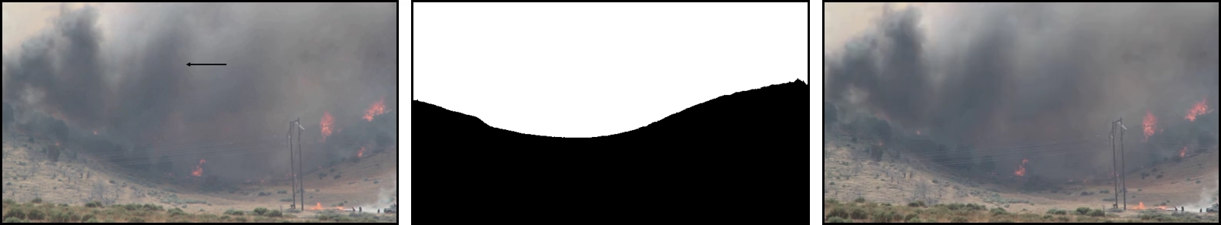
Demo

Slide 15
Conclusion
Controllable Animation of Fluid Elements in Still Images
CVPR’22
Propose a two-stage framework that transforms sparse user inputs into high-quality dense Eulerian flow fields.
Employ a UNet-based symmetric splatting mechanism to mitigate holes and distortions when generating long videos from a single image.

Slide 16
Limitations
Controllable Animation of Fluid Elements in Still Images
CVPR’22
Fluid-only assumption : Due to the assumption of a constant Eulerian flow field, the method cannot model rigid objects or structured motions.
Adjacent opposing flows : When neighboring fluid regions move in opposite directions, accurately separating boundaries remains challenging, which may result in blurred transitions.

Slide 17
Thanks

