Slide 1
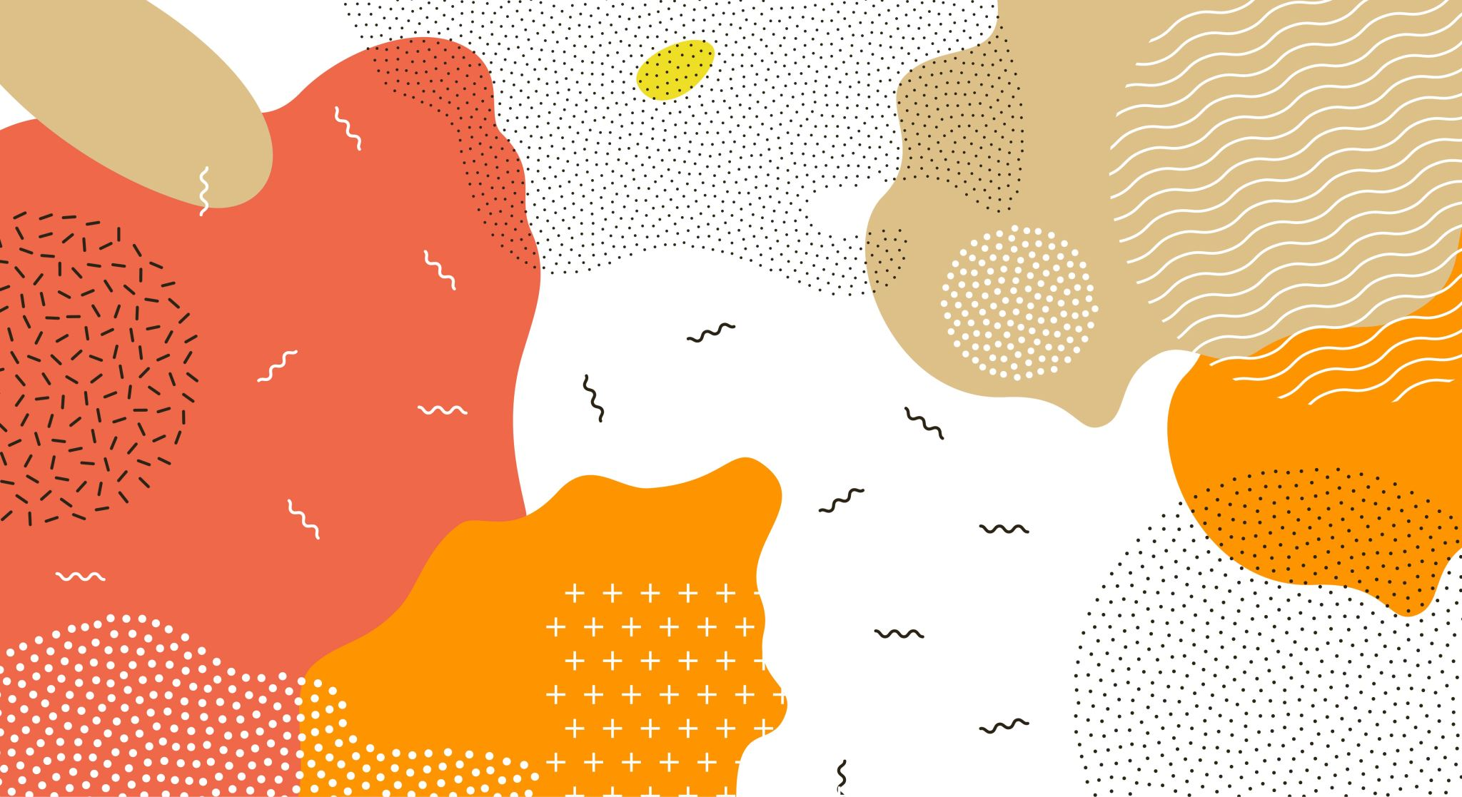
Yuan: Yielding Unblemished Aesthetics through a Unified Network for Visual Imperfections Removal in Generated Images
Kuan Yun Chao
趙冠雲
03/05/2025

Slide 2
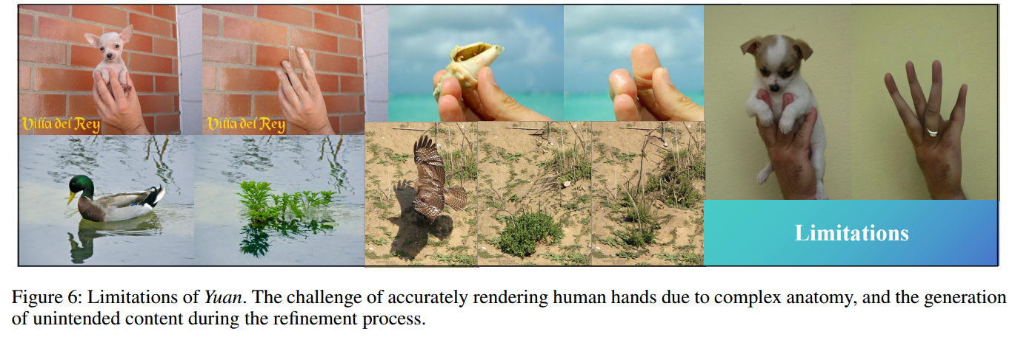
Contributions & Limitations
Automated imperfection detection
Context-aware inpainting
Comprehensive validation?

Slide 3
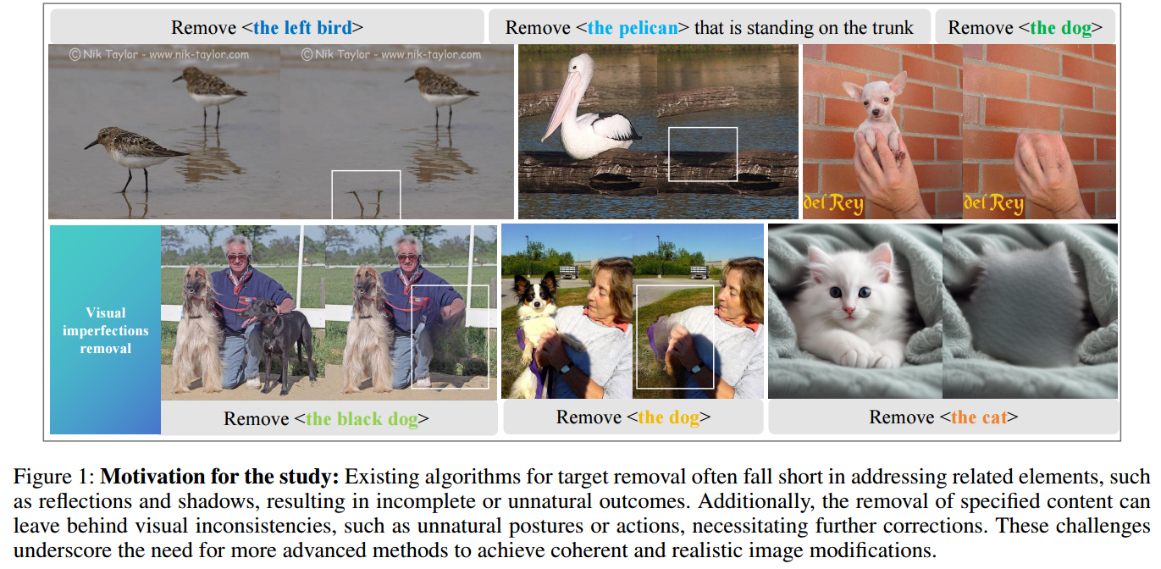
Related work & Motivation
- GANs, VAEs, DALL-E, Diffusion Models, etc.
Concept removal
Adv train, gen model
Watermark removal
Cnn freq filt
Shadow Handing
Editing Complex Scenes
User Interactions

Slide 4
Method

Slide 5
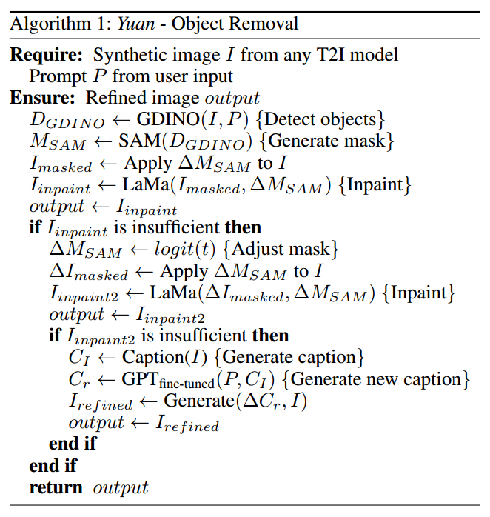
Cont.
SD for T2I
Ground DINO (DETR with Improved No-objects)
SAM (Segment Anything Model) 4 shadow
LaMa (Large Mask Inpainting) vs SD
Florence 2 captioning

Slide 6
Cont.

Slide 7
Experiment, Evaluation & Result
ImageNet100, Standford-dogs, Generated-cats
1 x RTX 4090
NIQE nat, BRISQUE dom, PI

Slide 8
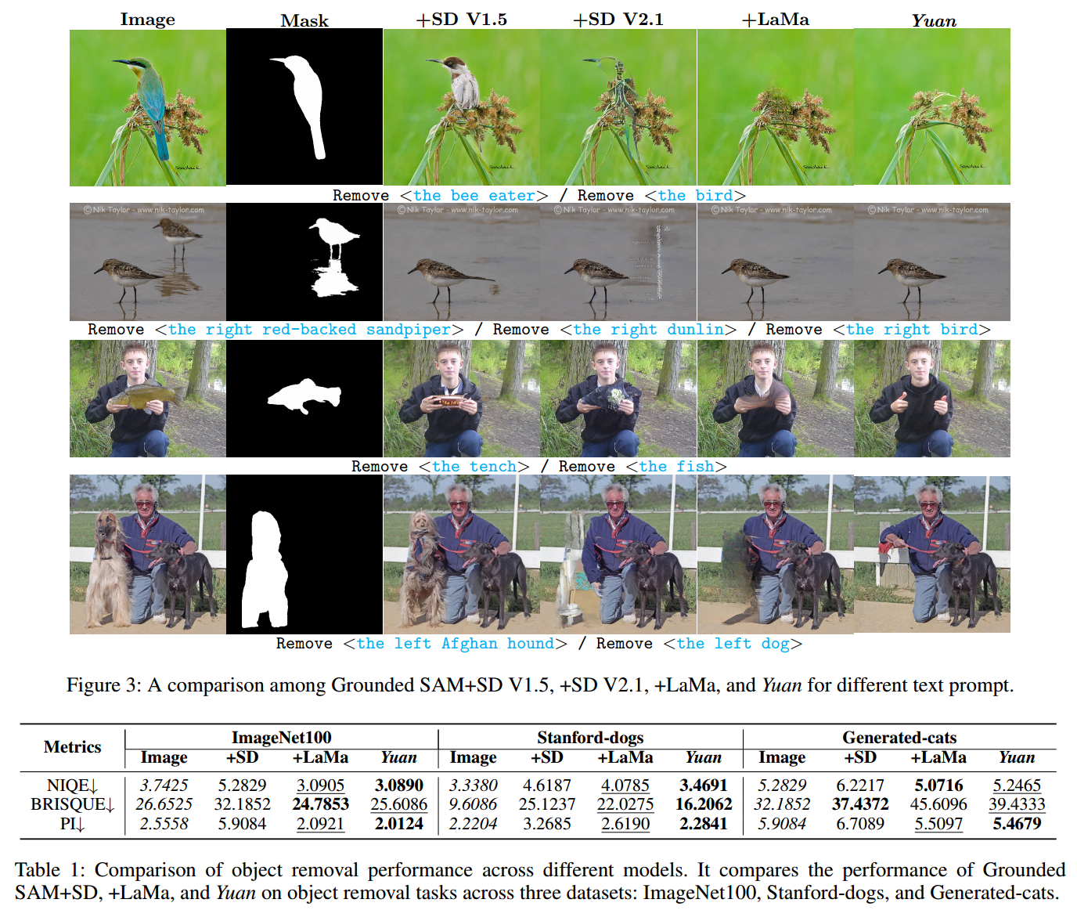
Cont.

